Slide 1
Sum-IT
By - Sreetama Banerjee, Piyush Chandra, Abhishek Ranjan

Slide 2
Elevator Pitch
Our vision is to build an artificial intelligence solution for financial documents and generate a summary efficiently, accurately, and intelligently. This will be beneficial to financial users to quickly identify any red flags or key information.

Slide 3
Redundant Information
Financial information overload
Limitations on processing information quickly, to make financial decision
Show relevant data to get gist of dataset.
Identify key ideas/facts and present to others
No specific App catering to financial domain

Slide 4
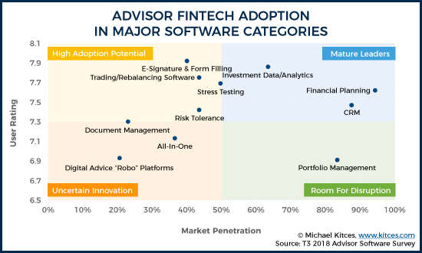
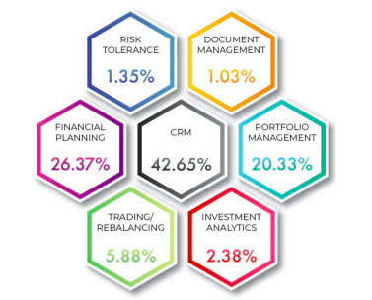
Market Analysis
Digital growth is becoming more prevalent across advisor servicing
functions,
63% now use M&A technology
“For many investors, data overload stands in the way of getting work done,” - Leonard Langsdorf, CTO Capco’s digital
innovation labs

Slide 5
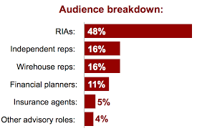
Opportunities/Market
Number of personal financial advisors expected to 30% by 2024
Freelance financial analysts
Freelance jobs work from home
Independent financial advisors
Financial Analytics Market to Grow at
CAGR of +11% by 2023
70% advisors still perform transactional activities on paper
Notes:
B2B and B2C in phases - first roll out with B2c: they are also our test/pilot users - their feedback will be crucial to us to evolve as a business - which slide to put this in?

Slide 6
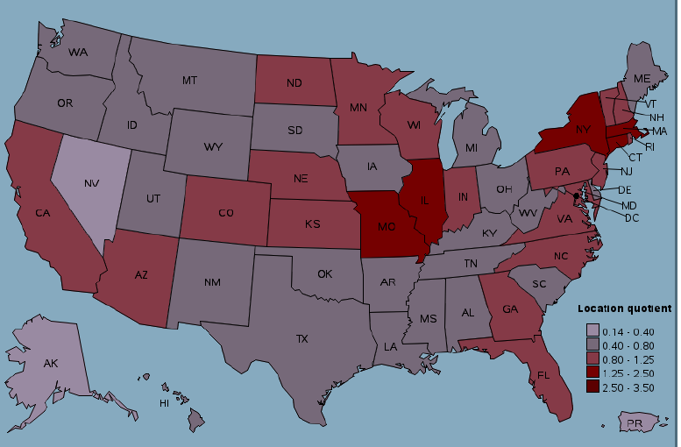
Opportunities/Market
In 2nd phase of roll-out
Independent brokers
Advisor firms - financial start-ups in investment management
Number of personal financial startups have increased by 25% from 2015 to 2018
Notes:
b v prop - competicitve world - reduce manual labour - time is money - employess free to invest in other important aspects

Slide 7
Business Model
Membership Benefits | Gold Member | Platinum Member
Characters Limit | 200,000 | Unlimited
Number of Uses | 100/month | Unlimited
Document Merge | Yes | Yes
Confidential | Yes | Yes
Browser Extension | No | Yes
Multi-lingual Support | No | Yes
Price/Month | $ 25 | $ 75
Price/Annual | $ 150 | $ 600
Priority Email Support | No | Yes

Slide 8
Market Adoption
Events
Customer Relationships
promotion : Content Marketing (linkedin), Blogs
Sales : website
Service : online support
Flash Pitch
hackathons
Partnering with finTech events and conferences - CIC

Slide 9
Growth Strategy
Marketing & Sales
Customer Service
Product Development
Trial memberships
Referral Bonuses
Annual package discounts/loyalty packages
Social Media Marketing
Dedicated phone support (toll free number)
Chat-bot
Self help web tool
Android app
Finance meeting summarizer
email extension
search analyser

Slide 10
Competition
 | AGOLO | RESOOMER | textcompactor
Products | Customizable Products for Abstractive and Extractive Data for B2B and B2C Customers. Nothing concrete for Financial Firms (Informative Summary) Yet to enter into chat summarization and email summarization domain | Caters only to B2C Customer. Premium Charges for large characters, browser extension, multilingual text summarization Launched Argumentative text summarizer in June 2018 | Caters only to B2C Customers for only small Texts (For ex. Up to 10 Pages of a pdf)
Pricing | Request sent for Pricing | Competitive pricing for premium membership (4 euros per month) | Nominal
Promotion | Social Media – Facebook, Twitter, LinkedIn News and Feeds Blogs and Publications News Articles and Magazines |  | Word of Mouth on platforms such as Quora Very less presence on social Media
Notes:
AGolo Resoomer Direct Competitors

Slide 11
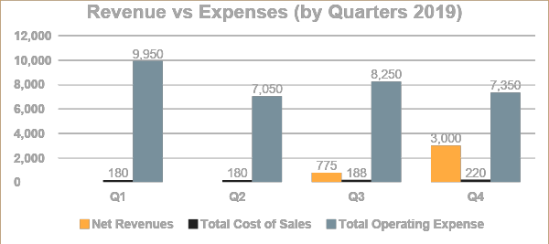
Overview of Financial Summary
Key Driving Metrics
 | 2019 | 2020 | 2021
Net Revenues (A) | $ 3,775.00 | $ 32,500.00 | $ 266,250.00
Cost of Sales (B) | $ 768.00 | $ 1905.00 | $ 5,753.00
Gross Profit (C= A - B) | $ 3,007.00 | $ 30,595.00 | $ 260, 498.00
Operating Expenses (D) | $ 32,600.00 | $ 48,900.00 | $ 115, 100.00
Operating Income (E = D - C) | $ (29,593.00) | $ (18,305.00) | $ 145, 398.00
Net Income (less tax) | $ (31,393.00) | $ (20,105.00) | $ 142, 398.00
 | 2019 | 2020 | 2021
New Users | 50 G | 150 (130G + 20P) | 1000 (700G + 300P)
Renewals | 0 | 10 | 50 (45G + 5P)
Average yearly Subscription fees | $ 150 | $ 225 | $ 285
Headcount | 3 | 4 | 7
Revenues per Employee | $ 1,258 | $ 8,125 | $ 88,750
Expense per Employee | $ 11,110 | $ 12,470 | $ 39,033
Notes:
Hosting - Servers (AWS, Azure). If small initially, can go for free-tier or up a 2nd level.
Marketing - You will be developing/refining/iterating so no marketing expenses during the initial 3 months (assumption) and when the prototype is ready, you will start promoting and will spend money
Office Equipments - First time only set-up costs like printer, a desktop, phone, internet etc
Professionals - Its to register your business as ‘Inc’ and other legal paper works (not sure whats the process, need to research further)
Fixed Costs - expenses which remain fixed for a period of time like office rent, food
Others - variable costs like stationary purchases, cabs etc (think of something)

Slide 12
Quaterly Operating Plan 2019
Income Statement |  |  |  |  |  |  | Total
 |  | Quarters | Q1 | Q2 | Q3 | Q4 | 2019
Revenues
 | Subscription Fees |  | - | - | 775 | 3,000 | 3,775
 | Professional Services |  | - | - | - | - | -
 |  | Net Revenues | - | - | 775 | 3,000 | 3,775
Cost of Sales
 | Hosting |  | 30 | 30 | 30 | 40 | 130
 | 3rd Party/Transaction fees |  | - | - | 8 | 30 | 38
 | Customer Support |  | - | - | - | - | -
 | Service Expense |  | 150 | 150 | 150 | 150 | 600
 |  | Total Cost of Sales | 180 | 180 | 188 | 220 | 768
Gross Profit |  |  | (180) | (180) | 587 | 2,780 | 3,007
 | Margin |  | - | - | 75.7% | 92.7% | 79.7%
Operating Expenses |  | Operating Expenses
 | Engineering |  | 1,500 | 1,500 | 1,500 | 1,500 | 6,000
 |  | Salaries/Benefits | - | - | - | - | -
 |  | Other | 1,500 | 1,500 | 1,500 | 1,500 | 6,000
 | Sales |  | - | - | 200 | 300 | 500
 |  | Commissions | - | - | - | - | -
 |  | Salaries/Benefits | - | - | - | - | -
 |  | Travel | - | - | 200 | 300 | 500
 |  | Other | - | - | - | - | -
 | Marketing |  | 3,450 | 3,450 | 3,450 | 3,450 | 13,800
 |  | Salaries/Benefits | - | - | - | - | -
 |  | SEM/SEO/PR | 1,500 | 1,500 | 1,500 | 1,500 | 6,000
 |  | Events/Conferences | 900 | 900 | 900 | 900 | 3,600
 |  | Travel | 900 | 900 | 900 | 900 | 3,600
 |  | Other | 150 | 150 | 150 | 150 | 600
 | General/Administrative |  | 5,000 | 2,100 | 3,100 | 2,100 | 12,300
 |  | Salaries/Benefits | - | - | - | - | -
 |  | Rent/Office | 1,500 | 1,500 | 1,500 | 1,500 | 6,000
 |  | Legal/Accounting | 2,000 | - | 1,000 | - | 3,000
 |  | Travel/Entertainment | 300 | 300 | 300 | 300 | 1,200
 |  | Other | 1,200 | 300 | 300 | 300 | 2,100
 | Total Operating Expense | Total Operating Expense | 9,950 | 7,050 | 8,250 | 7,350 | 32,600
Operating Income/(Loss) |  |  | (10,130) | (7,230) | (7,663) | (4,570) | (29,593)
Net Income/(Loss) |  |  | (10,580) | (7,680) | (8,113) | (5,020) | (31,393)

Slide 13
Demo

Slide 14
Technical Story
Training on Financial articles from BBC
Four algorithms used
1)Python Summarizer Library - Sumy
2)TfIdf
3)PageRank
4)CNN
Rouge metric was used for Model evaluation
Notes:
We calculate Rouge score for each of the generated Summaries

Slide 15
Metrics - Evaluation
Algorithm 1
Rouge metric - TfIdf
Rouge-1 value 0.5687637501169132
Rouge-2 value 0.4119476266861668
Rouge-3 value 0.4272123725329563
Algorithm 2
Rouge metric - PageRank
Rouge-1 value 0.700651203639658
Rouge-2 value 0.5452239485606658
Rouge-3 value 0.5218949110954344

Slide 16
Thanks!!!

