Slide 1
Problem Statement Title: Anomaly Detection [AI, ML & Analytics Theme]
Domain Name: AI, ML & Analytics Theme
Team Name: Code Snap

Slide 2
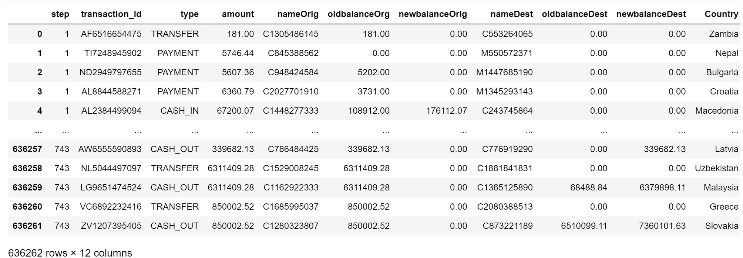
DATASET

Slide 3
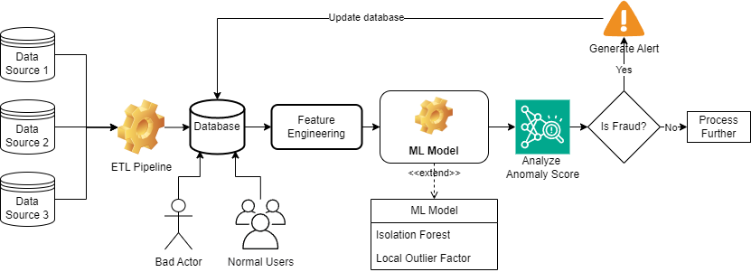
Flowchart

Slide 4
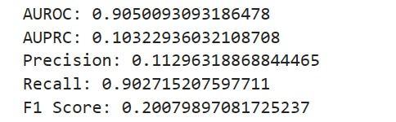
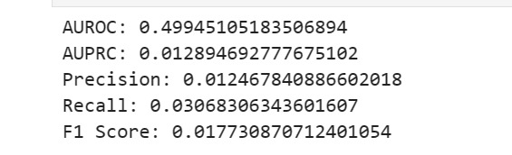
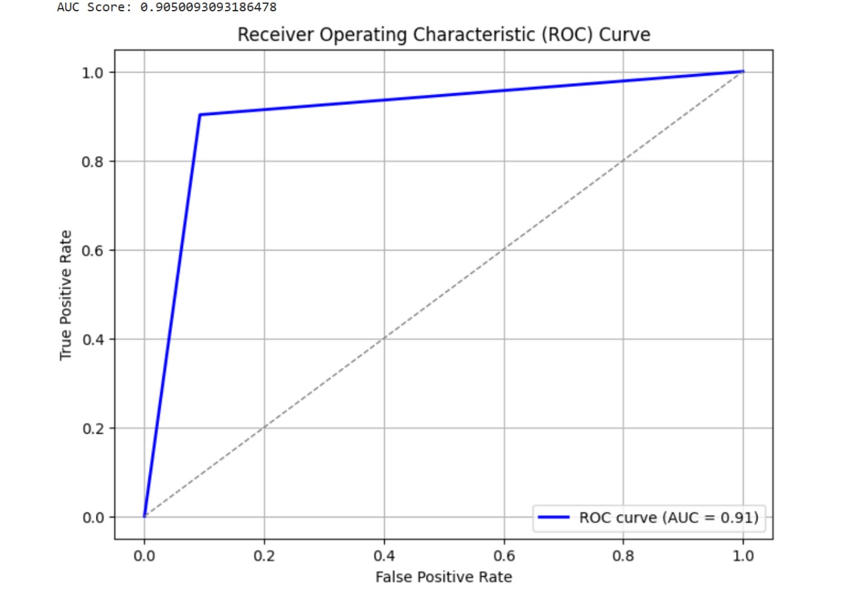
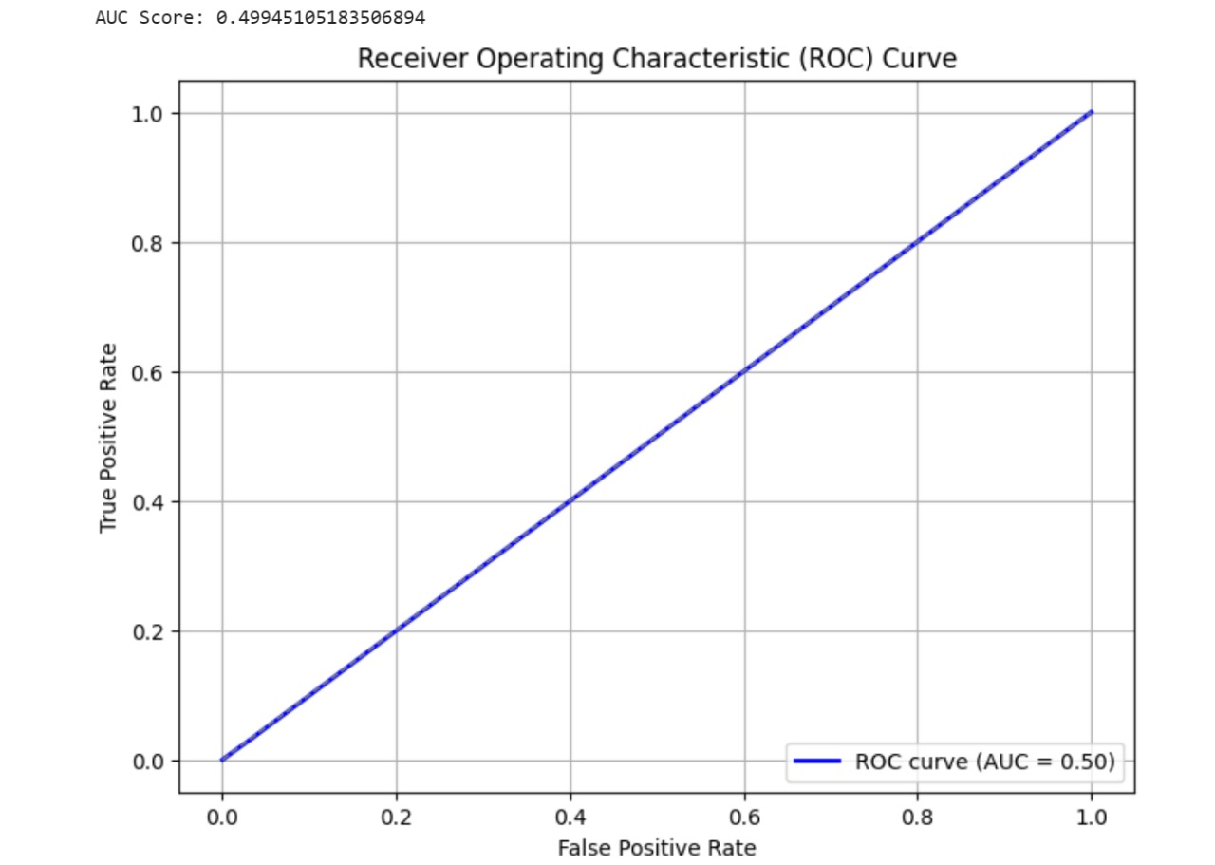
ISOLATION FOREST
LOCAL OUTLIER FACTOR

Slide 5
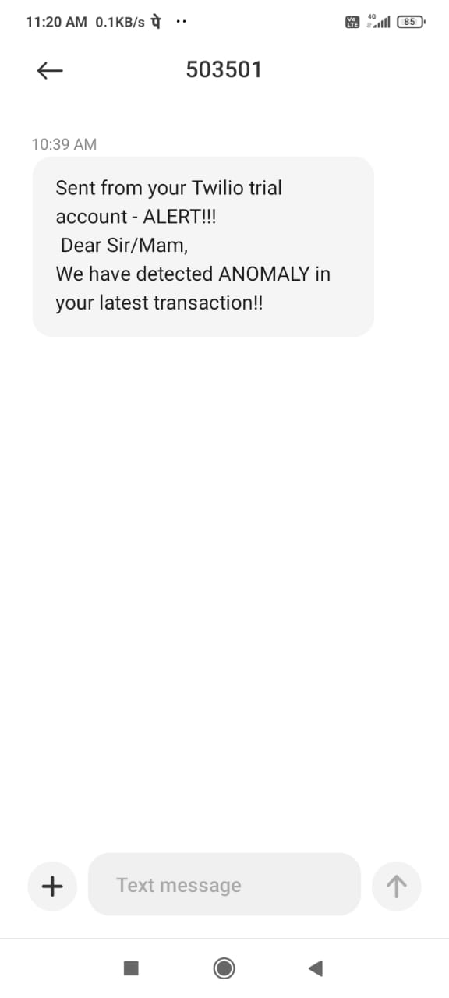
Screenshot of Realtime Alert

