Slide 1

Smart Dustbin System
Group No. : 19
Piyush Agarwal (IIT2020012)
Mayukh Biswas (IIT2020042)
Tarun Dabi (IIT2020045)
Ankit Jha (IIT2020049)
Rishabh Singal (IIT2020078)

Slide 2
Description
In this project the smart dustbin management system for CC3 building is required that uses
ultrasonic sensors and moisture sensors on each dustbins to show the current status of garbage
on the GUI. The ultrasonic sensor measures the distance between the objects using sound
waves and is attached at the cover and moisture sensor checks if the garbage is wet or dry. This
system will check the status and send the message to the admin that Dustbin is full, then message is sent to the collection van then garbage collection is done, if the Dustbin is not
cleaned in particular time then message is sent to higher authority and they will take appropriate action on it.

Slide 3

Design
a. Register Dustbin button:
A new screen should appear that registers the smart dustbin with
following details:
i. ID*: <Textfield> (ID type validation)
ii. Location*: <Textfield> (location type validation)
iii. Dimensions: <Textfield> (Number type validation)
(Corresponding update button)
b. Sensor Configuration button:
A new screen should appear to configure the thresholds:
i. Moisture sensor threshold*:
ii. Ultrasonic sensor threshold*:
c. Van Registration button:
A new screen should appear to register garbage collector Van:
i. Van ID.*:
ii. Driver Name:
iii. Email-ID*:
(Corresponding update button)
d. Framework configuration button:
A new window should appear to configure the simulation settings:
(Can be further improvised)
i. Van response delay:
ii. Dustbin status delay:
e. Start monitoring button:
A new window should appear for analysis which shows following details:
i. Sensed data from each dustbin
ii. Display panel to show the status of each dustbin
iii. If the dustbin is full, Van driver should be sent an email concerning
dustbin status and location to empty the dustbin within this time. If not
then the Van driver should be penalized. Accordingly, the status of the
dustbin can change.
f. Stop monitoring button
A log report should be generated along with the timestamp concerning
the status of the dustbin along with the Van ID that emptied the bin.
g. Quit

Slide 4
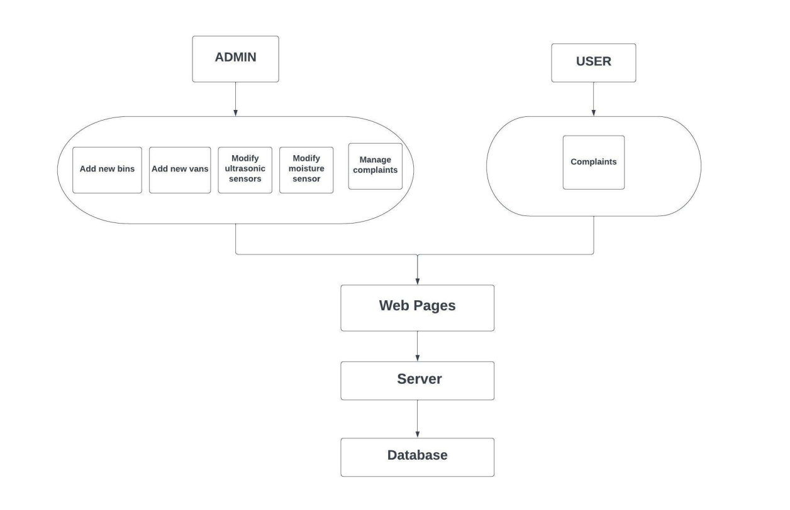
Architectural Diagram

Slide 5
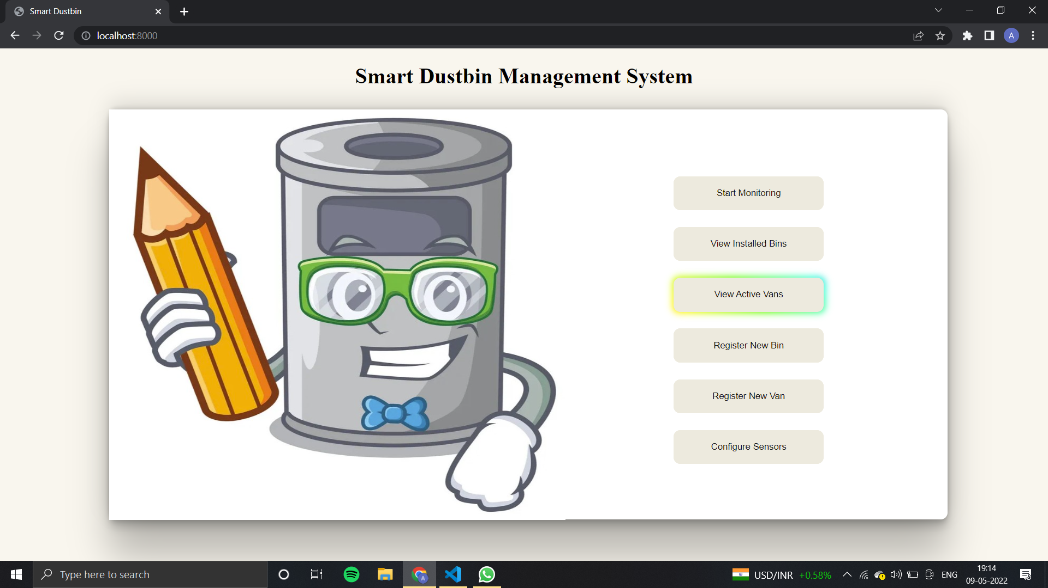
Home/Main Screen

Slide 6
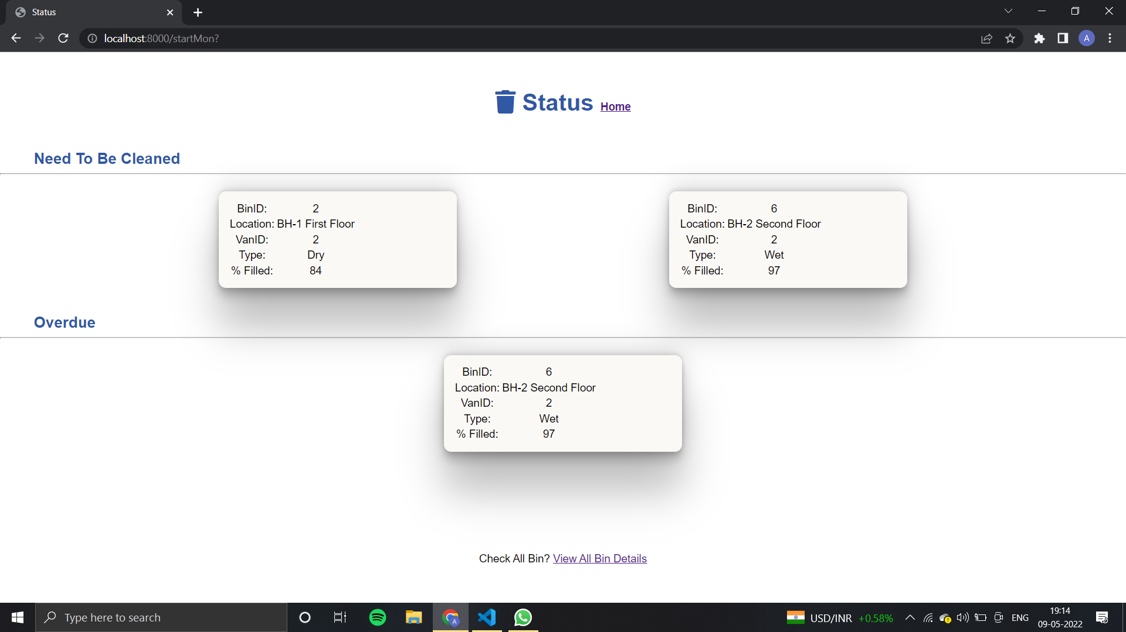
Active Bin Status Window

Slide 7
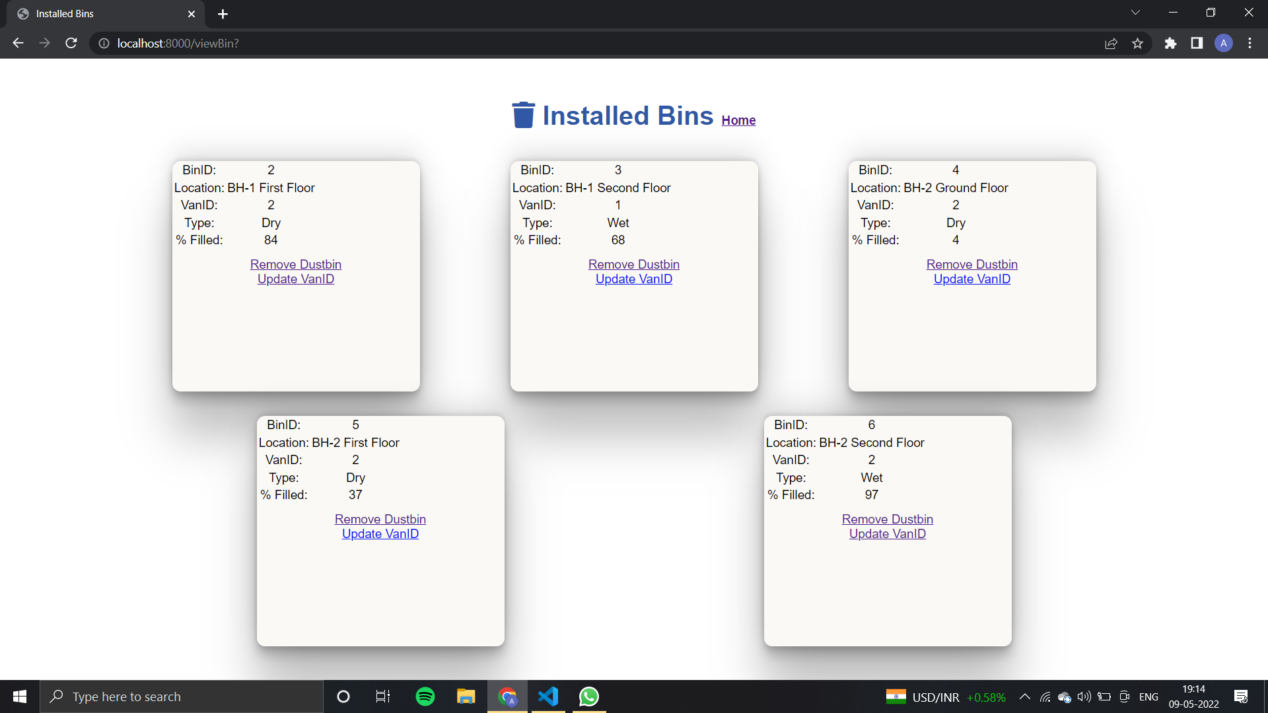
View Installed Bins Window

Slide 8
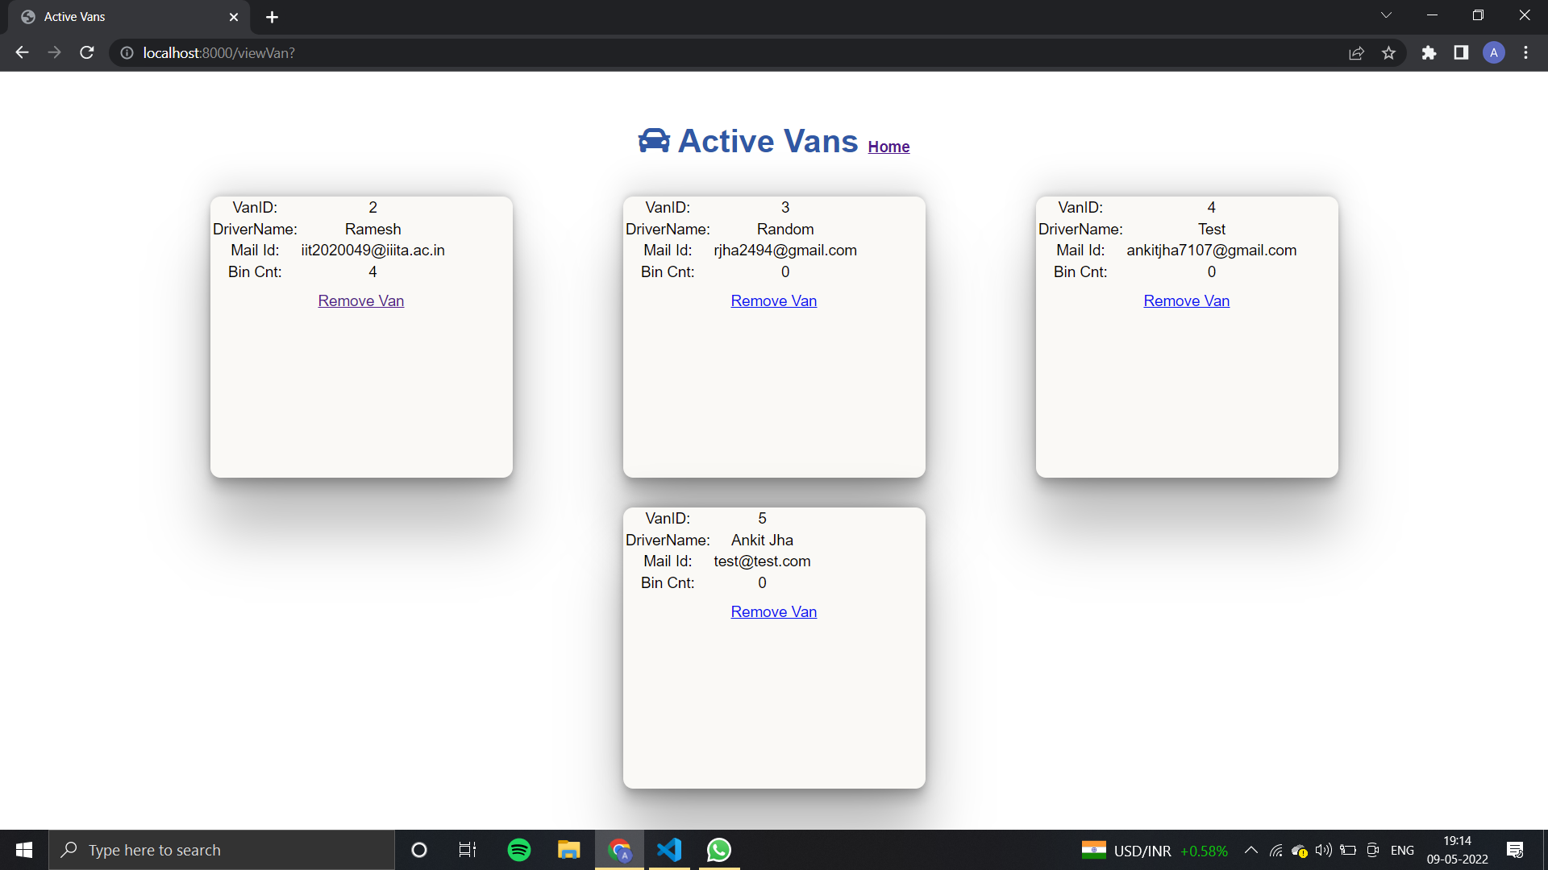
View Active Vans Window

Slide 9
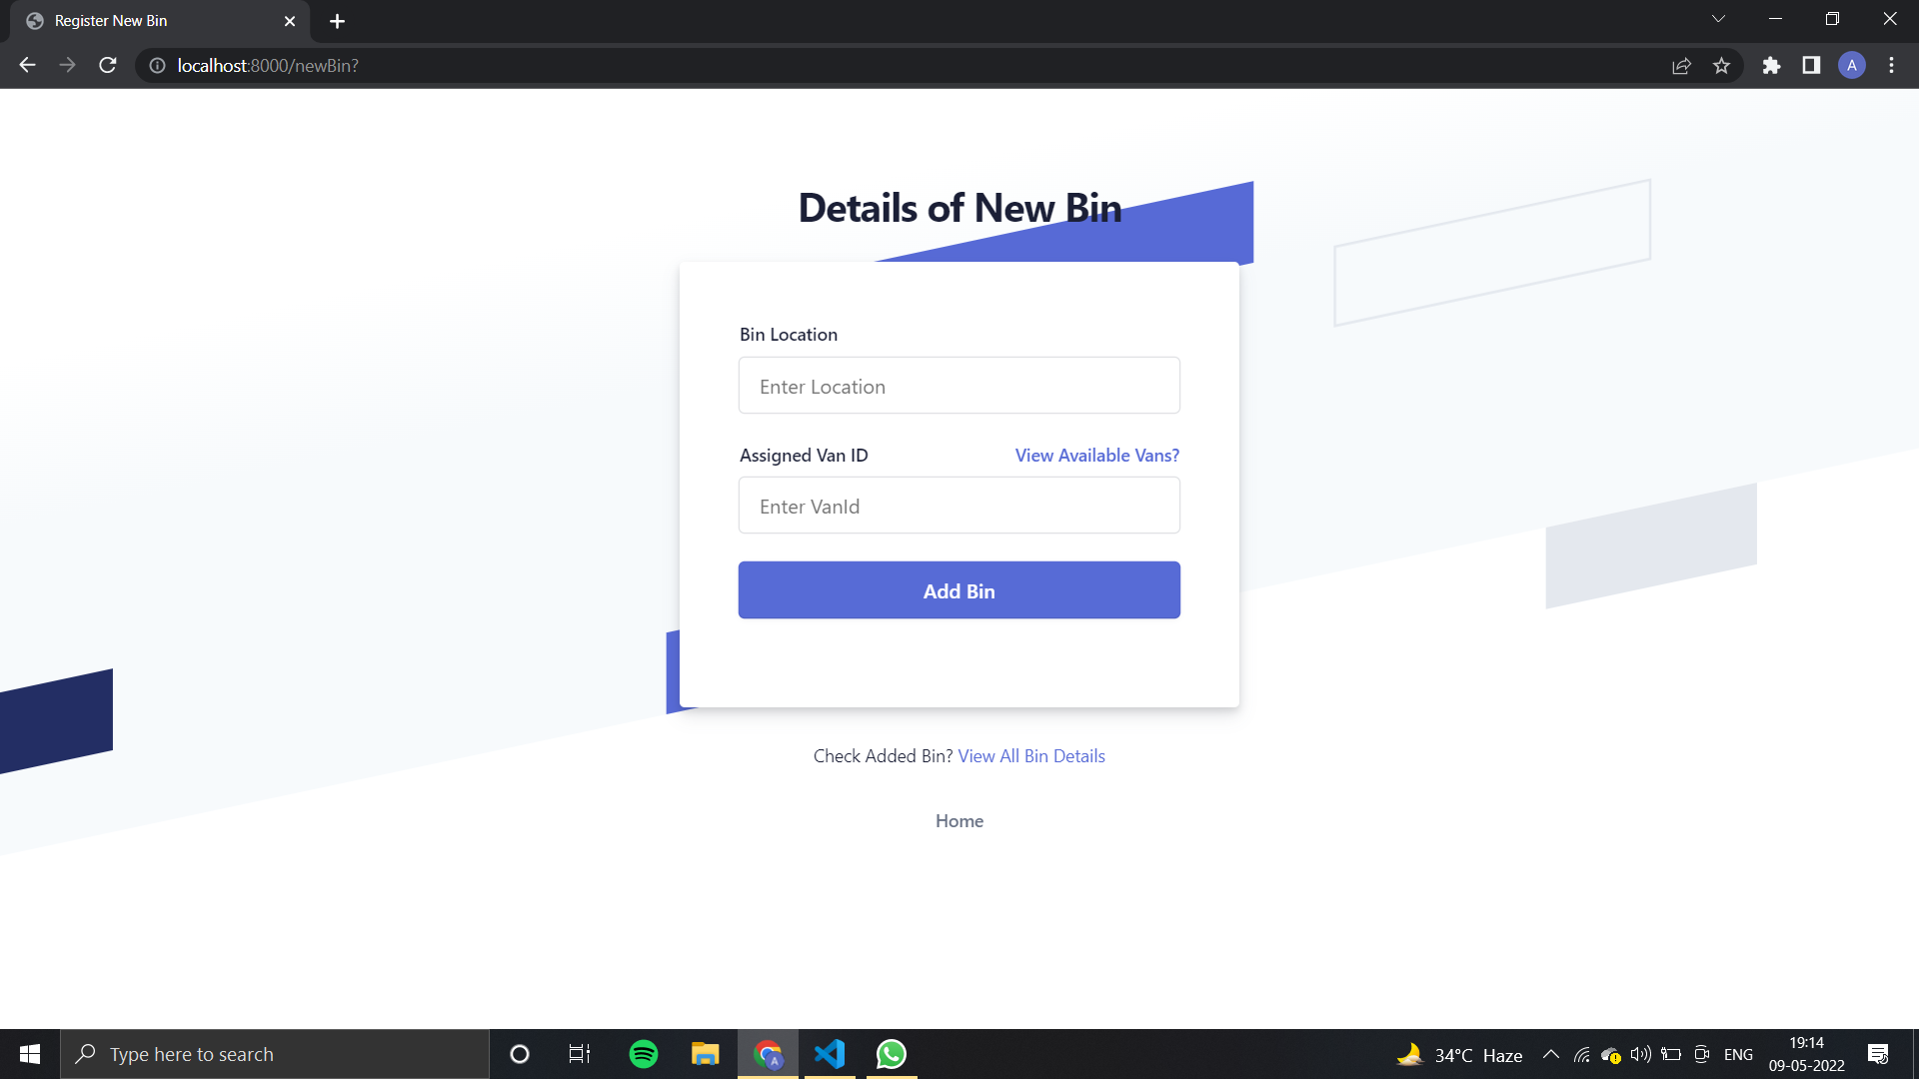
Register New Bin Window

Slide 10
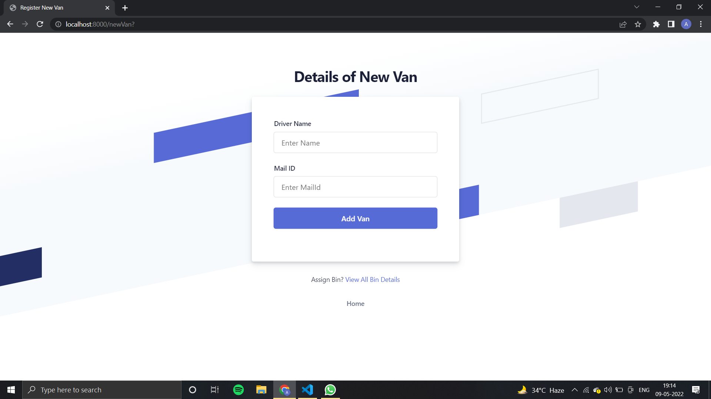
Register New Van Window

Slide 11
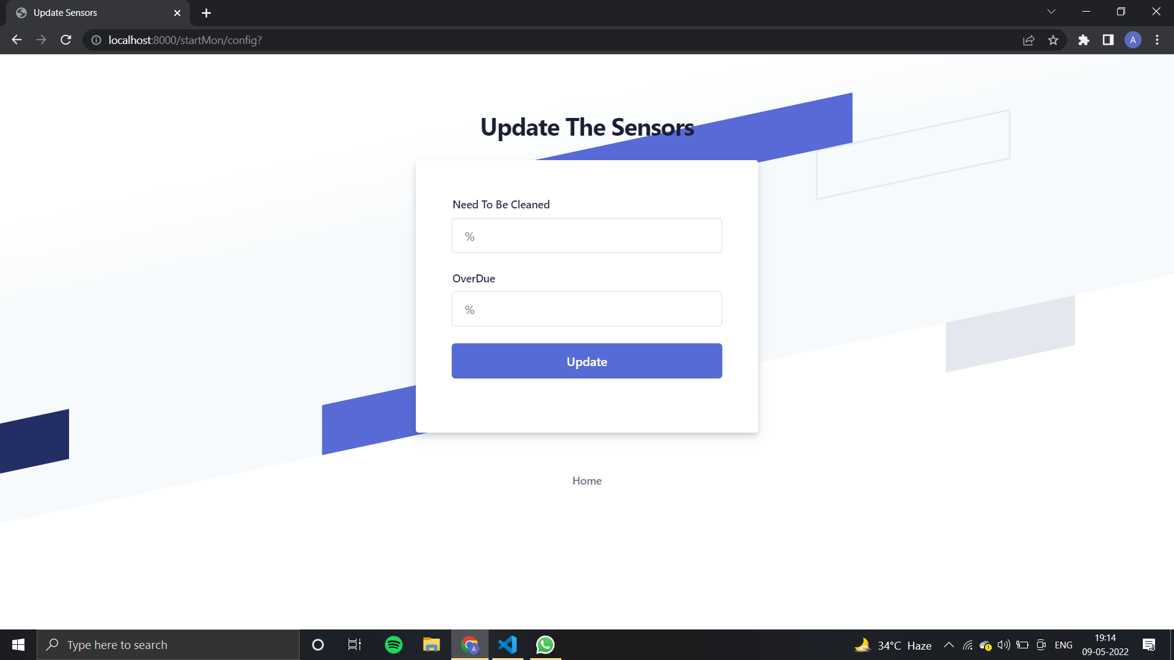
Configure Sensors Window

Slide 12
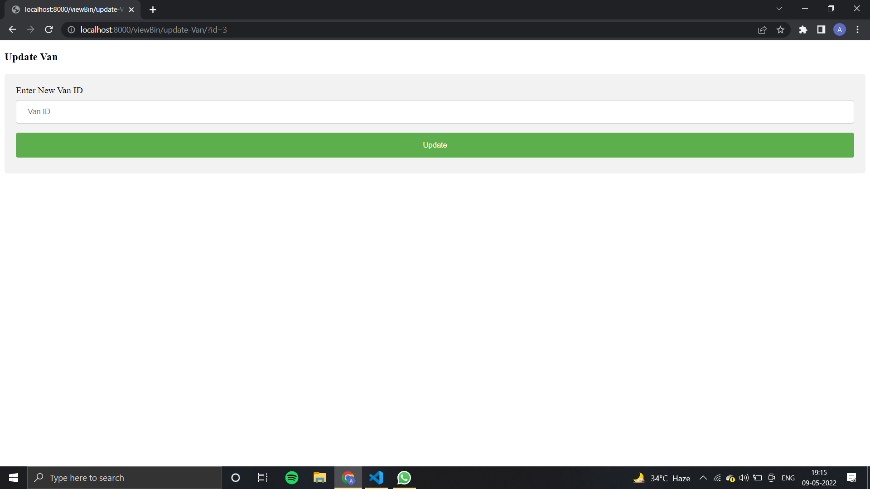
Updating Van Window

Slide 13
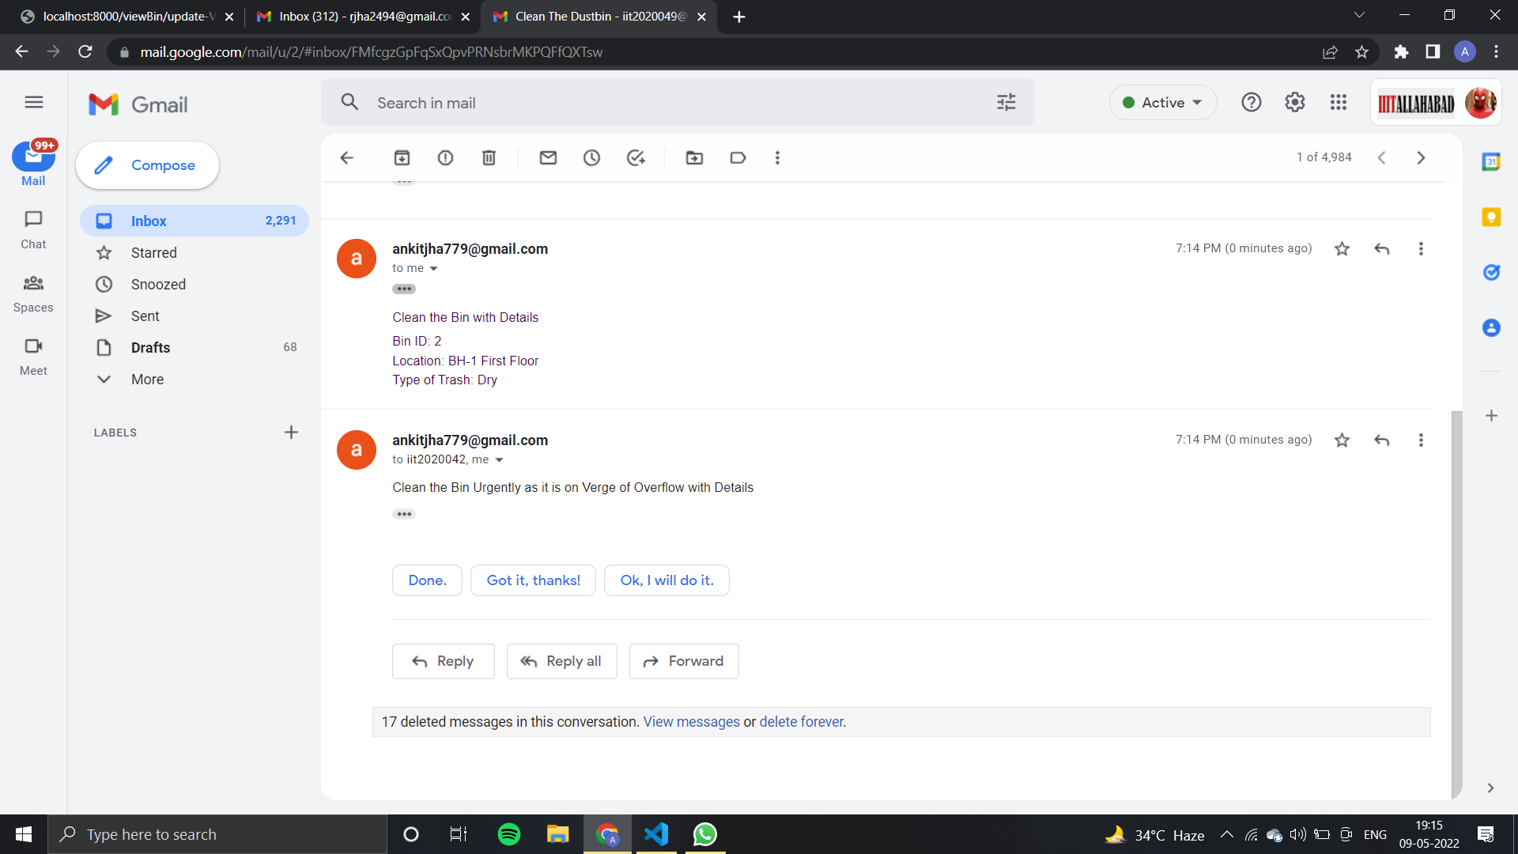
Notification received when a bin a filled to the admin or authorized mail ID

Slide 14
Drawbacks
As in our problem statement we are asked to implement only software part. So for the details (values) of how much bin is filled and other things we have to add manually in the database.

Slide 15
Thankyou

