Slide 1
Analysing Amazon Sales data
Ecommerce domain

Slide 2
Problem Statement
Analysing Amazon Sales data from 2017 to 2019 to meet increasing competition around the globe and the need for improved methods of distribution to reduce cost and to increase profits.

Slide 3
Data Description:
Our dataset is around 14 mb. We have customer, region and division & date tables as our four dimensions table and sales table as fact table with 18 columns.

Slide 4
Description of Data Transformation:
Grouping our sales as fact and remaining tables as dimension.
Merging customer address table with customer table using customer number.
Removing unwanted columns and adding conditional columns taking column type as base column.
Creating date table using Dax.

Slide 5
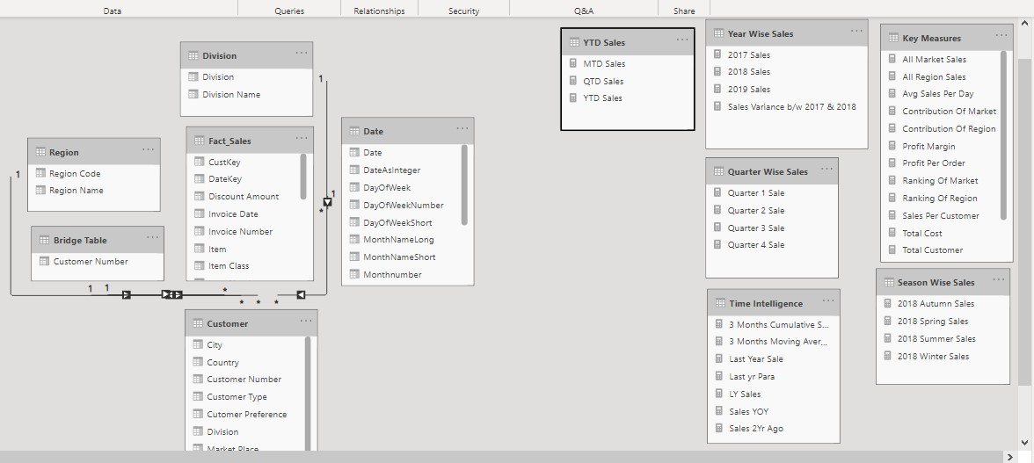
DATA MODELLING (STAR SCHEMA)

Slide 6
Dax Used HERE
Sum - used for single result means aggregating function
Sumx - used for iteration
Calculate- evaluate an expression in the current context
All - remove all the filters means external as well as internal
Avg - used for finding average
Rankx - used for finding ranking of an expression in the current context
Filter- used to filter the table

Slide 7
Time intelligence
Datebetween- return the date b/w to given date
Datesinperiod- return the date for the given period
Sameperiodlastyear, parelleperiod - used here for finding last year sales
Dateadd - to add or decrease the specified interval
Date - used for date
Totalmtd - used for finding MTD means from starting month to ending month
Totalqtd - used for finding QTD means from starting quarter to ending quarter
Totalytd - used for finding YTD means from starting year to ending year

Slide 8
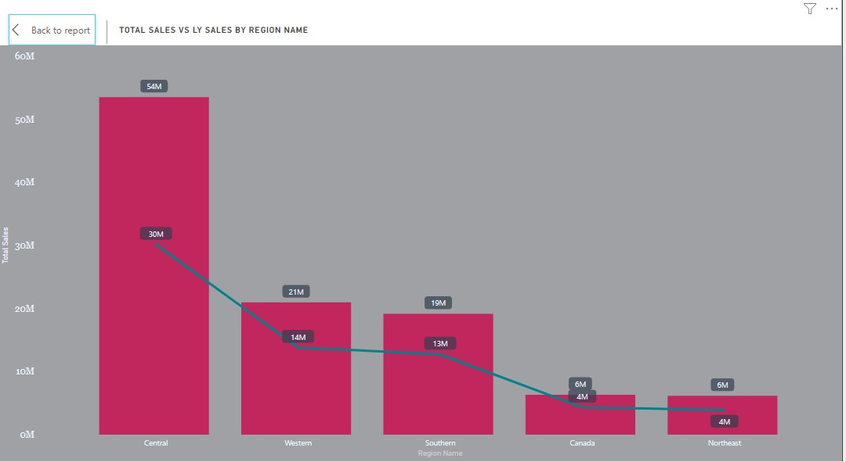
Insights derived in Total sales vs last year sales
Find total Sales vs last year sales by using Dax LY Sales = CALCULATE([Total Sales],SAMEPERIODLASTYEAR('Date'[Date]))
Total Sales = SUMX(Fact_Sales,Fact_Sales[Sales Amount])
By below Bar Chart we can see in Central Region Total Sales is highest almost 54M in comparison to others regions and Last Year Sale here is 30M.

Slide 9
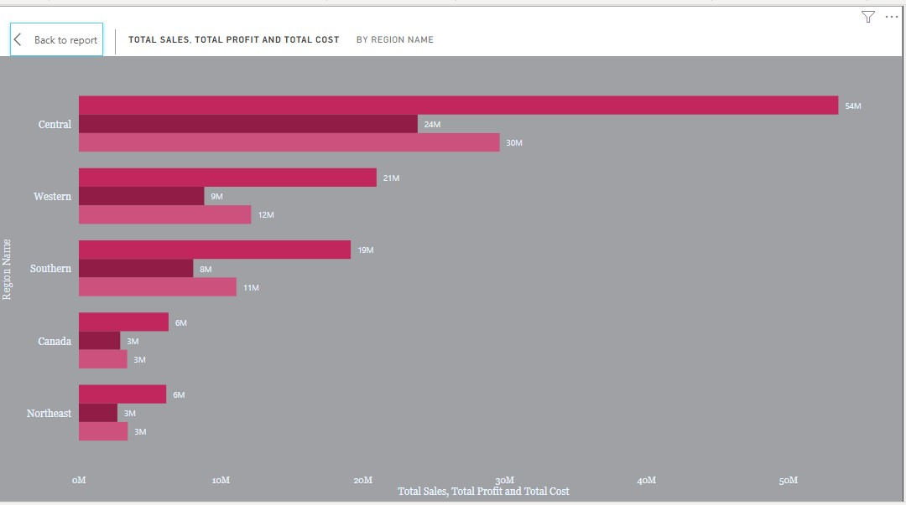
Insights derived in Total sales vs profit vs cost
Find total Sales vs cost vs profit ,by using Dax Total Sales = SUMX(Fact_Sales,Fact_Sales[Sales Amount])
Total Cost = SUMX(Fact_Sales,Fact_Sales[Sales Cost Amount])
Total Profit = [Total Sales]-[Total Cost]
By Clustered Bar Chart we can see that in Central Region Total Sales, profit, cost is highest in compare to others region and lowest is for northeast.

Slide 10
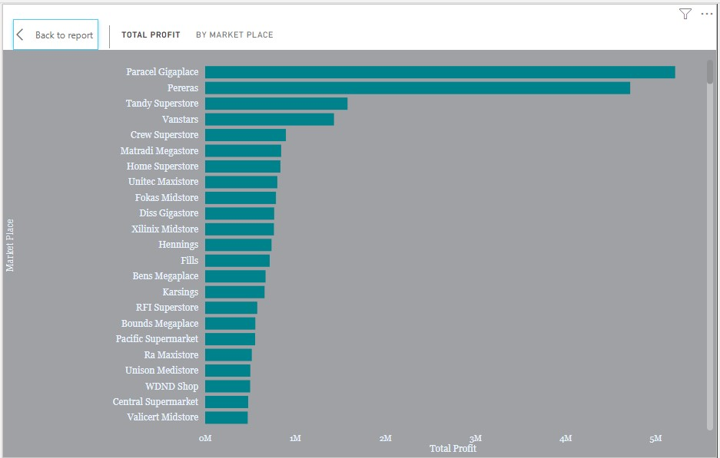
Insights derived Total Profit by Market Place
Find total Sales vs cost vs profit ,by using Dax Total Sales = SUMX(Fact_Sales,Fact_Sales[Sales Amount])
Total Cost = SUMX(Fact_Sales,Fact_Sales[Sales Cost Amount])
Total Profit = [Total Sales]-[Total Cost]
By Clustered Bar Chart we can see that Paracel Gigaplace has highest profit.

Slide 11
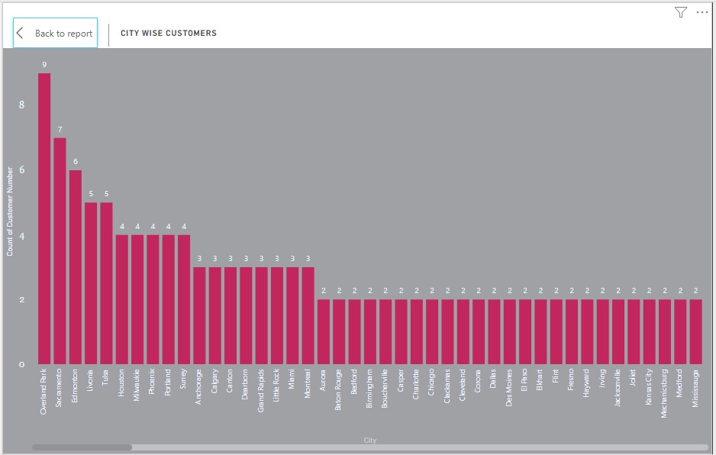
Insights derived Customers by City Wise
Used Clustered Column Chart and found that Overland Park has highest Customers and lowest customers are coming from Mississauga city.

Slide 12
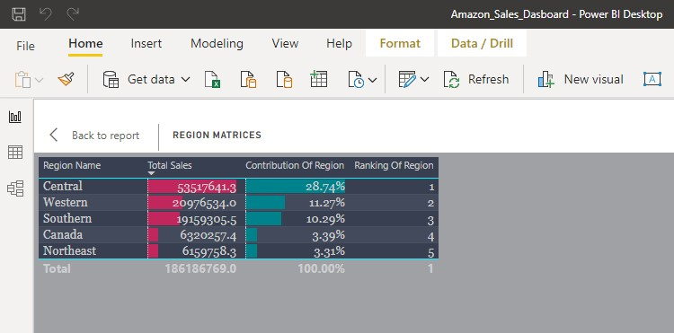
Used Table chart to see the ranking of different region interms of sales as well as to see the contribution of region towards sales.
By using Dax as, Ranking Of Region = RANKX(ALL(Region),[Total Sales]), Total Sales = SUMX(Fact_Sales,Fact_Sales[Sales Amount]), Contribution Of Region = DIVIDE([Total Sales],[All Region Sales]), All Region Sales = CALCULATE([Total Sales],ALL(Region[Region Name]))
Founded that Central region has highest sales , countribution is almost 28.74% and ranked 1 in sales.

Slide 13
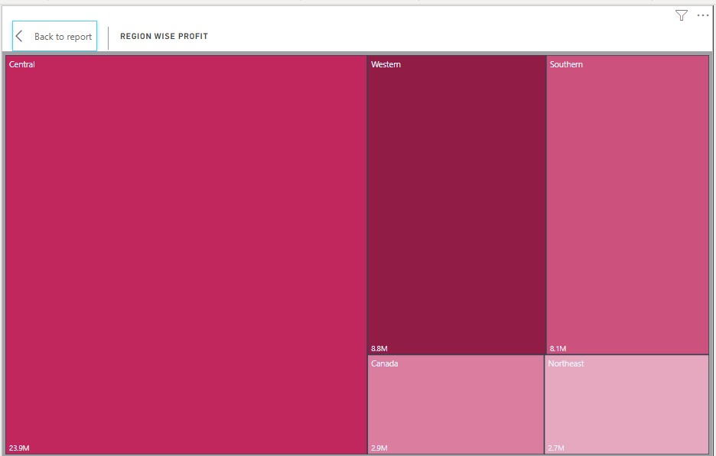
Used Tree Map visual and found that highest profit are coming from Central region and lowest are coming from northeast.

Slide 14
insights
Central Region is generating 50% of the overall sales.
US citizens preferred online shopping.
Paracel Giga place and Pereras are most visited and generating highest sales and profit among all.
Domestic division is generating highest sales.
In 2018 spring sales is lower than winter.
Hamel city has the highest sales throughout the year.
In 2017 we have highest sale and profit.
US has more customers.
Overland park has maximum customers.
In first quarter of the year we have highest sales.

