Slide 1
Analysing Amazon Sales data
Ecommerce domain

Slide 2
Problem Statement
Analysing Amazon Sales data from 2017 to 2019 to meet increasing competition around the globe and the need for improved methods of distribution to reduce cost and to increase profits.

Slide 3
insights
Central Region is generating 50% of the overall sales.
US citizens preferred online shopping.
Paracel Giga place and Pereras are most visited and generating highest sales and profit among all.
Domestic division is generating highest sales.
In 2018 spring sales is lower than winter.
Hamel city has the highest sales throughout the year.
In 2017 we have highest sale and profit.
US has more customers.
Overland park has maximum customers.
In first quarter of the year we have highest sales.

Slide 4
Data Description:
Our dataset is around 14 mb. We have customer, region and division & date tables as our four dimensions table and sales table as fact table with 18 columns.

Slide 5
Description of Data Transformation:
Grouping our sales as fact and remaining tables as dimension.
Merging customer address table with customer table using customer number.
Removing unwanted columns and adding conditional columns taking column type as base column.
Creating date table using Dax.

Slide 6
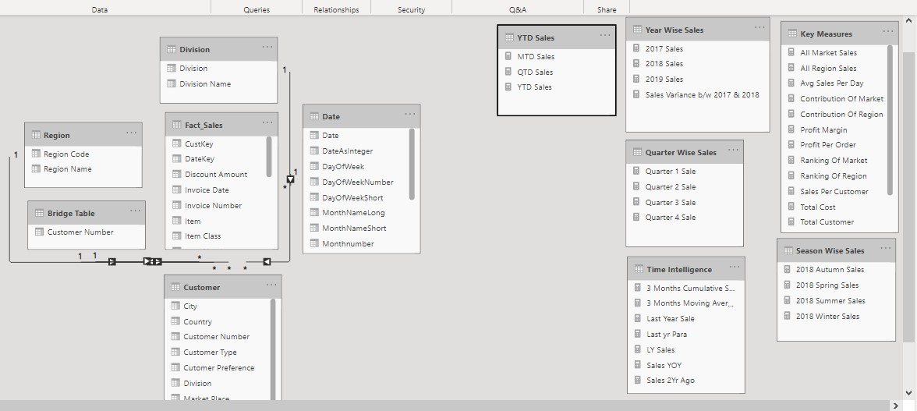
DATA MODELLING (STAR SCHEMA)

Slide 7
Dax Used HERE
Sum - used for single result means aggregating function
Sumx - used for iteration
Calculate- evaluate an expression in the current context
All - remove all the filters means external as well as internal
Avg - used for finding average
Rankx - used for finding ranking of an expression in the current context
Filter- used to filter the table

Slide 8
Time intelligence
Datebetween- return the date b/w to given date
Datesinperiod- return the date for the given period
Sameperiodlastyear, parelleperiod - used here for finding last year sales
Dateadd - to add or decrease the specified interval
Date - used for date
Totalmtd - used for finding MTD means from starting month to ending month
Totalqtd - used for finding QTD means from starting quarter to ending quarter
Totalytd - used for finding YTD means from starting year to ending year

