Slide 1

2nd May, 2030
CARBON CONTROL
Carbon Footprint Reduction using Data Visualisation
Mahir Mavani
Piyush Tandale
Prem Panchal
Alliance University
1M1B

Slide 2
PROBLEM STATEMENT
Communities, businesses, and individuals often lack clear visual insights into actions that reduce carbon emissions. Without accessible and understandable data, it becomes difficult to adopt sustainable practices. Data-driven tools such as dashboards can help visualize carbon emissions and energy patterns, enabling better understanding of low-carbon initiatives.

Slide 3
PROJECT OBJECTIVE
  Analyze global energy consumption and carbon emissions.
  Identify patterns related to renewable energy adoption and fossil fuel dependency.
  Develop an interactive dashboard to visualize sustainability indicators.
  Promote awareness of low-carbon strategies using data visualization.

Slide 4
DATASET USED
Dataset Name: Global Energy Consumption Dataset
Source: Kaggle
Key Variables Used:
  Country
  Year
  Carbon Emissions (Million Tons)
  Renewable Energy Share (%)
  Fossil Fuel Dependency (%)
  Total Energy Consumption

Slide 5
TOOLS AND TECHNOLOGIES
Tools Used:
  Tableau Public – Data visualization and dashboard development
  Excel / CSV Dataset – Data storage and preparation
  Canva – Presentation of results

Slide 6
WORK BREAKDOWN STRUCTURE
  Case Study Selection
Selected five countries (India, Germany, Brazil, Canada, Japan) as case studies to analyze energy patterns.
  Data Collection
Collected global energy consumption and carbon emissions data from the Kaggle dataset.
  Data Cleaning & Structuring
Filtered relevant countries and indicators and structured the dataset for visualization.
  Dashboard Development
Built interactive charts in Tableau showing emissions, renewable energy share, and fossil fuel dependency.
  Scenario Modeling
Analyzed how increased renewable energy adoption could help reduce fossil fuel dependency and carbon emissions.
  Presentation & Sharing
Published the dashboard on Tableau Public and presented insights through this report.

Slide 7
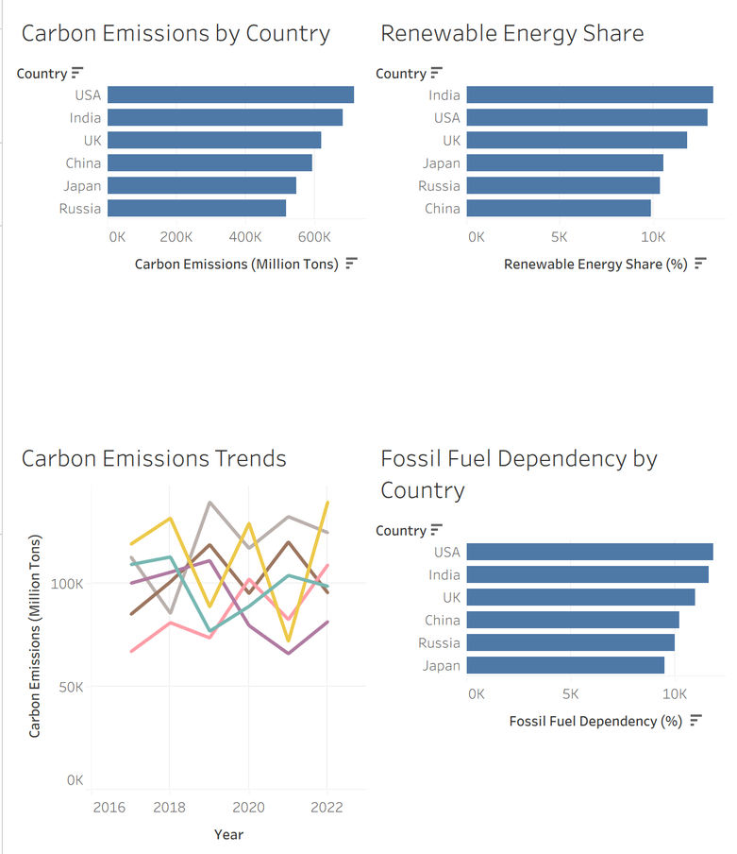
DASHBOARD VISUALIZATION
The dashboard compares countries using key sustainability indicators such as carbon emissions, renewable energy share, and fossil fuel dependency.
Link of the dashboard :
https://public.tableau.com/app/profile/mahir.mavani/viz/CarbonEmission_17735177577970/LowCarbonCase-StudyDashboard?publish=yes

Slide 8
IMPACT METRICS
  Case studies analyzed: 5 countries
  Indicators used: carbon emissions, renewable energy share, fossil fuel dependency
  Dashboard capability: compare countries and visualize sustainability trends
  Potential impact: supports awareness of low-carbon energy strategies.

Slide 9
PROTOTYPE DEVELOPMENT
  Developed an interactive dashboard using Tableau Public
  Built a web-based interface using HTML, CSS
  Integrated the dashboard into a website for user access
  Designed the interface to allow easy exploration of carbon emission data

Slide 10
LIVE DASHBOARD
  A functional prototype has been developed and deployed online
  Users can access and interact with the dashboard through a web interface
  Dashboard link :- https://relaxed-rugelach-ed2c73.netlify.app/

Slide 11
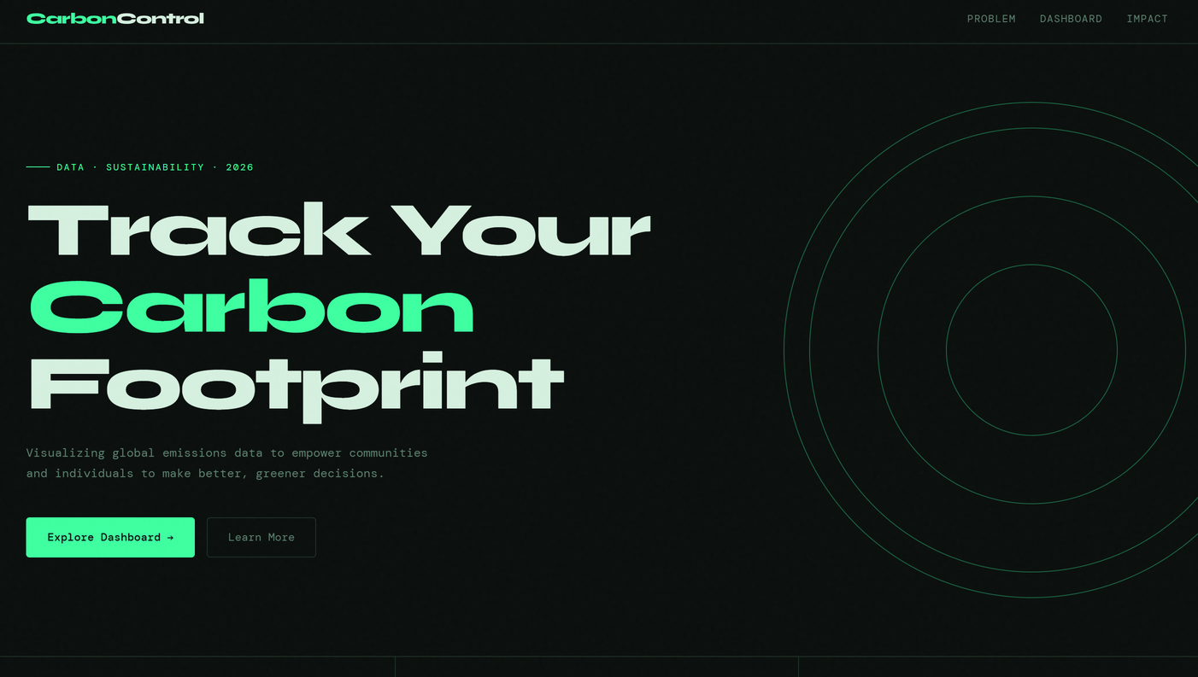
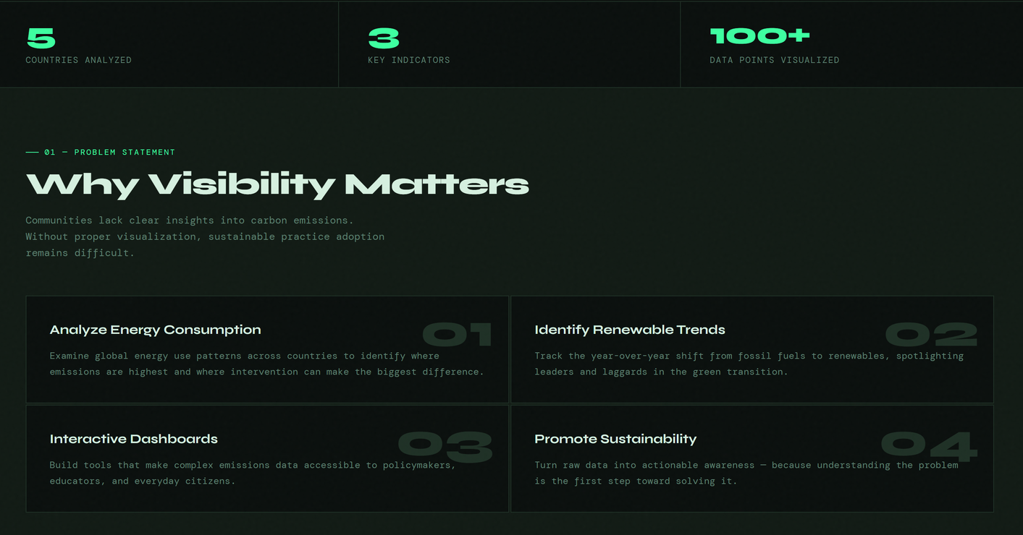
DASHBOARD VISUALS

Slide 12
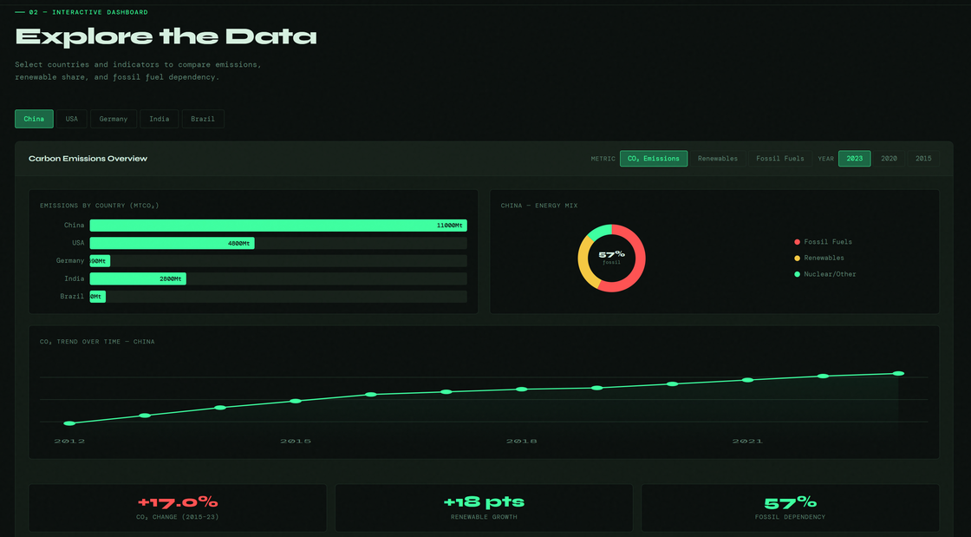
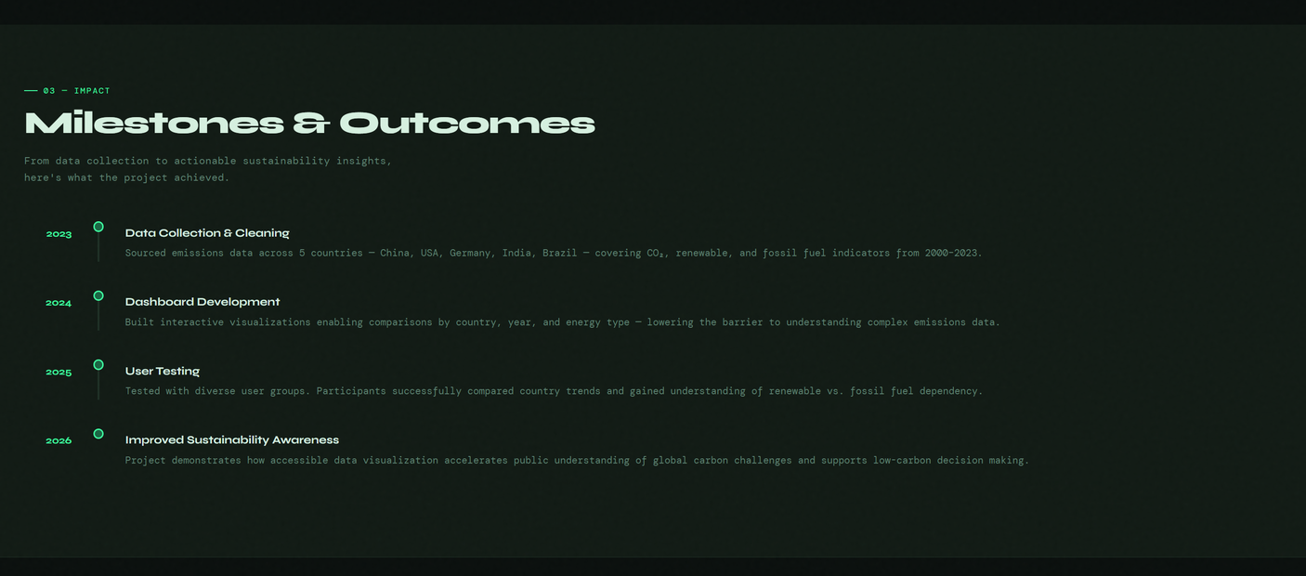

Slide 13
USER TESTING
  The prototype was tested with multiple users (students/peers)
  Users were asked to:
Compare countries
Analyze emission trends
Explore renewable energy data

Slide 14
USER FEEDBACK
  Majority users: 18–25 age group
  Usability: Easy to navigate (4–5 rating)
  Main actions: Compare data, analyze emissions, explore trends
  100% users said it improved understanding of carbon emissions
  Key insights: Emissions, renewable energy, sustainability trends
  Design: Well-rated (4–5), clean and visual
  Information: Easy to understand for most users
  Awareness increased for all users
  Future use: Mostly Yes, few Maybe
  Improvements: Real-time data, better UI, mobile support
  Best features: Graphs, comparisons, ease of use

Slide 15
CONCLUSION
Carbon Control is not just a dashboard, but a data-driven decision-support system that enables users to explore carbon emissions and sustainability trends. Through prototype development, real user testing, and feedback analysis, the project demonstrates how technology can bridge the gap between complex environmental data and user understanding. It reinforces the role of digital solutions in driving awareness and encouraging low-carbon, sustainable practices.

