Slide 1

To analyze factors affecting literacy rates of Maharashtra districts
By: Piyusha More

Slide 2
1. Maharashtra is one of top 10 literate state in India 2. Analyse top 10 high and low literacy rates of Maharashtra districts 3. Examining reasons behind why districts have low and high literacy rate 4. What are factors that affect district’s literacy?
INTRODUCTION

Slide 3
To find various factors that affect literacy rates in Maharashtra
OBJECTIVE

Slide 4
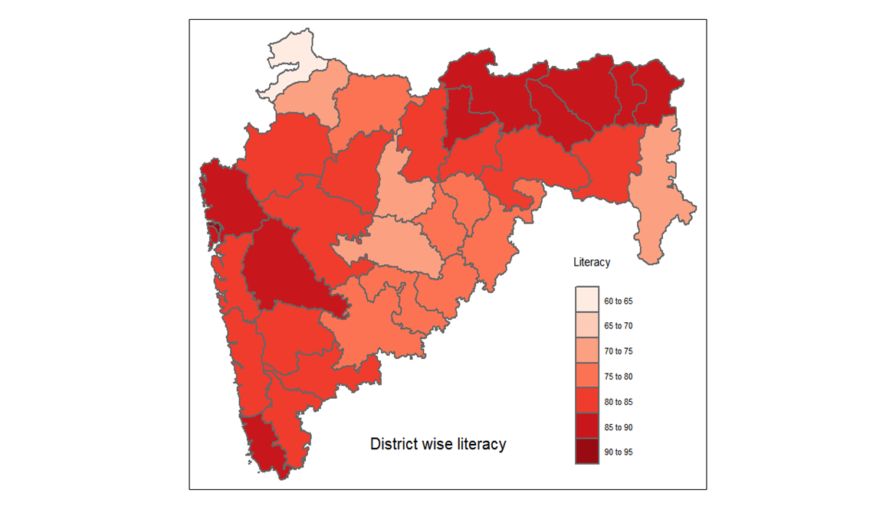
MAPS
For comparing literacies of every district with each other and understand which districts have higher or lower literacy

Slide 5
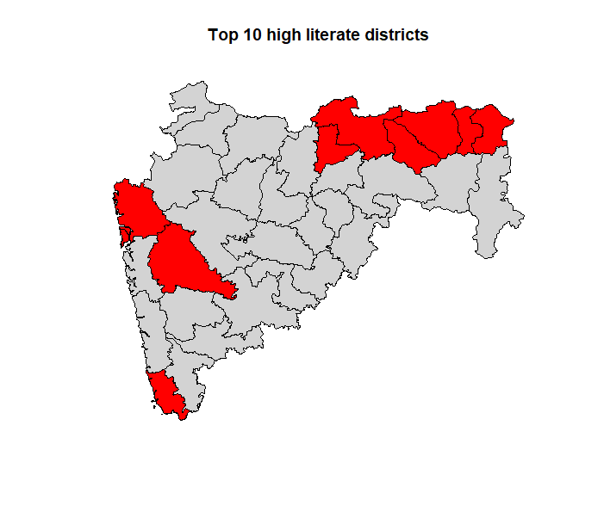
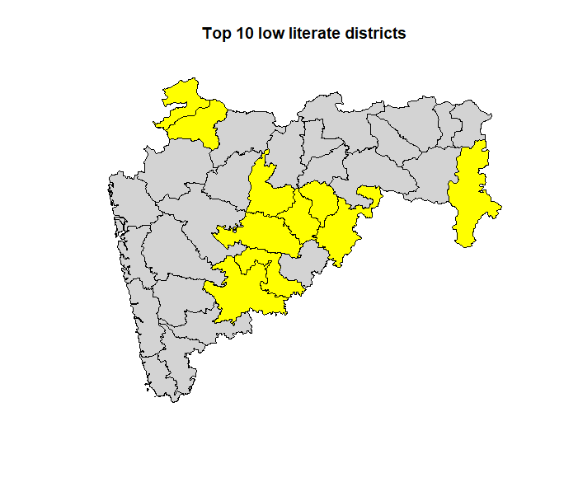
Top 10 high & low literacy rate districts

Slide 6
1. Showcase population of each district 2. Number of schools in selected top 10 districts 3. Total number of families below poverty line in those districts
3 factors which I decided to work on

Slide 7
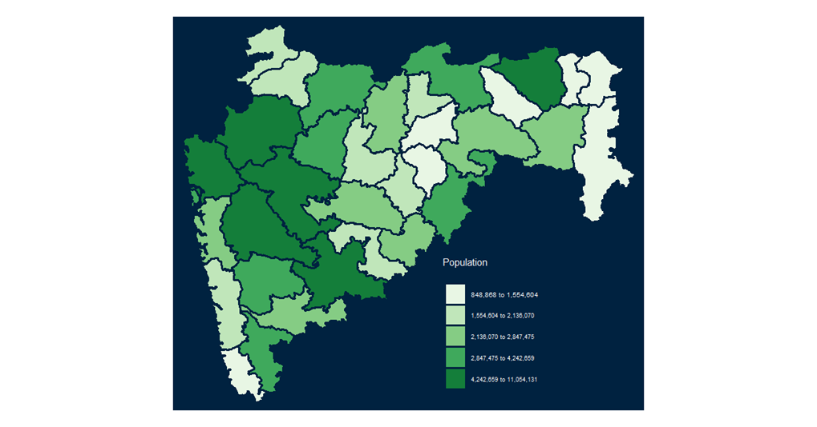
DISTRICT WISE POPULATION
Here we can see and compare dark shaded portion with top 10 high literate district map that maximum number of districts highly populated are also have high literate rates

Slide 8
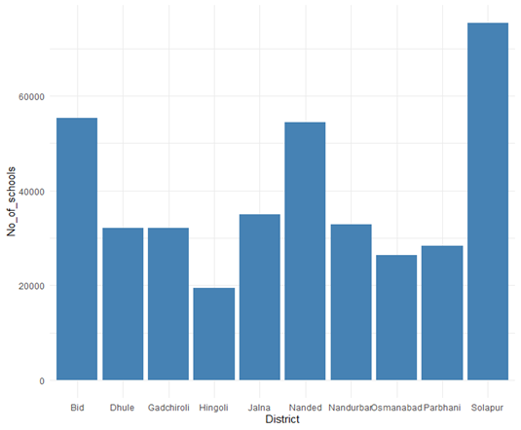
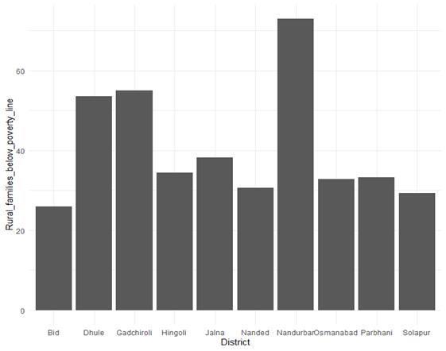
FOR TOP 10 LOW LITERATE DISTRICTS
Total number of families below poverty line
Number of schools

Slide 9
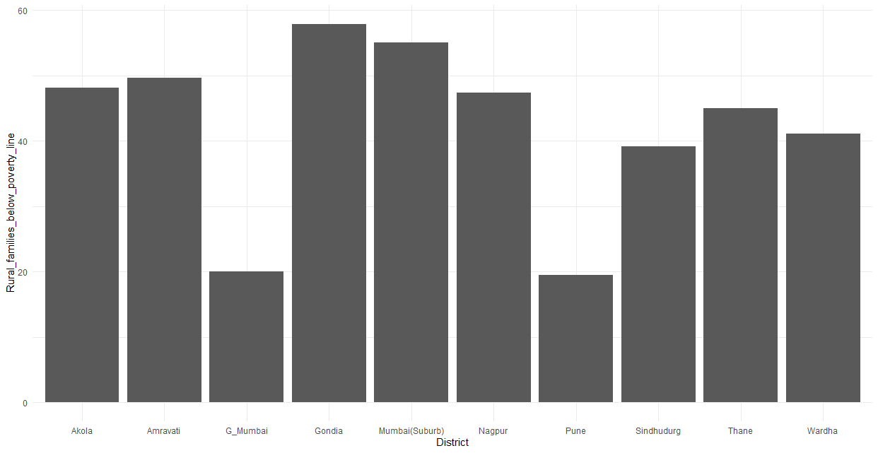
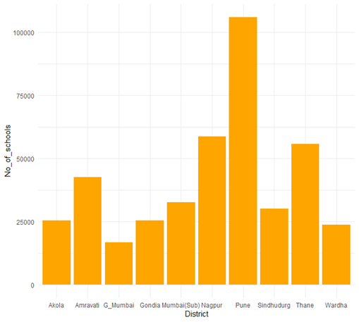
FOR TOP 10 HIGH LITERACY DISTRICTS
Number of schools
Total number of families below poverty line

Slide 10
CONCLUSION
While working on this project I learned new insights of Maharashtra state.
I could achieve my objective using function and packages of r-studio software.

