Slide 1
Estimating Population Dynamics
Using Coalescent Simulations
December 2nd , 2022
MATH 795: Simulation Modelling and Applications
Piyush Agarwal
Thanks to Dr. Rutherford and my supervisors Dr. Colijn and Dr. Chauve

Slide 2
Population Dynamics
How and Why of Population Size and Structure
Births
Deaths
Migration
A Very Powerful Framework because of the flexibility it provides
Free to choose your Population and define births, deaths and migration relevant to your population
How does the framework look like to an epidemiologist?

Slide 3
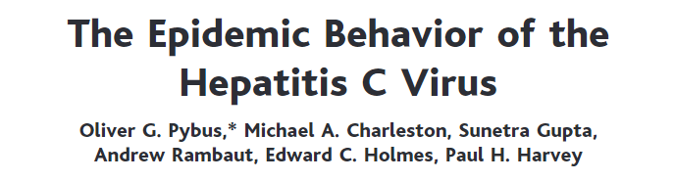
Why is it important?
Other than Answering questions regarding human history
Critical in Public Health and Disease Control
A Specific Example to drive the point Home:
Study was done in 2001, using HCV viral sequences and related coalescent methods.
4 subtypes in their analysis: 1a, 1b, 4, 6
From their analysis, 1a and 1b were growing faster whereas 4 and 6 were waning. 1A and 1B were spread mainly through injecting drug use. Predicted that 1a is the greatest threat to public health
Fast Forward 20 years, and subtype 1A is the most prevalent subtype in the developed world.

Slide 4
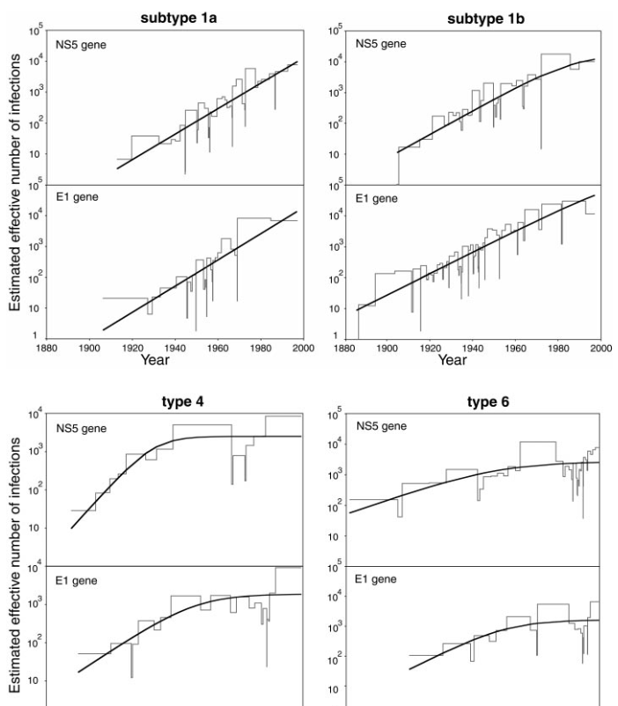
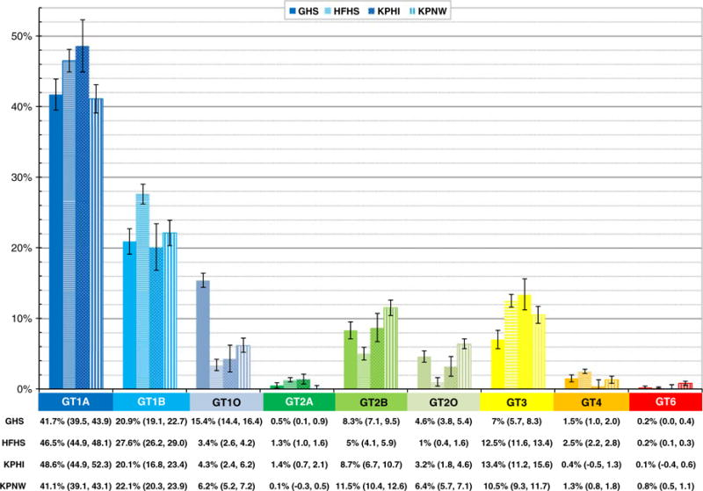
Study done in 2019 in United States
Image from Pybus etal
Showing waning of 4 and 6 and rise of 1a, 1b

Slide 5
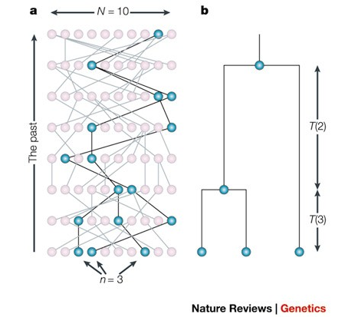

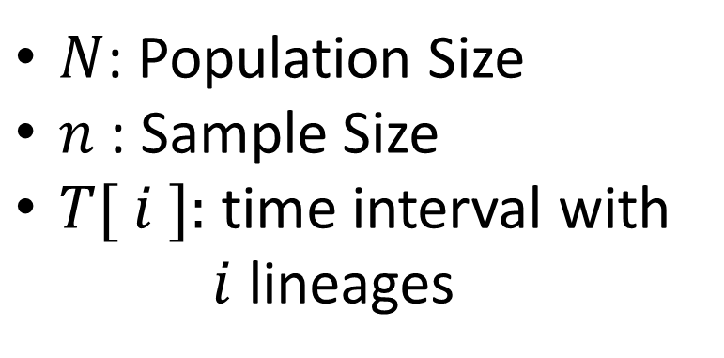
Coalescent Trees
$N$: Population Size
$n$ : Sample Size
$T[ i ]:$time interval with $i$ lineages
t=0
Fig : A Simple Coalescent Tree with $n=3$ [*]
[*] Image taken from Genealogical trees, coalescent theory and the analysis of genetic polymorphisms by Nordborg and Rosenberg

Slide 6
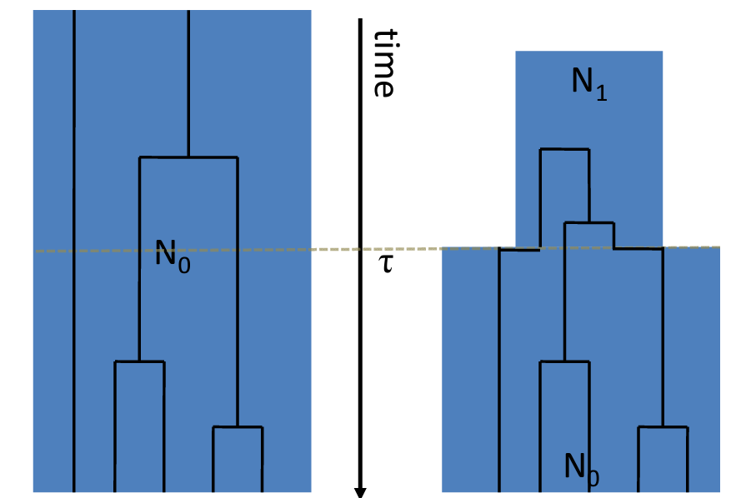

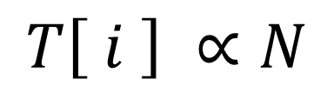

Inferring Pop. Dynamics from Coalescent Trees
$$T\left[ i \right] ∝N$$
Constant Population $N=N_{0}$
Variable Population $N=N_{0} t>τ othws N_{1}$
Fig : Coalescent Trees with constant and variable pop.[*]
[*] Image taken from Sebastian Zoellner slides

Slide 7
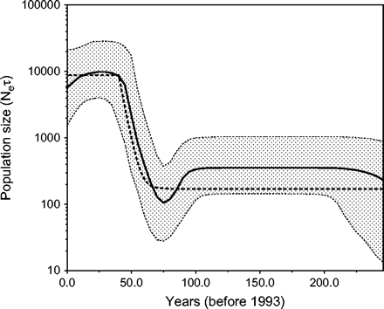
Bayesian Skyline
Given a set of gene sequence the method gives the posterior distribution of the population size through time.
The figure along side was computed using 63 viral sequences
The method is computationally intensive and doesn’t scale well with increasing number of sequences. So we look for other ways
Bayesian skyline plot derived from an alignment of Egyptian HCV sequences

Slide 8
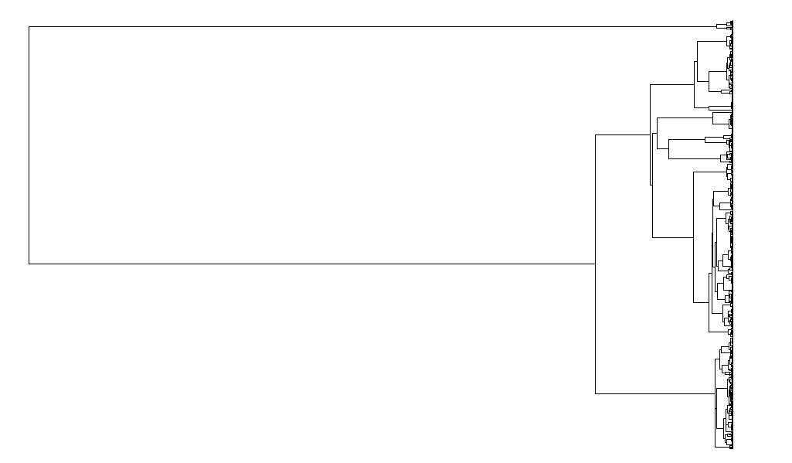






Proposed Methodology
To overcome this computational burden and use as much data as possible, we had the following idea:
Instead of doing this
Try to do this
$×{10}^{4}$
$×{10}^{3}$
$×{10}^{2}$
Fig1: Coalescent Tree with 1000 tips
Fig2: Coalescent Trees with 2,3 and 4 tips

Slide 9
Key Question
How much of the population dynamics can we infer from the second approach as compared to the first?
And this is where our dear friend SIMULATION comes in.

Slide 10
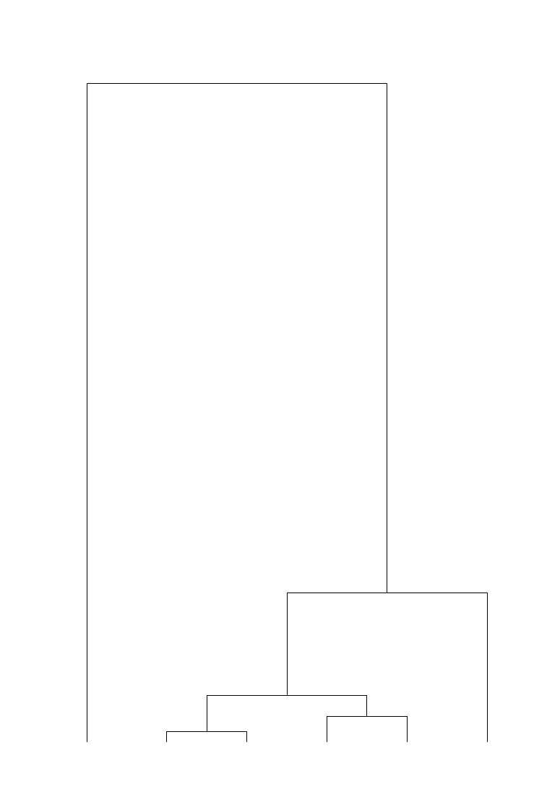
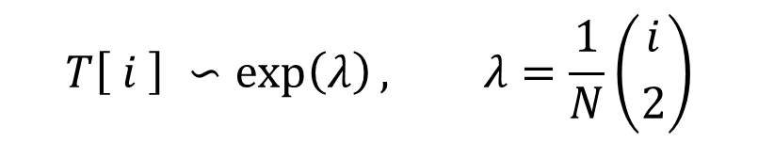
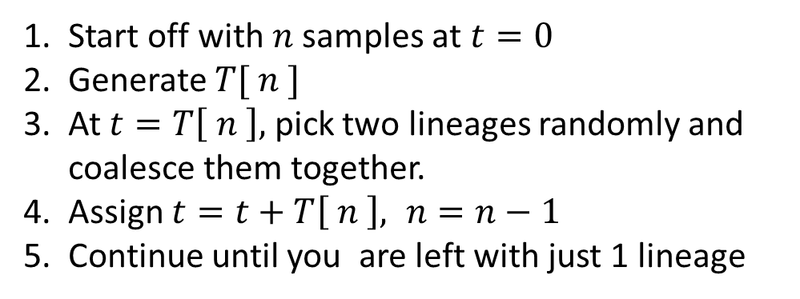


Simulation Model
Simulation is used to generate large coalescent trees.
Trees can be generated with varying levels of complexity.
Under the simplest of assumptions it looks like a pure death process
$$T\left[ i \right] ∽\exp\left(λ\right), λ=\frac{1}{N}\left({i \atop 2}\right)$$
$$T\left[ 2 \right]$$
Start off with $n$ samples at $t=0$
Generate $T[ n ]$
At $t=T\left[ n \right],$ pick two lineages randomly and coalesce them together.
Assign $t=t+T\left[ n \right], n=n−1$
Continue until you are left with just 1 lineage
$$T\left[ 3 \right]$$

Slide 11
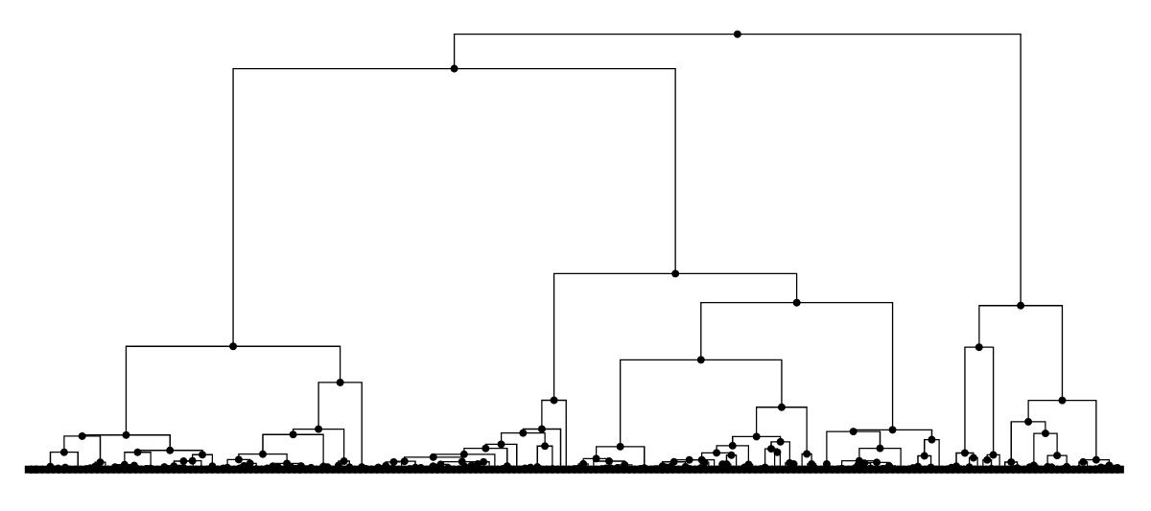
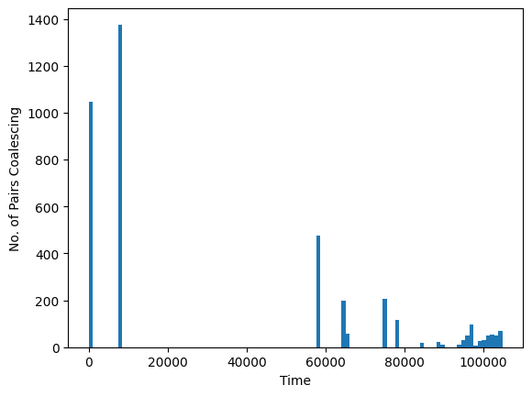
Preliminary Results
We work just with pairs to see if we can identify the times of coalescence
Fig: Coalescent Tree with 200 tips
Hist: 4000 random pairs sampled

Slide 12
Next Steps…
Probe and Quantify the results:
How many coalescent events are we able to identify?
What is the result of averaging?
Introduce complexity to the coalescent tree as in:
Add Mutations
Add Population Structure

