Slide 1

Computer Science and Engg.
Advance Programming in java
Unit -3 (RMI)
    Ashok Kumar Saini
    Assistant Professor
1

Slide 2
RMI – Remote Method Invocation
Introduction
What is RMI?
RMI System Architecture
How does RMI work?
Distributed Garbage Collection
RMI & the OSI Reference Model
Security
Programming with RMI
Copyright © 2001 Qusay H. Mahmoud

Slide 3
What is RMI?
A core package of the JDK1.1+ that can be used to develop distributed applications
Similar to the RPC mechanism found on other systems
In RMI, methods of remote objects can be invoked from other JVMs
In doing so, the programmer has the illusion of calling a local method (but all arguments are actually sent to the remote object and results sent back to callers)
Copyright © 2001 Qusay H. Mahmoud

Slide 4
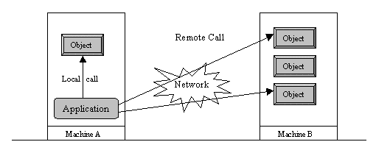
Local v. Remote method invocation
Copyright © 2001 Qusay H. Mahmoud

Slide 5
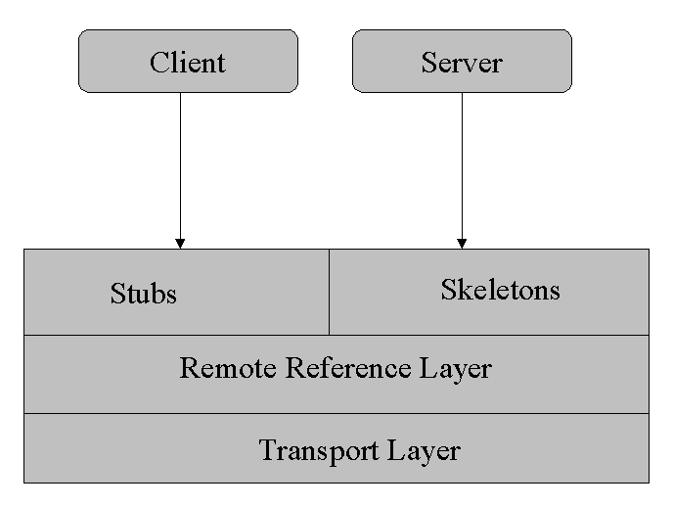
RMI System Architecture
Built in three layers (they are all independent):
  Stub/Skeleton layer
  Remote reference layer
  Transport layer
Copyright © 2001 Qusay H. Mahmoud

Slide 6
The Stub/Skeleton layer
The interface between the application layer and the rest of the system
Stubs and skeletons are generated using the RMIC compiler
This layer transmits data to the remote reference layer via the abstraction of marshal streams (that use object serialization)
This layer doesn’t deal with the specifics of any transport
Copyright © 2001 Qusay H. Mahmoud

Slide 7
The Stub/Skeleton l
Client stub responsible for:
  Initiate remote calls
  Marshal arguments to be sent
  Inform the remote reference layer to invoke the call
  Unmarshaling the return value
  Inform remote reference the call is complete
Server skeleton responsible for:
  Unmarshaling incoming arguments from client
  Calling the actual remote object implementation
  Marshaling the return value for transport back to client
Copyright © 2001 Qusay H. Mahmoud

Slide 8
The Remote Reference Layer
The middle layer
Provides the ability to support varying remote reference or invocation protocols independent of the client stub and server skeleton
Example: the unicast protocol provides point-to-point invocation, and multicast provides invocation to replicated groups of objects, other protocols may deal with different strategies…
Not all these features are supported….
Copyright © 2001 Qusay H. Mahmoud

Slide 9
The Transport Layer
A low-level layer that ships serialized objects between different address spaces
Responsible for:
  Setting up connections to remote address spaces
  Managing the connections
  Listening to incoming calls
  Maintaining a table of remote objects that reside in the same address space
  Setting up connections for an incoming call
  Locating the dispatcher for the target of the remote call
Copyright © 2001 Qusay H. Mahmoud

Slide 10
How does RMI work?
An invocation will pass through the stub/skeleton layer, which will transfer data to the remote reference layer
The semantics of the invocation are carried to the transport layer
The transport layer is responsible for setting up the connection
Copyright © 2001 Qusay H. Mahmoud

Slide 11
The Naming Registry
The remote object must register itself with the RMI naming registry
A reference to the remote object is obtained by the client by looking up the registry
Copyright © 2001 Qusay H. Mahmoud

Slide 12
Distributed Garbage Collection
RMI provides a distributed garbage collector that deletes remote objects no longer referenced by a client
Uses a reference-counting algorithm to keep track of live references in each Virtual Machine
RMI keeps track of VM identifiers, so objects are collected when no local or remote references to them
Copyright © 2001 Qusay H. Mahmoud

Slide 13
Programming with RMI
Anatomy of an RMI-based application
  Define a remote interface
  Provide an implementation of the remote interface
  Develop a client
  Generate stubs and skeletons
  Start the RMI registry
  Run the client and server
Copyright © 2001 Qusay H. Mahmoud

Slide 14
Define a remote interface
It specifies the characteristics of the methods provided by a server and visible to clients
  Method signatures (method names and the type of their parameters)
By looking at the interface, programmers know what methods are supported and how to invoke them
Remote method invocations must be able to handle error messages (e.g. can’t connect to server or server is down)
Copyright © 2001 Qusay H. Mahmoud

Slide 15
Characteristics of remote interface
Must be declared public
To make an object a remote one, the interface must extend the java.rmi.Remote interface
Each method declared in the interface must declare java.rmi.RemoteException in its throws clause.
Copyright © 2001 Qusay H. Mahmoud

Slide 16
Implement the remote interface
The implementation needs to:
  Specify the remote interface being implemented
  Define the constructor of the remote object
  Implement the methods that can be invoked remotely
  Create an instance of a remote object
  Register it with the RMI registry
see DateServerImpl example
Copyright © 2001 Qusay H. Mahmoud

Slide 17
Develop a client
Example:
  DateClient.java
Copyright © 2001 Qusay H. Mahmoud

Slide 18
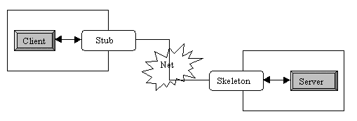
Generate stubs and skeletons
Use the rmic compiler
Place the remote interface and the stub class on the client side, and both the stub and skeleton on the server side.
  alternately, some of these files could be dynamically loaded (will see this later)
Copyright © 2001 Qusay H. Mahmoud

Slide 19
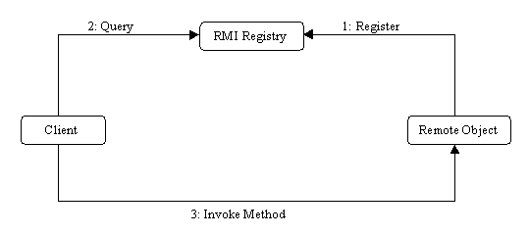
Start the RMI registry
It is a naming service that allows clients to obtains references to remote objects
Copyright © 2001 Qusay H. Mahmoud

Slide 20
Run the server and client
Run the rmi registery (default port: 1099)
Run the server
Run the client
Copyright © 2001 Qusay H. Mahmoud

Slide 21
Working with the RMI Registry
refer to the java.rmi.Naming class
Copyright © 2001 Qusay H. Mahmoud

Slide 22
What else?
Dynamically loading stubs and skeletons
Implementing callbacks
Implementing factories
How to sign objects over RMI
How to create custom RMI socket factories
SSL sockets
Remote object activation
Copyright © 2001 Qusay H. Mahmoud

Slide 23
create the remote interface
For creating the remote interface, extend the Remote interface and declare the RemoteException with all the methods of the remote interface. Here, we are creating a remote interface that extends the Remote interface. There is only one method named add() and it declares RemoteException.
import java.rmi.*;
public interface Adder extends Remote{
public int add(int x,int y)throws RemoteException;
}
Copyright © 2001 Qusay H. Mahmoud

Slide 24
Provide the implementation of the remote interface
Now provide the implementation of the remote interface. For providing the implementation of the Remote interface, we need to
Either extend the UnicastRemoteObject class,
or use the exportObject() method of the UnicastRemoteObject class
In case, you extend the UnicastRemoteObject class, you must define a constructor that declares RemoteException
import java.rmi.*;
import java.rmi.server.*;
public class AdderRemote extends UnicastRemoteObject implements Adder{
AdderRemote()throws RemoteException{
super();
}
public int add(int x,int y){return x+y;}
}
Copyright © 2001 Qusay H. Mahmoud

Slide 25
3) create the stub and skeleton objects using the rmic tool.
Next step is to create stub and skeleton objects using the rmi compiler. The rmic tool invokes the RMI compiler and creates stub and skeleton objects.
rmic AdderRemote
Copyright © 2001 Qusay H. Mahmoud

Slide 26
4) Start the registry service by the rmiregistry tool
Now start the registry service by using the rmiregistry tool. If you don't specify the port number, it uses a default port number. In this example, we are using the port number 5000.
rmiregistry 5000
Copyright © 2001 Qusay H. Mahmoud

Slide 27
5) Create and run the server application
Now rmi services need to be hosted in a server process. The Naming class provides methods to get and store the remote object. The Naming class provides 5 methods.
In this example, we are binding the remote object by the name sonoo.
import java.rmi.*;
import java.rmi.registry.*;
public class MyServer{
public static void main(String args[]){
try{
Adder stub=new AdderRemote();
Naming.rebind("rmi://localhost:5000/sonoo",stub);
}catch(Exception e){System.out.println(e);}
}
}
Copyright © 2001 Qusay H. Mahmoud

Slide 28
6) Create and run the client application
import java.rmi.*;
public class MyClient{
public static void main(String args[]){
try{
Adder stub=(Adder)Naming.lookup("rmi://localhost:5000/sonoo");
System.out.println(stub.add(34,4));
}catch(Exception e){}
}
}
Copyright © 2001 Qusay H. Mahmoud

Slide 29
import java.rmi.*;
public interface adder extends Remote{
public int add(int x,int y)throws RemoteException;
}
Copyright © 2001 Qusay H. Mahmoud

Slide 30
Client program
public class client {
public static void main(String args[]) throws RemoteException {
client c=new client();
c.connectRemote();
}
private void connectRemote()throws RemoteException
{
try{
Registry reg=LocateRegistry.getRegistry("localhost", 9998);
adder ad=(adder)reg.lookup("hi server1");
Scanner sc = new Scanner(System.in);
System.out.println("Enter the base number ::");
int x = sc.nextInt();
System.out.println("Enter the exponent number ::");
int y = sc.nextInt();
System.out.println("addition is "+ ad.add(x, y));
}
catch(NotBoundException|RemoteException e)
{
System.out.println(e);
} }}
Copyright © 2001 Qusay H. Mahmoud

Slide 31
Server program
public class server extends UnicastRemoteObject implements adder{
public server()throws RemoteException{
}
public int add(int x,int y)throws RemoteException
{ return x+y; }
public static void main(String args[]) throws RemoteException {
try {
Registry reg=LocateRegistry.createRegistry(9998);
reg.rebind("hi server1", new server());
System.out.println("server is ready");
}
catch(RemoteException e)
{
System.out.println(e);
} }
}
Copyright © 2001 Qusay H. Mahmoud

Slide 32
References
https://www.javatpoint.com/RMI
JDBC API Tutorial and Reference (book)
  http://java.sun.com/docs/books/jdbc/
  https://www.javatpoint.com/java-tutorial
https://www.tutorialspoint.com/java_rmi/java_rmi_application.htm
The complete reference Book by Herbert Schildt
Copyright © 2001 Qusay H. Mahmoud

