Slide 1
Art and Humanity

Slide 2
Humanity and Art
2 words . Humanity? Art?
Humanity – derived from humane or human
We’ll focus on ‘human’.
Humanity means ‘people in general’. ‘the human race’.
An individual. A member of the human race.
Or collective humanity. the whole race as a single unit. Society.
Humanity → Art

Slide 3
A human being ?
We are living organisms.
We have evolved from simpler forms over billions of years through natural selection. Hence we are terribly complex systems. But however we must remember we are just matter. ‘Billion year old carbon’.
We do stuff like ‘thinking’ and ‘feeling’. And there is a whole spectrum of these thoughts and feelings.
There are many like us and we interact with them and also immediate surroundings like our ecosystem.

Slide 4
Language -→Literary art.
Sounds , auditory system -→ music
Optical system -→ visual art. Graphic or performance. And other(sculpture, architecture).
Mathematics ?
But math is different because it claims to be objective.

Slide 5
From the artist’s point of view
Two components (1) Skill (2) Idea
Stretch and express man’s widest, most abstract thoughts
Share his insights and view of life and the human condition

Slide 6
From the audience’s point of View
Recreation
Loss of self-awareness
Transcendence of self. Knowledge of some earlier hidden truth or exciting facet of the human condition.
exaltation

Slide 7
Art
What is ART?
An aesthetic experience
seemingly quite a lack of words to express oneself accurately when making an aesthetic judgement
Conflicting views on the definition of art
Does a hard definition put a bound on creativity?

Slide 8
The involvement of Human Agency
The starry night sky is generally not termed as art. (A photo of the same may be)
Art typically refers only to human creations or creativity in general.
The interpretation of art depends on the one who views it and may well be different from the another person and the person who actually created it.

Slide 9
Some Views about Art
Ponder upon the following:
STATEMENTS ABOUT ART:
Must evoke an emotion
Must be unique
May make the viewer think
May not appeal to everyone

Slide 10
Cont..
SOME MORE STATEMENTS …
Must be beautiful
Must be pleasing to the senses
Can have a profound impact on how people perceive the world
Must reflect the technical skill of the artist
Not everything can be art

Slide 11
Cont..
AND SOME MORE:
Must be confusing or difficult to understand
Is created by people who have a special insight into life, nature, and the human condition
Must be something that can only be understood by intellectuals and connoisseurs
Must have been reviewed by a recognized art critic
Must fit nicely into an office setting or coordinate well with home décor

Slide 12
Is the human mind selective about Art? (Example – Music)
The 12 notes of western music model have frequencies that bear rather simple fractional ratios.
Ancient Greeks found out that they appeal to the human mind.
What is the fundamental difference between ‘noise’ and ‘melody’.

Slide 13
The Appeal of Symmetry
Well known fact that the human mind has an extreme affinity for symmetry
Nearly all famous monuments are symmetric
The reason, possibly is that our inner creative self is affected by the ample symmetry in the world around us.

Slide 14
A definition of ‘more pleasing’- open questions
Does humanity in general classify ‘art’ and ‘non-art’?
Is the division more based on a personal impression about a particular work?
Does the community verdict cloud our judgment?
Where do we draw the line..?
Is it right to draw the line..

Slide 15
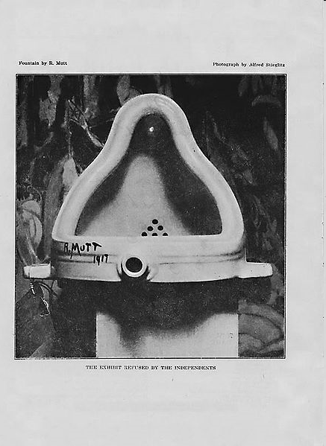
The Fountain
Fountain is a 1917 work by Marcel Duchamp. It is one of the pieces which he called readymades (also known as found art), because he made use of an already existing object—in this case a urinal, which he titled Fountain and signed "R. Mutt". The art show to which Duchamp submitted the piece stated that all works would be accepted, but Fountain was not actually displayed, and the original has been lost. The work is regarded by some as a major landmark in 20th century art.

Slide 16
Art – An Expression of Humanity
Greeting cards, self-made gifts for your near and dear ones .
Creative works sold by roadside vendors, street kids etc..
“Elementary” drawings made by little kids
Taare Zameen Par, the medium of communication for the protagonist, the flicker-book.

Slide 17
Even Mathematics is ART!
  Galileo Galilei in his Il Saggiatore wrote that “The universe is written in the language of mathematics, and its characters are triangles, circles, and other geometric figures.”
  A mathematician, like a painter or poet, is a maker of patterns. If his patterns are more permanent than theirs, it is because they are made with ideas. — G. H. Hardy
  Mathematics, rightly viewed, possesses not only truth, but supreme beauty — a beauty cold and austere, like that of sculpture, without appeal to any part of our weaker nature, without the gorgeous trappings of painting or music, yet sublimely pure, and capable of a stern perfection such as only the greatest art can show. The true spirit of delight, the exaltation, the sense of being more than Man, which is the touchstone of the highest excellence, is to be found in mathematics as surely as poetry.
  - Bertrand Russell

Slide 18
In the forest of Paradoxes – Nobel Lecture, J.M le Clezio
Once I had assimilated the system of primitive communism practised by the Amerindians, as well as their profound disgust for authority and their tendency towards natural anarchy, I came to see that art, as a form of individual expression, did not have any role to play in the forest. Besides, these people had nothing that resembled what we call art in our consumer society. Instead of hanging paintings on a wall, the men and women painted their bodies, and in general were loath to create anything lasting…..
But one night, a young woman came. She was known throughout the entire forest of the Emberá for her storytelling skills. Although I had no access to her tales other than through translation ,I quickly realized that she was a great artist, in the best sense of the term. The timbre of her voice, the rhythm of her hands tapping against her chest, against her heavy necklaces of silver coins, and above all the air of possession which illuminated her face and her gaze, a sort of measured, rhythmic trance, exerted a power over all those who were present. To the simple framework of her myths—the invention of tobacco, the first primeval twins, stories about gods and humans from the dawn of time—she added her own story, her life of wandering, her loves, the betrayals and suffering, the intense joy of carnal love, the sting of jealousy, her fear of growing old, of dying. She was poetry in action, ancient theatre, and the most contemporary of novels all at the same time. She was all those things with fire, with violence, she invented, in the blackness of the forest, amidst the surrounding chorus of insects and toads and the whirlwind of bats, a sensation which cannot be called anything other than beauty. As if in her song she carried the true power of nature, and this was surely the greatest paradox: that this isolated place, this forest, as far away as could be imagined from the sophistication of literature, was the place where art had found its strongest, most authentic expression.

Slide 19
Never Let Me Go..1
I should explain a bit here about the Exchanges we had at Hailsham. Four times a year–spring, summer, autumn, winter–we had a kind of big exhibition-cum-sale of all the things we’d been creating in the three months since the last Exchange. Paintings, drawings, pottery; all sorts of “sculptures” made from whatever was the craze of the day–bashed-up cans, maybe, or bottle tops stuck onto cardboard. For each thing you put in, you were paid in Exchange Tokens–the guardians decided how many your particular masterpiece merited–and then on the day of the Exchange you went along with your tokens and “bought” the stuff you liked. The rule was you could only buy work done by students in your own year, but that still gave us plenty to choose from, since most of us could get pretty prolific over a three-month period.
Looking back now, I can see why the Exchanges became so important to us. For a start, they were our only means, aside from the Sales–the Sales were something else, which I’ll come to later–of building up a collection of personal possessions. If, say, you wanted to decorate the walls around your bed, or wanted something to carry around in your bag and place on your desk from room to room, then you could find it at the Exchange. I can see now, too, how the Exchanges had a more subtle effect on us all. If you think about it, being dependent on each other to produce the stuff that might become your private treasures–that’s bound to do things to your relationships. The Tommy business was typical. A lot of the time, how you were regarded at Hailsham, how much you were liked and respected, had to do with how good you were at “creating.”

Slide 20
Never Let Me Go….2
Tommy’s voice was now down to a whisper. “What she told Roy, what she let slip, which she probably didn’t mean to let slip, do you remember, Kath? She told Roy that things like pictures, poetry, all that kind of stuff, she said they revealed what you were like inside . She said they revealed your soul.”

Slide 21
Never Let Me Go….3
Why did we take your artwork? Why did we do that? You said an interesting thing earlier, Tommy. When you were discussing this with Marie-Claude. You said it was because your art would reveal what you were like. What you were like inside. That’s what you said, wasn’t it? Well, you weren’t far wrong about that. We took away your art because we thought it would reveal your souls. Or to put it more finely, we did it to prove you had souls at all.”
She paused, and Tommy and I exchanged glances for the first time in ages. Then I asked:
“Why did you have to prove a thing like that, Miss Emily? Did someone think we didn’t have souls?” …..
---------------------------------------------------------------------------------------------------------
We demonstrated to the world that if students were reared in humane, cultivated environments, it was possible for them to grow to be as sensitive and intelligent as any ordinary human being. Before that, all clones–or students, as we preferred to call you–existed only to supply medical science. In the early days, after the war, that’s largely all you were to most people. Shadowy objects in test tubes…

Slide 22
To society as a whole
Economic importance … livelihood for people( Fashion, local artisans, handicrafts)
Brings people together, unites masses, cohesion… therefore peace , harmony.
Culture : gives direction to progress in society.
Society becomes more productive and constructive and less destructive.
Study of history.

Slide 23
Agent for Revolution
Harbinger of Change. Poets, Writers etc
Freedom Struggle
Renaissance
Rock ‘n’ Roll in 60’s 70’s – beatles etc

Slide 24
Art Movements
Clearly the human race and Art go back a long way.
There have been many Art Movements over history.
Classical, Neo-Classical
Realism , Naturalism.
Impressionism, Post-Impressionism
Expressionism.
Dadaism, Surrealism
Pop-Art

Slide 25
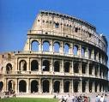

Classical, Neo-Classical
Classical (Roman, Greek): Geometry and symmetry rather than human expression.
Neoclassical art includes individual expression, ideas of love, courage, love of country, etc( eg David)

Slide 26
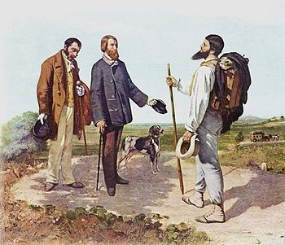
Realism, Naturalism
Realism: As a reaction to romanticism. Depiction of subjects as they appear in everyday life, without exaggeration or embellishment. Objective Reality. Accuracy and Truth
Naturalism: extends Realism with the Darwinian perspective of life.( futility of man against the world)
Bonjour Monsieur Courbet by Courbet

Slide 27
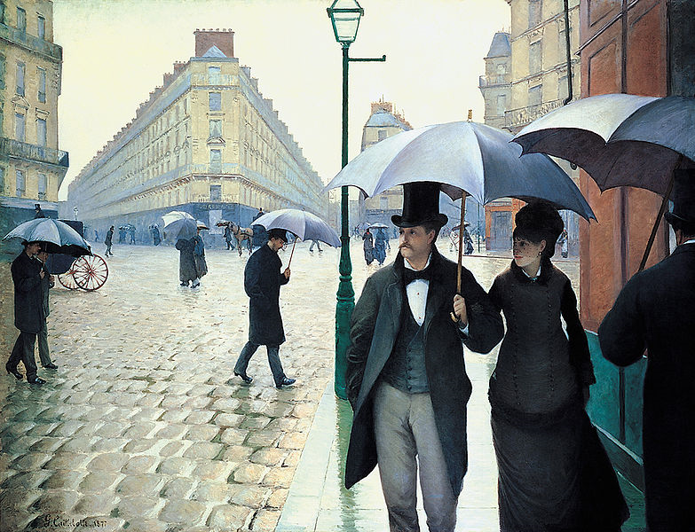
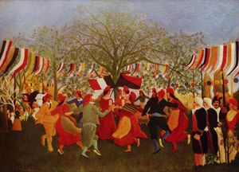
Impressionism, Post-Impressionism
Impressionism: no distinct subject matter. Does not want to focus attention. But present a snapshot or a glimpse
Post-Impressionism: rejected limitations of Impressionism. Dissatisfied by its lack of structure . Tried to bring in geometric shapes etc, Pointillism etc

Slide 28
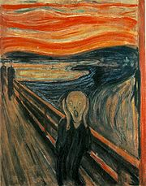
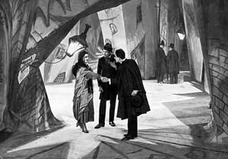
Expressionism.
Expressionism: Reaction to Naturalism and Impressionism. sought to express the meaning of ‘being alive’. The emotional experience rather than Physical reality. Distort reality for emotional effect.

Slide 29
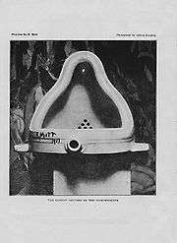
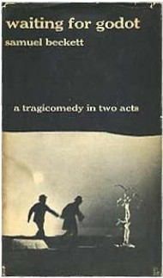
Dadaism...Surrealism
Dadaism: Post WW1. Rejection of prevailing standards in Art. It did the groundwork for Abstract Art.
Surrealism: element of surprise, unexpected juxtapositions. Absurd Theatre

Slide 30
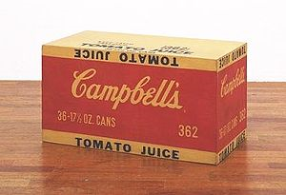
Pop-Art
Pop-Art: mass-produced , removes the material from its context and isolates the object. pop art refers not as much to the art itself as to the attitudes that led to it. Materialism, making a statement.

Slide 31
Thank You

