Slide 1

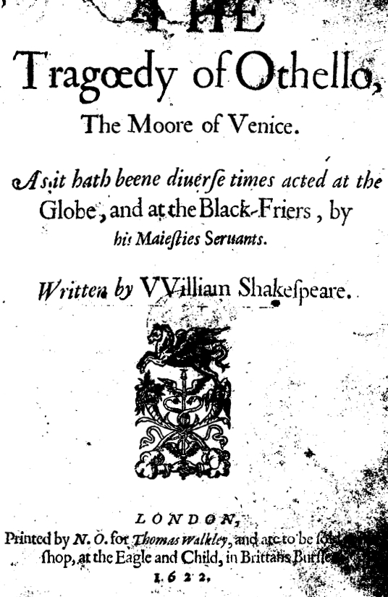
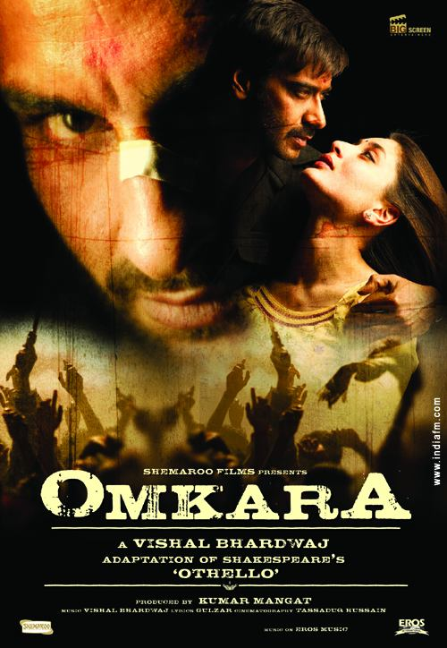
Piyush Ahuja
Pradeep Mathias

Slide 2
Contents
The Setting
Comparison of characters
Othello (Omkara) as a Tragedy
Iago
Symbolism, Motifs
Themes
Open/Discussion Questions

Slide 3
The Setting
Venice to Contemporary Rural India
Army General to Gangster 'Baahubali'
War threat vs State elections
Racism to Caste System

Slide 4
Characters
Character in the movie Character in the play
Omkara 'Omi' Shukla Othello
Dolly Mishra Desdemona
Ishwar 'Langda' Tyagi Iago
Keshav 'Kesu Firangi' Upadhyaya Cassio
Billo Chamanbahar Bianca
Indu Emilia
Rajan ’Rajju’ Tiwari Roderigo
Bhaisaab Duke of Venice

Slide 5
Othello, the Tragedy
Domestic tragedy with timeless themes
Noble and self-righteous
Fatal Flaw
  Jealousy and Suspicion
  Insecurity
  Naive Trust
Othello, a tragic hero?

Slide 6
Othello the 'Outsider'
Egyptian roots
General of the Venetian Army
Has insecurities

Slide 7
Symbolism
War
Handkerchief and 'Kamarband' (Waistband)
Song of The Willow in Othello, the black bird in Omkara – Premonition

Slide 8
The Clown
Comes in just 2 scenes
Distorts words
Pun on lie:
  DESDEMONA
  Do you know, sirrah, where Lieutenant Cassio lies?
  Clown
  I dare not say he lies any where.

Slide 9
Iago
Complex Character
“Motive-hunting of Motiveless Malignity”
Soliloquies
Dramatic Irony

Slide 10
Constricted Space
Narrowing the space
  Starts in Venice – a bustling international city
  Driven by external threat – Turkish invasion of Cyprus
  Action moves to domestic conflict
  Ends at the bedroom
  Smothering

Slide 11
Racism / Caste System
Moor vs Half-Brahmin
  Iago: “an old black ram is topping your white ewe.”
  Brabantio: “Would ever have, to incur a general mock, Run from her guardage to the sooty bosom”
  Duke: “If virtue no delighted beauty lack, Your son-in-law is far more fair than black.”
Marriage outside caste/colour

Slide 12
Role of women
Family vs Husband
Iago's take Act 2 Scene I
Views of Emilia and Desdemona Act 4 Scene III
“Honour Sacrifice”

Slide 13
Omkara – Today's Othello
Rural setting
Corrupt politicians and gangs
  Power play
Caste Issues
Gender Issues
Fascination with the West

Slide 14
Discussion
Is there a point being made in Omkara about power coming only through coercion today?
Keshu “Firangi” vs Langda Tyagi – is there a underlying assumption that the West is more “cultured”?
How do we react to suspicion?
How does loss (of reputation) affect us?
Is there a point being made in the play/movie regarding marriage outside class/caste?

Slide 15
THANK YOU

