Slide 1

Project Mentor S. D. Rane sir
Team Members:
Piyusha Shinde. 21UAI059
Prerana Shinde. 21UAI060
Ankita Tonape. 21UAI065
Sakshi Upadhye. 21UAI066
Akanksha Yedrave. 21UAI072
D. K. T. E. SOCIETY’S TEXTILE & ENGINEERING INSTITUTE,ICHALKARANJI.

Slide 2

TECHTALENTFORCAST

Slide 3
Problem Statement
The "Prediction of Jobs in Engineering & Technology with respect to skills & past grades" web project aims to address the challenge of helping engineering and technology students and professionals make informed career decisions by leveraging their skills and past academic performance to predict suitable job opportunities.

Slide 4
Problem Description
In today's rapidly evolving job market, engineering and technology students and professionals often face uncertainty when it comes to selecting a career path that aligns with their skills and academic achievements. This web project seeks to provide a data-driven solution to this problem.
The project will involve the development of a web platform that allows users to input their skills and academic grades. These inputs will be processed using advanced data analysis and machine learning algorithms to predict potential job opportunities within the field of engineering and technology that match the user's profile. The system will consider factors such as technical skills, soft skills, academic performance, and industry trends to make accurate predictions.

Slide 5
Key Features
User Profile Creation: Users will create profiles by providing information about their technical skills, past academic grades, and any relevant experiences or certifications.
Skills Assessment: The system will employ a skills assessment mechanism to evaluate a user's technical and soft skills. This assessment may include self-assessment questions or interactive tests.
Data Integration: The system will leverage data sources such as job listings, industry trends, and career progression data to stay up-to-date with the evolving job market.
Machine Learning Algorithms: Advanced machine learning models will be used to match user profiles with job opportunities based on their skills and academic performance. These algorithms will continually refine predictions as users update their profiles.
Job Recommendations: The platform will provide users with personalized job recommendations, including job descriptions, required qualifications, salary ranges, and potential career growth paths.
Skill Enhancement Suggestions: Users will receive suggestions on how to improve their skills or acquire additional qualifications to better align with their desired career paths.
User Feedback and Improvement: The system will collect feedback from users about the accuracy of job predictions and continuously improve its algorithms to enhance prediction accuracy.

Slide 6
Work Flow
End
Start
User Profile Creation
Skills Assessment
Data Integration
Machine Learning
Skill Enhancement Suggestion
User Feedback
Feedback Analysis

Slide 7
User's Data
System Architecture
Flask App(app.py,train.py)
HTML pages(index.html,home.html,about.html,feed.html)
Apply Learned model on Test data(Prediction)
Logistic regression
Accuracy comparison and Conclusion

Slide 8
Use case
Ll
Filling details
Ll
Preprocessing
Ll
Students
Prediction(Yes/no)
Admin

Slide 9
Student
System
Filling Details
Data Preprocessing
Request Home
Prediction
Display prediction
Display recommendation

Slide 10
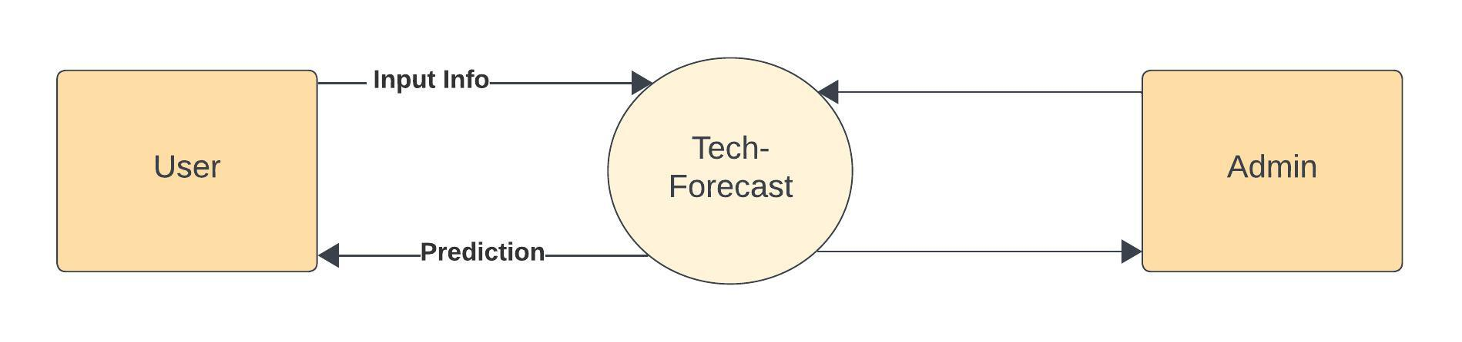
Data Flow Diagram
DFD Level 0

Slide 11
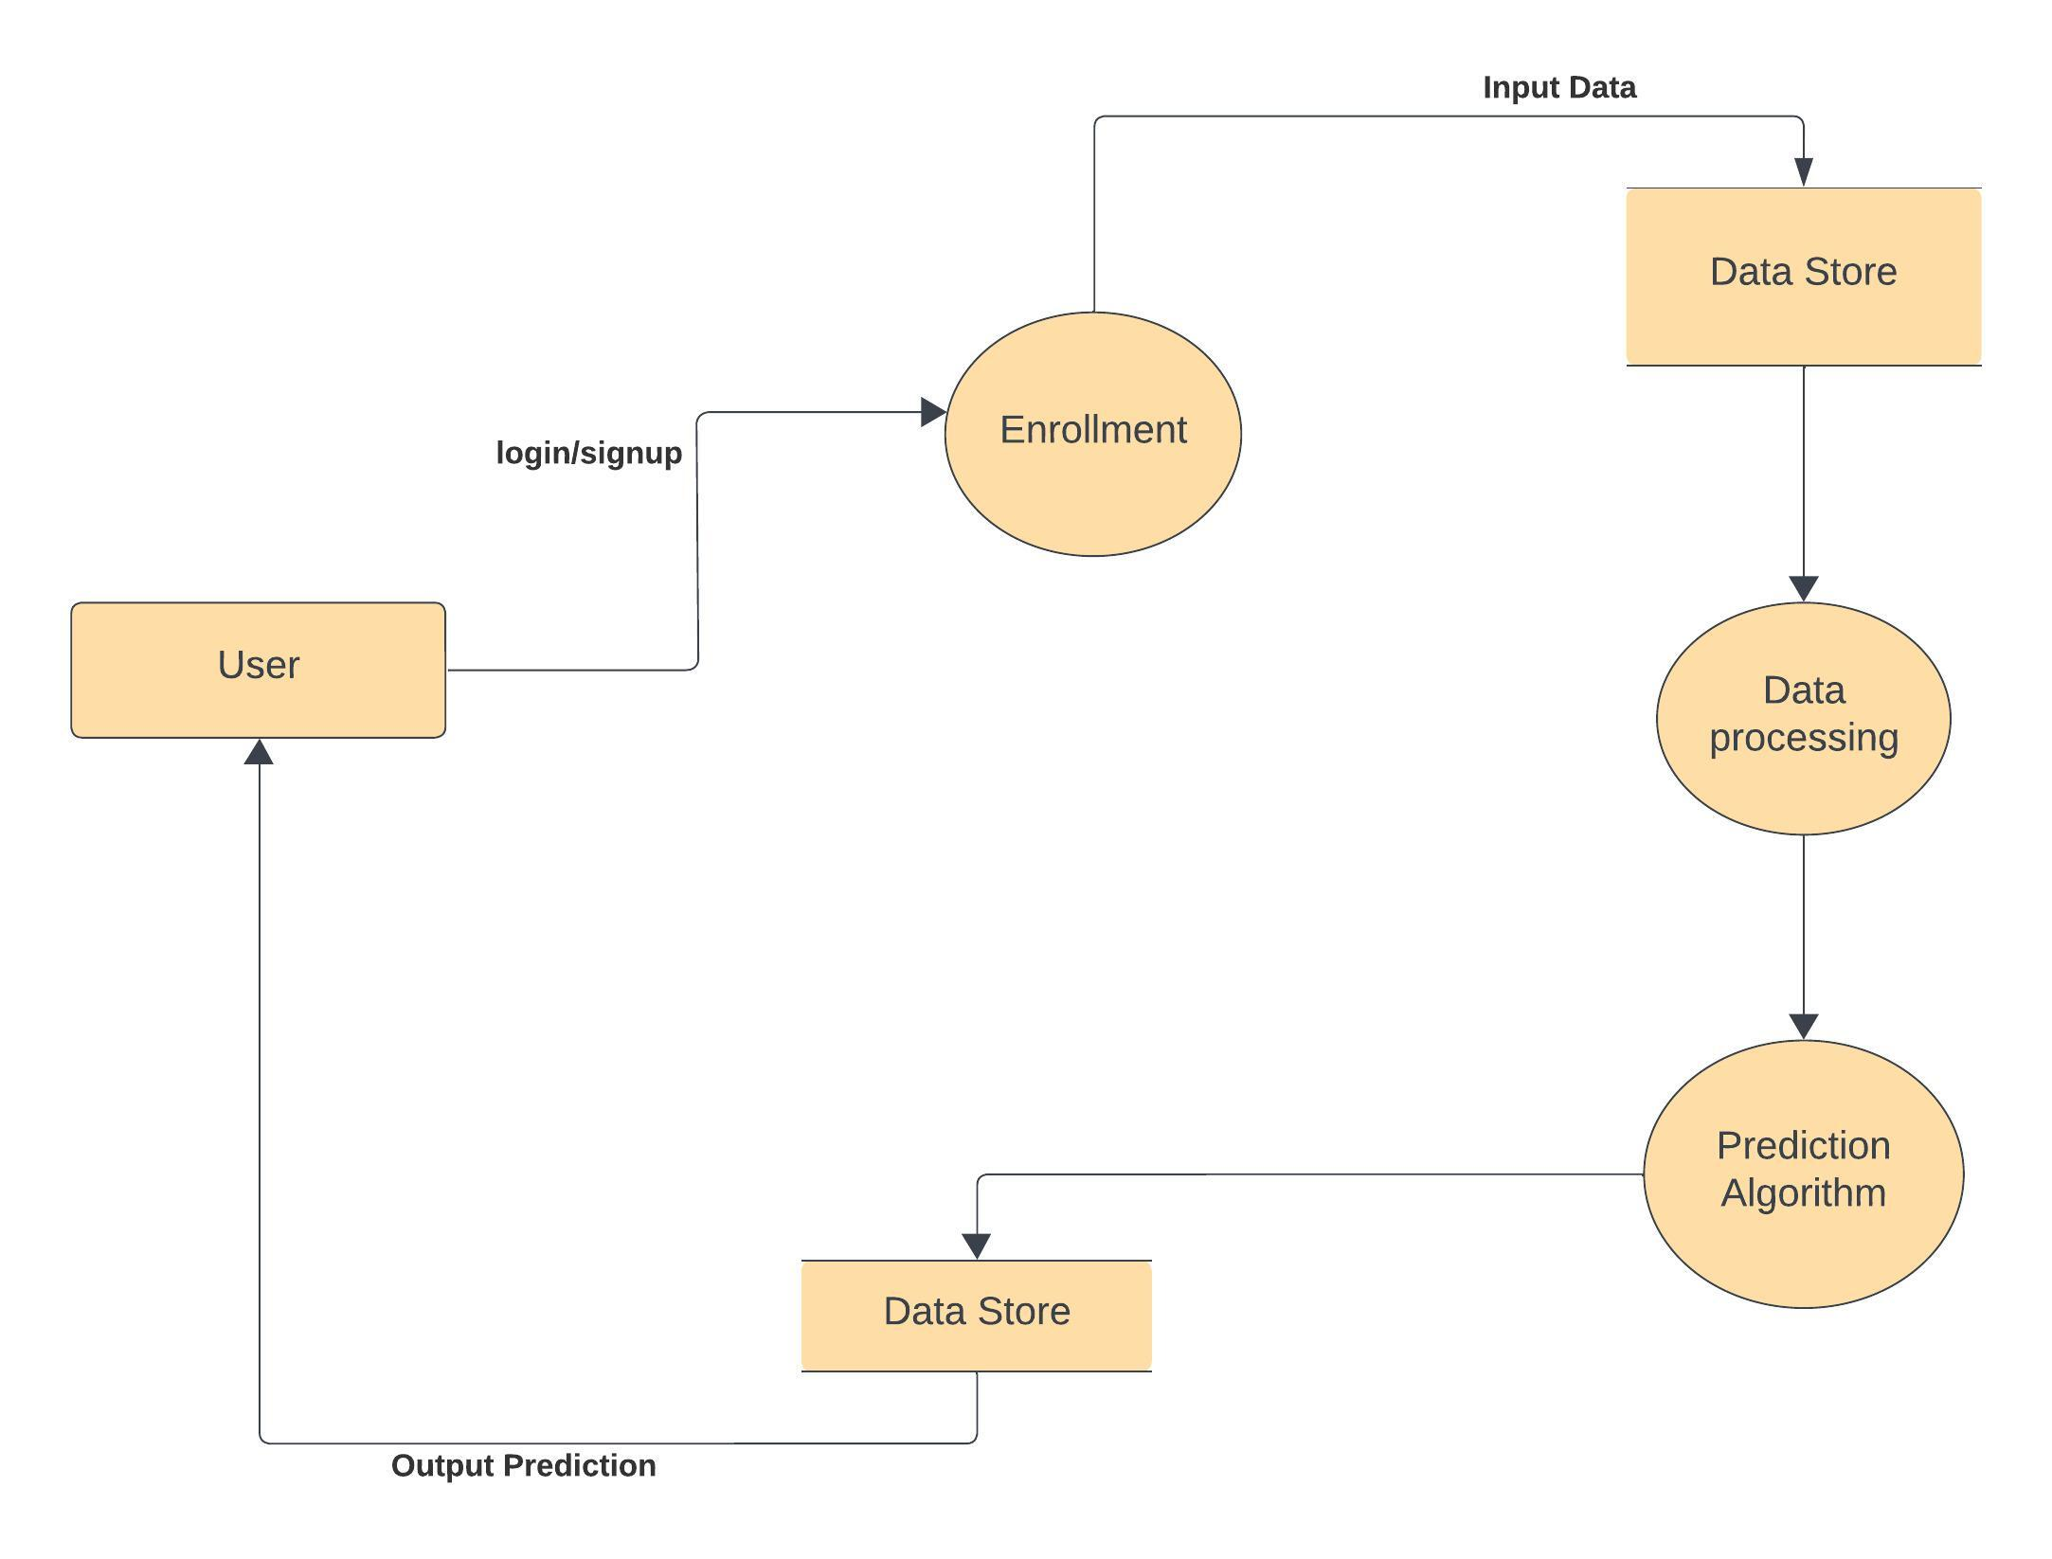
DFD Level 1

Slide 12
Abstract
In response to the complex decision-making landscape faced by engineering and technology students and professionals in the job market, the "Prediction of Jobs in Engineering & Technology with respect to skills & past grades" web project has been conceived. This initiative seeks to provide a solution to the challenge of career decision-making by harnessing the power of data. The web platform allows users to input their skills and past academic performance, employing advanced data analysis and machine learning algorithms to predict and recommend job opportunities aligned with their profiles. By considering technical skills, soft skills, academic achievements, and industry trends, the project aims to empower individuals with the insights needed for making informed and strategic career choices in the dynamic field of engineering and technology.

Slide 13



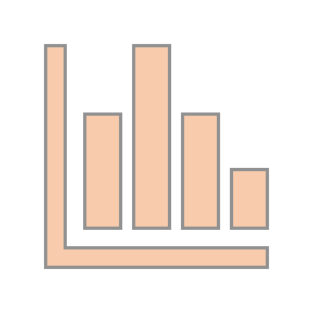




Slide 14
THANK YOU

