Slide 1
Project Proposal
DaaS
Team 11
Divya Gurnani 201306525
Lovlean Arora 201305590
Piyush Bansal 201102022
Vaibhav Gupta 201130109

Slide 2
Problem Statement
Build an API for data as a service from data.gov.in, to query and serve the data in json format.

Slide 3
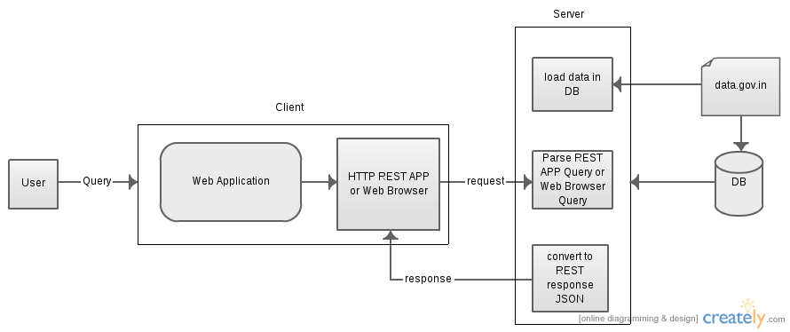
System Design

Slide 4
End Users
The data.gov.in website is designed to host information of various sectors like Agricultural based, health based, and Indian statistics.
The end users will be specific to the type of information being sought. For e.g:
Collect ambulance DB available in India- Health ministry, hospital management, patients.
Construction of deep tube wells over the years– Bureaucrats of Agriculture dept, Farmers.
Android Application developers- Rajya Sabha Business App, All India Pin code Directory

Slide 5
Thank You

