Slide 1
ML PROJECT
Food Delivery
Time Prediction
Linear Regression · Decision Tree · Random Forest · XGBoost
45,593
12
4
0.8195
Train Records
Features
Models
Best R²

Slide 2
Problem Statement & Objectives
⚠️ The Problem
🎯 Project Goal
Late = Unhappy
Build a supervised machine learning regression model that accurately predicts food delivery time (in minutes) based on:
• Delivery agent information
• Road & traffic conditions
• Environmental / weather factors
• Order characteristics
Customers lose trust when food is late. Satisfaction drops immediately.
📉 High ETA = Lost Orders
Overestimating time makes users abandon before placing orders.

Slide 3
Project Objectives
01
02
03
EDA & Preprocessing
Feature Engineering
Train 4 Models
Perform exploratory data analysis and clean real-world delivery dataset.
Create meaningful features like GPS-based haversine distance.
Linear Regression, Decision Tree, Random Forest, and XGBoost.
04
05
Evaluate & Compare
Best Model Prediction
Compare model performance using MAE, RMSE, and R² score.
Use the best-performing model to predict delivery time on test data.

Slide 4
Dataset Description
Kaggle
~45,000
~11,000
12
Source
Train Records
Test Records
Features
Selected Features
🎯 Target Variable
Delivery_person_Age — Agent age
Delivery_person_Ratings — Customer rating
distance_km — GPS Haversine distance
order_hour — Hour extracted from timestamp
Vehicle_condition — Vehicle score
multiple_deliveries — Handling multiple orders
Weather, Traffic, Order type, Vehicle, Festival, City
Time_taken(min)
Delivery duration in minutes
Train / Validation Split
80% Training (~36,000 samples)
20% Validation (~9,000 samples)
random_state = 42

Slide 5
Step 1 — Data Preprocessing
Cleaning raw Kaggle data
Raw data had quality issues — strings instead of numbers, hidden spaces, missing values. 5 steps fixed it.
01 Strip Whitespace
02 Fix Target Column
03 Fill Missing Values
Problem:
Problem:
Problem:
Columns had hidden spaces
e.g. ' Sunny ' not 'Sunny'
Target was a string:
'(min) 24' — can't train on text
Age, Ratings, multiple_deliveries
had NaN or string 'NaN'
Kaggle
Fix:
Fix:
Fix:
45,593
str.strip() on ALL string
columns in train & test
Regex extracts the number:
'(min) 24' → 24.0 (float)
Age → 30 | Ratings → 4.5
multiple_deliveries → 0
11,399
col = col.str.strip()
.str.extract(r'(\d+)').astype(float)
pd.to_numeric(...).fillna(30)
04 Label Encoding
05 StandardScaler
12
Problem:
Problem:
Time_taken(min)
6 text columns (Weather, Traffic,
City…) — models need numbers
Linear Regression is sensitive
to scale (Age 25 vs km 12000)
80% / 20%
Fix:
Fix:
LabelEncoder fitted on train+test
COMBINED — no unseen labels at test
Scale ONLY for Linear Regression.
Tree models are scale-invariant.
random_state=42
le.fit(concat([train,test]))
col = le.transform(col)
X_sc = scaler.fit_transform(X)
# NOT used for tree models

Slide 6
Step 2 — Feature Engineering
2 new columns built
Raw data had GPS coordinates and timestamps but no distance or time values. We engineered 2 new columns from scratch.
FEATURE 1 — distance_km (Haversine Formula)
Why needed?
Haversine formula:
Result:
Raw data had 4 GPS columns (restaurant lat/lon + delivery lat/lon). ML models cannot use raw coordinates — they need real-world distance in km.
R = 6371 km (Earth radius)
a = sin2(dlat/2) + cos(lat1)*cos(lat2)*sin2(dlon/2)
dist = 2R * arctan2(sqrta, sqrt(1-a))
train['distance_km'] = train.apply(
lambda x: haversine(lat1,lon1,lat2,lon2), axis=1)
New column: distance_km
Added to train AND test
Example:
Restaurant(12.9N,77.6E)
Delivery (13.1N,77.7E)
-> distance = 24.3 km
FEATURE 2 — order_hour (Timestamp Extraction)
Why needed?
Code:
Examples:
'Time_Orderd' was a string: '14:30'. Models need numbers. Hour (0-23) lets the model learn morning/lunch/dinner rush-hour patterns.
df['order_hour'] = pd.to_datetime(
df['Time_Orderd'], format='%H:%M',
errors='coerce'
).dt.hour.fillna(12)
# errors->NaT for bad strings
# fillna(12) = noon default
'08:15' -> 8 (morning)
'13:30' -> 13 (lunch)
'19:45' -> 19 (dinner)
'NaN' -> 12 (noon)
Captures rush-hour
slowdown patterns

Slide 7
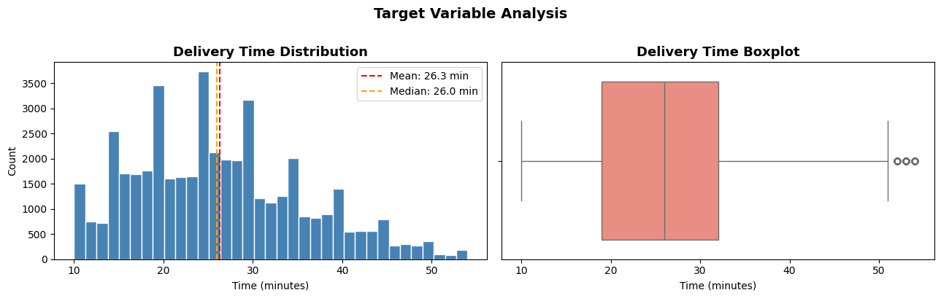
Graph 1 — Target Variable: Delivery Time Distribution
EDA
📌 Insights
• Mean = 26.3 min
• Median = 26.0 min
• Range: 10–54 min
• Near-normal dist.
• Few outliers (>50)
• Mean ≈ Median → no heavy skew
What this tells us: Delivery times cluster between 20–35 min. The symmetric shape means linear and tree models can learn the pattern well.

Slide 8
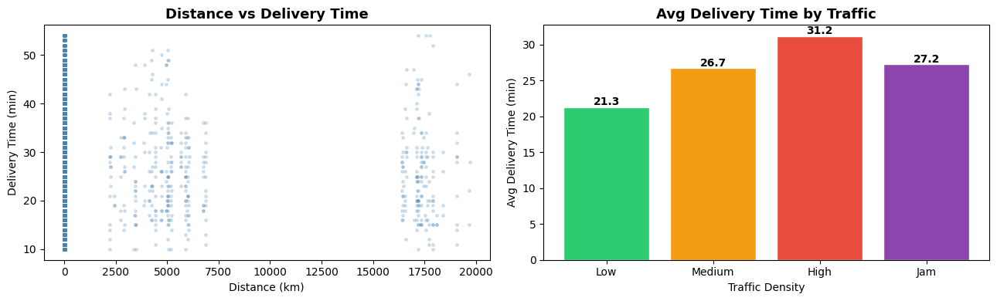
Graph 2 — Distance & Traffic vs Delivery Time
EDA
📌 Insights
• Low traffic: 21.3 min
• Medium: 26.7 min
• High: 31.2 min
• Jam: 27.2 min
• Traffic = key predictor
• Distance data has outliers (GPS scale issue)
Traffic density clearly impacts delivery time. 'High' traffic causes ~10 min extra vs Low. The scatter shows distance data needs scaling — haversine fixes this.

Slide 9
Understanding the Metrics: MAE · RMSE · R²
Evaluation
MAE
Mean Absolute Error
Lower is better ↓
Formula: Average of |Actual − Predicted|
Best: 3.168 (XGBoost)
Meaning: Average error in minutes. Easy to interpret.
→ MAE = 3.17 min → model is wrong by ~3 min on average
RMSE
Root Mean Squared Error
Lower is better ↓
Formula: √ Average of (Actual − Predicted)²
Best: 3.978 (XGBoost)
Meaning: Penalizes large errors more. Sensitive to outliers.
→ RMSE = 3.98 min → slightly higher than MAE = some big errors exist
R²
R-Squared (Coefficient of Determination)
Higher is better ↑
Formula: 1 − (SS_residual / SS_total)
Best: 0.8195 (XGBoost)
Meaning: % of variance explained. Max = 1.0 (perfect).
→ R² = 0.82 → model explains 82% of delivery time variation

Slide 10
ML Pipeline — 8 Steps
Methodology
1
2
3
4
Load Data
Clean Data
Feature Engg.
Encode+Scale
train.csv + test.csv
Shape, dtypes, NaN check
Strip spaces, fix target column
'(min) 24' → 24
Haversine dist from GPS
Extract order_hour
LabelEncode 6 cat cols
StandardScaler → LinReg only
5
6
7
8
80/20 Split
Train Models
Evaluate
Predict
~36K train / ~9K val
random_state=42
LinReg·DecTree
RandForest·XGBoost
MAE, RMSE, R²
Compare all 4 models
XGBoost on test set
Save submission CSV

Slide 11
Models & Hyperparameters
Training
Linear Regression
Decision Tree
• Default (no regularization)
LinearRegression()
• max_depth=8
DecisionTreeRegressor(max_depth=8,
min_samples_leaf=20)
• Scaling: StandardScaler
• min_samples_leaf=20, random_state=42
Baseline · Assumes linear relationship · Fastest to train
Captures non-linearity · Can overfit · Interpretable
Random Forest
XGBoost ★
• n_estimators=100
RandomForestRegressor(n_estimators=100,
random_state=42)
• n_estimators=200, lr=0.05
XGBRegressor(n_estimators=200,
learning_rate=0.05, max_depth=6,
subsample=0.8)
• random_state=42
• max_depth=6, subsample=0.8, colsample_bytree=0.8
Ensemble of 100 trees · Reduces variance · No scaling needed
Gradient boosting + regularization · Best performer

Slide 12
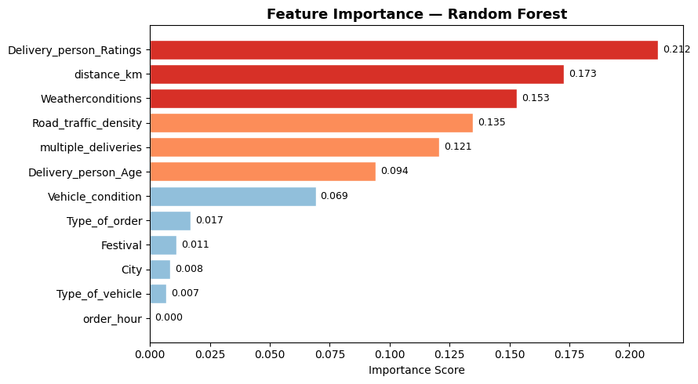
Graph 3 — Feature Importance (Random Forest)
Key ML Concept
📌 What is Feature Importance?
Measures how much each feature contributes to reducing prediction error across all trees in the Random Forest.
Top Predictors:
1. Delivery_person_Ratings
0.212
2. distance_km
0.173
3. Weatherconditions
0.153
4. Road_traffic_density
0.135
5. multiple_deliveries
0.121
6. Delivery_person_Age
0.094
Color: Red > 0.15 · Orange > 0.08 · Blue ≤ 0.08

Slide 13
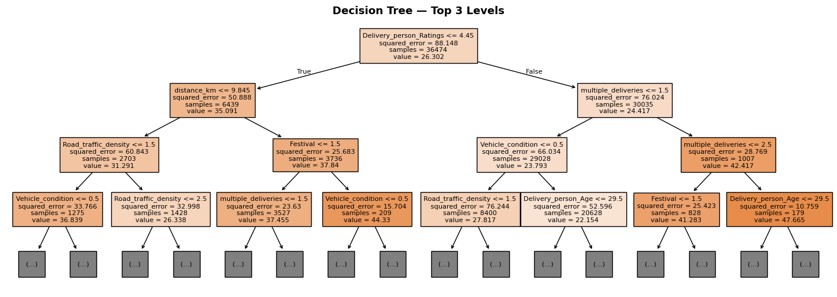
Graph 4 — Decision Tree Structure (Top 3 Levels)
Model Insight
How to read this:
Each node shows: Split condition | MSE (error) | Samples | Mean value. Darker = lower error. Tree goes max_depth=8 levels deep.

Slide 14
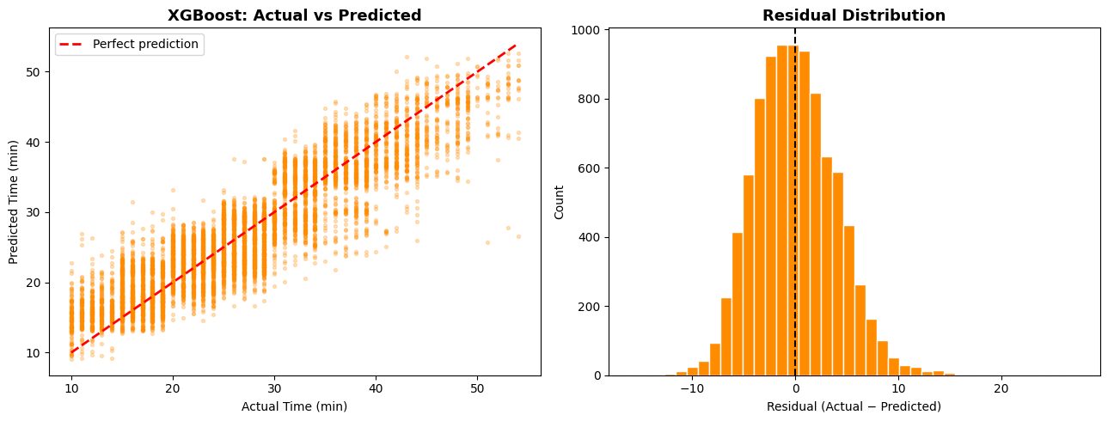
Graph 5 — XGBoost: Actual vs Predicted & Residuals
Best Model Analysis
📌 Reading This
Left plot:
Points close to red dashed line = good predictions
Red line:
Perfect prediction (Actual = Predicted)
Residuals:
Actual − Predicted
Peak at 0:
Model is mostly unbiased
Normal bell:
Errors are well distributed
R² = 0.8195
82% variance explained

Slide 15
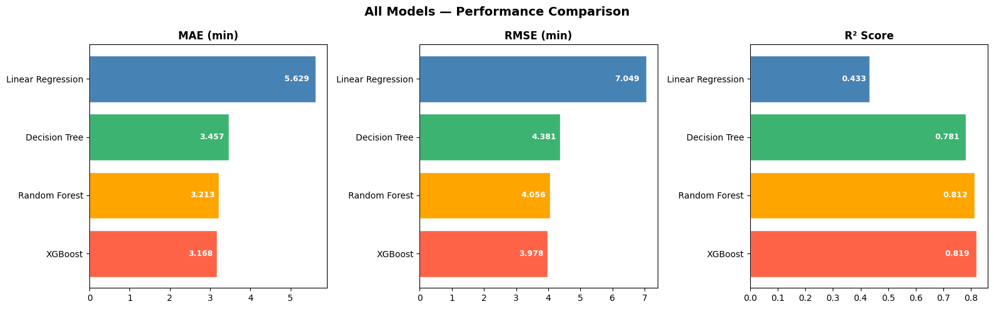
Graph 6 — All Models Performance Comparison
Results
Model | MAE (min) | RMSE (min) | R² Score | Rank
Linear Regression | 5.629 | 7.049 | 0.433 | 4th ❌
Decision Tree | 3.457 | 4.381 | 0.781 | 3rd
Random Forest | 3.213 | 4.056 | 0.812 | 2nd
XGBoost ★ | 3.168 | 3.978 | 0.8195 | 1st 🏆

Slide 16
Conclusion
🏆 XGBoost wins — MAE: 3.168 min | RMSE: 3.978 min | R²: 0.8195
• Tree-based models beat Linear Regression because delivery data has non-linear patterns.
• Feature engineering (haversine distance, order_hour) gave the model real-world predictive power.
• Top features: Delivery_person_Ratings (0.212), distance_km (0.173), Weatherconditions (0.153).
• XGBoost's gradient boosting + subsample=0.8 regularization kept overfitting in check.
Future Improvements
→ GridSearchCV / Optuna tuning
→ Detailed weather (continuous)
→ Model stacking / blending
→ Day-of-week & holiday features
→ REST API deployment

