Slide 1

Master of Business Administration in Technology
Management
Capstone Project Topic Approval Presentation
Academic Year 2024-25
Semester VIII
SVKM’s NMIMS
Mukesh Patel School of Technology Management and Engineering, Vile Parle, Mumbai- 400056
Department of Artificial Intelligence

Slide 2
A PRESENTATION ON
IntelliStake
The AI-Vetted Startup Investing Platform
By
AYUSH VAIDYA – R009 – 70512200015
DEVASHISH SHARMA – R012 – 70051220013
PIYUSH BORAKHADE – R055 - 70512300041
Under the guidance of
Dr. Anagha Raich
Academic Year 2025–26

Slide 3
Problem Definition & Market Gap
The Accessibility Crisis & Systemic Gatekeeping
Restricted Entry: High-growth venture capital remains a "closed-loop" asset class, historically restricted to the top 1% (accredited investors), leaving the general public with no access to early-stage wealth creation.
Liquidity Trap: Private equity investments are traditionally "illiquid," requiring a 7–10 year lock-in period with virtually no secondary market for retail participants to exit.
Operational Friction: Manual KYC and traditional banking compliance move at "T+2" speeds, failing to meet the "T+0" instant-settlement demands of modern digital markets.
Accessibility: Retail locked out of top 1%.
The Information Gap & Operational Vulnerability
Pitch Deck Poisoning: A sharp rise in AI-generated "data forgery," where founders use synthetic credentials and fabricated traction charts to inflate startup valuations.
Asymmetric Due Diligence: Retail investors lack the multi-million dollar analytical tools used by tier-1 firms to verify messy financials and founder backgrounds.
Security Fragility: Centralized investment desks are increasingly vulnerable to Oracle manipulation and data breaches, jeopardizing both investor funds and sensitive corporate IP.
Liquidity Risk: Frozen assets for 7-10y.

Slide 4
Literature Review (2023-2025 Synthesis)
Research Paper | Methodology | Key Finding | Strategic Insight
VCBench (2025) | Adversarial LLM Testing | LLMs achieve 6x higher precision. | AI > Human screening.
SSFF (2025) | Multi-Agent RAG | L5 founders 3.8x more likely to succeed. | Focus on founder quality.
R.A.I.S.E. (2025) | Reasoning-Based AI | Multi-step reasoning improves accuracy by 50%. | CoT is essential.
HedgeAgents (2025) | Balanced Trading Agents | 68.4% return with hedging. | Agentic hedging works.
BLM-Optimization (2025) | LLM Black-Litterman | Style-consistent views outperform. | AI for portfolios.
On-chain Permissioning | ZKP + SSI | Privacy-preserving KYC on public ledgers. | Compliant DeFi.
STO Secondary Markets | Real Estate STO Data | Tokenization provides liquidity. | Liquidity for illiquid assets.
Interpretable ML (2025) | XGBoost Ensembles | 0.978 precision for exit predictions. | High accuracy model.

Slide 5
System Architecture: The 'Trust-Engine' Workflow
1. Data Ingestion Layer
AI Agents scrape LinkedIn, GitHub & Crunchbase • Verifies 'Founder Alpha'
2. Evaluation Layer (The Brain)
Multimodal LLMs • Bayesian Upates • Success Probability Calculation
3. Execution Layer (The Spine)
Smart Contracts mint ERC-3643 Tokens • Milestone-Based Escrow Lock

Slide 6
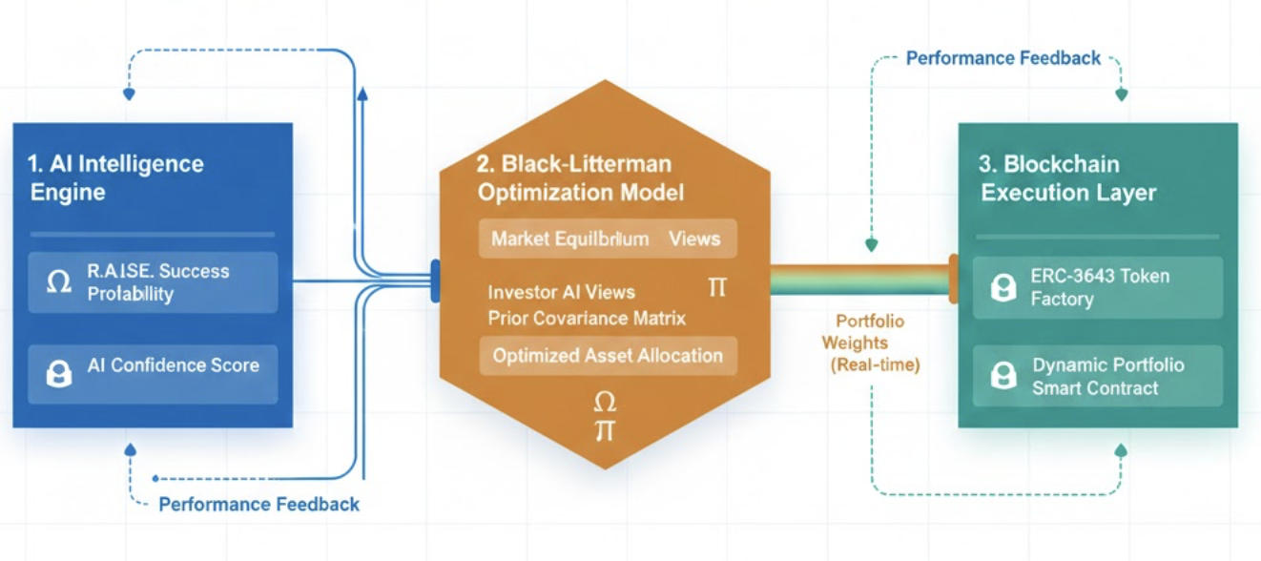
Portfolio Optimization via Black-Litterman Model
Quantitative View Synthesis: Converts qualitative AI success probabilities (1–10) into mathematical "Investor Views," bridging the gap between narrative-driven startups and data-driven finance.
Precision-Weighted Allocation: Assigns a confidence level (Ω) to each startup based on the R.A.I.S.E. reasoning stability, ensuring uncertain signals do not over-influence the portfolio.
Market-Neutral Equilibrium: Merges traditional market sector data with AI-derived "Alpha" to prevent the "all-in" fallacy and maintain a balanced, institutional-grade asset distribution.
Adaptive Rebalancing: Dynamically updates portfolio weights as the AI Auditor flags new risks or milestones, shifting capital from high-burn risks to high-traction opportunities in real-time.

Slide 7
AI Domain - Agentic Due Diligence
Multi-Agent Swarm
OSINT Agent: Cross-references public data across LinkedIn and GitHub for credential verification.
Financial Analyst: Utilizes FinBERT to analyze burn rate, Customer Acquisition Cost (CAC), and Lifetime Value (LTV).
Market Scoper: Validates TAM/SAM/SOM claims against real-time industry reports.
Adversarial Auditor: Specialized agent to detect AI-generated fake revenue charts or forged documentation.
Reasoning (R.A.I.S.E.)
Chain-of-Thought (CoT): Provides explicit, human-readable logic for every investment recommendation.
Memory-Augmentation: Uses a Vector DB to store and identify historical scam patterns.

Slide 8
Finance Domain - Tokenized Equity & Risk
Tokenization (ERC-3643)
Security Token Standard: Enables built-in on-chain compliance and regulatory oversight.
Identity Registry: Links transactions to Soulbound Tokens (SBT) for permanent, private KYC.
Automated Sanctions: Instantly blocks transfers to or from blacklisted addresses.
Black-Litterman Model
Balanced Portfolios: Moves beyond individual stock picking to institutional-grade portfolio construction.
AI-Generated Views: Converts the AI 'Potential Score' (1–10) into a quantitative input for the model.
Optimization: Aims to maximize the Sharpe ratio for diversified startup baskets.

Slide 9
Blockchain & Cybersecurity - The Fiduciary Spine
Milestone Escrow
• Smart Contract Gating: 30% initial release.
• DAO Voting: Quarterly unlock based on deliverables.
• Refunds: Automatic return if milestones missed.
Oracle Defense
• Proof of Reality: Chainlink verifies off-chain revenue.
• Reputation Staking: Data providers slashed for lies.
• Anti-Mirroring: AI monitors for fake data loops.

Slide 10
Tools & Technology Stack
Technology/Tool Language | Category | Specific Use | Justification (Why Chosen)
Python | LangChain (Python) | LangChain AI Orchestration, Financial Scoring, Sentiment, and Risk Scoring | Precise and real-time processing using FinBERTfor financial sentiment and risk assessment.
Solidity (v0.8.x) | Neo4j / Hugging Face | Developing R.A.I.S.E. Logic and AI-BERT Models for pattern analysis | Critical for verifying "Scam Patterns" and ensuring high-fidelity risk scoring.
Solidity (v0.8.x) | Hardhat / Pinecone | ERC-3643 Token Standard implementation and Vector DB management | Facilitates secure on-chain compliance and efficient retrieval of complex financial data.
Solidity (v0.8.x) | Foundry | Smart Contract development and rate-stripping logic | Provides a robust, industrial-grade testing environment for fiduciary smart contracts.
React / Next.js | Ethers.js / Web3Modal | Chainlink Oracles integration for real-time revenue and activity monitoring | Essential for connecting the front-end to blockchain state and verifying off-chain "Proof of Reality".
AWS SageMaker | Google AI Platform | Large-scale model training and deployment | Scalable infrastructure required for hosting FinBERT and adversarial auditing agents.
IPFS / Filecoin | Postman | Decentralized storage for DAO governance and audit logs | Ensures immutable and transparent storage for all project documentation and fiduciary records.
Accessibility: Retail locked out of top 1%.
Liquidity Risk: Frozen assets for 7-10y.

Slide 11
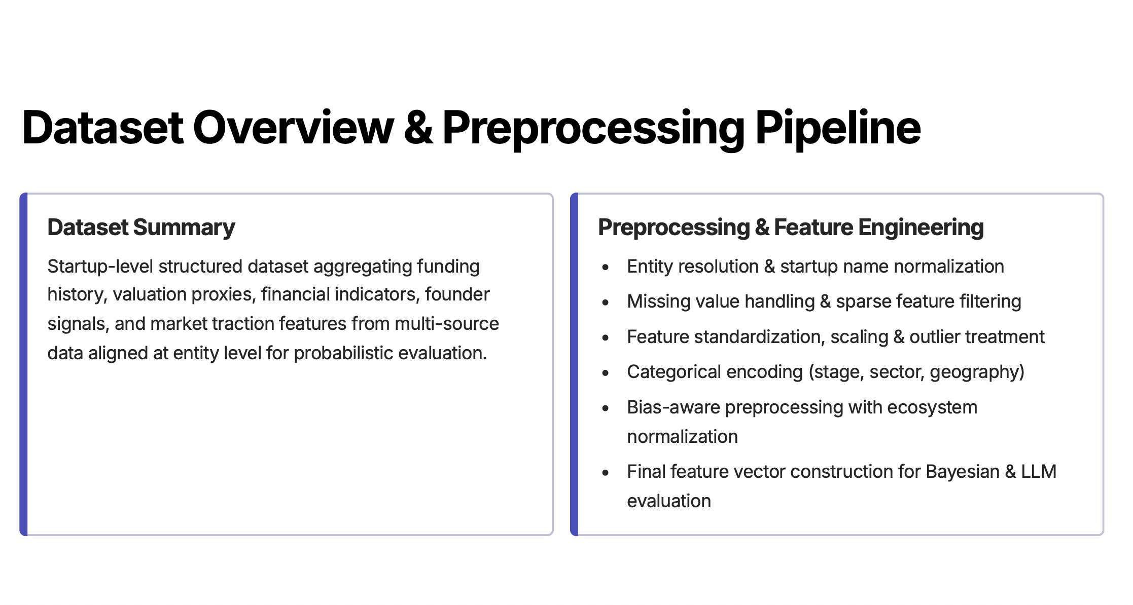

Slide 12
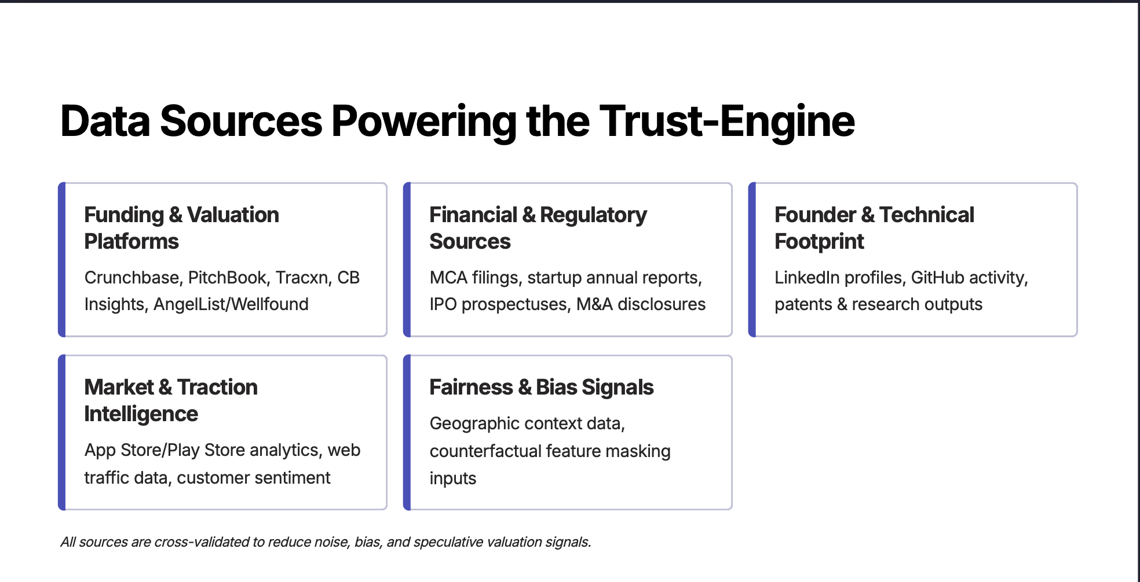

Slide 13
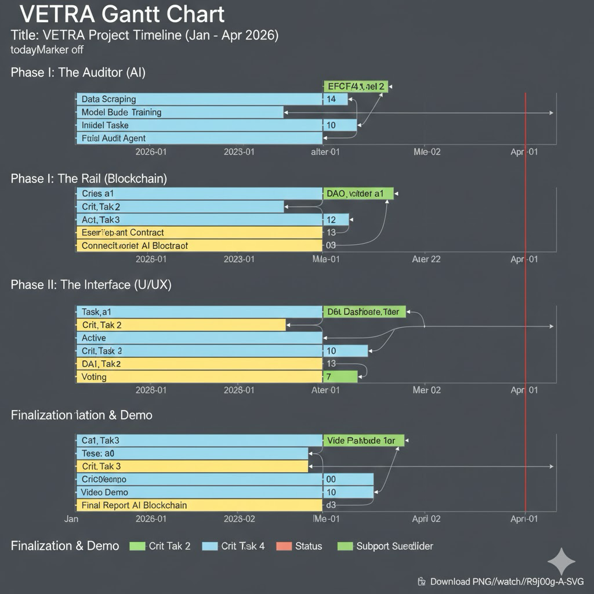
Project Timeline
Accessibility: Retail locked out of top 1%.
https://www.pmi.org
Liquidity Risk: Frozen assets for 7-10y.

Slide 14
References
[1] R. Chen et al., “VCBench: Benchmarking LLMs in venture capital,” arXiv preprint, Sep. 2025.
Available: https://arxiv.org/abs/2509.14448
[2] X. Wang, Y. Ihlamur, and F. Alican, “SSFF: Investigating LLM predictive capabilities for startup success through a multi-agent framework with enhanced explainability and performance,” arXiv preprint, Apr. 2025.
Available: https://arxiv.org/abs/2405.19456
[3] J. Preuveneers, J. Ternasky, F. Alican, and Y. Ihlamur, “Reasoning-Based AI for Startup Evaluation (R.A.I.S.E.): A memory-augmented, multi-step decision framework,” arXiv preprint, Apr. 2025.
Available: https://arxiv.org/abs/2504.12090
[4] E. Ozince and Y. Ihlamur, “Automating venture capital: Founder assessment using LLM-powered segmentation, feature engineering and automated labeling techniques,” arXiv preprint, Jul. 2024.
Available: https://arxiv.org/abs/2407.04885
[5] Y. Lee et al., “LLM-Enhanced Black-Litterman portfolio optimization,” arXiv preprint, 2025.
Available: https://arxiv.org/abs/2504.14345
[6] F. Piper et al., “Privacy-Preserving on-chain Permissioning for decentralized systems,” arXiv preprint, 2025.
Available: https://www.researchgate.net/publication/399058094_Privacy-Preserving_On-chain_Permissioning_for_KYC-Compliant_Decentralized_Applications
[7] J. Kreppmeier et al., “Real estate security token offerings,” IEEE Security & Privacy, vol. XX, no. X, pp. XX–XX, 2023.
Available: https://www.sciencedirect.com/science/article/pii/S0378426623001450
[8] S. Mashhadi et al., “Interpretable ML for predicting startup outcomes,” arXiv preprint, 2025.
Available: https://arxiv.org/abs/2510.09465

