Slide 1

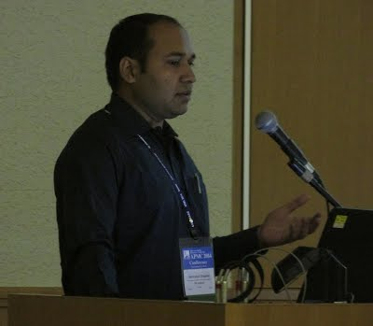
SIGNAL AND SYSTEM
4th semester COURSE PROJECT WORK
BLIND SIGNAL SEPARATION USING MODULATION AND DEMODULATION
Guided by- NiTESH AGARWAL -15100023
DR.SHRIVISHAL TRIPATHI PIYUSH YADUVANSHI -15100027
POOJA JAISWAL - 15100028

Slide 2
WHAT IS BLIND SIGNAL
The Blind signal separation(using modulation demodulation) is the separation of a set of different source signals from a set of mixed signals, without the help of information or with very small information about the source signals or the mixing procedure.

Slide 3
Technology and terminology used-
Probability density function
Cumulative distribution function (CDF)
Statistical Independence
MATLAB
Degree of statistical independence

Slide 4
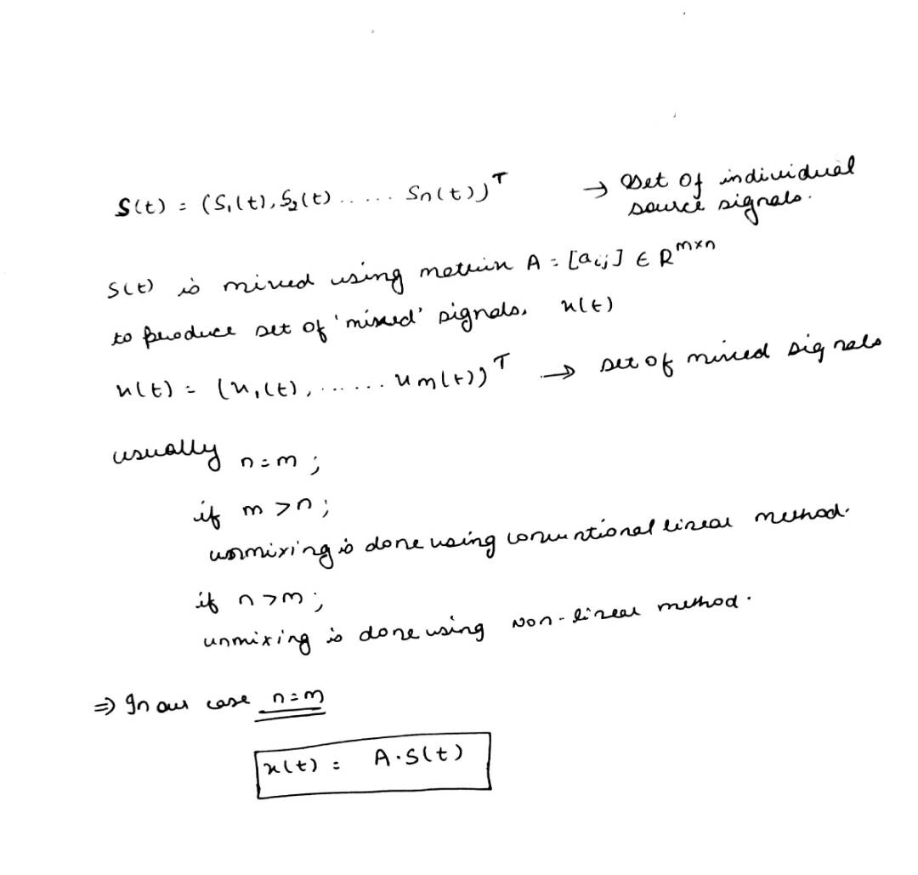
Mathematical representation

Slide 5
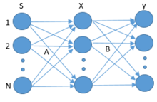
Representation of Blind source separation

Slide 6
There are different kinds of methods of blind signal separation
Temporal Predictability
Independent Component Analysis
Dependent component analysis
Common spatial pattern

Slide 7
Properties of Temporal Predictability
1. Temporal predictability (conjecture)— The temporal predictability of any signal mixture is less than
(or equal to) that of any of its component source signals.
2. Gauss-ian probability density function— The central limit theorem ensures that the extent to which the probability density function of any mixture approximates a gauss-ian distribution is greater than (or equal to) any of its component source signals.
3. Statistical Independence—The degree of statistical independence between any two signal mixtures is less than (or equal to) the degree of independence between any two source signals.

Slide 8
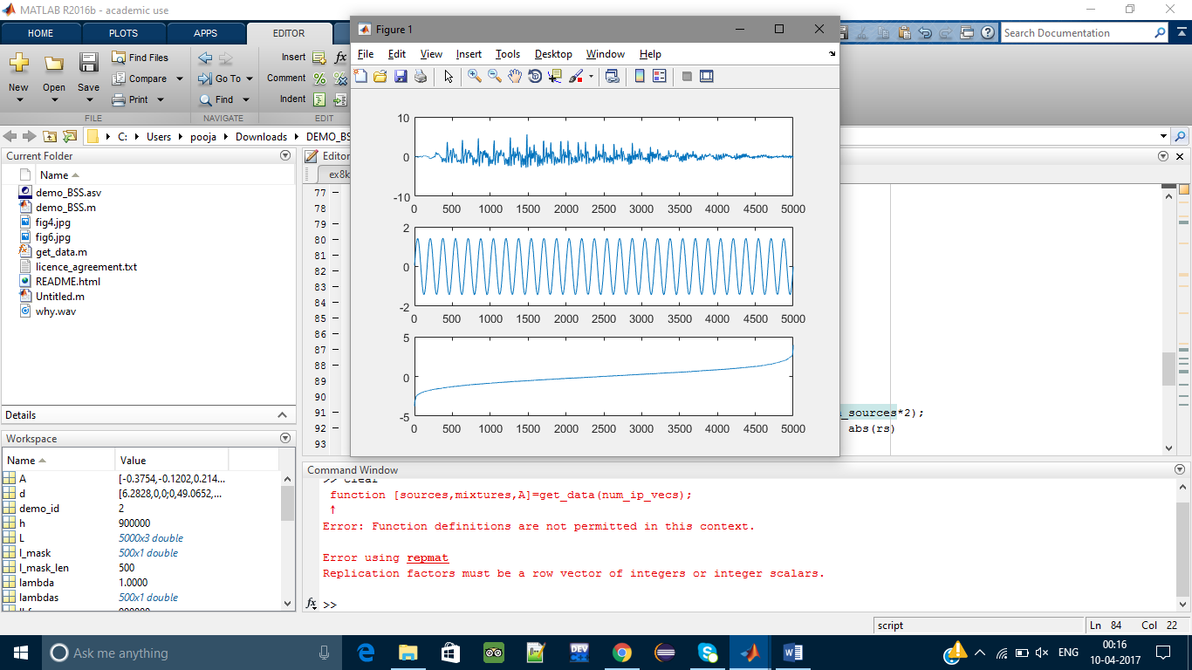
INPUT SIGNALS

Slide 9
Ultimate Aim
Each signal consisted of 3000 samples. So we can say that sampling frequency is 3000 hertz. The correlation betwEEn source signal and recovered signals are given in output-matrix .The three recovered signals each had a correlation of matrix r > 0.99, with only one of the source signals, and other correlations were close to zero. Note that the mixtures used here do not include any temporal delays or echoes.

Slide 10
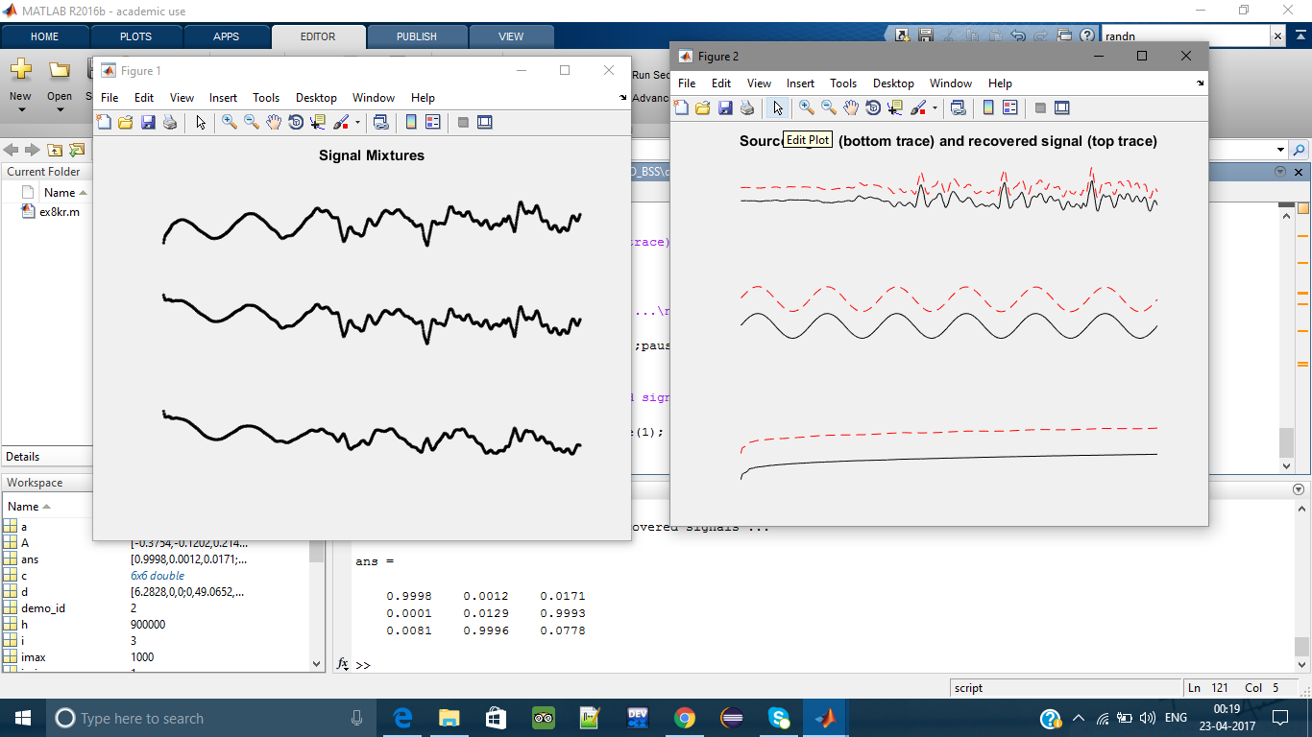
Signal mixtures AND recovered SIGNAL

Slide 11
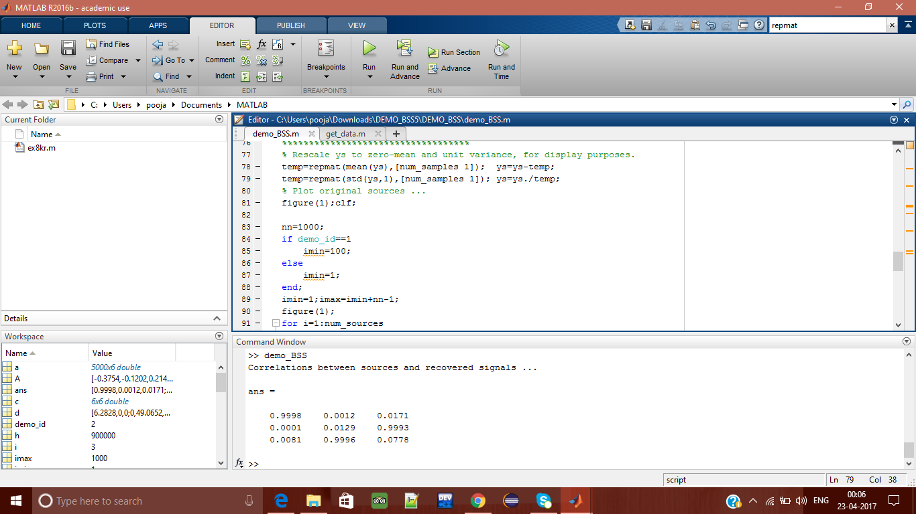
Output Co-relation Matrix: Source Signals vs Signals Recovered Expected s1 s2 s3 y1 0.000 0.001 1.000 y2 1.000 0.000 0.000 y3 0.042 0.999 0.002

