Slide 1

SMIT NEWS APP
Team no: 40
Members: Bhaskar Acharya(UI Designer+Frontend)
Piyush Ranjan(UI+Frontend+Backend)
Manish Kumar Sah(UI Designer+Frontend)

Slide 2
Approach to Build
Make Simple and attractive User-Interface(UI).
To Use Web View for Non- Members and contents out of database.
To use Card View + ImageView + RecyclerView for showing news list.
For Database, we used SQL-Lite.
Authenticating User for Viewing and adding their post along with Editorial Board for Manipulating the news.

Slide 3
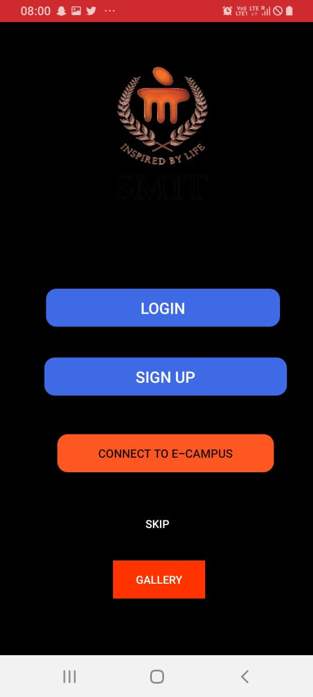
HOME PAGE
This section shows home page of the app.
There are buttons(<Button>) which will redirect you to the other respective activities(using .intent() ).
Web Views are loaded for non-members for viewing news.

Slide 4
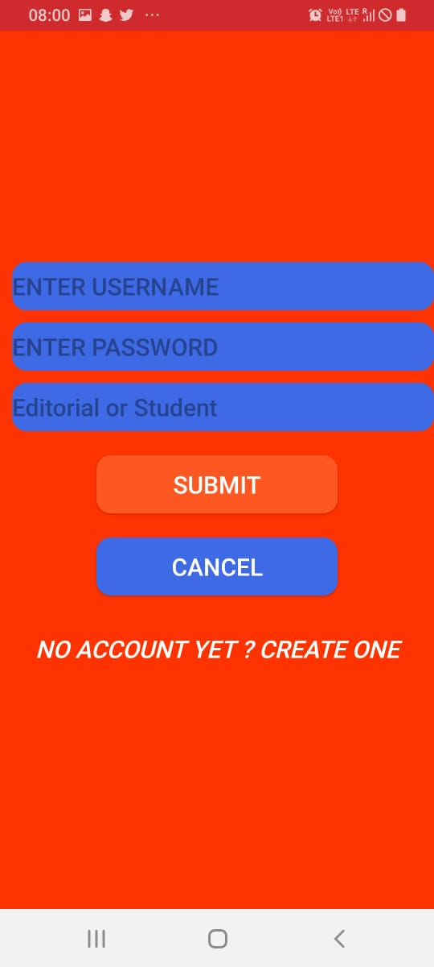
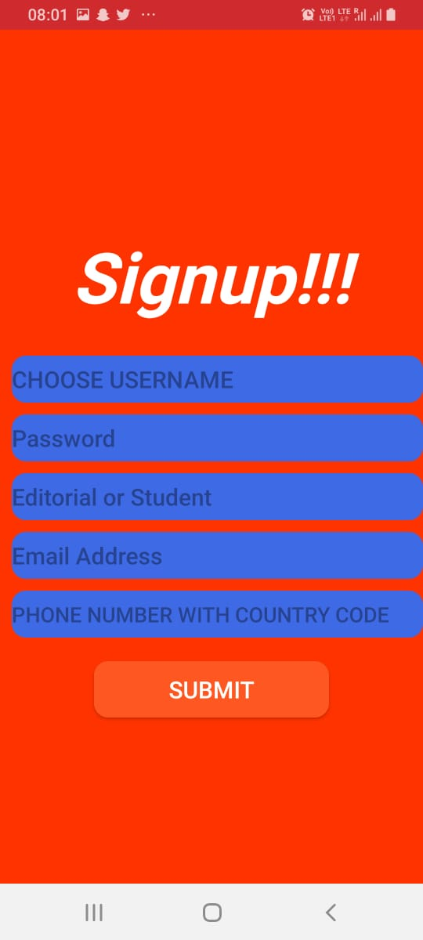
LOGIN PAGE AND SIGN-UP PAGE
User can login both as Student and Editorial Board.
When Editorial, another activity for editing and database access will open.
User can sign-up both as student and editorial(with other verification).
After sign-up, the information will be pushed to the database and will be displayed on user profile as well.

Slide 5
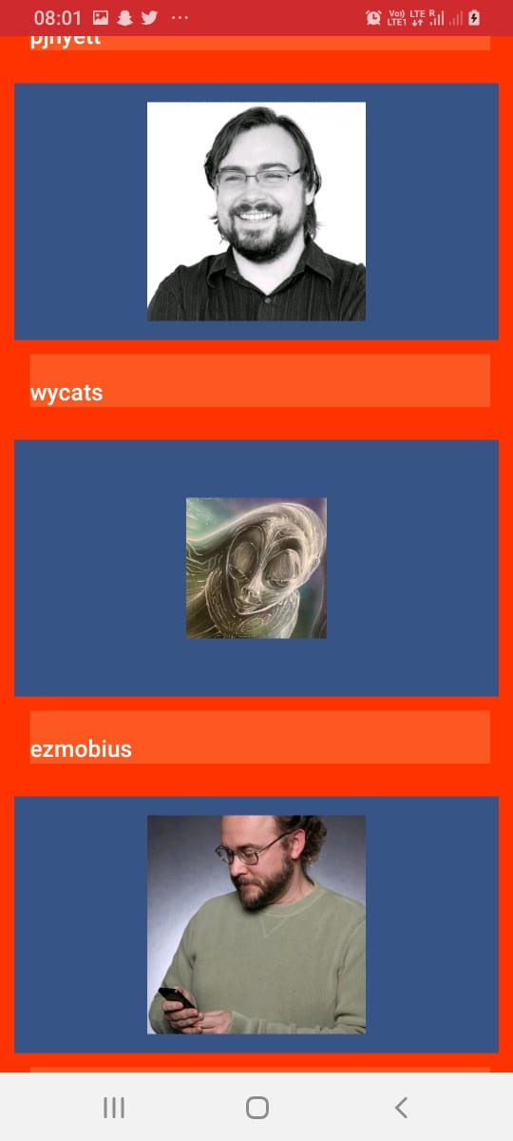
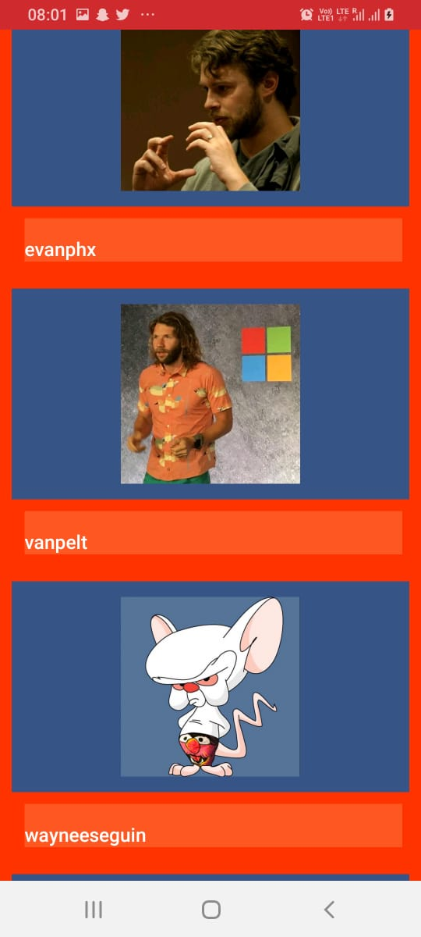
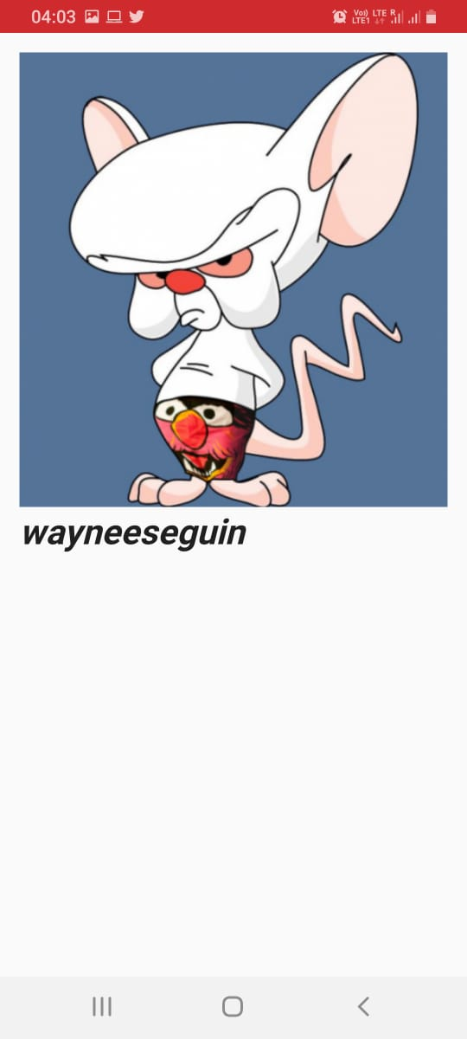
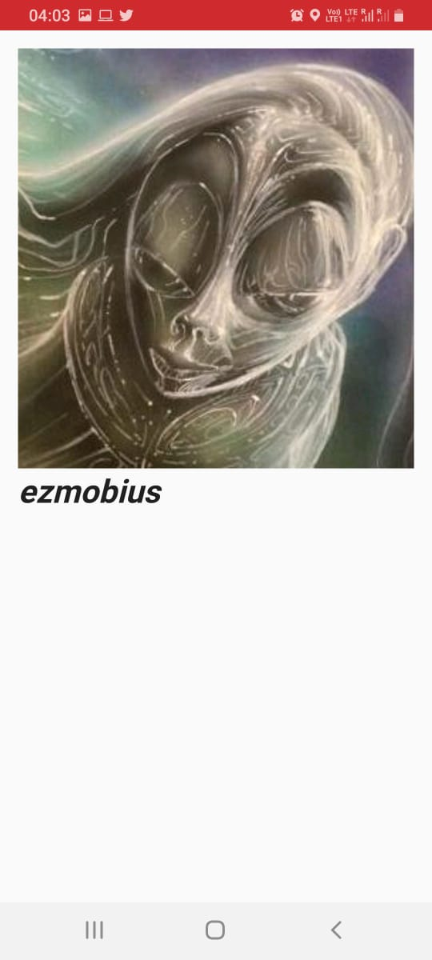
We used JSON,GSON Builder and Volley for getting API from api.github.com for testing purposes. The news in the app can be loaded through API connections and also through editorial boards and users. The new bulletin would be loaded in following format , and on clicking upon a headline it will load in similar fashion to the third image.
NEWSFEED DESCRIPTION

Slide 6

DATABASE DETAILS
We have used SQLITE as database for this application as of now.
We are using SQL-Lite Queries for pushing and Fetching Data.

Slide 7
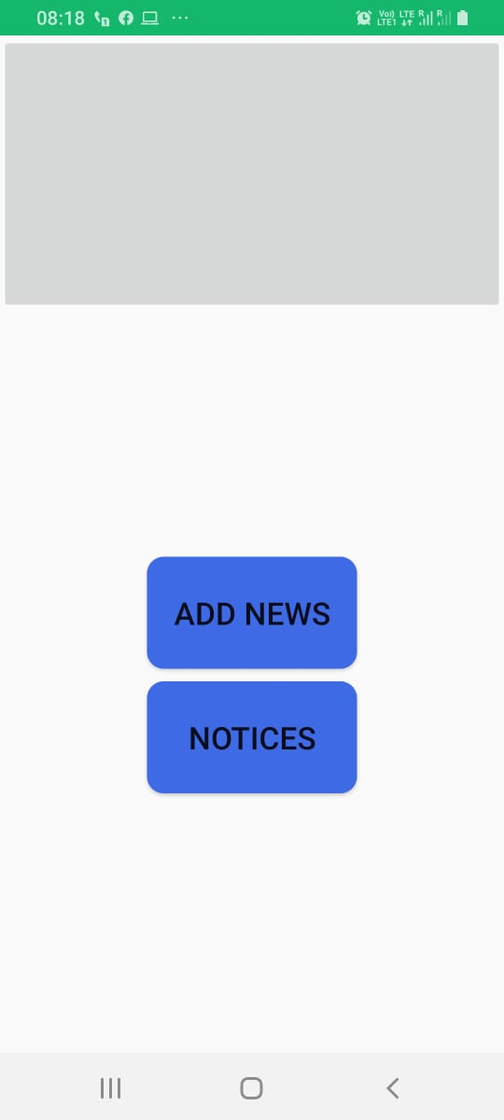
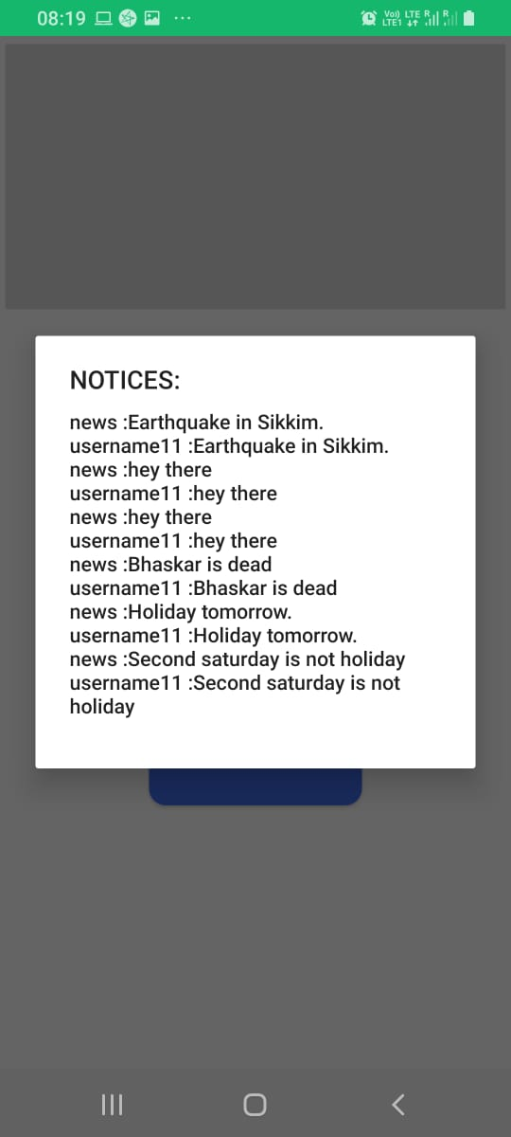
PROFILE.XML AFTER SUCCESSFUL LOGIN
After successful login, a user profile will open with all necessary details.
It will use the Database(SQL-Lite) for fetching the data of the matched user.

Slide 8
HOW DATABASE WORKS FOR USERS
After providing necessary information, it will check the authentication as ‘Student’ or ‘Editorial’.
If Editorial, then it will open an activity for editing the news, else it will only open the viewing activity.

Slide 9
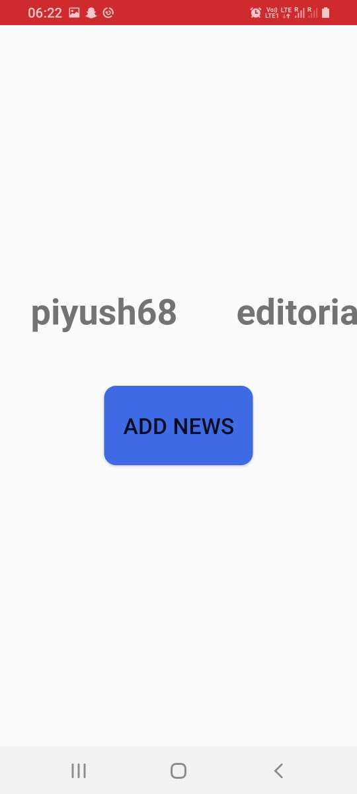
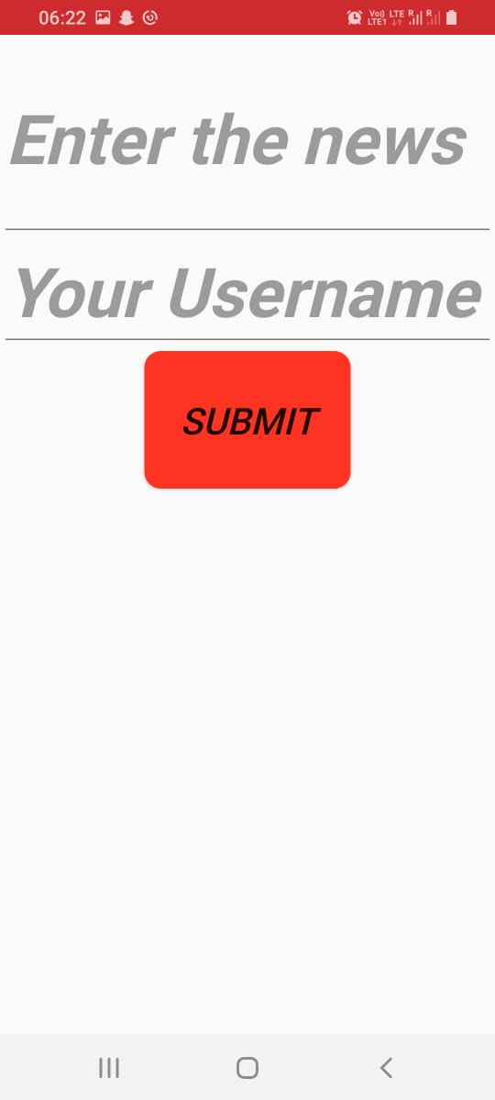
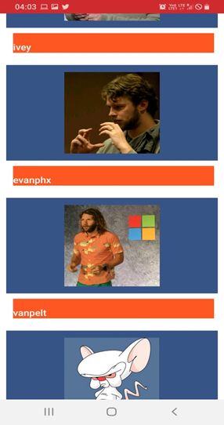

Login.xml
FOR Student
News card
News Timeline
Profile.xml
EDITORIAL BOARD
HOME PAGE
Sign-up
FLOWCHART OF WORKING

Slide 10
CONCLUSION
This application is the BETA version.
We used API’s from GitHub for testing the features we added in the app.
News will Update automatically with the help of database(old news will go down in the timeline)(to be implemented)

Slide 11
THANK YOU!

