Slide 1
Power bi visualization of us accidents

Slide 2


Slide 3
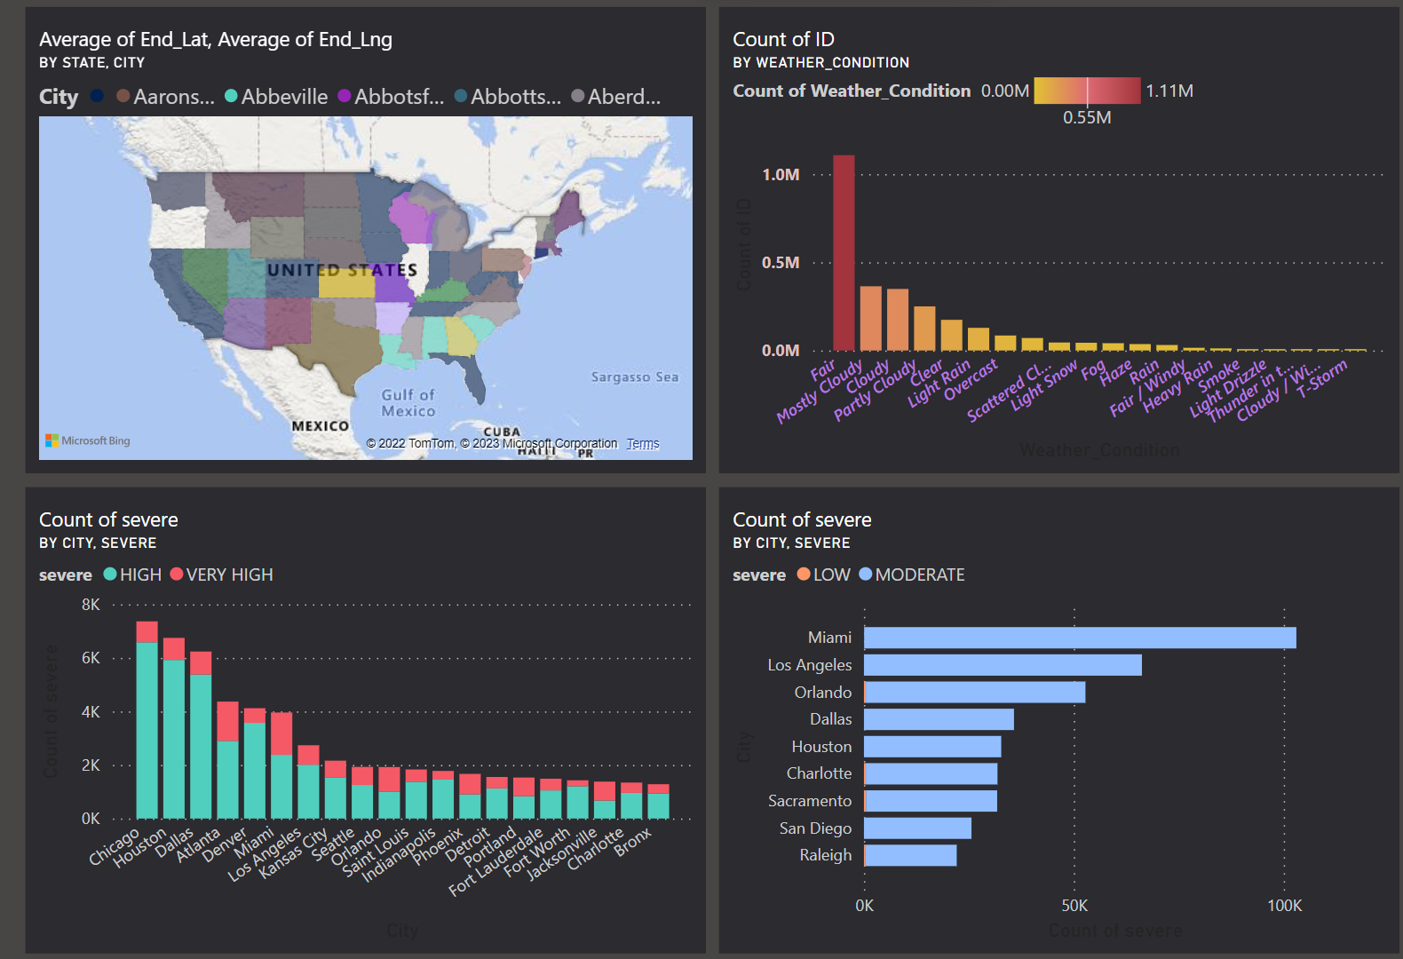

Slide 4
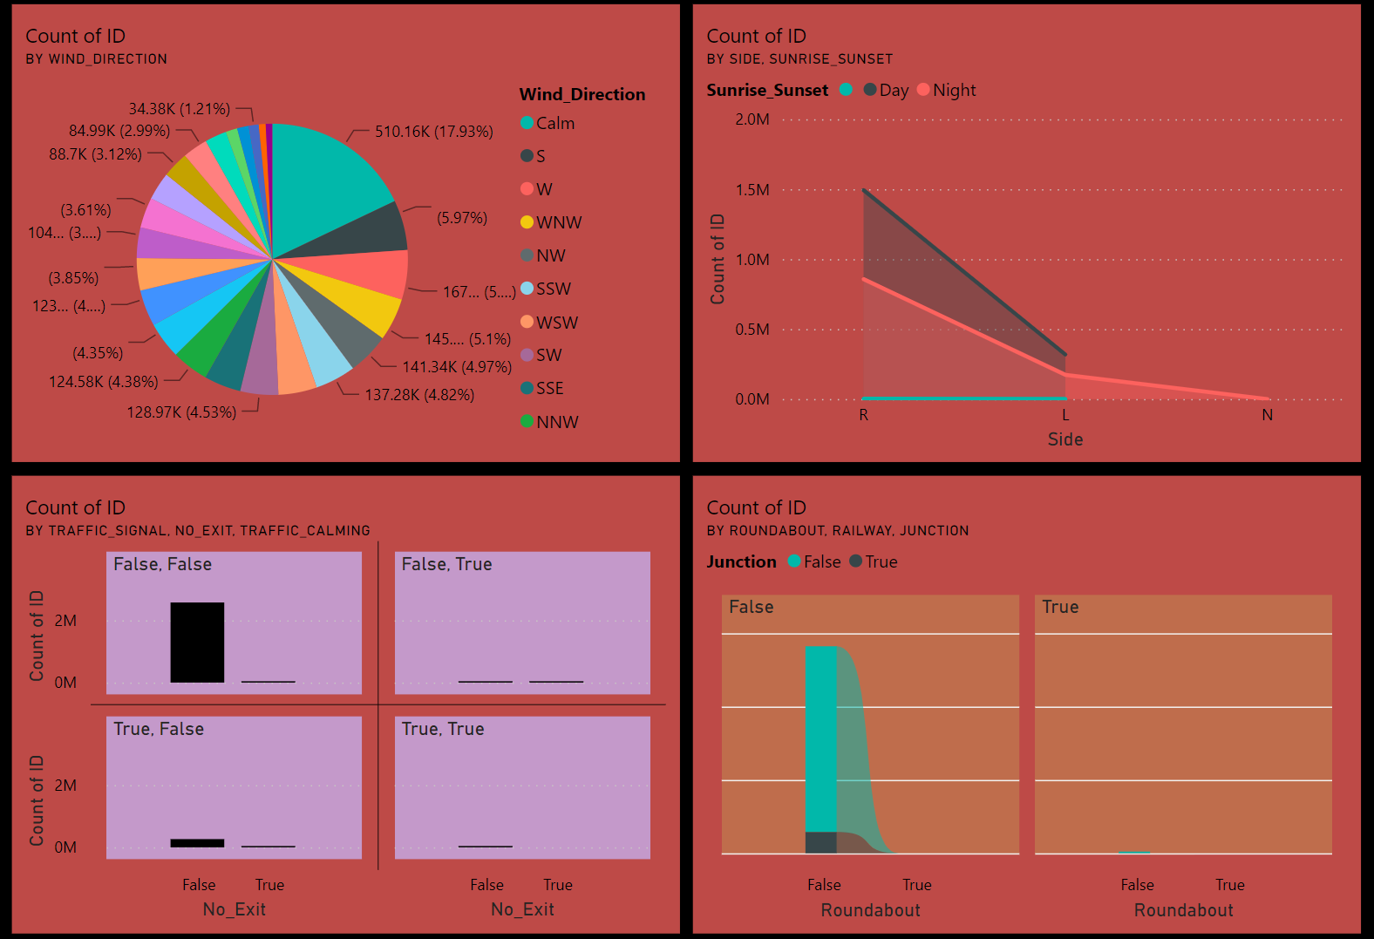

Slide 5
