Slide 1

Project Title-Seasonal Agriculture Performance Analysis
Piyush Doshi Walchand Institute of Technology
AICTE STU ID: STU6a568082f420a1784053890

Slide 2

PROBLEM STATEMENT
Agricultural performance changes across different seasons due to variations in rainfall, temperature, soil conditions, and farming practices. Raw agricultural data does not clearly show these seasonal differences. This project analyzes seasonal agricultural data to identify meaningful patterns, trends, relationships, and variations that can support better agricultural planning

Slide 3
Project Description This project analyzes a seasonal agriculture dataset using Python in Google Colab. The dataset was explored, cleaned, and visualized to compare agricultural performance across Kharif, Rabi, and Zaid seasons. The analysis focused on crop yield, revenue, rainfall, and relationships among numerical variables. The project provides data-driven insights that help understand seasonal agricultural performance.

Slide 4

WHO ARE THE END USERS?
Farmers
Agricultural Researchers
Government Agricultural Departments
Policy Makers
Agricultural Planning Organizations
Data Analysts

Slide 5

Technology Used
Google Colab – Used to develop and run the project.
Python – Main programming language used for analysis.
Pandas – Used for data loading, cleaning, and analysis.
NumPy – Used for numerical calculations.
Matplotlib – Used to create graphs and data visualizations.

Slide 6
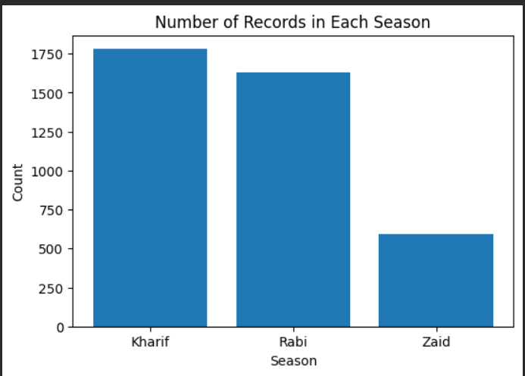
RESULTS : Number of Records in Each Season
Observation: Kharif has the highest number of records (1779), followed by Rabi (1627) and Zaid (594). This indicates that Kharif farming activities are more frequently represented in the dataset

Slide 7
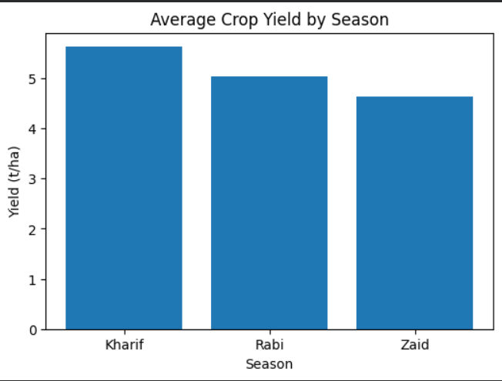
RESULTS : Average Crop Yield by Season
Observation: The graph compares the average crop yield across Kharif, Rabi, and Zaid seasons, showing that agricultural productivity varies between seasons

Slide 8
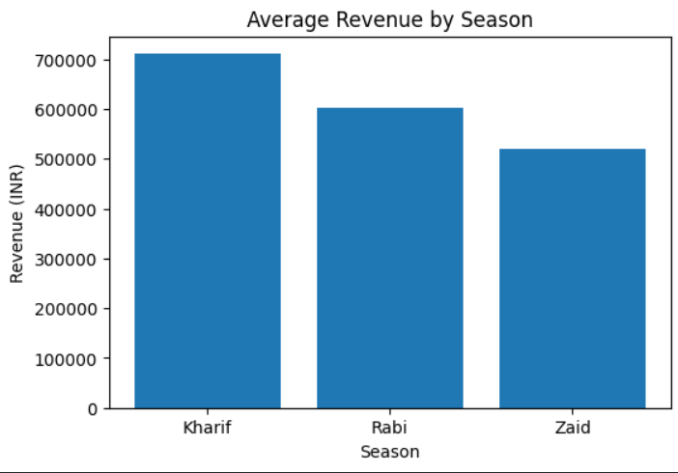
RESULTS : Average Revenue by Season
Observation: Revenue differs across seasons, helping compare the economic performance of agricultural activities during Kharif, Rabi, and Zaid seasons

Slide 9
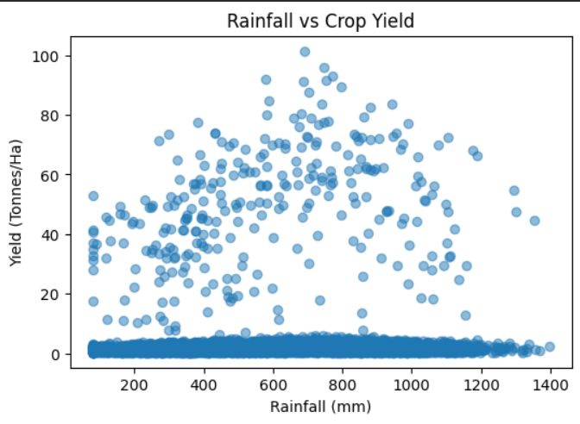
RESULTS : Rainfall vs Crop Yield
Observation: The scatter plot helps identify the relationship between rainfall and crop yield. Each point represents one farm record

Slide 10
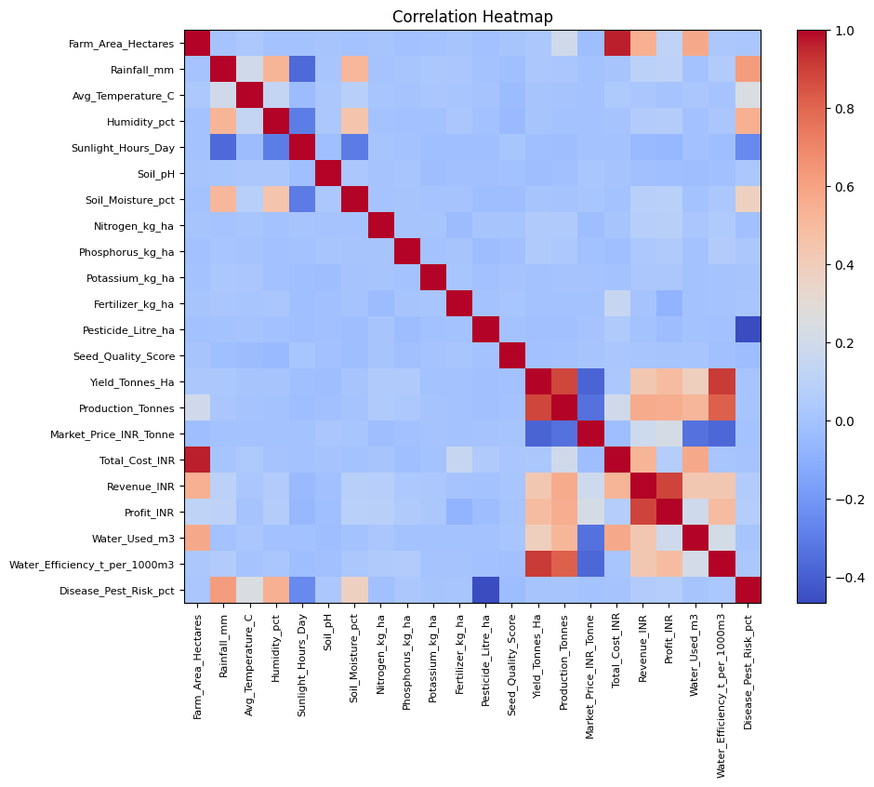
RESULTS : Correlation Heatmap
Observation: The heatmap shows positive and negative relationships among numerical variables. Darker colors indicate stronger relationships.

Slide 11
Future scope
Develop a machine learning model for crop yield prediction.
Create an interactive dashboard using Power BI or Tableau.
Integrate real-time weather data for better analysis.
Perform region-wise seasonal performance comparison.
Build a farmer decision-support system using data analytics.

Slide 12
GitHub Link
LINK
https://github.com/piyushdoshi215-a11y/Seasonal-Agriculture-Performance-Analysis

Slide 13
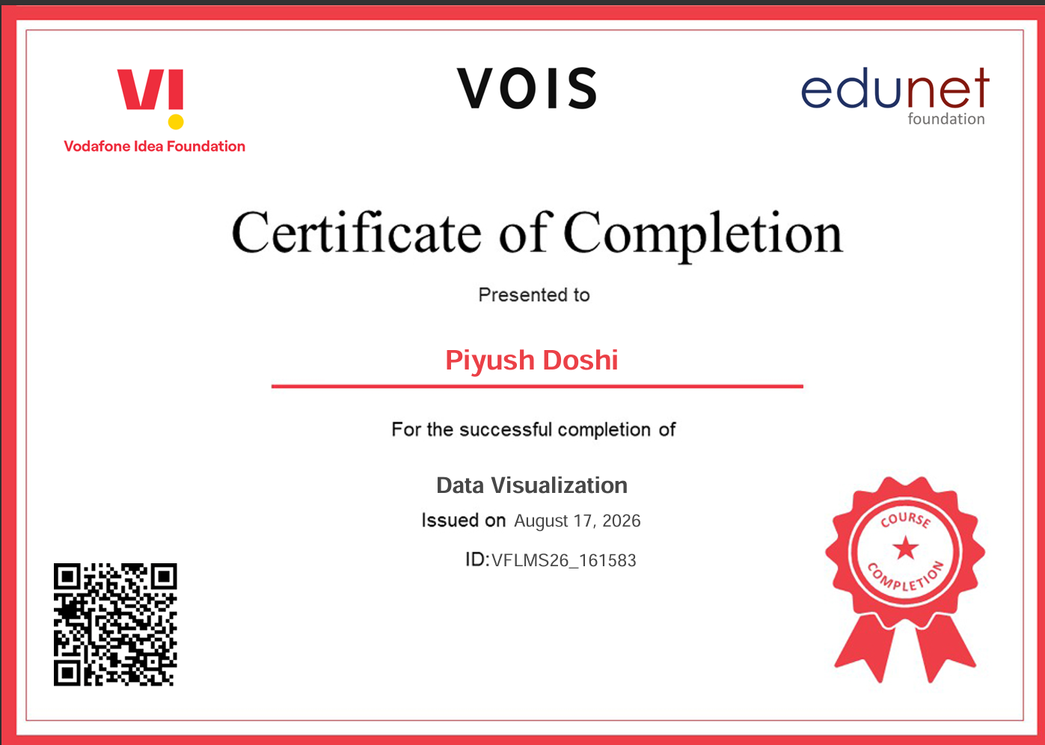
VOIS Course completion certificate - Course name- Data Visualization

Slide 14
Thank you
Questions & Discussion
.
.

