Slide 1
ICU • HEPATOLOGY • TRANSPLANT CRITICAL CARE
Role of Liver Support Systems
in the ICU
The Peri-Transplant Setting — with a focus on PLEX & CRRT
Recent advances and futuristic directions in extracorporeal liver support
Prepared for Dr. Amit • Gleneagles • Keynote

Slide 2
ROADMAP
What this talk covers
01
02
03
The clinical problem
Why support the liver?
CRRT
ALF, ACLF & the peri-transplant window
Toxins, immune storm & multi-organ failure
Ammonia control & metabolic rescue
04
05
06
Plasma exchange (PLEX)
Albumin dialysis
Future directions
The strongest survival evidence
MARS / Prometheus — lessons learned
Bioartificial liver, cells & AI
Role of Liver Support Systems in the ICU • Peri-Transplant Setting
02

Slide 3
THE CLINICAL PROBLEM
Liver failure is a multi-organ emergency
Rapid loss of hepatic function → encephalopathy, coagulopathy and circulatory collapse
Detoxification fails — ammonia, bilirubin, bile acids & toxins accumulate
Hours–days
Window from presentation to irreversible multi-organ failure
Synthesis fails — coagulopathy, hypoalbuminaemia, hypoglycaemia
Immune dysregulation — a systemic inflammatory / cytokine storm
2 goals
Bridge to recovery OR bridge to transplantation
Multi-organ failure — brain, kidney, circulation & lungs follow
The liver can regenerate — if the patient survives the acute hit
Liver support buys time — either for the native liver to regenerate, or for a graft to become available.
Role of Liver Support Systems in the ICU • Peri-Transplant Setting
03

Slide 4
DEFINITIONS
ALF vs ACLF vs the peri-transplant patient
Acute liver failure (ALF)
Sudden failure in a previously healthy liver. Coagulopathy + encephalopathy within weeks. Often a single insult (paracetamol, virus).
Acute-on-chronic liver failure (ACLF)
Acute decompensation on cirrhosis with organ failures and high short-term mortality. Driven by systemic inflammation.
Peri-transplant ICU patient
On the waiting list or post-graft — needing organ support to stay a viable transplant candidate or to recover the new graft.
Role of Liver Support Systems in the ICU • Peri-Transplant Setting
04

Slide 5
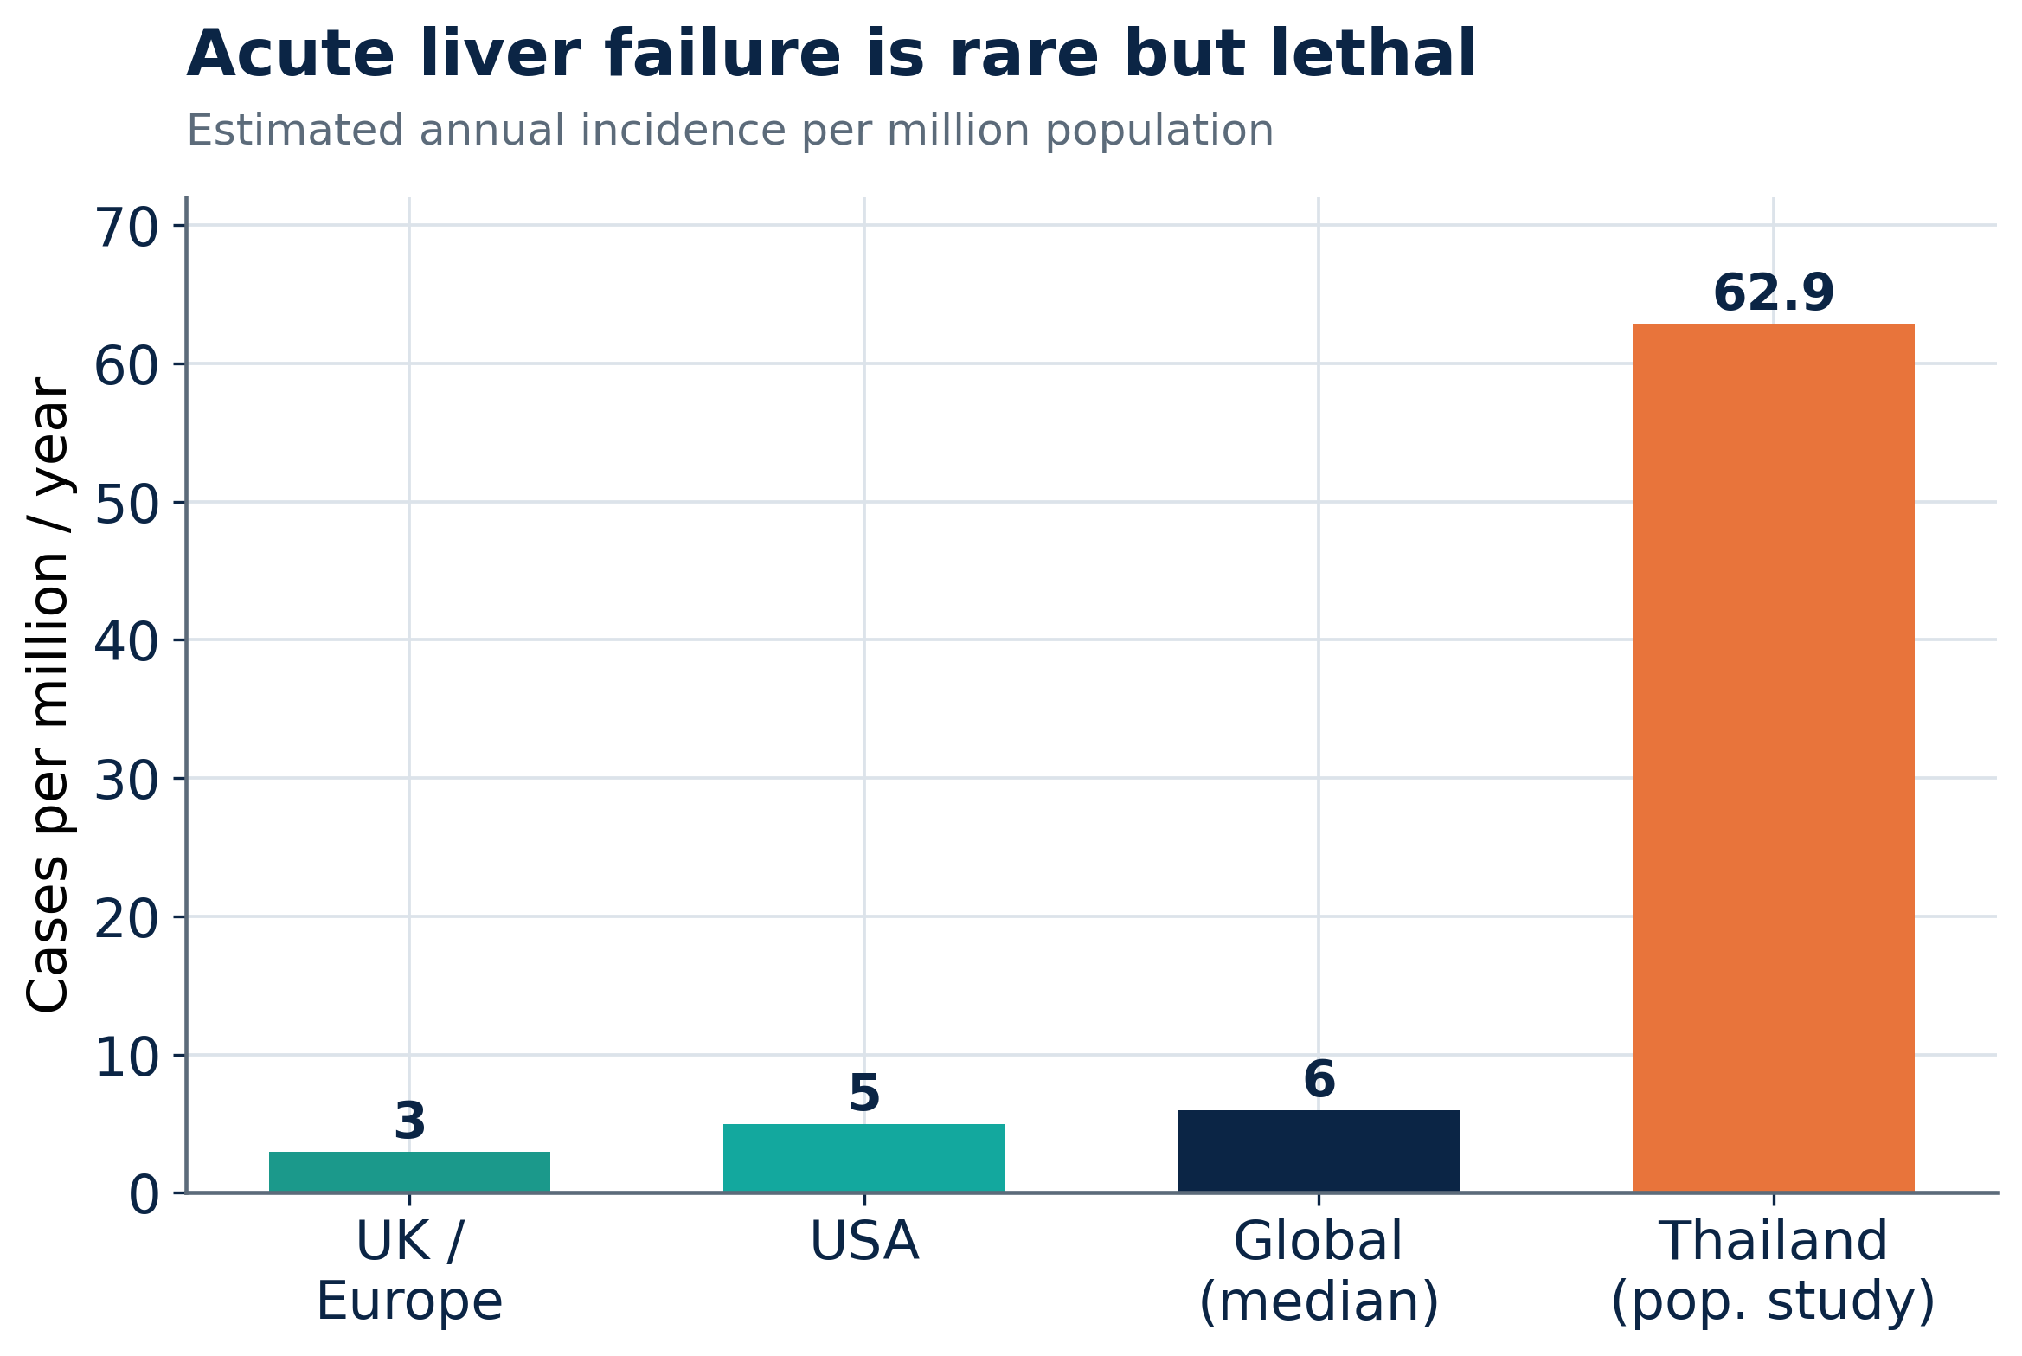
EPIDEMIOLOGY
Rare, but with very high mortality
~1–6 / million
Annual ALF incidence in the developed world
27%
30-day mortality in a population-based ALF cohort
<0.01%
Received a transplant where access is limited
Role of Liver Support Systems in the ICU • Peri-Transplant Setting
05

Slide 6
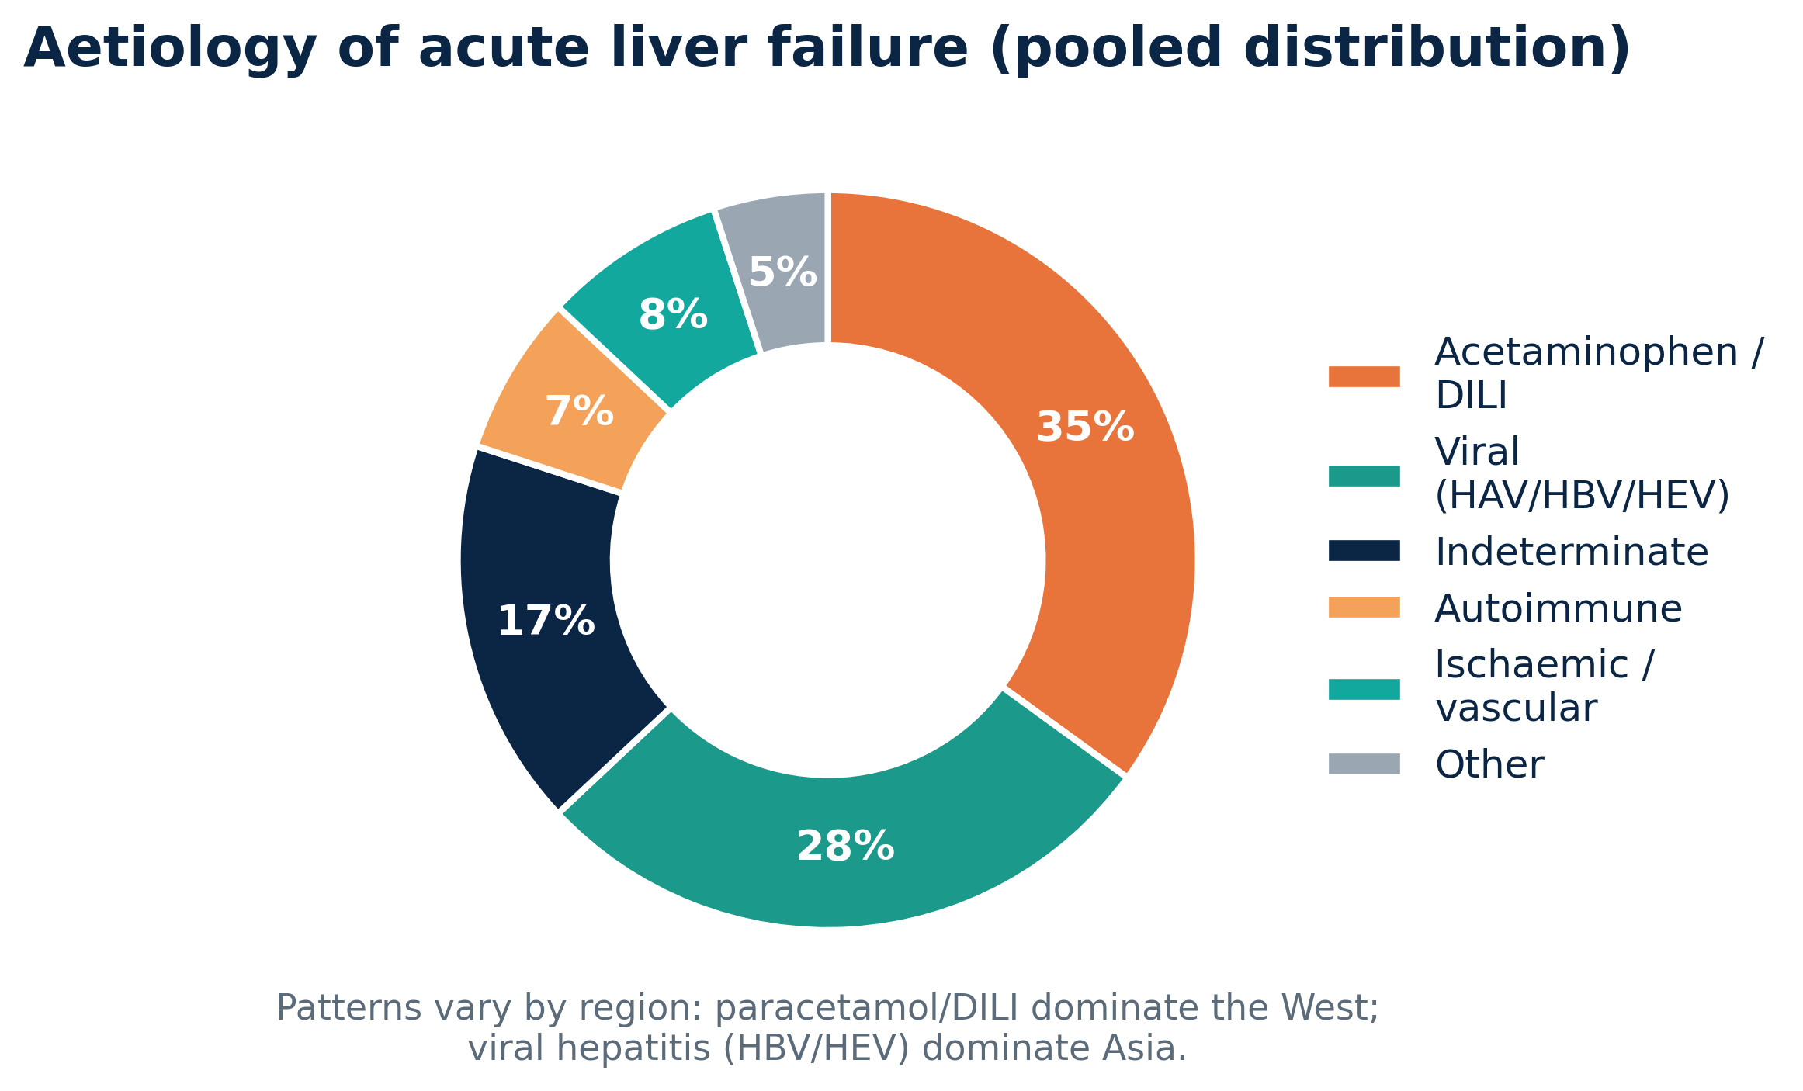
AETIOLOGY
Causes drive the therapeutic choice
Paracetamol / DILI — the dominant Western cause; supportive ± NAC
Viral (HBV, HEV) — dominant across Asia; antiviral + support
Indeterminate — a large subgroup; high transplant need
Immune & vascular — may respond to PLEX / steroids
Role of Liver Support Systems in the ICU • Peri-Transplant Setting
06

Slide 7
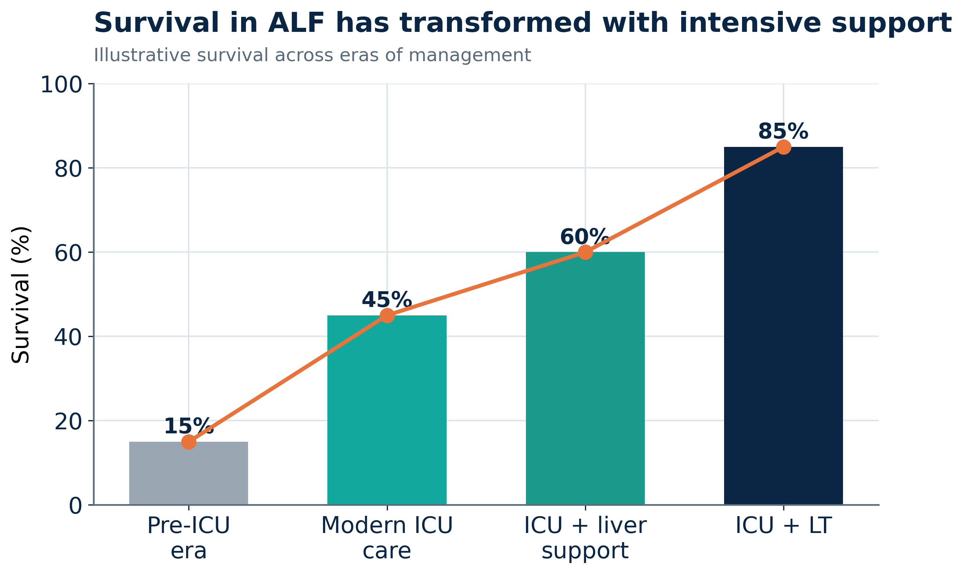
WHY IT MATTERS
Intensive support has transformed survival
Each layer of organ support — modern ICU care, then extracorporeal liver support, then transplantation — has incrementally improved survival in liver failure.
Role of Liver Support Systems in the ICU • Peri-Transplant Setting
07

Slide 8
MECHANISM
The rationale for extracorporeal liver support
Remove what the failing liver can't — and modulate the inflammatory storm
08

Slide 9
TARGETS
What liver support actually removes
Water-soluble toxins
Protein-bound toxins
Inflammatory mediators
Missing factors
Ammonia, urea, small molecules
Bilirubin, bile acids, aromatic amino acids
Cytokines, DAMPs, chemokines
Coagulation factors, albumin, opsonins
→ CRRT
→ PLEX / albumin dialysis
→ PLEX (immune reset)
→ PLEX replaces them
Key idea: no single device replaces the liver — modalities are combined to cover different toxin classes.
Role of Liver Support Systems in the ICU • Peri-Transplant Setting
09

Slide 10
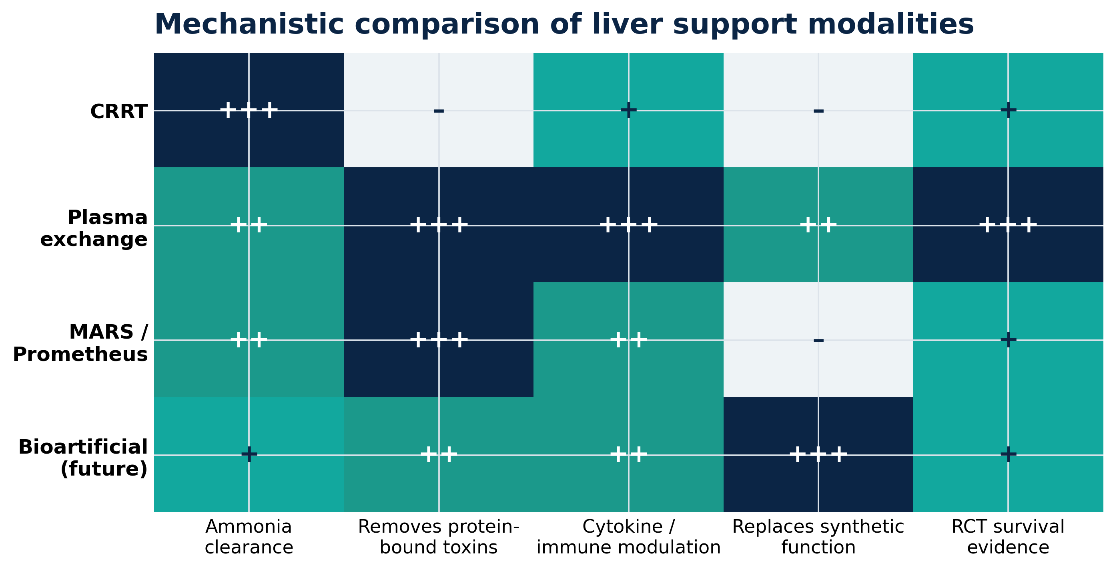
CLASSIFICATION
A mechanistic map of the options
Artificial (cell-free): CRRT, PLEX, MARS, Prometheus • Bioartificial (cell-based): the emerging frontier
Role of Liver Support Systems in the ICU • Peri-Transplant Setting
10

Slide 11
MODALITY 01
CRRT
Continuous renal replacement therapy — the metabolic workhorse of the liver ICU
11

Slide 12
CRRT
Principles & indications in liver failure
Continuous & gentle — slow solute removal suits the haemodynamically fragile
Start early
Ammonia control — the key non-renal indication in ALF
CRRT is often begun BEFORE stage-3 AKI — to control ammonia, not just for the kidneys
Avoids ICP swings — preferred over intermittent HD in cerebral oedema
CVVHDF
Manages AKI / HRS — fluid, acid-base & electrolyte control
High-flow continuous veno-venous haemodiafiltration maximises ammonia clearance
Platform for combination — runs alongside PLEX in many protocols
Ammonia clearance is lower than urea/creatinine → higher effluent doses are used in hyperammonaemia.
Role of Liver Support Systems in the ICU • Peri-Transplant Setting
12

Slide 13
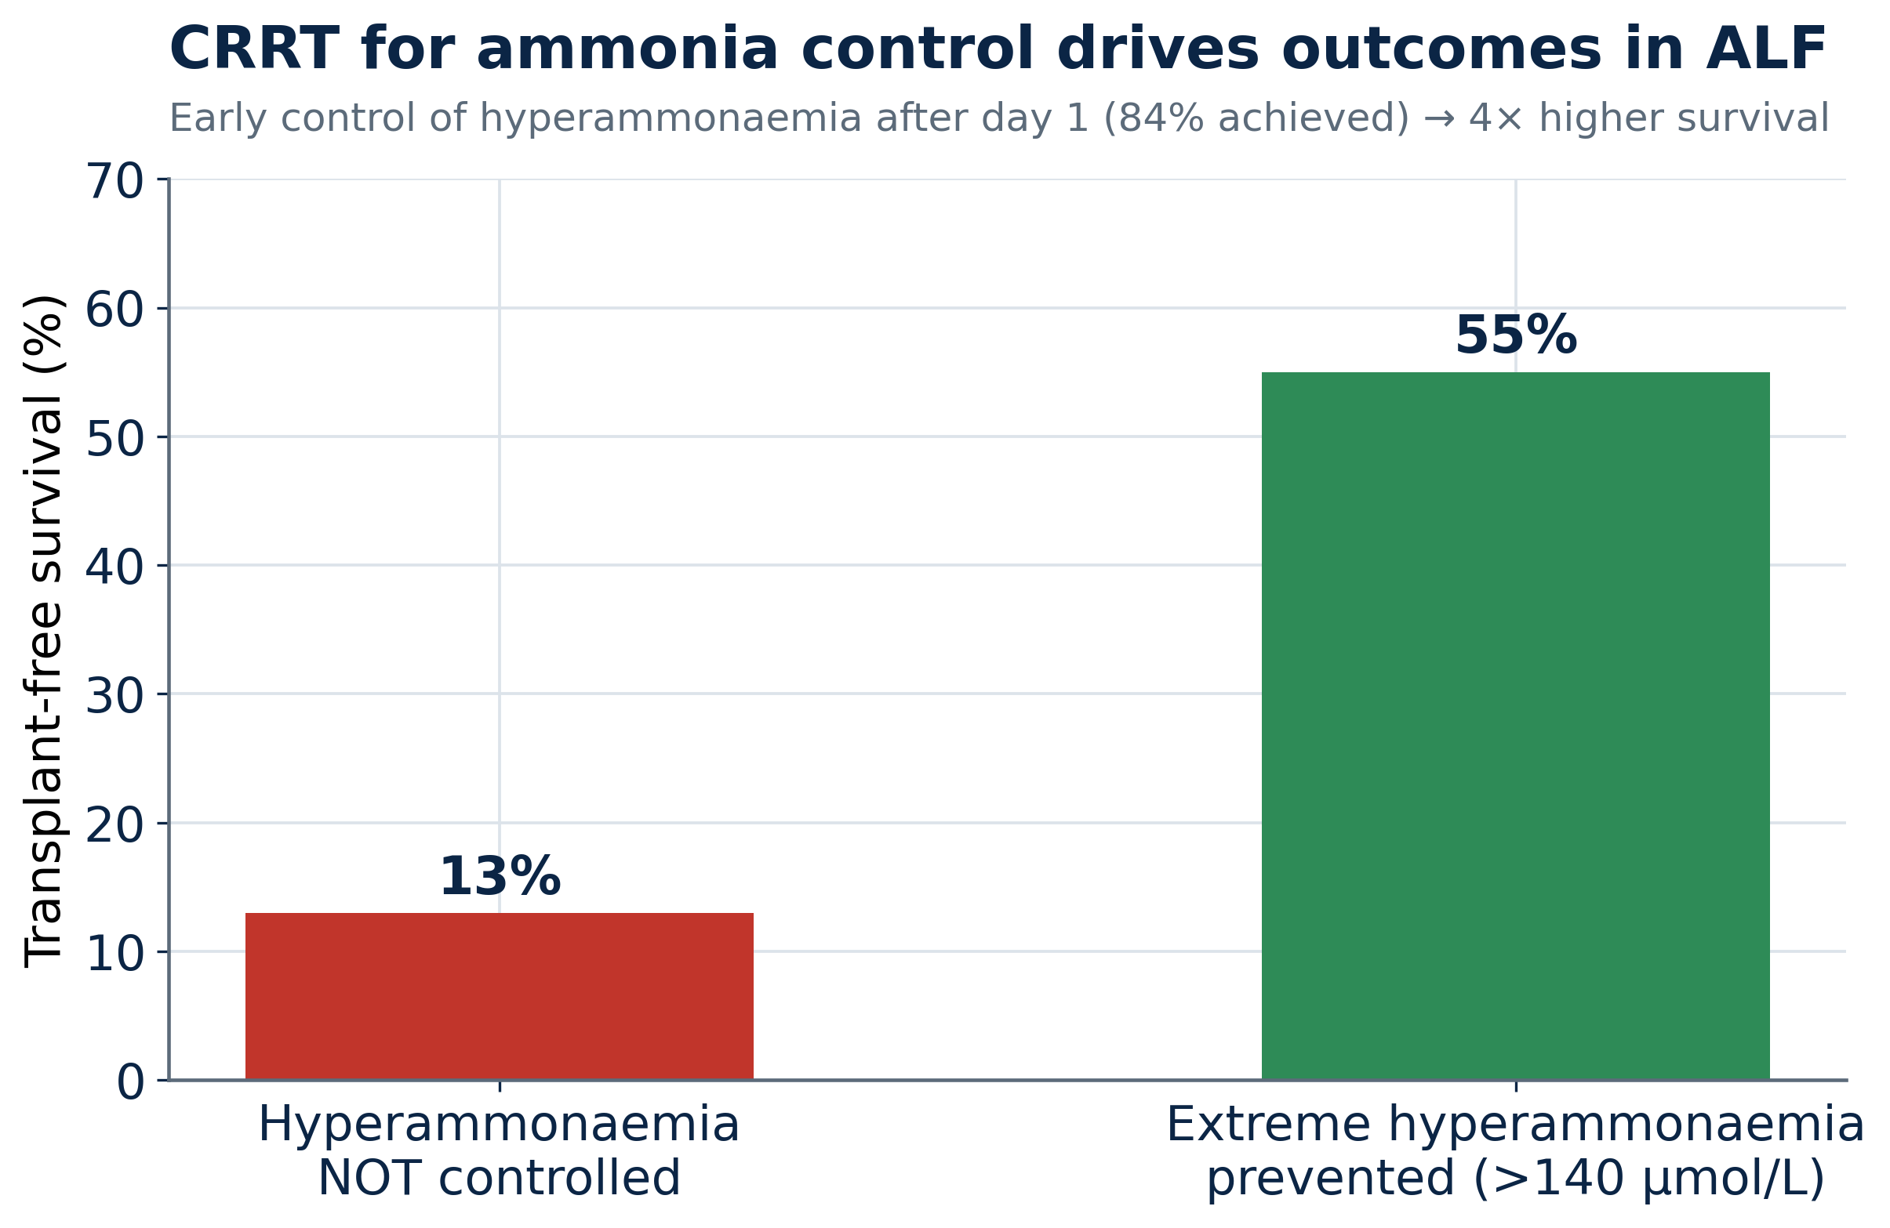
CRRT • EVIDENCE
Controlling ammonia changes outcomes
84%
Achieved control of extreme hyperammonaemia (>140 µmol/L) after day 1 with CRRT
4×
Higher transplant-free survival when extreme hyperammonaemia was prevented (55% vs 13%)
Role of Liver Support Systems in the ICU • Peri-Transplant Setting
13

Slide 14
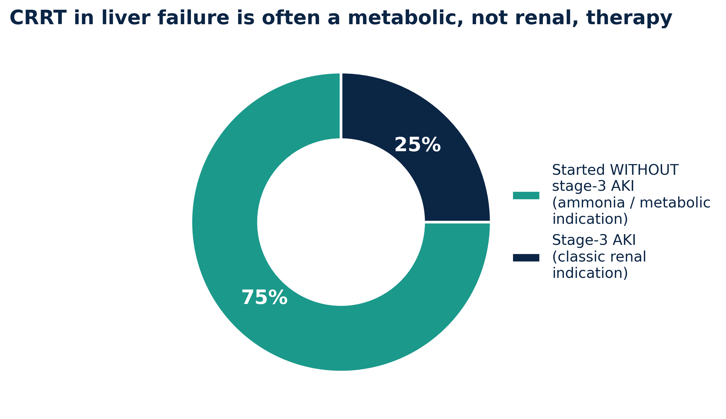
CRRT • INSIGHT
Often a metabolic therapy, not a renal one
Three-quarters started without stage-3 AKI — driven by ammonia & encephalopathy
Neuroprotection lowering ammonia reduces intracranial hypertension risk
Peri-transplant stabilises HRS and volume status before / after graft
Role of Liver Support Systems in the ICU • Peri-Transplant Setting
14

Slide 15
MODALITY 02
Plasma exchange
Therapeutic plasma exchange (PLEX / TPE) — the strongest survival evidence to date
15

Slide 16
PLEX
One therapy, three simultaneous actions
REMOVE
REPLACE
RESET
Clears protein-bound toxins, bilirubin, bile acids & aromatic amino acids
Restores coagulation factors, albumin & opsonins via fresh plasma
Dampens the cytokine / DAMP-driven inflammatory storm
Unlike CRRT or albumin dialysis, PLEX is the only modality that simultaneously detoxifies, replaces synthetic function and modulates immunity — which likely explains its survival signal.
Role of Liver Support Systems in the ICU • Peri-Transplant Setting
16

Slide 17
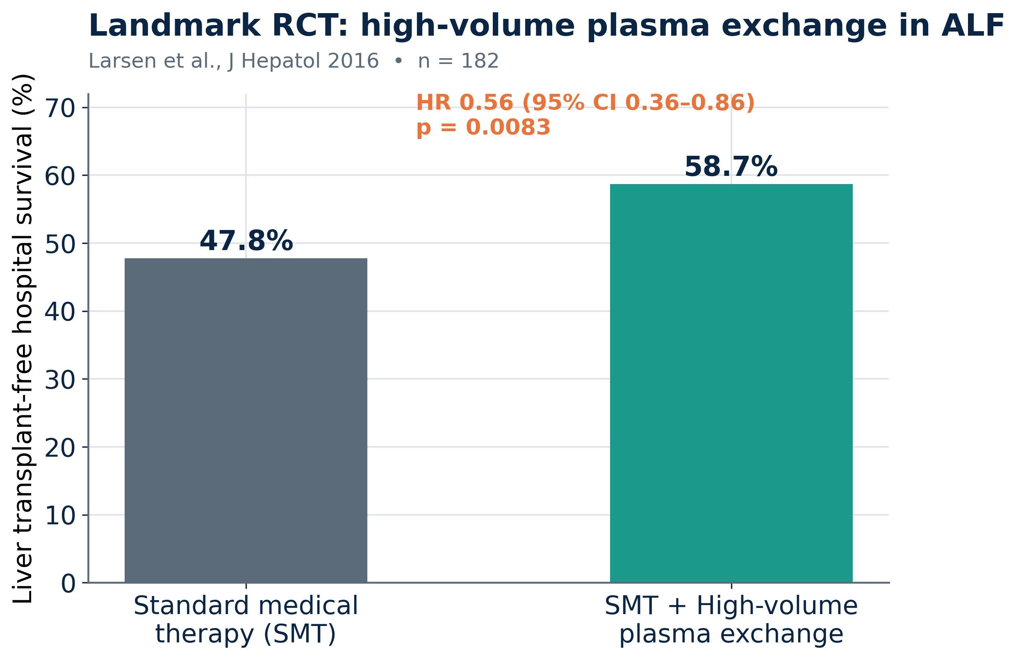
PLEX • LANDMARK TRIAL
High-volume PLEX improves survival in ALF
First RCT of PLEX in ALF 182 patients; J Hepatol 2016
+11% absolute survival transplant-free survival vs standard care
Mechanism confirmed attenuated innate immune activation
Now in EASL guidance Level I, Grade 1 recommendation for ALF
Role of Liver Support Systems in the ICU • Peri-Transplant Setting
17

Slide 18
PLEX • REFINEMENT
Standard-volume PLEX may be enough
High-volume PLEX (HVP) — 8–12 L/day exchange established the survival benefit in the landmark trial
Standard-volume PLEX — a later RCT showed comparable improvement in outcomes with less plasma
Practical implications — lower plasma requirement, fewer resources, better feasibility in most ICUs
Timing is critical — earlier initiation is associated with better response — 'the battle can be lost if late'
Take-home: efficacy is robust across HVP and standard-volume protocols — favour earlier, resource-appropriate PLEX.
Role of Liver Support Systems in the ICU • Peri-Transplant Setting
18

Slide 19
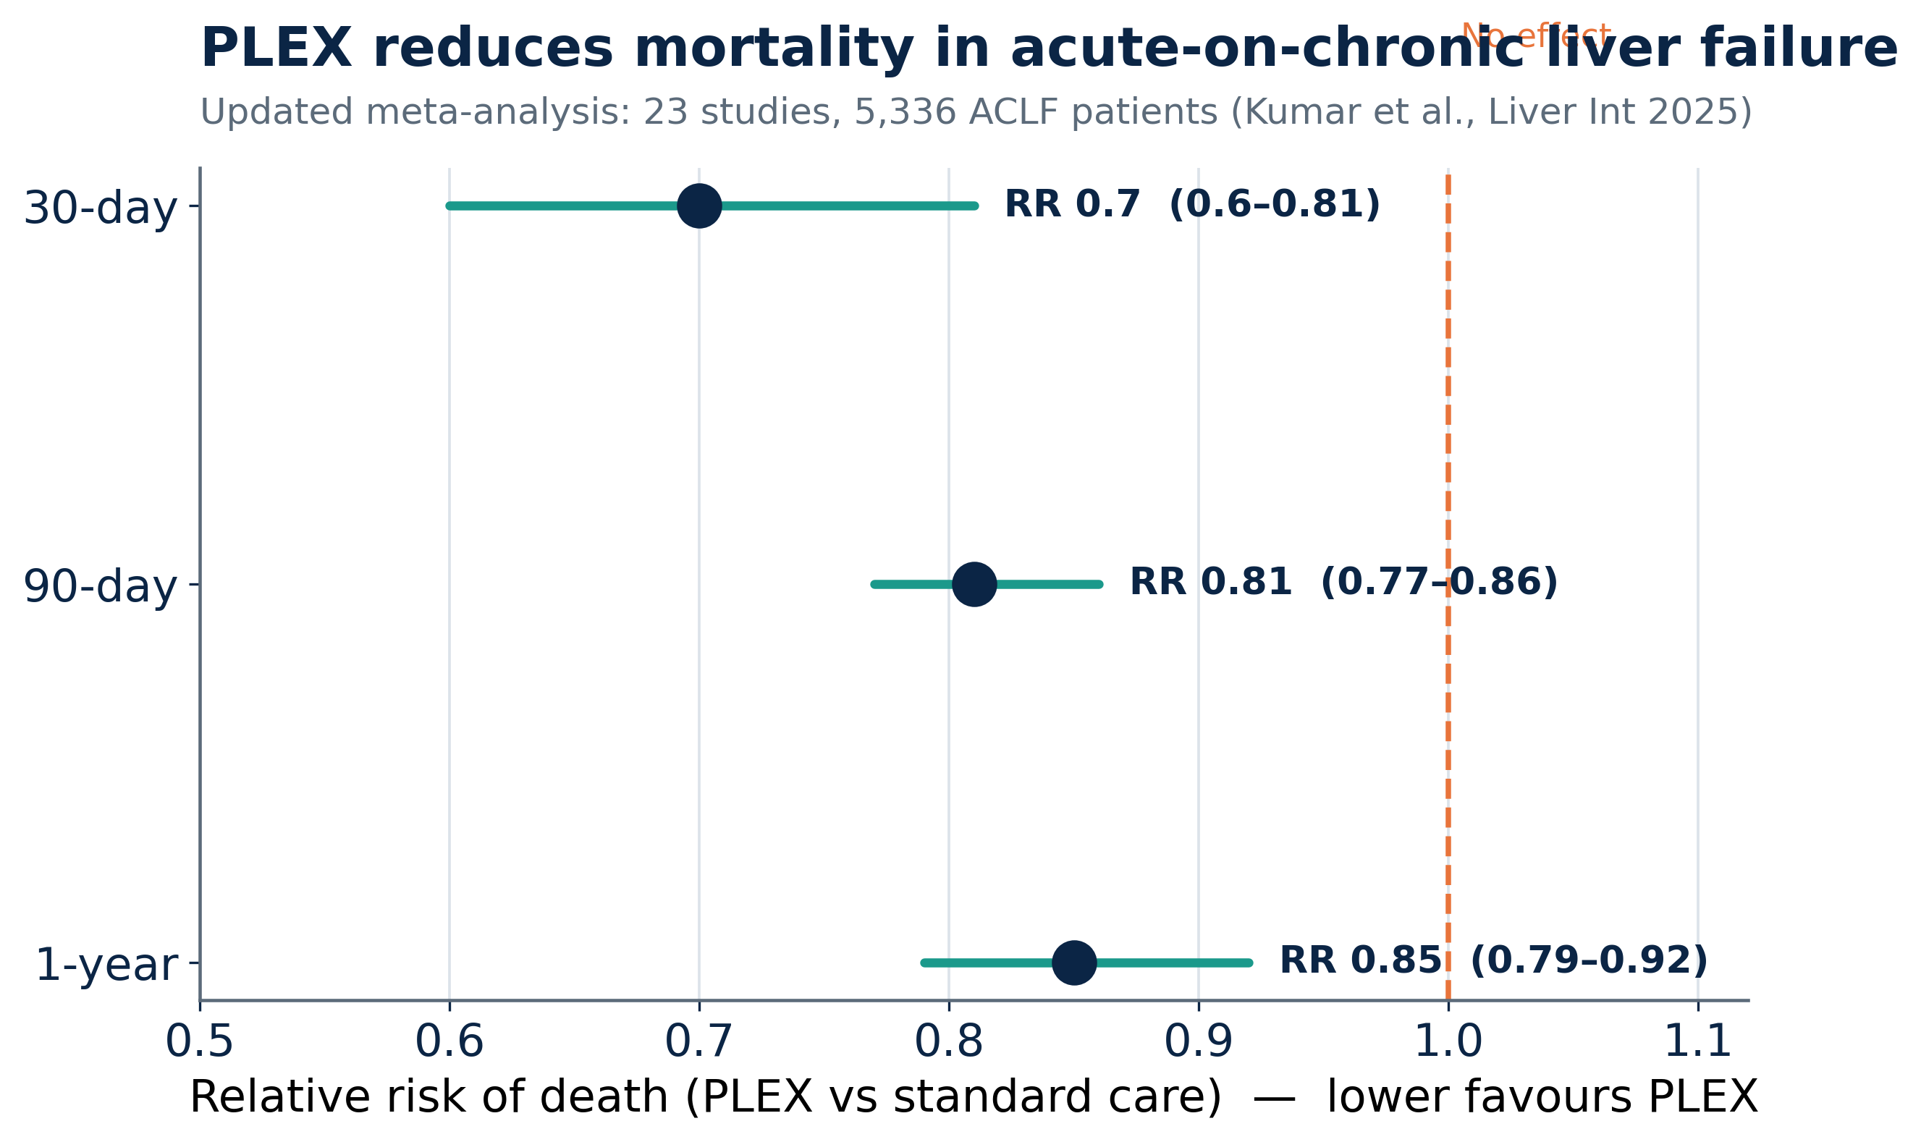
PLEX • ACLF EVIDENCE
Mortality benefit out to one year
5,336
ACLF patients across 23 studies in the pooled analysis
30% ↓
Relative risk of death at 30 days with PLEX
Golden 2 wks
APASL window for early TPE in ACLF
Role of Liver Support Systems in the ICU • Peri-Transplant Setting
19

Slide 20
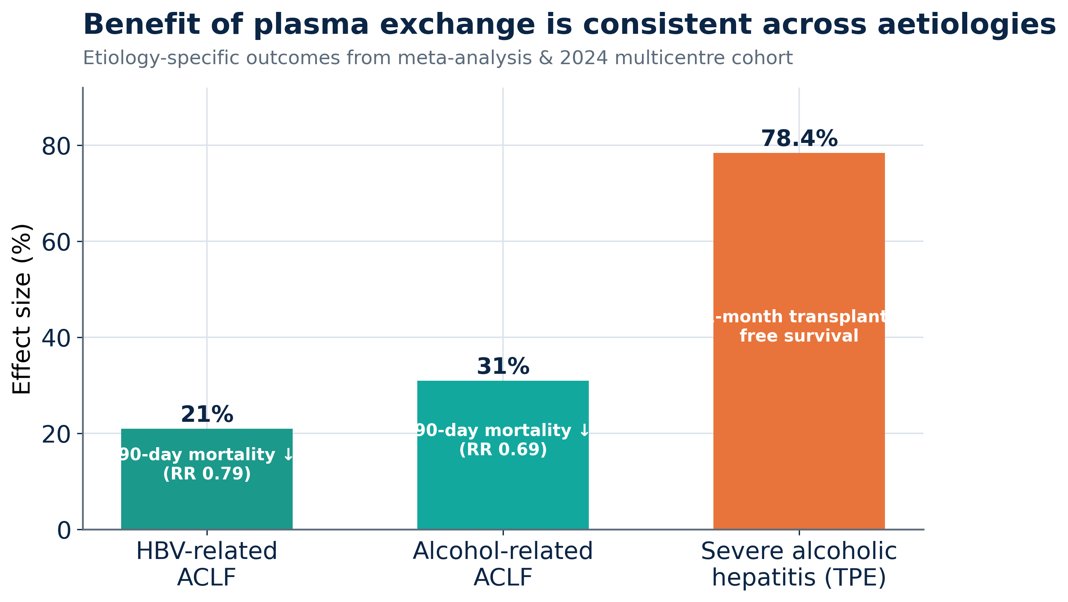
PLEX • SUBGROUPS
Consistent across major aetiologies
Benefit is seen in HBV- and alcohol-related ACLF, and a 2024 multicentre cohort reported 78% one-month transplant-free survival in severe alcoholic hepatitis treated with PLEX.
Role of Liver Support Systems in the ICU • Peri-Transplant Setting
20

Slide 21
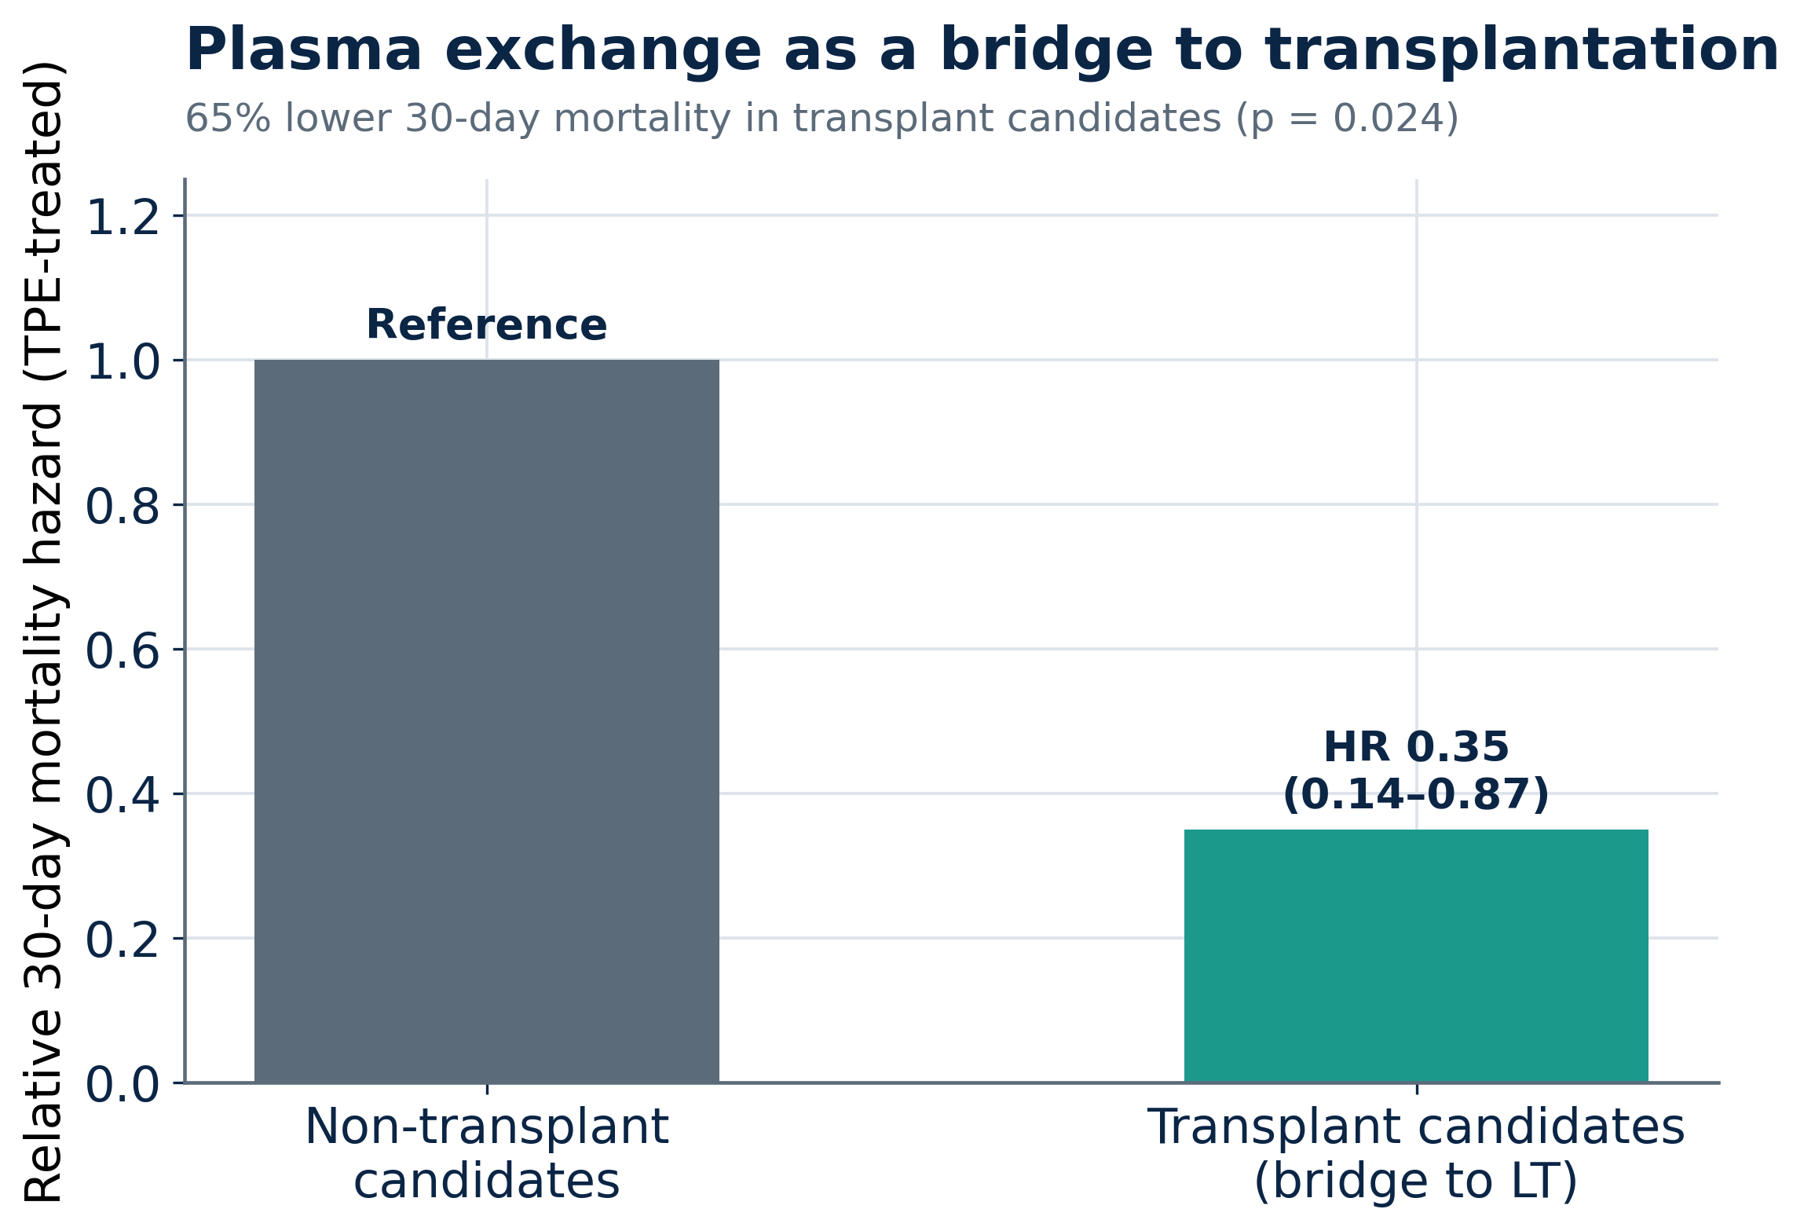
PLEX • PERI-TRANSPLANT
PLEX as a bridge to transplantation
Keeps candidates viable controls HE, coagulopathy & inflammation while waiting
65% lower 30-day mortality in transplant candidates vs non-candidates (p=0.024)
ABO-incompatible grafts PLEX lowers isoagglutinin titres peri-operatively
Bridge to recovery too buys time for native liver regeneration
Role of Liver Support Systems in the ICU • Peri-Transplant Setting
21

Slide 22
MODALITY 03
Albumin dialysis
MARS & Prometheus — strong biochemistry, elusive survival benefit
22

Slide 23
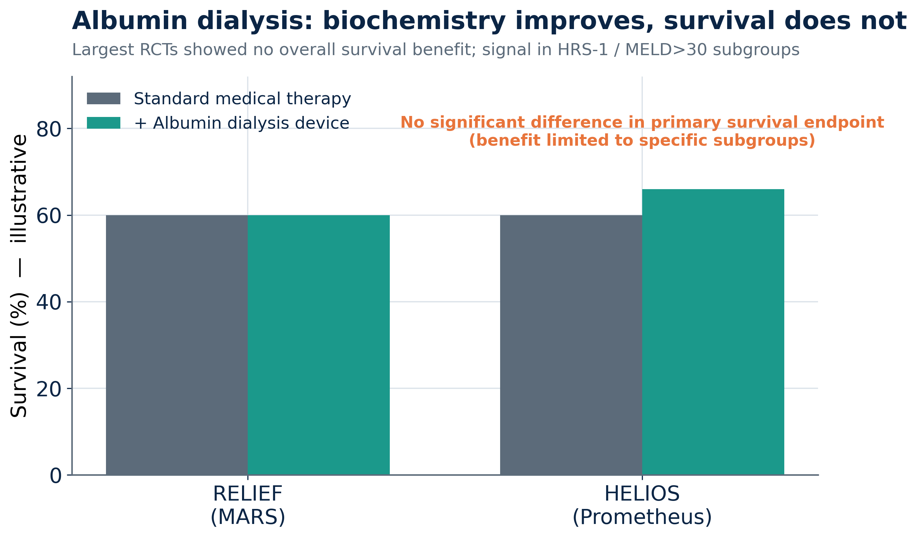
ALBUMIN DIALYSIS
What the big RCTs taught us
RELIEF (MARS) largest ACLF RCT — no overall survival benefit
HELIOS (Prometheus) lower bilirubin, no 28/90-day survival gain
Subgroups benefit HRS-1 and MELD >30 signals
Role today selected refractory cases; pruritus, HE relief
Role of Liver Support Systems in the ICU • Peri-Transplant Setting
23

Slide 24
SYNTHESIS
Choosing the right tool for the patient
Modality | Best for | Key evidence | Peri-transplant role
CRRT | Ammonia, AKI, ICP, volume | ↑ survival via ammonia control | Workhorse — pre/post graft
PLEX / TPE | Toxins + immunity + factors | RCT & meta-analysis survival benefit | Bridge to LT / recovery
MARS / Prometheus | Refractory jaundice, HE, pruritus | Biochemistry ↑, survival neutral | Selected subgroups
Bioartificial | Synthetic function (future) | Investigational | Emerging
Role of Liver Support Systems in the ICU • Peri-Transplant Setting
24

Slide 25
ALGORITHM
An integrated peri-transplant pathway
Recognise
Stabilise
Support
Decide
Bridge / Transplant
ALF / ACLF + organ failures
ICU care, NAC, antivirals, sepsis Rx
CRRT for ammonia/AKI + PLEX for toxins/immunity
Recovery likely? List for transplant?
PLEX bridge → LT or native recovery
Throughout: treat the precipitant, support every failing organ, and re-assess transplant candidacy daily.
Role of Liver Support Systems in the ICU • Peri-Transplant Setting
25

Slide 26
RECENT ADVANCES
What's changed in the last few years
PLEX enters guidelines
Standard-volume PLEX
ACLF survival data matures
High-volume PLEX is now a Grade-1 recommendation for ALF
Comparable benefit with fewer resources — broader feasibility
Large 2025 meta-analysis confirms 30-/90-day & 1-year benefit
Ammonia-targeted CRRT
Bridge-to-LT evidence
Etiology-specific use
Early, high-dose CRRT for hyperammonaemia gains traction
PLEX improves outcomes in listed candidates
Strong signals in alcohol-associated & HBV ACLF
Role of Liver Support Systems in the ICU • Peri-Transplant Setting
26

Slide 27
LOOKING AHEAD
Futuristic directions
From detoxification today to true liver replacement and regeneration tomorrow
27

Slide 28
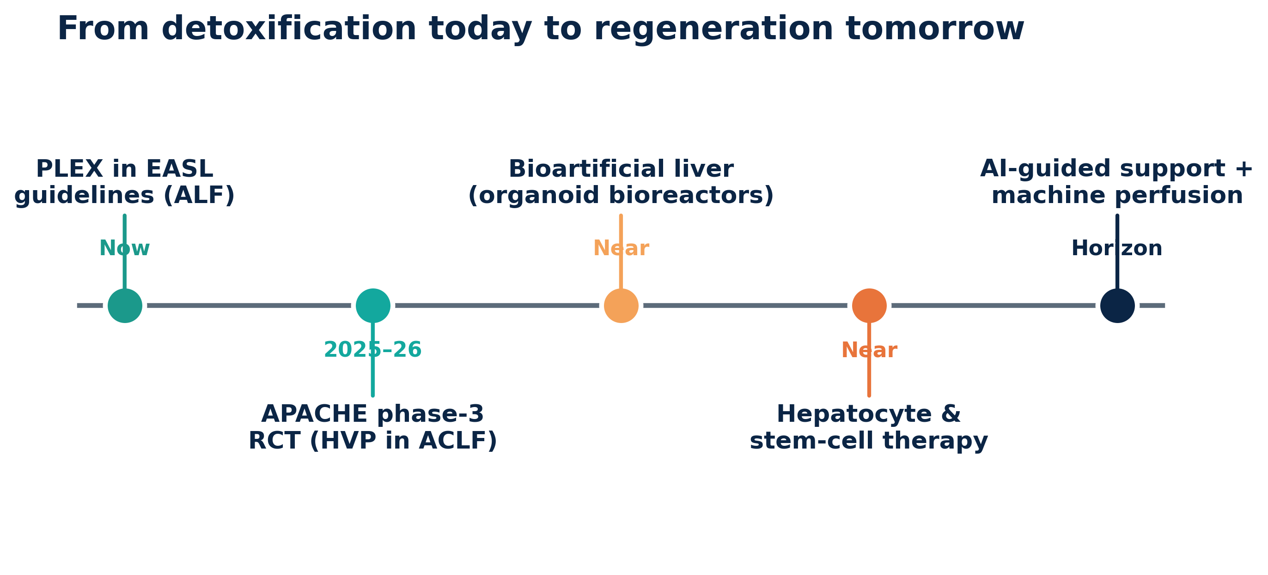
THE FRONTIER
Where liver support is heading
Bioartificial liver — organoid / hepatocyte bioreactors that add synthetic function, not just detoxification
Role of Liver Support Systems in the ICU • Peri-Transplant Setting
28

Slide 29
ON THE HORIZON
Trials & technologies to watch
APACHE phase-3 RCT
High-volume PLEX with 5% albumin in moderate-severe ACLF — could redefine the standard of care.
Bioartificial liver devices
3-D hepatocyte/organoid bioreactors aim to replace synthetic function, not just detoxify.
Cell-based & gene therapy
Hepatocyte transplantation and stem-cell-derived liver cells as a bridge or alternative to LT.
AI-guided & perfusion tech
Machine perfusion expands the donor pool; AI may individualise support timing & dosing.
Role of Liver Support Systems in the ICU • Peri-Transplant Setting
29

Slide 30
KEY TAKEAWAYS
Five messages to take to the bedside
1
Buy time, target the toxin. Liver support bridges to recovery or transplant — match the modality to the toxin class.
2
PLEX has the strongest evidence. Survival benefit in ALF (RCT) and ACLF (meta-analysis) — start early.
3
CRRT is a metabolic therapy. Use it for ammonia and ICP control, not only for the kidneys.
4
Albumin dialysis: pick your patient. Biochemistry improves; reserve for selected refractory subgroups.
5
The future is regenerative. Bioartificial livers, cell therapy and AI-guided support are coming.
30

Slide 31
EVIDENCE BASE
Key references
Larsen FS et al. High-volume plasma exchange in acute liver failure: an open RCT. J Hepatol 2016;64:69–78.
Maiwall R et al. Standard-volume plasma exchange improves outcomes in ALF: an RCT. Clin Gastroenterol Hepatol 2022.
Kumar R et al. Therapeutic plasma exchange in ACLF improves survival — an updated meta-analysis. Liver Int 2025.
Bañares R et al. (RELIEF) Extracorporeal albumin dialysis with MARS in ACLF. Hepatology 2013.
Kribben A et al. (HELIOS) Effects of Prometheus in patients with ACLF. Gastroenterology 2012.
Cardoso FS et al. CRRT & hyperammonaemia in acute liver failure. Crit Care / J Hepatol reports.
EASL Clinical Practice Guidelines on the management of acute (fulminant) liver failure. J Hepatol.
APACHE trial (NCT03702920): plasma exchange with albumin 5% in ACLF.
Figures generated from published trial & meta-analysis data; some values are illustrative for teaching. Verify before clinical use.
Role of Liver Support Systems in the ICU • Peri-Transplant Setting
31

