Slide 1
Ethereum
Ethereum is a decentralized open source blockchain featuring smart contract functionality. Ether is the native cryptocurrency token of the Ethereum platform.

Slide 2
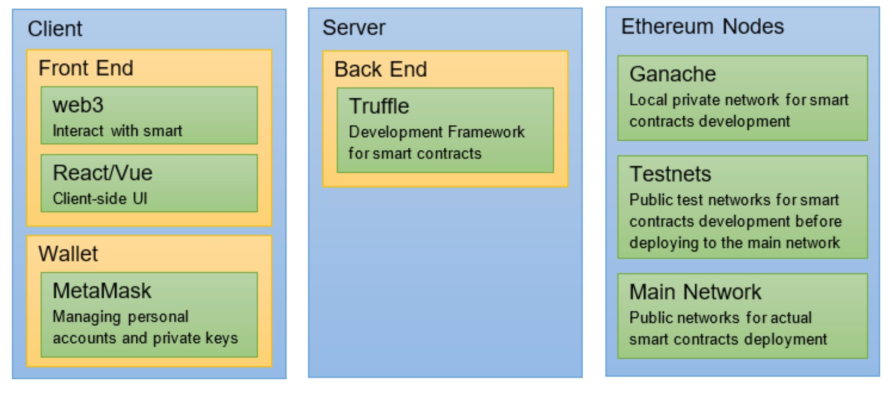
Ethereum Architecture

Slide 3
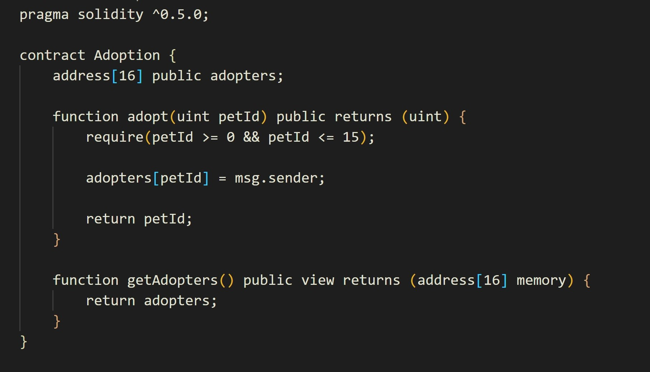
Smart Contract in Ethereum
Smart contracts contain the business logic of Dapp. These contracts oversee reading from and writing to the Ethereum blockchain. Smart contacts are written in a programming language called Solidity, which looks like JavaScript.

Slide 4
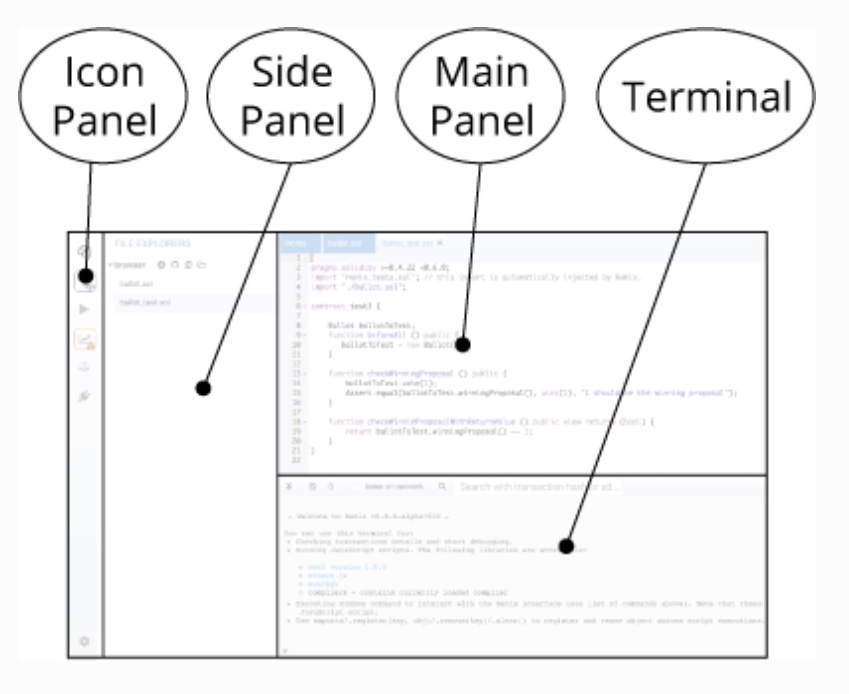
IDE For Smart Contract
Remix : It is a powerful, open-source tool that helps you write Solidity contracts straight from the browser.

Slide 5
Development Framework
Software frameworks include many of the needed features or provide easy plugin systems to pick the tools you desire.
Frameworks come with a lot of out-of-the-box functionality, like:
Features to spin up a local blockchain instance.
Utilities to compile and test your smart contracts.
Client development add-ons to build your user-facing application within the same project/repository.
Configuration to connect to Ethereum networks and deploy contracts, whether to a locally running instance, or one of Ethereum's public networks.
Decentralized app distribution - integrations with storage

Slide 6
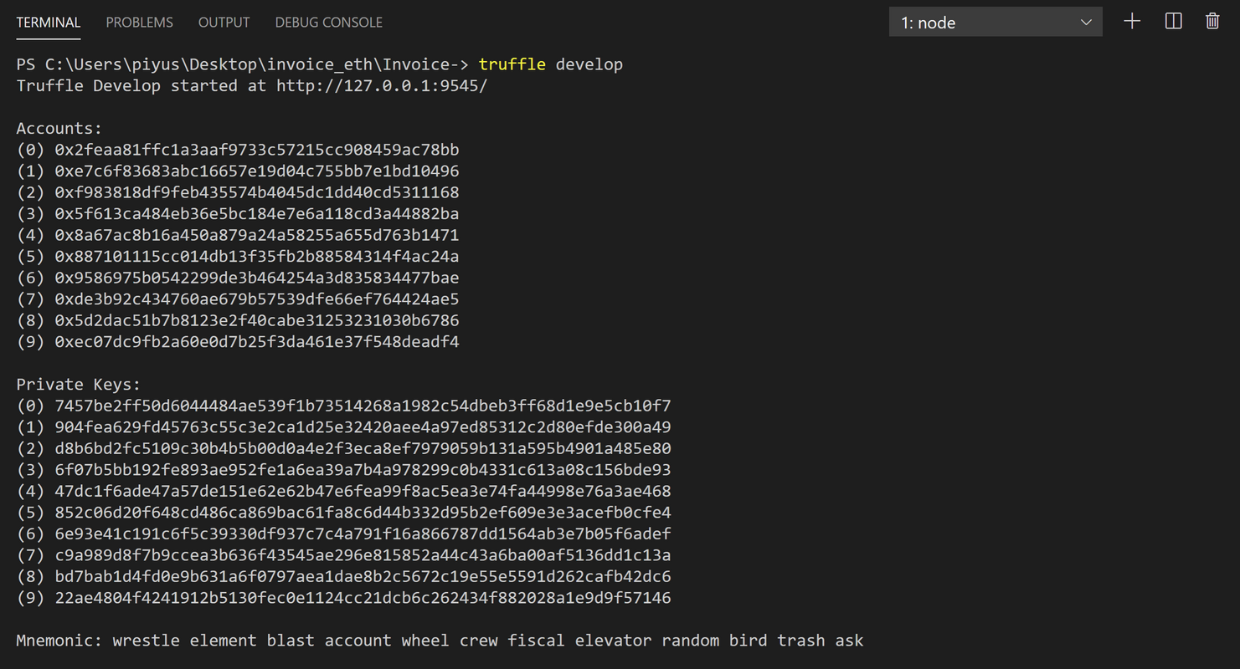
Development Framework
Sample Development Framework:
Truffle, Embark, builder, Brownie, Etherlime, etc.
Truffle - A development environment, testing framework, build pipeline, and other tools. In other words, it helps you develop smart contracts, publish them, and test them.
It helps to connect the Ethereum networks like Ganache, Rinkeby, Ropsten with client like geth.
What are these networks?

Slide 7
Types of Networks
Main Network (Mainnet):
The ETHER or ETH carry the real value of ether for the transactions.
Test Network:
The Ether on the TestNet does not carry any real value and is only for collaborative testing on the network. Testnets like Ropston, Rinkeby, Kovan, etc.
Private Network:
The private nodes can be quickly launched with minimal storage and memory requirements and without much effort. This network can be started using geth client on local machine.

Slide 8
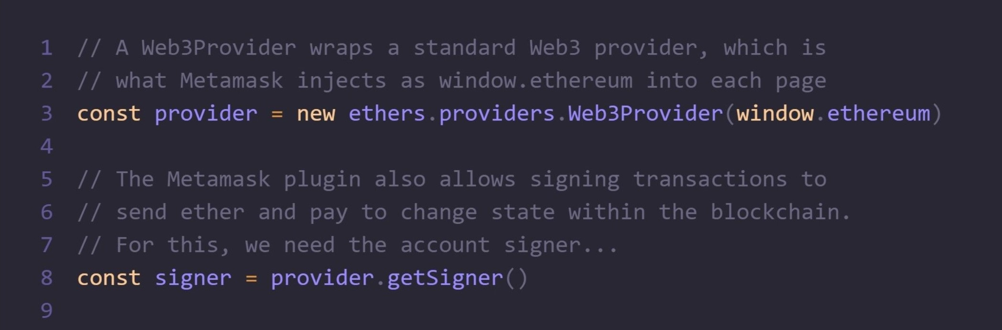
Ethereum Client API
In order for a web app to interact with the Ethereum blockchain (i.e. read blockchain data and/or send transactions to the network), it must connect to an Ethereum node.

Slide 9
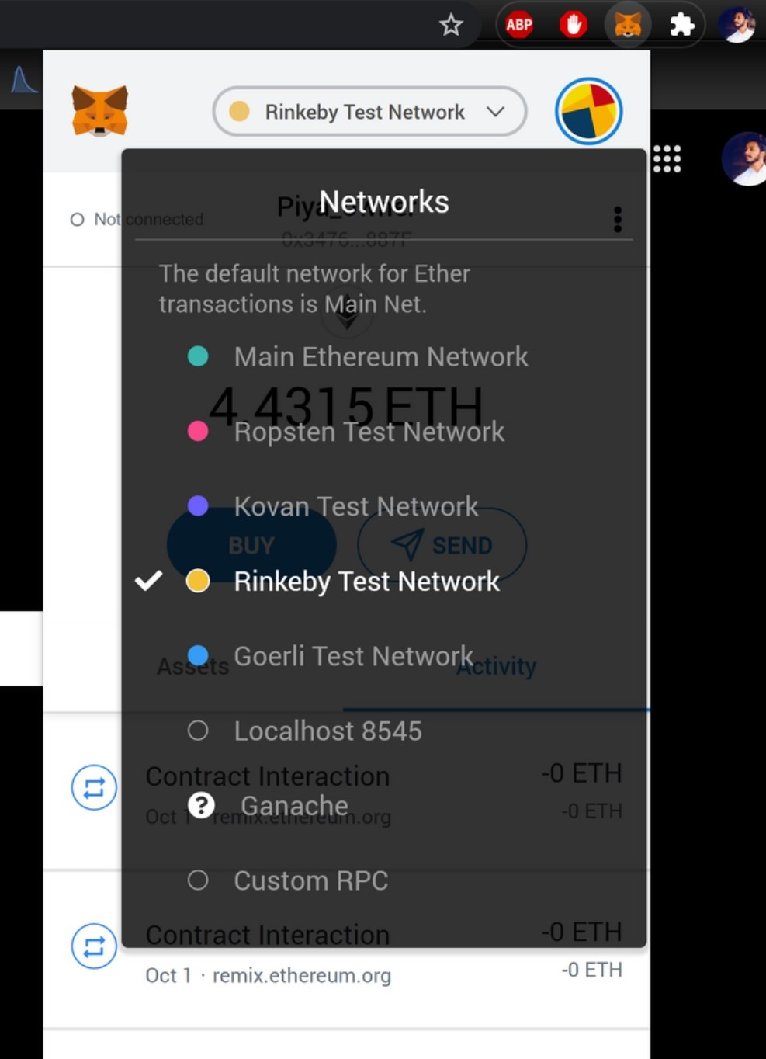
MetaMask
MetaMask is a browser plugin that serves as an Ethereum wallet.
Users can store Ether and other ERC-20 tokens in the MetaMask wallet.
The wallet can also be used to interact with decentralized applications, or dapps.

Slide 10
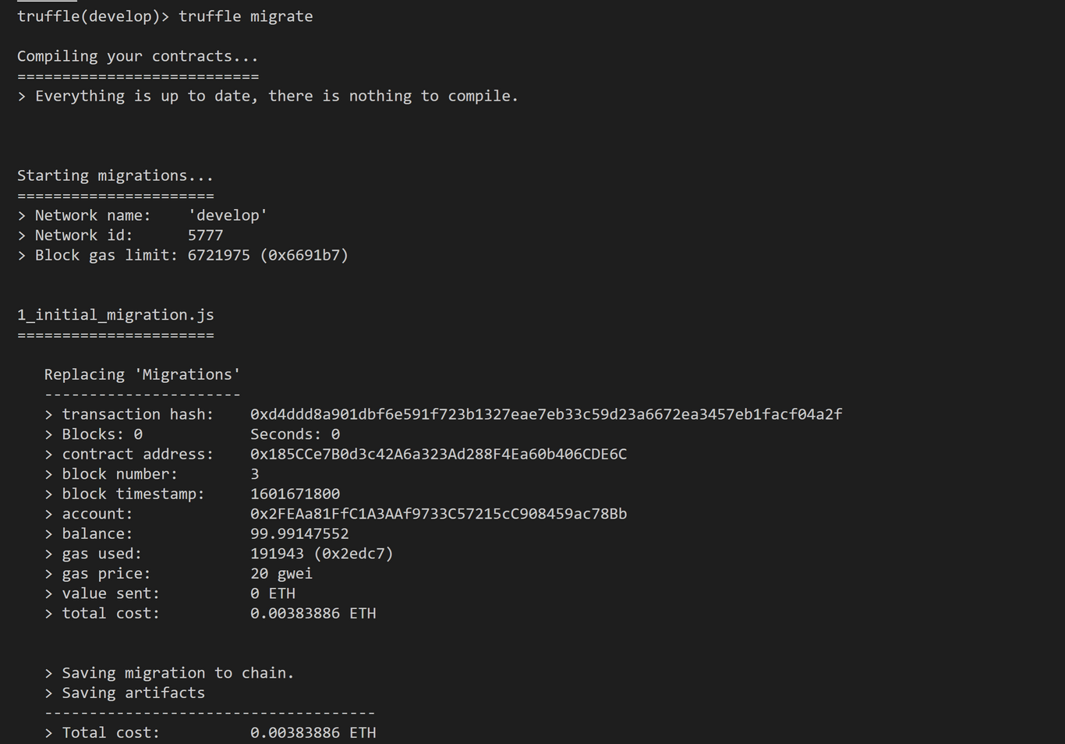
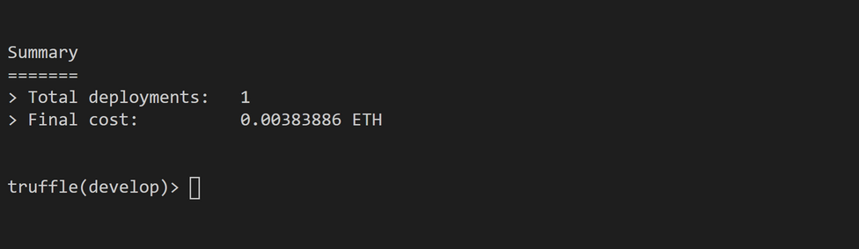
Transactions
A submitted transaction includes the following information:
Recipient– receiving address
Signature– the identifier of the sender. This is generated when the sender's private key signs the transaction and confirms the sender has authorised this transaction
Value– amount of ETH to transfer from sender to recipient.
Data– optional field to include arbitrary data
gasLimit– the maximum amount of gas units that can be consumed by the transaction. Units of gas represent computational steps
gasPrice– the fee the sender pays per unit of gas

Slide 11
Multiple Transactions
Ethereum blockchain can perform multiple transactions using Multiple addresses. These public addresses can help perform transactions using Ethereum node. This scenario can be considered as one to many transactions.
There are several thousands of transactions that are getting fired across Ethereum network, every second. Only when a transaction becomes part of a valid Block, they are final. If a transaction is not picked up by any miner, then it stays in the Mempool or you can say its still left for processing.

Slide 12
Multiple Users on Multiple Machine
There is a necessity to have an efficient way to reliably share data between users and the server .
This functionality can occur through different mechanisms, though the prevailing method that I am aware of is through WebSocket's. WebSocket’s are used to send data packets to and from your server and are an interoperable, cross-compatible, browser-oriented solution for sending and receiving data, both between users and between the server applications.
This users can perform transactions easily using testnets like kovan, rinkeby, Ropsten or mainnet.

Slide 13
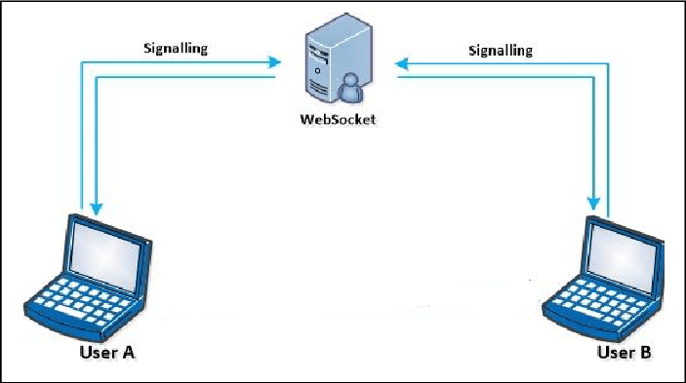
Sockets
Sockets provide connection between buyers and seller. The system must work in a clustered environment. Individual server nodes should be able to go down without affecting the rest of the system.

Slide 14
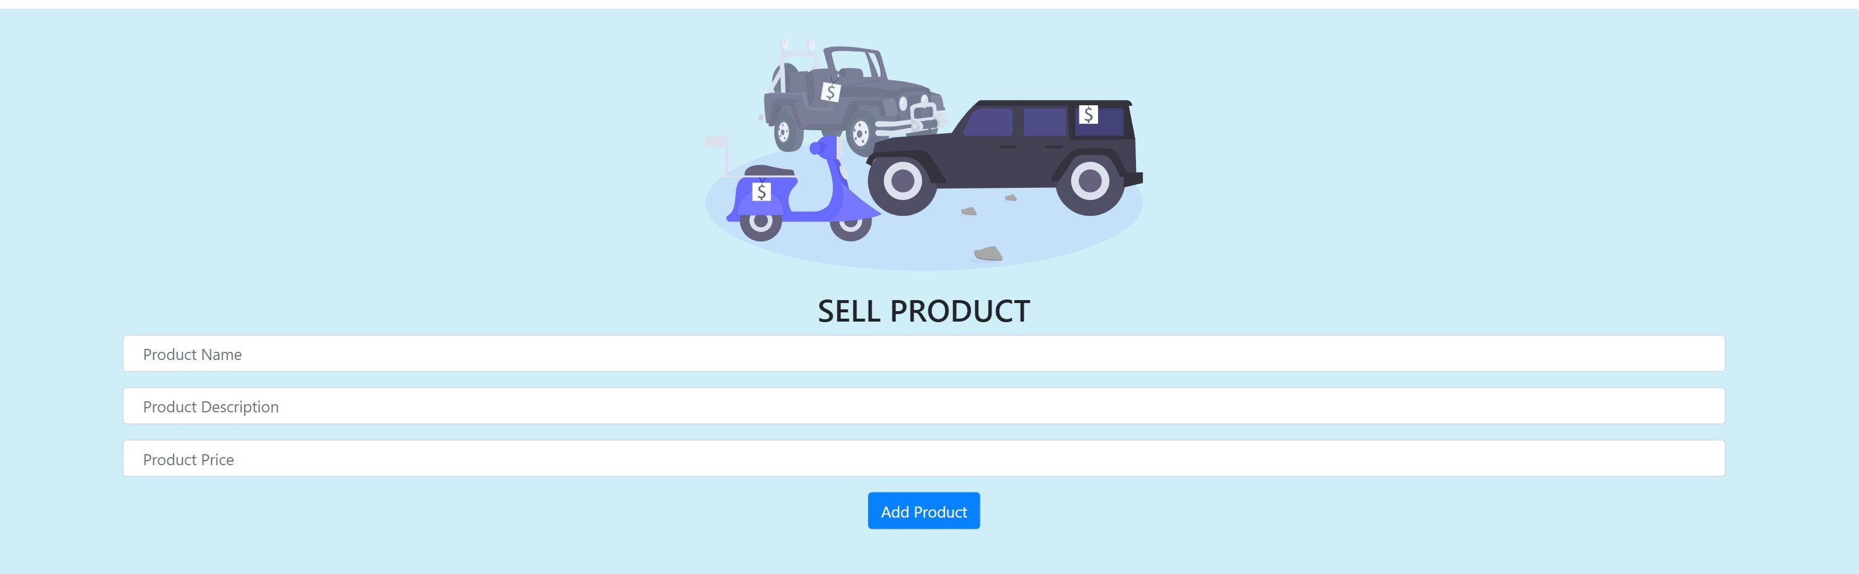
Application
Buying and selling Product
Seller : Seller post the advertise on the application about the Product and its related information. Information includes product name, product price, product description.

Slide 15
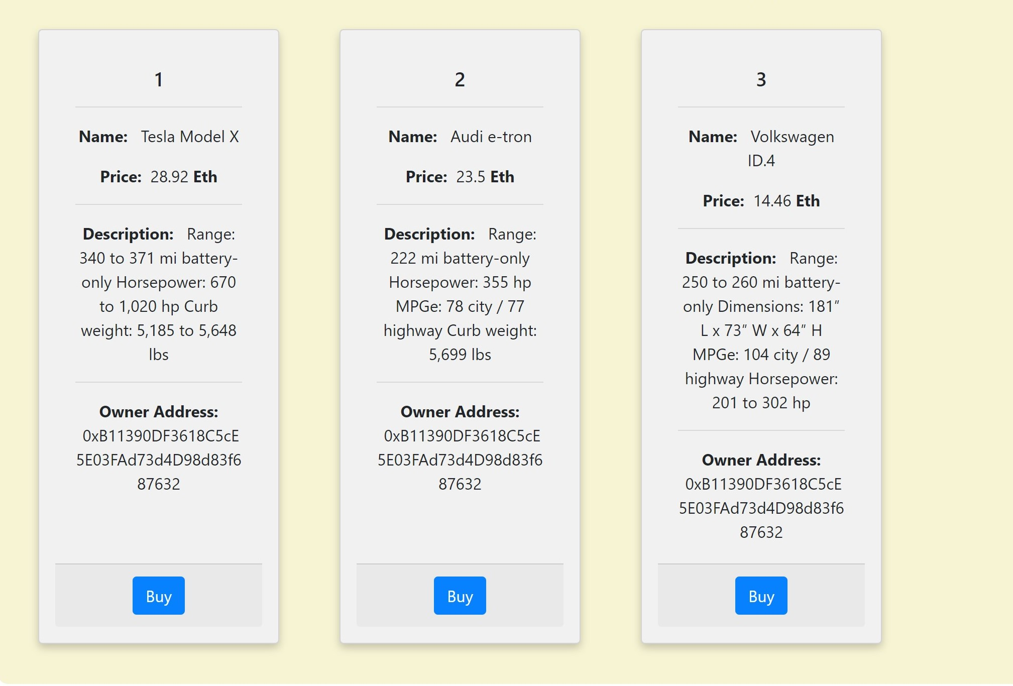
Application
Buying and selling Product
Buyer: Buyer can purchase the product using one click (buy), after authentication if buyer is valid, transaction take place and details are updated in blockchain, and owner of product is changed.

