Slide 1
Understanding Modifiers
What are modifiers?
  Adjectives
  Adverbs
  Phrases
  Clauses
Troublesome modifiers
Bad/badly
  Good/well
Review A
Review B

Slide 2
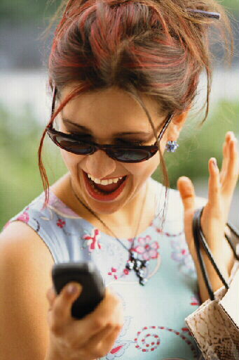
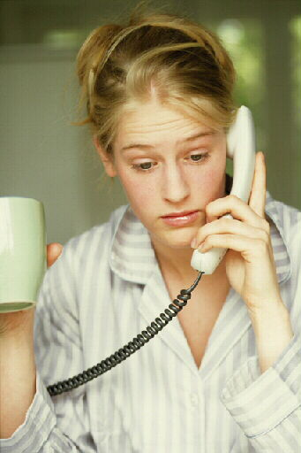
What are modifiers?
You’re so excited about the skirt you just bought that you call your best friend.
I bought a skirt!
When did you buy it?
What does it look like?
How much did it cost?
Where did you buy it?
Your friend can’t see the skirt you just bought. What questions will she ask?

Slide 3

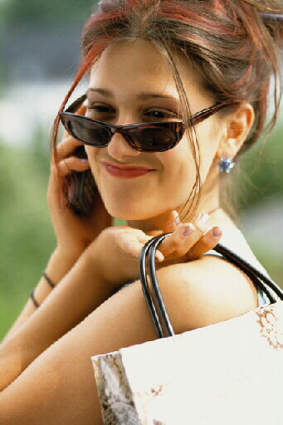
What are modifiers?
A modifier is a word or word group that makes the meaning of another word or word group more specific.
What does it look like?
How much did it cost?
When did you buy it?
Where did you buy it?
I bought a cute, blue skirt at the mall today for only ten dollars!
I bought a cute, blue skirt at the mall today.
I bought a cute, blue skirt at the mall.
I bought a cute, blue skirt.

Slide 4

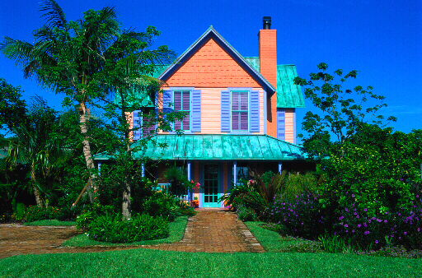
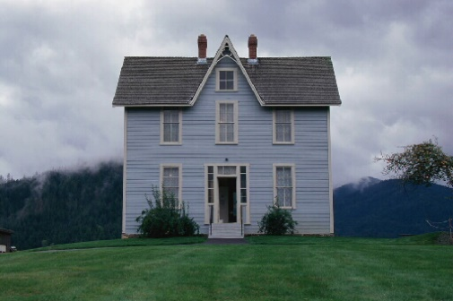
What are modifiers?
Adjectives
Some modifiers are one-word modifiers.
An adjective is a word that makes the meaning of a noun or pronoun more specific.
Noun
They lived in a house.
Adjective
They lived in a colorful house.
They lived in an old house.

Slide 5

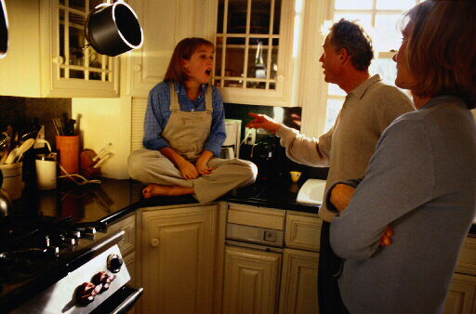
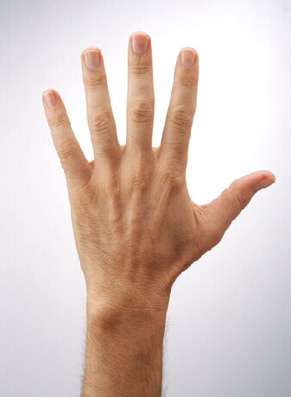
What are modifiers?
Adjectives
An adjective makes the meaning of a noun or pronoun more specific by telling what kind, which one, or how many.
blue sky
sky
What kind?
girl
Which one?
that girl
fingers
How many?
five fingers

Slide 6
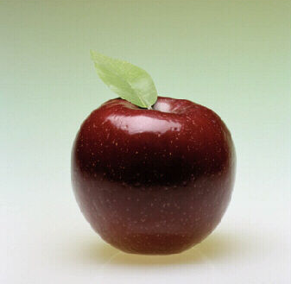
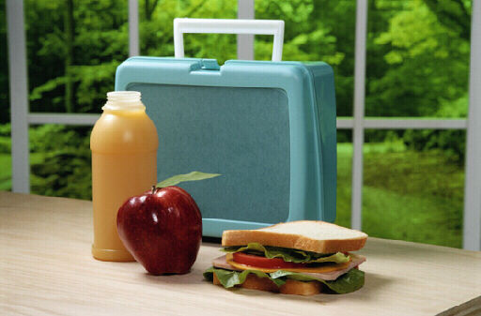
What are modifiers?
Adjectives
Three little words—a, an, and the—are the most frequently used adjectives. We call these three adjectives articles.
an apple
A and an are indefinite articles because they refer to any member of a group.
The is a definite article because it refers to someone or something in particular.
the apple with lunch

Slide 7
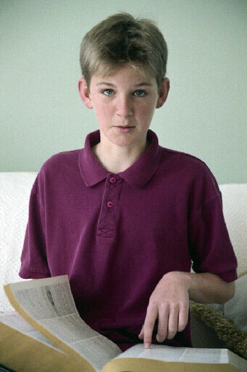



What are modifiers?
Adjectives
Adjectives that tell which one or which ones are called demonstrative adjectives. This, that, these, and those are the demonstrative adjectives.
Which one?
Which ones?
this definition
those mountains

Slide 8
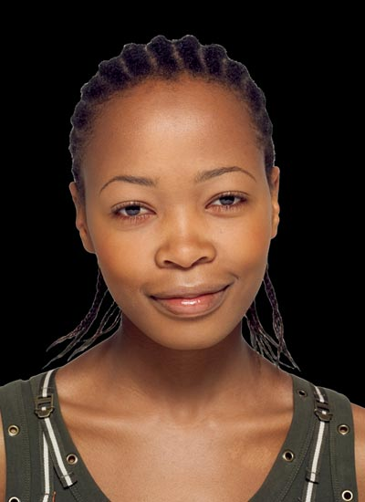

What are modifiers?
Adjectives
This, that, these, and those can be used as adjectives and as pronouns.
Grammar Gal Says...
Demonstrative adjectives modify nouns or pronouns.
Did you draw this picture?
Demonstrative pronouns take the place of nouns.
Did you draw this?

Slide 9

What are modifiers?
Adjectives
Identify the adjectives in the paragraph below. (Do not include the articles a, an, and the.)
Butterflies have a fragile appearance, but they often fly long distances during migration. The monarch is an orange-and-black butterfly. Huge flocks of these colorful butterflies fly south every September. Some monarchs spend the winter in a small forest in California. Many tourists come to see the thick clusters of orange wings.

Slide 10
What are modifiers?
Adjectives
Identify the adjectives in the paragraph below. (Do not include the articles a, an, and the.)
Butterflies have a fragile appearance, but they often fly long distances during migration. The monarch is an orange-and-black butterfly. Huge flocks of these colorful butterflies fly south every September. Some monarchs spend the winter in a small forest in California. Many tourists come to see the thick clusters of orange wings.

Slide 11
What are modifiers?
Adjectives
On Your Own
Fill in the blanks with appropriate adjectives.
1. Cameron wore a _________ sweater.
2. The water was ________ and ________.
3. Have you seen the ________ cat Mia adopted?
4. A ________ lizard was crawling up the tree.
5. That ________ sculpture won _______ place in the art contest.
[End of Section]

Slide 12
What are modifiers?
Adjectives
Possible Answers
Fill in the blanks with appropriate adjectives.
1. Cameron wore a _________ sweater.
2. The water was ________ and _________.
3. Have you seen the ________ cat Mia adopted?
4. A ________ lizard was crawling up the tree.
5. That ________ sculpture won _______ place in the art contest.
blue
cold
refreshing
adorable
scaly
abstract
first

Slide 13
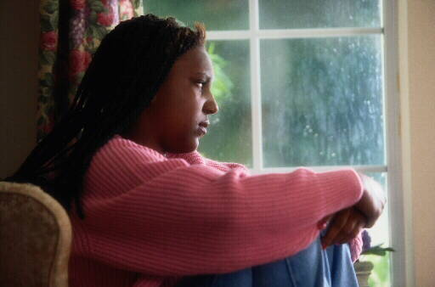
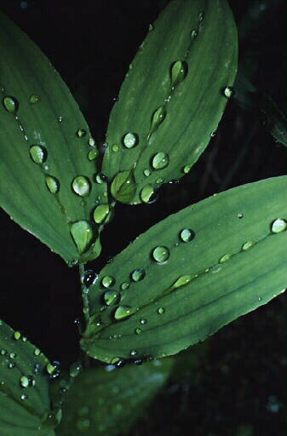
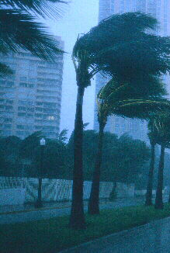
What are modifiers?
Adverbs
An adverb is a word that makes the meaning of a verb, an adjective, or another adverb more specific.
Verb
The rain fell.
Adverb
The rain fell violently.
The rain fell softly.

Slide 14
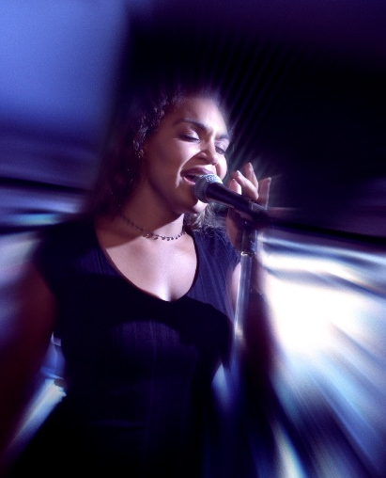
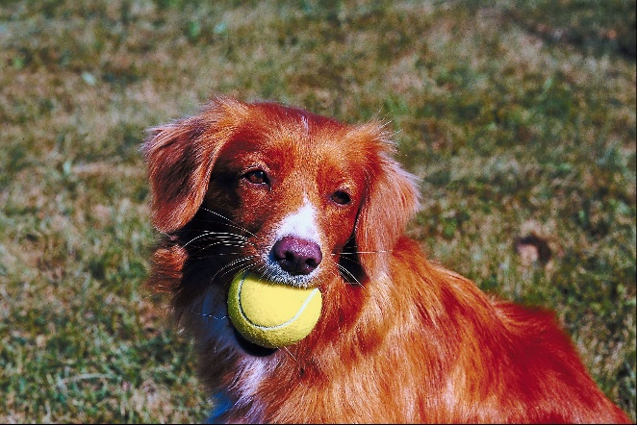
What are modifiers?
Adverbs
An adverb is a word that makes the meaning of a verb, an adjective, or another adverb more specific.
Adverb
Adjective
Beth is an exceptionally fine singer.
Adverb
Adverb
The dog caught the ball quite quickly.

Slide 15
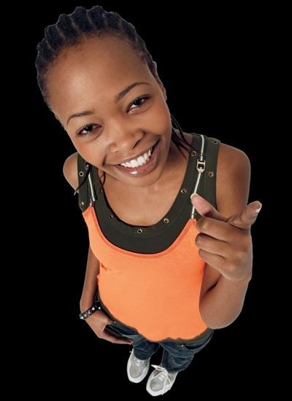
What are modifiers?
Adverbs
Many adverbs end in –ly, but the –ly ending doesn’t always mean that a word is an adverb.
Grammar Gal Says...
Some adjectives end in –ly:
an early class, a lonely person, the daily newspaper
Some adverbs don’t end in –ly.
I’m almost done. He never forgets a name. Call me later.

Slide 16
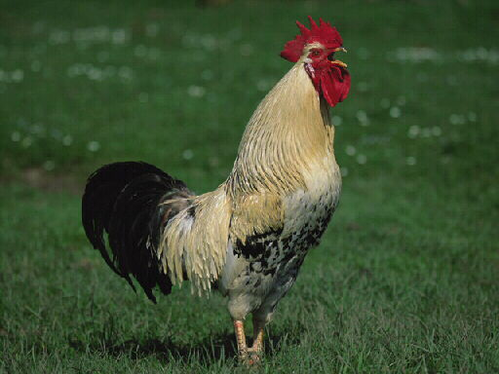
What are modifiers?
Adverbs
An adverb tells where, when, how, or to what extent (how much, how long, or how often).
Verb
The rooster crowed.
Where?
The rooster crowed outside.
When?
The rooster crowed today.
How?
The rooster crowed loudly.
To what extent?
The rooster never crowed.

Slide 17
What are modifiers?
Adverbs
Identify the adverbs in the sentences below.
1. Christina listened closely to the sound.
2. She took a very careful step into the room.
3. Christina’s heart was beating incredibly rapidly, but her thoughts were quite clear.

Slide 18
What are modifiers?
Adverbs
Identify the adverbs in the sentences below.
1. Christina listened closely to the sound.
Closely modifies the verb listened.

Slide 19
What are modifiers?
Adverbs
Identify the adverbs in the sentences below.
2. She took a very careful step into the room.
Very modifies the adjective careful.

Slide 20
What are modifiers?
Adverbs
Identify the adverbs in the sentences below.
3. Christina’s heart was beating incredibly rapidly, but her thoughts were quite clear.
Incredibly modifies the adverb rapidly.
Rapidly modifies the verb was beating.
Quite modifies the adjective clear.

Slide 21
What are modifiers?
Adjectives and adverbs
On Your Own
Decide whether the underlined modifier is an adjective (ADJ) or an adverb (ADV). Be prepared to explain which word the adjective or adverb modifies.
___ 1. Marc drew an almost straight line without using a ruler.
___ 2. The students visited the new school yesterday.
___ 3. The Jacksons’ cat was clinging desperately to a branch of the tree.
___ 4. Didn’t anyone else see that fascinating movie?
[End of Section]

Slide 22
What are modifiers?
Adjectives and adverbs
On Your Own
Decide whether the underlined modifier is an adjective (ADJ) or an adverb (ADV). Be prepared to explain which word the adjective or adverb modifies.
___ 1. Marc drew an almost straight line without using a ruler.
___ 2. The students visited the new school yesterday.
___ 3. The Jacksons’ cat was clinging desperately to a branch of the tree.
___ 4. Didn’t anyone else see that fascinating movie?
ADV
ADJ
ADV
ADJ

Slide 23
What are modifiers?
Phrases
Some modifiers are word groups. Phrases can also be used as adjectives or adverbs.
A prepositional phrase can be used as an adjective or an adverb.
Prepositional phrase
The members of the concert band wear uniforms.
Noun
Prepositional phrase
We will hold auditions in the cafeteria.
Verb

Slide 24
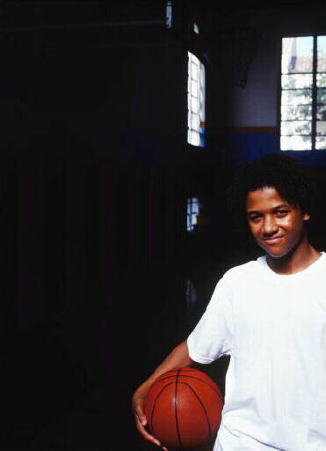
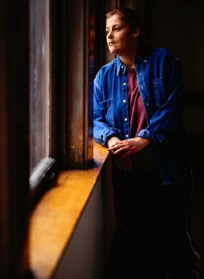


What are modifiers?
Phrases
A phrase is a group of related words that
  is used as a single part of speech
  does not contain both a verb and its subject
in the storage room
to play basketball
looking out the window
will be writing
behind the door
tired of running

Slide 25
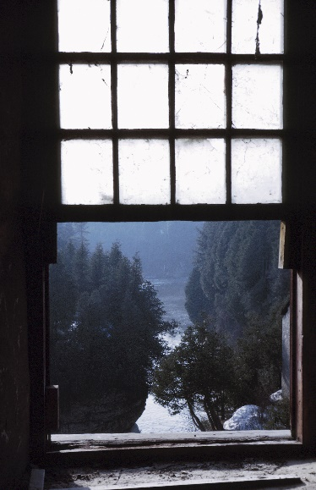
What are modifiers?
Phrases
A prepositional phrase includes a preposition, the object of the preposition, and any modifiers of the object.
Prep.
The window in the storage room was open.
Prepositional phrase
The prepositional phrase in the storage room is an adjective phrase that modifies the noun window.

Slide 26
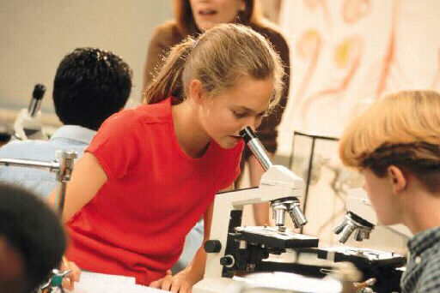
What are modifiers?
Phrases
A participial phrase can be used as an adjective.
Participial phrase
Closing the book, Kim turned off the light.
Noun
Participial phrase
The girl looking in the microscope is my sister.
Noun

Slide 27
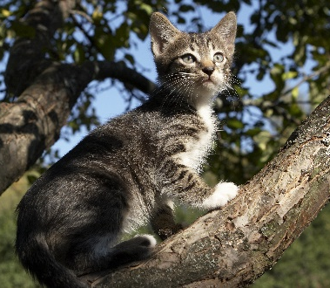
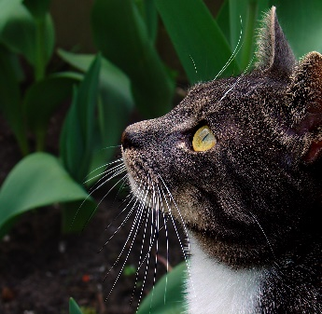
What are modifiers?
Phrases
A participial phrase is used as an adjective and consists of a participle and any complements or modifiers the participle has.
Participial phrase
Terrified by the dog, the cat climbed a tree.
Participial phrase
The cat sitting in the grass heard the dog.
Both participial phrases modify the noun cat.

Slide 28
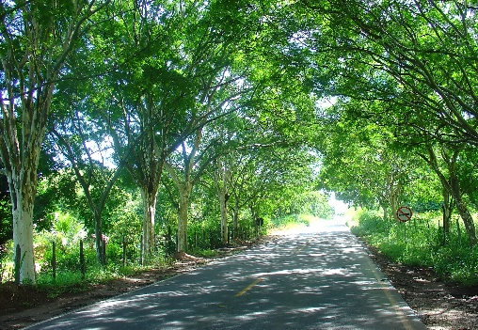
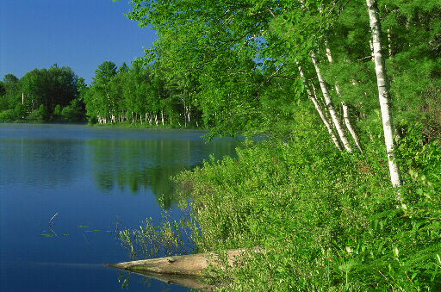
What are modifiers?
Phrases
An infinitive phrase can be used as an adverb or as an adjective.
Infinitive phrase
I am going to the lake to meet my friends.
Verb
Infinitive phrase
This route is the quickest way to get there.
Noun

Slide 29
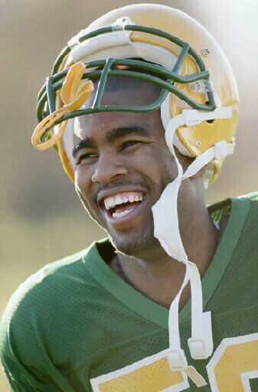
What are modifiers?
Phrases
An infinitive phrase consists of an infinitive* and any complements or modifiers the infinitive has. The entire phrase can be used as a noun, an adjective, or an adverb.
Infinitive phrase
Chris is the player to watch.
The infinitive phrase to watch is used as an adjective to modify the noun player.
*An infinitive is a verb form that uses to and a verb.

Slide 30
What are modifiers?
Phrases
Identify whether each italicized phrase is being used as an adverb or an adjective. Be prepared to explain your answer.
What is the meaning of this word?
We went to his house to hear his new CD.
3. They sailed across the lake.
4. Humming happily, Sabina left the house.

Slide 31
What are modifiers?
Phrases
Identify whether each italicized phrase is being used as an adverb or an adjective. Be prepared to explain your answer.
What is the meaning of this word?
Noun
Prepositional phrase
The prepositional phrase of this word is used as an adjective to modify the noun meaning. The phrase tells which meaning.

Slide 32
What are modifiers?
Phrases
Identify whether each italicized phrase is being used as an adverb or an adjective. Be prepared to explain your answer.
We went to his house to hear his new CD.
Verb
Infinitive phrase
The infinitive phrase to hear his new CD is used as an adverb to modify the verb went. The phrase tells why we went to his house.

Slide 33
What are modifiers?
Phrases
Identify whether each italicized phrase is being used as an adverb or an adjective. Be prepared to explain your answer.
3. They sailed across the lake.
Verb
Prepositional phrase
The prepositional phrase across the lake is used as an adverb to modify the verb sailed. The phrase tells where they sailed.

Slide 34
What are modifiers?
Phrases
Identify whether each italicized phrase is being used as an adverb or an adjective. Be prepared to explain your answer.
4. Humming happily, Sabina left the house.
Participial phrase
Noun
The participial phrase Humming happily is used as an adjective to modify the noun Sabina. The phrase describes Sabina.

Slide 35
What are modifiers?
Phrases
On Your Own
Identify whether the italicized phrase is being used as an adverb (ADV) or as an adjective (ADJ). Also, identify the word or words that are being modified.
_____ 1. Turn in your draft by the end of next week.
_____ 2. School clubs are one place to make friends.
_____ 3. That is the first house built on this street.
_____ 4. With a smile, the teacher returned our tests.
[End of Section]

Slide 36
What are modifiers?
Phrases
Answers
Identify whether the italicized phrase is being used as an adverb (ADV) or as an adjective (ADJ). Also, identify the word or words that are being modified.
_____ 1. Turn in your draft by the end of next week.
_____ 2. School clubs are one place to make friends.
_____ 3. That is the first house built on this street.
_____ 4. With a smile, the teacher returned our tests.
ADV
ADJ
ADJ
ADV

Slide 37
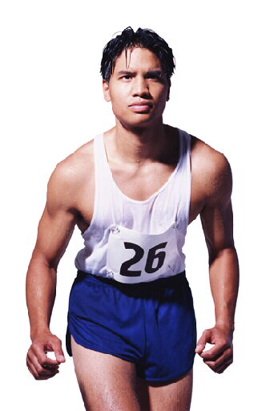
What are modifiers?
Clauses
Like words and phrases, clauses can also be used as adjectives and adverbs.
An adjective clause is a subordinate clause that modifies a noun or pronoun.
Adjective clause
Luis, who is in my class, won the race.
Noun
Adjective clause
This is the new song that I like.
Noun

Slide 38
What are modifiers?
Clauses
A clause is a word group that contains a verb and its subject.
Subject
Verb
Subject
Verb
We watched the game.
after my cousins arrived
Independent clause
Subordinate clause
An independent clause expresses a complete thought and can stand by itself as a complete sentence.
A subordinate clause does not express a complete thought and cannot be a sentence.

Slide 39
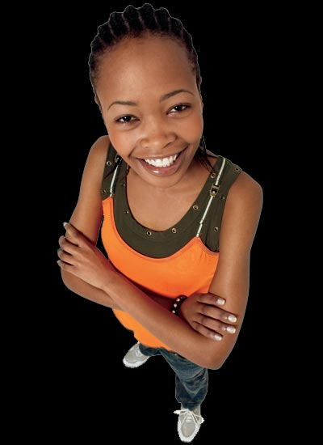
What are modifiers?
Clauses
Adjective clauses are often introduced by a relative pronoun: who, whom, whose, which, or that. Sometimes the relative pronoun is left out.
Grammar Gal Says...
Here is the salad that you ordered.
Here is the salad you ordered.

Slide 40
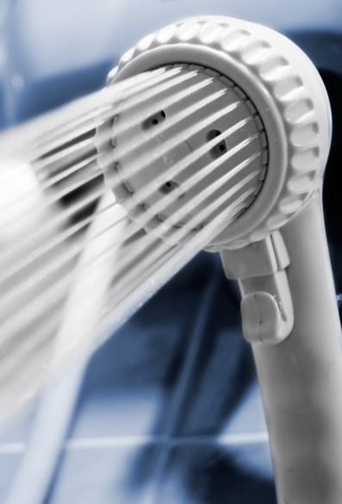
What are modifiers?
Clauses
An adverb clause usually tells something about the action of the verb.
I sing in the shower
whenever I am happy.
because no one can hear me there.
as if I were onstage.
if I’ve had a hard day at school.
Verb
When?
Why?
How?
Under what condition?

Slide 41
What are modifiers?
Clauses
Adverb clauses are introduced by subordinating conjunctions. These words show the relationship between the clause and the word or words it modifies.
Grammar Gal Says...
Common Subordinating Conjunctions
after | because | since | when
although | before | so that | whenever
as | even though | than | where
as if | if | though | wherever
as long as | in order that | unless | whether
as soon as | once | until | while

Slide 42
What are modifiers?
Clauses
Identify whether the italicized clause is being used as an adverb or as an adjective. Be prepared to explain your answer.
I left early because I needed to study.
I gave him a key that would open the front door.
3. That pasture, which is part of the next farm, has a creek on it.
4. When you arrive, call us.

Slide 43
What are modifiers?
Clauses
Identify whether the italicized clause is being used as an adverb or as an adjective. Be prepared to explain your answer.
I left early because I needed to study.
Verb
Adverb clause
The clause because I needed to study is used as an adverb to modify the verb left. The clause tells why the student left early.

Slide 44
What are modifiers?
Clauses
Identify whether the italicized clause is being used as an adverb or as an adjective. Be prepared to explain your answer.
I gave him a key that would open the front door.
Noun
Adjective clause
The clause that would open the front door is used as an adjective to modify the noun key. The clause tells what kind of key was given.

Slide 45
What are modifiers?
Clauses
Identify whether the italicized clause is being used as an adverb or as an adjective. Be prepared to explain your answer.
Noun
Adjective clause
3. That pasture, which is part of the next farm, has a creek on it.
The clause which is part of the next farm is used as an adjective to modify the noun pasture. The phrase tells which pasture.

Slide 46
What are modifiers?
Clauses
Identify whether the italicized clause is being used as an adverb or as an adjective. Be prepared to explain your answer.
4. When you arrive, call us.
Adverb clause
Verb
The clause When you arrive is used as an adverb to modify the verb call. The clause tells when to call us.

Slide 47
What are modifiers?
Clauses
On Your Own
Identify whether the italicized clause is being used as an adverb (ADV) or as an adjective (ADJ). Also, identify the word or words that are being modified.
_____ 1. As long as he starts early, he will arrive on time.
_____ 2. She is the person whom I trust most.
_____ 3. The audience cheered when the music ended.
_____ 4. The family that lives next door is from Japan.
[End of Section]

Slide 48
What are modifiers?
Clauses
On Your Own
Identify whether the italicized clause is being used as an adverb (ADV) or as an adjective (ADJ). Also, identify the word or words that are being modified.
_____ 1. As long as he starts early, he will arrive on time.
_____ 2. She is the person whom I trust most.
_____ 3. The audience cheered when the music ended.
_____ 4. The family that lives next door is from Japan.
ADV
ADJ
ADV
ADJ

Slide 49
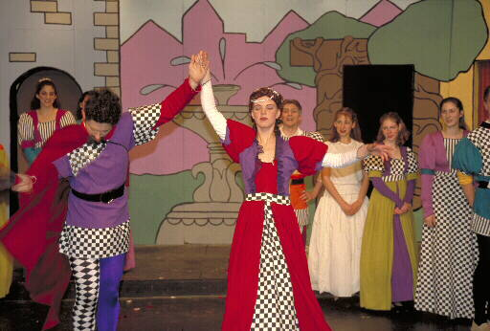
Troublesome modifiers
Bad/badly
Bad is always an adjective.
Tells what kind of play
The play was bad.
Noun
Badly is usually an adverb.
Tells how the play was performed
The play was performed badly.
Verb

Slide 50
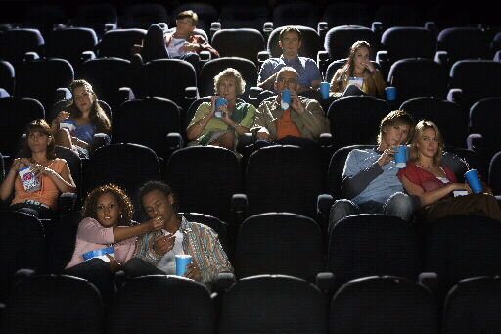
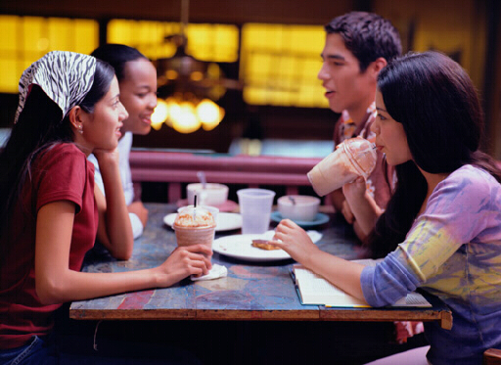
Troublesome modifiers
Good/well
Good is always an adjective.
Max told me about a good movie.
Noun
The food tastes good.
Noun

Slide 51
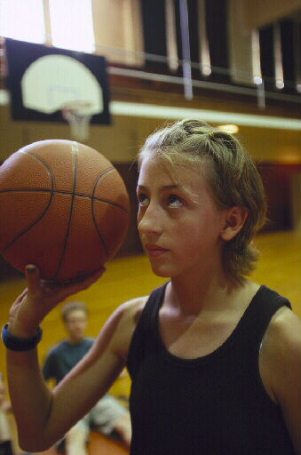
Troublesome modifiers
Good/well
Well has different meanings as an adjective and an adverb.
Gina feels well again.
She played well today.
Noun
Verb
Well is an adjective when it means “in good health” or “satisfactory.”
Well is an adverb when it means “capably.”

Slide 52

Troublesome modifiers
Identify the word that is being modified and choose the correct modifier in parentheses.
1. Our team played really (good, well) at the state championships.
2. This soup tastes terrible! It must be (bad, badly).
3. Have you read any (good, well) books recently?

Slide 53
Troublesome modifiers
Identify the word that is being modified and choose the correct modifier in parentheses.
1. Our team played really (good, well) at the state championships.
The adverb well modifies the verb played. In this sentence, well means “capably” and tells how the team played.

Slide 54
Troublesome modifiers
Identify the word that is being modified and choose the correct modifier in parentheses.
2. This soup tastes terrible! It must be (bad, badly).
The adjective bad modifies It, the pronoun that takes the place of the noun soup.

Slide 55
Troublesome modifiers
Identify the word that is being modified and choose the correct modifier in parentheses.
3. Have you read any (good, well) books recently?
The adjective good modifies the noun books. The adjective good tells what kind of books.

Slide 56
Troublesome modifiers
On Your Own
Most of the following sentences contain an error in modifier usage. If a sentence contains an error, revise it. If the sentence is correct, write Correct.
1. The dish was damaged bad when it fell.
2. I hope your classes are going good.
3. He doesn’t play piano badly, but he can’t sing at all.
[End of Section]

Slide 57
Troublesome modifiers
Answers
Most of the following sentences contain an error in modifier usage. If a sentence contains an error, revise it. If the sentence is correct, write Correct.
1. The dish was damaged badly when it fell.
2. I hope your classes are going well.
3. He doesn’t play piano badly, but he can’t sing at all.
Correct

Slide 58
Review A
Identify whether the italicized modifier is an adjective (ADJ) or an adverb (ADV). Be prepared to explain your answers.
____ 1. Walk with care on icy sidewalks.
____ 2. When we reached the park, the rain began.
____ 3. The coach doesn’t tolerate silly behavior.
____ 4. Is this the salad that I ordered?
____ 5. Running as fast as he could, Ben reached the bus just in time.
____ 6. A tree behind the house lost a branch.
____ 7. Your dog is very hungry!

Slide 59
Review A
Identify whether the italicized modifier is an adjective (ADJ) or an adverb (ADV). Be prepared to explain your answers.
____ 1. Walk with care on icy sidewalks.
____ 2. When we reached the park, the rain began.
____ 3. The coach doesn’t tolerate silly behavior.
____ 4. Is this the salad that I ordered?
____ 5. Running as fast as he could, Ben reached the bus just in time.
____ 6. A tree behind the house lost a branch.
____ 7. Your dog is very hungry!
Adv
Adv
Adj
Adj
Adj
Adj
Adv

Slide 60
Review B
Complete each sentence by choosing the appropriate modifier: good, well, bad, or badly. Be prepared to explain your answers.
1. I didn’t go to the game because I wasn’t feeling _______ yesterday.
2. Carl is studying tonight because he did so _______ on the last quiz.
3. The drums sound _______, but the woodwinds still need some practice.
4. Ruff is not very well trained, but he’s not a _______ dog.

Slide 61
Review B
Complete each sentence by choosing the appropriate modifier: good, well, bad, or badly. Be prepared to explain your answers.
1. I didn’t go to the game because I wasn’t feeling _______ yesterday.
2. Carl is studying tonight because he did so _______ on the last quiz.
3. The drums sound _______, but the woodwinds still need some practice.
4. Ruff is not very well trained, but he’s not a _______ dog.
well
badly
good
bad

Slide 62
The End

