Slide 1
Using Colons
Why are colons important?
Colons to mean “note what follows”
Colons in conventional situations
Review A
Review B

Slide 2

Why are colons important?
:
The colon is a special punctuation mark that can serve several different purposes.
A colon can signal the reader to “get ready” for what’s next in the sentence.
Our family has lived in many states:
California, Arizona, Maine, and Texas.
The colon says, “Now get ready to hear what those states are.”

Slide 3
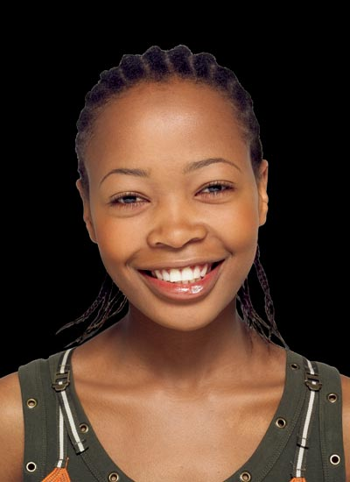

Why are colons important?
Often there is a number in the clause preceding the semicolon.
Grammar Gal Says...
I have three favorite ice creams: chocolate, strawberry, and vanilla.

Slide 4
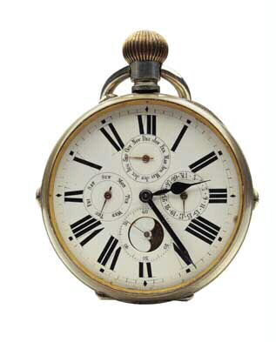

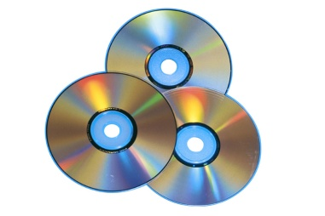
Why are colons important?
Colons are also used to separate elements in certain conventional situations.
2:20 P.M.
Isaiah 21:6
Whales: Giants of the Sea
All of these would be difficult to read without the colon to mark the separate parts.
[End of Section]

Slide 5
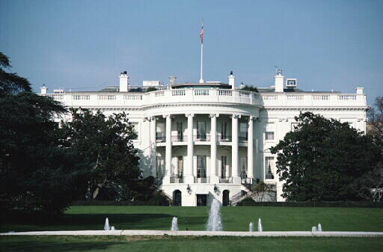
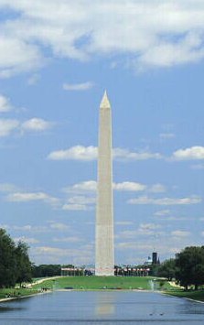
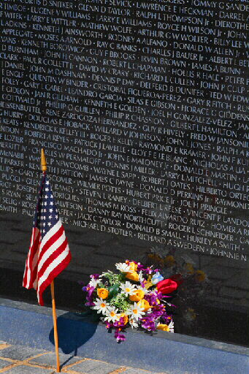

Colons to mean “note what follows”
Use a colon before a list of items, especially after expressions such as the following and as follows.
In Washington, D.C., we visited three important sites: the White House, the Washington Monument, and the Vietnam Veterans Memorial.
Please bring the following supplies: pencils, paper, compasses, rulers, scissors, tape, and protractors.

Slide 6
Colons to mean “note what follows”
Do not place a colon right after a verb.
Verb
Additional supplies are: a toothbrush and toothpaste, a towel, and a pillow.
Incorrect
Correct
Additional supplies are a toothbrush and toothpaste, a towel, and a pillow.
Correct
Additional supplies are as follows: a toothbrush and toothpaste, a towel, and
a pillow.

Slide 7
Colons to mean “note what follows”
Do not place a colon right after a preposition.
Preposition
You need to shop for: brown shoelaces, a quart of milk, and five or six carrots.
Incorrect
Correct
You need to shop for brown shoelaces, a quart of milk, and five or six carrots.
Correct
You need to shop for the following items: brown shoelaces, a quart of milk, and five or six carrots.

Slide 8
Colons to mean “note what follows”
Prepositions
Common Prepositions
about | at | in | to
above | except | like | upon
as | for | on | with
Preposition
Preposition
above the sofa
except Lyn, Angie, and me

Slide 9
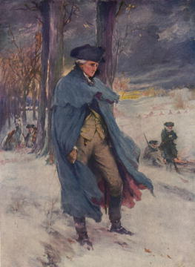
Colons to mean “note what follows”
Use a colon before a long, formal statement or quotation.
Thomas Paine’s first pamphlet in the series The American Crisis starts with these famous words:
“These are the times that try men’s souls. The summer soldier and the sunshine patriot will, in this crisis, shrink from the service of their country; but he that stands it now deserves the love and thanks of man and woman.”

Slide 10

Colons to mean “note what follows”
Unlike a semicolon, a colon does NOT require an independent clause after it. You can have a single word, phrase or clause after a colon. If the clause is very long, you can capitalize the first word.
Grammar Gal Says...
There is one time of day when I don’t like to talk: when I wake up.
There is one time of day when I don’t like to talk: when I wake up.
Clause

Slide 11
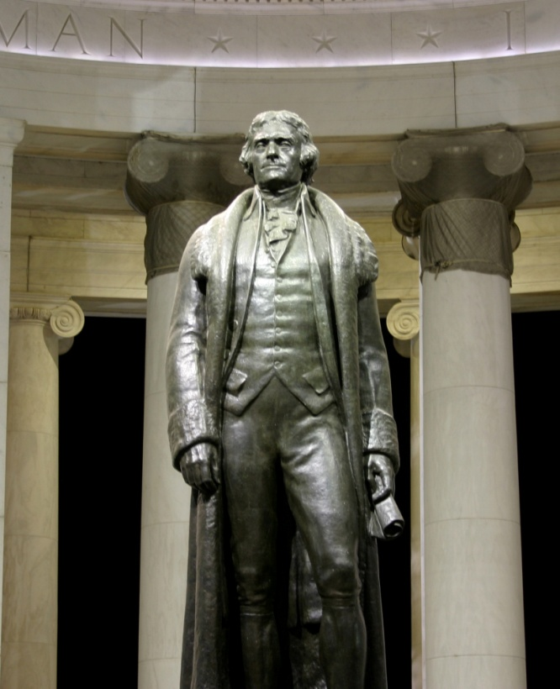

Colons to mean “note what follows”
Use a colon between independent clauses when the second clause explains or restates the first. You can think of a colon as saying “in other words. . .”
Thomas Jefferson had many talents: He was a writer, a politician, an architect, and an inventor.

Slide 12

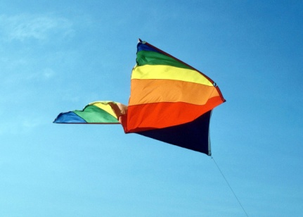
Colons to mean “note what follows”
Independent clause
An independent clause (or main clause) has a subject and a verb and expresses a complete thought. An independent clause can stand by itself as a sentence.
Subject
Verb
Grandfather helps with the kite.
Grandfather helps with the kite.
Grandfather helps with the kite.
Subject
Verb
Most kites are very colorful.
Most kites are very colorful.
Most kites are very colorful.

Slide 13
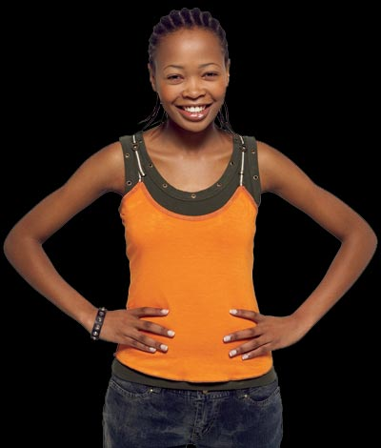
Colons to mean “note what follows”
When an independent clause follows a colon, the first word of the clause is capitalized.
Grammar Gal Says...
Lois felt that she had done something worthwhile: She had finished her first volunteer project.

Slide 14

Colons to mean “note what follows”
Add colons where they are needed in the following sentences. If a sentence is already correct, label it C.
1. I deserve a good grade I did well on the test and also completed my lab successfully.
2. The qualities I like in a person are as follows reliability, loyalty, and willingness to work.
3. At the festival we ate tacos, refried beans, and tortilla chips.

Slide 15
Colons to mean “note what follows”
Add colons where they are needed in the following sentences. If a sentence is already correct, label it C.
:
1. I deserve a good grade I did well on the test and also completed my lab successfully.

Slide 16
Colons to mean “note what follows”
Add colons where they are needed in the following sentences. If a sentence is already correct, label it C.
:
2. The qualities I like in a person are as follows reliability, loyalty, and willingness to work.

Slide 17
Colons to mean “note what follows”
Add colons where they are needed in the following sentences. If a sentence is already correct, label it C.
3. At the festival we ate tacos, refried beans, and tortilla chips.
C

Slide 18
Colons to mean “note what follows”
On Your Own
Add colons where they are needed in the following sentences.
  Sara arrived at the meeting early Mr. Bryant had asked her to set up the tables and chairs.
  Jeremy had this Mark Twain quotation taped to his folder “Man is the only animal that blushes. Or needs to.”
  My niece has several items with that logo a poster, a notebook, and a clock.
[End of Section]

Slide 19
Colons to mean “note what follows”
Answers
Add colons where they are needed in the following sentences.
  Sara arrived at the meeting early Mr. Bryant had asked her to set up the tables and chairs.
  Jeremy had this Mark Twain quotation taped to his folder “Man is the only animal that blushes. Or needs to.”
  My niece has several items with that logo a poster, a notebook, and a clock.
:
:
:

Slide 20
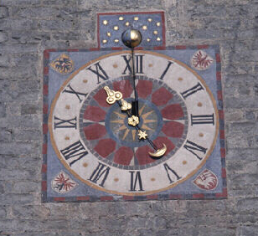

Colons in conventional situations
Use a colon in certain conventional situations:
Between the hour and the minute in times
11:25 tomorrow morning
Between chapter and verse in Biblical references
Proverbs 3:3

Slide 21
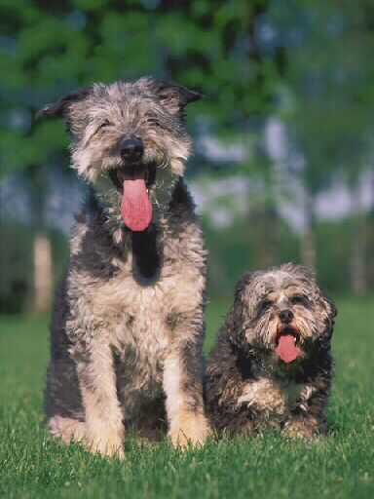

Colons in conventional situations
Use a colon in certain conventional situations:
Between a title and a subtitle
Mutts: America’s Dogs
After the salutation of a business letter
Dear Ms. Weinberg:

Slide 22
Colons in conventional situations
Add colons where they are needed in the following sentences.
1. I think the story of Moses and Pharaoh’s daughter is told in Exodus 2 5–10.
2. Usually the mail arrives at about 2 00.
3. Her favorite book is The Great Kapok Tree A Tale of the Amazon Rain Forest.
4. The letter began, “Dear Sir I have enclosed my entry form and fee.”

Slide 23
Colons in conventional situations
Add colons where they are needed in the following sentences.
1. I think the story of Moses and Pharaoh’s daughter is told in Exodus 2 5–10.
:

Slide 24
Colons in conventional situations
Add colons where they are needed in the following sentences.
:
2. Usually the mail arrives at about 2 00.

Slide 25
Colons in conventional situations
Add colons where they are needed in the following sentences.
:
3. Her favorite book is The Great Kapok Tree A Tale
of the Amazon Rain Forest.

Slide 26
Colons in conventional situations
Add colons where they are needed in the following sentences.
:
4. The letter began, “Dear Sir I have enclosed my entry form and fee.”

Slide 27
Colons in conventional situations
On Your Own
Add colons where they are needed in the following sentences.
1. Heather’s essay is titled “Mary Had a Little Lamb The Social Benefits of Pet Ownership.”
2. An enduring statement of loyalty can be found in
Ruth 1 16.
3. Randy woke up at 7 15 and left for swim practice at
8 00.
4. I began the letter by writing, “Dear Mr. Edmonds Please consider me for admission to your program.”
[End of Section]

Slide 28
Colons in conventional situations
Answers
Add colons where they are needed in the following sentences.
1. Heather’s essay is titled “Mary Had a Little Lamb The Social Benefits of Pet Ownership.”
2. An enduring statement of loyalty can be found in
Ruth 1 16.
3. Randy woke up at 7 15 and left for swim practice at
8 00.
4. I began the letter by writing, “Dear Mr. Edmonds Please consider me for admission to your program.”
:
:
:
:
:

Slide 29
Review A
Add colons where they are needed in the following sentences.
1. The directions were as follows Cover with plastic, place in microwave oven, and cook for ten minutes.
2. The bus will be leaving at 3 45 this afternoon.
3. Have you read African Laughter Four Visits to Zimbabwe?
4. I made a list of things to get at the store toothpaste, milk, wax paper, and cat food.
5. At his retirement dinner, Mr. Gonzalo had this to say “It was a long and rewarding career, but I’m glad it’s over.”
[End of Section]

Slide 30
Review A
Add colons where they are needed in the following sentences.
1. The directions were as follows Cover with plastic, place in microwave oven, and cook for ten minutes.
2. The bus will be leaving at 3 45 this afternoon.
3. Have you read African Laughter Four Visits to Zimbabwe?
4. I made a list of things to get at the store toothpaste, milk, wax paper, and cat food.
5. At his retirement dinner, Mr. Gonzalo had this to say “It was a long and rewarding career, but I’m glad it’s over.”
:
:
:
:
:

Slide 31
Review B
Add colons where they are needed in the following sentences. If a sentence is already correct, label it C.
1. “In Shakespeare’s Hamlet, Polonius offers the following advice to his son ‘Neither a borrower nor a lender be.’”
2. There are three countries I’d like to visit above all France, Japan, and Greece.
3. Sherry’s favorite artists are Jacob Lawrence, Romare Bearden, and Margaret Burroughs.
4. You should start saving your money Open a savings account or invest in stocks and bonds.
[End of Section]

Slide 32
Review B
Add colons where they are needed in the following sentences. If a sentence is already correct, label it C.
1. “In Shakespeare’s Hamlet, Polonius offers the following advice to his son ‘Neither a borrower nor a lender be.’”
2. There are three countries I’d like to visit above all France, Japan, and Greece.
3. Sherry’s favorite artists are Jacob Lawrence, Romare Bearden, and Margaret Burroughs.
4. You should start saving your money Open a savings account or invest in stocks and bonds.
:
:
C
:

Slide 33
The End

