Slide 1
Writing with Special Focus:
Postponing Adjectives
Postponing adjectives
Review A
Review B

Slide 2
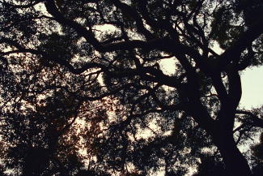
Postponing adjectives
Adjectives often come before the noun they modify.
Adjectives
Noun
The
black and ominous
trees seemed to lean towards each other.
trees seemed to lean towards each other.
Look what happens when author Jack London places the adjectives later in the sentence.
They seemed to lean towards each other,
black and ominous.

Slide 3
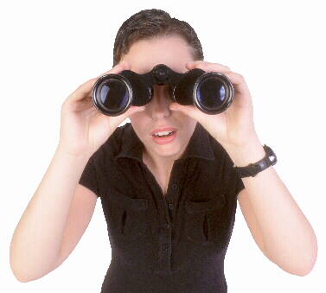
Postponing adjectives
Placing adjectives later in the sentence, after the noun they modify, is called postponing the adjectives.
Because the words in the sentence aren’t in the normal order, the reader is forced to slow down and focus on the description.

Slide 4
Postponing adjectives
In “The Legend of Sleepy Hollow,” Washington Irving could have described Ichabod Crane this way:
Heavy-hearted and crest-fallen Ichabod
pursued his travels homeward.
Instead, Irving wrote the sentence this way.
It was the very witching time of night that Ichabod, heavy-hearted and crestfallen, pursued his travels homeward.
Adjectives after the noun

Slide 5
Postponing Adjectives
Sometimes a group of words separates adjectives from the noun they modify.
In this example, Willa Cather uses two sets of adjectives and includes a group of words between the noun and the adjectives.
I was content to let her watch the sea—the sea that seemed now to have come into me, warm and soft, still and strong.
Noun
Pair 1
Pair 2

Slide 6

Postponing adjectives
Nouns can also be followed by a series of modifiers, as in this beautiful sentence written by Jack London.
Adverbial Clause
Adjective
The land itself was a desolation, lifeless, without movement, so lone and cold that the spirit of it was not even that of sadness.
The land itself was a desolation, lifeless, without movement, so lone and cold that the spirit of it was not even that of sadness.
The land itself was a desolation, lifeless, without movement, so lone and cold that the spirit of it was not even that of sadness.
The land itself was a desolation, lifeless, without movement, so lone and cold that the spirit of it was not even that of sadness.
The land itself was a desolation, lifeless, without movement, so lone and cold that the spirit of it was not even that of sadness.
The land itself was a desolation, lifeless, without movement, so lone and cold that the spirit of it was not even that of sadness.
Prepositional
Phrase
Adjective Pair
All of these modifiers function as adjectives.

Slide 7

Postponing adjectives
Revise each of the following sentences by placing the boldface adjectives directly after the noun they modify. Delete words as necessary.
1. A swift and graceful hawk soared along the mountain ridge.
2. The bus was new and sparkling. It pulled up to the stop.
3. Someone had scrawled a word in the margin. The word was faint and barely legible.

Slide 8
Postponing adjectives
Revise each of the following sentences by placing the boldface adjectives directly after the noun they modify. Delete words as necessary.
1. A hawk, swift and graceful, soared along the mountain ridge.

Slide 9
Postponing adjectives
Revise each of the following sentences by placing the boldface adjectives directly after the noun they modify. Delete words as necessary.
2. The bus, new and sparkling, pulled up to the stop.

Slide 10
Postponing adjectives
Revise each of the following sentences by placing the boldface adjectives directly after the noun they modify. Delete words as necessary.
3. Someone had scrawled a word, faint and barely legible, in the margin.

Slide 11
Postponing adjectives
On Your Own
Revise each of the following sentences by placing the boldfaced adjectives directly after the noun they modify. Delete any words as necessary.
1. We heard the wolf’s sad but frightening howl.
2. That shrill and repetitive song annoys Angie.
The swimmer startled a school of fish. They were fast and shimmering.
4. A rocket lit the clouds. It was roaring and smoking.
5. The letter was old and much-read. It lay at the bottom of the drawer.
[End of Section]

Slide 12
Postponing adjectives
Answers
Revise each of the following sentences by placing the boldfaced adjectives directly after the noun they modify. Delete any words as necessary.
1. We heard the wolf’s howl, sad but frightening.
2. That song, shrill and repetitive, annoys Angie.
3. The swimmer startled a school of fish, fast and shimmering.
4. A rocket, roaring and smoking, lit the clouds.
5. The letter, old and much-read, lay at the bottom of the drawer.

Slide 13
Review A
The following sentences are from works of literature. For each sentence, identify the noun that the underlined adjectives modify and bring into focus.
1. She was dressed in rich materials—satins, and lace, and silks—all of white. (Great Expectations,Charles Dickens)
2. Once upon a midnight dreary, while I pondered, weak and weary (“The Raven,” Edgar Allan Poe)
3. As I was going down to dinner that evening, I was stopped by Lars Ebbling, freshly brushed and scented, wearing a white uniform, and polished and glistening as one of his own engines. (“On the Gull’s Road,” Willa Cather)

Slide 14
Review A
The following sentences are from works of literature. For each sentence, identify the noun that the underlined adjectives modify and bring into focus.
1. She was dressed in rich materials—satins, and lace, and silks—all of white. (Great Expectations,Charles Dickens)
2. Once upon a midnight dreary, while I pondered, weak and weary (“The Raven,” Edgar Allan Poe)
3. As I was going down to dinner that evening, I was stopped by Lars Ebbling, freshly brushed and scented, wearing a white uniform, and polished and glistening as one of his own engines. (“On the Gull’s Road,” Willa Cather)

Slide 15
Review B
Revise the second sentence in each item and add it to the first as a pair of postponed adjectives.
1. Snowflakes fell. They were tiny and delicate.
2. The ice sculpture shone. It was delicate and glistening.
3. Antoine begins his speech. He is suddenly brave and ready to face the audience.
4. This new treatment strikes a major blow against cancer. The treatment is stronger and less harmful to the patient.
5. As the rumor spread, new details were added. The details grew more scandalous and outlandish with each telling.

Slide 16
Review B
Revise the second sentence in each item and add it to the first as a pair of postponed adjectives.
[possible answers]
1. Snowflakes fell, tiny and delicate.
2. The ice sculpture shone, delicate and glistening.
3. Antoine begins his speech, suddenly brave and ready to face the audience.
4. This new treatment, stronger and less harmful to the patient, strikes a major blow against cancer.
5. As the rumor spread, new details were added, more scandalous and outlandish with each telling.

Slide 17
The End

