Slide 1

Correcting Run-On Sentences
What is a run-on sentence?
How to fix a run-on sentence
  Separate sentences
  Compound sentences
Review A
Review B

Slide 2

What is a run-on sentence?
Jesse just got back his essay and is reading his teacher’s comments.
Content?
“Great!”
Organization?
“Clear.”
Areas for improvement?
“Work on eliminating run-on sentences.”
What should Jesse do to revise his paper? Where should he start?

Slide 3
What is a run-on sentence?
A run-on sentence is two or more complete sentences run together as one.
Run-on sentences can be confusing because they do not show where one idea ends and another one begins.
EXAMPLES
Reading is important textbooks help students learn.
Schools today usually have books for every student, most schools also have televisions and computers.

Slide 4

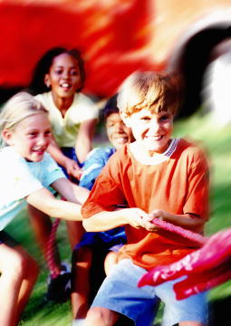
What is a run-on sentence?
A complete sentence is a group of words that contains a subject and a verb and expresses a complete thought.
Subject
Verb
The weather was beautiful.
The weather was beautiful.
The weather was beautiful.
Subject
Verb
The children played in the yard.
The children played in the yard.
The children played in the yard.

Slide 5
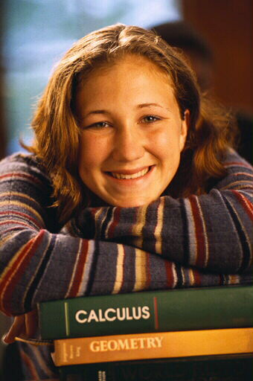



What is a run-on sentence?
Where are the complete sentences in the examples below?
Reading is important textbooks help students learn.
Schools today usually have books for every student, most schools also have televisions and computers.

Slide 6


What is a run-on sentence?
To figure out where one sentence ends and another begins, look for changes in the topic or idea.
Grammar Guy Says...
Schools today usually have books for every student, most schools also have televisions and computers.
Schools today usually have books for every student, most schools also have televisions and computers.
The first sentence is about books in schools.
The second sentence is about televisions and computers in schools.

Slide 7
What is a run-on sentence?
Reading is important textbooks help students learn.
This run-on sentence is an example of a fused sentence. There is no punctuation between the two sentences.
Sentence 1
Sentence 2

Slide 8

What is a run-on sentence?
Schools today usually have books for every student, most schools also have televisions and computers.
This run-on sentence is an example of a comma splice. There is only a comma between the two sentences.
,
Sentence 1
Sentence 2

Slide 9

What is a run-on sentence?
Identify the complete sentences in the run-ons below.
1. Hollywood is famous many films are made in Hollywood.
2. Movies entertain millions of people every day the cinema is popular all over the world.
3. The director makes many decisions, the producers take care of the business end of moviemaking.

Slide 10
What is a run-on sentence?
Identify the complete sentences in the run-ons below.
1. Hollywood is famous many films are made in Hollywood.
Hollywood is famous.
Many films are made in Hollywood.

Slide 11
What is a run-on sentence?
Identify the complete sentences in the run-ons below.
2. Movies entertain millions of people every day the cinema is popular all over the world.
Movies entertain millions of people every day.
The cinema is popular all over the world.

Slide 12
What is a run-on sentence?
Identify the complete sentences in the run-ons below.
3. The director makes many decisions, the producers take care of the business end of moviemaking.
The director makes many decisions.
The producers take care of the business end of moviemaking.

Slide 13
What is a run-on sentence?
On Your Own
Identify the following items as correct sentences (C) or run-ons (R). Be prepared to explain your answers.
___ 1. Movie theaters opened in the early 1900s. They played short films.
___ 2. Many films take years to make they require the skills of hundreds of workers.
___ 3. Thomas Edison worked with George Eastman, another inventor, to make roll film Eastman is now remembered for his contributions to filmmaking.
[End of Section]

Slide 14
What is a run-on sentence?
Answers
Identify the following items as correct sentences (C) or run-ons (R). Be prepared to explain your answers.
___ 1. Movie theaters opened in the early 1900s. They played short films.
___ 2. Many films take years to make they require the skills of hundreds of workers.
___ 3. Thomas Edison worked with George Eastman, another inventor, to make roll film Eastman is now remembered for his contributions to filmmaking.
C
R
R

Slide 15
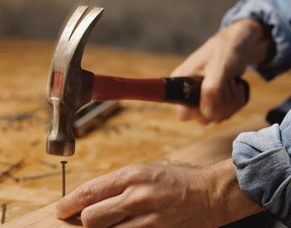
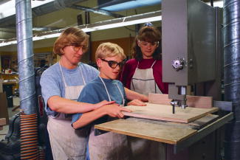
How to fix a run-on sentence
To fix a run-on sentence, you need to do one of two things:
Cut it apart.
OR
Join it properly.

Slide 16
How to fix a run-on sentence
How you revise a run-on sentence depends upon the relationship you want to show between the ideas.
IF
THEN
Ideas are NOT closely related
Make two
sentences
Ideas ARE closely related
Make a compound sentence
AND
Ideas ARE equally important

Slide 17
How to fix a run-on sentence
Separate sentences
Strategy 1: Make Two Sentences
Break a run-on into two separate sentences when
  the ideas are not closely related or
  at least one sentence is long or complex or
  separate sentences flow better in the paragraph in which they appear
During the Civil War, female nurses were very brave. For instance, they risked their lives carrying supplies to military hospitals.
During the Civil War, female nurses were very brave for instance they risked their lives carrying supplies to military hospitals.

Slide 18
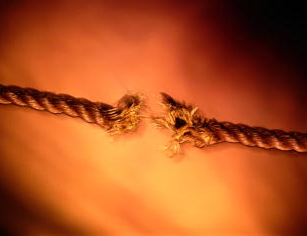
How to fix a run-on sentence
Separate sentences
Strategy 1: Make Two Sentences
To make two separate sentences,
  put an end mark after the first complete sentence
  then, capitalize the first word of the next complete sentence.
Today, schools usually have books for every student. Most schools also have televisions and computers.
Today, schools have books for every student most schools also have televisions and computers.

Slide 19
How to fix a run-on sentence
Separate sentences
Revise the following run-on sentences by making two separate sentences.
My grandmother was an artist I have many of her paintings.
Sally is captain of the soccer team she helped organize the tournament.
3. We went to see the school play Clark was playing one of the main characters.

Slide 20
How to fix a run-on sentence
Separate sentences
Revise the following run-on sentences by making two separate sentences.
My grandmother was an artist I have many of her paintings.
My grandmother was an artist. I have many of her paintings.

Slide 21
How to fix a run-on sentence
Separate sentences
Revise the following run-on sentences by making two separate sentences.
Sally is captain of the soccer team she helped organize the tournament.
Sally is captain of the soccer team. She helped organize the tournament.

Slide 22
How to fix a run-on sentence
Separate sentences
Revise the following run-on sentences by making two separate sentences.
3. We went to see the school play Clark was playing one of the main characters.
We went to see the school play. Clark was playing one of the main characters.

Slide 23
How to fix a run-on sentence
Separate sentences
On Your Own
Revise the following sentences by making two separate sentences. Be prepared to explain your answers.
1. My car’s tire was flat this morning the tire had a nail in it.
2. In July there will be free concerts at the park I plan to go to every show.
3. Like many college students, my brother lives on campus, he walks to all his classes and spends a lot of time at the student center.
[End of Section]

Slide 24
How to fix a run-on sentence
Separate sentences
Answers
My car’s tire was flat this morning. The tire had a nail in it.
In July there will be free concerts at the park. I plan to go to every show.
Like many college students, my brother lives on campus. He walks to all his classes and spends a lot of time at the student center.

Slide 25
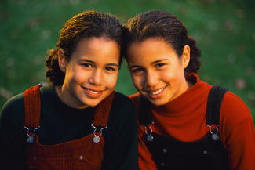
How to fix a run-on sentence
Compound sentences
Strategy 2: Make a Compound Sentence
When the complete thoughts in a run-on sentence are closely related and of equal importance, you may want to make a compound sentence.
There are three common ways to make a compound sentence.

Slide 26
How to fix a run-on sentence
Compound sentences
A compound sentence contains two or more independent clauses and no subordinate clauses.
independent clause
After our long morning hike, we were hungry,
independent clause
so we stopped for lunch.

Slide 27
How to fix a run-on sentence
Compound sentences
An independent clause (or main clause) expresses a complete thought and can stand by itself as a sentence.
An independent clause has a subject and a verb and expresses a complete thought.
Subject
Verb
After our long morning hike, we were hungry,
After our long morning hike, we were hungry,
After our long morning hike, we were hungry,
Subject
Verb
so we stopped for lunch.
so we stopped for lunch.
so we stopped for lunch.

Slide 28
How to fix a run-on sentence
Compound sentences
A subordinate clause (or dependent clause) does not express a complete thought and cannot stand by itself as a sentence.
A subordinate clause has a subject and a verb but does not express a complete thought.
Subject
Verb
After we unpacked the food
After we unpacked the food
After we unpacked the food
Subject
Verb
While we ate lunch
While we ate lunch
While we ate lunch

Slide 29

How to fix a run-on sentence
Compound sentences
The ideas in a compound sentence must be BOTH closely related AND of equal importance.
If the ideas in a run-on sentence don’t meet both of these conditions, you need to find another way to revise the run-on sentence.
Grammar Guy Says...

Slide 30

How to fix a run-on sentence
Compound sentences
Run-on
Grammar Guy Says...
The park is a mile from our house, the ride was easy and pleasant.
These two ideas are not closely related. Two separate sentences would work well in this case.
Revised
The park is a mile from our house. The ride was easy and pleasant.

Slide 31

How to fix a run-on sentence
Compound sentences
Strategy 2: Make a Compound Sentence
You can make a compound sentence by using a comma and a coordinating conjunction.
Canada has ten provinces, and each has its own government.
Canada has ten provinces each has its own government.

Slide 32
How to fix a run-on sentence
Compound sentences
Coordinating Conjunctions
and | but | or | nor
for | yet | so
A coordinating conjunction joins words or groups of words that are used in the same way.

Slide 33
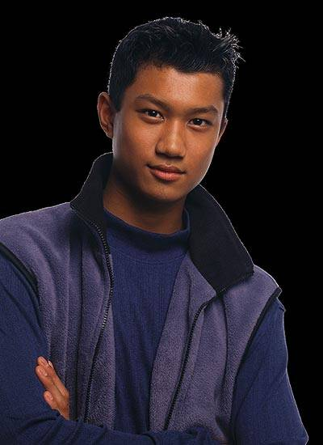
How to fix a run-on sentence
Compound sentences
Use the memory device FANBOYS to help you remember the coordinating conjunctions.
Grammar Guy Says...
For
And
Nor
But
Or
Yet
So

Slide 34
How to fix a run-on sentence
Compound sentences
Strategy 2: Make a Compound Sentence
You can make a compound sentence by using a semicolon.
Canada has ten provinces each has its own government.
Canada has ten provinces; each has its own government.

Slide 35
How to fix a run-on sentence
Compound sentences
Strategy 2: Make a Compound Sentence
You can make a compound sentence by using a semicolon and a conjunctive adverb followed by a comma.
Canada has ten provinces each has its own government.
Canada has ten provinces; also, each has its own government.

Slide 36
How to fix a run-on sentence
Compound sentences
Common Conjunctive Adverbs
also | incidentally | next
anyway | indeed | nonetheless
besides | instead | otherwise
consequently | likewise | still
finally | meanwhile | then
furthermore | moreover | therefore
however | nevertheless | thus
Conjunctive adverbs express specific relationships between ideas. Be sure to choose the conjunctive adverb that most clearly expresses what you want to say.

Slide 37
How to fix a run-on sentence
Compound sentences
Revise the following run-on sentences by making each one a compound sentence.
1. We put the picnic basket on the table we walked over to the playground.
2. The girls climbed on the playscape I sat under a tree and read.
3. When we returned to the table, we heard squealing and chattering, a family of squirrels had started lunch without us.

Slide 38
How to fix a run-on sentence
Compound sentences
Revise the following run-on sentences by making each one a compound sentence.
1. We put the picnic basket on the table we walked over to the playground.
We put the picnic basket on the table, and we walked over to the playground.

Slide 39
How to fix a run-on sentence
Compound sentences
Revise the following run-on sentences by making each one a compound sentence.
2. The girls climbed on the playscape I sat under a tree and read.
The girls climbed on the playscape; meanwhile, I sat under a tree and read.

Slide 40
How to fix a run-on sentence
Compound sentences
Revise the following run-on sentences by making each one a compound sentence.
3. When we returned to the table, we heard squealing and chattering, a family of squirrels had started lunch without us.
When we returned to the table, we heard squealing and chattering; a family of squirrels had started lunch without us.

Slide 41
How to fix a run-on sentence
Compound sentences
On Your Own
Revise the following run-on sentences by making each one a compound sentence. Be prepared to explain your answers.
1. The math class is difficult I have to study every night.
2. We thanked the volunteers for cleaning the park the mayor sent all of them a handwritten thank-you note.
3. My metal patio chairs were too hot to touch, we spread a blanket out on the grass and had a picnic in the backyard.
[End of Section]

Slide 42
How to fix a run-on sentence
Compound sentences
Possible Answers
1. The math class is difficult, so I have to study every night.
2. We thanked the volunteers for cleaning the park, and the mayor sent all of them a handwritten thank-you note.
3. My metal patio chairs were too hot to touch; therefore, we spread a blanket out on the grass and had a picnic in the backyard.

Slide 43
Review A
Identify the following items as correct sentences (C) or run-ons (R). Be prepared to explain your answers.
___ 1. Where were you born I was born in Nashville, Tennessee.
___ 2. Last summer he took swimming lessons, now he feels much more confident in the water.
___ 3. At the art museum, we saw many beautiful paintings, I enjoyed the sculpture galleries more.
___ 4. Anita learned to knit from her grandmother. Her grandmother knows how to crochet, too.
___ 5. No one likes to make mistakes we can all learn from our mistakes.
[End of Section]

Slide 44
Review A
Identify the following items as correct sentences (C) or run-ons (R). Be prepared to explain your answers.
___ 1. Where were you born I was born in Nashville, Tennessee.
___ 2. Last summer he took swimming lessons, now he feels much more confident in the water.
___ 3. At the art museum, we saw many beautiful paintings, I enjoyed the sculpture galleries more.
___ 4. Anita learned to knit from her grandmother. Her grandmother knows how to crochet, too.
___ 5. No one likes to make mistakes we can all learn from our mistakes.
R
R
R
C
R

Slide 45
Review B
Revise each run-on sentence by making two separate sentences or a compound sentence. Be prepared to explain your answers.
1. On Sunday mornings, my family always makes a big breakfast, everyone likes omelets.
2. Making an omelet is not very difficult you must have all the ingredients ready and take your time.
3. I like chopped tomatoes, onions, and green peppers in my omelets, my sister likes to add mushrooms, too.
4. Sometimes I grate a little cheddar cheese for the top of the omelet you don’t have to use cheese if you don’t like it.
[End of Section]

Slide 46
Review B
Possible Answers
Revise each run-on sentence by making two separate sentences or a compound sentence. Be prepared to explain your answers.
1. On Sunday mornings, my family always makes a big breakfast, everyone likes omelets.
2. Making an omelet is not very difficult you must have all the ingredients ready and take your time.
3. I like chopped tomatoes, onions, and green peppers in my omelets, my sister likes to add mushrooms, too.
4. Sometimes I grate a little cheddar cheese for the top of the omelet you don’t have to use cheese if you don’t like it.
1. On Sunday mornings, my family always makes a big breakfast. Everyone likes omelets.
2. Making an omelet is not very difficult, but you must have all the ingredients ready and take your time.
3. I like chopped tomatoes, onions, and green peppers in my omelets, and my sister likes to add mushrooms, too.
4. Sometimes I grate a little cheddar cheese for the top of the omelet; however, you don’t have to use cheese if you don’t like it.

Slide 47
The End

