Slide 1

Customizing GrammarNotes

Slide 2
Customizing GrammarNotes
From time to time, you may want to customize a GrammarNotes slide or an entire presentation to better meet the needs of a particular class or group of students. The following tutorial will give you basic information for creating custom presentations.
NOTE: PowerPoint offers users more than one way to give most commands, usually by clicking on the screen or by using a combination of keystrokes. This tutorial will show you one common way to perform a task; feel free to use the way that is most familiar to you.

Slide 3
Customizing GrammarNotes
Feature Menu
Before You Customize
Editing an Individual Slide
Text Animation
Images Audio
Hyperlinks Video
Editing a Presentation
Adding/Deleting Slides
Rearranging Slides
Slide Transitions
Printing a Presentation

Slide 4

Before You Customize
Customizing GrammarNotes
Before you customize
  Create a folder for customized presentations on your desktop or hard drive.
  Copy the presentation(s) you wish to customize from the GrammarNotes disk to this folder.
[End of Section]

Slide 5
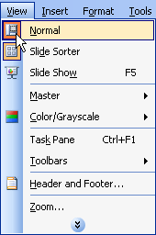
Editing an Individual Slide
Make sure you are in Normal View.

Slide 6
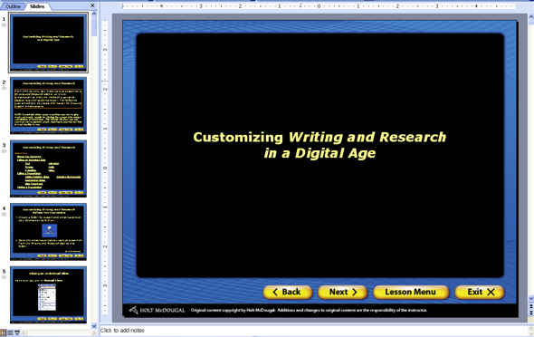
Editing an Individual Slide
Tabs on the left side of the screen allow you to move between thumbnails of the slides and an outline.
Tabs
Main area
The main area of the screen is a large view of the current slide.

Slide 7
Editing an Individual Slide
The notes area at the bottom of the screen is where you can add notes to each slide. You may want to use this space for background information or for discussion questions.
Notes area
[End of Section]

Slide 8
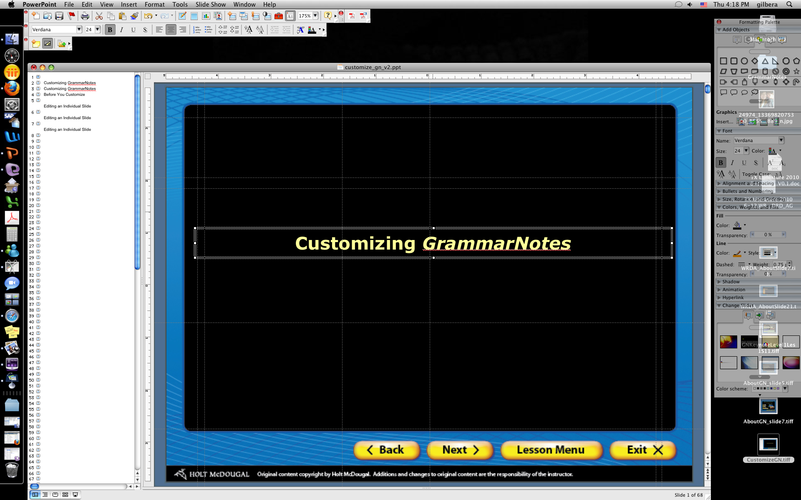
Editing an Individual Slide
Text
The text on a slide resides in text boxes.
From Normal View, select the text box by clicking on it. Now you can edit the text within the box.

Slide 9

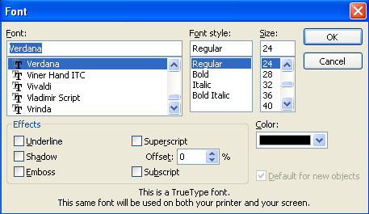
Editing an Individual Slide
Text
You can also change the font, color, and size of the text.
  Highlight the text you want to format.
  Click the Format menu and select Font.
  Choose from the options in the dialog box.

Slide 10
Editing an Individual Slide
Text
You can easily resize, move, add, or delete text boxes.
To resize a text box, click and drag one of the small white handles.
To move a text box, hold your cursor over the box perimeter until you see a small cross. Click and drag the cross to move the box.

Slide 11

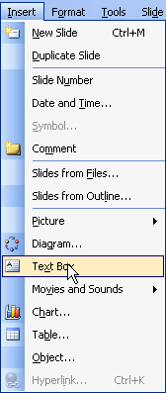
Editing an Individual Slide
Text
To add a text box, click the Text Box button in the drawing toolbar or choose Text Box from the Insert drop-down menu.
Click and drag the mouse to create the size box you want.

Slide 12
Editing an Individual Slide
Text
To delete a text box, click on the text box to select it. Then, press the Delete or Backspace key on your keyboard.
[End of Section]

Slide 13
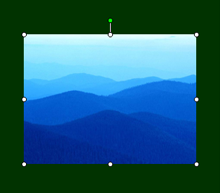
Editing an Individual Slide
Images
Images add visual richness to a presentation and help reinforce meaning.
To resize an image
  Click the image to select it.
  Click and drag one of the four corner handles to resize the image.
  Click one of the four middle handles to stretch the image.
  NOTE: Stretching an image will cause some distortion.

Slide 14
Editing an Individual Slide
Images
To move an image
  Click the image to select it.
  Drag the image with your mouse or use the arrow keys on your keyboard to move the image into position.
  Click anywhere outside the image to deselect it.

Slide 15
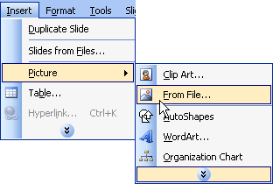
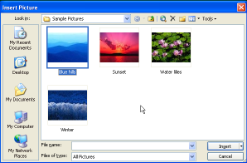
Editing an Individual Slide
Images
To add an image
  Click the Insert menu, select Picture, and click From File.
  Find the appropriate folder on your desktop or hard drive.
  Click the desired image file.
  Click Insert.
Notes:
Green PN background

Slide 16
Editing an Individual Slide
Images
To delete an image
  Click the image to select it.
  Press the Delete or Backspace key on your keyboard.
[End of Section]

Slide 17
Editing an Individual Slide
Hyperlinks
Hyperlinks let you navigate quickly through your presentation without having to view every slide.
Hyperlinks also let you link your presentation to Web sites if the computer you are using has an Internet connection.

Slide 18
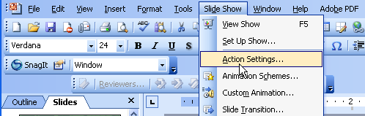
Editing an Individual Slide
Hyperlinks
To link to another slide
  Select the text you wish to make a hyperlink.
  Click the Slide Show menu and select Action Settings.

Slide 19
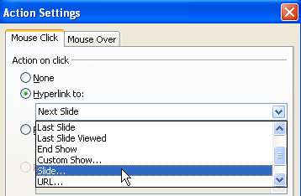
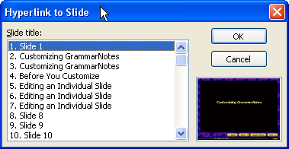
Editing an Individual Slide
Hyperlinks
To link to another slide
  On the Mouse Click tab, select the radio button for Hyperlink to.
  Click the Hyperlink to drop-down arrow and select Slide.
  Select the slide you wish to link to.
  Click OK.

Slide 20
Editing an Individual Slide
Hyperlinks
To link to a Web site
  Select the text you wish to make a hyperlink.
  Click the Slide Show menu and select Action Settings.

Slide 21
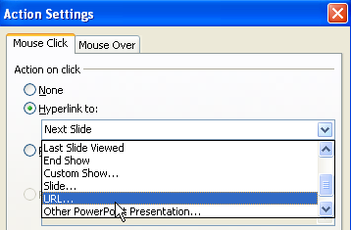
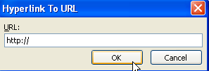
Editing an Individual Slide
Hyperlinks
To link to a Web site
  On the Mouse Click tab, select the radio button for Hyperlink to.
  Click the Hyperlink to drop-down arrow and select URL.
  Type the address of the Web site.
  Click OK.
[End of Section]

Slide 22
Editing an Individual Slide
Animation
Animation allows you to control how text and images are revealed on your slides, enhancing your students’ understanding. For example, by controlling the timing of animations, you can illustrate cause-and-effect relationships.
2nd
1st
1st
2nd
OR

Slide 23
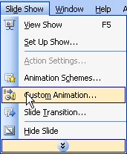
Editing an Individual Slide
Animation
To animate a text box or image
  Click on the text box or image to select it.
  Click the Slide Show menu and select Custom Animation.

Slide 24
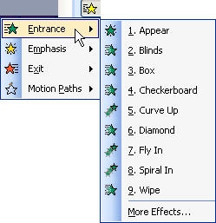
Editing an Individual Slide
Animation
To animate a text box or image
  Click the Add Effect button in the Custom Animation window.
  Click the effect (Entrance, Emphasis, Exit) you want to use and select the animation type.

Slide 25
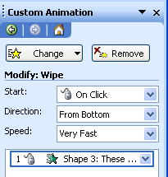
Editing an Individual Slide
Animation
To modify the effect you chose, use the options in the Custom Animation window.
These options control how the animation is activated and how fast the animation occurs, among other things.

Slide 26
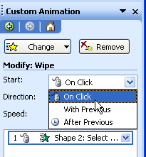
Editing an Individual Slide
Animation
To organize the animation of several objects
  Select the item you want to change in the Custom Animation window.
  If you want the item to animate with a mouse click, select On Click in the Start box.

Slide 27
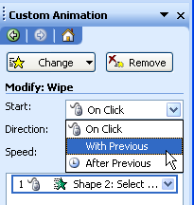
Editing an Individual Slide
Animation
To organize the animation of several objects
  If you want the item to animate automatically, select With Previous or After Previous in the Start box.

Slide 28
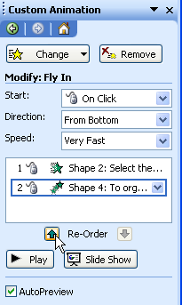
Editing an Individual Slide
Animation
To change the order of the animation of several objects
  Select the item you want to change in the Custom Animation window.
  Click the up or down Re-Order arrows to change the order of the animations.

Slide 29
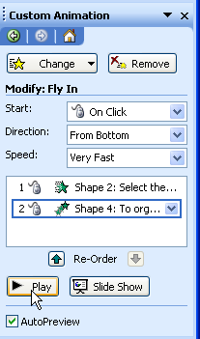
Editing an Individual Slide
Animation
To preview the animation
  Click the Play button.
  Revise the animation until you are satisfied with how it works.
[End of Section]

Slide 30
Editing an Individual Slide
Audio
Another way to make your presentations more engaging is to add audio clips.
Audio clips can consist of everything from sound effects, such as squealing brakes or honking horns, to famous speeches, such as Richard Nixon’s “Checkers” speech.

Slide 31

Editing an Individual Slide
Audio
To play audio clips, a computer requires a sound card and speakers. Be sure to test your slide show on the equipment you will use for your presentation to make certain that it can play your audio clips.
It’s also a good idea to adjust the volume ahead of time so that it’s not too loud or too soft during your presentation.

Slide 32
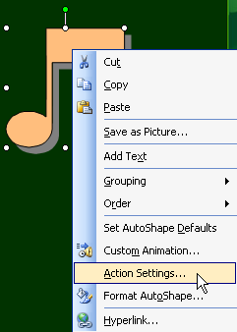
Editing an Individual Slide
Audio
To attach an audio clip to a graphic
  Right-click on the graphic and select Action Settings.

Slide 33
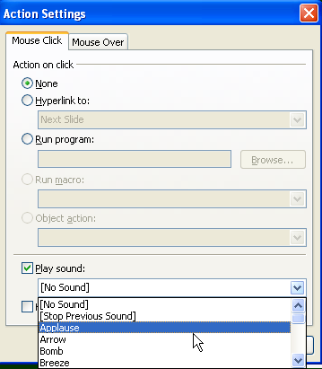
Editing an Individual Slide
Audio
To attach an audio clip to a graphic
  Select Mouse Click or Mouse Over.
  Click the Play sound box.
  Click the Play sound drop-down arrow to see a list of built-in audio clips.
  Click on the sound you wish to insert.

Slide 34
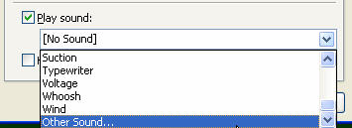
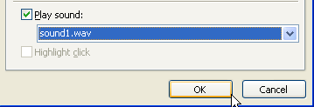
Editing an Individual Slide
Audio
To attach an audio clip to a graphic
  To choose a custom sound, click Other Sound, at the bottom of the list. Find the audio file you wish to use, and click it.
  Click OK.

Slide 35
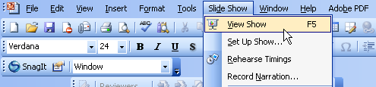
Editing an Individual Slide
Audio
To play an audio clip that is attached to a graphic, click the graphic. The audio will play only if you’re running the presentation in View Show mode.

Slide 36
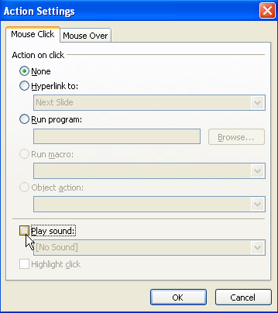
Editing an Individual Slide
Audio
To delete an audio clip attached to a graphic
  Right-click on the graphic.
  De-select Play sound.
  Click OK.
[End of Section]

Slide 37
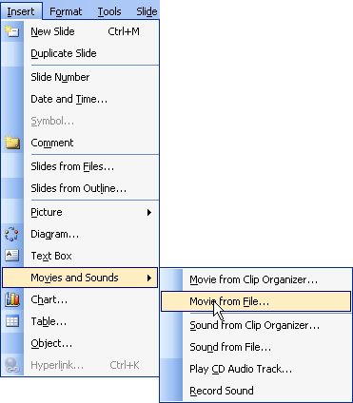
Editing an Individual Slide
Video
To attach a video clip to a presentation
  Click the Insert menu, select Movies and Sounds, and click Movie from File.
  Find the desired video file on your desktop or hard drive, and click it.

Slide 38
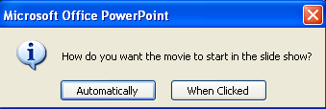
Editing an Individual Slide
Video
To attach a video clip to a presentation
  Click OK.
  A prompt will appear asking whether you want your video to play automatically or when clicked. Choose the appropriate response.

Slide 39

Editing an Individual Slide
Video
To resize a video
  Click the video to select it.
  Click and drag one of the four corner handles to resize the video.

Slide 40
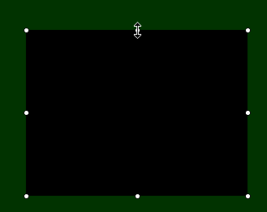
Editing an Individual Slide
Video
Avoid clicking and dragging a video by the middle handles. Doing so will stretch the video out of proportion.

Slide 41

Editing an Individual Slide
Video
To move a video
  Click the video to select it.
  Use the arrow keys on your keyboard to move the video.

Slide 42
Editing an Individual Slide
Video
To delete a video
  Click the video to select it.
  Press the Delete or Backspace key on your keyboard.
[End of Section]

Slide 43
Editing a Presentation
PowerPoint makes it easy to add, delete, or rearrange presentation slides. You can also control slide transitions—the way a slide or group of slides first appears to your audience.
[End of Section]

Slide 44
Editing a Presentation
Adding/Deleting Slides
The easiest way to add a slide to a presentation is to duplicate an existing slide. Doing this will ensure that the duplicate slide has the same design as the other slides in the
presentation.

Slide 45

Editing a Presentation
Adding/Deleting Slides
To add a slide to your presentation
  In Normal View, make sure the slide you wish to duplicate is displayed on your screen.
  Click the Insert menu and select Duplicate Slide. The slide on your screen is the new
  slide.

Slide 46
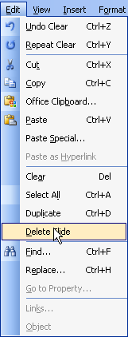
Editing a Presentation
Adding/Deleting Slides
To delete a slide from your presentation
  In Normal View, make sure the slide you wish to delete is displayed on your screen.
  Click the Edit menu and select Delete Slide.
[End of Section]

Slide 47
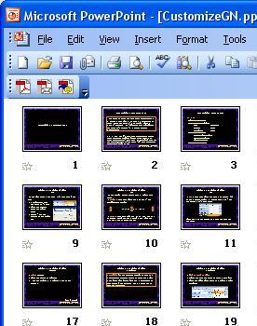
Editing a Presentation
Rearranging Slides
To rearrange slides in your presentation
  Click the Slide Sorter View button to switch to Slide Sorter View.
  Click and drag the slide you wish to move to its new location.
  NOTE: A vertical line will appear to show where the slide will be inserted.

Slide 48
Editing a Presentation
Rearranging Slides
To rearrange a group of slides
  In Slide Sorter View, hold down the Shift key and click each of the slides you wish to move.
  Drag the slides to their new location.
[End of Section]

Slide 49
Editing a Presentation
Slide Transitions
Slide transitions not only give a presentation a polished, professional appearance but they also create a flow from one slide or idea to the next.
Too many different slide transitions can be distracting and make a presentation look unprofessional. Use one or two transitions consistently throughout a presentation, and add different ones sparingly—only for special emphasis.

Slide 50
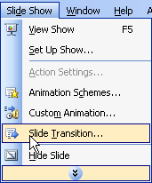
Editing a Presentation
Slide Transitions
To add a slide transition
  In Normal View, make sure the slide you wish to add a transition to is displayed on your screen.
  Click the Slide Show menu and select Slide Transition.

Slide 51
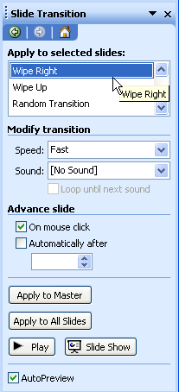
Editing a Presentation
Slide Transitions
To add a slide transition
  Click the transition you want to use. A preview of the transition will appear.
  You can modify the speed of the transition and how the slide advances by using the options in the right-hand pane.

Slide 52
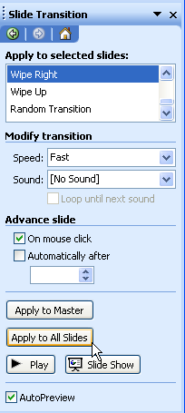
Editing a Presentation
Slide Transitions
To add a slide transition
  Click Apply to All Slides to apply the transition to all slides in the presentation.

Slide 53
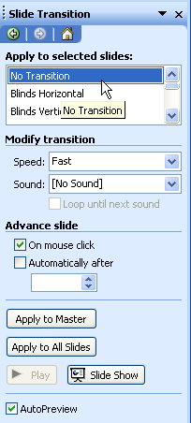
Editing a Presentation
Slide Transitions
To delete a slide transition
  In Normal View, make sure the slide you wish to delete a transition from is displayed on your screen.
  Click No Transition from the list of available transitions.

Slide 54
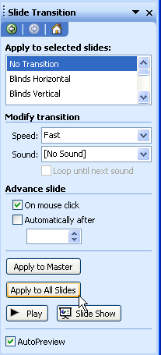
Editing a Presentation
Slide Transitions
To delete a slide transition
  Click Apply to All Slides to remove the transition from all slides in the presentation.
[End of Section]

Slide 55
Printing
Printing a presentation can help you proofread what you’ve done or serve as a helpful handout for your students. While PowerPoint offers several options for printing, we’ll focus on the most common one—lecture notes.
Choosing print options wisely can save you money on toner and paper. Whenever possible, choose black-and-white copies and multiple slides on a page.

Slide 56
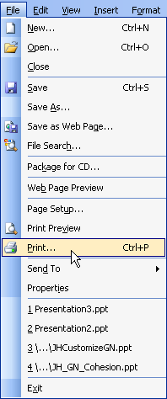
Printing
To print lecture notes
  Click the File menu and choose Print.

Slide 57
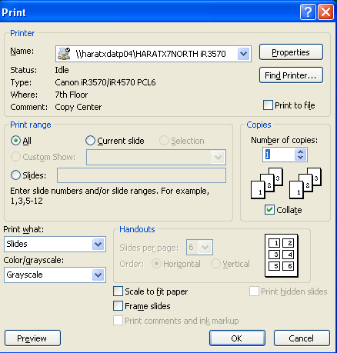
Printing
To print lecture notes
  In the Print range box, choose the slides you wish to print.
  In the Copies box, enter the number of copies you wish to print.

Slide 58
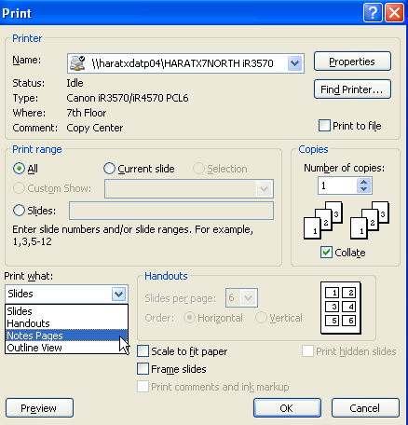
Printing
To print lecture notes
  Click the Print what drop-down arrow to display a list of options.
  Click on Notes Pages.

Slide 59
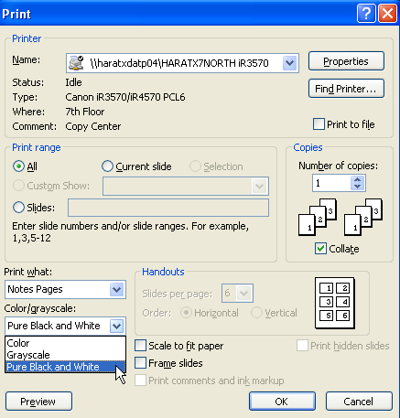
Printing
To print lecture notes
  Click on the Color/Grayscale drop-down arrow to display a list of options.
  Click on Pure Black and White.

Slide 60
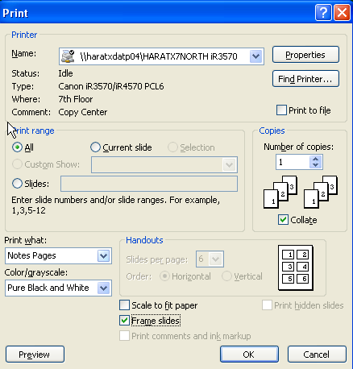
Printing
To print lecture notes
  Make sure the Frame slides option is checked.
  Click OK.
[End of Section]

Slide 61
The End

