Slide 1
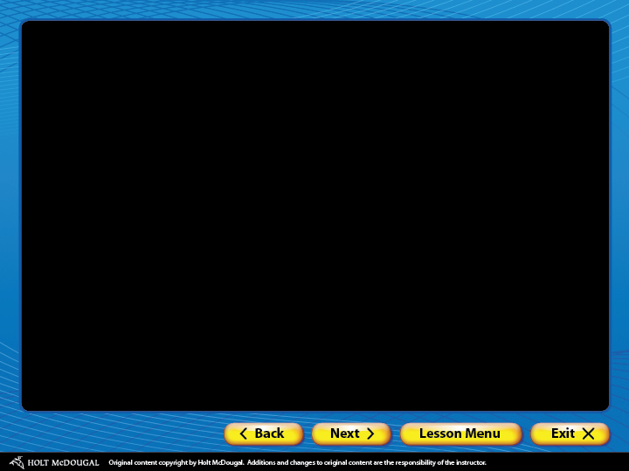
Using Pronoun-Antecedent Agreement
What is pronoun-antecedent agreement?
Number
Gender
  Indefinite pronouns
  Compound antecedents
Solving common pronoun agreement problems
  Expressions of amount
  Plural forms
Review A
Review B

Slide 2
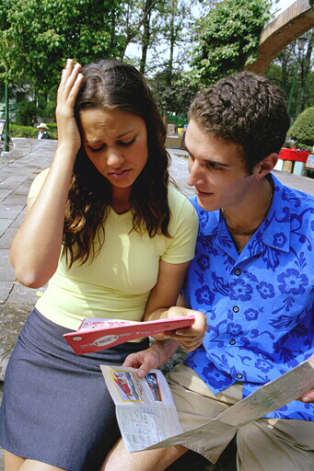
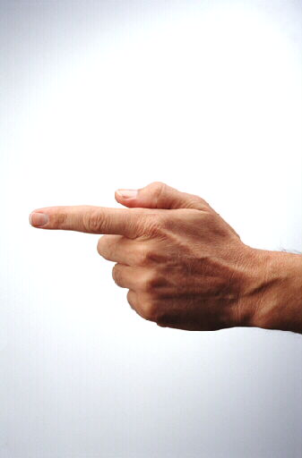
What is pronoun-antecedent agreement?
You may have heard that it is rude to point, but that’s exactly what pronouns do.
A pronoun “points” to a noun or another
pronoun called its antecedent.
Antecedent
Pronoun
Carrie explained that she had forgotten.
Carrie explained that she had forgotten.
Carrie explained that she had forgotten.
When a pronoun and its antecedent do not agree, listeners and readers become lost.

Slide 3
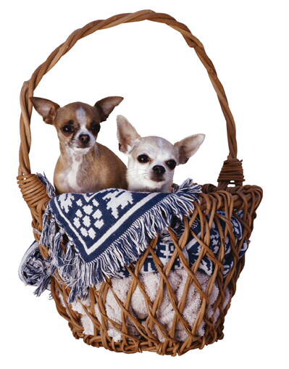
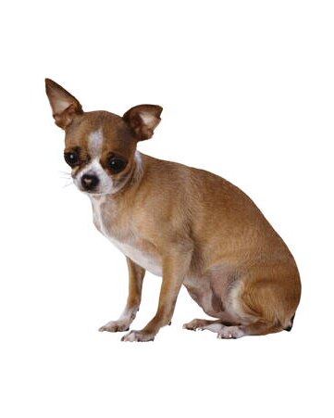
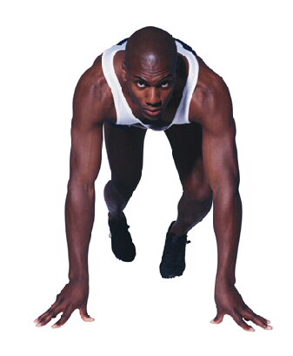
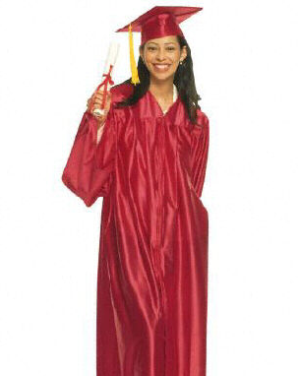
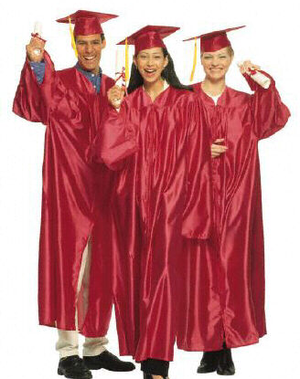
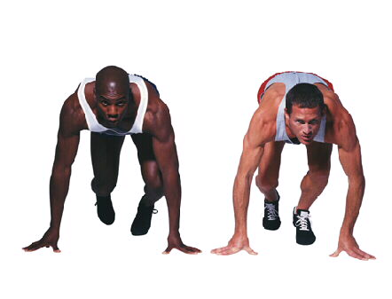
What is pronoun-antecedent agreement?
Number
A pronoun should agree in both number and gender with its antecedent.
A word that refers to one thing is singular.
A word that refers to more than one is plural.
dog
dogs
man
men
she
SINGULAR
they
PLURAL

Slide 4
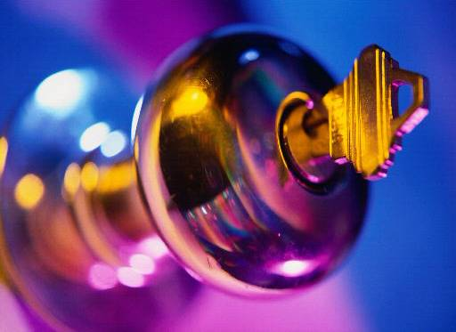
What is pronoun-antecedent agreement?
Number
Use singular pronouns to refer to singular antecedents.
Singular
Antecedent
Singular
Pronoun
Close the door and lock it.
Close the door and lock it.
Close the door and lock it.
Singular Personal Pronouns
I | me | my, mine
you | you | your, yours
he, she, it | him, her, it | his, hers, its

Slide 5

What is pronoun-antecedent agreement?
Number
Use plural pronouns to refer to plural antecedents.
Plural
Antecedent
Plural
Pronoun
Open the blinds and raise them.
Open the blinds and raise them.
Open the blinds and raise them.
Plural Personal Pronouns
we | us | our, ours
you | you | your, yours
they | them | their, theirs

Slide 6
What is pronoun-antecedent agreement?
Gender
Some singular pronouns indicate gender.
Masculine pronouns refer to males.
Feminine pronouns refer to females.
Neuter pronouns refer to places, things, ideas, and animals.
Masculine
he
him
his
himself
Feminine
she
her
her, hers
herself
Neuter
it
it
its
itself

Slide 7
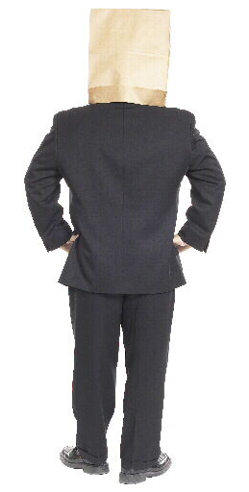
What is pronoun-antecedent agreement? Indefinite pronouns
Indefinite pronouns refer to a person or thing whose exact identity is unknown.
Some indefinite pronouns are singular.
Some are plural.
Some may be either singular or plural depending on how they are used.

Slide 8

What is pronoun-antecedent agreement? Indefinite pronouns
The following indefinite pronouns are singular:
Singular Indefinite Pronouns
anybody | either | neither | one
anyone | everybody | nobody | somebody
anything | everyone | no one | someone
each | everything | nothing | something
Each of the teams had its mascot at the game.
Everybody in the girls’ league paid her dues.
One of the boys left his pen behind.

Slide 9
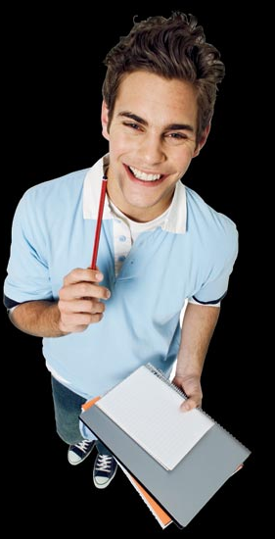

What is pronoun-antecedent agreement? Indefinite pronouns
When you do not know the gender of the antecedent, you can rearrange the sentence to avoid the problem.
Grammar Guy Says...
Someone left his or her pen behind.
Someone left a pen behind.
All members paid their dues.
Everybody in the club paid his or her dues.

Slide 10
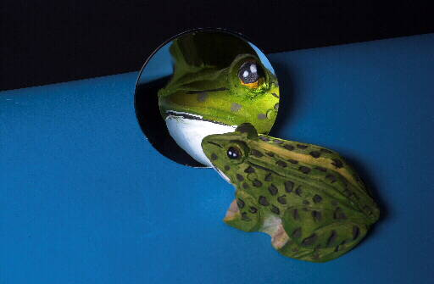
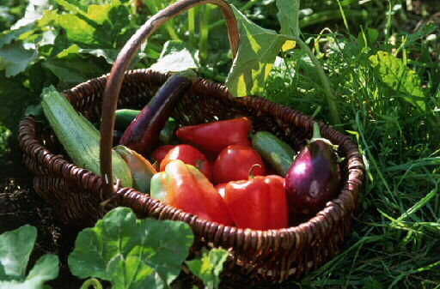
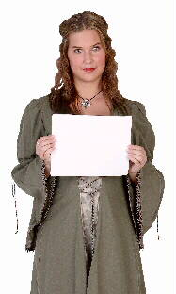
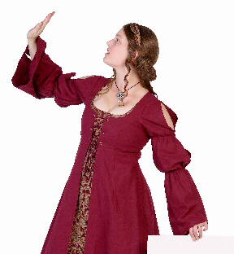
What is pronoun-antecedent agreement? Indefinite pronouns
The following indefinite pronouns are plural:
Plural Indefinite Pronouns
both | few | many | several
Both of the sisters recited their lines.
Few of the animals recognized themselves.
If many are ripe, pick them.

Slide 11

What is pronoun-antecedent agreement? Indefinite pronouns
The following indefinite pronouns may be singular or plural, depending on how they are used:
Singular or Plural Indefinite Pronouns
all | more | none
any | most | some
Singular
Most of the movie is over. Should I restart it?
Plural
Most of these films are new. Have you seen them?

Slide 12

What is pronoun-antecedent agreement? Indefinite pronouns
Complete each sentence by providing pronouns that agree with their antecedents. Then, identify the antecedent.
1. You may borrow one of these pens but don’t keep ________.
2. Several of the ducklings followed ________
mother across the pond.
3. Although some of these houses are new,
________ look historic.

Slide 13
What is pronoun-antecedent agreement? Indefinite pronouns
Complete each sentence by providing pronouns that agree with their antecedents. Then, identify the antecedent.
Antecedent
1. You may borrow one of these pens but don’t keep _____.
it
The singular pronoun it agrees with the singular antecedent one.

Slide 14
What is pronoun-antecedent agreement? Indefinite pronouns
Complete each sentence by providing pronouns that agree with their antecedents. Then, identify the antecedent.
Antecedent
2. Several of the ducklings followed _____ mother across the pond.
their
The plural pronoun their agrees with the plural antecedent several.

Slide 15
What is pronoun-antecedent agreement? Indefinite pronouns
Complete each sentence by providing pronouns that agree with their antecedents. Then, identify the antecedent.
Antecedent
3. Although some of these houses are new, _____ look historic.
they
In this sentence, some refers to the plural word houses. The plural pronoun they agrees with the plural antecedent some.

Slide 16
What is pronoun-antecedent agreement? Indefinite pronouns
On Your Own
The following sentences contain errors in pronoun-antecedent agreement. Identify each error, and give the form of the pronoun that agrees with its antecedent.
1. Each of the boys built their own computer.
2. Few of the butterflies reach the end of its migration.
3. We saw only some of the city as we drove through them.
4. If someone arrives early, they should wait by the door.
5. None of the actors had memorized his or her lines.
[End of Section]

Slide 17
What is pronoun-antecedent agreement? Indefinite pronouns
Answers
The following sentences contain errors in pronoun-antecedent agreement. Identify each error, and give the form of the pronoun that agrees with its antecedent.
1. Each of the boys built his own computer.
boys
2. Few of the butterflies reach the end of their migration.
butterflies
3. We saw only some of the city as we drove through it.
city
4. If someone arrives early, he or she should wait by the door.
someone
5. None of the actors had memorized their lines.
None

Slide 18
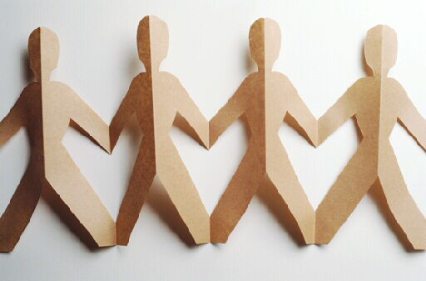
What is pronoun-antecedent agreement?
Compound antecedents
A compound antecedent is two or
more antecedents joined by and or or.
Use a plural pronoun to refer to two
or more antecedents joined by and.
Antecedent 1
Antecedent 2
Nina
and
Paul
drew pictures of themselves.
Antecedent 1
Antecedent 2
The
car
and the
truck
honked their horns.

Slide 19
What is pronoun-antecedent agreement?
Compound antecedents
Use a singular pronoun to refer to two or more singular antecedents joined by or or nor.
Singular
Singular
Paula
or
Janet
will present her views.
Singular
Singular
Neither
Max
nor
Pablo
said that he would.

Slide 20
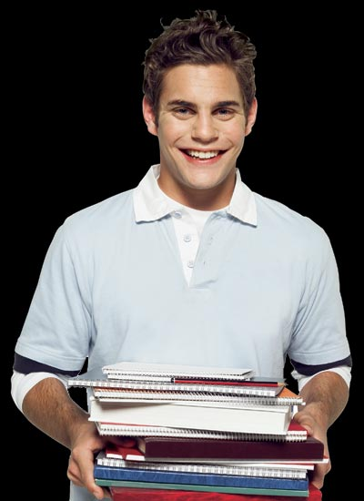
What is pronoun-antecedent agreement?
Compound antecedents
Sentences with antecedents of different number may be unclear or awkward.
Grammar Guy Says...
UNCLEAR
Neither the macaw nor the parrots have eaten their fruit.
AWKWARD
Neither the macaw nor the parrots have eaten its or their fruit.

Slide 21
What is pronoun-antecedent agreement?
Compound antecedents
Revise sentences to avoid unclear and awkward constructions like these.
Grammar Guy Says...
Neither the macaw nor the parrots have eaten their fruit.
REVISED
Neither the macaw nor the parrots have eaten the fruit.
UNCLEAR
REVISED
AWKWARD
Neither the macaw nor the parrots have eaten its or their fruit.
None of the birds have eaten their fruit.

Slide 22
What is pronoun-antecedent agreement?
Compound antecedents
Complete each sentence by providing pronouns that agree with their antecedents.
1. Some male birds and reptiles care for ________ young.
2. Either Stu or Mike will lend me ________
fishing gear.
3. Neither my mother nor my aunt knew where
________ was born.

Slide 23
What is pronoun-antecedent agreement?
Compound antecedents
Complete each sentence by providing pronouns that agree with their antecedents.
1. Some male birds and reptiles care for _____ young.
their
In this sentence, the antecedents male birds and reptiles are joined by and. The plural pronoun their agrees with the compound subject.

Slide 24
What is pronoun-antecedent agreement?
Compound antecedents
Complete each sentence by providing pronouns that agree with their antecedents.
2. Either Stu or Mike will lend me _____ fishing gear.
his
In this sentence, the singular antecedents Stu and Mike are joined by or. The singular pronoun his agrees with the compound subject.

Slide 25
What is pronoun-antecedent agreement?
Compound antecedents
Complete each sentence by providing pronouns that agree with their antecedents.
3. Neither my mother nor my aunt knew where _____ was born.
she
In this sentence, the singular antecedents mother and aunt are joined by neither/nor. The singular pronoun she agrees with the compound subject.

Slide 26
What is pronoun-antecedent agreement?
Compound antecedents
On Your Own
Most of the following sentences contain pronouns that do not agree with their antecedents. If a pronoun does not agree with its antecedent, provide the correct pronoun. If a sentence is already correct, write C.
1. Both Wanda and Sam were pleased with herself.
2. A fly or a bee can enter the plant, but they cannot escape.
3. This plate and cup bear the mark of its maker.
4. Neither Bill nor Andy think that the coat is theirs.
I do not expect fame or reward but would welcome it.
[End of Section]

Slide 27
What is pronoun-antecedent agreement?
Compound antecedents
Answers
Most of the following sentences contain pronouns that do not agree with their antecedents. If a pronoun does not agree with its antecedent, provide the correct pronoun. If a sentence is already correct, write C.
1. Both Wanda and Sam were pleased with themselves.
2. A fly or a bee can enter the plant, but it cannot escape.
3. This plate and cup bear the mark of their maker.
4. Neither Bill nor Andy think that the coat is his.
5. I do not expect fame or reward but would welcome it. C

Slide 28
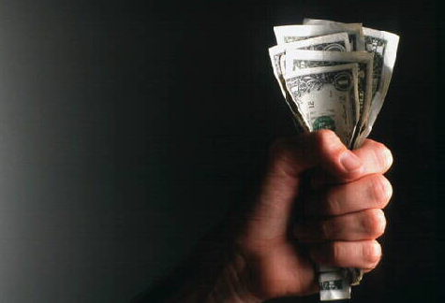
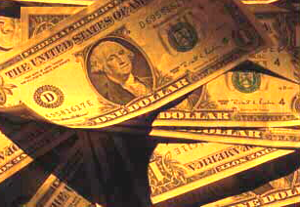
Special problems in pronoun agreement
Expressions of amount
An expression of amount (a measurement, percentage, or fraction) may be singular or plural, depending on how it is used.
An expression of amount is
singular when the amount is thought of as a unit.
Here is five dollars. Is it enough?
plural when the amount is thought of as separate parts.
Five dollars were counterfeit, weren’t they?

Slide 29
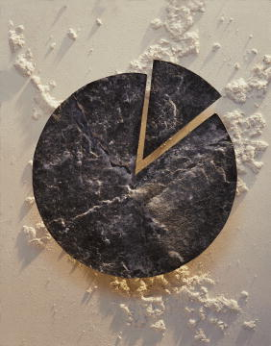
Special problems in pronoun agreement
Expressions of amount
A fraction or a percentage is
singular when it refers to a singular word.
This farmer has set aside ten percent of his land and agreed to let it go wild.
plural when it refers to a plural word.
This farmer has set aside ten percent of his fields and agreed to let them go wild.

Slide 30
Special problems in pronoun agreement
Plural forms
Some nouns that are plural in form take singular pronouns.
Plural Forms That Take Singular Pronouns
civics | gymnastics | molasses
economics | linguistics | mumps
electronics | mathematics | news
genetics | measles | physics
This article is about genetics and how it has grown.
I have good news. Do you want to hear it?

Slide 31
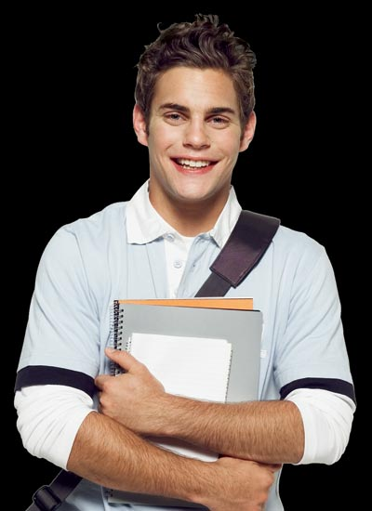
Special problems in pronoun agreement
Plural forms
Many nouns ending in –ics, such as athletics, acoustics, and ethics, may be singular or plural.
Grammar Guy Says...
Such nouns are generally singular when they refer to a science, system, or skill.
We learned about ethics and how it relates to other branches of philosophy.
Such nouns are plural when they refer to qualities or individual items.
Let me tell you about my ethics and how I developed them.

Slide 32
Special problems in pronoun agreement
Plural forms
Even when plural in form, these types of nouns take singular pronouns:
titles of a creative work—books, songs, movies, or paintings
After Chad read Mules and Men, he wrote report on it.
names of countries, cities, or organizations
Hot Springs, Arkansas, is famous for its popular health resort.

Slide 33
Special problems in pronoun agreement
Expressions of amount / Plural forms
Complete each sentence by providing pronouns that agree with their antecedents.
1. Ten percent of the customers were unhappy with _____ purchases.
2. Miriam decided to work in electronics after she took a class about _____.
3. I am reading War and Peace, and I am almost done with _____.

Slide 34
Special problems in pronoun agreement
Expressions of amount / Plural forms
Complete each sentence by providing pronouns that agree with their antecedents.
1. Ten percent of the customers were unhappy with _____ purchases.
their
In this sentence, percent refers to the plural word customers. The plural pronoun their agrees with the plural antecedent percent.

Slide 35
Special problems in pronoun agreement
Expressions of amount / Plural forms
Complete each sentence by providing pronouns that agree with their antecedents.
2. Miriam decided to work in electronics after she took a class in _____.
it
The singular pronoun it agrees with the singular antecedent electronics.

Slide 36
Special problems in pronoun agreement
Expressions of amount / Plural forms
Complete each sentence by providing pronouns that agree with their antecedents.
3. I am reading War and Peace, and I am almost done with _____.
it
Titles of creative works are singular. The singular pronoun it agrees with the singular antecedent War and Peace.

Slide 37
Special problems in pronoun agreement
Expressions of amount / Plural forms
On Your Own
Most of the following sentences contain pronouns that do not agree with their antecedents. If a pronoun does not agree with its antecedent, provide the correct pronoun. If a sentence is already correct, write C.
1. Grand Forks is in North Dakota. Did you drive through them on your trip?
2. Fifty percent of the wall has received its last coat of paint.
3. The chart explains mumps and how people catch them.
4. The speaker talked about mathematics and why we should study them.
5. Nine tenths of the employees had driven him- or herself to work.
[End of Section]

Slide 38
Special problems in pronoun agreement
Expressions of amount / Plural forms
Answers
Most of the following sentences contain pronouns that do not agree with their antecedents. If a pronoun does not agree with its antecedent, provide the correct pronoun. If a sentence is already correct, write C.
1. Grand Forks is in North Dakota. Did you drive through it on your trip?
2. Fifty percent of the wall has received its last coat of paint. C
3. The chart explains mumps and how people catch it.
4. The speaker talked about mathematics and why we should study it.
5. Nine tenths of the employees had driven themselves to work.

Slide 39
Review A
Complete each sentence by providing pronouns that agree with their antecedents.
I like this painting, but ________ is not my favorite.
Both of the accused men deserve ________ day in court.
No one in the hiking group left ________ trash behind.
Brad and Janet took a wrong turn, and __________ had to ask for directions.
5. If the transmission or the drive shaft is causing the problem, you may have to replace ________.

Slide 40
Review A
Possible Answers
Complete each sentence by providing pronouns that agree with their antecedents.
it
I like this painting, but ________ is not my favorite.
their
Both of the accused men deserve ________ day in court.
any
No one in the hiking group left ________ trash behind.
they
Brad and Janet took a wrong turn, and __________ had to ask for directions.
5. If the transmission or the drive shaft is causing the problem, you may have to replace ________.
it

Slide 41
Review B
The following sentences contain errors in pronoun-antecedent agreement. Identify each error, and give the form of the pronoun that agrees with its antecedent.
1. If you find any of the puzzle pieces, please save it.
The Future Farmers of America has a list of upcoming events on their Web site.
3. Paul studies physics because he enjoys them.
4. Three eighths of the plants have grown since we measured it last week.
5. Everyone signed their name at the bottom of the mural.
[End of Section]

Slide 42
Review B
The following sentences contain errors in pronoun-antecedent agreement. Identify each error, and give the form of the pronoun that agrees with its antecedent.
1. If you find any of the puzzle pieces, please save them.
2. The Future Farmers of America has a list of upcoming events on its Web site.
3. Paul studies physics because he enjoys it.
4. Three eighths of the plants have grown since we measured them last week.
5. Everyone signed his or her name at the bottom of the mural.

Slide 43
The End

