Slide 1

Understanding Verb Forms
What are the principal parts of verbs?
Regular verbs
Irregular verbs
Review A
Review B

Slide 2

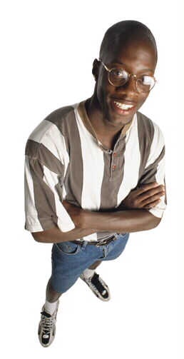
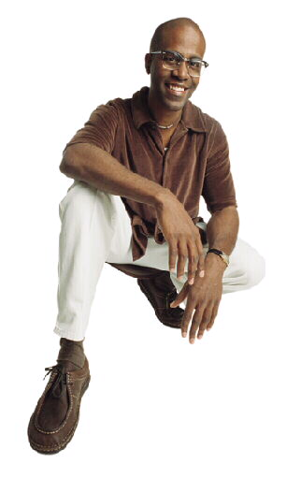
What are the principal parts of verbs?
Like people, verbs wear different “clothes” for different occasions.
He often wears a suit.
He wore jeans on Saturday.
He has worn casual clothes.

Slide 3
What are the principal parts of verbs?
Verbs have four principal parts, each of which performs a different function.
Base Form
sing
ask
Present Participle
[is] sing
ing
[is] ask
ing
Past
s
a
ng
ask
ed
Past Participle
[have] s
u
ng
[have] ask
ed
More about participles

Slide 4
What are the principal parts of verbs? Participles
When used as part of a verb phrase, participles follow a helping verb.
Helping Verb
Helping Verb
Who is asking?
The bells had rung.
Who is asking?
The girl had sung.
Verb Phrase
Verb Phrase

Slide 5
What are the principal parts of verbs?
These principal parts are used to form all of the different verb tenses.
Base Form
The girls sing every day.
Present Participle
The girls are singing now.
Past
The girls sang yesterday.
Past Participle
The girls have sung already.

Slide 6
What are the principal parts of verbs?
Tense
The tense of a verb indicates the time of the action or state of being expressed by the verb.
Perfect tenses indicate that something happened or existed before a specific point in time.
Past
Present
Future
Past
Future
Present
Past Perfect
Present Perfect
Future Perfect
Max has enough money to buy a bicycle.
Max has worked all summer to buy it.
Max will work next summer also.
He worked last summer as well.
Max will have worked three summers in a row.
He had worked as a life guard before then.

Slide 7

Regular verbs
A regular verb generally forms its past and past participle by adding –d or –ed to the base form.
Base Form
Past
Past Participle
work
work
ed
[have] work
ed
blame
blame
d
[have] blame
d
The present participle is formed by adding –ing.
Present Participle
work
ing

Slide 8


Regular verbs
A common mistake is to leave the –d or –ed ending off the past and past participle forms.
Grammar Guy Says...
NONSTANDARD
They use to live in Texas.
Are you suppose to meet them tomorrow?
STANDARD
They used to live in Texas.
Are you supposed to meet them tomorrow?

Slide 9


Regular verbs
Most regular verbs that end in e drop the e before adding –ing.
blam
blame
ing
Some verbs double the final consonant before adding –ing or –ed.
napp
nap
ing
napp
nap
ed

Slide 10

Regular verbs
Give the correct past or past participle form of each verb in parentheses.
1. Mother Teresa (help) many people.
2. As I walked by, they (smile).
3. Martin had (plan) a surprise party for me.

Slide 11
Regular verbs
Give the correct past or past participle form of each verb in parentheses.
1. Mother Teresa helped many people.

Slide 12
Regular verbs
Give the correct past or past participle form of each verb in parentheses.
2. As I walked by, they smiled.

Slide 13
Regular verbs
Give the correct past or past participle form of each verb in parentheses.
3. Martin had planned a surprise party for me.

Slide 14
Regular verbs
On Your Own
Give the correct form (past, past participle, or present participle) of the italicized verb, as indicated in parentheses.
1. Most people (laugh) at the drawing yesterday. (past)
2. I am (design) a model of a drawbridge right now. (present participle)
3. Officers have (discover) the stolen money. (past participle)
4. As I pointed the camera, Meredith (grin). (past)
5. Steve is (skip) stones across the lake. (present participle)
[End of Section]

Slide 15
Regular verbs
Answers
Give the correct form (past, past participle, or present participle) of each verb, as indicated in parentheses.
1. Most people laughed at the drawing yesterday. (past)
2. I am designing a model of a drawbridge right now. (present participle)
Officers have discovered the stolen money. (past participle)
4. As I pointed the camera, Meredith grinned. (past)
5. Steve is skipping stones across the lake. (present participle)

Slide 16

Irregular verbs
Some verbs do not fit the regular pattern.
An irregular verb forms its past and past participle in some way other than by adding –d or –ed.
Base Form
Past
Past Participle
sing
s
a
ng
[have] s
u
ng
set
set
[have] set

Slide 17
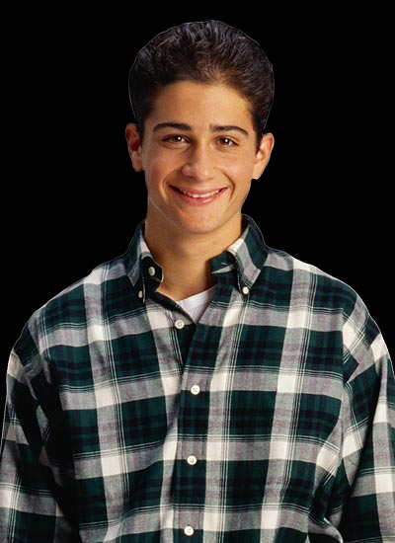
Irregular verbs
Since most English verbs are regular, people sometimes try to make irregular verbs follow the regular pattern. Such verb forms are not standard.
Grammar Guy Says...
NONSTANDARD
STANDARD
throwed
threw
shrinked
shrank
choosed
chose

Slide 18
Irregular verbs
Changing vowels
1. Some irregular verbs form the past and past participle by changing vowels.
Base Form
Past
Past Participle
sing
s
a
ng
[have] s
u
ng
Other verbs that change vowels
come | came | [have] come
drink | drank | [have] drunk
lead | led | [have] led
run | ran | [have] run

Slide 19
Irregular verbs
Changing consonants
2. Other irregular verbs form the past and past participle by changing consonants.
Base Form
Past
Past Participle
[have] ben
bend
ben
t
t
Other verbs that change consonants
build | built | [have] built
make | made | [have] made
send | sent | [have] sent
spend | spent | [have] spent

Slide 20
Irregular verbs
Changing vowels and consonants
3. Some irregular verbs form the past and past participle by changing both vowels and consonants.
Base Form
Past
Past Participle
fly
fl
ew
[have] fl
own
Other verbs that change vowels and consonants
catch | caught | [have] caught
choose | chose | [have] chosen
do | did | [have] done
go | went | [have] gone

Slide 21
Irregular verbs
No Change
4. A few irregular verbs make no change at all in their past and past participle forms.
Base Form
Past
Past Participle
set
set
[have] set
Other Verbs that Make No Change
burst | burst | [have] burst
cut | cut | [have] cut
hit | hit | [have] hit
let | let | [have] let

Slide 22
Irregular verbs
Give the correct past or past participle form of each verb in parentheses.
1. Paul (drink) a quart of water before the race.
2. We have (spend) ten dollars so far.
3. The class (catch) tadpoles for the aquarium.
4. Before she scored a home run, Janice had (hit) the ball twice.

Slide 23
Irregular verbs
Give the correct past or past participle form of each verb in parentheses.
1. Paul drank a quart of water before the race.

Slide 24
Irregular verbs
Give the correct past or past participle form of each verb in parentheses.
2. We have spent ten dollars so far.

Slide 25
Irregular verbs
Give the correct past or past participle form of each verb in parentheses.
3. The class caught tadpoles for the aquarium.

Slide 26
Irregular verbs
Give the correct past or past participle form of each verb in parentheses.
4. Before she scored a home run, Janice had
hit the ball twice.

Slide 27
Irregular verbs
On Your Own
Give the correct form (past or past participle) of each verb given in parentheses.
1. The winner ________ across the finish line. (run)
2. Richard has ________ an amazing dinner for us. (make)
3. Their pipes ________ in the freezing temperatures. (burst)
4. We all ________ to the parking lot during the fire drill. (go)
5. What else could you have ________? (do)
[End of Section]

Slide 28
Irregular verbs
Answers
Give the correct form (past or past participle) of each verb given in parentheses.
ran
1. The winner ________ across the finish line. (run)
made
2. Richard has ________ an amazing dinner for us. (make)
burst
3. Their pipes ________ in the freezing temperatures. (burst)
went
4. We all ________ to the parking lot during the fire drill. (go)
done
5. What else could you have ________? (do)

Slide 29
Review A
Give the correct form (past, past participle, or present participle) of each italicized verb, as indicated in parentheses.
1. The engineer (blame) a bad wire for the malfunction. (past)
2. One team has (ask) for a time out. (past participle)
3. Large hailstones are (hit) the roof. (present participle)
4. Each chef (choose) his knife carefully. (past)
5. We have (sing) nearly every song in the book. (past participle)

Slide 30
Review A
Give the correct form (past, past participle, or present participle) of each italicized verb, as indicated in parentheses.
1. The engineer blamed a bad wire for the malfunction. (past)
2. One team has asked for a time out. (past participle)
3. Large hailstones are hitting the roof. (present participle)
4. Each chef chose his knife carefully. (past)
5. We have sung nearly every song in the book. (past participle)

Slide 31
Review B
The following sentences contain nonstandard or misspelled verb forms. Identify each error, and provide the standard form of the verb.
1. Everyone is suppose to stay seated until the bell rings.
2. I have setted the table for one too many by mistake.
3. The mail carrier rung the doorbell after leaving the package.
4. Several kittens were naping on top of the sofa.
5. We should have went north instead of south at that exit.
[End of Section]

Slide 32
Review B
The following sentences contain nonstandard or misspelled verb forms. Identify each error, and provide the standard form of the verb.
1. Everyone is supposed to stay seated until the bell rings.
2. I have set the table for one too many by mistake.
3. The mail carrier rang the doorbell after leaving the package.
4. Several kittens were napping on top of the sofa.
5. We should have gone north instead of south at that exit.

Slide 33
The End

