Slide 1

Correcting Dangling Modifiers
What is a dangling modifier?
How to fix dangling modifiers
Review A
Review B

Slide 2
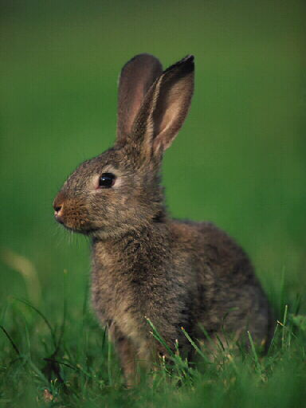
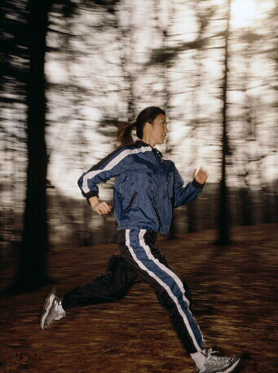
What is a dangling modifier?
A modifier clearly and sensibly modifies another word or word group.
Training for a marathon, Sue jogs every morning.
Adjective phrase
But look at this sentence:
?
Jogging in the park, a rabbit watched me.
Adjective phrase
A rabbit?
Who or what is jogging through the park?

Slide 3
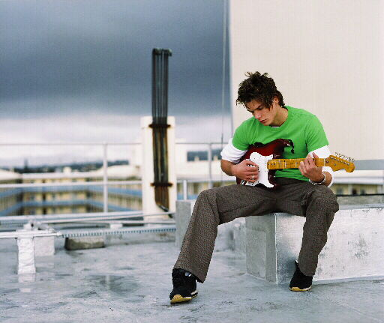
What is a dangling modifier?
A dangling modifier is a modifier that doesn’t clearly and sensibly modify another word or word group.
?
?
?
Frustrated, the chord was replayed by the guitarist.
Beginning the song again, a string broke.
To master the guitar, practice is needed.
Did the string begin the song again?
Is practice mastering the guitar?
Was the chord frustrated?

Slide 4
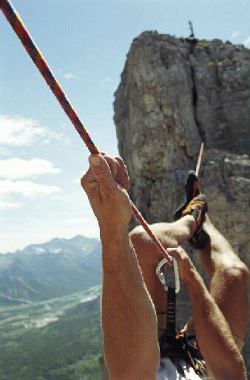
What is a dangling modifier?
Dangling modifiers often occur at the beginning of a sentence. When a sentence begins with a participial phrase or infinitive phrase, use these steps to spot dangling modifiers.
Step 1: The subject of the phrase should come right after the comma. Look at the word or word group right after the comma.
Participial phrase
Moving carefully, the rope was held tightly.
Moving carefully, the rope was held tightly.

Slide 5
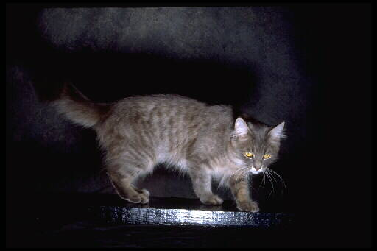
What is a dangling modifier?
Participial phrases
A participial phrase is used as an adjective and consists of a participle and any complements or modifiers the participle has.
Participial phrase
Terrified by the dog, the cat climbed a tree.
Participial phrase
The cat watching the bird heard the dog.
Both participial phrases modify the noun cat.

Slide 6
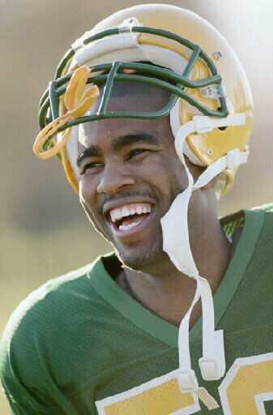
What is a dangling modifier?
Infinitive phrases
An infinitive phrase consists of an infinitive and any complements or modifiers the infinitive has. The entire phrase can be used as a noun, an adjective, or an adverb.
Inf. phrase
Chris is the player to watch.
The infinitive phrase to watch is used as an adjective to modify the noun player.

Slide 7
What is a dangling modifier?
Step 2: Ask yourself, “Does it make sense for the phrase to modify the word or word group after the comma?”
Participial phrase
?
Dangling modifier
Moving carefully, the rope was held tightly.
Was the rope moving carefully?
No, it doesn’t make sense for moving carefully to modify rope. Rope is not the subject of the participial phrase.
If the sentence doesn’t make sense, you probably have a dangling modifier.

Slide 8

What is a dangling modifier?
Try it out with this sentence:
?
Dangling modifier
Looking through the keyhole, the test tube gleamed in the light.
Which word or word group follows the comma?
test tube
Does it make sense that the test tube is looking through the keyhole?
No.
The phrase is a dangling modifier.

Slide 9

What is a dangling modifier?
Many dangling modifiers are right at the beginning of the sentence, but dangling modifiers can occur in other places in a sentence as well.
Dangling modifier
My exam results were poor, having overslept.
Did the exam results oversleep?
No.
Dangling modifier
The scenery, driving through the mountains, was spectacular.
Did the scenery drive through the mountains?
No.

Slide 10

What is a dangling modifier?
Identify the dangling modifier in each of the following sentences.
1. Hurrying through the last chapter, the book was fascinating.
2. To repair an appliance, experience is helpful.
3. Exhausted by the long practice, dinner sounded great.

Slide 11
What is a dangling modifier?
Identify the dangling modifier in each of the following sentences.
?
1. Hurrying through the last chapter, the book was fascinating.
Which word or word group follows the comma?
book
Does it make sense that the book is hurrying through the last chapter?
No.
The phrase is a dangling modifier.

Slide 12
What is a dangling modifier?
Identify the dangling modifier in each of the following sentences.
?
2. To repair an appliance, experience is helpful.
Which word or word group follows the comma?
experience
Does it make sense that experience is repairing an appliance?
No.
The phrase is a dangling modifier.

Slide 13
What is a dangling modifier?
Identify the dangling modifier in each of the following sentences.
?
3. Exhausted by the long practice, dinner sounded great.
Which word or word group follows the comma?
dinner
Does it make sense that dinner is exhausted by the long practice?
No.
The phrase is a dangling modifier.

Slide 14
What is a dangling modifier?
On Your Own
Circle the word or word group that appears to be modified by the underlined word or phrase. Then, determine whether the underlined word or phrase is a dangling modifier. Write D for a dangling modifier or C if the modifier is not
dangling.
___ 1. Hiking in the mountains, the views were great.
___ 2. Looking over my shoulder, I saw a gigantic wave.
___ 3. Out of breath from running, the bus left before I reached the stop.
[End of Section]

Slide 15
What is a dangling modifier?
Answers
Circle the word or word group that appears to be modified by the underlined word or phrase. Then, determine whether the underlined word or phrase is a dangling modifier. Write D for a dangling modifier or C if the modifier is not
dangling.
___ 1. Hiking in the mountains, the views were great.
___ 2. Looking over my shoulder, I saw a gigantic wave.
___ 3. Out of breath from running, the bus left before I reached the stop.
D
C
D

Slide 16
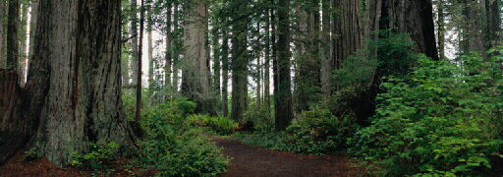
How to fix dangling modifiers
To fix a dangling modifier, you will need to make the meaning logical and clear.
Strategy 1: Revise the word group that follows the dangling modifier.
Dangling modifier
?
Lost and thirsty, the trail was a welcome sight.
Lost and thirsty, the hikers welcomed the sight of the trail.
Was the trail “lost and thirsty”?
No. A logical subject—such as hikers—needs to follow the comma.
Now the modifier lost and thirsty logically and clearly modifies the subject hikers.

Slide 17

How to fix dangling modifiers
Strategy 1: Revise the word group that follows the dangling modifier.
Dangling modifier
?
To become a doctor, years of study are required.
Does to become a doctor sensibly modify years?
No. A logical subject—such as you—needs to follow the comma.
To become a doctor, you must study for years.
Now the infinitive phrase clearly and sensibly tells why you must study.

Slide 18

How to fix dangling modifiers
Strategy 2: Change the dangling modifier into a clause.
Dangling modifier
?
Lost and thirsty, the trail was a welcome sight.
Because we were lost and thirsty, the trail was a welcome sight.
Changing the dangling modifier into an adverb clause makes the meaning clear. The adverb clause explains why the trail was a welcome sight.

Slide 19
How to fix dangling modifiers
A clause is a word group that contains a verb and its subject.
Subject
Verb
Subject
Verb
We watched the game.
We watched the game after my cousins arrived.
We watched the game
after my cousins arrived
Independent clause
Subordinate clause
An independent clause expresses a complete thought and can stand by itself as a complete sentence.
A subordinate clause does not express a complete thought and cannot be a sentence. It must be attached to an independent clause.

Slide 20


How to fix dangling modifiers
Dangling modifiers often occur when the verb in a sentence is in the passive voice.
Grammar Guy Says...
Passive voice
The ball was caught by me.
The action is done to the subject ball.
Active voice
I caught the ball.
The action is done by the subject I.

Slide 21

How to fix dangling modifiers
Grammar Guy Says...
Changing a sentence from the passive voice to the active voice often eliminates a dangling modifier.
Passive voice
?
Reaching as high as possible, the ball was caught by me.
Active voice
Reaching as high as possible, I caught the ball.

Slide 22
How to fix dangling modifiers
Strategy 2: Change the dangling modifier into a clause.
Dangling modifier
?
To become a doctor, years of study are required.
If you want to become a doctor, you must study for years.
Changing the modifier into an adverb clause and revising the word after the comma makes the meaning clear. Now the adverb clause explains why you must study.

Slide 23
How to fix dangling modifiers
Revise each sentence to correct the underlined dangling modifier.
Looking out the window, a rare bird was spotted.
To wake up early, the alarm clock should be set.
3. Watching the sunset, time seemed to stand still.

Slide 24
How to fix dangling modifiers
Revise each sentence to correct the underlined dangling modifier.
Possible Answers
Looking out the window, I spotted a rare bird.
In the original sentence, the participial phrase seemed to modify bird. In this revised sentence, a logical subject I has been added.
When I was looking out the window, I spotted a rare bird.
In this revised sentence, the adverbial clause modifies spotted and tells when the rare bird was spotted.

Slide 25
How to fix dangling modifiers
Revise each sentence to correct the underlined dangling modifier.
Possible Answers
To wake up early, set the alarm clock.
To wake up early, you should set the alarm clock.
In the original sentence, the infinitive phrase seemed to modify alarm clock. In these revised sentences, a logical subject you has been added. (You is the understood subject in the first sentence.)

Slide 26
How to fix dangling modifiers
Revise each sentence to correct the underlined dangling modifier.
Possible Answers
3. While we were watching the sunset, time seemed to stand still.
In the original sentence, the participial phrase seemed to modify time. In this revised sentence, the adverbial clause modifies seemed and tells when time seemed to stand still.
3. Watching the sunset, we felt that time seemed to stand still.
In this revised sentence, a logical subject we has been added.

Slide 27
How to fix dangling modifiers
On Your Own
Revise each sentence to correct the dangling modifier.
1. Together, the fruit was picked and put into baskets.
2. Perched on a stool by the sink, the potatoes were easy to peel.
3. My telephone rang right after walking in the door.
4. To find our way, the map was unfolded.
[End of Section]

Slide 28
How to fix dangling modifiers
Possible Answers
Revise each sentence to correct the dangling modifier.
1. Together, the fruit was picked and put into baskets.
2. Perched on a stool by the sink, the potatoes were easy to peel.
3. My telephone rang right after walking in the front door.
4. To find our way, the map was unfolded.
1. Together, the workers picked the fruit and put it into baskets.
2. Perched on a stool by the sink, I peeled the potatoes easily.
3. My telephone rang right after I walked in the front door.
4. To find our way, we unfolded the map.

Slide 29
Review A
Identify the dangling modifier in each sentence.
1. Earth appeared very small walking on the moon.
2. To fly on the space shuttle, training is necessary.
3. Winning the game, a celebration seemed like a great idea.
4. Leaving my dirty shoes outside, the floor was kept clean.
5. Frustrated, all of the scientists’ results were reexamined.
[End of Section]

Slide 30
Review A
Identify the dangling modifier in each sentence.
1. Earth appeared very small walking on the moon.
2. To fly on the space shuttle, training is necessary.
3. Winning the game, a celebration seemed like a great idea.
4. Leaving my dirty shoes outside, the floor was kept clean.
5. Frustrated, all of the scientists’ results were reexamined.

Slide 31
Review B
Revise each sentence to correct the dangling modifier.
1. Taking care of children, a sense of humor is needed.
2. Meaning to be respectful, his hat was removed.
3. Hot and tired, the water tasted refreshing to her.
4. Being hungry, the refrigerator was opened.
5. Looking overgrown, Kyle decided to mow the lawn.
[End of Section]

Slide 32
Review B
Possible Answers
Revise each sentence to correct the dangling modifier.
1. Taking care of children, a sense of humor is needed.
1. When you take care of children, you need a sense of humor.
2. Meaning to be respectful, his hat was removed.
2. Meaning to be respectful, he removed his hat.
3. Hot and tired, the water tasted refreshing to her.
3. Because she was hot and tired, the water tasted refreshing to her.
4. Being hungry, the refrigerator was opened.
4. Being hungry, the kids opened the refrigerator.
5. Kyle decided to mow the lawn because it looked overgrown.
5. Looking overgrown, Kyle decided to mow the lawn.

Slide 33
The End

