Slide 1

Correcting Misplaced Modifiers
What is a misplaced modifier?
How to fix misplaced modifiers
One-word modifiers
Phrase modifiers
Clause modifiers
Review A
Review B

Slide 2
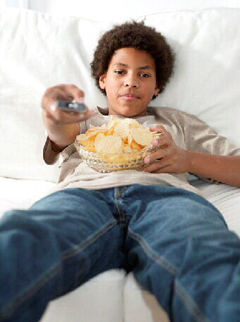
What is a misplaced modifier?
One little word can make a big difference.
Notice how the placement of the word only changes the meaning of the sentence.
only
only
only
On Saturdays, my brother and I watch movies on TV.
^
^
^
Do you watch on Saturdays, but not on any other day?
Do you have one brother and no others?
Do you watch movies, but nothing else?
In each position, only modifies a different word.

Slide 3
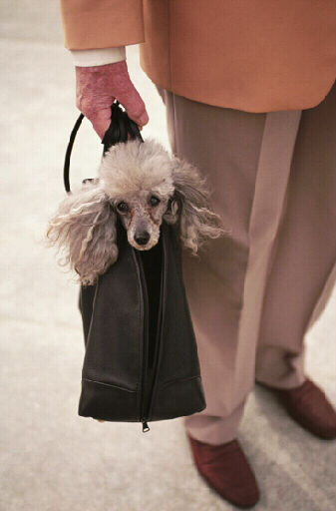
What is a misplaced modifier?
A word, phrase, or clause that seems to modify the wrong word or word group in a sentence is called a misplaced modifier.
Misplaced modifiers are confusing.
misplaced modifier
Her dog sat as she waited for the bus patiently.
Verb
Verb
Who is sitting? The dog? The girl?
Who is waiting? The girl? The dog?

Slide 4

What is a misplaced modifier?
A misplaced modifier can be funny, too.
misplaced modifier
The bowl slipped off the table, which was full of soup.
Noun
Noun
What was probably full of soup? The table? The bowl?
Common sense tells us that the bowl, not the table, was full of soup.
The noun table is right before the adjective clause, so the table seems to be full of soup.

Slide 5
What is a misplaced modifier?
A misplaced modifier can be one word.
one word
OR
Helplessly, the parakeet escaped as the girl watched.
Who was helpless?
The escaping parakeet?
The watching girl?

Slide 6

What is a misplaced modifier?
A misplaced modifier can also be a clause or a phrase.
OR
phrase
The dog chased the ducks, yapping and barking.
Who was yapping and barking?
The ducks? The dog?
OR
clause
The team will receive a trophy that wins the game.
Who wins the game?
The team? The trophy?

Slide 7
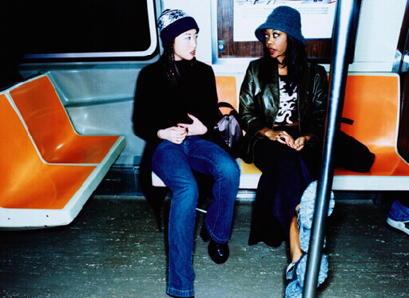
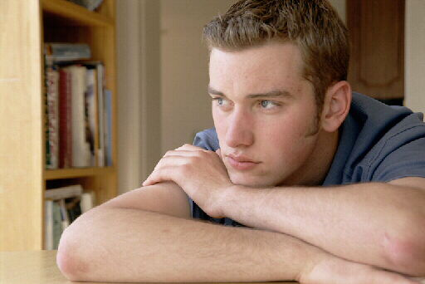
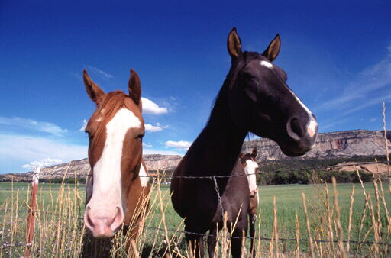
What is a misplaced modifier?
Phrase
A phrase is a group of related words that
  is used as a single part of speech
  does not contain a verb and its subject
on the subway
to go hiking
knocking on the door
have been thinking
held tightly
in the field

Slide 8

What is a misplaced modifier?
Clause
A clause is a word group that contains a verb and its subject.
subject
verb
subject
verb
We work in my garden
when the weather is nice.
clause
clause
subject
verb
subject
verb
They like the flowers
that I planted.
clause
clause

Slide 9

What is a misplaced modifier?
Identify the misplaced modifier in each of the following sentences.
1. About six inches long, the Tyrannosaurus rex had sharp teeth.
2. I found many earthworms planting my garden.
3. An old log sat in the fireplace that was covered with moss.

Slide 10
What is a misplaced modifier?
Identify the misplaced modifier in each of the following sentences.
1. About six inches long, the Tyrannosaurus rex had sharp teeth.
Was the T. rex about six inches long, or were its teeth six inches long?

Slide 11
What is a misplaced modifier?
Identify the misplaced modifier in each of the following sentences.
2. I found many earthworms planting my garden.
Was I planting my garden, or were the earthworms planting my garden?

Slide 12
What is a misplaced modifier?
Identify the misplaced modifier in each of the following sentences.
3. An old log sat in the fireplace that was covered with moss.
Was the log covered with moss, or was the fireplace covered with moss?

Slide 13
What is a misplaced modifier?
On Your Own
Determine whether the underlined word or phrase is a misplaced modifier. Write M for a misplaced modifier or C if the modifier is not misplaced.
___ 1. We watched a film about how comets are formed in science class.
___ 2. In a tank at the aquarium, we watched the seals play.
___ 3. Exhausted, the hikers needed a good night’s rest.
[End of Section]

Slide 14
What is a misplaced modifier?
Answers
Determine whether the underlined word or phrase is a misplaced modifier. Write M for a misplaced modifier or C if the modifier is not misplaced.
___ 1. We watched a film about how comets are formed in science class.
___ 2. In a tank at the aquarium, we watched the seals play.
___ 3. Exhausted, the hikers needed a good night’s rest.
M
M
C

Slide 15
How to fix misplaced modifiers
Place modifying words, phrases, and clauses as near as possible to the words they modify.
Sandra saw a bird’s nest.
with two eggs
Where should these two phrases be placed in this sentence?
looking up
Looking up,
Sandra saw a bird’s nest
with two eggs.
Who was looking up? Sandra was.
What had two eggs? The nest did.

Slide 16
How to fix misplaced modifiers
One-word modifiers
Be especially careful to place the following modifiers right before the word they modify so that your meaning is clear.
almost | even | hardly | just
merely | nearly | not | only
All of the members were not at the meeting.
=
No members came to the meeting.
Not all of the members were at the meeting.
=
Some of the members were at the meeting.

Slide 17
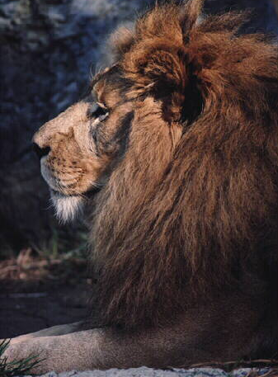
How to fix misplaced modifiers
Phrase modifiers
When a sentence contains several modifying phrases, follow these steps to make sure none of them are misplaced.
Maria took a picture in the grass of a lion using her new camera.
Step 1: Find the basic sentence.
Maria took a picture.

Slide 18

How to fix misplaced modifiers
Phrase modifiers
Step 2: One at a time, insert the phrases near the word or words they modify.
Phrase 1:
of a lion
This phrase should modify picture.
Maria took a picture
of a lion.

Slide 19
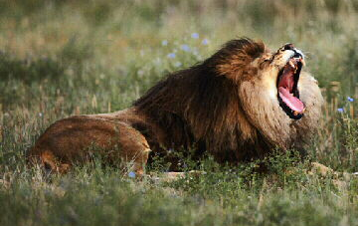
How to fix misplaced modifiers
Phrase modifiers
Step 2: One at a time, insert the phrases near the word or words they modify.
Phrase 2:
in the grass
This phrase should modify lion.
Maria took a picture of a lion
in the grass.

Slide 20

How to fix misplaced modifiers
Phrase modifiers
Step 2: One at a time, insert the phrases near the word or words they modify.
Phrase 3:
using her new camera
This phrase should modify Maria.
Using her new camera,
Maria took a picture of a lion in the grass.

Slide 21
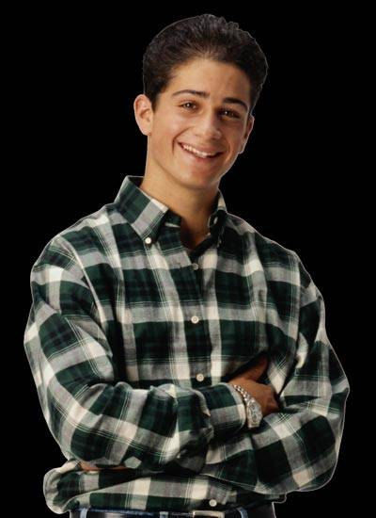

How to fix misplaced modifiers
Phrase modifiers
Sometimes the placement of a phrase has to be changed when you add another phrase.
Grammar Guy Says...
of a lion
Maria took a picture using her new camera.
This sentence is correct, but look what happens when you add another phrase.
Maria took a picture of a lion using her new camera.
Using her new camera, Maria took a picture of a lion.
Now the placement of both phrases makes sense.
Was the lion using her new camera?

Slide 22
How to fix misplaced modifiers
Clause modifiers
When a modifying clause seems to be misplaced, follow these steps to fix the sentence.
misplaced modifier
There is a car in the garage that has no windshield.
Step 1: Figure out which thing lacks a windshield. The car? The garage?
OR
misplaced modifier
There is a car in the garage that has no windshield.
Place the modifier as close as possible to the thing it modifies–in this case, the car.

Slide 23
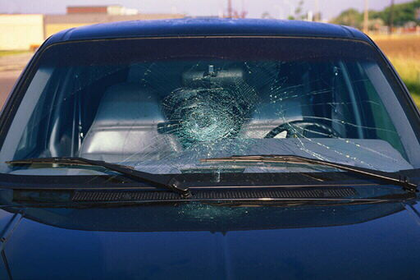
How to fix misplaced modifiers
Clause modifiers
Step 2: Decide if a phrase or another clause is between the clause and the word it should be modifying.
misplaced modifier
There is a car in the garage that has no windshield.
in the garage
Prep. phrase
The prepositional phrase separates the adjective clause from the noun it modifies, car.

Slide 24
How to fix misplaced modifiers
Clause modifiers
Step 3: Decide where to move the word, phrase, or clause that is in the wrong place.
misplaced modifier
There is a car in the garage that has no windshield.
in the garage
Prep. phrase
misplaced modifier
In the garage,
there is a car that has no windshield.
Moving the phrase to the beginning of the sentence eliminates the confusion. Now the clause is next to word it modifies.

Slide 25
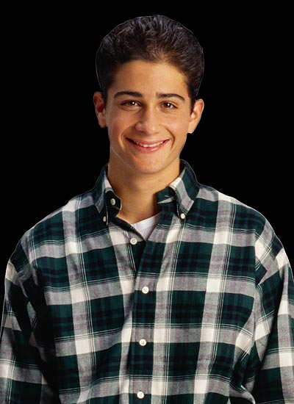
How to fix misplaced modifiers
Clause modifiers
Check your punctuation when you move a clause or a phrase. Usually, we use a comma after the introductory phrase or clause.
Grammar Guy Says...
As I rode my bicycle, a dog chased me.
Chasing a crow, the dog barked loudly.

Slide 26
How to fix misplaced modifiers
Revise each sentence to correct the underlined misplaced modifier. Be prepared to explain your answer.
Pierre saw a Great Dane cycling through the park.
In different countries, I read about unusual customs.
3. Jan showed the rooms to her visitors that she had painted.

Slide 27
How to fix misplaced modifiers
Revise each sentence to correct the underlined misplaced modifier. Be prepared to explain your answer.
OR
Pierre saw a Great Dane cycling through the park.
Cycling through the park, Pierre saw a Great Dane.
Pierre—not the Great Dane—was cycling through the park.

Slide 28
How to fix misplaced modifiers
Revise each sentence to correct the underlined misplaced modifier. Be prepared to explain your answer.
OR
In different countries, I read about unusual customs.
I read about unusual customs in different countries.
The customs are in different parts of the world. I did not read in different parts of the world.

Slide 29
How to fix misplaced modifiers
Revise each sentence to correct the underlined misplaced modifier. Be prepared to explain your answer.
OR
3. Jan showed the rooms to her visitors that she had painted.
Jan showed the rooms that she had painted to her visitors.
Jan didn’t paint the visitors; she painted the rooms.

Slide 30
How to fix misplaced modifiers
On Your Own
Revise each sentence to correct the misplaced modifier.
1. The mayor pledged she would build more roads at the meeting.
2. The winners marched off the platform carrying trophies.
3. I watched the hawk grab its prey with my new pair of binoculars.
4. There was a bird in the tree that had a strange- looking beak.
[End of Section]

Slide 31
How to fix misplaced modifiers
Answers
Revise each sentence to correct the misplaced modifier.
1. The mayor pledged she would build more roads at the meeting.
2. The winners marched off the platform carrying trophies.
3. I watched the hawk grab its prey with my new pair of binoculars.
4. There was a bird in the tree that had a strange- looking beak.
1. At the meeting, the mayor pledged she would build more roads.
2. Carrying trophies, the winners marched off the platform.
3. With my new pair of binoculars, I watched the hawk grab its prey.
4. In the tree, there was a bird that had a strange- looking beak.

Slide 32
Review A
Identify the misplaced modifier in each sentence.
1. Frank listened to music climbing the mountains.
2. Flying over the bridge, Lisa spotted a blue heron.
3. Did you find any of the hats your grandmother wore in the attic?
4. The softball team almost practices every afternoon.
5. The plane landed safely on the runway that had engine trouble.
[End of Section]

Slide 33
Review A
Identify the misplaced modifier in each sentence.
1. Frank listened to music climbing the mountains.
2. Flying over the bridge, Lisa spotted a blue heron.
3. Did you find any of the hats your grandmother wore in the attic?
4. The softball team almost practices every afternoon.
5. The plane landed safely on the runway that had engine trouble.

Slide 34
Review B
Revise each sentence to correct the misplaced modifier.
1. Running, the track seemed very long to the athlete.
2. I found a huge boulder taking a shortcut through the woods.
3. I have nearly read all of his books.
4. We could see corn growing from our car window.
5. The picture was hanging on the wall that we bought last month.
[End of Section]

Slide 35
Review B
Revise each sentence to correct the misplaced modifier.
Revise each sentence to correct the misplaced modifier.
1. Running, the track seemed very long to the athlete.
1. The track seemed very long to the running athlete.
2. I found a huge boulder taking a shortcut through the woods.
2. Taking a shortcut through the woods, I found a huge boulder.
3. I have nearly read all of his books.
3. I have read nearly all of his books.
4. We could see corn growing from our car window.
4. From our car window, we could see corn growing.
5. The picture was hanging on the wall which we bought last month.
5. The picture that we bought last month was hanging on the wall.

Slide 36
The End

