Slide 1

Using End Marks
What are end marks?
Periods
Sentences
Abbreviations
Question marks
Exclamation points
Review A
Review B

Slide 2
What are end marks?
How difficult is this paragraph to read?
have you ever thought you were dreaming but woke up to find that the dream was really happening one morning last week I dreamed that I was swimming when I finally woke up I realized that a pipe had burst water was pouring through the ceiling what a mess it made
Have you ever thought you were dreaming but woke up to find that the dream was really happening? One morning last week, I dreamed that I was swimming. When I finally woke up, I realized that a pipe had burst; water was pouring through the ceiling. What a mess it made!
You can figure it out, of course. But without punctuation and capital letters, it’s not as easy to read.

Slide 3
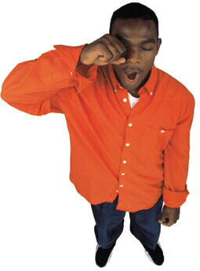
What are end marks?
End marks—periods, question marks, and exclamation points—are punctuation marks that tell the reader where a sentence ends. Where you place end marks can change the meaning of a sentence.
I’ll be up late tomorrow I have a big test
I’ll be up late tomorrow. I have a big test.
I’ll be up late. Tomorrow I have a big test.

Slide 4
What are end marks?
End marks also indicate the purpose of a sentence.
Statement
I finished my paper last night.
Question
Did you finish your paper last night?
Exclamation
I finally finished that paper!
Command
Hurry up and finish that paper!
Request
Please finish the paper today.

Slide 5

What are end marks?
When you speak, you can make your meaning clear by
the tone and pitch of your voice
the pauses in your speech
your gestures and expressions
When you write, however, you use end marks and other punctuation to help the reader understand your meaning.
[End of Section]

Slide 6

Periods
The period is the most common end mark.
Periods are used to end
statements
indirect questions
requests and mild commands
Also, we use a period after most abbreviations.

Slide 7


Periods
Sentences
A statement ends with a period.
My sister has a new car.
I didn’t enjoy the movie.
Statements are also called declarative sentences.

Slide 8
Periods
Sentences
An indirect question ends with a period.
An indirect question does not use a speaker’s exact words. An indirect question is a type of statement.
I wondered what plant grows that fast.
Indirect question
What plant grows that fast?
Direct question

Slide 9

Periods
Sentences
A request or a mild command ends with a period.
Request
Please bring me a glass of water.
Command
Put it on the table in the kitchen.
Requests and commands are imperative sentences.

Slide 10
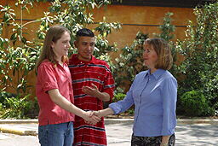



Periods
Abbreviations
An abbreviation is a shortened version of a word or word group.
Periods are used in abbreviations of
personal names
titles
geographical terms
time
units of measurement

Slide 11


Periods
Abbreviations
To abbreviate or not to abbreviate? As a general rule, only a few abbreviations are appropriate in the body of a formal paper for a general audience.
Grammar Gal Says...
The prof. introduced Dr. Smith, who was born in Sacramento, Calif.
The professor introduced Dr. Smith, who was born in Sacramento, California.

Slide 12
Periods
Abbreviations
Personal names
Some people are known by their initials.
J. K. Rowling
W.E.B. DuBois
Two initials: Put a space between the initials.
Three initials: No spaces between the initials.
Abbreviate a person’s name only if the person is known by that abbreviation.
President John F. Kennedy
President J. F. Kennedy

Slide 13
Periods
Abbreviations
Titles
Abbreviate social titles before the full name or before the last name alone.
Dr. Sara Michaels
Mr. Alonzo
Abbreviate civil and military titles if used before the full name (or initials and last name). Spell out if used before the last name only.
Sen. John Smith
Senator Smith
Prof. E. Q. Jones
Professor Jones

Slide 14

Periods
Abbreviations
Titles
Abbreviate titles and academic degrees that follow proper names.
Marcus Williams, Jr.
Sara Michaels, M.D.
E. Q. Jones, Ph.D.

Slide 15

Periods
Abbreviations
Geographical terms
When you abbreviate a state, capitalize both letters, and do not use periods. Abbreviate names of states and political units only in tables, notes, and bibliographies. Spell them out in text.
Galveston, TX | Orlando, FL
Malibu, CA | Cape Cod, MA
They live in Galveston, Texas, near the beach.

Slide 16

Periods
Abbreviations
Geographical terms
You may abbreviate addresses in letters and on envelopes. Spell out every word of an address in text.
Envelope
41 W. Maple St.
Text
We live at 41 West Maple Street.

Slide 17
Periods
Abbreviations
Time
Abbreviate common era designations.
A.D. 1492
=
Anno domini, Latin for “in the year of our Lord”
or
1200 C.E.
=
Common Era (sometimes used in place of A.D.)
1200 B.C.
=
Before Christ
or
1200 B.C.E.
=
Before Common Era (sometimes used in place of B.C.)

Slide 18
Periods
Abbreviations
When you write the name of a century, put the abbreviation for the era after the name.
Grammar Gal Says...
in the fifteenth century A.D.
When you use the abbreviation with a specific year, the abbreviation comes before the date only when it’s A.D. When you use B.C., it follows the year.
A.D. 1492
305 B.C.

Slide 19

Periods
Abbreviations
Time
You may abbreviate names of months and days in tables, notes, and bibliographies.
Note
Thurs., Mar. 21
In text, spell out the names of months and days.
Text
The meeting took place on Thursday, March 21.

Slide 20
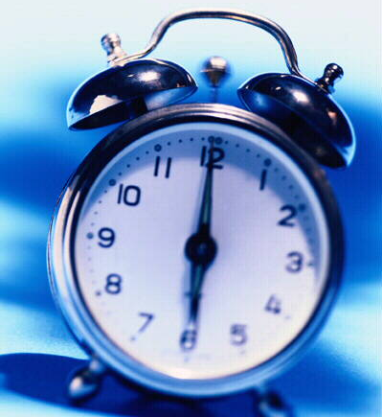
Periods
Abbreviations
Time
Abbreviate the designations for the two halves of the day measured by clock time.
8:30 A.M.
6:00 P.M.
A.M. =
ante meridiem, Latin phrase meaning “before noon”
P.M. =
post meridiem, Latin phrase meaning “after noon”

Slide 21

Periods
Abbreviations
When you use A.M. or P.M. with times of the day, do not also use the words morning, afternoon, or evening.
Grammar Gal Says...
The bus leaves at 6:30 A.M. in the morning.
The bus leaves at 6:30 A.M.
OR
The bus leaves at 6:30 in the morning.

Slide 22
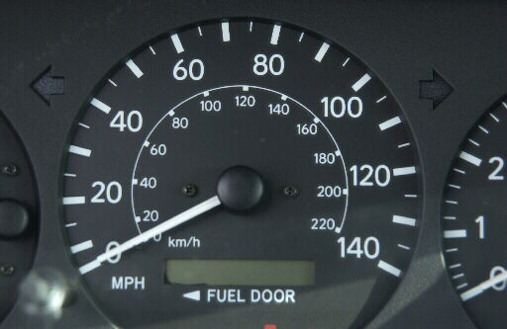
Periods
Abbreviations
Units of measurement
You may abbreviate units of measurement in tables, notes, and bibliographies. In text, spell out the names of units. Note that mph does not have periods.
Speed Limits
Highway | 70 mph
Town | 45 mph
Forty-five miles per hour is the speed limit in town.

Slide 23

Periods
Abbreviations
Units of measurement
Abbreviations for units of measurement are usually written without periods.
millimeter
mm
pound
lb
yard
yd
teaspoon
tsp
Use a period with the abbreviation for inch (in.) to prevent confusing it with the word in.
inch
in.

Slide 24
Periods
Abbreviations
When a statement ends with an abbreviation, don’t add another period. But when the sentence is a question or an exclamation, do add the question mark or exclamation point.
Grammar Gal Says...
He just received his Ph.D.
When did he receive his Ph.D.?

Slide 25

Periods
Add periods where needed in the following sentences.
1. This is the correct address
2. Please meet me after school
3. Mr and Mrs Jackson came to visit us last week
4. Those paintings were made before 3000 BC

Slide 26
Periods
Add periods where needed in the following sentences.
1. This is the correct address.
A statement, or declarative sentence, ends with a period.

Slide 27
Periods
Add periods where needed in the following sentences.
2. Please meet me after school.
A request or mild command ends with a period.

Slide 28
Periods
Add periods where needed in the following sentences.
3. Mr. and Mrs. Jackson came to visit us last week.
Use a period after abbreviations of social titles such as Mr., Mrs., and Dr.

Slide 29
Periods
Add periods where needed in the following sentences.
4. Those paintings were made before 3000 B.C.
An abbreviation that designates an era has a period after each letter. Also, if an abbreviation with a period ends a statement, do not add another period.

Slide 30
Periods
On Your Own
Add periods where needed in the following sentences.
1. Dr Falcon will be in his office this morning
2. I wonder who left that jacket here
3. Does that movie end by 9:45 PM?
4. Franklin D Roosevelt was the president at that time
5. All of my friends enjoy hiking
[End of Section]

Slide 31
Periods
Answers
Add periods where needed in the following sentences.
1. Dr Falcon will be in his office this morning
2. I wonder who left that jacket here
3. Does that movie end by 9:45 PM?
4. Franklin D Roosevelt was the president at that time
5. All of my friends enjoy hiking
1. Dr. Falcon will be in his office this morning.
2. I wonder who left that jacket here.
3. Does that movie end by 9:45 P.M.?
4. Franklin D. Roosevelt was the president at that time.
5. All of my friends enjoy hiking.

Slide 32
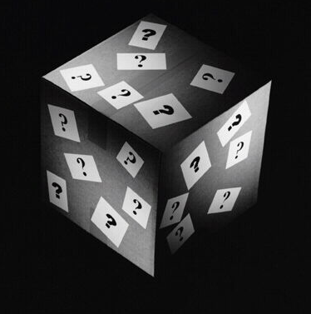
Question marks
A direct question ends with a question mark.
Are you almost ready to leave?
Why don’t you ask her?
How did you do that problem?
Questions are also called interrogative sentences.

Slide 33
Question marks
Sometimes a direct question has the same word order as a statement.
Statement
You’re not ready to leave yet.
Question
You’re not ready to leave yet?
This form of question is common in speaking (and in written dialogue). In formal writing, you should avoid writing questions in this way.

Slide 34
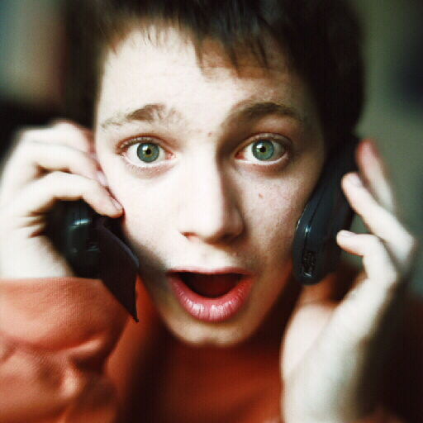

Exclamation points
An exclamation ends with an exclamation point.
We won the championship!
That bug is huge!
Exclamations are also called exclamatory sentences.

Slide 35
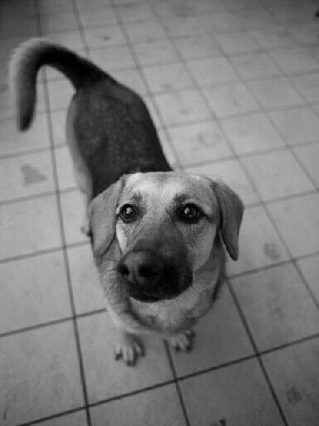

Exclamation points
A strong command ends with an exclamation point.
Sit down right now!
Watch out!
Commands and requests are imperative sentences.

Slide 36


Exclamation points
An interjection is often followed by an exclamation point.
Ouch! That rose has sharp thorns!
Sometimes, an interjection is followed by a comma rather than an exclamation point.
Oh, I really don’t know.

Slide 37
Exclamation points
An interjection is a word that expresses emotion.
ah | hurrah | uh-oh | wow
aha | oh | well | yahoo
cool | oops | whew | yikes
hey | ouch | whoa | yippee

Slide 38
Exclamation points
An interjection is not grammatically related to the sentence, so it is set off from the rest of the sentence by a comma or with an exclamation point.
Well! I’ve never been so insulted in my life!
Well, I think I have finally finished that paper.
Make sure the punctuation you use with an interjection reflects the intensity of the emotion you intend.

Slide 39
Question marks and exclamation points
Insert question marks or exclamation points, as appropriate, in the following sentences.
1. You must be kidding
2. Do you think James remembered my book
3. Oh, no Mikey, don’t touch that

Slide 40
Question marks and exclamation points
Insert question marks or exclamation points, as appropriate, in the following sentences.
1. You must be kidding!
Use an exclamation point to end an exclamation (or exclamatory sentence).

Slide 41
Question marks and exclamation points
Insert question marks or exclamation points, as appropriate, in the following sentences.
2. Do you think James remembered my book?
Use a question mark to end a direct question (or interrogative sentence).

Slide 42
Question marks and exclamation points
Insert question marks or exclamation points, as appropriate, in the following sentences.
3. Oh, no! Mikey, don’t touch that!
Use an exclamation point after a strong interjection. Also use an exclamation point to end a strong command.

Slide 43
Question marks and exclamation points
On Your Own
Add question marks or exclamation points, as appropriate, to the following sentences.
1. Would you please play this game with me
2. That’s the silliest idea I’ve ever heard
3. He’s not still driving that car, is he
4. I nearly ran over that dog Yikes
Answer me right now
[End of Section]

Slide 44
Question marks and exclamation points
Answers
Add question marks or exclamation points, as appropriate, to the following sentences.
1. Would you please play this game with me
2. That’s the silliest idea I’ve ever heard
3. He’s not still driving that car, is he
4. I nearly ran over that dog Yikes
Answer me right now
1. Would you please play this game with me?
2. That’s the silliest idea I’ve ever heard!
3. He’s not still driving that car, is he?
4. I nearly ran over that dog! Yikes!
5. Answer me right now!

Slide 45
Review A
In the following sentences, add or replace end marks as needed. If a sentence is already correct, write C.
  1. I read an article about snakes?
  2. Can you tell me the way to the park!
  3. She asked whether the student was named Phil.
  4. The author of the book was born in Wisconsin
  5. Wow. What a great shot that was
[End of Section]

Slide 46
Review A
In the following sentences, add or replace end marks as needed. If a sentence is already correct, write C.
  1. I read an article about snakes.
  2. Can you tell me the way to the park?
  3. She asked whether the student was named Phil.
  4. The author of the book was born in Wisconsin.
  5. Wow! What a great shot that was!
C

Slide 47
Review B
Add end marks as needed in the following sentences.
  How exciting your trip must have been
  Please turn out the light when you leave the room
  Mr Watson, what is the best way to hard-boil an egg
  The students were listening closely to the guest speaker, Elizabeth B Brown, MD
  Everyone wondered why he always arrived late
[End of Section]

Slide 48
Review B
Add end marks as needed in the following sentences.
  How exciting your trip must have been!
  Please turn out the light when you leave the room.
  Mr. Watson, what is the best way to hard-boil an egg?
  The students were listening closely to the guest speaker, Elizabeth B. Brown, M.D.
  Everyone wondered why he always arrived late.

Slide 49
The End

