Slide 1

Writing with Detail:
Adverbials and Appositives
Identifying adverbials
Adding detail with adverbials
Identifying appositives
Adding detail with appositives
Review A
Review B

Slide 2
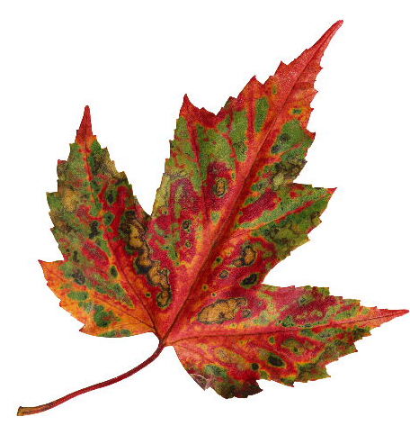
Adding detail
Adverbials and appositives
Descriptive writing shows not only what happened but how it happened.
The leaf fell slowly to earth.
What
The leaf fell to earth.
How
Writers also add detail and dimension by renaming nouns.
They arrived in Ningbo.
They arrived in Ningbo, a Chinese port city.
The first example includes detail in an adverbial. The second includes an appositive.

Slide 3
Identifying adverbials
An adverb modifies a verb, an adjective, or another adverb.
Verb
Adverb
Adverb
Adjective
Adverb
Adverb
fell
slowly
hardly
dry
quite
slowly
An adverbial is a word or group of words (such as a phrase or clause) that functions as an adverb.
fell
from a branch
fell
when the wind blew
fell
quickly

Slide 4
Identifying adverbials
Adverbials provide detail by answering the following questions.
Where?
They met here.
They met in the park.
When?
He left today.
He left when I arrived.
How?
She sang softly.
She sang with joy.
To what extent?
I ate too much.
I ate more than he did.

Slide 5
Identifying adverbials
When Jack London wrote White Fang, he used many adverbials to provide detail:
The men slept, breathing heavily, side by side, under the one covering. The fire died down, and the gleaming eyes drew closer the circle they had flung about the camp. The dogs clustered together in fear, now and again snarling menacingly as a pair of eyes drew close.
The men slept, breathing heavily, side by side, under the one covering. The fire died down, and the gleaming eyes drew closer the circle they had flung about the camp. The dogs clustered together in fear, now and again snarling menacingly as a pair of eyes drew close.
The men slept, breathing heavily, side by side, under the one covering. The fire died down, and the gleaming eyes drew closer the circle they had flung about the camp. The dogs clustered together in fear, now and again snarling menacingly as a pair of eyes drew close.
The men slept, breathing heavily, side by side, under the one covering. The fire died down, and the gleaming eyes drew closer the circle they had flung about the camp. The dogs clustered together in fear, now and again snarling menacingly as a pair of eyes drew close.
The men slept, breathing heavily, side by side, under the one covering. The fire died down, and the gleaming eyes drew closer the circle they had flung about the camp. The dogs clustered together in fear, now and again snarling menacingly as a pair of eyes drew close.
The men slept, breathing heavily, side by side, under the one covering. The fire died down, and the gleaming eyes drew closer the circle they had flung about the camp. The dogs clustered together in fear, now and again snarling menacingly as a pair of eyes drew close.
The men slept, breathing heavily, side by side, under the one covering. The fire died down, and the gleaming eyes drew closer the circle they had flung about the camp. The dogs clustered together in fear, now and again snarling menacingly as a pair of eyes drew close.
The men slept, breathing heavily, side by side, under the one covering. The fire died down, and the gleaming eyes drew closer the circle they had flung about the camp. The dogs clustered together in fear, now and again snarling menacingly as a pair of eyes drew close.
The men slept, breathing heavily, side by side, under the one covering. The fire died down, and the gleaming eyes drew closer the circle they had flung about the camp. The dogs clustered together in fear, now and again snarling menacingly as a pair of eyes drew close.
The men slept, breathing heavily, side by side, under the one covering. The fire died down, and the gleaming eyes drew closer the circle they had flung about the camp. The dogs clustered together in fear, now and again snarling menacingly as a pair of eyes drew close.
The men slept, breathing heavily, side by side, under the one covering. The fire died down, and the gleaming eyes drew closer the circle they had flung about the camp. The dogs clustered together in fear, now and again snarling menacingly as a pair of eyes drew close.
The men slept, breathing heavily, side by side, under the one covering. The fire died down, and the gleaming eyes drew closer the circle they had flung about the camp. The dogs clustered together in fear, now and again snarling menacingly as a pair of eyes drew close.
The men slept, breathing heavily, side by side, under the one covering. The fire died down, and the gleaming eyes drew closer the circle they had flung about the camp. The dogs clustered together in fear, now and again snarling menacingly as a pair of eyes drew close.
How many adverbials can you find?
12

Slide 6

Identifying adverbials
Without the adverbials, the passage would be hard to understand and much less detailed.
The men slept, breathing. The fire died, and the gleaming eyes drew the circle they had flung. The dogs clustered.
The passage is hard to understand because no adverbials indicate where, when, how, and to what extent the action happened.

Slide 7

Identifying adverbials
Identify each adverbial in the following sentences from Jack London’s White Fang. Each sentence may contain more than one adverbial. Be prepared to identify what question each adverbial answers.
1. He got out of bed carefully. . . .
2. He glanced casually at the huddling dogs.
3. He rubbed his eyes and looked at them more sharply.

Slide 8
Identifying adverbials
Identify each adverbial in the following sentences from Jack London’s White Fang. Each sentence may contain more than one adverbial. Be prepared to identify what question each adverbial answers.
1. He got out of bed carefully. . . .
Out of bed is an adverbial phrase and carefully is an adverb. Both adverbials modify the verb got. Out of bed answers the question “Where?” and carefully answers the question “How?”.

Slide 9
Identifying adverbials
Identify each adverbial in the following sentences from Jack London’s White Fang. Each sentence may contain more than one adverbial. Be prepared to identify what question each adverbial answers.
2. He glanced casually at the huddling dogs.
Casually is an adverb and at the huddling dogs is an adverbial phrase. Both adverbials modify the verb glanced. Casually answers the question “How?” and at the huddling dogs answers the question “Where?”.

Slide 10
Identifying adverbials
Identify each adverbial in the following sentences from Jack London’s White Fang. Each sentence may contain more than one adverbial. Be prepared to identify what question each adverbial answers.
3. He rubbed his eyes and looked at them more sharply.
At them is an adverbial phrase; more and sharply are adverbs. At them and sharply modify the verb looked. At them answers the question “Where?” and sharply answers the question “How?”. More modifies the adverb sharply and answers the question “To what extent?”.

Slide 11
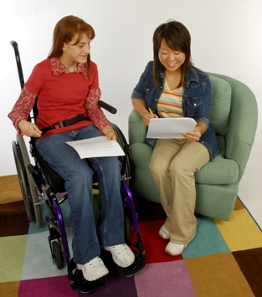
Adding detail with adverbials
To add detail to your writing, include
words, phrases, and clauses that answer these questions:
The hail dented cars along our block.
Where?
The hail dented cars.
We left.
When?
After the movie was over, we left.
Maya makes money.
How?
Maya makes money by mowing lawns.
To what extent?
Mix the ingredients.
Mix the ingredients thoroughly.

Slide 12
Adding detail with adverbials
On Your Own
The following sentences describe a scene but are not very detailed. Add detail to each of the following sentences by adding adverbials.
1. The ranger looked.
2. Smoke was rising.
3. She had to act.
4. Grabbing her radio, she sent an urgent message.
5. A fire crew arrived.
[End of Section]

Slide 13
Adding detail with adverbials
Possible Answers
The following sentences describe a scene but are not very detailed. Add detail to each of the following sentences by adding adverbials.
1. The ranger looked over the treetops.
2. In the distance smoke was rising from the forest.
3. She had to act quickly.
4. Grabbing her radio, she sent an urgent message back to headquarters.
5. Fortunately a fire crew arrived just in time.

Slide 14

Identifying appositives
Another way to add detail is by using appositives.
An appositive is a noun or pronoun placed beside
another noun or pronoun to identify or describe it.
This is my friend
Seth.
This is my friend
An appositive phrase consists of an appositive and any of its modifiers. Sometimes an appositive phrase precedes the noun to which it refers.
A trained mechanic,
He repairs aircraft.
he repairs aircraft.
he repairs aircraft.

Slide 15


Identifying appositives
As in math, an appositive shows what a noun or pronoun “equals.”
Grammar Guy Says...
She is my sister Sarah.
sister
=
Sarah
A talented designer, she interns at an architectural firm.
she
=
a talented designer

Slide 16
Identifying appositives
See how authors add detail by renaming nouns.
William Shakespeare, Hamlet
This one is Lucianus, nephew to the king.
Nephew to the king renames Lucianus.
Edith Wharton, Ethan Frome
Frome was in the habit of walking into Starkfield to fetch home his wife's cousin, Mattie Silver.
Mattie Silver renames cousin.

Slide 17
Identifying appositives
Appositives can be much longer than a single word, as in this example from “The Interlopers,” by Saki.
. . . if there was a man in the world whom he detested and wished ill will to, it was Georg Znaeym, the inheritor of the quarrel and the tireless game snatcher and raider of the disputed border forest.
the inheritor of the quarrel and the tireless game snatcher and raider of the disputed border forest renames Georg Znaeym.

Slide 18
Identifying appositives
Identify the appositive in each of the following sentences. Be prepared to tell what each appositive defines or renames.
1. There we met Yvonne’s mother, Nora.
2. A friendly cat, Sombra behaves like a dog.
3. The famous astronomer Galileo Galilei used this telescope.

Slide 19
Identifying appositives
Identify the appositive in each of the following sentences. Be prepared to tell what each appositive defines or renames.
1. There we met Yvonne’s mother, Nora.
Nora is an appositive that identifies mother.

Slide 20
Identifying appositives
Identify the appositive in each of the following sentences. Be prepared to tell what each appositive defines or renames.
2. A friendly cat, Sombra behaves like a dog.
The appositive a friendly cat comes at the beginning of the sentence and identifies Sombra.

Slide 21
Identifying appositives
Identify the appositive in each of the following sentences.
3. The famous astronomer Galileo Galilei used this telescope.
The appositive Galileo Galilei renames astronomer.

Slide 22
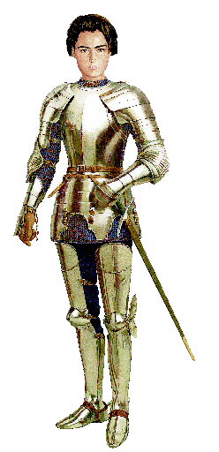
Adding detail with appositives
Some writers repeat nouns and use multiple appositives to provide detail and rhythm.
In Shakespeare’s Henry V, the young king gives his outnumbered troops an inspiring speech.
Appositive
Appositive
We few, we happy few, we band of brothers.
vs.
There are few of us. We are happy. We are a band of brothers.
Not very poetic, is it?

Slide 23
Adding detail with appositives
Appositives also provide a way to combine short,
choppy sentences.
On top of the mountain is a radio tower.
The tower is the tallest structure in the state.
the tallest structure in the state.
Turn one group of words into an appositive,
and add it to the other sentence.
On top of the mountain is a radio tower,
the tallest structure in the state.

Slide 24
Adding detail with appositives
On Your Own
Use appositives to add detail to sentences in items 1-3. Use appositives to combine sentences in items 4-5.
1. My brother will be on leave next month.
2. The car rolled into the parking lot.
3. Our neighborhood was a success story.
This fish is brightly colored. It is called a tetra.
Dr. Bam spoke to our class. He is a respected physician.
[End of Section]

Slide 25
Adding detail with prepositional phrases
Possible Answers
Use appositives to add detail to sentences in items 1-3. Use appositives to combine sentences in items 4-5.
1. My brother Andrew will be on leave next month.
2. The car, a red hybrid, rolled into the parking lot.
A combination of apartments and single-family homes, our neighborhood was a success story.
This fish, a tetra, is brightly colored.
5. A respected physician, Dr. Bam spoke to our class.

Slide 26
Review A
Provide extra detail by adding adverbials to the following sentences. Be prepared to identify which question each adverbial answers.
1. An envelope had been hidden.
2. They will meet us.
3. Sandra improved her paper.
4. This milk carton is empty.
5. We baked the bread.

Slide 27
Review A
Provide extra detail by adding adverbials to the following sentences. Be prepared to identify which question each adverbial answers.
[possible answers]
1. An envelope had been hidden behind the pipe.
Where?
2. They will meet us after one o’clock.
When?
How?
3. Sandra improved her paper by revising it.
To what extent?
4. This milk carton is nearly empty.
5. We baked the bread too long.
To what extent?

Slide 28
Review B
Add detail to each of the following sentences by adding appositives.
1. This letter is from our mayor.
2. The badger is a fierce predator.
3. My classmate won the contest.
4. Juan’s father provided the music.
5. We have known each other for ten years.

Slide 29
Review B
Add detail to each of the following sentences by adding appositives.
[possible answers]
1. This letter is from our mayor, Ms. Greeley.
2. The badger, a large rodent, is a fierce predator.
3. My classmate Bree Ann won the contest.
4. Juan’s father, Mr. Suarez, provided the music.
5. Childhood friends, we have known each other for ten years.

Slide 30
The End

