Slide 1

Writing with Liveliness: Strong Action Verbs
Strong action verbs
Saying more with less
Forming strong action verbs
Review A
Review B

Slide 2
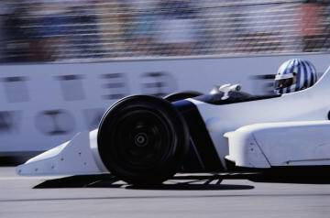

Strong action verbs
One way to become a better writer is to pay particular attention to the verbs that you use.
The best writers use strong action verbs to make
their writing specific and engaging.
Strong action verbs bring sentences to life.
The race car roared around the track.
The cheetah streaked across
the plain.

Slide 3
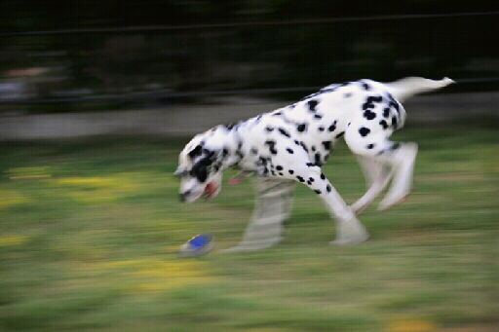
Strong action verbs
Look for opportunities to improve your writing by changing less-descriptive verbs to strong action verbs.
What happens when the writer replaces the verb in this sentence with a stronger action verb?
The dog went after the ball.
The dog raced after the ball.
The dog romped after the ball.
The dog dashed after the ball.

Slide 4


Strong action verbs
Strong action verbs give the reader more information than weak verbs. They often answer the question How? about the verb.
WEAK
STRONG
She walked to the door.
She sprinted to the door.
We ate the bread.
We gobbled the bread.
He held the baby.
He cradled the baby.
I said my name.
I whispered my name.

Slide 5
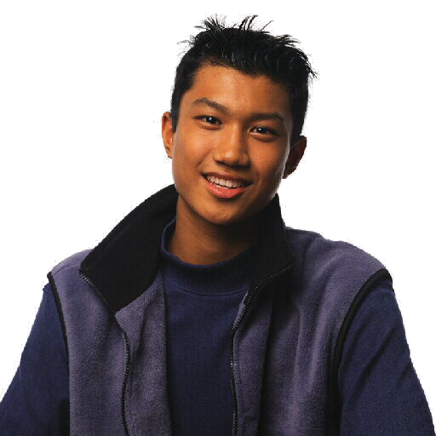

Strong action verbs
Look up weak verbs in a thesaurus to find stronger replacements. Remember, though, that these synonyms may have different meanings.
Grammar Guy Says...
grip
“to hold firmly”
cradle
“to hold gently”

Slide 6

Strong action verbs
The following sentences contain weak verbs. Replace each underlined verb with a strong action verb that is more lively.
1. Planes regularly fly above our house.
2. “I love this roller coaster!” Pete said.
3. The next player moved her bat in wide arcs.
4. The leaf fell to the ground.

Slide 7
Strong action verbs
The following sentences contain weak verbs. Replace each underlined verb with a strong action verb that is more lively.
1. Planes regularly soar above our house.
[possible answer]

Slide 8
Strong action verbs
The following sentences contain weak verbs. Replace each underlined verb with a strong action verb that is more lively.
2. “I love this ride!” Pete laughed.
[possible answer]

Slide 9
Strong action verbs
The following sentences contain weak verbs. Replace each underlined verb with a strong action verb that is more lively.
3. The next player swung her bat in wide arcs.
[possible answer]

Slide 10
Strong action verbs
The following sentences contain weak verbs. Replace each underlined verb with a strong action verb that is more lively.
4. The leaf drifted to the ground.
[possible answer]

Slide 11
Saying more with less
Adverbs modify verbs by showing where, when, how, or to what extent the action took place.
An adverb can make a weak verb more specific.
WEAK VERB + ADVERB
STRONG VERB
walk confidently
stride
run clumsily
lumber
ask politely
request
The best writers, however, choose a single strong verb that does the work of the adverb.

Slide 12
Saying more with less
Likewise, a verb may be followed by a prepositional phrase.
VERB + PREPOSITIONAL PHRASE
STRONG VERB
throw at a target
hurl
break into pieces
shatter
touch for a moment
graze
A single strong verb does the work of the verb plus prepositional phrase with fewer words.

Slide 13
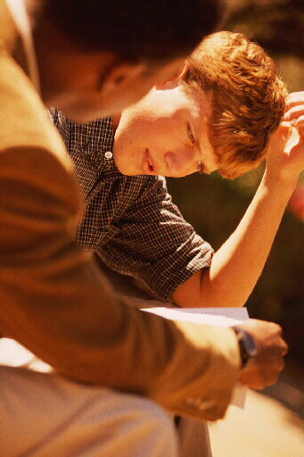
Saying more with less
Prepositional Phrase
A prepositional phrase contains
a preposition
a noun or pronoun (the object of the preposition)
any modifiers of the object
discussion
after
our long
discussion

Slide 14
Saying more with less
The following sentences contain verbs followed by adverbs or prepositional phrases. Replace each underlined expression with a single strong verb.
1. The lost balloon moved gently over the trees.
2. Vince looked briefly at his watch.
3. Books were put on top of each other all over the desk.
4. Waves rolled loudly onto the beach.

Slide 15
Saying more with less
The following sentences contain verbs followed by adverbs or prepositional phrases. Replace each underlined expression with a single strong verb.
1. The lost balloon floated over the trees.
[possible answer]

Slide 16
Saying more with less
The following sentences contain verbs followed by adverbs or prepositional phrases. Replace each underlined expression with a single strong verb.
2. Vince glanced at his watch.
[possible answer]

Slide 17
Saying more with less
The following sentences contain verbs followed by adverbs or prepositional phrases. Replace each underlined expression with a single strong verb.
3. Books were piled all over the desk.
[possible answer]

Slide 18
Saying more with less
The following sentences contain verbs followed by adverbs or prepositional phrases. Replace each underlined expression with a single strong verb.
4. Waves crashed onto the beach.
[possible answer]

Slide 19
Strong action verbs
Saying more with less
On Your Own
Replace each underlined word or group of words with a single strong verb.
1. A small frog was under the porch.
2. With each goal the fans cheered loudly.
3. Sumiko wiped the engine firmly until it gleamed.
4. The marching soldiers came to a stop at the checkpoint.
5. These deer run to safety whenever they sense people.
[End of Section]

Slide 20
Strong action verbs
Saying more with less
Possible Answers
Replace each underlined word or group of words with a single strong verb.
1. A small frog squatted under the porch.
2. With each goal the fans whooped.
3. Sumiko buffed the engine until it gleamed.
4. The marching soldiers halted at the checkpoint.
5. These deer flee whenever they sense people.

Slide 21
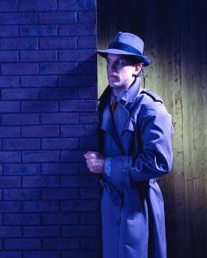
Forming strong action verbs
Sometimes sentences can be made more lively by turning a noun into a verb.
We took measurements of the window.
measurements
measured
We measured the window.
Look at your own sentences and ask
whether any nouns have verbs “hiding”
in them.

Slide 22
Forming strong action verbs
We can make the following sentences more lively and concise by turning a noun into an action verb.
The class made a list of possible topics.
1.
list
The class listed possible topics.
listed
2.
suggestion
Tom offers the suggestion that we go for a hike.
Tom suggests that we go for a hike.
suggests

Slide 23
Forming strong action verbs
Another way to form strong action verbs is by adding a prefix or a suffix to an adjective.
ADJECTIVE
+ SUFFIX
= VERB
simple
–ify
simplify (make simple)
modern
–ize
modernize (make modern)
PREFIX
+ ADJECTIVE
+ SUFFIX
= VERB
en–
live
–en
enliven (make lively)

Slide 24
Forming strong action verbs
Prefixes and suffixes
A prefix is a word part added before a base word.
Prefix
Base Word
re–
view
=
review
A suffix is a word part added after a base word.
Base Word
Suffix
know
–able
=
knowable

Slide 25
Forming strong action verbs
Turn each word into a strong action verb by changing a noun or adjective into a verb or by adding a prefix or suffix.
1. information
2. beautiful
3. light
4. symbol

Slide 26
Forming strong action verbs
Turn each word into a strong action verb by changing a noun or adjective into a verb or by adding a prefix or suffix.
1. information
NOUN
inform
The suffix –ation turns verbs into nouns. Removing the suffix makes the word a verb again.

Slide 27
Forming strong action verbs
Turn each word into a strong action verb by changing a noun or adjective into a verb or by adding a prefix or suffix.
2. beautiful
ADJECTIVE
beautify
Here the suffix –ify replaces another suffix, –ful.

Slide 28
Forming strong action verbs
Turn each word into a strong action verb by changing a noun or adjective into a verb or by adding a prefix or suffix.
3. light
ADJECTIVE
enlighten
The prefix –en and the suffix –en make the adjective into a strong action verb.

Slide 29
Forming strong action verbs
Turn each word into a strong action verb by changing a noun or adjective into a verb or by adding a prefix or suffix.
4. symbol
NOUN
symbolize
The suffix –ize turns the noun into a strong action verb.

Slide 30
Forming strong action verbs
On Your Own
Revise each sentence by turning the underlined word into a verb. Delete other words as necessary.
1. A surprising number of people cast their votes yesterday.
2. We had a discussion about the new security plan.
3. That concert has been made public widely.
4. After the rally, our fundraising became more intense.
5. The new bulbs make the room considerably brighter.
[End of Section]

Slide 31
Forming strong action verbs
Answers
Revise each sentence by turning the underlined word into a verb. Delete other words as necessary.
1. A surprising number of people voted yesterday.
2. We discussed the new security plan.
3. That concert has been publicized widely.
4. After the rally, our fundraising intensified.
5. The new bulbs considerably brighten the room.

Slide 32
Review A
The following paragraph contains weak verbs and wordy expressions. Revise it so that each sentence contains at least one strong action verb.
At the Rock Climbing Championships climbers were in competition with each other on a three-story climbing wall. In one event, each person was timed as he or she went up a short route. In another, climbers made attempts to go as high as possible. More than one competitor actually was at the top of the huge wall.

Slide 33
Review A
The following paragraph contains weak verbs and wordy expressions. Revise it so that each sentence contains at least one strong action verb.
[possible answer]
At the Rock Climbing Championship climbers competed with each other on a three-story climbing wall. In one event, each person was timed as he or she raced up a short route. In another, climbers attempted to scale as high as possible. More than one competitor actually reached the top of the huge wall.

Slide 34
Review B
Tell a brief adventure story in which the main character takes a risk. Use as many strong action verbs as possible to make your story come alive.

Slide 35
Review B
Tell a brief adventure story in which the main character takes a risk. Use as many strong action verbs as possible to make your story come alive.
[possible answer]
Vivian bounded up the stairs two at a time, gripping her precious cargo. Her eyes darted to her watch: only one minute left. As she skidded around a corner, she spotted her target and dashed for it. With a final lunge, she bounded into the room and slammed her burden on the desk. Her paper would not be counted late.

Slide 36
The End

