Slide 1

Correcting Sentence Fragments
What is a sentence fragment?
How to fix phrase fragments
How to fix subordinate clause fragments
Using fragments for stylistic effect
Review A
Review B

Slide 2
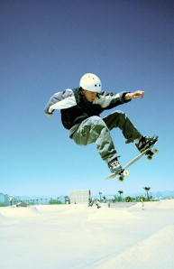
What is a sentence fragment?
Not all “sentences” are created equal. Look at the following two groups of words:
FRAGMENT
He practiced everyday. Determined to win.
He practiced everyday. Determined to win.
He practiced everyday. Determined to win.
He practiced everyday. Determined to win.
They both begin with a capital letter.
They both end with a period.
BUT
The second does not express a complete thought. It is a sentence fragment.

Slide 3


What is a sentence fragment?
A sentence fragment does not have all the basic parts of a complete sentence.
Fragments do not express a complete thought and are missing important information.
EXAMPLES
No subject
Is a large, hairy spider.
No verb
Some tarantulas to a length of 3 1/2 inches.
Not a complete thought
Although tarantulas are often feared.

Slide 4

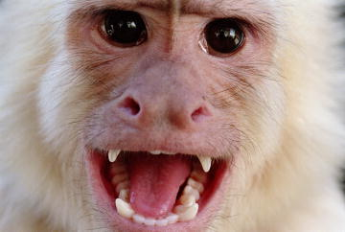
What is a sentence fragment?
Complete sentence
A complete sentence is a group of words that contains a subject and a verb and expresses a complete thought.
Subject
Verb
The streets are crowded.
The streets are crowded.
The streets are crowded.
Subject
Verb
A monkey cried a warning.
A monkey cried a warning.
A monkey cried a warning.

Slide 5

What is a sentence fragment?
To identify sentence fragments, use a simple test:
1. Does the group of words have a subject?
2. Does it have a verb?
3. Does it express a complete thought?
If the answer to any of these questions is no, you have a fragment.

Slide 6
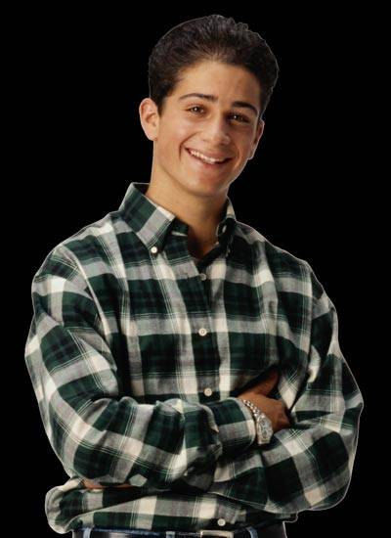

What is a sentence fragment?
Here are other tests to identify sentence fragments.
Grammar Guy Says...
Test 1: Yes-No Question
Turn the word group into the question “Did ?”
If the question makes sense, the word group is a complete sentence. If not, then it is a fragment.
The neighbor’s dog howled.
SENTENCE
Did the neighbor’s dog howl?
Left after lunch.
Did left after lunch?
FRAGMENT
Source: Linguist Rei Noguchi

Slide 7

What is a sentence fragment?
Test 2: Frame
Grammar Guy Says...
Plug the group of words into the frame “I know that .”
If the statement makes sense, the word group is a complete sentence. If not, then it is a fragment.
She is a friend.
I know that she is a friend.
SENTENCE
Singing a song.
I know that singing a song.
FRAGMENT
Source: Linguist Rei Noguchi

Slide 8
What is a sentence fragment?
Apply the test to the following group of words:
The days are getting shorter now.
The days are getting shorter now.
The days are getting shorter now.
The days are getting shorter now.
Sentence
1. Does the group of words have a subject?
YES
2. Does it have a verb?
YES
3. Does it express a complete thought?
YES

Slide 9

What is a sentence fragment?
Apply the test to the following group of words:
Because you have done so well.
Because you have done so well.
Because you have done so well.
Because you have done so well.
Fragment
1. Does the group of words have a subject?
YES
2. Does it have a verb?
YES
3. Does it express a complete thought?
NO
What happens because you have done so well?

Slide 10

What is a sentence fragment?
Identify which of the following are sentence fragments. Be prepared to explain your answer.
1. Fears vampire bats.
2. Most horror tales about vampire bats are not true.
3. Although they do bite other animals.

Slide 11
What is a sentence fragment?
Identify which of the following are sentence fragments. Be prepared to explain your answer.
1. Fears vampire bats.
FRAGMENT
Subject:
No
Verb:
Yes. Fears.
Complete thought:
No
The group of words is a fragment because it has no subject and does not express a complete thought.

Slide 12
What is a sentence fragment?
Identify which of the following are sentence fragments. Be prepared to explain your answer.
2. Most horror tales about vampire bats are not true.
SENTENCE
Subject:
Yes. Tales.
Verb:
Yes. Are.
Complete thought:
Yes
The group of words is a sentence because it has a subject and a verb and expresses a complete thought.

Slide 13
What is a sentence fragment?
Identify which of the following are sentence fragments. Be prepared to explain your answer.
3. Although they do bite other animals.
FRAGMENT
Subject:
Yes. They.
Verb:
Yes. Do bite.
Complete thought:
No
The group of words is a fragment. Although it has a subject and a verb, it does not express a complete thought.

Slide 14
What is a sentence fragment?
On Your Own
Determine whether each group of words is a fragment or a complete sentence. If the item is a complete sentence, write C. If a subject is missing, write S. If a verb is missing, write V. If the item has a subject and a verb but does not express a complete thought, write I.
___ 1. Truman Capote was an American author.
___ 2. Grew up in Alabama.
___ 3. When he moved to New York City.
[End of Section]

Slide 15
What is a sentence fragment?
Answers
Determine whether each group of words is a fragment or a complete sentence. If the item is a complete sentence, write C. If a subject is missing, write S. If a verb is missing, write V. If the item has a subject and a verb but does not express a complete thought, write I.
___ 1. Truman Capote was an American author.
___ 2. Grew up in Alabama.
___ 3. When he moved to New York City.
C
S
I

Slide 16
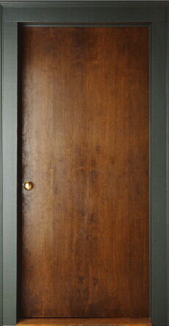
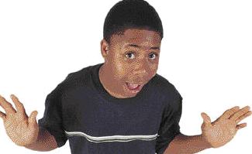

How to fix phrase fragments
A phrase is a group of words that does not have a subject and a verb. By itself, a phrase is a fragment.
Imagine . . .
Someone walks in and says . . .
then leaves!
For several good reasons.
What did he mean “for several good reasons”?
?
A phrase cannot make sense by itself.

Slide 17
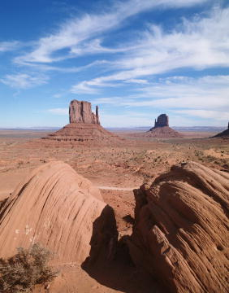
How to fix phrase fragments
Three kinds of phrases are often mistaken for sentences:
  Verbal phrases
Studying deserts.
  Appositive phrases
A strange rock formation.
  Prepositional phrases
Of volcanic rock.

Slide 18
How to fix phrase fragments
Verbal phrases
A verbal is a word that is formed from a verb but is used as another part of speech.
VERB
VERBAL
study
studying
A verbal phrase is a phrase that contains a verbal.
VERB
VERBAL
VERBAL PHRASE
study
studying
studying deserts
fold
folded
folded in two
see
to see
to see clearly

Slide 19
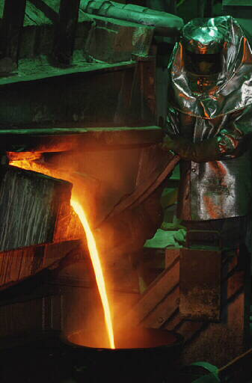
How to fix phrase fragments
Appositive phrases
An appositive is a word that identifies a nearby noun or pronoun.
This material is strong.
This material, steel, is strong.
An appositive phrase consists of an appositive and its modifiers.
This material, highly tempered steel, is strong.

Slide 20

How to fix phrase fragments
Prepositional phrases
A prepositional phrase contains
a preposition
a noun or pronoun that is the object of the preposition
any modifiers of the object
below
buildings
the towering office
buildings

Slide 21

How to fix phrase fragments
There are two ways to fix a phrase fragment:
Strategy 1: Add words to form a complete sentence.
  Verbal phrases
Studying deserts.
I enjoy studying deserts.
  Appositive phrases
A strange rock formation.
We saw Devil’s Tower, a strange rock formation.
  Prepositional phrases
Of volcanic rock.
Devil’s Tower is made of volcanic rock.

Slide 22
How to fix phrase fragments
Strategy 2: Combine it with another sentence.
  Verbal phrases
We have spent two weeks. Studying deserts.
We have spent two weeks studying deserts.
  Appositive phrases
We saw Devil’s Tower. A strange rock formation.
We saw Devil’s Tower, a strange rock formation.
  Prepositional phrases
Devil’s Tower is a giant column. Of volcanic rock.
Devil’s Tower is a giant column of volcanic rock.

Slide 23
How to fix phrase fragments
Make each phrase fragment part of a complete sentence, adding commas where needed.
Humans have kept dogs. For centuries.
Herding sheep and cattle and guarding property. Many dogs more than earn their keep.
3. A well-trained border collie. Syd is a great help around the ranch.

Slide 24
How to fix phrase fragments
Make each phrase fragment part of a complete sentence, adding commas where needed.
Possible Answer
Humans have kept dogs for centuries.

Slide 25
How to fix phrase fragments
Make each phrase fragment part of a complete sentence, adding commas where needed.
Possible Answer
Herding sheep and cattle and guarding property, many dogs more than earn their keep.

Slide 26
How to fix phrase fragments
Make each phrase fragment part of a complete sentence, adding commas where needed.
Possible Answer
3. Syd, a well-trained border collie, is a great help around the ranch.

Slide 27
How to fix phrase fragments
On Your Own
Rewrite the following paragraph to correct phrase fragments. Change capitalization and punctuation wherever necessary.
Heroes come in all shapes and sizes. Women, men, adults, and children. However, one hero looked quite different from what you might imagine. Named Antis. This hero was a German shepherd dog.
[End of Section]

Slide 28
How to fix phrase fragments
Possible Answer
Rewrite the following paragraph to correct phrase fragments. Change capitalization and punctuation wherever necessary.
Heroes come in all shapes and sizes. They can be women, men, adults, and children. However, one hero looked quite different from what you might imagine. Named Antis, this hero was a German shepherd dog.

Slide 29
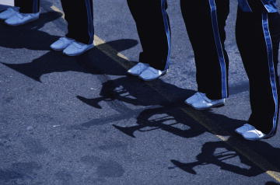
How to fix subordinate clause fragments
A clause is a group of words that contains a subject and a verb.
An independent clause (or main clause) expresses a complete thought and can stand by itself as a sentence.
Subject
Verb
Before the ceremony, the band played a fanfare.
Before the ceremony, the band played a fanfare.
Before the ceremony, the band played a fanfare.

Slide 30
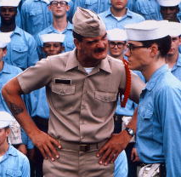
How to fix subordinate clause fragments
A subordinate clause (or dependent clause) cannot stand by itself as a sentence.
A subordinate clause has a subject and a verb but does not express a complete thought.
Subject
Verb
when he realized his mistake
when he realized his mistake
when he realized his mistake
Subject
Verb
who accepted responsibility
who accepted responsibility
who accepted responsibility

Slide 31

How to fix subordinate clause fragments
Subordinate clause fragments suggest questions that they do not answer.
To whom is this statement referring? It would be complete if it ended with a question mark.
What happened when he realized his mistake?
What happened because he was just learning?
When he realized his mistake.
Who accepted responsibility.
Because he was just learning.

Slide 32
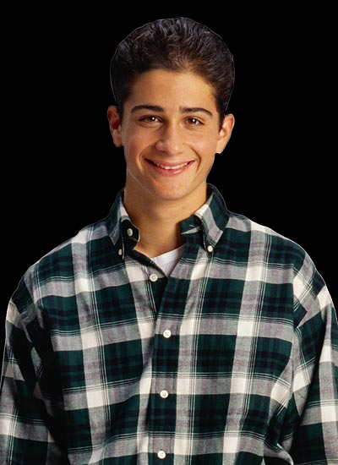
How to fix subordinate clause fragments
Here’s a tip: When a sentence begins with because, it must have two parts.
Grammar Guy Says...
Because the recruit was just learning
,
the sergeant forgave him.
Make sure to use a comma to separate the two parts of the sentence.

Slide 33
How to fix subordinate clause fragments
There are two ways to fix a subordinate clause fragment:
Strategy 1: Add words to form a complete sentence.
Who accepted responsibility.
I admire the man who accepted responsibility.
Strategy 2: Combine it with another sentence.
Since he was just learning. The sergeant forgave him.
Since he was just learning, the sergeant forgave him.

Slide 34
How to fix subordinate clause fragments
A subordinate clause telling why, where, when or how is called an adverb clause.
Grammar Guy Says...
Usually you can place an adverb clause before or after the independent clause in a sentence.
The sergeant forgave the recruit
Since he was just learning
Adverb
clause
,
since he was just learning.
Adverb
clause
the sergeant forgave the recruit.
When the adverb clause comes first, use a comma to separate it from the independent clause.

Slide 35
How to fix subordinate clause fragments
Make a complete sentence from each of the following subordinate clauses.
1. Who inspires me.
2. Because I enjoy acting.
3. Before I bought tickets to the play.

Slide 36
How to fix subordinate clause fragments
Make a complete sentence from each of the following subordinate clauses.
Possible Answer
1. Who inspires me.
When I watch films, I often see an actor who inspires me.

Slide 37
How to fix subordinate clause fragments
Make a complete sentence from each of the following subordinate clauses.
Possible Answer
2. Because I enjoy acting.
I volunteer at the community theater because I enjoy acting.

Slide 38
How to fix subordinate clause fragments
Make a complete sentence from each of the following subordinate clauses.
Possible Answer
3. Before I bought tickets to the play.
Before I bought tickets to the play, I made sure my favorite actor was playing the leading role.

Slide 39
How to fix subordinate clause fragments
On Your Own
Rewrite the following paragraph to correct subordinate clause fragments. Change capitalization and punctuation wherever necessary.
People have been using cosmetics for thousands of years. In Africa, the ancient Egyptians used perfumes, hair dyes, and makeup. That they made from plants and minerals. While they often used cosmetics to be more attractive. They also used them to protect their skin from the hot sun.
[End of Section]

Slide 40
How to fix subordinate clause fragments
Possible Answer
Rewrite the following paragraph to correct subordinate clause fragments. Change capitalization and punctuation wherever necessary.
People have been using cosmetics for thousands of years. In Africa, the ancient Egyptians used perfumes, hair dyes, and makeup that they made from plants and minerals. While they often used cosmetics to be more attractive, they also used them to protect their skin from the hot sun.

Slide 41
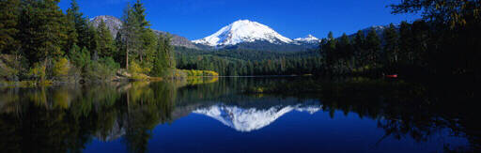
Using fragments for stylistic effect
By itself, a sentence fragment does not express a complete thought.
When he reached the lake, the hiker stopped to take in the beauty. The stark mountains. The lush valley. The still water.
The stark mountains. The lush valley. The still water.
However, an experienced writer may use a fragment for effect if it is clearly related to a nearby sentence.
[End of Section]

Slide 42
Review A
Identify each fragment as a phrase (P) or a subordinate clause (S). Then, add words to make it a complete sentence.
___ 1. Walking around in a spacesuit.
___ 2. That she prefers walking.
___ 3. To welcome the family.
___ 4. Instead of eating out.
___ 5. If we go outside the house.
[End of Section]

Slide 43
Review A
Possible Answers
Identify each fragment as a phrase (P) or a subordinate clause (S). Then, add words to make it a complete sentence.
___ 1. Walking around in a spacesuit.
___ 1. Walking around in a spacesuit is not easy.
P
___ 2. Magda explained that she prefers walking.
___ 2. That she prefers walking.
S
___ 3. To welcome the family.
___ 3. To welcome the family, we hosted a picnic.
P
___ 4. Let’s make dinner instead of eating out.
___ 4. Instead of eating out.
P
___ 5. If we go outside the house.
___ 5. If we go outside the house, we can get a better look.
S

Slide 44
Review B
Revise the fragments in the following paragraph. Change capitalization and punctuation wherever necessary.
Whenever I visit the beach. I think about the underwater world. Though the marine life is interesting. The ocean floor is really what interests me. The deepest known spot in the Pacific Ocean is the Mariana Trench. Which is the deepest known spot in any ocean. Plunging deep enough to swallow Mount Everest. It lies 36,198 feet below sea level.
[End of Section]

Slide 45
Review B
Possible Answers
Revise the fragments in the following paragraph. Change capitalization and punctuation wherever necessary.
Whenever I visit the beach, I think about the underwater world. Though the marine life is interesting, the ocean floor is really what interests me. The deepest known spot in the Pacific Ocean is the Mariana Trench, which is the deepest known spot in any ocean. Plunging deep enough to swallow Mount Everest, it lies 36,198 feet below sea level.

Slide 46
The End

