Slide 1

Using Subject-Verb Agreement
What is subject-verb agreement?
  Phrases or clauses between subjects and verbs
  Indefinite pronouns
  Compound subjects
Solving common agreement problems
  Subjects after verbs
  Expressions of amount
  Plural forms
  Don’t and doesn’t
Review A
Review B

Slide 2
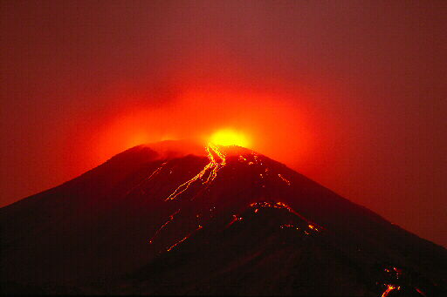
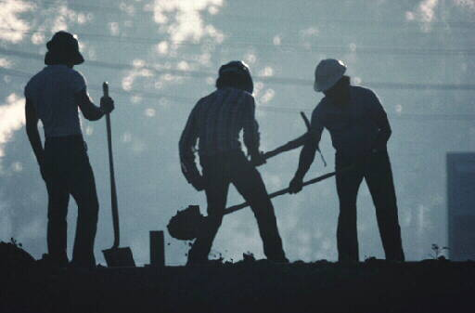
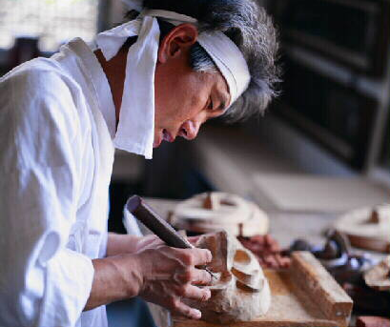
What is subject-verb agreement?
All sentences have subjects and verbs.
Subject
Verb
The volcano erupts.
The volcano erupts.
The volcano erupts.
Subject
Verb
Three workers dig.
Three workers dig.
Three workers dig.
Subject
Verb
An artist makes a mask.
An artist makes a mask.
An artist makes a mask.

Slide 3
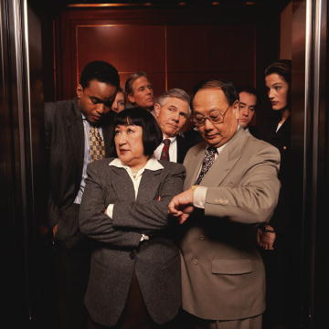
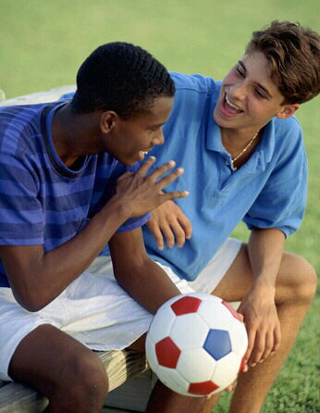
What is subject-verb agreement?
Subject
The subject tells whom or what a sentence is about.
Subject
The elevator is broken.
The elevator is broken.
Subject
What are Harry and Lucas talking about?
What are Harry and Lucas talking about?

Slide 4
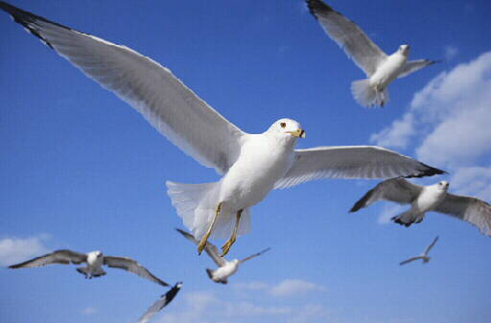
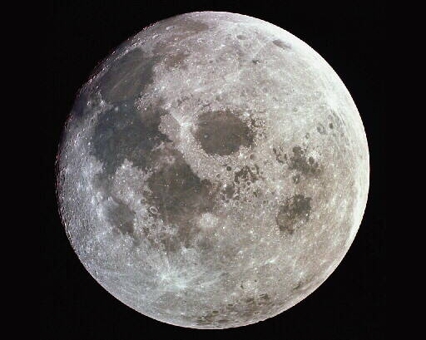
What is subject-verb agreement?
Verb
A verb expresses an action or a state of being.
Verb
The gulls soar.
ACTION
The gulls soar.
Verb
The moon is full.
STATE
OF BEING
The moon is full.

Slide 5


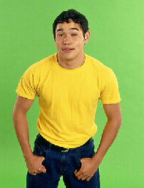

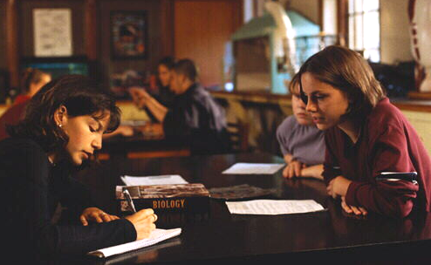
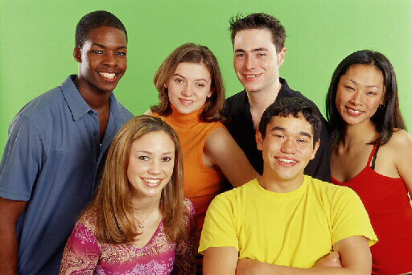
What is subject-verb agreement?
Number
Subjects and verbs agree in number to show that they belong together.
A word that refers to one thing is singular.
A word that refers to more than one is plural.
students
student
leaf
leaves
he
SINGULAR
they
PLURAL

Slide 6
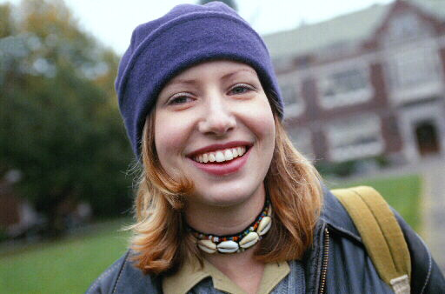
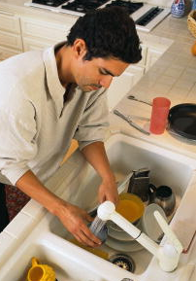
What is subject-verb agreement?
Singular Subjects
Singular subjects take singular verbs.
Singular
Subject
Singular
Verb
Earline attends college.
Earline attends college.
Earline attends college.
Singular
Subject
Singular
Verb
He washes the dishes.
He washes the dishes.
He washes the dishes.

Slide 7
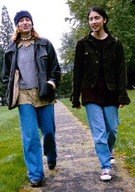
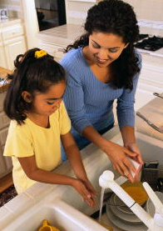

What is subject-verb agreement?
Plural Subjects
Plural subjects take plural verbs.
Plural
Subject
Plural
Verb
Both women attend college.
Both women attend college.
Both women attend college.
Plural
Subject
Plural
Verb
They wash the dishes.
They wash the dishes.
They wash the dishes.

Slide 8


What is subject-verb agreement?
Plural Subjects
Generally, nouns ending in −s are plural, but verbs ending in −s are singular.
Grammar Gal Says...
NOUN
VERB
SINGULAR
dog
barks
PLURAL
dogs
bark

Slide 9
What is subject-verb agreement?
Plural Subjects
In a verb phrase, the first helping (auxiliary) verb agrees with the subject.
Grammar Gal Says...
Singular
Subject
Singular
Helping Verb
Verb Phrase
He
He
is washing
is washing
the dishes.
Plural
Subject
Plural
Helping Verb
They
They
are washing
are washing
the dishes.

Slide 10
What is subject-verb agreement?
Phrases or clauses between subjects and verbs
group of words
Sometimes a group of words comes between the subject and the verb.
Subject
Verb
Verb
Visitors
leave their coats here.
to the museum
leave their coats here.
When deciding if a verb should be singular or plural, you can usually ignore words between the verb and its subject.
Subject
Verb
Visitors
to the museum
leave their coats here.

Slide 11

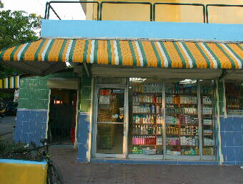

What is subject-verb agreement?
Phrases or clauses between subjects and verbs
Subject
Verb
A book of poems is on the table.
A book of poems is on the table.
Is agrees with book, not poems.
Subject
Verb
The men who own the store are brothers.
The men who own the store are brothers.
Are agrees with men, not store.

Slide 12


What is subject-verb agreement?
Identify the subject of each verb in parentheses. Then, choose the form of the verb that agrees with that subject.
1. Food drive donations (go, goes) in that box.
2. The cost of new tires (was, were) more than we expected.
3. The firefighters whom we saw at the grocery store (shops, shop) there weekly.

Slide 13
What is subject-verb agreement?
Identify the subject of each verb in parentheses. Then, choose the form of the verb that agrees with that subject.
Subject
1. Food drive donations (go, goes) in that box.
The subject is donations. The plural verb go agrees with plural subject donations.

Slide 14
What is subject-verb agreement?
Identify the subject of each verb in parentheses. Then, choose the form of the verb that agrees with that subject.
Subject
2. The cost of new tires (was, were) more than we expected.
The subject is cost. The singular verb was agrees with singular subject cost.

Slide 15
What is subject-verb agreement?
Identify the subject of each verb in parentheses. Then, choose the form of the verb that agrees with that subject.
Subject
3. The firefighters whom we saw at the grocery store (shops, shop) there weekly.
The subject is firefighters. The plural verb shop agrees with plural subject firefighters.

Slide 16
What is subject-verb agreement?
On Your Own
For each of the following sentences, choose the correct form of the verb in parentheses.
1. The posters in that box (need, needs) new frames.
2. A container of pens (sit, sits) beside the phone.
3. The magazines that need to be returned to the library
(is, are) on the table.
Students who volunteer at the fall festival (receive, receives) two free tickets.
5. The picture of the elephants (was, were) a gift.
[End of Section]

Slide 17
What is subject-verb agreement?
Answers
For each of the following sentences, choose the correct form of the verb in parentheses.
1. The posters in that box (need, needs) new frames.
2. A container of pens (sit, sits) beside the phone.
3. The magazines that need to be returned to the library
(is, are) on the table.
4. Students who volunteer at the fall festival (receive, receives) two free tickets.
5. The picture of the elephants (was, were) a gift.

Slide 18

What is subject-verb agreement?
Indefinite pronouns
Indefinite pronouns refer to a person or thing whose exact identity is unknown.
Some indefinite pronouns are singular.
Some are plural.
Some may be either singular or plural depending on how they are used.

Slide 19
What is subject-verb agreement?
Indefinite pronouns
The following indefinite pronouns are singular:
Singular Indefinite Pronouns
anybody | either | neither | one
anyone | everybody | nobody | somebody
anything | everyone | no one | someone
each | everything | nothing | something
Subject
Subject
Subject
Verb
Verb
Verb
Each of the athletes runs effortlessly.
Someone was waving a large flag.
Neither of the women is ready to start.

Slide 20

What is subject-verb agreement?
Indefinite pronouns
The words one, thing, and body are singular. So are the indefinite pronouns that contain these words.
Grammar Gal Says...
Is anyone late?
Is one late?
A thing has been lost.
Nothing has been lost.
His body looks fit.
Everybody looks fit.

Slide 21
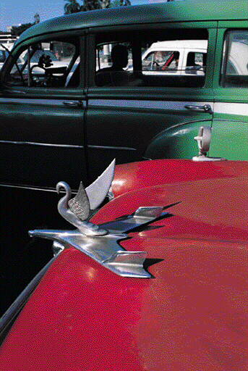
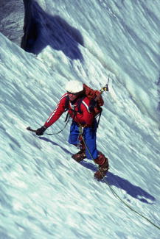
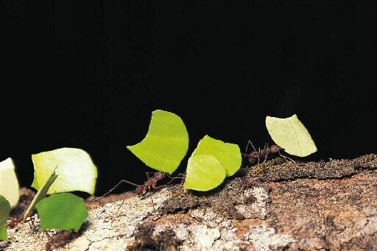
What is subject-verb agreement?
Indefinite pronouns
The following indefinite pronouns are plural:
Plural Indefinite Pronouns
both | few | many | several
Verb
Subject
Are both cars antiques?
Subject
Verb
Few have climbed that high.
Subject
Verb
Several of the ants work together.

Slide 22
What is subject-verb agreement?
Indefinite pronouns
The following indefinite pronouns may be singular or plural, depending on how they are used:
Singular or Plural Indefinite Pronouns
all | more | none
any | most | some
Subject
Verb
Some of the test was easy.
singular when they refer to singular words.
Subject
Verb
Some of the questions were hard.
plural when they refer to plural words.

Slide 23
What is subject-verb agreement?
Indefinite pronouns
Identify the subject of each verb in parentheses. Then, choose the form of the verb that agrees with that subject.
1. Each of the dogs (has, have) its own bowl.
2. Few of these jobs (sounds, sound) very challenging.
3. Most of the painting (is, are) finished now.

Slide 24
What is subject-verb agreement?
Indefinite pronouns
Identify the subject of each verb in parentheses. Then, choose the form of the verb that agrees with that subject.
Subject
1. Each of the dogs (has, have) its own bowl.

Slide 25
What is subject-verb agreement?
Indefinite pronouns
Identify the subject of each verb in parentheses. Then, choose the form of the verb that agrees with that subject.
Subject
2. Few of these jobs (sounds, sound) very challenging.

Slide 26
What is subject-verb agreement?
Indefinite pronouns
Identify the subject of each verb in parentheses. Then, choose the form of the verb that agrees with that subject.
Subject
3. Most of the painting (is, are) finished now.

Slide 27
What is subject-verb agreement?
Indefinite pronouns
On Your Own
For each of the following sentences, choose the correct form of the verb in parentheses.
1. (Was, Were) both of the meetings canceled?
2. Some of the plants (require, requires) full sun.
3. Each of the children (want, wants) a new toy.
Everybody (enjoy, enjoys) the new art class.
5. Several of the lights (is, are) out.
[End of Section]

Slide 28
What is subject-verb agreement?
Indefinite pronouns
Answers
For each of the following sentences, choose the correct form of the verb in parentheses.
1. (Was, Were) both of the meetings canceled?
2. Some of the plants (require, requires) full sun.
3. Each of the children (want, wants) a new toy.
4. Everybody (enjoy, enjoys) the new art class.
5. Several of the lights (is, are) out.

Slide 29
What is subject-verb agreement?
Compound subjects
A compound subject is two or more subjects that are joined by a coordinating conjunction and that have the same verb.
Subjects joined by and usually take plural verbs.
Subject 1
Subject 2
Verb
Ramón
and
she
like hiking.
Subject 1
Subject 2
Subject 3
Verb
Africa,
Australia,
and
Antarctica
are continents.

Slide 30
What is subject-verb agreement?
Coordinating conjunctions
Coordinating Conjunctions
and | but | for | nor
or | yet | so
A coordinating conjunction joins words or groups of words that are used in the same way.

Slide 31
What is subject-verb agreement?
Compound subjects
Singular subjects joined by or or nor take a singular verb.
Singular
Singular
Verb
Marcelo
or
Donya
knows the address.
Singular
Singular
Verb
Neither our
phone
nor our
doorbell
was working.

Slide 32
What is subject-verb agreement?
Compound subjects
Plural subjects joined by or or nor take a plural verb.
Plural
Plural
Verb
Mice
or
rats
make these holes.
Plural
Plural
Verb
Neither
problems
nor
delays
keep me from trying.

Slide 33
What is subject-verb agreement?
Compound subjects
When a singular AND a plural subject are joined by or or nor, the verb agrees with the nearer subject.
Plural
Singular
Verb
Neither the
potatoes
nor the
roast
is done.
The verb is agrees with the nearer subject roast.
Singular
Plural
Verb
Lyle
or his
friends
are responsible.
The verb are agrees with the nearer subject friends.

Slide 34
What is subject-verb agreement?
Compound subjects
For each of the following sentences, choose the form of the verb that agrees with the compound subject.
1. Marlon and she (is, are) dance champions.
2. Neither Alexander nor Elizabeth (owns, own) a car.
3. The director or the actors (has, have) to compromise.

Slide 35
What is subject-verb agreement?
Compound subjects
For each of the following sentences, choose the form of the verb that agrees with the compound subject.
1. Marlon and she (is, are) dance champions.

Slide 36
What is subject-verb agreement?
Compound subjects
For each of the following sentences, choose the form of the verb that agrees with the compound subject.
2. Neither Alexander nor Elizabeth (owns, own) a car.

Slide 37
What is subject-verb agreement?
Compound subjects
For each of the following sentences, choose the form of the verb that agrees with the compound subject.
3. The director or the actors (has, have) to compromise.

Slide 38
What is subject-verb agreement?
Compound subjects
On Your Own
For each of the following sentences, choose the verb that agrees with the compound subject.
1. Lucy and Mia (has, have) roles in the play.
2. Water or juice (is, are) available at the snack bar.
3. Neither cell phones nor radios (work, works) in the tunnel.
4. Bill and his family (go, goes) to the park on the weekend.
5. The birds or a squirrel (eat, eats) the birdseed.
[End of Section]

Slide 39
What is subject-verb agreement?
Compound subjects
Answers
For each of the following sentences, choose the verb that agrees with the compound subject.
1. Lucy and Mia (has, have) roles in the play.
2. Water or juice (is, are) available at the snack bar.
3. Neither cell phones nor radios (work, works) in the tunnel.
4. Bill and his family (go, goes) to the park on the weekend.
5. The birds or a squirrel (eat, eats) the birdseed.

Slide 40
Solving common agreement problems
Subjects after verbs
In some sentences, the subject comes after the verb.
Subject
Here
(is, are)
is
a set of keys.
a set of keys.
When the subject follows the verb . . .
1. Find the subject.
2. Make sure that the verb agrees with it.

Slide 41
Solving common agreement problems
Subjects after verbs
When the subject follows the verb, rearrange the sentence in “normal” order to check for proper subject-verb agreement.
Grammar Gal Says...
Here
(is, are)
a set of keys.
A set of keys
A set of keys
(is, are)
here.
is

Slide 42
Solving common agreement problems
Subjects after verbs
Subjects also appear after verbs in questions.
Compound Subject
Where
(is, are)
are
Heather and Chris now?
Heather and Chris now?
1. Find the subject.
2. Make sure that the verb agrees with it.
Remember that subjects joined by and usually take plural verbs.

Slide 43
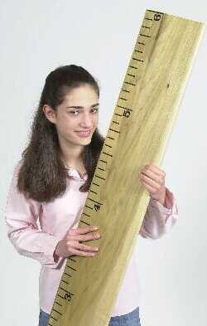
Solving common agreement problems
Expressions of amount
An expression of amount may be singular or plural, depending on how it is used.
An expression of amount is
singular when the amount is thought of as a unit
Three fourths of the pizza
is
gone.
plural when it is thought of as separate parts
Three fourths of the songs
are
new.

Slide 44
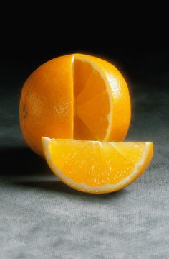
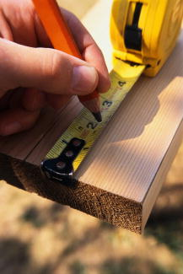
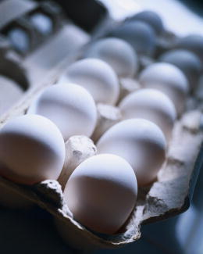
Solving common agreement problems
Expressions of amount
An expression of amount can be a measurement, a percentage, or a fraction.
One sixth (1/6)
Two inches
One hundred percent (100%)

Slide 45
Solving common agreement problems
Expressions of amount
When trying to decide whether a word is singular or plural, ask yourself if the word it or the word they or them could be used instead.
Grammar Gal Says...
Three fourths of the pizza is gone.
It is gone.
It is singular, so you use is.
Two slices of the pizza are gone.
They are gone.
They is plural, so you use are.

Slide 46
Solving common agreement problems Subjects after verbs / Expressions of amount
Identify the subject of each verb in parentheses. Then, choose the form of the verb that agrees with that subject. Be prepared to explain your answer.
1. There (is, are) several seats left.
2. Five dollars (buys, buy) less today than three years ago.
3. (Does, Do) five months have fewer than thirty-one days?

Slide 47
Solving common agreement problems Subjects after verbs / Expressions of amount
Identify the subject of sentence. Then, choose the form of the verb that agrees with that subject. Be prepared to explain your answer.
Subject
1. There (is, are) several seats left.
The subject, seats, comes after the verb. Seats is plural, so the correct verb form is are.

Slide 48
Solving common agreement problems Subjects after verbs / Expressions of amount
Identify the subject of each verb in parentheses. Then, choose the form of the verb that agrees with that subject. Be prepared to explain your answer.
Subject
2. Five dollars (buys, buy) less today than three years ago.
The subject, dollars, refers to a single unit. Therefore, the singular verb form buys is correct.

Slide 49
Solving common agreement problems Subjects after verbs / Expressions of amount
Identify the subject of each verb in parentheses. Then, choose the form of the verb that agrees with that subject. Be prepared to explain your answer.
Subject
3. (Does, Do) five months have fewer than thirty-one days?
The subject, months, comes after the helping verb. The subject also refers to separate parts rather than to a single unit. Therefore, the plural verb form Do is correct.

Slide 50
Solving common agreement problems Subjects after verbs / Expressions of amount
On Your Own
For each of the following sentences, choose the correct form of the verb in parentheses.
1. When (is, are) the project due?
2. Here (lies, lie) several generations of veterans.
3. Three hours (was, were) a long time to be stuck in traffic.
One fourth of the paper (is, are) finished.
5. Sixty percent of the votes (has, have) been counted.
[End of Section]

Slide 51
Solving common agreement problems Subjects after verbs / Expressions of amount
Answers
For each of the following sentences, choose the correct form of the verb in parentheses.
1. When (is, are) the project due?
2. Here (lies, lie) several generations of veterans.
3. Three hours (was, were) a long time to be stuck in traffic.
4. One fourth of the paper (is, are) finished.
5. Sixty percent of the votes (has, have) been counted.

Slide 52
Solving common agreement problems
Plural forms
Some nouns that are plural in form take singular verbs.
Plural Forms That Take Singular Verbs
civics | gymnastics | molasses
economics | linguistics | mumps
electronics | mathematics | news
genetics | measles | physics
Subject
Verb
Subject
Subject
Verb
Verb
Verb
News of the theft was broadcast immediately.
Does economics interest you?
Linguistics is the study of language.

Slide 53
Solving common agreement problems
Plural forms
Many nouns ending in –ics, such as athletics, acoustics, ethics, politics, and tactics, may be singular or plural, depending on how they are used.
Grammar Gal Says...
Such nouns are generally singular when they refer to a science, system, or skill.
Such nouns are plural when they refer to qualities or individual items.
These statistics show that the crime rate is falling nationwide.
Statistics is a field that deals with collecting and presenting data.

Slide 54
Solving common agreement problems
Plural forms
Even when plural in form, these types of nouns take singular verbs.
titles of a creative work—books, songs, movies, or paintings
Subject
Verb
“Greensleeves” is an old English folk song.
Verb
Subject
Is Three Musicians a painting by Pablo Picasso?

Slide 55
Solving common agreement problems
Plural forms
Even when plural in form, these types of nouns take singular verbs.
names of countries, cities, or organizations
Verb
Subject
Is Grand Rapids smaller than Detroit?
Subject
Verb
The United Nations was founded in 1945.

Slide 56

Solving common agreement problems
Don’t and doesn’t
The contractions don’t and doesn’t should agree with their subjects.
Don’t is the contraction of do not. Use it with I and you and with all plural subjects.
Singular |  | Plural
I | don’t | we | don’t
you | don’t | you | don’t
 |  | they | don’t
You
Don’t
I
don’t
don’t
the floats look beautiful?
need special permission.
have any paper.

Slide 57
Solving common agreement problems
Don’t and doesn’t
Doesn’t is the contraction of does not. Use it with all singular subjects except I and you.
Singular |  | Plural
I | don’t | we | don’t
you | don’t | you | don’t
 |  | they | don’t
he/she/it | doesn’t
Doesn’t
The tire
He
she remind you of Grandma?
doesn’t
doesn’t
have enough air.
want to go.

Slide 58
Solving common agreement problems
Plural Forms / Don’t and doesn’t
For each of the following sentences, provide the correct form of the verb in parentheses.
1. (Don’t, Doesn’t) he want to see the game?
2. Once common, measles (has, have) now been nearly eliminated in the U.S.
3. Romeo and Juliet (appear, appears) on the list of plays.

Slide 59
Solving common agreement problems
Plural Forms / Don’t and doesn’t
For each of the following sentences, provide the correct form of the verb in parentheses.
1. (Don’t, Doesn’t) he want to see the game?

Slide 60
Solving common agreement problems
Plural Forms / Don’t and doesn’t
For each of the following sentences, provide the correct form of the verb in parentheses.
2. Once common, measles (has, have) now been nearly eliminated in the U.S.

Slide 61
Solving common agreement problems
Plural Forms / Don’t and doesn’t
For each of the following sentences, provide the correct form of the verb in parentheses.
3. Romeo and Juliet (appear, appears) on the list of plays.

Slide 62
Solving common agreement problems
Plural Forms / Don’t and doesn’t
On Your Own
For each of the following sentences, choose the correct form of the verb in parentheses.
1. (Doesn’t, Don’t) the bus stop here?
2. The Academy of Arts (is, are) now accepting applications.
3. Nighthawks (has, have) always been my favorite painting by Edward Hopper.
Gymnastics (involves, involve) many young athletes.
5. They (don’t, doesn’t) make that model of car anymore.
[End of Section]

Slide 63
Solving common agreement problems
Plural Forms / Don’t and doesn’t
Answers
For each of the following sentences, choose the correct form of the verb in parentheses.
1. (Doesn’t, Don’t) the bus stop here?
2. The Academy of Arts (is, are) now accepting applications.
3. Nighthawks (has, have) always been my favorite painting by Edward Hopper.
4. Gymnastics (involves, involve) many young athletes.
5. They (don’t, doesn’t) make that model of car anymore.

Slide 64
Review A
Provide the correct form of the verb in parentheses.
Members of the club ________ turns as president. (take)
Fred or his brother ________ us every summer. (visit)
Both of these shoes ________ new laces. (need)
Neither the judge nor the jurors ________ the defendant. (know)
5. ________ she need more time to finish the test? (do)

Slide 65
Review A
Provide the correct form of the verb in parentheses.
take
Members of the club ________ turns as president. (take)
visits
Fred or his brother ________ us every summer. (visit)
need
Both of these shoes ________ new laces. (need)
know
Neither the judge nor the jurors ________ the defendant. (know)
Does
5. ________ she need more time to finish the test? (do)

Slide 66
Review B
For each of the following sentences, if the subject and verb do not agree, write the correct form of the verb. If the verb already agrees with the subject, write C.
One half of the melon have been eaten.
Here is the books you reserved.
Whatever the challenge, I always does my best.
Physics looks into the nature of matter and energy.
5. Artists and writers draws inspiration from the view.
[End of Section]

Slide 67
Review B
For each of the following sentences, if the subject and verb do not agree, write the correct form of the verb. If the verb already agrees with the subject, write C.
1. One half of the melon has been eaten.
Here are the books you reserved.
Whatever the challenge, I always do my best.
4. Physics looks into the nature of matter and energy. C
5. Artists and writers draw inspiration from the view.

Slide 68
The End

