Slide 1

Mastering Six Troublesome Verbs
Why are these verbs troublesome?
Lie / Lay
Sit / Set
Rise / Raise
Review A
Review B

Slide 2

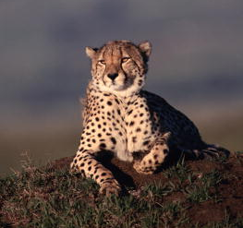
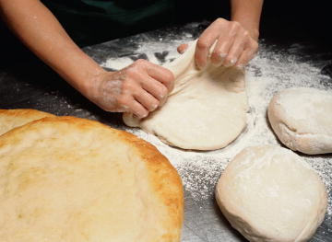

Why are these verbs troublesome?
Six verbs in English require special attention.
lie
lay
sit
set
rise
raise
Does the cheetah
lie
still or
lay
still?
Are the girls
sitting
or
setting
?
Does dough
rise
or
raise
?

Slide 3
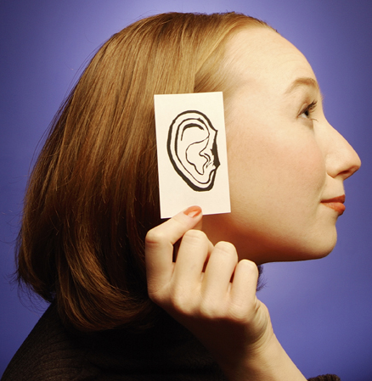
Why are these verbs troublesome?
One way to distinguish these verbs is to ask …
Does the verb have a direct object or not?
Bridget lies asleep until eight.
NO OBJECT
The dog lays its bone down.
The dog lays its bone down.
OBJECT

Slide 4
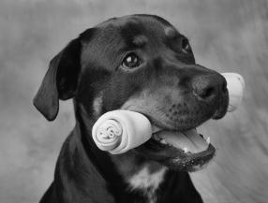
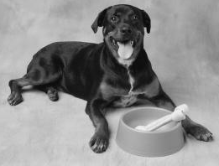
Why are these verbs troublesome?
Direct Object
A direct object is a word or word group that receives the action of the verb or shows the result of the action.
DIRECT
OBJECT
The dog lays its bone down.
bone
lays what down?
bone

Slide 5
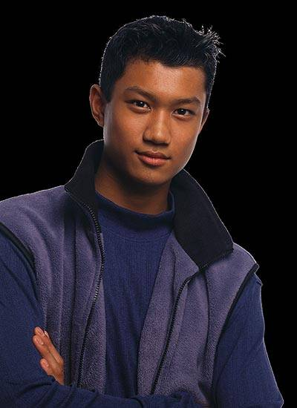

Six troublesome verbs
To help, here’s a list of the troublesome verbs and their definitions:
Grammar Guy Says...
Lie | To recline, to rest
Lay | To put (something) in place
Sit | To be in place
Set | To put into a place
Rise | To go upward
Raise | To move (something) up

Slide 6


Lie / Lay
The verb lie means “to rest,” “to recline,” or “to be in place.”
Dora lies on the hammock.
The verb lay means “to put (something) in place.” Lay generally takes an object.
Object
Mark lays the cup on the saucer.
Mark lays the cup on the saucer.

Slide 7
Lie / Lay
Lie can also mean “to tell an untruth.” The past and past participle forms for this meaning of lie are lied and [have] lied.
Grammar Guy Says...
The boy lied about breaking the window.

Slide 8
Lie / Lay
Principal Parts of Lie and Lay
Base Form | Present Participle | Past | Past Participle
lie | [is] lying | lay | [have] lain
lay | [is] laying | laid | [have] laid
lay
lay
These verbs are easy to confuse because the past form of lie is also lay.
BASE FORM
OF LAY
Could you lay this box on the shelf?
PAST FORM
OF LIE
The cat lay on the sofa until I shooed it off.

Slide 9

Lie / Lay
Principal Parts of Lie and Lay
Base Form | Present Participle | Past | Past Participle
lie | [is] lying | lay | [have] lain
lay | [is] laying | laid | [have] laid
[have] lain
laid
[have] laid
Notice that the past participle of lie is [have] lain.
This coin has lain in the earth for two millennia.
The past and past participle forms of lay are laid and [have] laid.
Dad laid the blanket across his lap.
I have laid my change on the counter.

Slide 10


Lie / Lay
For each of the following sentences, choose the correct verb form in parentheses.
1. Do not (lie, lay) the socks there.
2. Eduardo (lay, laid) in the sleeping bag.
3. Kitty had (laid, lain) the book down.

Slide 11
Lie / Lay
For each of the following sentences, choose the correct verb form in parentheses.
1. Do not (lie, lay) the socks there.
Lay is the correct form because the verb means “to put (something) in place” and takes the object socks.

Slide 12
Lie / Lay
For each of the following sentences, choose the correct verb form in parentheses.
2. Eduardo (lay, laid) in the sleeping bag.
In this sentence, lay is the past form of lie. The verb means “to rest” or “to recline” and does not take an object.

Slide 13
Lie / Lay
For each of the following sentences, choose the correct verb form in parentheses.
3. Kitty had (laid, lain) the book down.
Laid is the correct past participle of lay. The verb means “to put (something) in place” and takes the object book.

Slide 14
Lie / Lay
On Your Own
Give the correct form of lie or lay in the blank for each of the following sentences.
1. The children ______ down for a nap.
2. Please ______ your wet towel on the dryer.
3. My sister has ______ on the ground to watch ants.
4. Who ______ this rake where someone could step on it?
5. A snake is ______ across the trail, sunning itself.
[End of Section]

Slide 15
Lie / Lay
Answers
Give the correct form of lie or lay in the blank for each of the following sentences.
1. The children ______ down for a nap.
2. Please ______ your wet towel on the dryer.
3. My sister has ______ on the ground to watch ants.
4. Who ______ this rake where someone could step on it?
5. A snake is ______ across the trail, sunning itself.
lie
lay
lain
laid
lying

Slide 16
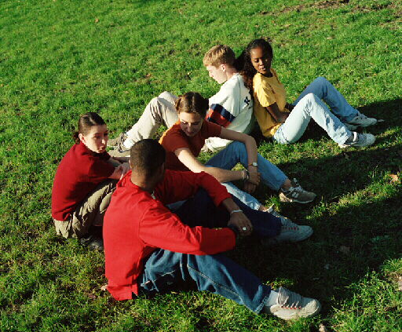
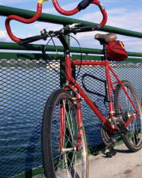
Sit / Set
The verb sit means “to rest in a seated, upright position” or “to be in a place.”
The friends are sitting on the grass.
The verb set means “to put (something) in a place.” Set generally takes an object.
Object (set what?)
Someone has set a bike against the fence.
Someone has set a bike against the fence.

Slide 17
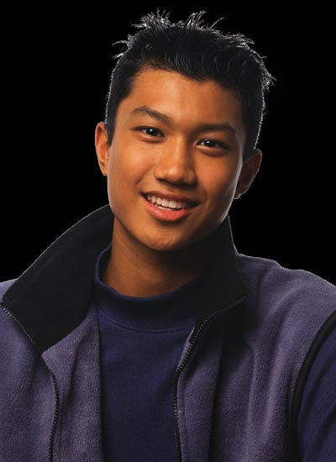
Sit / Set
Set has other meanings that do not require a direct object. Check a dictionary to see whether or not the meaning you intend takes an object.
Grammar Guy Says...
The sun set an hour ago.
NO OBJECT

Slide 18
Sit / Set
Principal Parts of Sit and Set
Base Form | Present Participle | Past | Past Participle
sit | [is] sitting | sat | [have] sat
set | [is] setting | set | [have] set
sat
[have] sat
set
[have] set
The past and past participle forms of sit are sat.
Because there was no room, I sat on the floor.
Before then I had sat at a desk.
The past and past participle forms of set are set and [have] set.
Mary forgot where she had set her keys.
The mail carrier set a package on the front step.

Slide 19
Sit / Set
For each of the following sentences, choose the correct verb form in parentheses.
1. You can (sit, set) in the front seat or in back.
2. Visitors (sat, set) their boots on the mat.
3. He had (sat, set) in the rocker since dusk.

Slide 20
Sit / Set
For each of the following sentences, choose the correct verb form in parentheses.
1. You can (sit, set) in the front seat or in back.
Sit is the correct form because the verb means “to rest in a seated, upright position” and takes no object.

Slide 21
Sit / Set
For each of the following sentences, choose the correct verb form in parentheses.
2. Visitors (sat, set) their boots on the mat.
Set is the correct form because the verb means “to put (something) in a place” and takes the object boots.

Slide 22
Sit / Set
For each of the following sentences, choose the correct verb form in parentheses.
3. He had (sat, set) in the rocker since dusk.
Sat is the correct past form of sit and does not take an object.

Slide 23
Sit / Set
On Your Own
Give the correct form of sit or set in the blank for each of the following sentences.
1. Please ______ here, Mrs. Brown.
2. Did you ______ the dough in a warm place?
3. At the concert, Keith ______ near Isabelle.
4. Someone ______ a hot iron on my shirt!
5. We had ______ still for almost an hour.
[End of Section]

Slide 24
Sit / Set
Answers
Give the correct form of sit or set in the blank for each of the following sentences.
1. Please ______ here, Mrs. Brown.
2. Did you ______ the dough in a warm place?
3. At the concert, Keith ______ near Isabelle.
4. Someone ______ a hot iron on my shirt!
5. We had ______ still for almost an hour.
sit
set
sat
set
sat

Slide 25
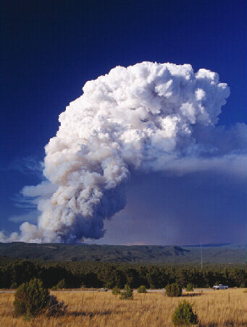

Rise / Raise
The verb rise means “to go upward.”
Smoke still rises from the brush fires.
The verb raise means “to move (something) upward.” Raise generally takes an object.
Object (raise what?)
Please raise your hand.
Please raise your hand.

Slide 26

Rise / Raise
Raise can also mean “to grow” or “to bring to maturity.” Both of these uses also take an object.
Grammar Guy Says...
Object
John raises organic vegetables.
John raises organic vegetables.

Slide 27
Rise / Raise
Principal Parts of Rise and Raise
Base Form | Present Participle | Past | Past Participle
rise | [is] rising | rose | [have] risen
raise | [is] raising | raised | [have] raised
rose
[have] risen
raised
[have] raised
The past and past participle forms of rise are rose and [have] risen.
The sun rose earlier today.
It had risen by the time I woke up.
The past and past participle forms of raise are raised and [have] raised.
The firefighters raised a ladder from the truck.
Both peacocks have raised their tail feathers.

Slide 28
Rise / Raise
For each of the following sentences, choose the correct verb form in parentheses.
1. That store often (rises, raises) its prices.
2. Balloons are (rising, raising) from the crowd.
3. The marchers (raised, rose) a giant banner.

Slide 29
Rise / Raise
For each of the following sentences, choose the correct verb form in parentheses.
1. That store often (rises, raises) its prices.
Raises is the correct form because the verb means “to move (something) upward” and takes the object prices.

Slide 30
Rise / Raise
For each of the following sentences, choose the correct verb form in parentheses.
2. Balloons are (rising, raising) from the crowd.
Rising is the correct form because the verb means “to go upward” and takes no object.

Slide 31
Rise / Raise
For each of the following sentences, choose the correct verb form in parentheses.
3. The marchers (raised, rose) a giant banner.
Raised is the correct form because the verb means “to move (something) upward” and takes the object banner.

Slide 32
Rise / Raise
On Your Own
Give the correct form of rise or raise in the blank for each of the following sentences.
1. ______ your hand if you need more time.
2. The fans will ______ for the national anthem.
3. Fireworks ______ and exploded overhead.
4. The children ______ their flag for Cinco de Mayo.
5. The plane has ______ into the clouds.
[End of Section]

Slide 33
Rise / Raise
Answers
Give the correct form of rise or raise in the blank for each of the following sentences.
1. ______ your hand if you need more time.
2. The fans will ______ for the national anthem.
3. Fireworks ______ and exploded overhead.
4. The children ______ their flag for Cinco de Mayo.
5. The plane has ______ into the clouds.
Raise
rise
rose
raised
risen

Slide 34
Review A
For each sentence, give the correct form of the verb indicated in parentheses.
Dark clouds (lie) over the city all last week.
I (lay) my keys on the table when I came in.
Everyone (sit) perfectly still until the last note sounded.
As she prepared for the operation, the surgeon (set) each instrument on a tray.
Carla has (rise) to the top of her class.
6. Mr. Powell has (raise) the flag over the capitol for forty years.

Slide 35
Review A
For each sentence, give the correct form of the verb indicated in parentheses.
Dark clouds lay over the city all last week.
I laid my keys on the table when I came in.
Everyone sat perfectly still until the last note sounded.
As she prepared for the operation, the surgeon set each instrument on a tray.
Carla has risen to the top of her class.
6. Mr. Powell has raised the flag over the capitol for forty years.

Slide 36
Review B
If a verb in one of the following sentences is incorrect, write the correct form. If it is already correct, write C.
1. The cattle were lying in the shade by the stream.
2. An owl was setting on a branch, watching us closely.
3. Do you think the temperature will raise much higher?
4. Why don’t you lie those things down?
5. The captain of the damaged ship rose a distress signal.
[End of Section]

Slide 37
Review B
If a verb in one of the following sentences is incorrect, write the correct form. If it is already correct, write C.
C
1. The cattle were lying in the shade by the stream.
sitting
2. An owl was setting on a branch, watching us closely.
rise
3. Do you think the temperature will raise much higher?
lay
4. Why don’t you lie those things down?
raised
5. The captain of the damaged ship rose a distress signal.

Slide 38
The End

