Slide 1

Improving Your Spelling
Why is good spelling important?
Good spelling habits
ie and ei
–cede, –ceed, and –sede
Prefixes
Suffixes
Plurals of nouns
Review A
Review B

Slide 2

Why is good spelling important?
Let’s admit it: English is not always easy to spell.
English has been influenced by many other languages. One result is that some sounds can be represented by different letters.
garage
enough
accede
through
As you say these words, what do you notice about the sounds some letters make—or don’t make?

Slide 3
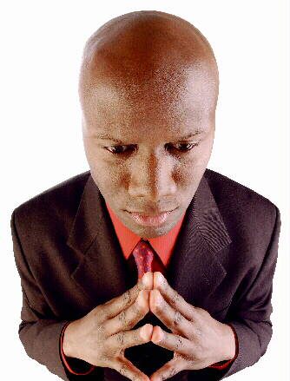
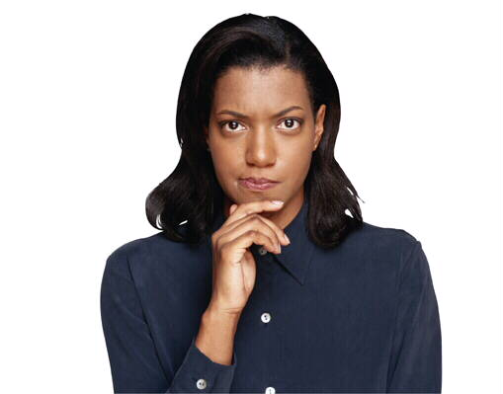
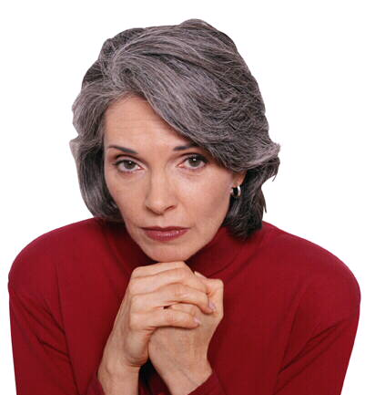
Why is good spelling important?
Poor spelling distracts from communication. It keeps the reader from focusing on what you have to say. It sends the wrong message—about you.
I guess she’s not very careful. . .
Didn’t he read this before he sent it?
What a mess!
[End of Section]

Slide 4



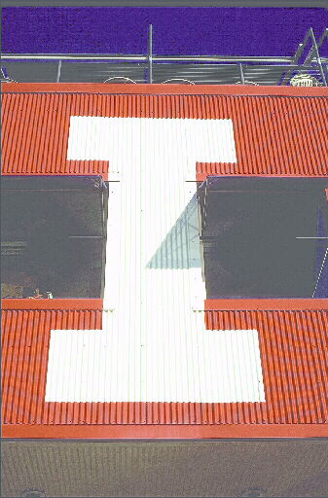
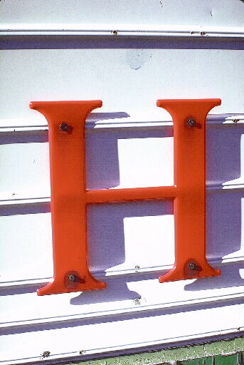
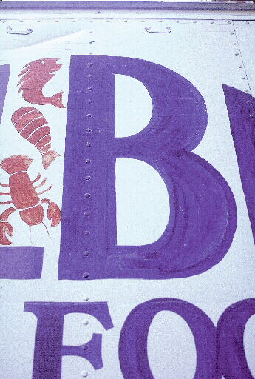

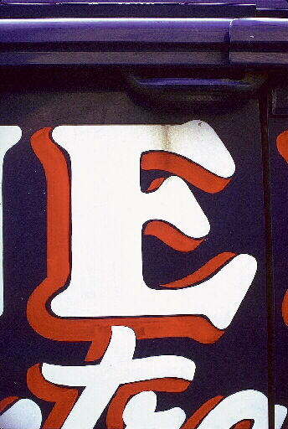
Good spelling habits
Good spelling habits are important.
Most of us are not “natural” spellers. But we can all improve if we
Pronounce words carefully
Use a dictionary
Spell words by syllable
Proofread for careless errors
Keep a spelling notebook

Slide 5
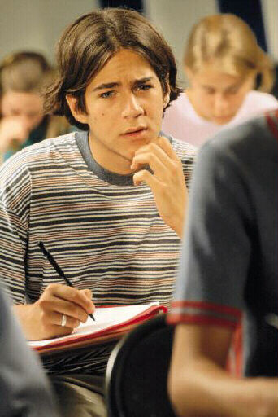
Good spelling habits
Pronounce words carefully
How do you pronounce environment?
Mispronunciation can lead to misspelling.
If you say en•vi•ern•ment instead of en•vi•ron•ment, you might spell the word incorrectly.
  Practice saying a word.
  Study it.
  Write it from memory.

Slide 6

Good spelling habits
Use a dictionary
Don’t guess.
Even good spellers have to look up words.
Spell by syllable
A syllable is a word part that is pronounced as one uninterrupted sound.
awk/ward
awkward
can/di/date
candidate
When you’re learning to pronounce and spell a new word, it’s easier to break it up into syllables.

Slide 7
Good spelling habits
Proofread for careless errors
Read your work. Dot your i’s. Cross your t’s. Is that letter a g or a q? Should that word be there, their, or they’re?
Don’t rely on spelling checkers alone. They’re great, BUT. . .
  sometimes you have to write by hand, and
  most spelling checkers overlook words that sound alike but are spelled differently.

Slide 8

Good spelling habits
Keep a spelling notebook
Correct Spelling
Syllables and Accents
Trouble Spots
Comments
probably
′
Pronounce both b’s
prob•a•bly
probably
usually
′
u•su•al•ly
usually
usual + ly
Never enter a misspelled word.
Use a dictionary!
Which letters give you problems?
Anything that will help you remember
[End of Section]

Slide 9
ie and ei
Write ie when the sound is a long e.
achieve
chief
niece
believe
yield
relief
When the long e comes after c, write ei.
ceiling
receive
perceive

Slide 10
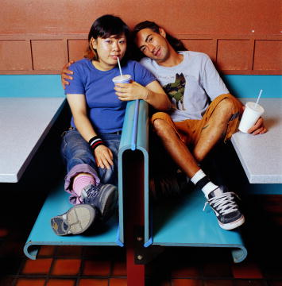

ie and ei
Write ei when the sound is not a long e.
height
weigh
heir
foreign
veil
counterfeit
Exceptions
kerchief
seize
mischief
leisure
friend
either
[End of Section]

Slide 11


ie and ei
This rhyme will help you decide between ie and ei.
Grammar Gal Says...
I before e
except after c
or when sounded like a
as in neighbor and weigh.

Slide 12
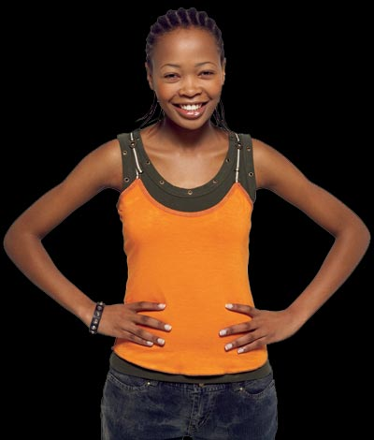
ie and ei
But don’t apply any of these rules when i and e are in different syllables.
Grammar Gal Says...
de • i • ty
sci • ence
so • ci • e • ty

Slide 13

–cede, –ceed, and –sede
Only one English word ends in –sede.
❶
supersede
Only three words end in –ceed.
❶
❷
❸
exceed
proceed
succeed
Almost all other words with this sound end with –cede.
precede
intercede
concede
secede
recede
accede

Slide 14


ie and ei
–cede, –ceed, and –sede
For each sentence, choose the correct word in parentheses.
1. “One of you is a (thief, theif)!” shouted the detective.
2. The movie (exceded, exceeded) my expectations.
3. Did you invite your (friends, freinds) to the play?
4. The band will (precede, preceed) the team onto the field.

Slide 15
ie and ei
–cede, –ceed, and –sede
For each sentence, choose the correct word in parentheses.
1. “One of you is a (thief, theif)!” shouted the detective.
The sound is a long e, and the letters do not follow c. Write ie.

Slide 16
ie and ei
–cede, –ceed, and –sede
For each sentence, choose the correct word in parentheses.
2. The movie (exceded, exceeded) my expectations.
Exceed is one of only three words spelled with
–ceed. The other two are proceed and succeed

Slide 17
ie and ei
–cede, –ceed, and –sede
For each sentence, choose the correct word in parentheses.
3. Did you invite your (friends, freinds) to the play?
Friend is an exception to the rule. Most words that do not have a long e sound are written with ei.

Slide 18
ie and ei
–cede, –ceed, and –sede
For each sentence, choose the correct word or words in parentheses.
4. The band will (precede, preceed) the team onto the field.
Only supersede is written with –sede. Only exceed, proceed, and succeed are written with
–ceed. All the others are written with –cede.

Slide 19
ie and ei
–cede, –ceed, and –sede
On Your Own
Correct any misspelled words in these sentences. If all the words are spelled correctly, write C.
  None of our neighbors has a dog.
  Brad beleives that he will win the scholarship.
  Did I recieve a letter today?
  The band is marching onto the feild now.
  Niether Kevin nor Sean can give us a ride.
[End of Section]

Slide 20
ie and ei
–cede, –ceed, and –sede
Answers
Correct any misspelled words in these sentences. If all the words are spelled correctly, write C.
  1. None of our neighbors has a dog.
  2. Brad believes that he will win the scholarship.
  3. Did I receive a letter today?
  4. The band is marching onto the field now.
  5. Neither Kevin nor Sean can give us a ride.
C

Slide 21
Prefixes
When you add a prefix to a word, don’t change the spelling of the original word.
A prefix is a word part that is added before a base word or root.
mis
+
understand
=
misunderstand
un
+
known
=
unknown
over
+
throw
=
overthrow
[End of Section]

Slide 22
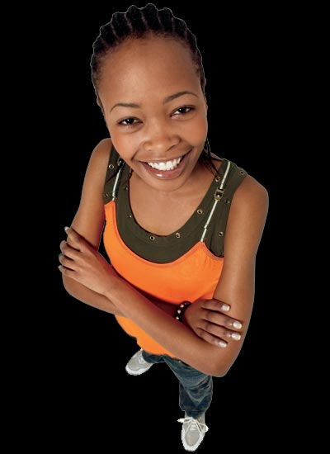
Prefixes
Notice that the spelling of the original word doesn’t change even when the original word begins with the same letter that ends the prefix.
Grammar Gal Says...
misstated
overrule
immobile

Slide 23
Suffixes
Suffixes are more complicated than prefixes.
A suffix is a word part that is added after a base word or root.
smooth
+
ly
=
smoothly
wonder
+
ful
=
wonderful
courage
+
ous
=
courageous

Slide 24
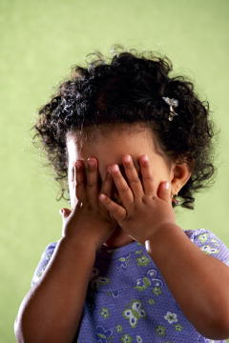
Suffixes
When you add –ly or –ness, the spelling of the original word usually remains the same.
kindly
kindness
Exception
Change y to i except for one-syllable words.
happy
happily
happiness
shy
shyly
shyness

Slide 25
Suffixes
Drop a final silent e when you add a suffix that begins with a vowel.
admire
admiring
admiration
rise
riser
rising
Keep a final silent e when you add a suffix that begins with a consonant.
safety
hopeful
pavement

Slide 26
Suffixes
Here are some exceptions to the rules for adding suffixes to words that end in silent e.
Grammar Gal Says...
+
=
true
ly
truly
+
=
awe
ful
awful
nine
+
=
th
ninth
argue
+
=
ment
argument
dye
+
=
ing
dyeing

Slide 27
Suffixes
When you add a suffix to a word that ends in y:
  Change the y to i if there’s a consonant right before the y, unless the suffix begins with i.
beauty
beautiful
terrify
terrifying
  Just add the suffix if there’s a vowel right before the y.
pay
payment

Slide 28
Suffixes
Here are some exceptions to the rules for adding suffixes to words that end in y.
Grammar Gal Says...
+
=
lady
like
ladylike
+
=
baby
hood
babyhood
day
+
=
ly
daily
say
+
=
ed
said

Slide 29
Suffixes
When a word ends in a consonant, double the final consonant if
  the suffix begins with a vowel,
+
prefer
ing
  the word is one syllable or is accented on the last syllable,
′
+
pre/fer
ing
prefer
  and the word ends with a single consonant preceded by a single vowel.
+
prefer
ing
preferring

Slide 30
Suffixes
Don’t double the final consonant unless the answer to every question is “yes.”
run + ing
fasten + er
1. Does the suffix start with a vowel?
YES
YES
2. Does the word have one syllable or the accent on the last syllable?
YES
NO
3. Does the word end in a single consonant preceded by one vowel?
YES
YES
running
fastener

Slide 31
Suffixes
In some words, the final consonant may or may not be doubled. In these cases, both spellings are correct.
Grammar Gal Says...
traveler
travel
traveller
shoveling
shovel
shovelling

Slide 32
Prefixes and Suffixes
For each sentence, choose the correct spelling in parentheses.
1. I think you (mistated, misstated) my position on that issue.
2. We plan on (surprising, surpriseing) her on her birthday.
3. The (funniest, funnyest) part of the movie was at the beginning.

Slide 33
Prefixes and Suffixes
For each sentence, choose the correct spelling in parentheses.
1. I think you (mistated, misstated) my position on that issue.
When you add a prefix (mis–), the spelling of the original word (stated) does not change.

Slide 34
Prefixes and Suffixes
For each sentence, choose the correct spelling in parentheses.
2. We plan on (surprising, surpriseing) her on her birthday.
Drop the final silent e when you add a suffix that begins with a vowel.

Slide 35
Prefixes and Suffixes
For each sentence, choose the correct spelling in parentheses.
3. The (funniest, funnyest) part of the movie was at the beginning.
When a word ends in y, and there’s a consonant right before the y, change the y to i before you add the suffix.

Slide 36
Prefixes and Suffixes
On Your Own
Provide the correct spelling of the word and the prefix or suffix in parentheses.
  Last night’s meeting was ______________ . (un + necessary)
  We had already come up with a ___________ solution to the problem. (sense + ible)
  My grandfather lived on a farm during his ___________. (boy + hood)
  She ________ that we should bring lunch. (say + ed)
[End of Section]

Slide 37
Prefixes and Suffixes
Answers
Provide the correct spelling of the word and the prefix or suffix in parentheses.
  Last night’s meeting was ______________ . (un + necessary)
  We had already come up with a ___________ solution to the problem. (sense + ible)
  My grandfather lived on a farm during his ___________. (boy + hood)
  She ________ that we should bring lunch. (say + ed)
unnecessary
sensible
boyhood
said

Slide 38

Plurals of nouns
The plurals of most nouns are formed by adding either s or es.
Singular
Plural
For most nouns, simply add s.
boat
boats
storm
storms
Add es if the noun ends in s, x, z, ch, or sh.
mess
messes
box
boxes
porch
porches

Slide 39
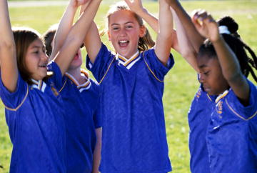
Plurals of nouns
Singular
Plural
Nouns ending in y
If a noun ends in y preceded by a consonant, change y to i and add es.
fly
flies
pony
ponies
diary
diaries
Don’t change the y to i in proper nouns.
Mary
Marys
Kelly
Kellys
There are three Marys on my team.

Slide 40
Plurals of nouns
Singular
Plural
Nouns ending in f or fe
For some nouns that end in f or fe, add s.
giraffe
giraffes
roof
roofs
For others, change the f to v before adding s or es. Listen for the phonetic differences in the words.
knife
knives
wolf
wolves
self
selves

Slide 41
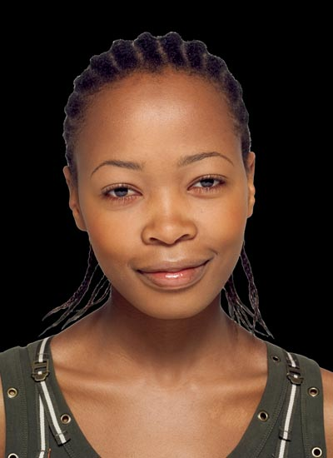
Plurals of nouns
Some nouns that end in f can correctly form their plurals either way.
Grammar Gal Says...
scarfs
scarf
scarves
hoofs
hoof
hooves

Slide 42
Plurals of nouns
Singular
Plural
Nouns ending in o
For nouns that end in o preceded by a vowel, add s.
radio
radios
kangaroo
kangaroos
If the final o is preceded by a consonant, add es.
echo
echoes
hero
heroes
tomato
tomatoes

Slide 43
Plurals of nouns
Some nouns that end in o can correctly form their plurals either way.
Grammar Gal Says...
cargos
cargo
cargoes
mosquitos
mosquito
mosquitoes

Slide 44
Plurals of nouns
Also, just add s to proper nouns and to musical terms that end in o—even if the o is preceded by a consonant.
Grammar Gal Says...
Sakamoto
Sakamotos
solo
solos
piano
pianos

Slide 45
Plurals of nouns
Singular
Plural
Nouns that have irregular plurals
mouse
mice
Some nouns form their plurals in irregular ways.
child
children
foot
feet
man
men
Some nouns don’t change form at all.
sheep
sheep
fish
fish

Slide 46
Plurals of nouns
For each sentence, choose the correct spelling of the plural noun in parentheses.
1. Who left the (dishes, dishs) in the sink?
2. James enjoys adventure (storys, stories).
3. We can do that job by (ourselfs, ourselves).
4. The (radioes, radios) are tuned to different stations.

Slide 47
Plurals of nouns
For each sentence, choose the correct spelling of the plural noun in parentheses.
1. Who left the (dishes, dishs) in the sink?
When a noun ends in s, x, z, ch, or sh, form the plural by adding es.

Slide 48
Plurals of nouns
For each sentence, choose the correct spelling of the plural noun in parentheses.
2. James enjoys adventure (storys, stories).
When a noun ends in y preceded by a consonant, change y to i and add es.

Slide 49
Plurals of nouns
For each sentence, choose the correct spelling of the plural noun in parentheses.
3. We can do that job by (ourselfs, ourselves).
For many nouns that end in f or fe, change the f to v before adding s or es.

Slide 50
Plurals of nouns
For each sentence, choose the correct spelling of the plural noun in parentheses.
4. The (radioes, radios) are tuned to different stations.
When a noun ends in o preceded by a vowel, form the plural by adding s.

Slide 51
Plurals of nouns
On Your Own
Provide the correct plural of the noun in parentheses.
  The weather announcer is predicting strong _______ tonight. (wind)
  The roadside _________ are full of water. (ditch)
  Be sure to get extra __________ for the radio. (battery)
  We have two _________ of bread and a lot of peanut butter. (loaf)
  It’s so cold that my _________ are chattering. (tooth)
[End of Section]

Slide 52
Plurals of nouns
Answers
Provide the correct plural of the noun in parentheses.
  The weather announcer is predicting strong _______ tonight. (wind)
  The roadside _________ are full of water. (ditch)
  Be sure to get extra __________ for the radio. (battery)
  We have two _________ of bread and a lot of peanut butter. (loaf)
  It’s so cold that my _________ are chattering. (tooth)
winds
ditches
batteries
loaves
teeth

Slide 53
Review A
For each sentence, choose the correctly spelled word in parentheses.
1. Class, you may (procede, proceed) to the cafeteria.
2. It was a great (relief, releif) when the exam was over.
3. They are (notifiing, notifying) all the parents now.
4. Washington, D.C., has two (daily, dayly) newspapers.
5. Martin and Ed are practicing their (soloes, solos) in the choir room.
[End of Section]

Slide 54
Review A
For each sentence, choose the correctly spelled word in parentheses.
1. Class, you may (procede, proceed) to the cafeteria.
2. It was a great (relief, releif) when the exam was over.
3. They are (notifiing, notifying) all the parents now.
4. Washington, D.C., has two (daily, dayly) newspapers.
5. Martin and Ed are practicing their (soloes, solos) in the choir room.

Slide 55
Review B
For each sentence, circle any misspelled words and then write the word correctly.
1. The moon shone brightly through the leafs.
2. The armys gathered on the broad plain.
3. If you had three wish’s, what would you wish for?
4. Her neice is my sister’s best friend.
5. Have you finished writeing your paper yet?
[End of Section]

Slide 56
Review B
For each sentence, circle any misspelled word and then write the word correctly.
1. The moon shone brightly through the leafs.
2. The armys gathered on the broad plain.
3. If you had three wish’s, what would you wish?
4. Her neice is my sister’s best friend.
5. Have you finished writeing your paper yet?
leaves
armies
wishes
niece
writing

Slide 57
The End

