Slide 1
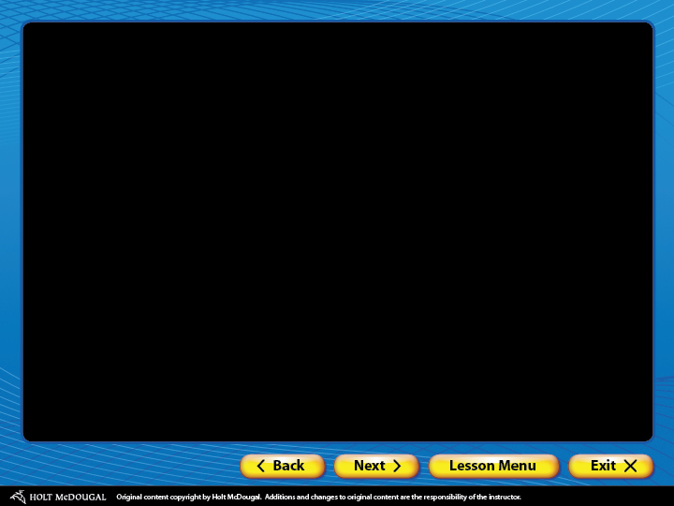
About GrammarNotes
Introduction
Navigation
Visually rich presentations
Animated examples
Types of practice
Special features
Student handouts
Getting started
Printing slides
Customizing slides
Other ways to use GrammarNotes

Slide 2
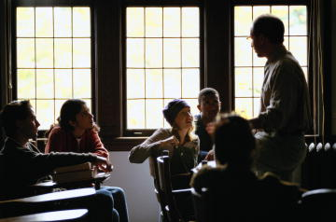
About GrammarNotes
The Power of GrammarNotes
Motivation
Visual richness with animations and images
Interactivity
Whole-class instruction
Guided practice
Handouts
Standardized test practice

Slide 3
About GrammarNotes
Types of Presentations
Correcting Common Grammar Errors
Connecting Grammar with Writing and Literature

Slide 4
About GrammarNotes
Features of GrammarNotes
Easy-to-use navigation
Visually rich presentations
Animated examples of concepts
Three types of practice: Practice, On Your Own, Review
Special features: Customizing GrammarNotes, Grammar Glossary, Test Prep
Printable student handouts

Slide 5
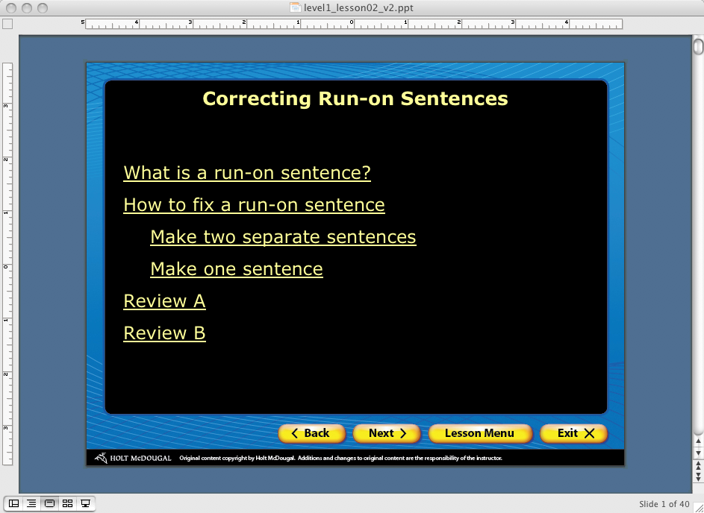
About GrammarNotes
Navigation
Menus clearly identify topics and subtopics.

Slide 6
About GrammarNotes
Navigation
Click-again arrows prompt you to click again to reveal more information.
Navigation buttons in the bottom frame allow you to move easily within and between presentations.

Slide 7
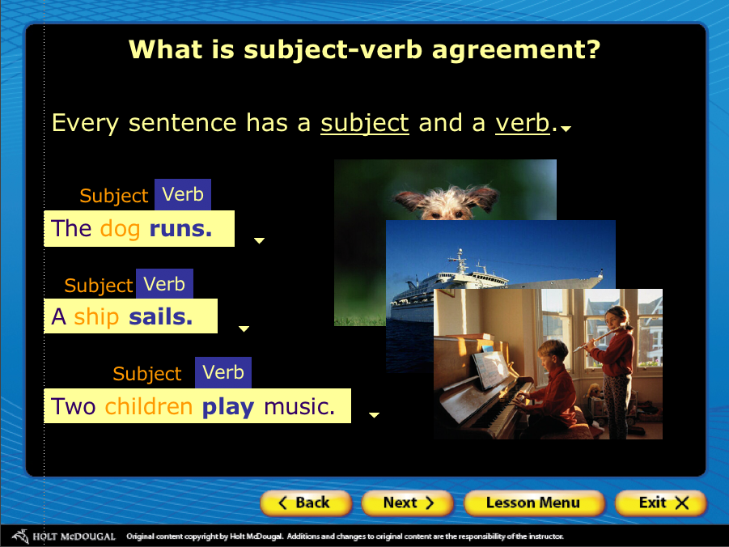
About GrammarNotes
Visually Rich Presentations
Images in the presentations help reinforce and illustrate concepts and keep students engaged.

Slide 8
About GrammarNotes
Animated Examples
Animated examples provide visual reinforcements for the concepts being taught.
A prepositional phrase contains
a preposition
a noun or pronoun (object of the preposition)
any modifiers of the object
beneath
the beautiful fall
leaves

Slide 9
About GrammarNotes
Types of Practice
Each presentation offers students several chances to practice what they’ve learned.
Practice – reinforces learning after specific concepts have been covered
On Your Own – tests comprehension at the end of each section in a presentation
Review – covers concepts from the entire presentation

Slide 10


About GrammarNotes
Special Features
Grammar Glossary—an alphabetical handbook of grammar terms with animated examples
Handouts—a collection of Word files of Practice, On Your Own, and Review exercises from each presentation

Slide 11


About GrammarNotes
Special Features
Standardized Test Preparation—a collection of grammar and usage test items in standardized test format
Clicker Icon—Appears in lesson presentations that are best designed for the use of a student response system. The use of the system is not essential to the lesson but offers options for instruction.

Slide 12
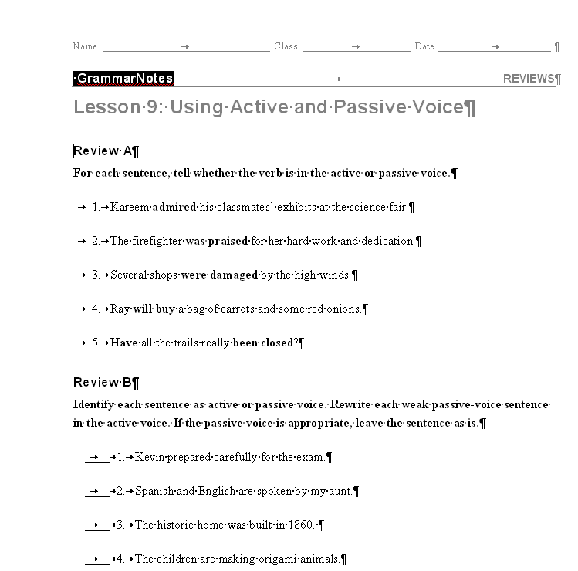
About GrammarNotes
Student Handouts
Teachers can print out copies of all review materials and standardized test prep materials.

Slide 13

About GrammarNotes
Getting Started
Before you use GrammarNotes with a class
Check your equipment. Make sure your computer and projector work properly together.
Preview the presentations. Click through one collection to get used to the navigation and the different types of practice.

Slide 14

About GrammarNotes
Getting Started
When you use GrammarNotes with a class
Click through animations at a pace that allows students to read all the information.
Use printable handouts to reinforce concepts.
Click on underlined hyperlinks for further information and definitions.
[End of Section]

Slide 15
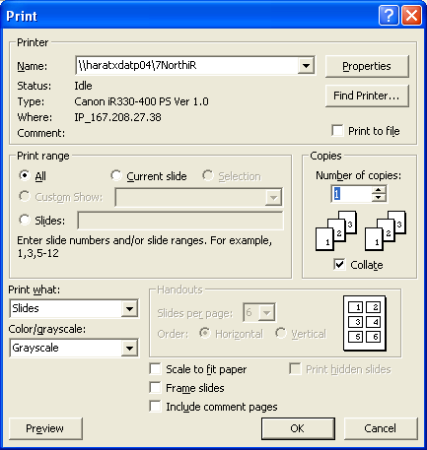
About GrammarNotes
Printing Slides
You may want to print some or all of the slides in a presentation. To print slides
  Open a presentation, and choose Print from the File menu. This will open a Print pop-up menu.

Slide 16
About GrammarNotes
Printing Slides
To print all or some slides in a presentation:
In the Print range section, choose the range of slides.
  All—all slides
  Current slide—current slide
  Slides—enter the slide range you want to print (for example 4–8).

Slide 17
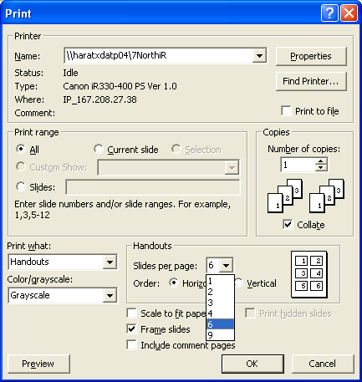
About GrammarNotes
Printing Slides
To print more than one slide per page:
  In the Print what section select Handouts.
2
1
  Choose the number of slides under Slides per page.

Slide 18
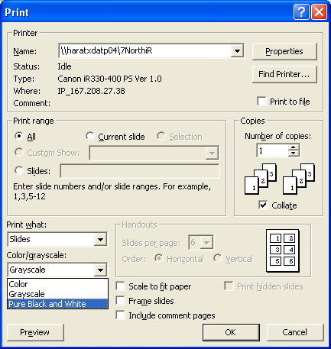
About GrammarNotes
Printing Slides
Make sure to choose the Pure Black and White print option so that the text shows.
[End of Section]

Slide 19
About GrammarNotes
Customizing Slides
To tailor these presentations to the abilities and interests of your students or to your teaching plan, you can
  add, delete, edit, or reorganize slides
  add images, audio clips, or video clips
  change animation on slides
[End of Section]

Slide 20
About GrammarNotes
Other Ways to Use GrammarNotes
Assign individuals or teams of students to be “guest instructors” for a particular concept.
Print out presentations as study guides for students who need extra help.
Allow students who miss a presentation to check out the GrammarNotes disk to catch up.
[End of Section]

Slide 21
The End

