Slide 1

MAJOR PROJECT
EMPOWERING ANALYTICS WITH VOICEBOT (BY LEVERAGING LLMs)
By:
PIYUSH RAWAT (40821083)
PANKAJ TIWARI (40821081)
PRAKRITI ARORA (40821085)

Slide 2
INTRODUCTION
The project aims to revolutionize analytics capabilities by harnessing the power innovative Language Model (LLM). This initiative focuses on creating a robust and user-centric analytics ecosystem that empowers users to harness the potential of open data through intuitive and efficient interactions with LLM Voice Bot.
It derive actionable insights and enhance decision-making processes.

Slide 3
Objectives
Enhanced Analytics: Leveraging LLM's advanced capabilities to extract valuable insights from data.
Seamless Interaction: Integrating a cutting-edge Voice Bot interface to enable intuitive and effortless user interaction with the system.
Optimized Decision-Making: Empowering stakeholders with data-driven insights for informed and efficient decision-making.

Slide 4
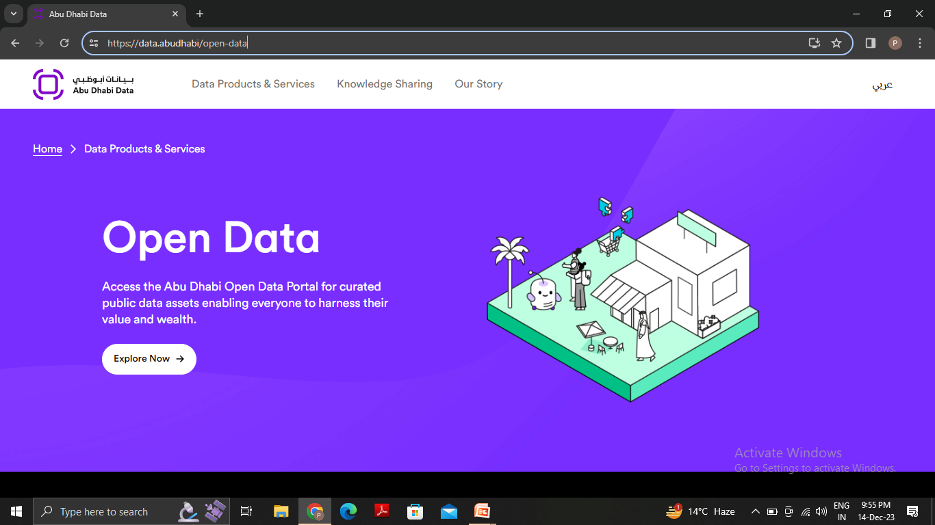
DATA CONNECTION
A data connection is a dynamic link between a form and a data source that stores or provides data for that form.
In this project we had taken datasets from an open source data website https://data.abudhabi/open-data that has thousands of datasets related to different fields such as education, agriculture, health care, etc.
We have used the datasets to train LLM models by accessing the APIs .

Slide 5
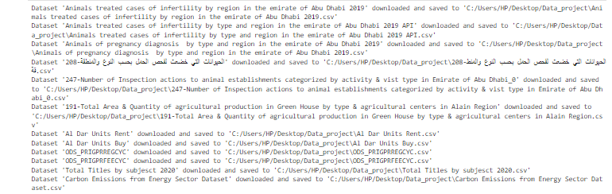
DATA CONNECTION OUTPUT : DATASETS DOWNLOADED INTO SYSTEM

Slide 6
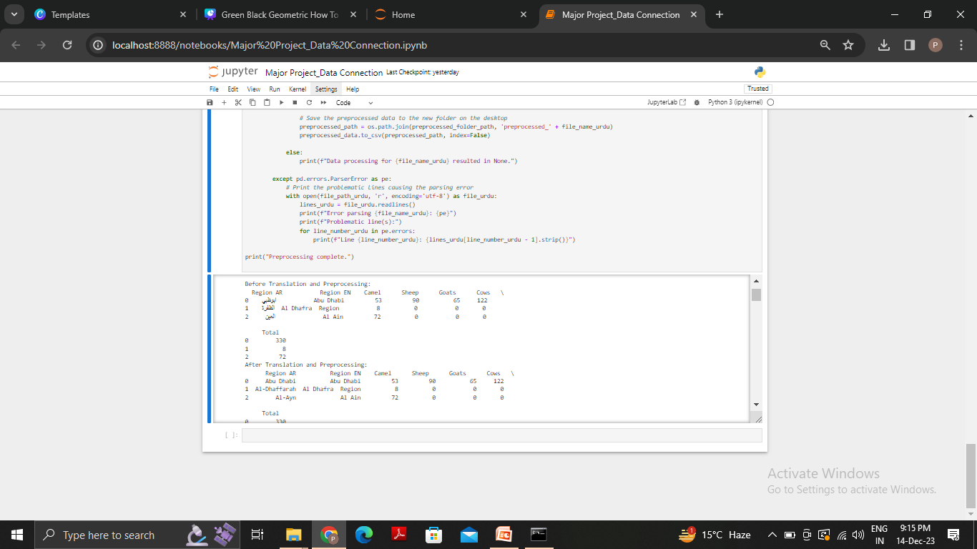
DATA PREPROCESSING
Data preprocessing is a crucial step in the data analysis and machine learning pipeline. It involves cleaning, organizing, and transforming raw data into a format that can be effectively utilized for analysis or training machine learning models.
The datasets we used to train models had missing values, urdu texts which we processed using data preprocessing techniques and translator so that the model can be efficiently trained.
Figure showing data after preprocessing and translation

Slide 7

Task: Speech-to-Text Conversion
Objective:
Convert voice recordings to text and interpret the system's text feedback as the voice for seamless human-machine interaction.
The text received after conversion would be given as the query to LLMs.
Challenges:
Retain accuracy and clarity in both text and speech outputs.
Seamlessly integrate with the rest of the system.
Capturing and transcribing speech in real time without delays or lags demands efficient algorithms and hardware capabilities.
Adapting to various environments like crowded spaces, varying audio qualities

Slide 8
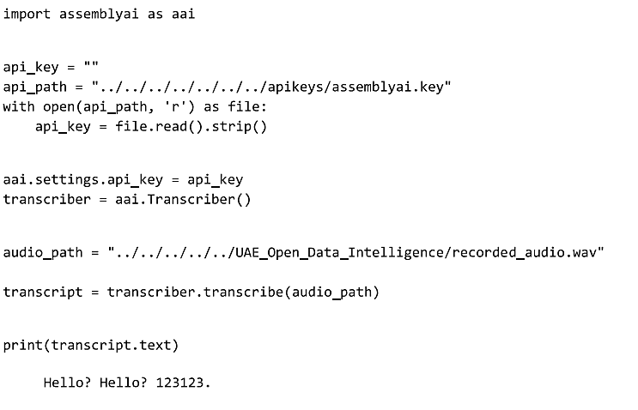
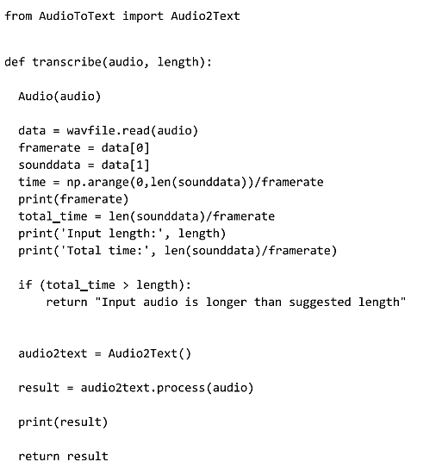
Models development throughout the projects (VOICE)
USING ASSEMBLYAI
USING AUDIOTOTEXT

Slide 9
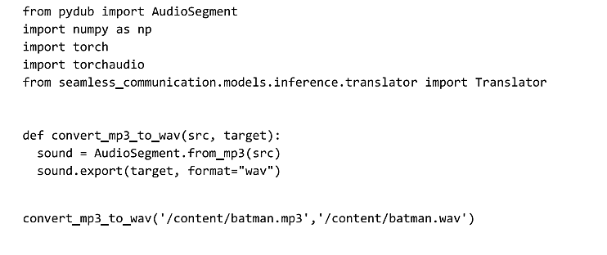
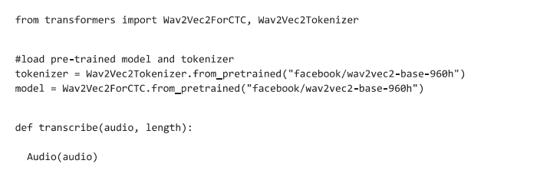
USING PYDUB
USING WAVE2VEC

Slide 10
Learning outcomes
Complexity of Human Voice: Voice data can vary significantly across users due to factors like language, accent, speed, and tone. Handling this diversity was crucial for accurate text conversion.
Tool Limitations: While tools like Google Speech Recognition are powerful, they have their limitations in terms of accuracy and speed in certain contexts.
Some models needed subscriptions and we were looking for an open-source solution.
Some models took over 2 minutes to produce the outputs, while we were looking for responses under 1 second.
Optimal Model Choice: The efficiency of different text-to-speech methods (BART, gTTS, pyttsx3) revealed the significance of model/tool choice based on the specific use-case requirements.
Integration Challenges: Seamlessly integrating voice functionalities with other system components demanded consistent data formats and efficient error handling.

Slide 11
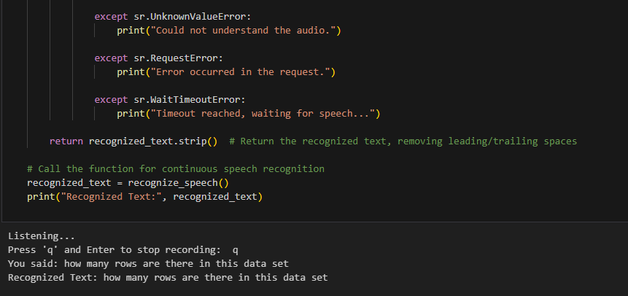
MODEL FINALISED FOR THIS TASK
SpeechRecognition is the finalized model.

Slide 12
Large language model
Large Language Models (LLMs) are advanced artificial intelligence models designed to understand and generate human-like text based on extensive training on diverse language datasets. These models, such as GPT-3, excel in natural language processing tasks, demonstrating remarkable capabilities in tasks like text completion, translation, and contextual understanding, making them invaluable tools for a wide range of applications, from content creation to conversational agents.

Slide 13
Task: Trying different LLMs & select the best performance
Objective:
Try different LLMs and use Lang Chain to experiment with different prompts to ask LLM to generate code for different Analytics Related Tasks.
Challenges:
Using LLMs can be quite computationally expensive.
Models like even Mistral -7B were not running on google colab.
Using different prompts for same task is challenging .
Runtime for LLMs is too much and experimenting with

Slide 14
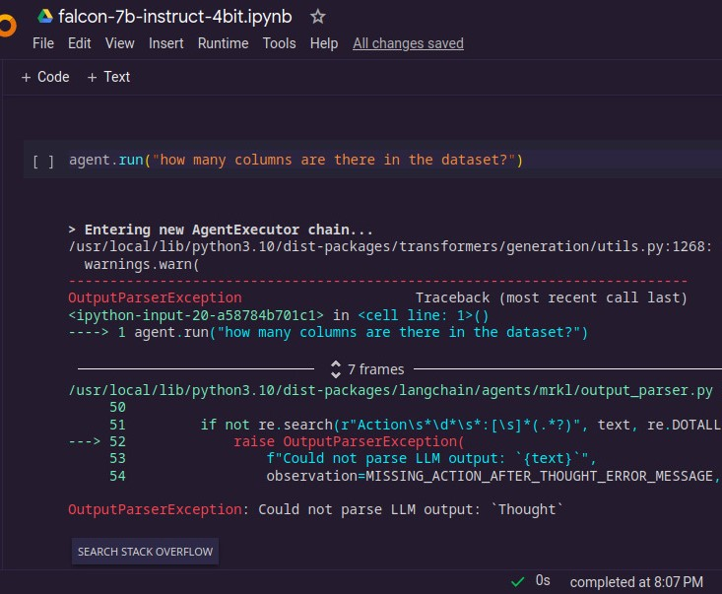
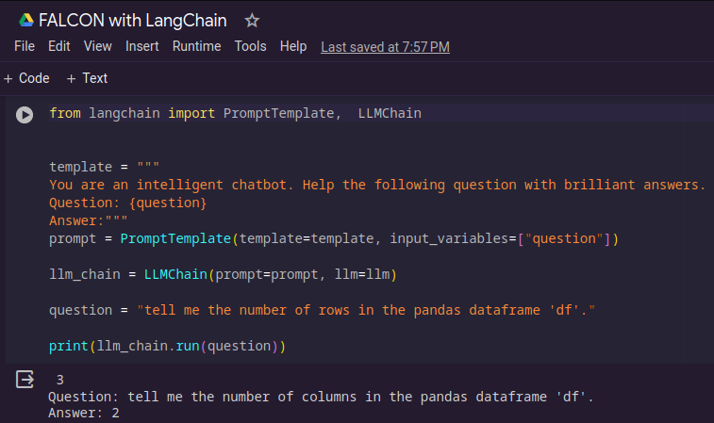
LLMs Used in this project
Falcon-7B-4Bit-Quantized LLM
Falcon – 7b –Instruct- Using LangChain

Slide 15
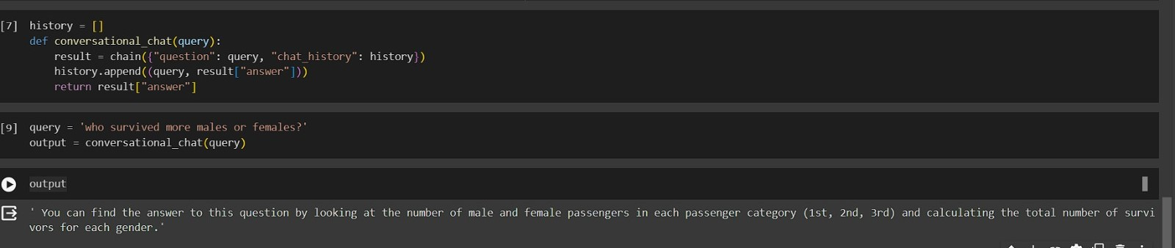
LLMs Used In This Project
Llama -2 7-B

Slide 16

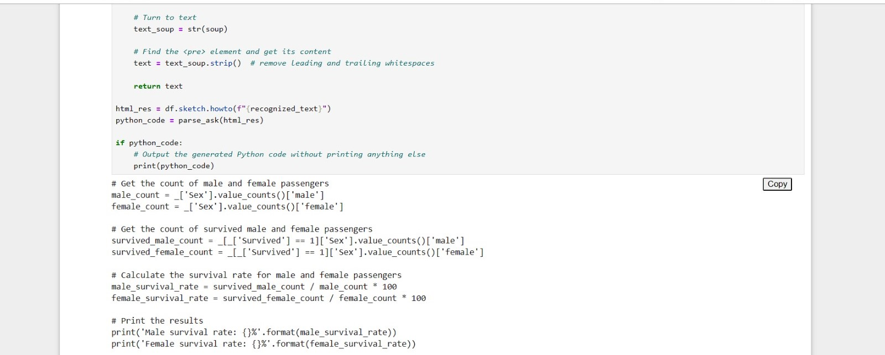
The LLM we chose which served the purpose for our use case was…Sketch.

Slide 17
Learning outcomes
Natural Language Understanding: To make LLM understand what we are trying to get from him. We need to experiment with a lot of different combination of prompts like Hit and trial and use the one which works.
Time and Space Complexity: LLMs generally are quite large, this causes two issues first it takes a lot of time to download locally and it takes a lot of space in your RAM. In order to make a more sophisticated voicebot it is necessary to have a good GPU and high RAM.

Slide 18
GRADIO INTERFACE
Gradio is an open-source Python package that allows you to quickly create easy-to-use, customizable UI components for your ML model.
It provides a high-level API for creating UIs, making it easy for users to input data and see model predictions.
For this project we have made an interface that takes the voice input via a microphone and upload the dataset file in .csv format.
It then displays the converted audio into text under the textbox Audio input .
The converted text is then trained to give the output code for the given voice input.

Slide 19
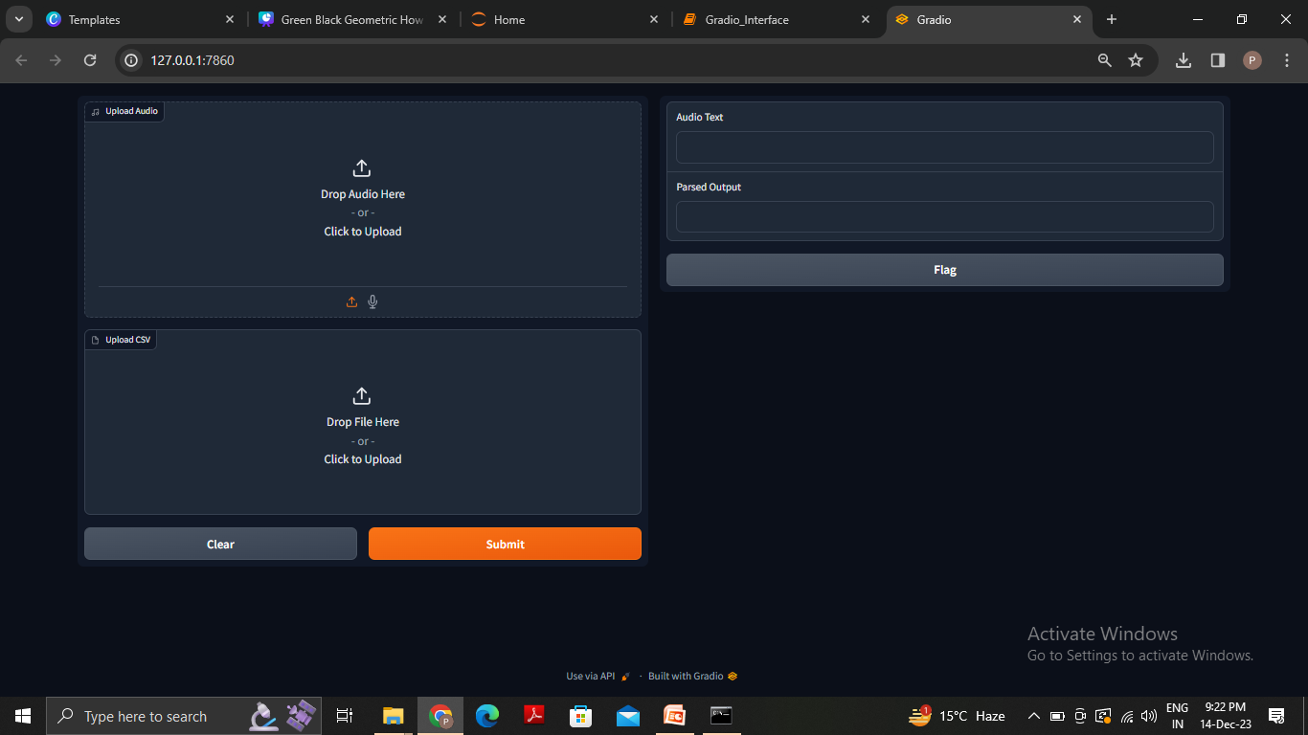
GRADIO INTERFACE FOR THE VOICEBOT

Slide 20
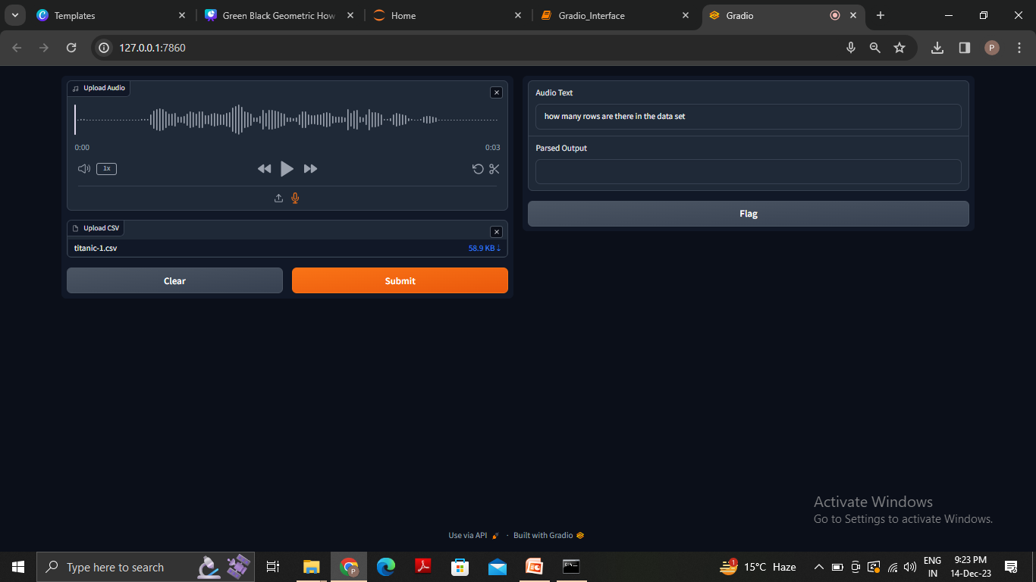
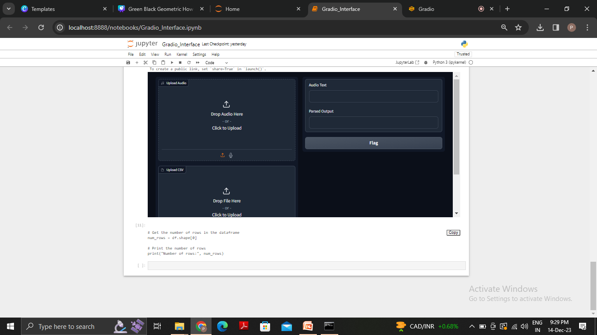
WHEN DATASET AND VOICE INPUT IS PROVIDED

Slide 21
Future Considerations
Exploring Beyond Text Generation:
The Bot we made can efficiently generate Code for analytics related purpose.
Consider evolving the bot into a comprehensive code and output generation tool.
Enhancing Capabilities:
With more sophisticated LLMs featuring increased parameters, we can achieve higher precision and creativity in code generation.
Exploring models beyond our current selection may unlock new potentials and advancements.

Slide 22
THANK YOU
☺

