Slide 1
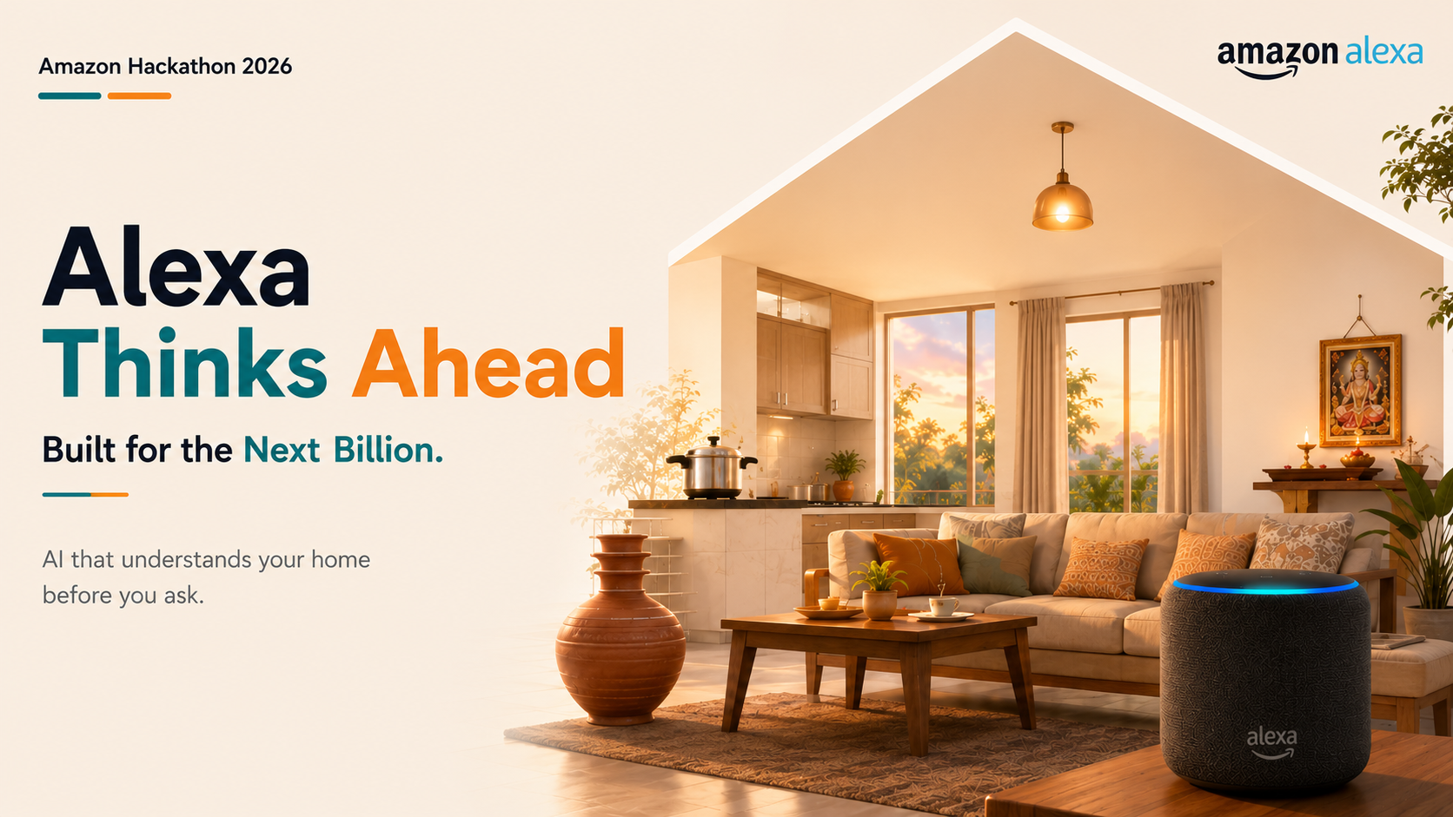
Team Bar Raisers · Priyanshu Agarwal & Piyush Kumar

Slide 2
THE NEXT TEN MINUTES
01
The problem
From a command-taker to a household partner.
What today's Alexa can't do
02
The scenario
Dadaji's 6:45 bath — thirty mornings of it
03
What I need as a customer
And what we built for each need
04
Live demo
One day in an Indian home
05
Tech architecture
A routine model + an LLM that knows today
Alexa that learns the rhythm of an Indian home and acts before anyone asks — every action explained, every liberty earned.
06
Impact & future vision
What this unlocks for the next billion
07
Questions
2 / 9

Slide 3
THE PROBLEM
Indian homes run on rhythm.
Smart homes still
wait for orders.
“Alexa, you should already know this.” — a multi-generational household issues dozens of commands a day to devices that never learn what happens next.
05:30
06:15
07:30
08:00
14:00
17:00
18:30
Morning pooja
Geyser for bath
Pressure-cooker breakfast
Water motor on
Power cut
Tuition hours
Evening chai
Reactive, not ready
Context-blind
Trust was never earned
"Alexa, turn on the geyser" — every single morning. The assistant obeys, but the hot water is still 20 minutes late.
It doesn't know a power cut is different during a child's online class, or that grandparents bathe before everyone wakes.
No explanations, no way to correct it — so families keep automation switched off and do everything by hand.
3 / 9

Slide 4
THE SCENARIO — DADAJI'S BATH
30 mornings. One pattern.
6 AM
7 AM
8 AM
9 AM
Day 1
M
96%
Day 2
T
Day 3
W
Day 4
T
Day 5
F
Day 6
S
Day 7
S
SURE ABOUT DADAJI'S BATH
Day 8
M
Day 9
T
Day 10
W
Day 11
T
Day 14 — she's sure now. Dadaji bathes at 6:45, every weekday.
Day 12
F
Day 13
S
Day 14
S
Day 15
M
Day 16
T
Day 17
W
Sundays? Around 8. She knows that too.
Day 18
T
Day 19
F
Day 20
S
Day 21
S
Day 22
M
Day 23
T
No one told her. She just watched the geyser.
Day 24
W
Day 25
T
Day 26
F
Day 27
S
Day 28
S
Day 29
M
Day 30
T
6:45 AM
4 / 9

Slide 5
WHAT I NEED AS A CUSTOMER
Four things a family would actually ask for.
“It should already be ready.”
It acts ahead of the routine — the geyser is hot before the 6:45 bath, the living room is cool before Rajesh walks in. Zero commands for the daily rhythm.
“It should understand my home.”
India-first context, not hardcoded rules — pooja mornings, tariff windows, power cuts, tuition hours all ride into the reasoning as context it actually weighs.
“It should never overreach.”
Autonomy is graduated and earned — five trust tiers per device category; one override immediately lowers what it may do on its own.
“It should explain itself.”
Every action ships with a plain-language reason — "pre-heating the geyser at 05:15, the family wakes around 06:00" — and a one-tap Override.
5 / 9

Slide 6

LIVE DEMO
One day in an Indian home.
6 / 9

Slide 7
TECH ARCHITECTURE
A routine model that knows the house, an LLM that knows today.
Two timescales, one decision — slow-learned trends meet today’s context inside the reasoning core.
REAL-TIME — THE DECISION PATH
1 · CAPTURE
recent
context
6 · REASONING CORE
action +
reason
7 · TRUST GATE
Home events
2 · INGEST
3 · STORE
Amazon Bedrock — Claude
Safety & permissions
who left or arrived
lights & appliances on/off
geyser · AC · motor usage
temperature & occupancy
voice interactions
Event stream
Time-series DB
learned patterns + today's
context → "what should the
home do next, and why" —
the Alexa+ pattern
confidence score ×
earned trust tier →
act · suggest ·
stay silent
validate & de-duplicate,
enrich with device,
member, room, time
raw event log —
months of the home's
own history
historical data
(months)
LIVE
8 · ALEXA ACTS
Today's context
Takes action
occupancy · festival or special
day · tariff window · weather
geyser, AC, lights, locks,
announcements
OFFLINE — LEARNING THE RHYTHM, NIGHTLY
real-time decision path
4 · PROCESS
5 · TRAIN
offline learning path
Feature pipeline
Routine model — DNN
learned patterns — P(event x at time t)
feedback loop
clean & sessionize by
time window; features:
time, season, occupancy
sequence model over the
event series (LSTM /
Transformer)
outcome — accepted or overridden → trust rises or falls · every action becomes tomorrow's training data
7 / 9

Slide 8
IMPACT & FUTURE VISION
Built for the next billion homes.
~1 hour
It sets itself up. Most people never open the routines tab — automation that demands configuration never gets adopted. This one configures itself, just by watching.
given back to the family every day — the small chores of remembering (geyser, motor, locks, cooling) simply stop existing.
A power cut isn't an emergency. The inverter carries what matters — the online class, the grandparents' room — and quietly sheds the rest.
More than a speaker. For homes like these, the Echo in the living room stops being a music box and becomes the household's brain — that is what makes Alexa indispensable.
Where this goes next
Sensor fusion
Location-aware context
Reflexes for emergencies
Hear the pressure-cooker whistle and the water-motor hum — context from sound and power signatures, no new hardware.
The home knows its city — the electricity board's outage schedule, municipal water timings, local weather, the region's festival calendar. Alexa arrives pre-informed.
Sub-100 ms on-device inference for safety-critical events — a gas leak or a fire can't wait for a 3-second cloud round-trip.
8 / 9

Slide 9
THANK YOU
Questions?
An Alexa that earns trust, one morning chai at a time.
Live demo — 54.252.207.144
github.com/piyushk-dev/hackon_project
Team Bar Raisers — Priyanshu Agarwal & Piyush Kumar · HackOn with Amazon
9 / 9

