Slide 1

Customer Shopping Behavior Analysis
Uncovering insights from 3,900 purchases across product categories to guide strategic business decisions.

Slide 2
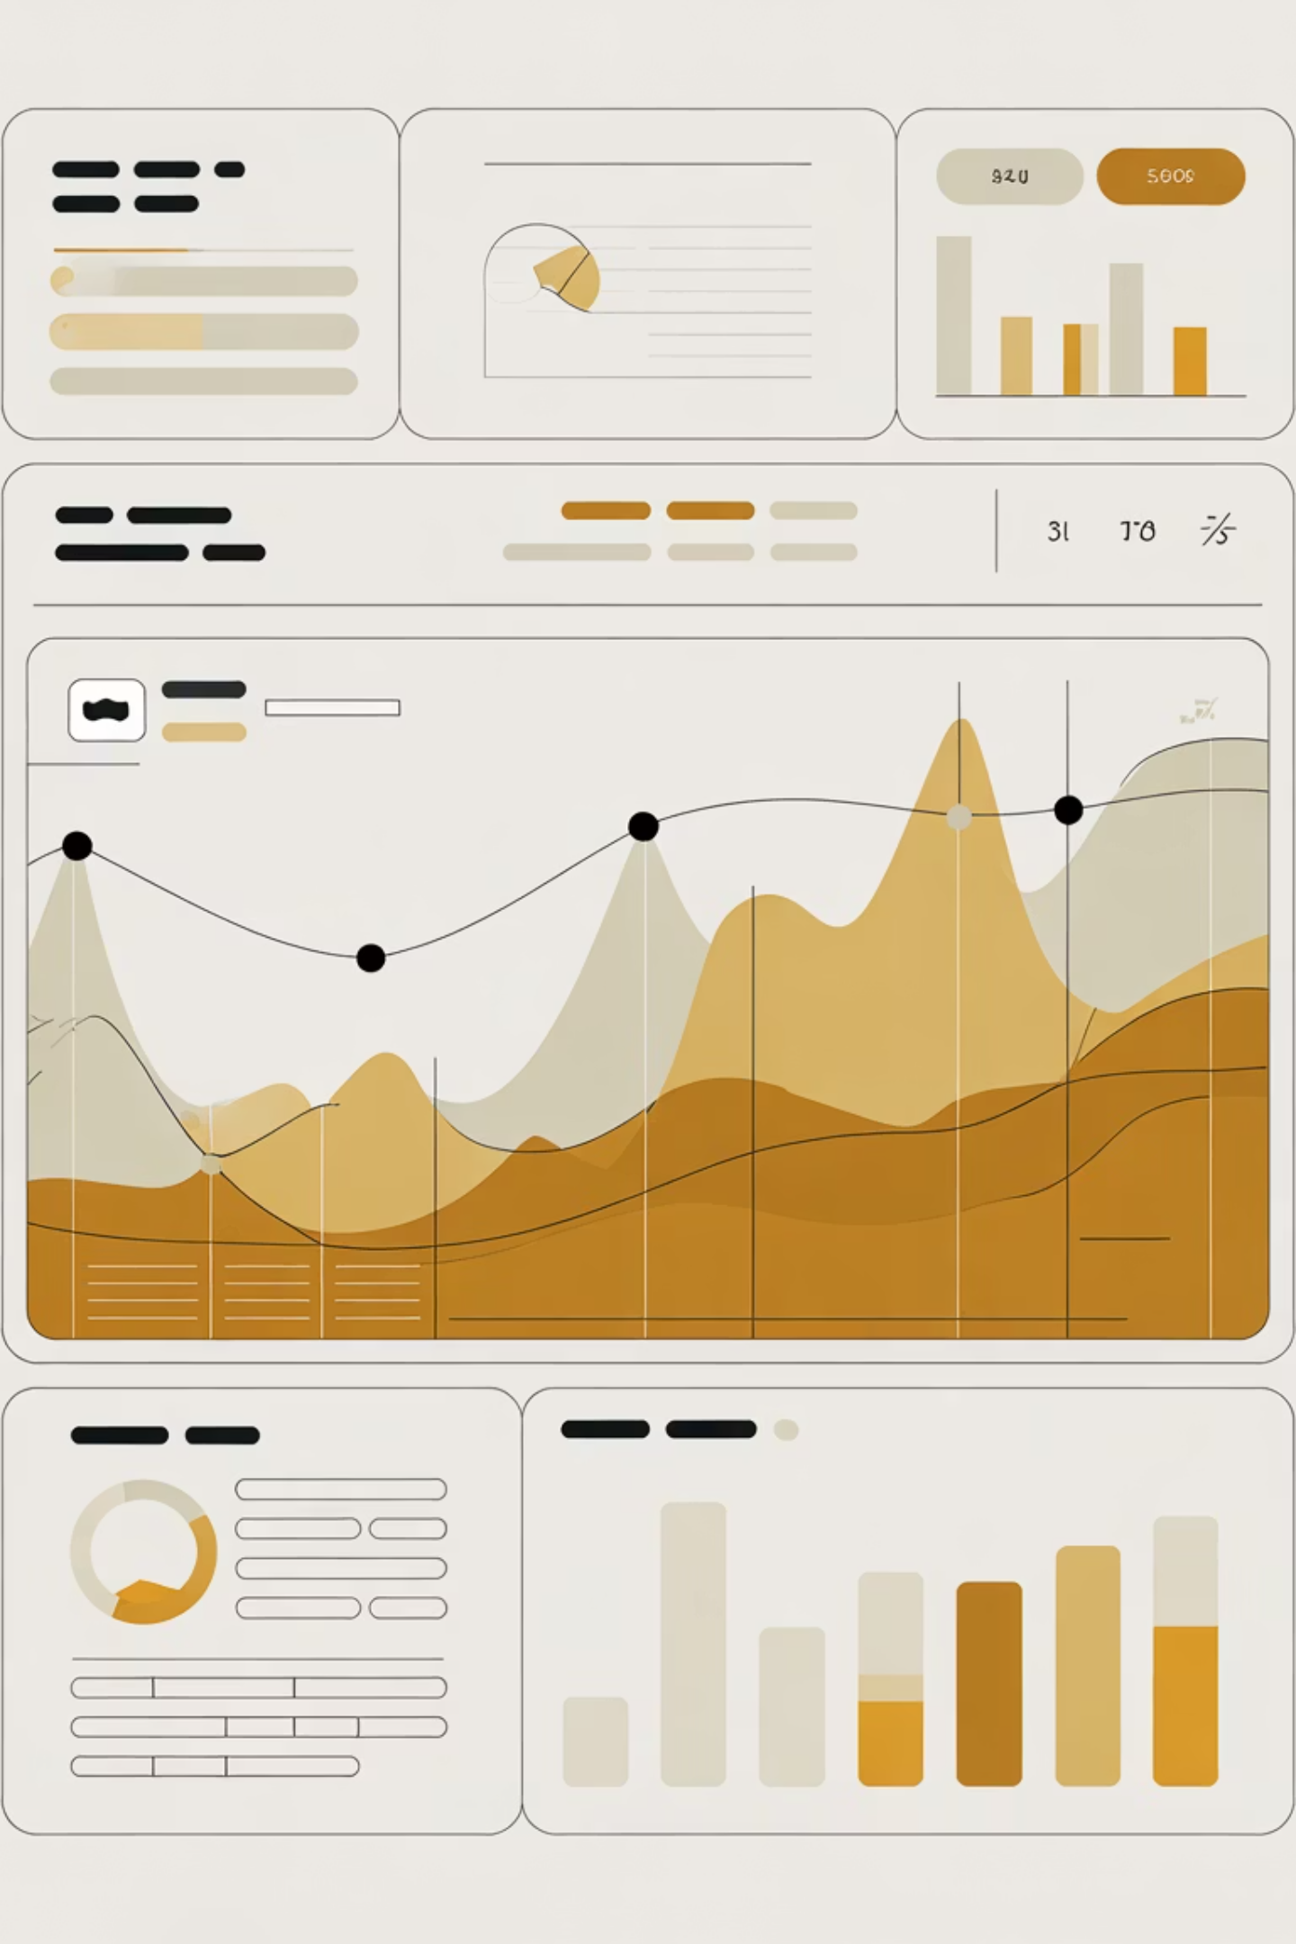
Dataset Overview
3,900 Purchases
18 Columns
Complete transactional records analyzed
Demographics, purchase details, behavior metrics
37 Missing Values
Review ratings imputed by category median

Slide 3

Customer Demographics & Segments
3,116
701
83
Loyal Customers
Returning Customers
New Customers
Fresh acquisition potential
Repeat purchasers driving revenue
Growth opportunity segment
Age range: 18–70 years. Average age: 44 years.

Slide 4

Revenue Analysis by Demographics
By Gender
By Age Group
Male: $157,890
Young Adult: $62,143
Female: $75,191
Middle-aged: $59,197
Adult: $55,978
Senior: $55,763

Slide 5

Subscription Impact
1,053
2,847
Subscribers
Non-Subscribers
Avg spend: $59.49
Avg spend: $59.87
Subscribers generate $62,645 total revenue. Non-subscribers: $170,436. Opportunity: convert high-value non-subscribers.

Slide 6
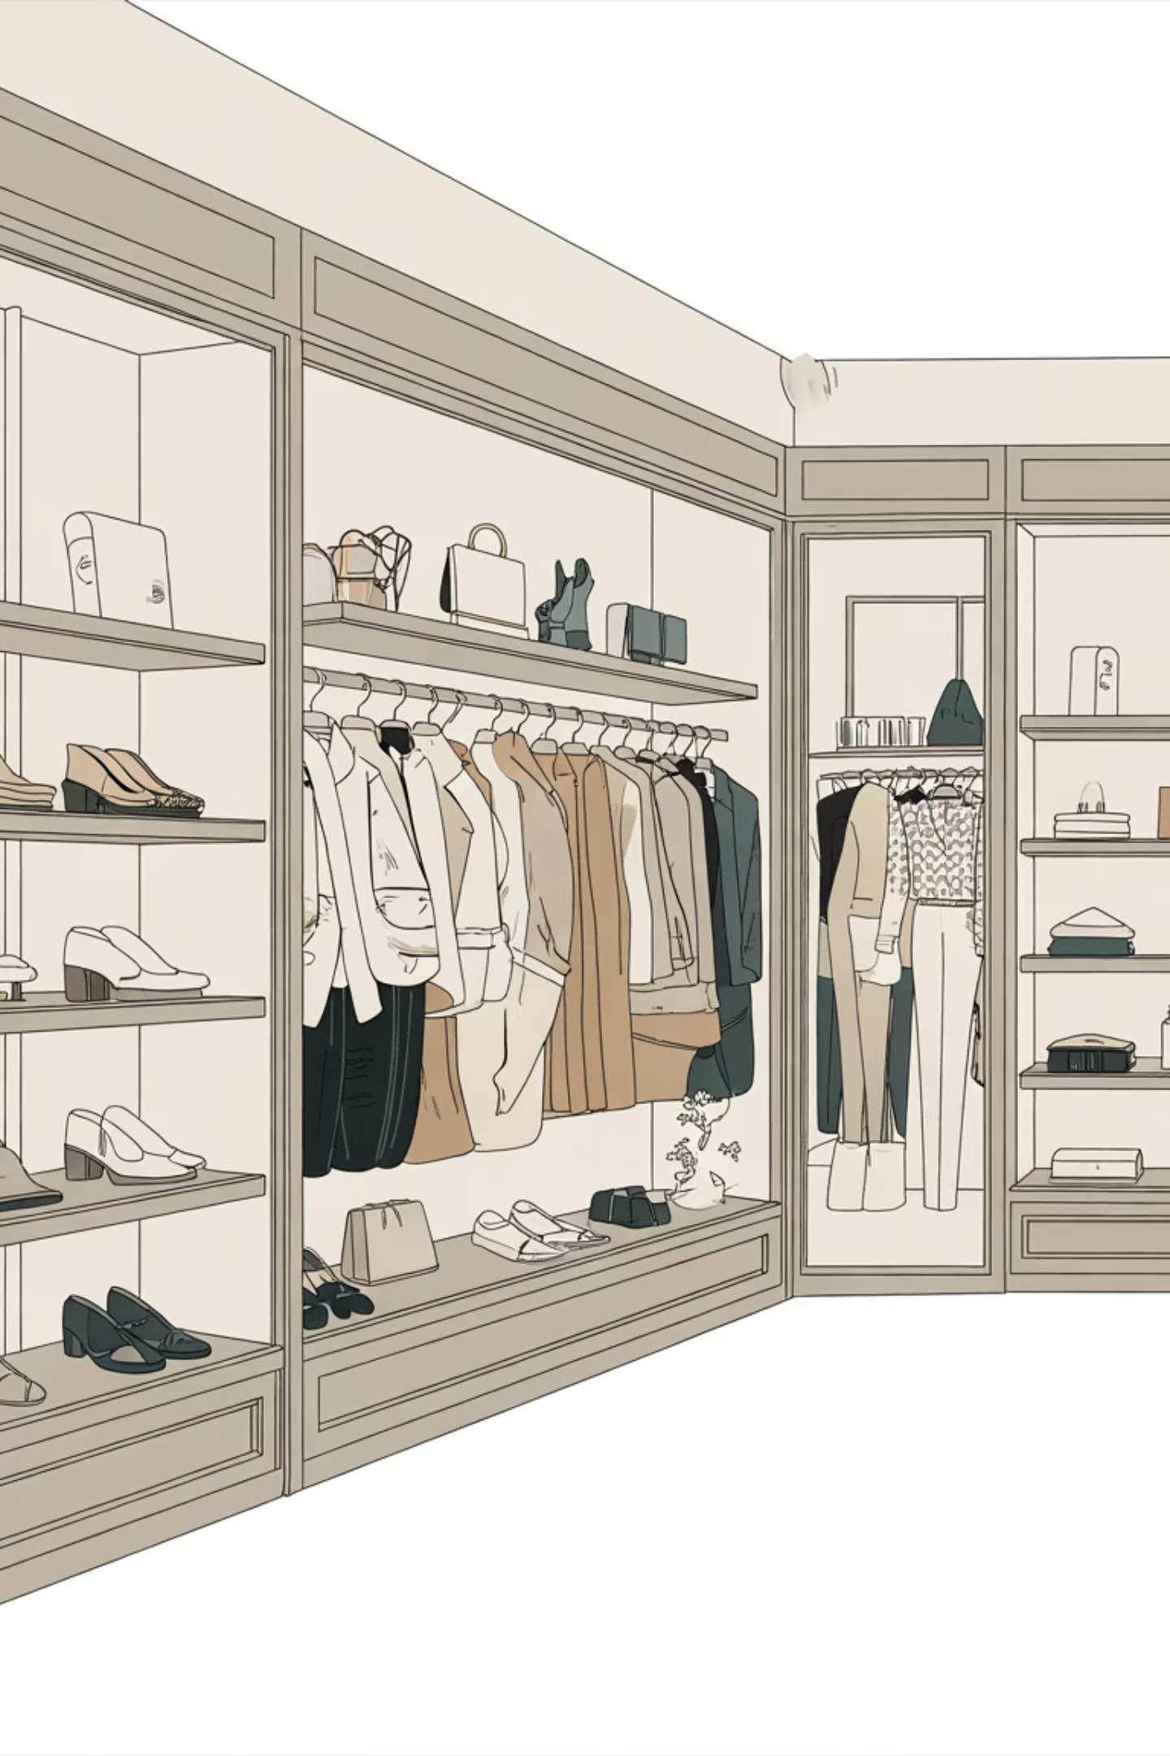
Top Products by Category
Accessories
Jewelry (171), Sunglasses (161), Belt (161)
Clothing
Blouse (171), Pants (171), Shirt (169)
Footwear
Sandals (160), Shoes (150), Sneakers (145)
Outerwear
Jacket (163), Coat (161)

Slide 7
Discount & Promotion Insights
Top 5 discount-dependent products:
1
Hat
50% discount rate
2
Sneakers
49.66% discount rate
3
Coat
49.07% discount rate
4
Sweater
48.17% discount rate
5
Pants
47.37% discount rate

Slide 8

Shipping & Purchase Behavior
Shipping Preference
Purchase Frequency
Free Shipping: 2,223 orders
Every 3 Months: 584 customers
Express: Avg $60.48
High-Spending Discount Users: 839 customers
Standard: Avg $58.46
Repeat buyers (5+ purchases): 958 with subscriptions

Slide 9
Top-Rated Products
Gloves
Sandals
Boots
3.86 rating
3.84 rating
3.82 rating
Hat
Skirt
3.80 rating
3.78 rating
Customer satisfaction drives loyalty. Highlight top-rated products in marketing campaigns.

Slide 10


Strategic Recommendations
Boost Subscriptions
Promote exclusive benefits to convert non-subscribers
Loyalty Programs
Reward repeat buyers to strengthen "Loyal" segment
Review Discount Policy
Balance sales with margin control on high-discount items
Targeted Marketing
Focus on high-revenue age groups and express-shipping users

