Slide 1
Project 1: Amazon Sales Analysis

Slide 2
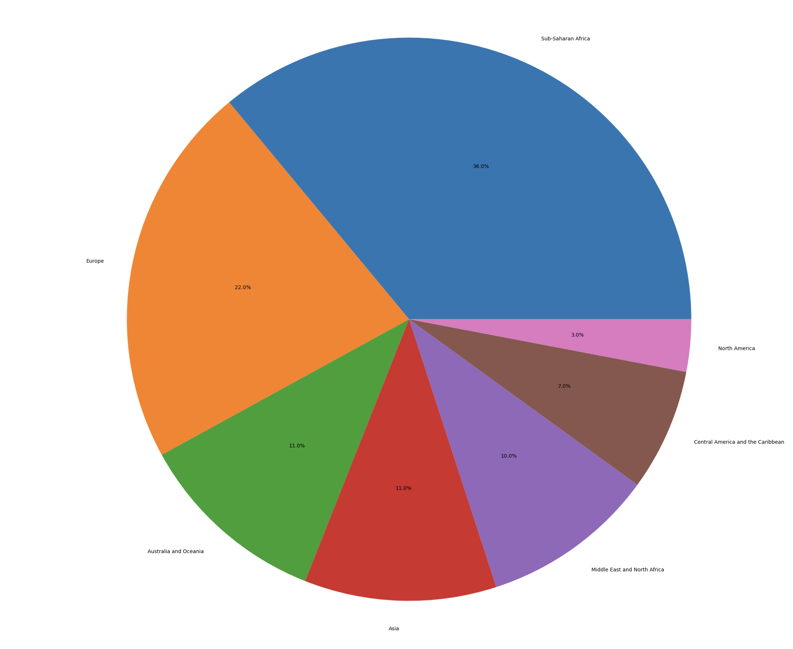
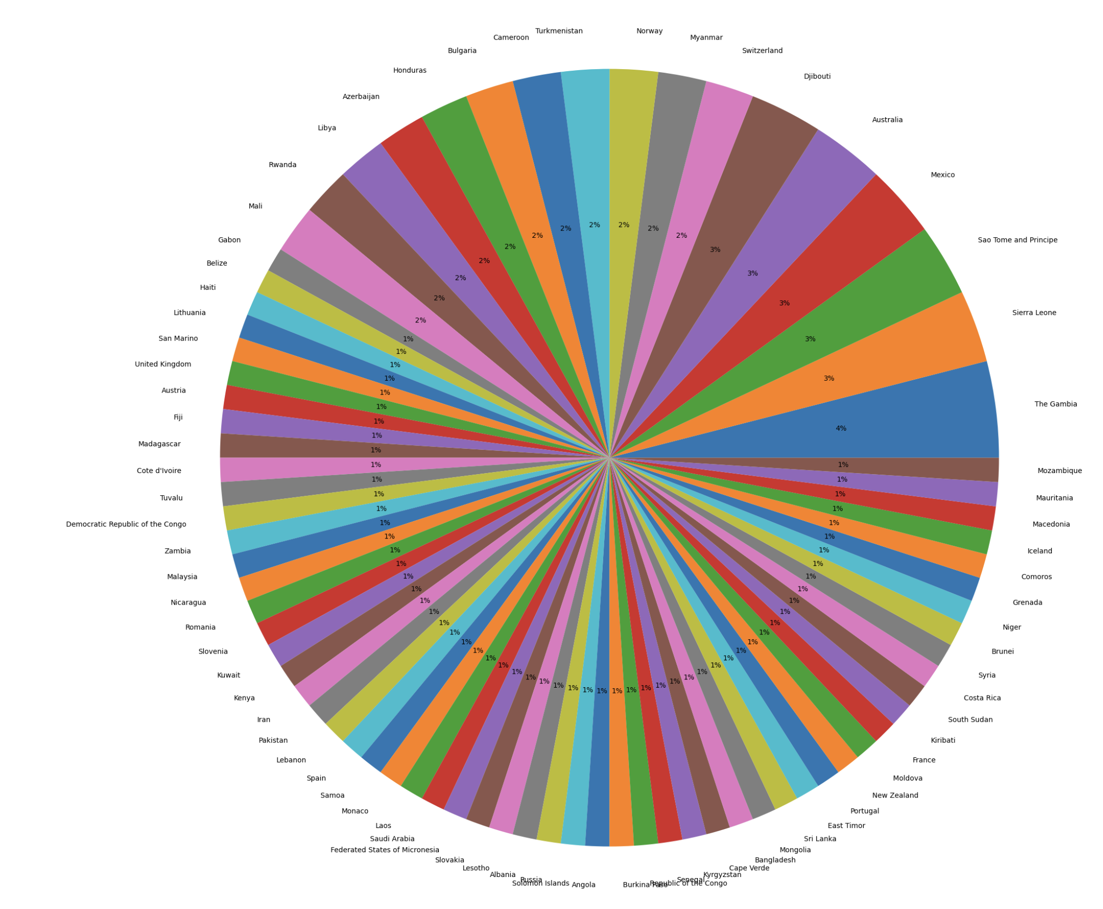
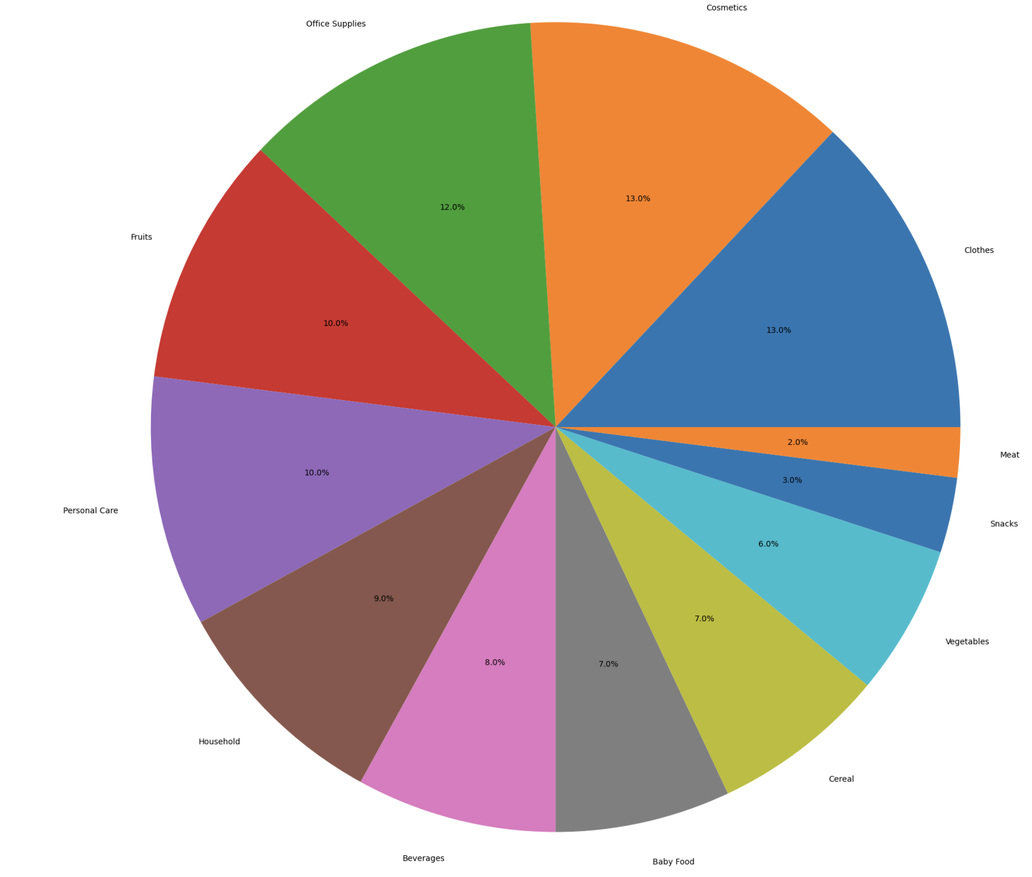
Region Wise Distribution
Country Wise Distribution
Item Wise Distribution

Slide 3
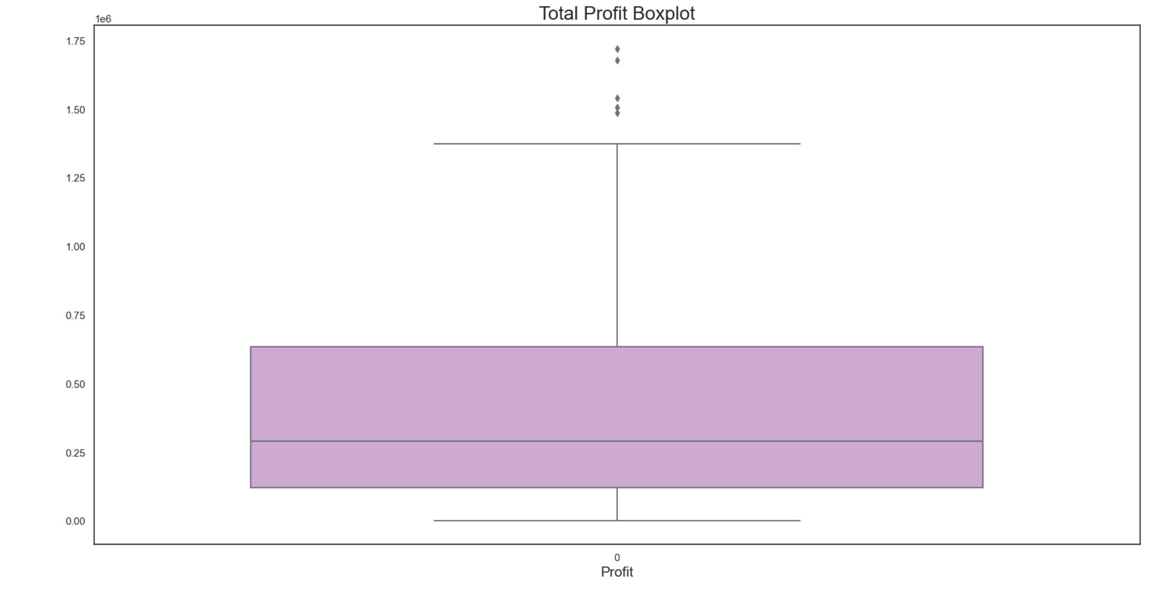
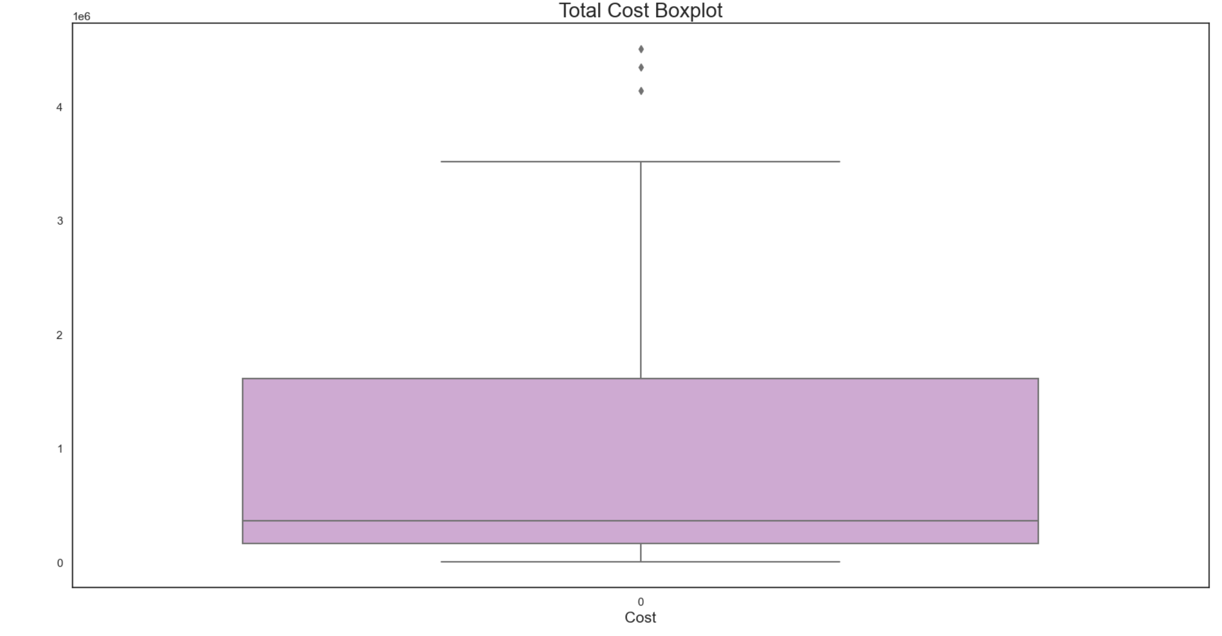
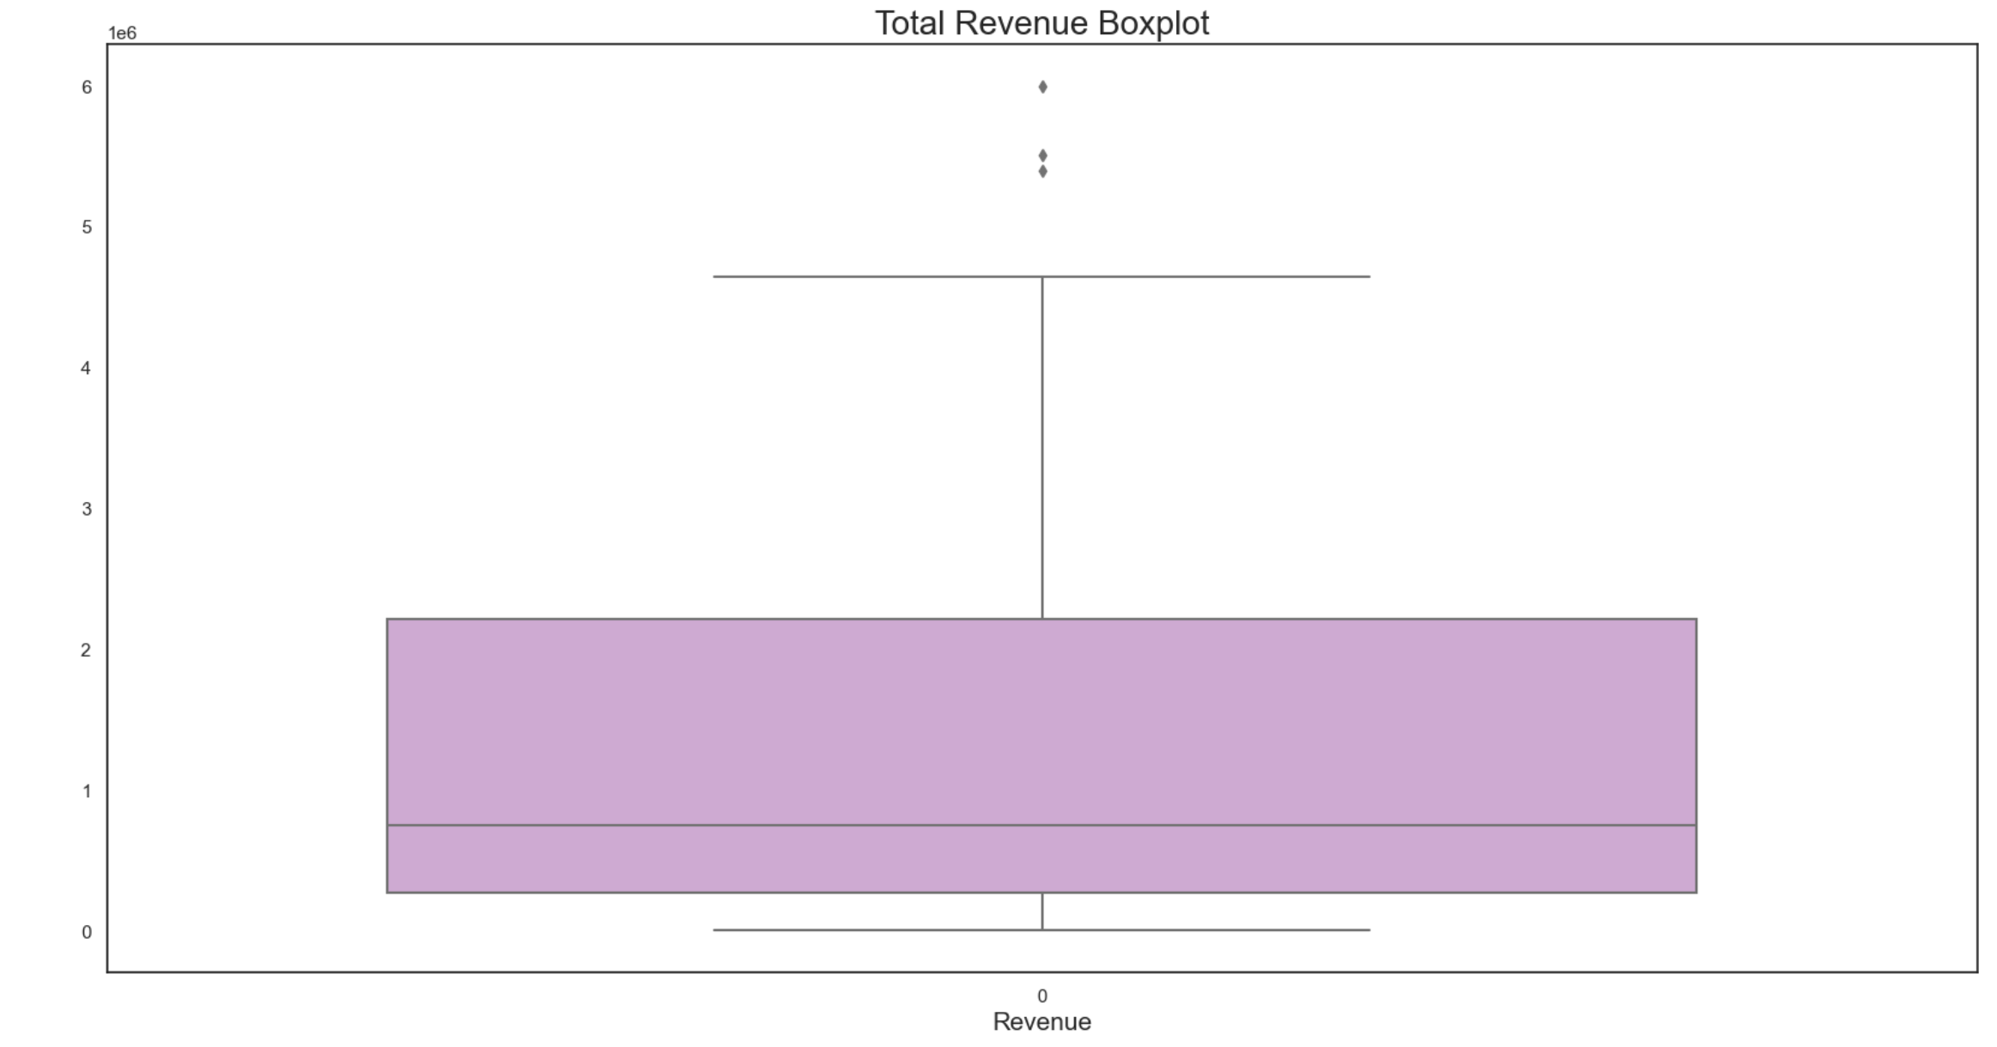
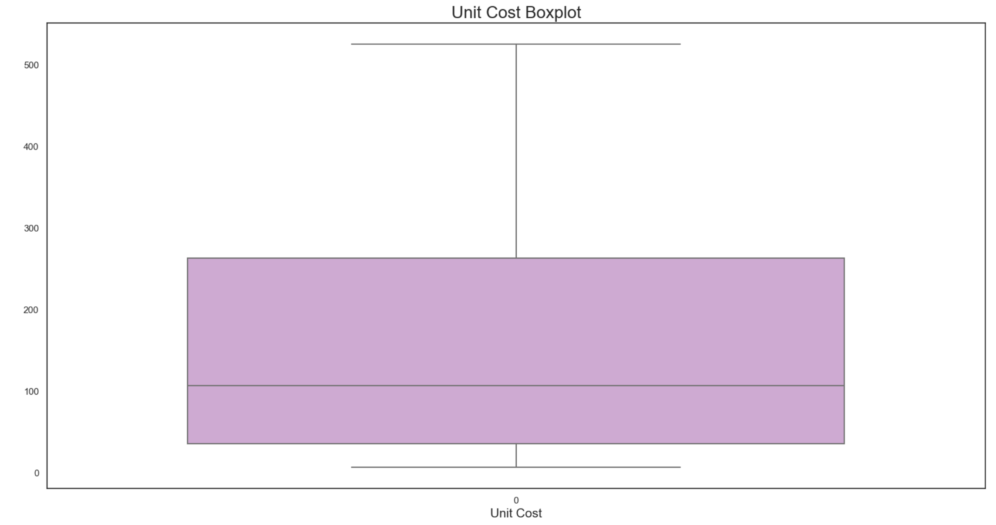
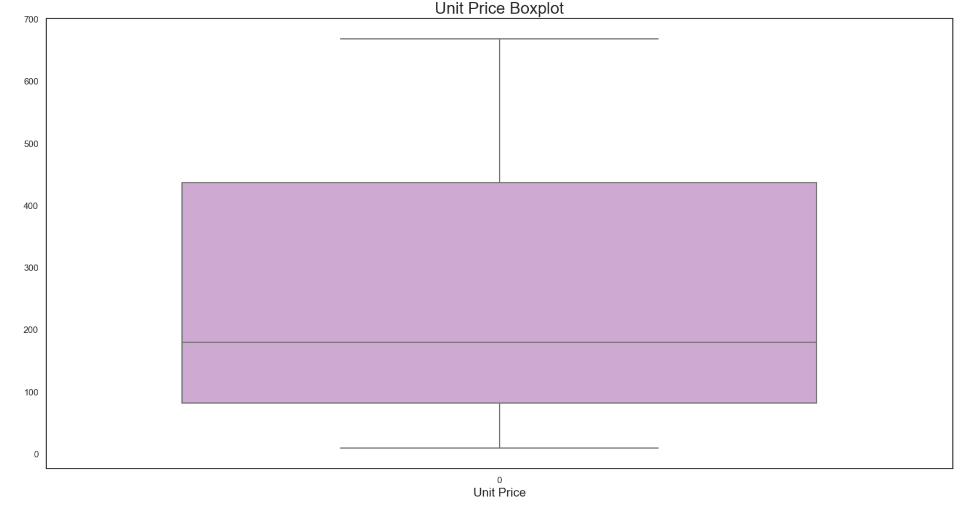
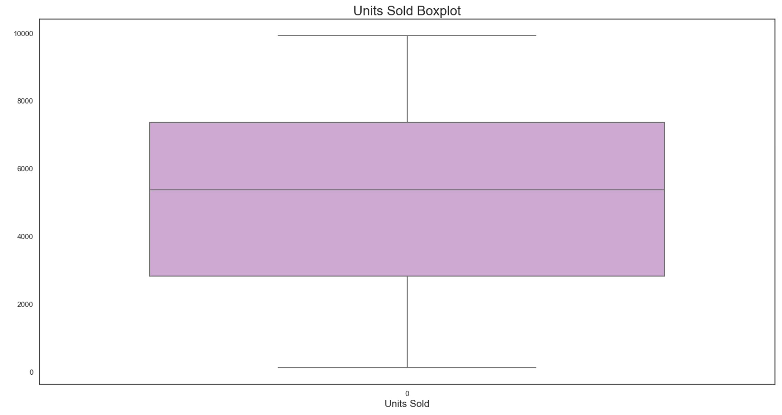
Total Profit Boxplot: | Total Cost Boxplot:
Total Revenue Boxplot: | Unit Cost Boxplot:
Unit Price Boxplot: | Units Sold Boxplot:

Slide 4
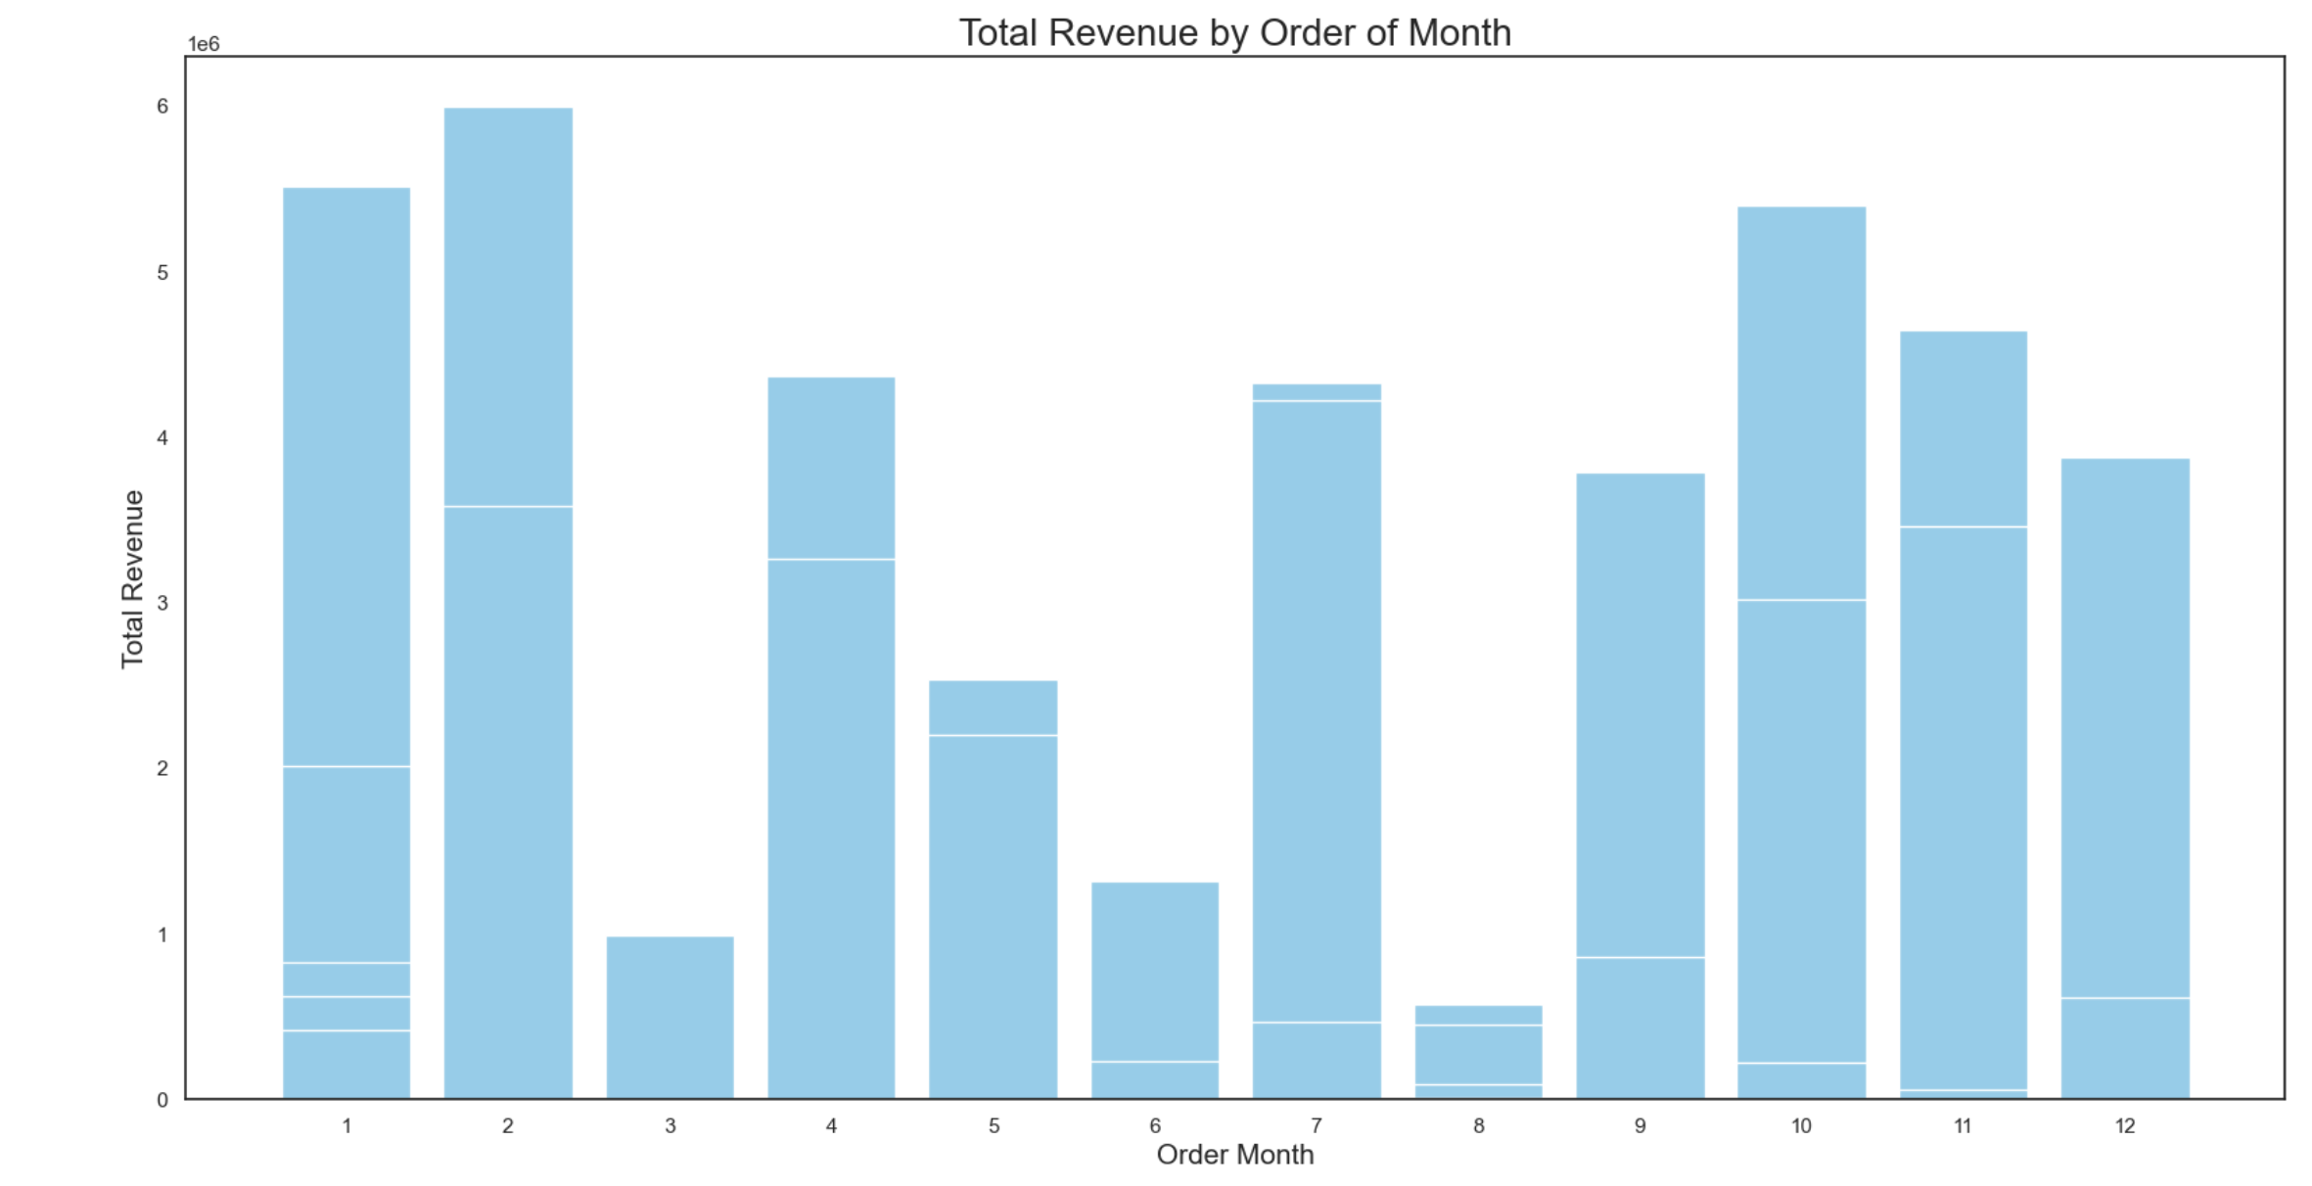
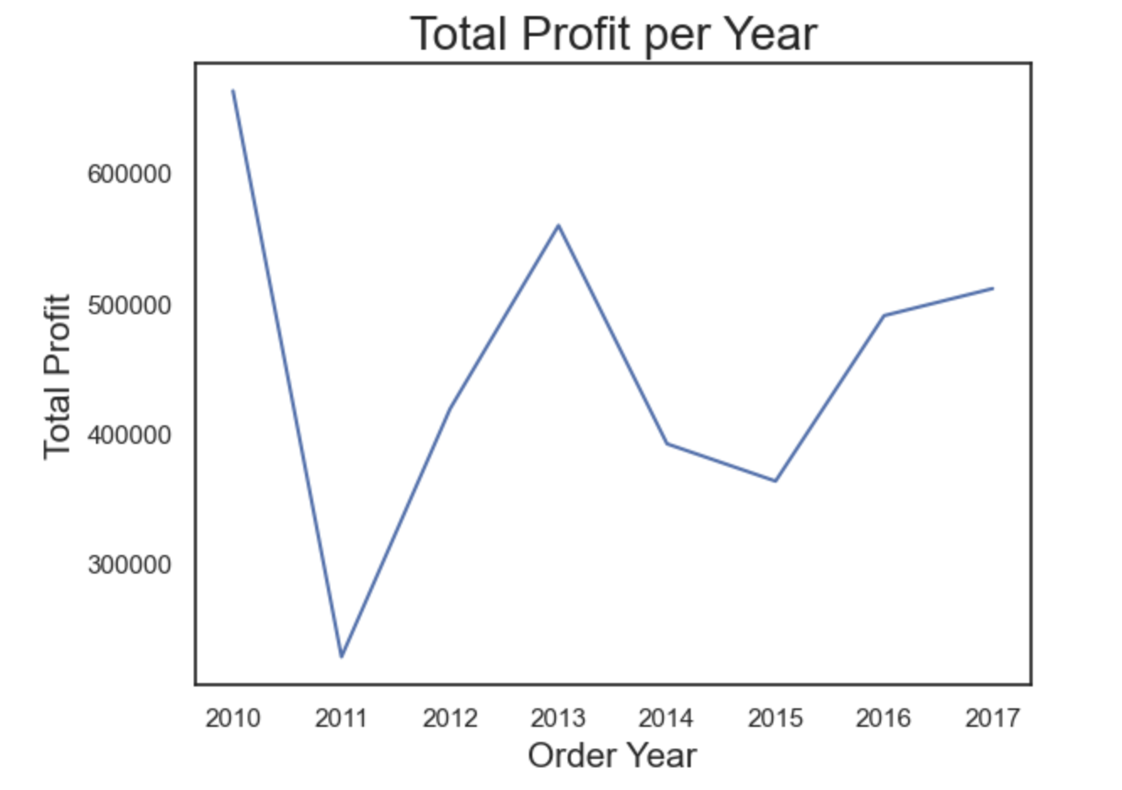
Month Wise Total Revenue:
Total Profit per Year:

Slide 5
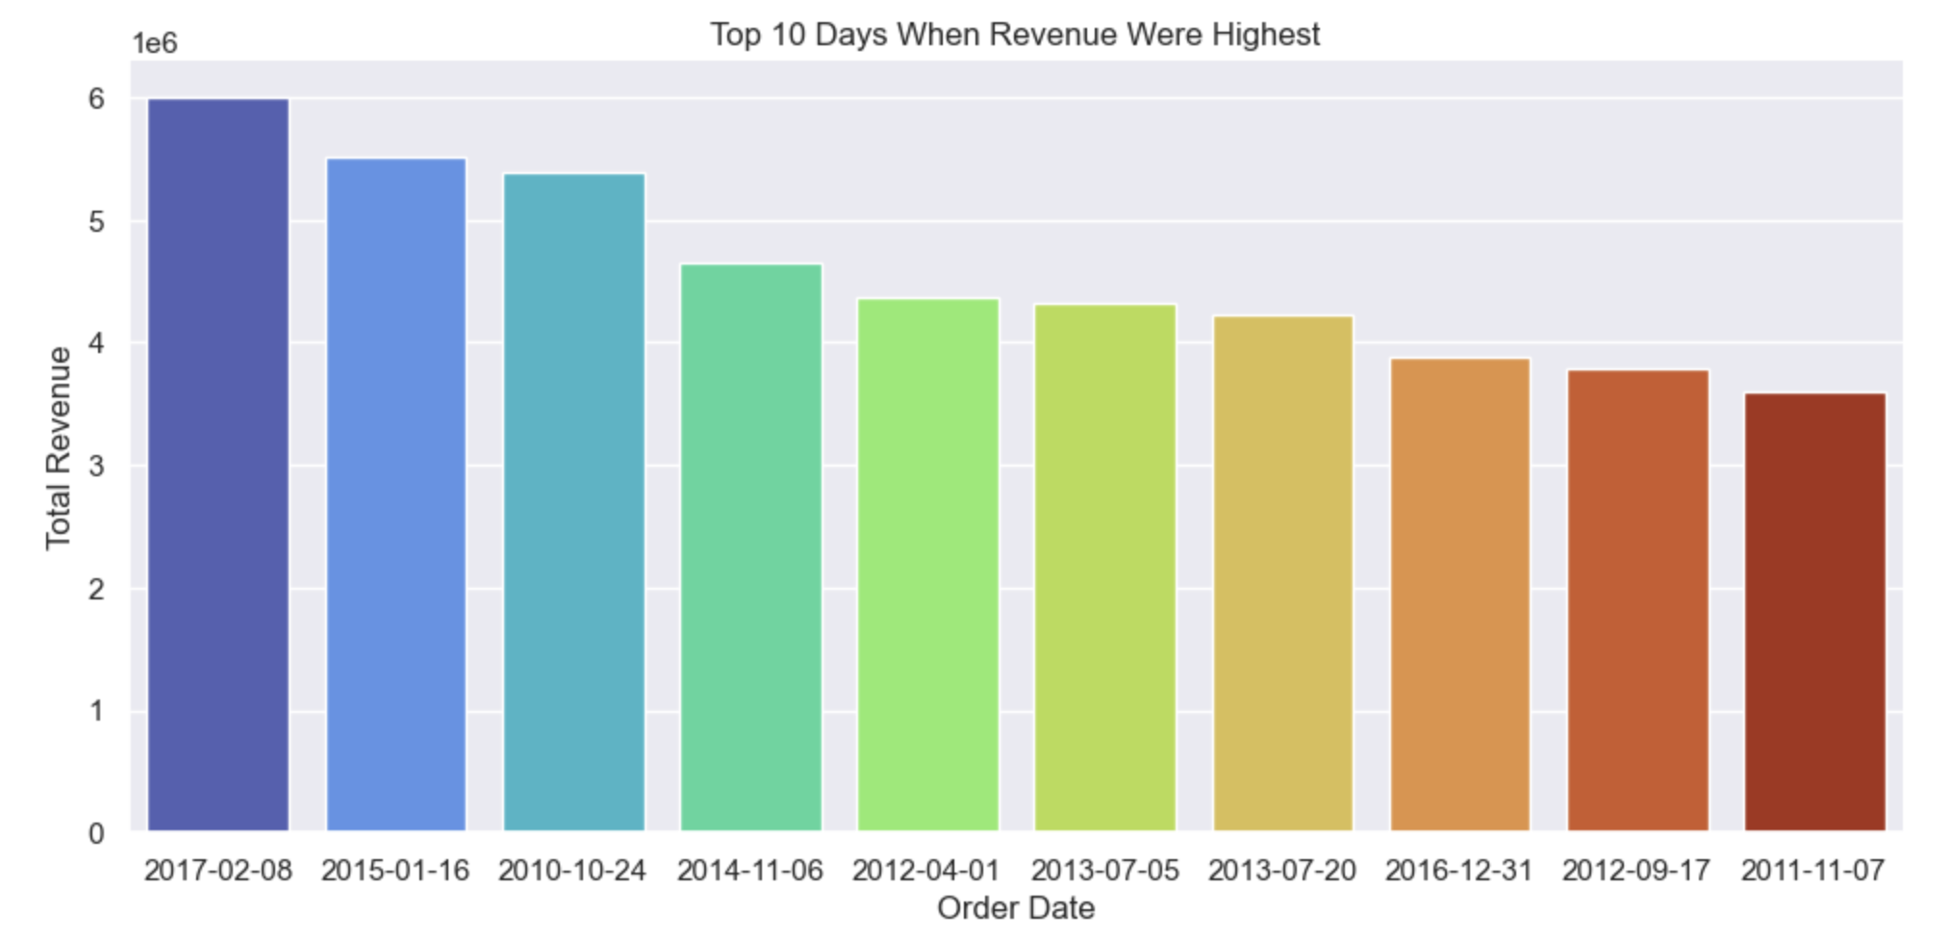
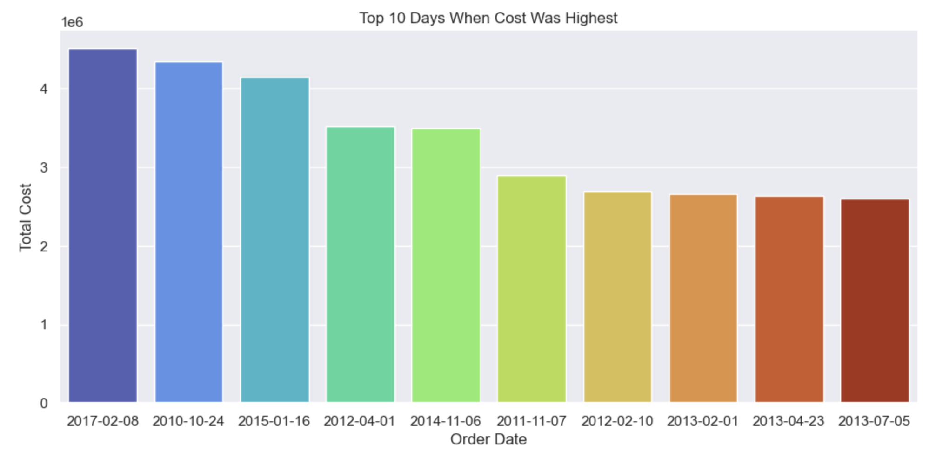
Top 10 Days when the Revenue Were Highest:
Top 10 Days when the Cost Was Highest:

Slide 6
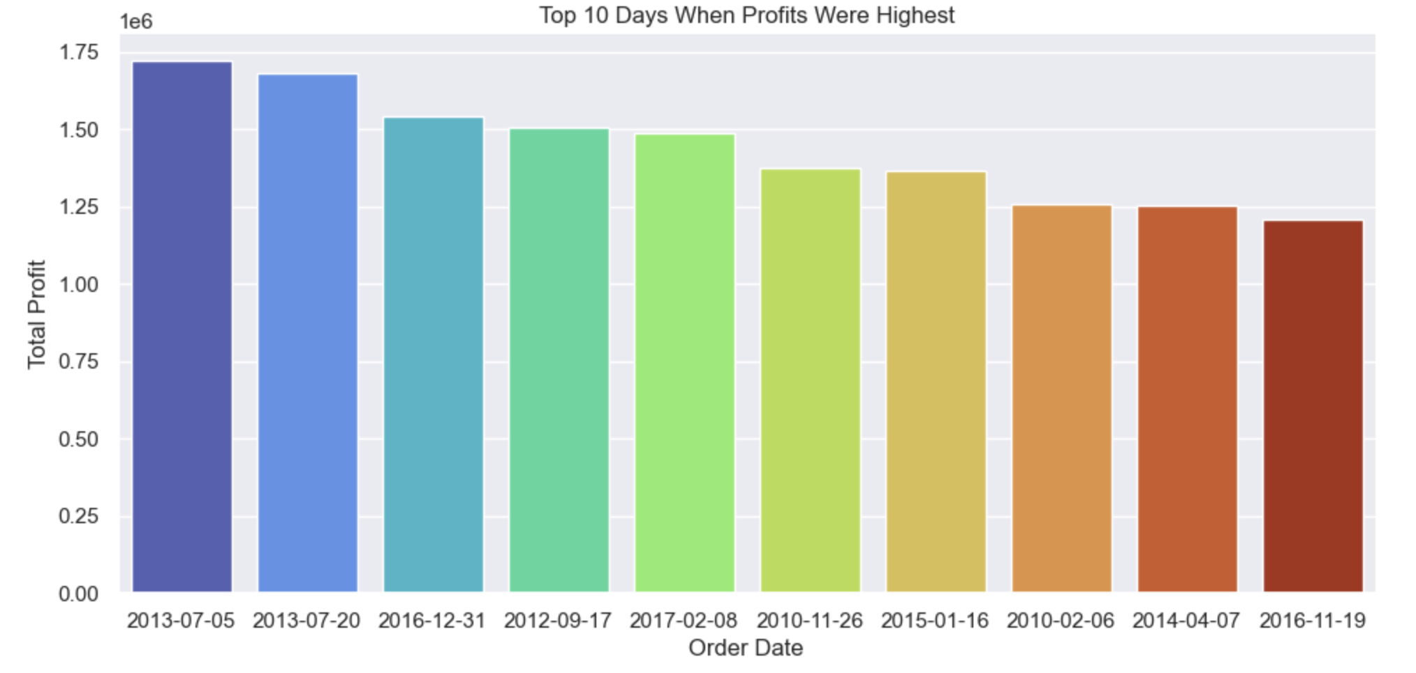
Top 10 Days when the Profits Were Highest:

Slide 7
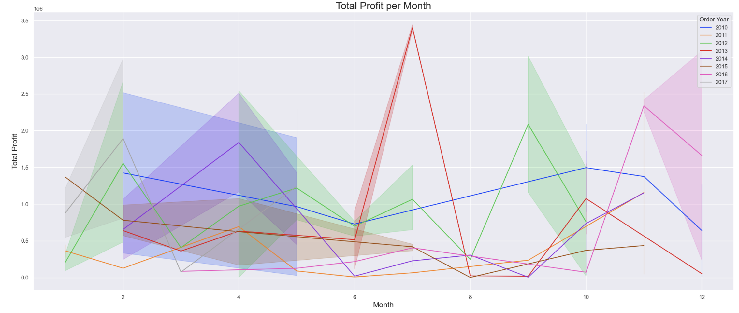
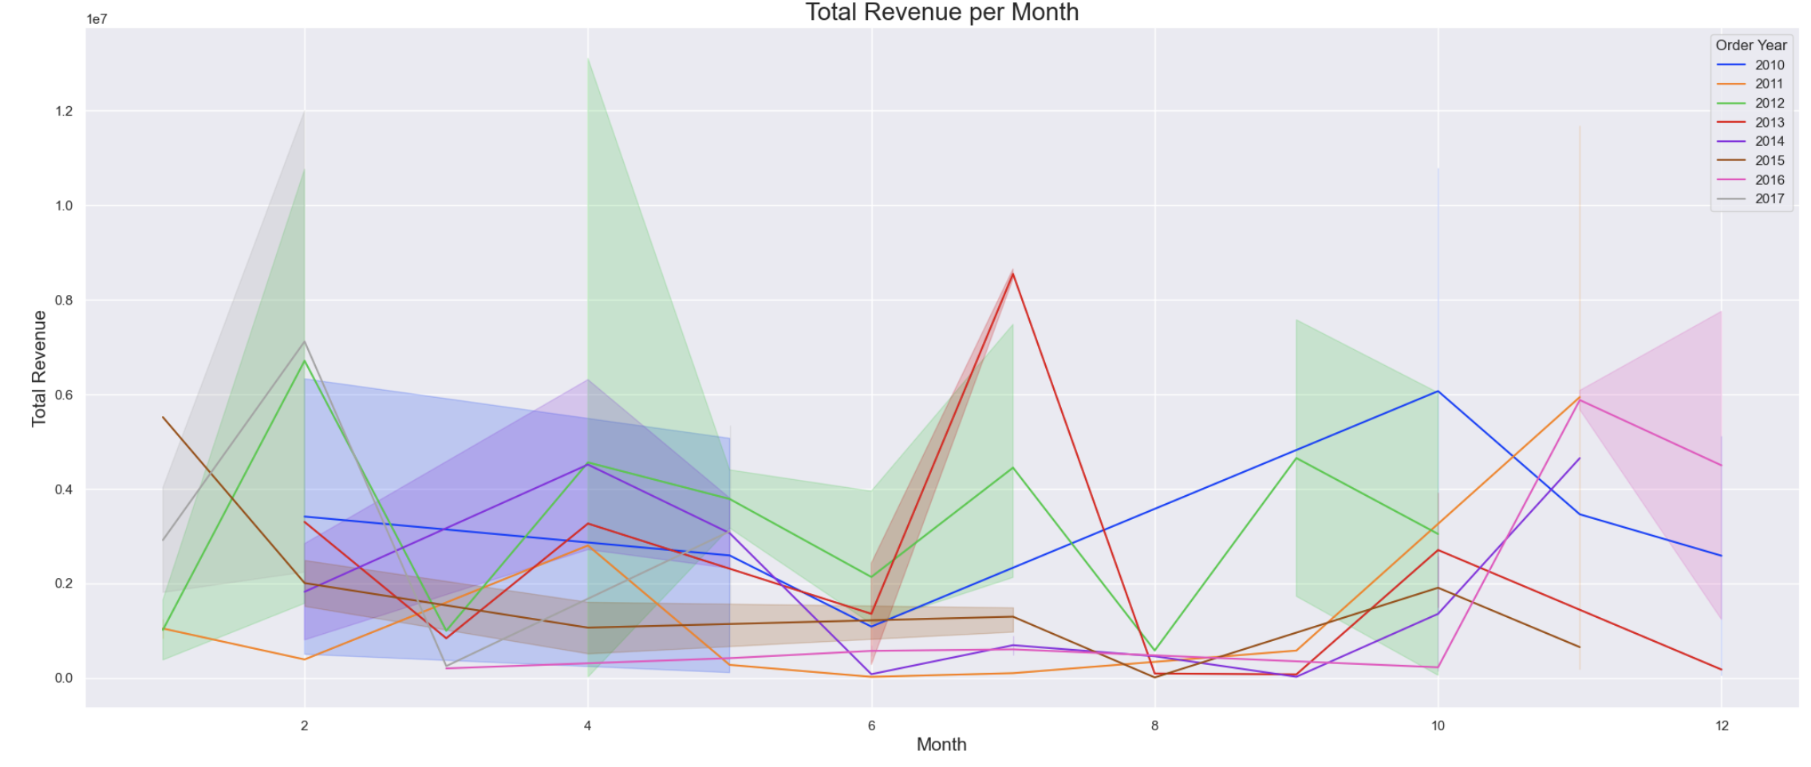
Total Profit per Month
Total Revenue per Month

Slide 8
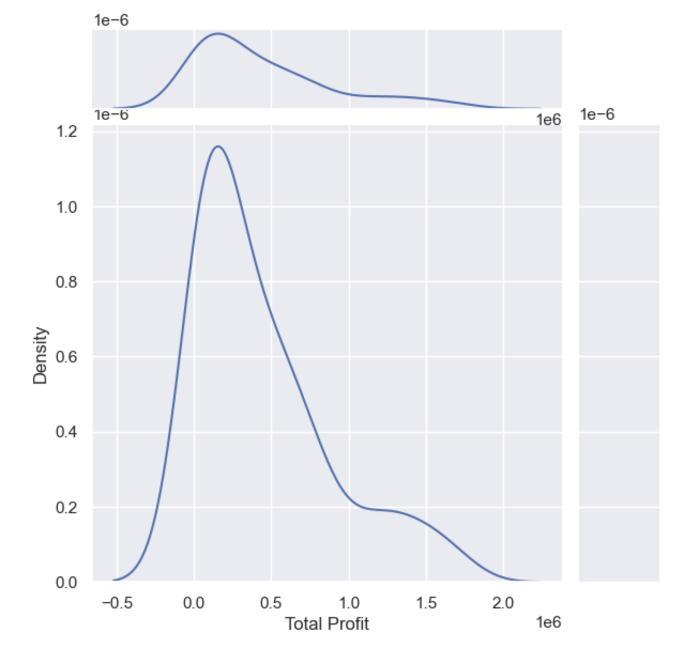
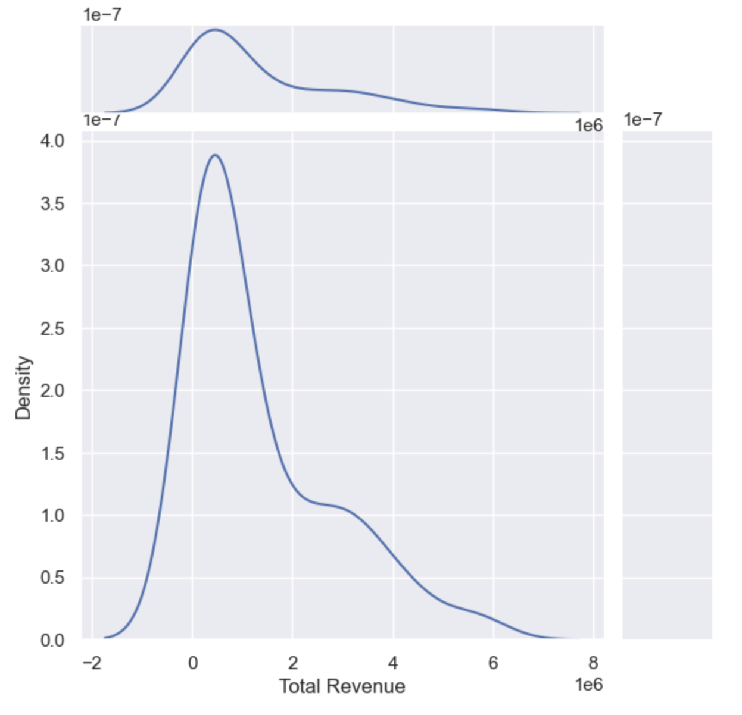
Total Profit:
Total Revenue:

