Slide 1

Heart Disease Diagnosis
By: Piyush Kumar

Slide 2
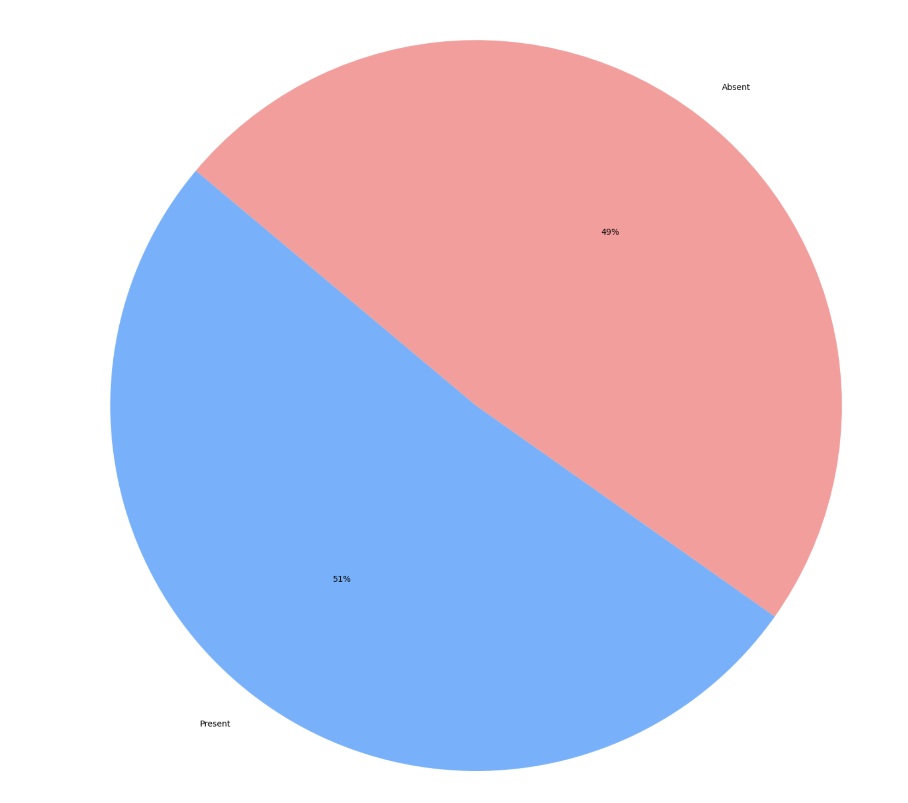
Heart Disease Population Percent

Slide 3
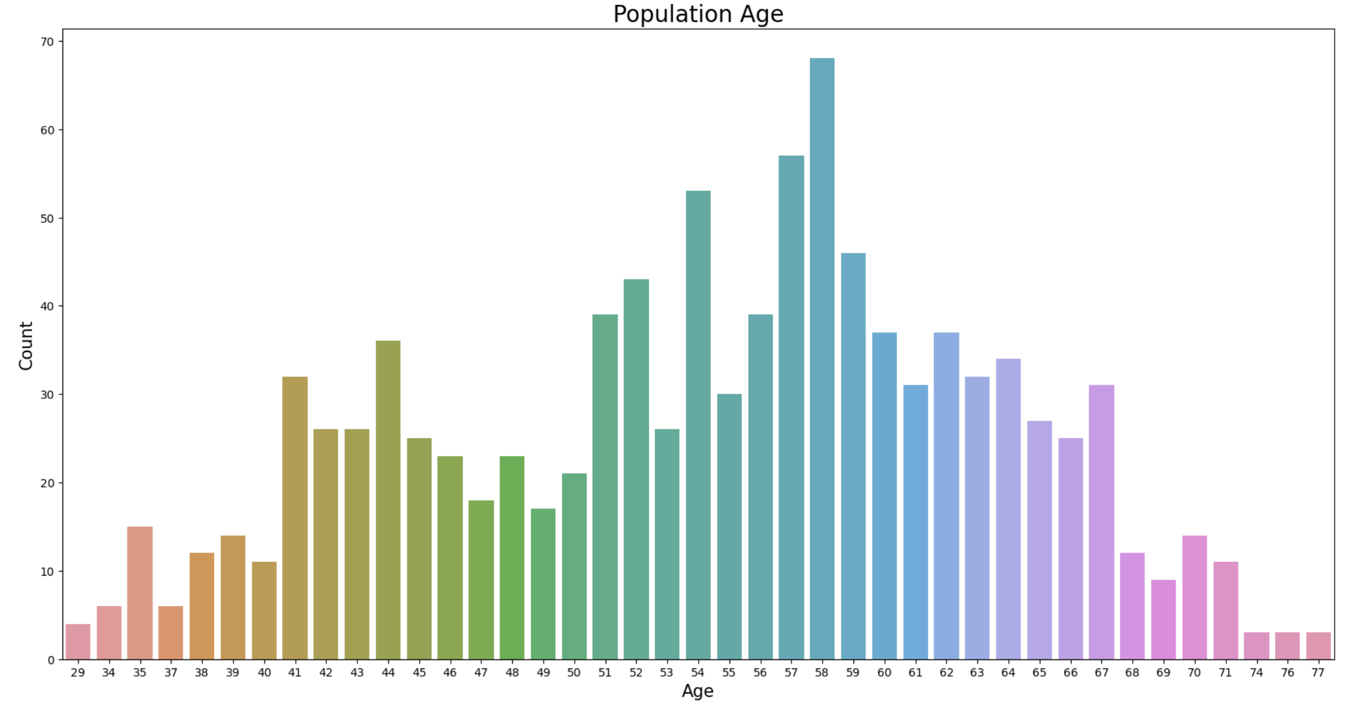
Population Age

Slide 4
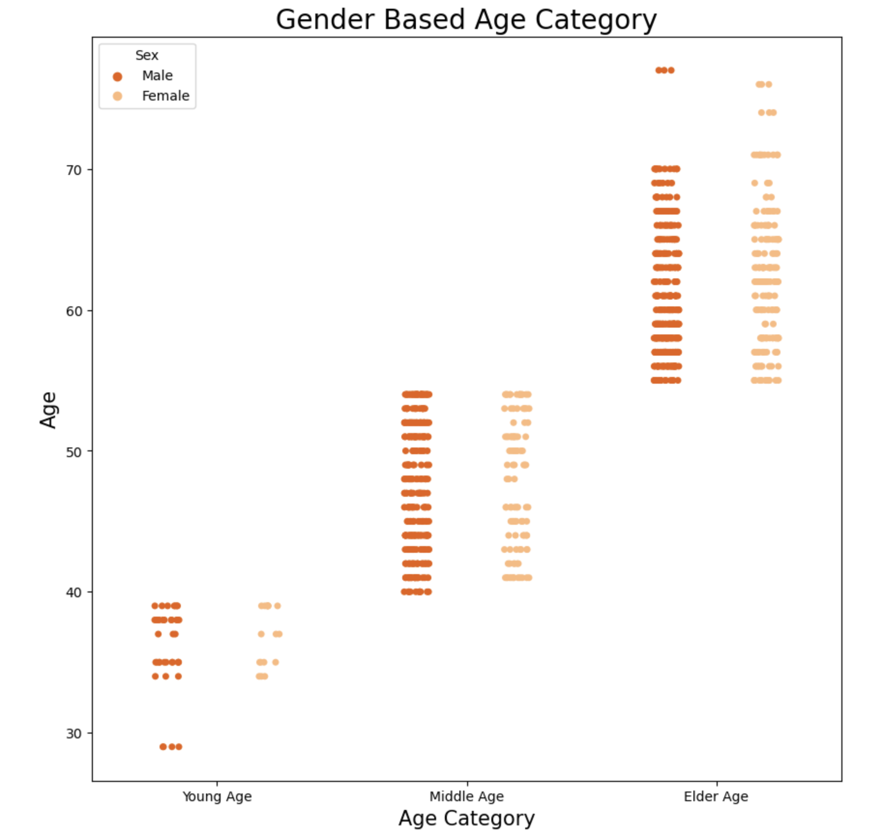
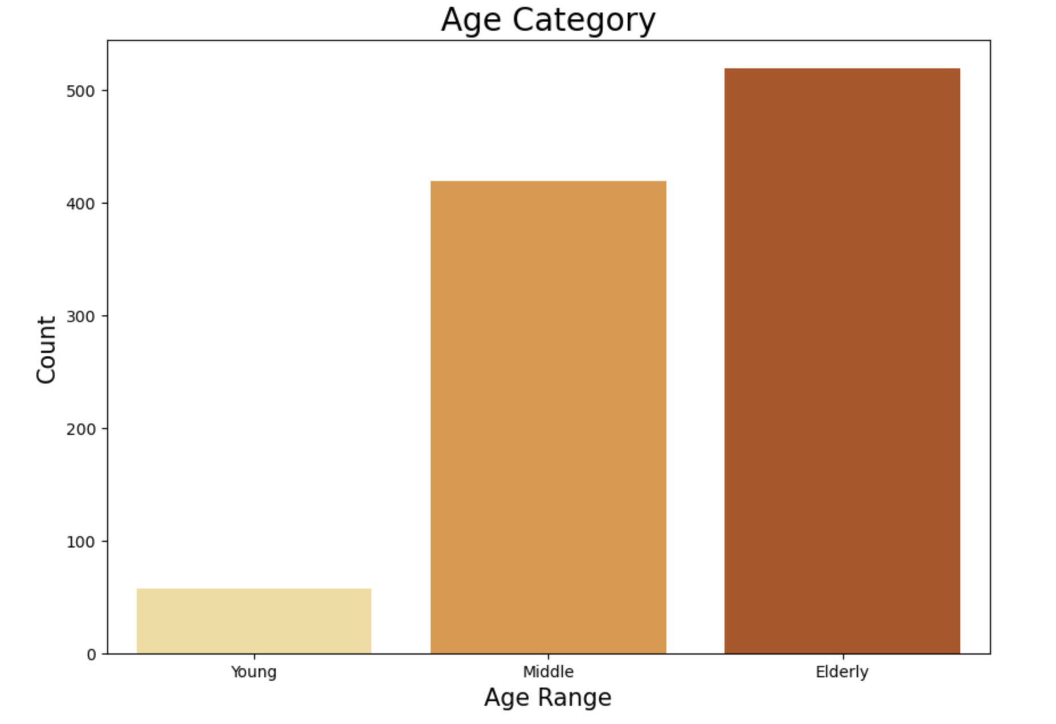
Age Category
Gender Based Age Category

Slide 5
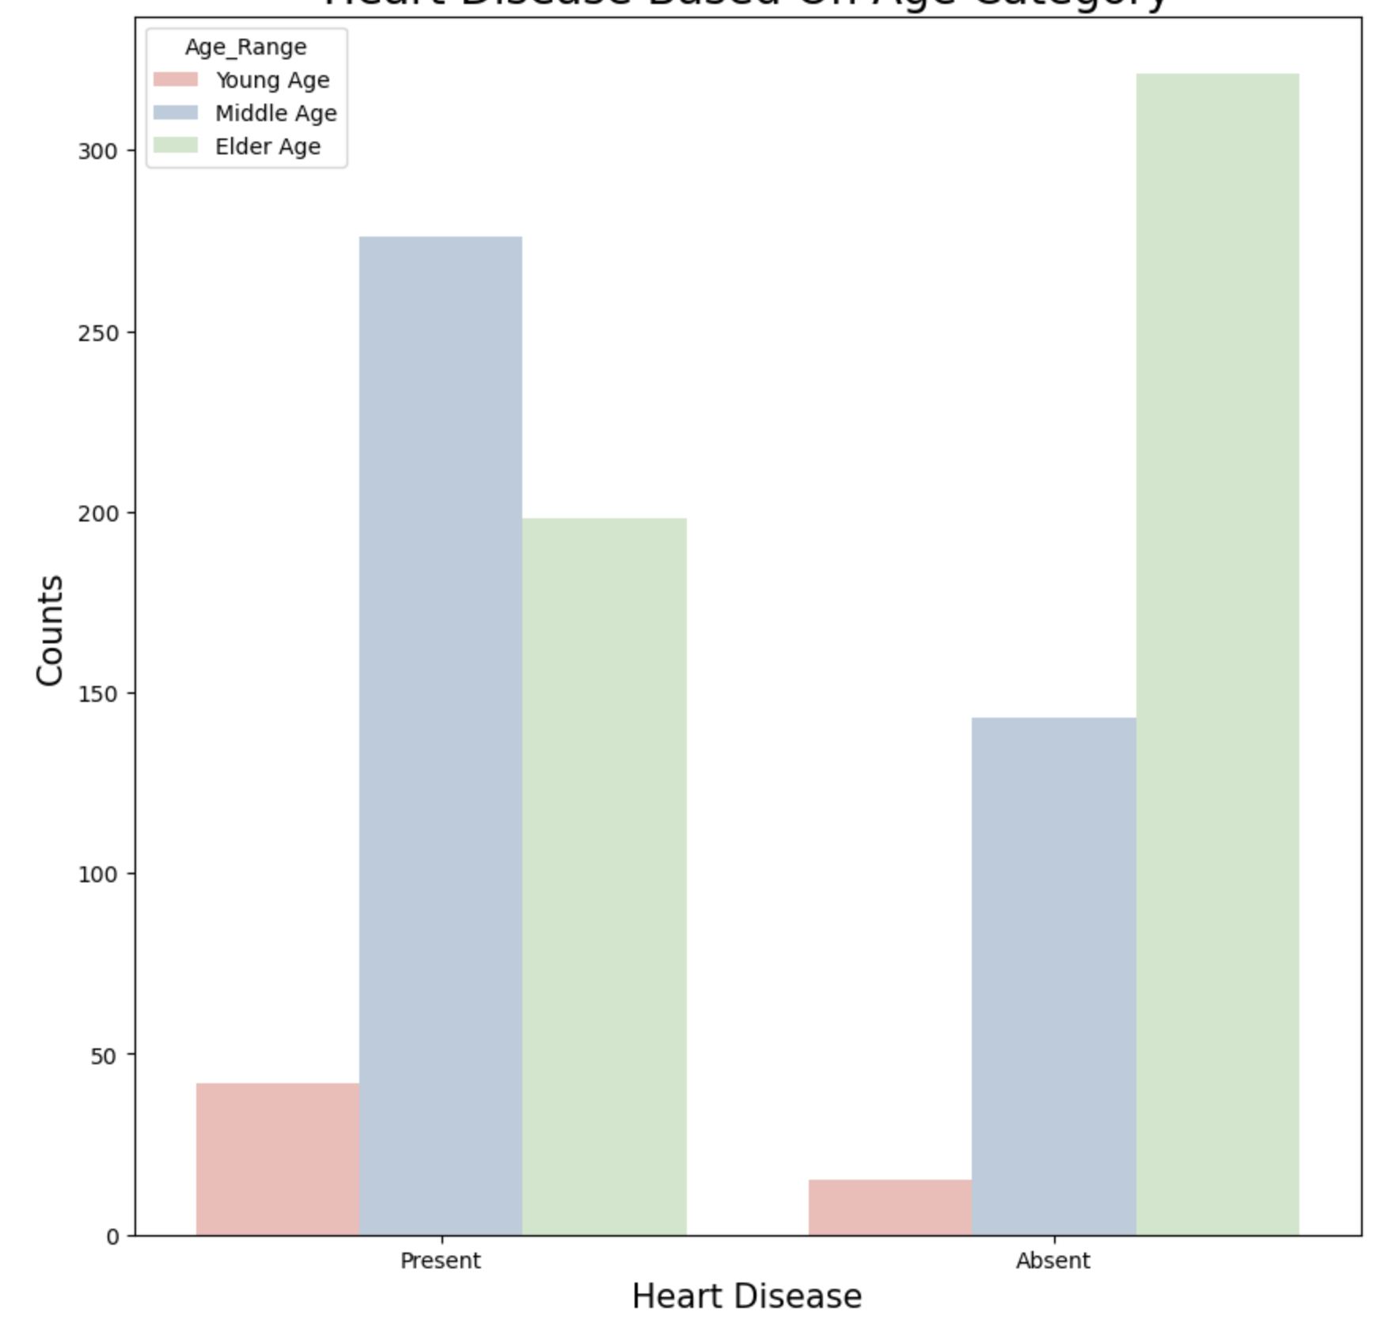
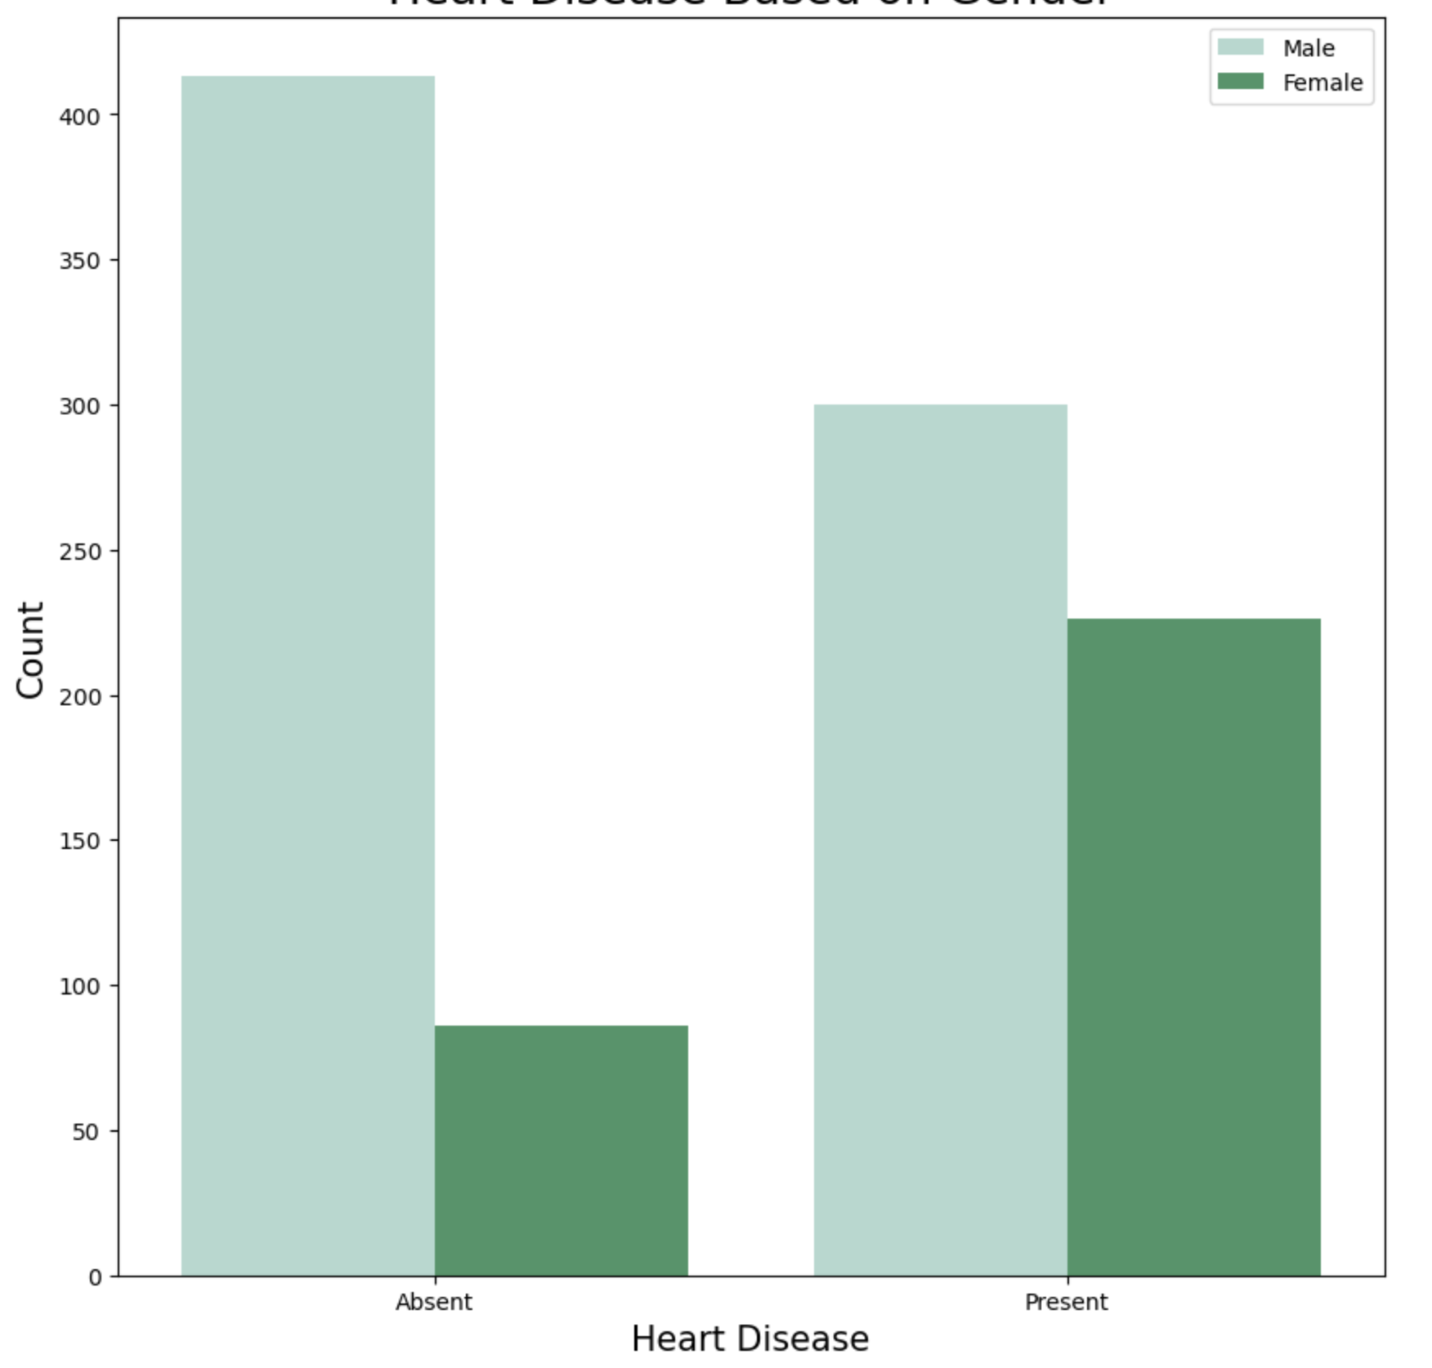
Heart Disease Based on Age Category
Heart Disease Based on Gender

Slide 6
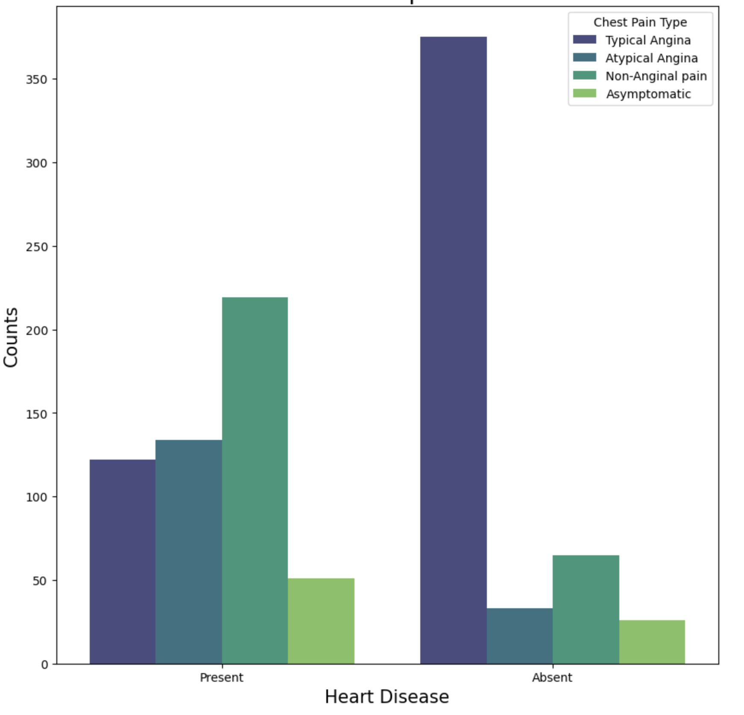
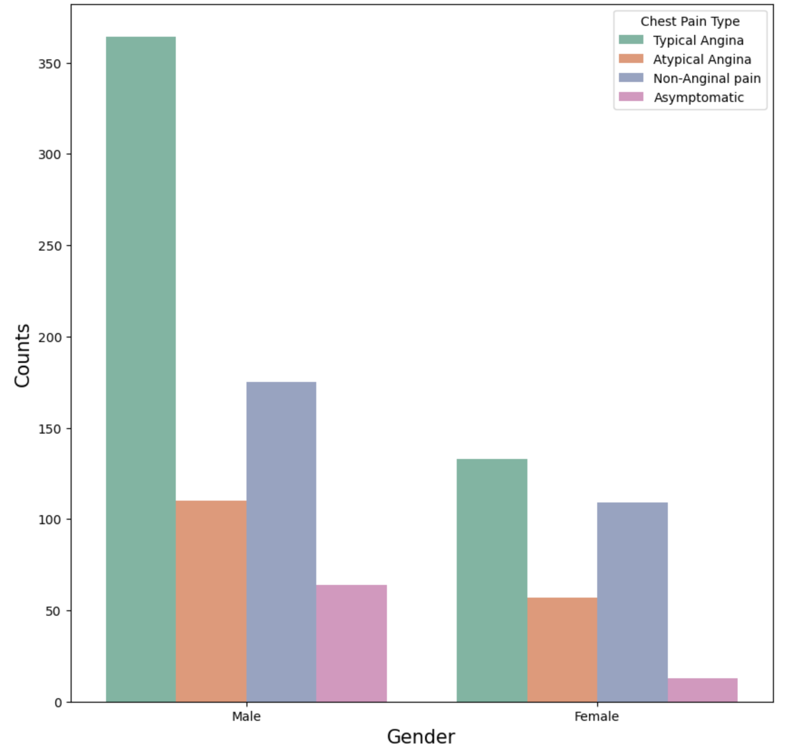
Chest Pain Experienced
Chest Pain Based on Gender

Slide 7
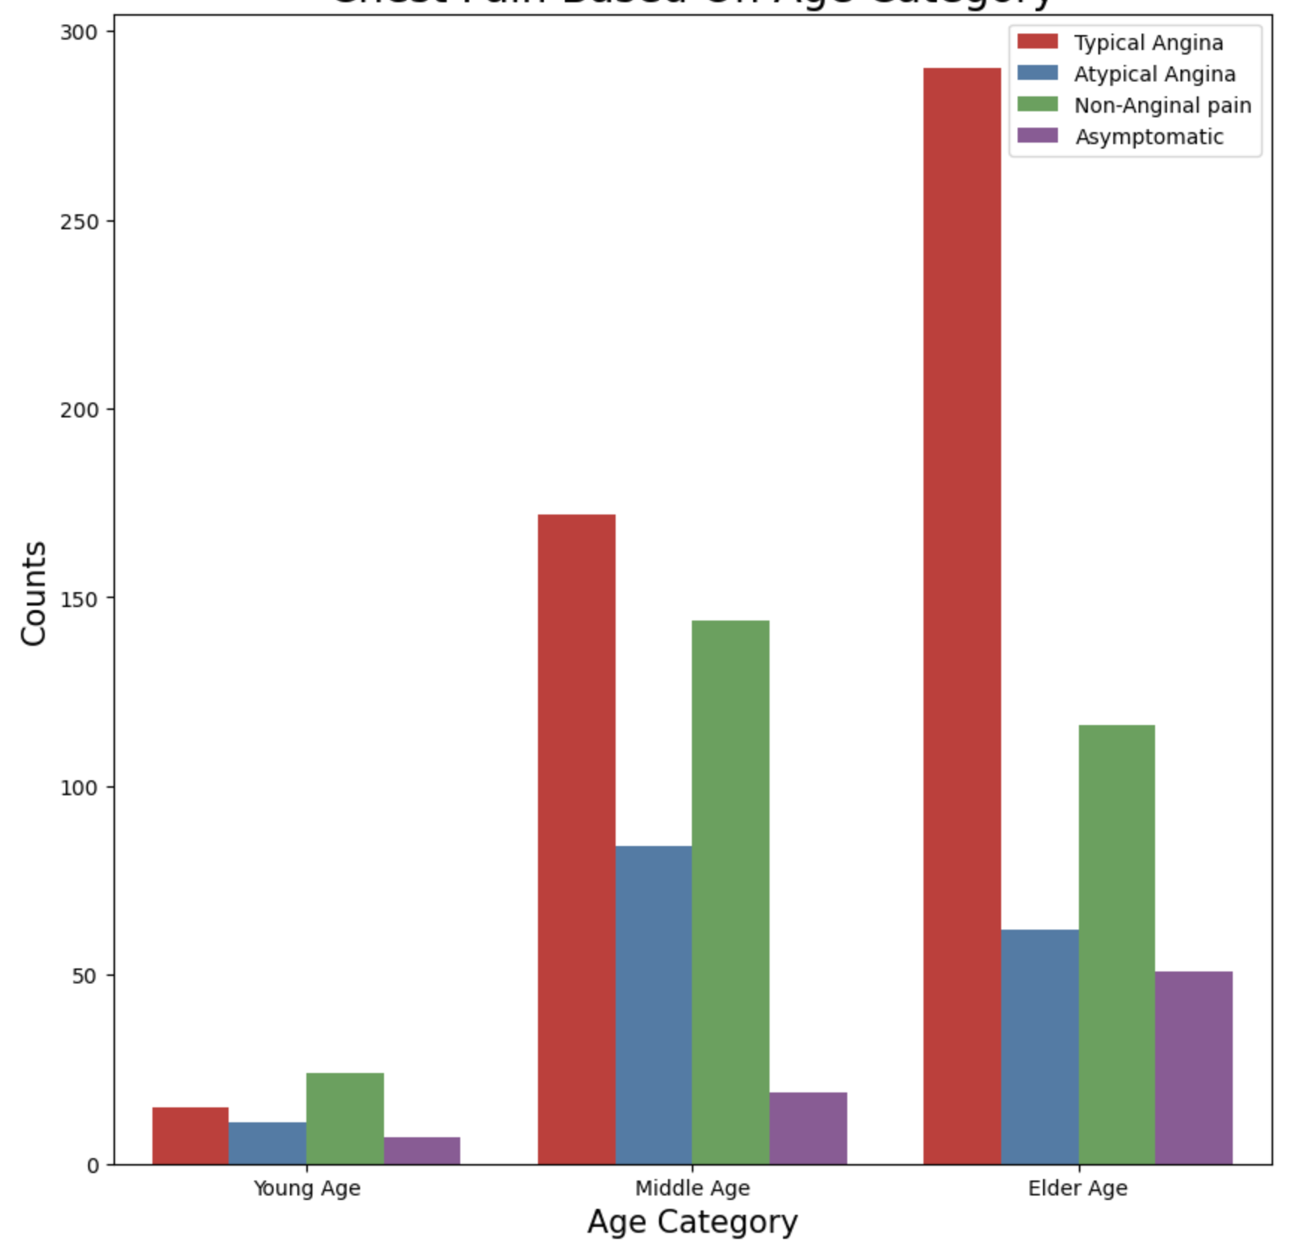
Chest Pain Based on Age Category

Slide 8
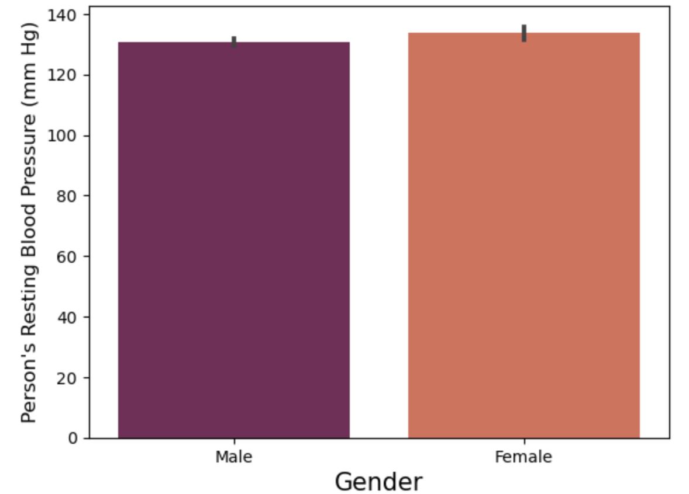
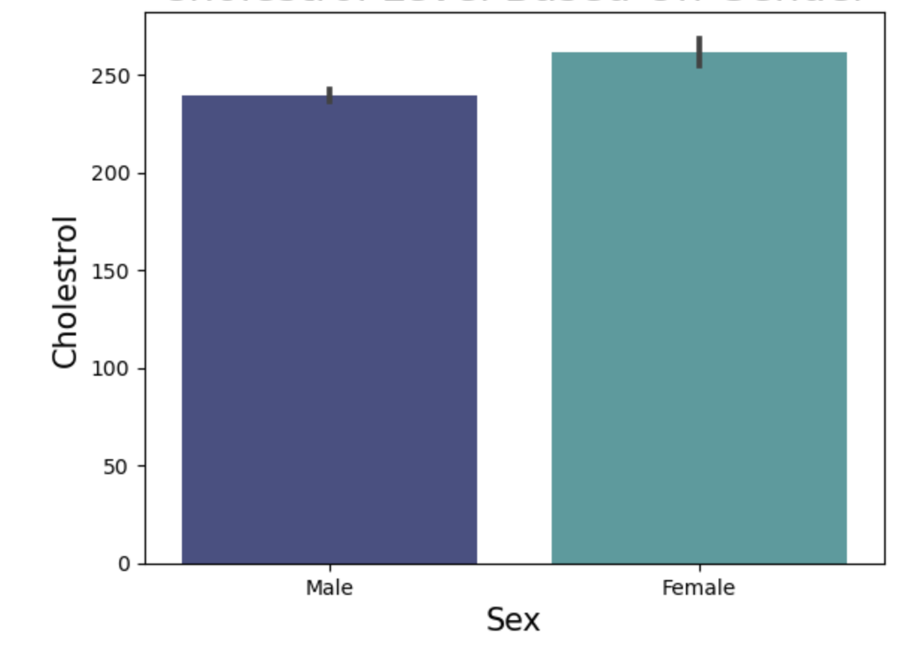
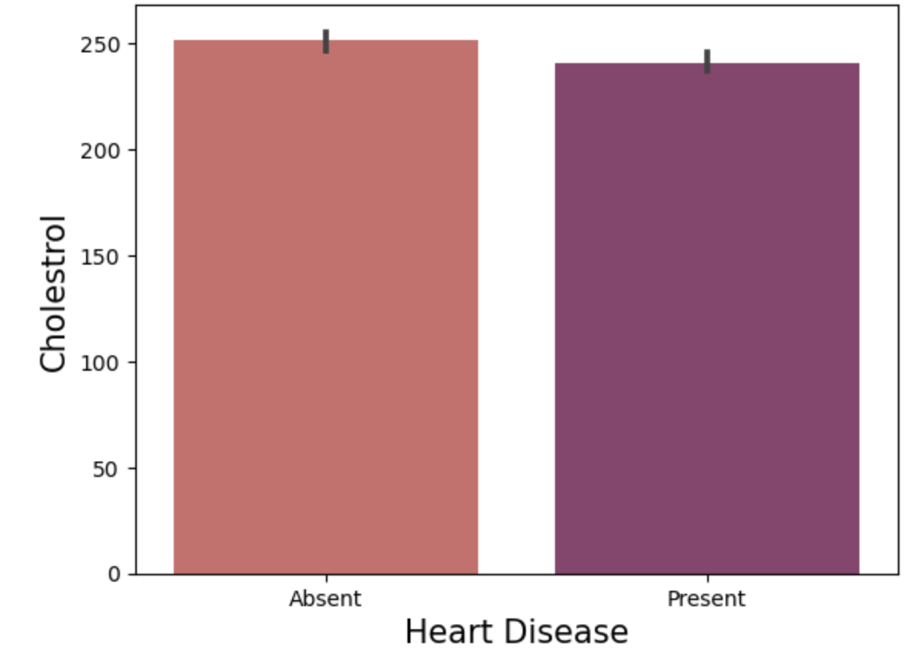
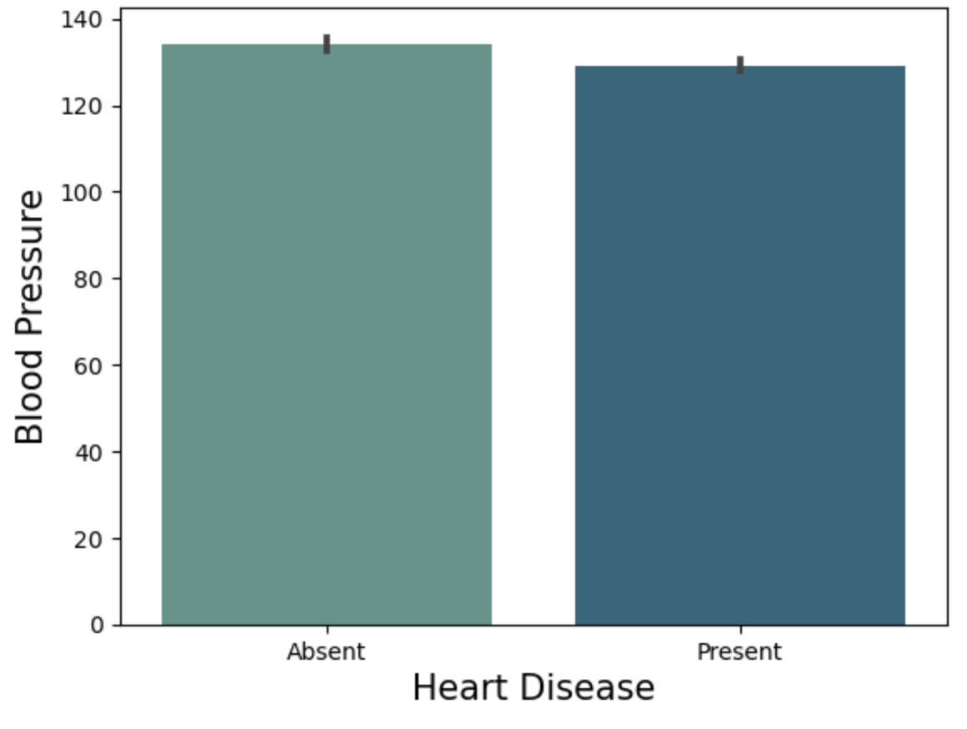
Blood Pressure in Males vs Females | Cholesterol Level Based on Gender
Cholesterol vs Heart Disease | Blood Pressure vs Heart Disease

Slide 9
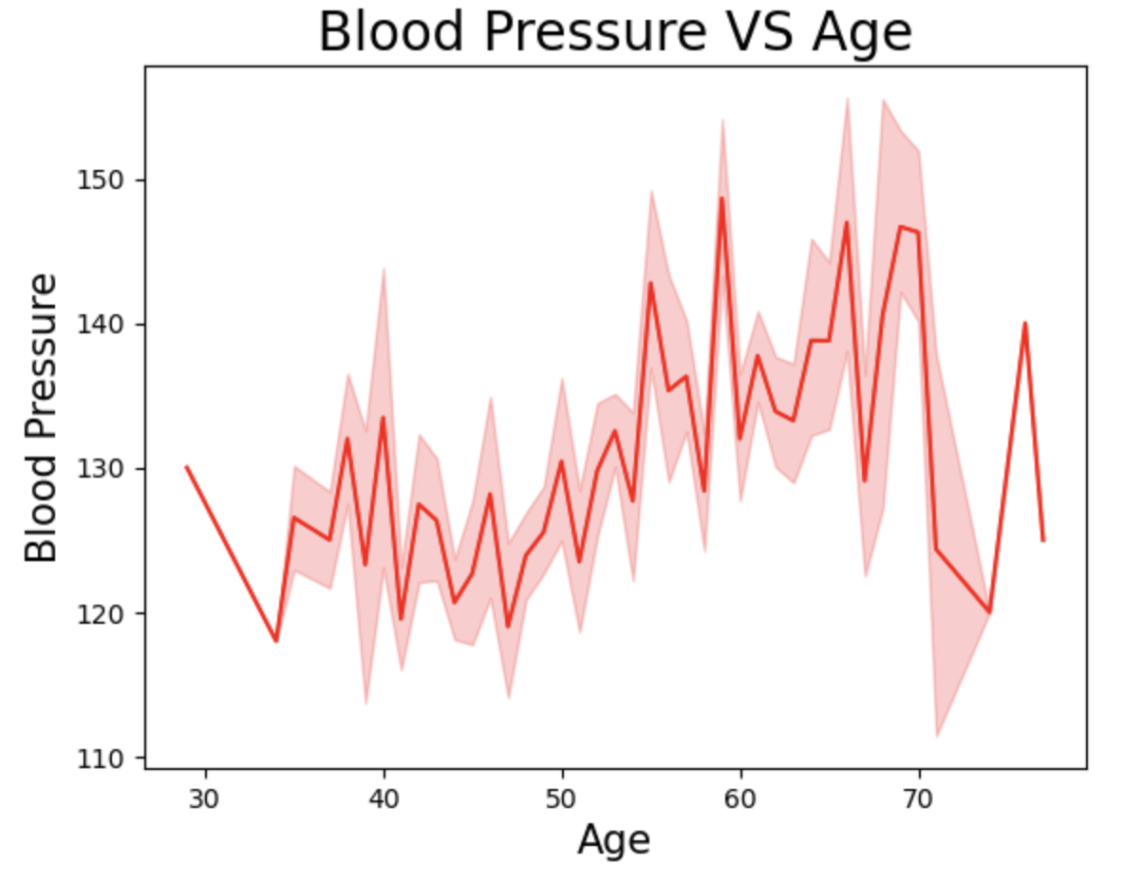
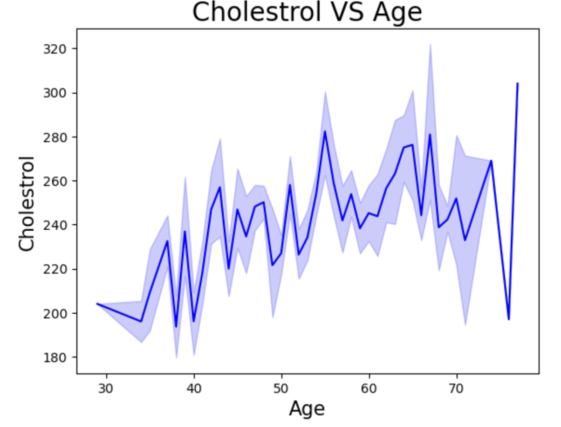
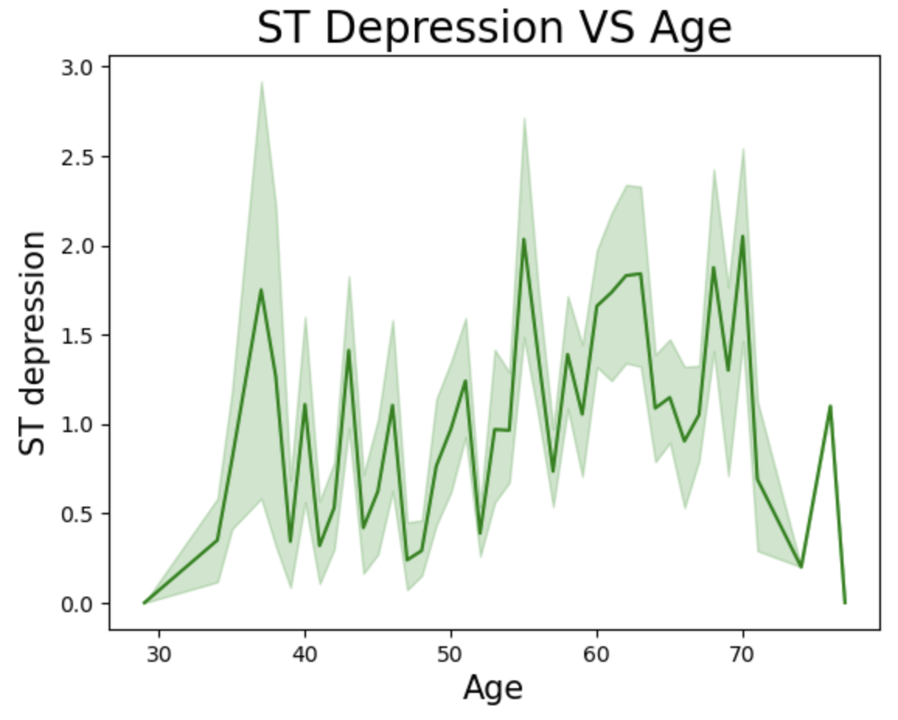
Blood Pressure vs Age
 | Cholesterol vs Age
ST Depression vs Age

Slide 10
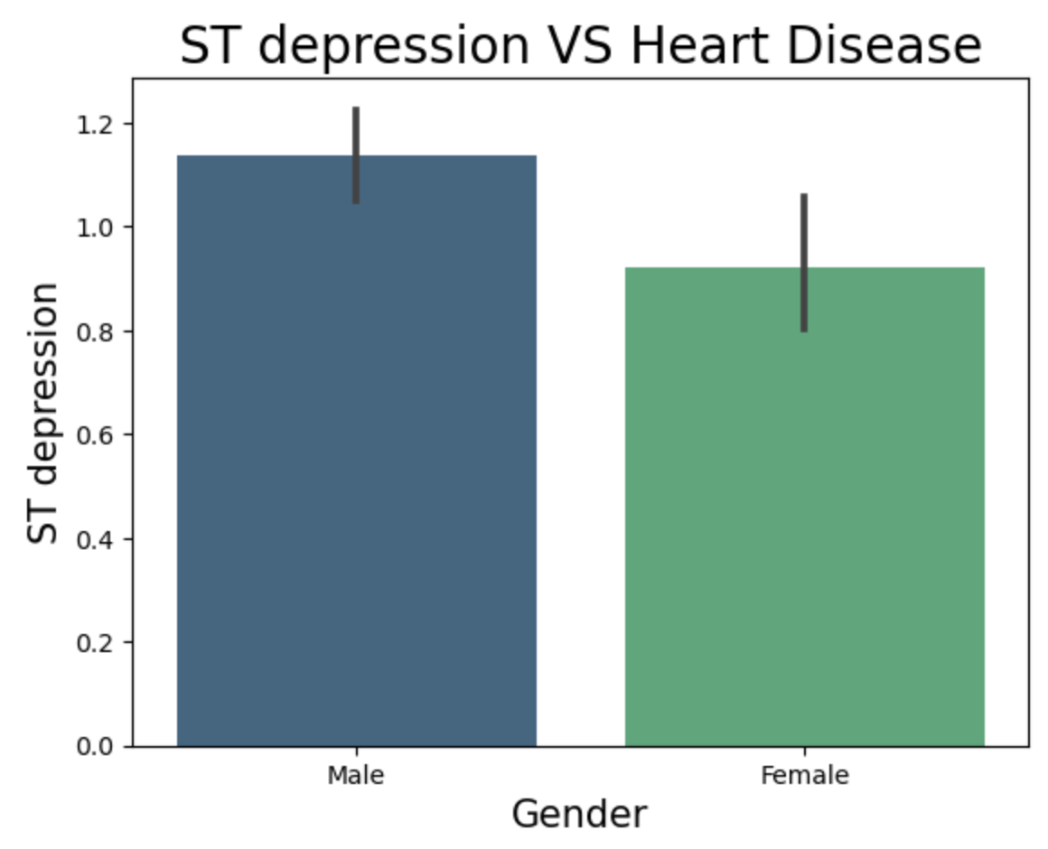
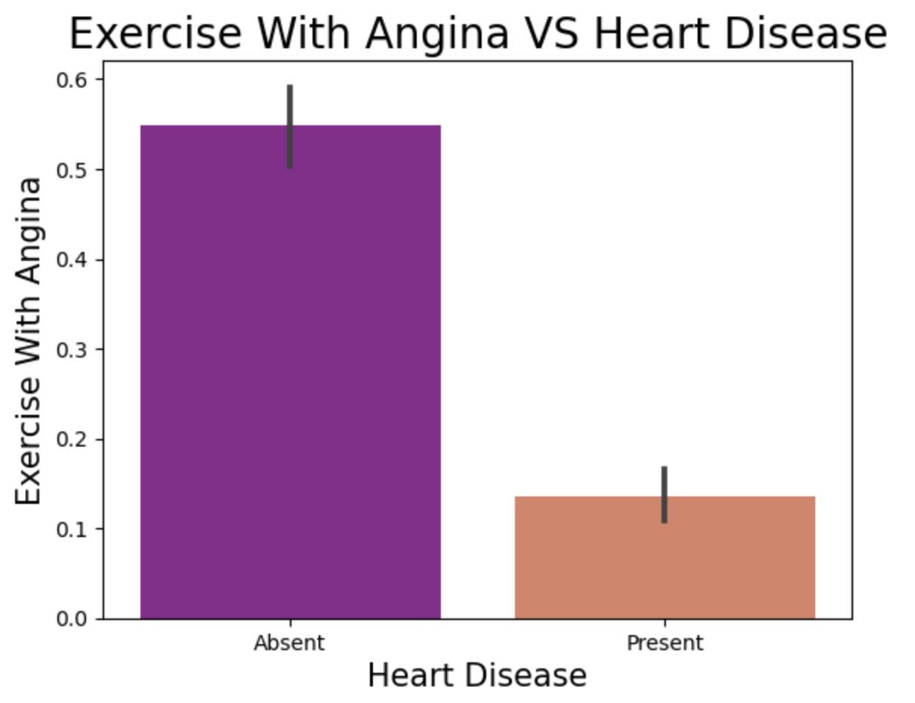
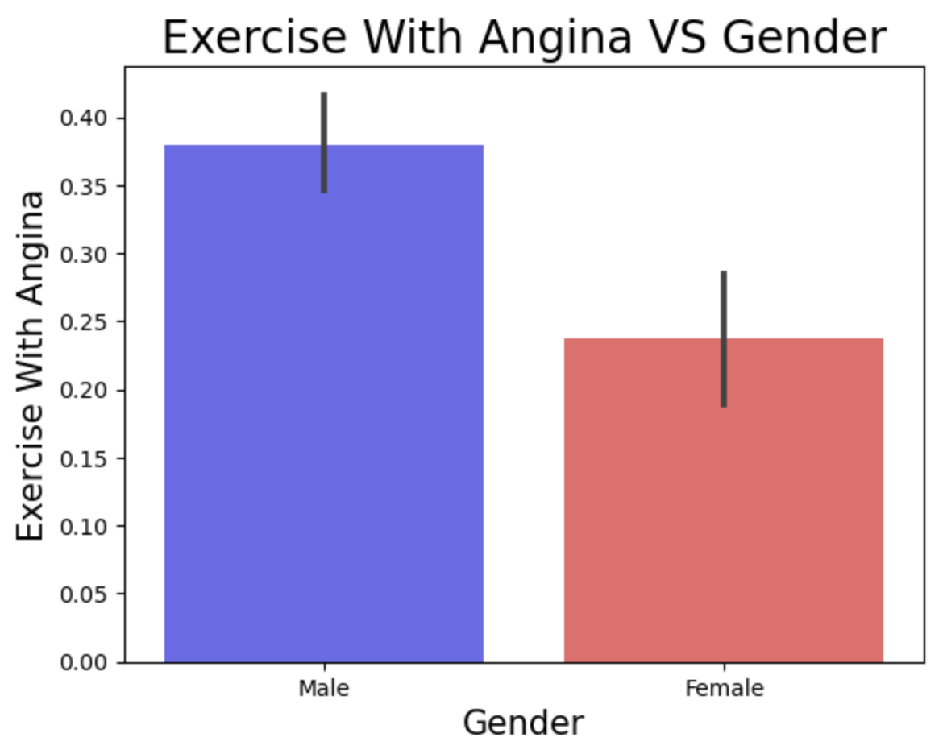
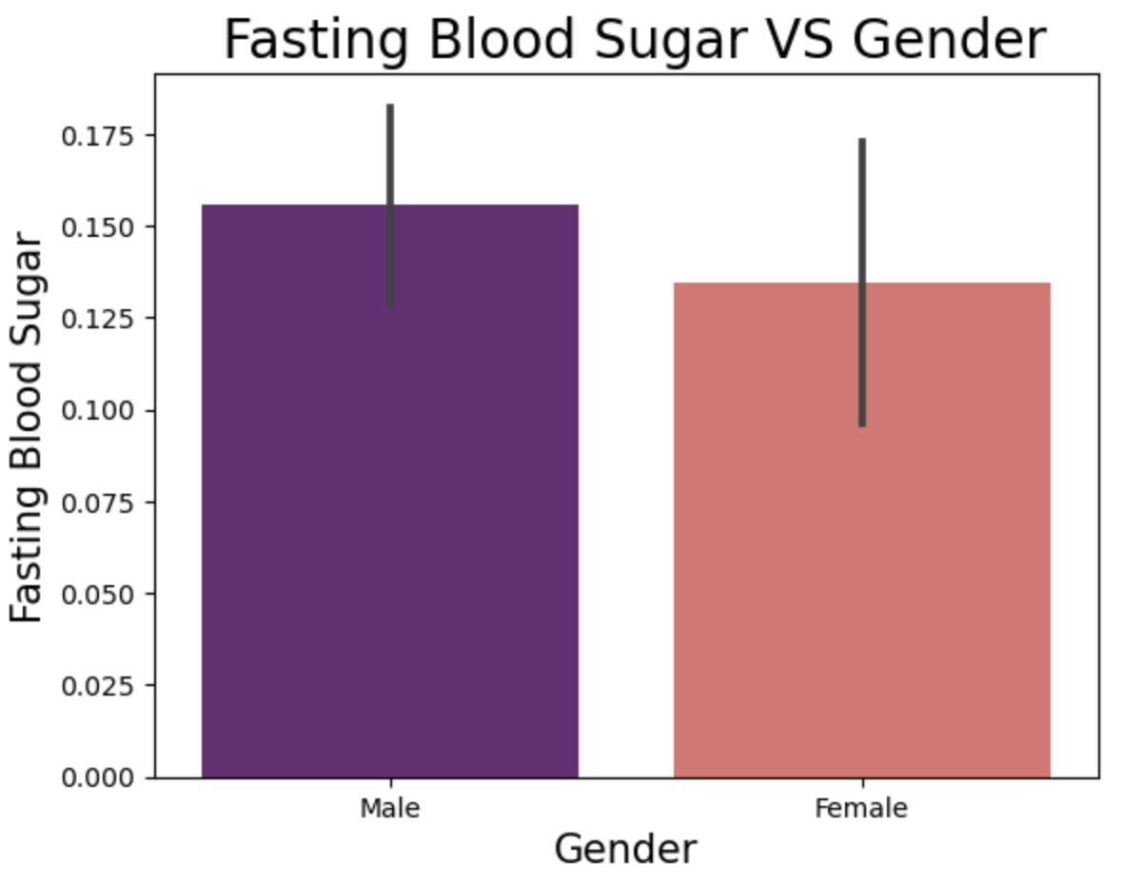
ST Depression VS Heart Disease | Exercise With Angina VS Heart Disease
Exercise With Angina VS Gender | Blood Sugar VS Gender

