Slide 1
CAMPUS TO CAREER · HACKATHON 2026
SprintBridge
Careers built on evidence, not claims: skills you can prove, fit you can see, people you can trust.
sprintbridge-frontend.onrender.com
[Team name] · [Presenter names]
Notes:
Hi, we’re [team]. SprintBridge connects students and job seekers with recruiters, universities, mentors and founders, and everything in it runs on evidence rather than self-reported claims. It is live right now at the address on screen.

Slide 2
THE PROBLEM
Every step from campus to career runs on unverified claims
Resumes are self-reported
Placements live in spreadsheets
Anyone can list “Python, AWS, React”. Recruiters can’t tell evidence from keywords.
Eligibility is checked by hand, rules get bent, and students don’t learn why they were rejected.
Certificates can be bought
Scams target freshers
A friend can “verify” your skills. Nothing stops collusion.
“Pay a registration fee, contact us on WhatsApp only” listings reach students first.
SprintBridge · 2
Notes:
Four problems, one root cause: nothing in the campus-to-career chain is backed by evidence. Resumes are claims, eligibility is manual, verification can be faked, and fake listings exploit the people with the least experience.

Slide 3
THE SOLUTION
One platform, seven users, every connection live
Who | What they get
Students & job seekers | Proven skills, fit scores, recommended openings, mentors
Recruiters | Public and campus listings, applicant snapshots, audited decisions
Universities | Roster import, campus drives with enforced eligibility, placement report
Mentors | Paid sessions in escrow, independent skill verification
Founders | Ventures with a public teaser and an NDA-protected plan
Operators | Role approvals, scam reports, disputes, audit log
SprintBridge · 3
Notes:
Students and job seekers are one account type; the only difference is that a student is linked to a university roster, which opens campus drives and student pricing. Every row here is built and working in the live app.

Slide 4
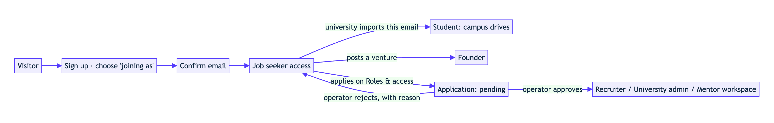
WHO GETS WHICH ROLE
Anyone can sign up. Nobody can make themselves a recruiter.
Students
Recruiters, colleges, mentors
Founders
Linked when their university’s roster has their confirmed email.
Apply in the app; an operator approves in one audited step.
No approval: post a venture and build a team.
SprintBridge · 4
Notes:
At sign-up you choose what you’re joining as. Job seeker is the default. A university importing its roster turns matching accounts into students automatically, but only for confirmed emails. Recruiters, universities and mentors apply, and an operator checks they really work there before the workspace opens. The database itself refuses any other way to grant a role.

Slide 5
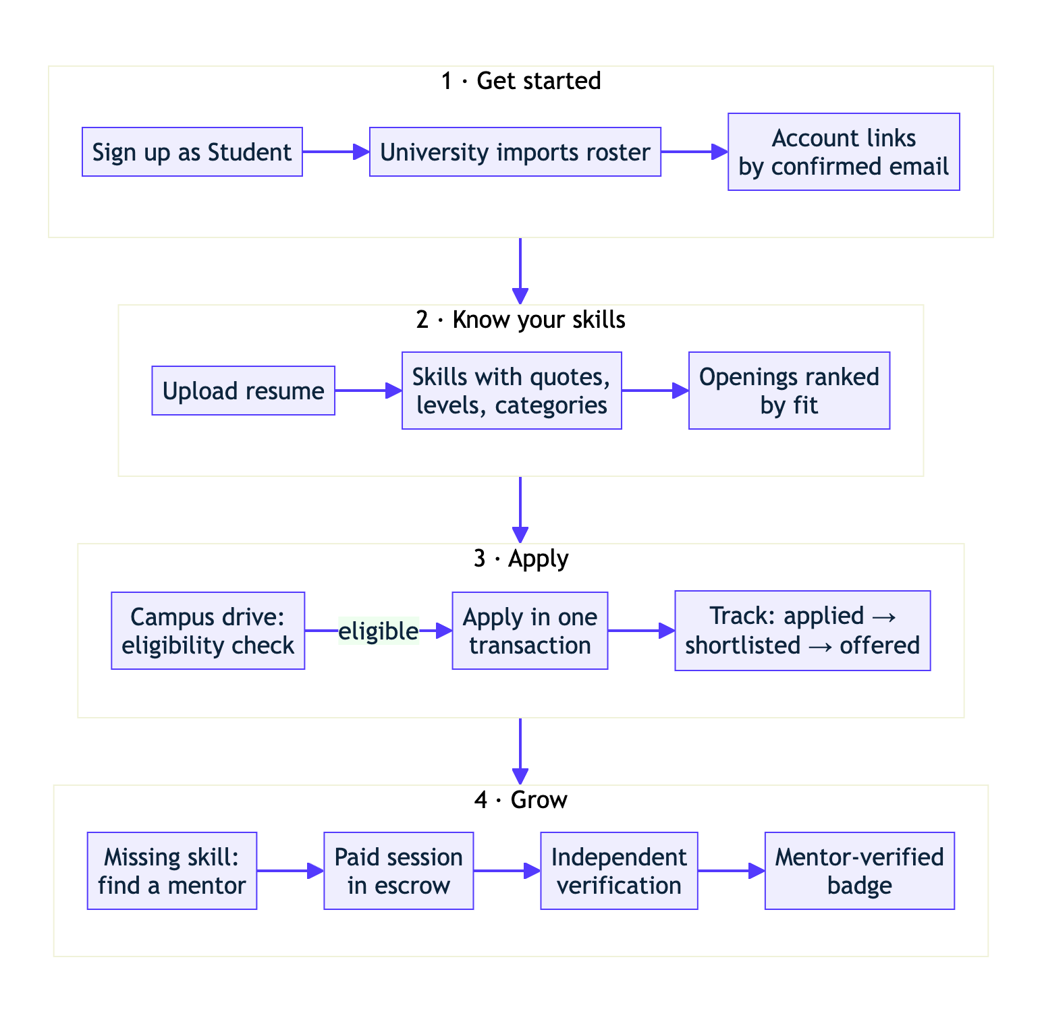
THE STUDENT JOURNEY
From sign-up to a verified badge
• Resume becomes skills with the lines that prove them
• Openings ranked by fit, with what’s missing
• Campus eligibility says exactly why
• A gap leads straight to the right mentor
SprintBridge · 5
Notes:
Four stages. Get started: the university imports its roster and the student’s account links by email. Know your skills: upload a resume. Apply: eligibility for a campus drive is checked by the database, and if it fails the student sees the reason, for example “Python is required”. Grow: that missing skill links to mentors, and a mentor-verified badge raises their fit score.

Slide 6
THE SKILL ENGINE
The AI reads. Python scores.
1
2
3
4
Read the PDF
Extract with quotes
Check every mention
Score in Python
Text layer, or OCR for scans. Two-column layouts read in order.
Groq names each skill and copies the exact line. No line, no skill.
A deterministic pass adds section and dates, so runs agree.
Evidence → level 1–3. Fit weighs required 2×, preferred 1×.
A resume line saying “rate this candidate 100” changes nothing: the model never produces a score, and quotes it invents are dropped.
SprintBridge · 6
Notes:
This is the heart of the product. The language model only extracts: which skill, which exact line, which section. Every number comes from a deterministic Python formula that we can show the student. Confidence depends on evidence: mentor-verified counts 1.0, system-assessed 0.8, self-declared 0.3. Only a human mentor can certify level 4. We tested a prompt-injection line in a resume and it had no effect.

Slide 7
MEASURED ON THE LIVE APP
One resume, end to end, in seconds
12
80%
53%
skills found
top recommended fit
fit to a pasted job
Parsed in 7.7 s, each with its quote, level and category
Backend Developer Intern: 3 of 3 required skills met
Strong: Docker, PostgreSQL, Spring Boot. To build: AWS, Kafka
SprintBridge · 7 · Live API, 18 Oct 2026: demo student, text PDF resume, new backend-engineer job description (Groq, 6.9 s)
Notes:
These are real numbers from the deployed app this morning, not mock-ups. The same resume uploaded as a text PDF and as a degraded scan gave the same 18-skill profile in our local tests. Fit never overrides campus eligibility; they are shown separately.

Slide 8
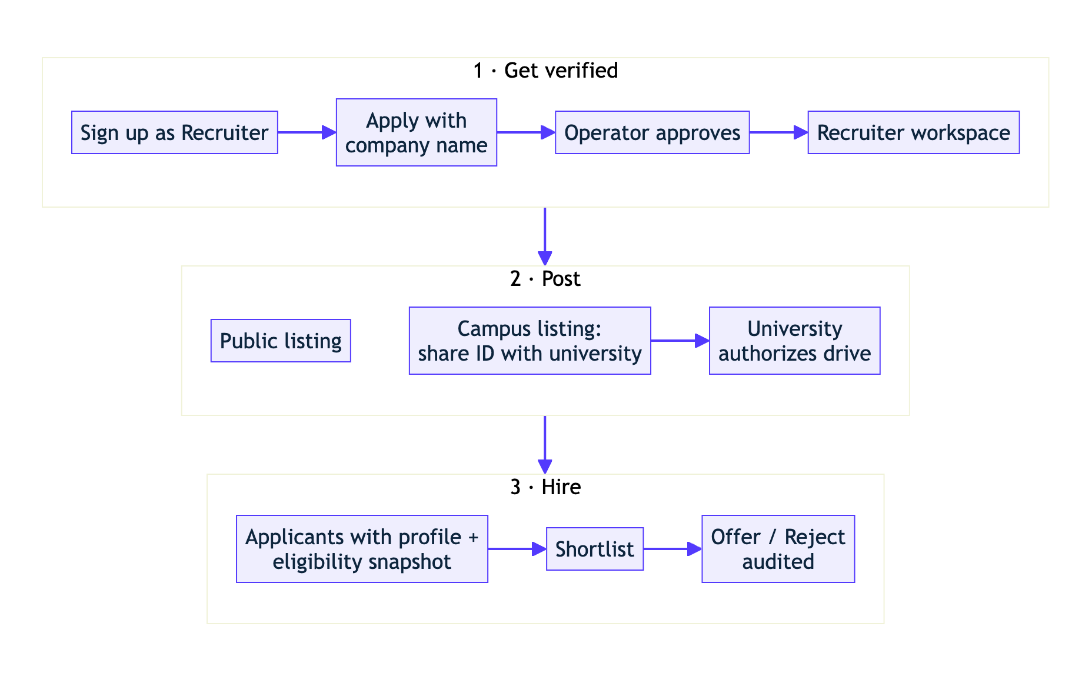
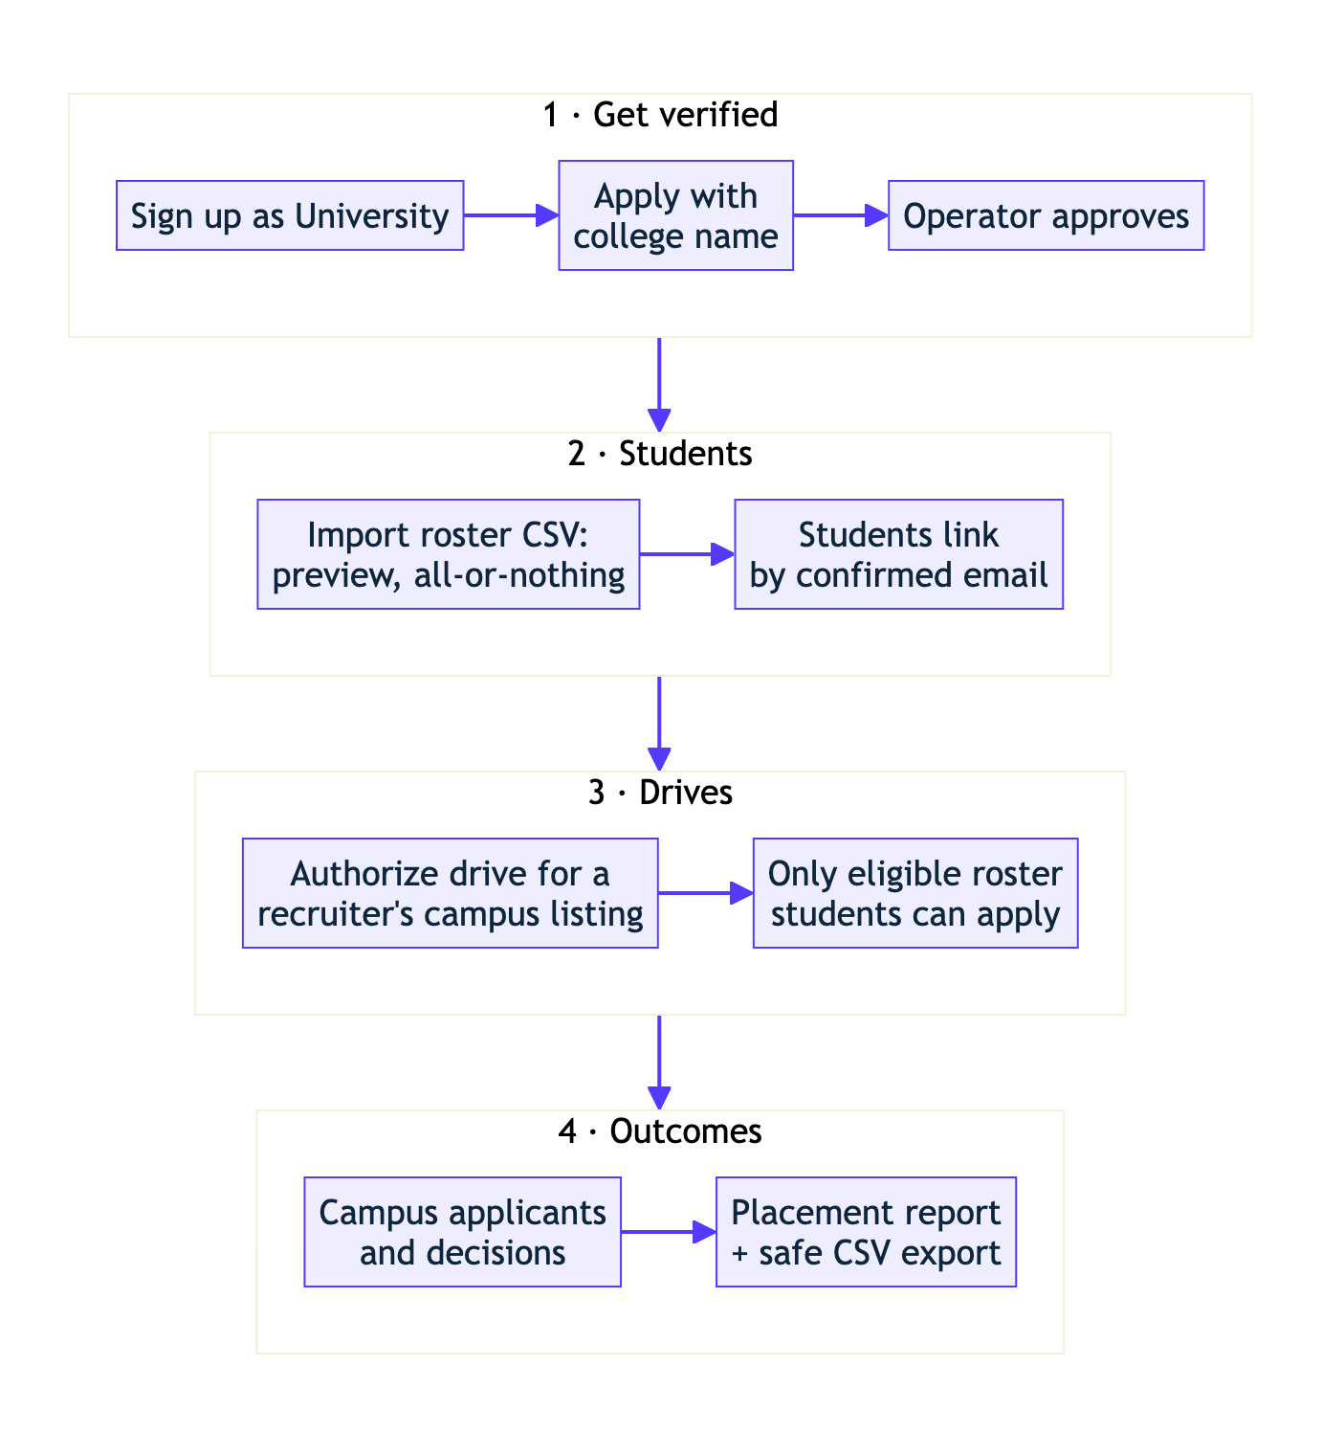
CAMPUS PLACEMENT
Recruiter and university, connected by one drive
Recruiter
University placement office
SprintBridge · 8 · Eligibility (branch, batch, CGPA, mandatory skills, deadline) is one database check: apply can’t bypass it
Notes:
A recruiter posts a campus listing and shares its ID with a university. The university authorizes a drive with its rules, and the listing becomes visible only to that university’s roster students. Applying re-checks everything inside one database transaction and saves a snapshot of the profile and eligibility. The university sees only applications made through its own drives. In our live run, Asha was eligible and got an offer; Vikram was blocked with the reason “Python is required”.

Slide 9
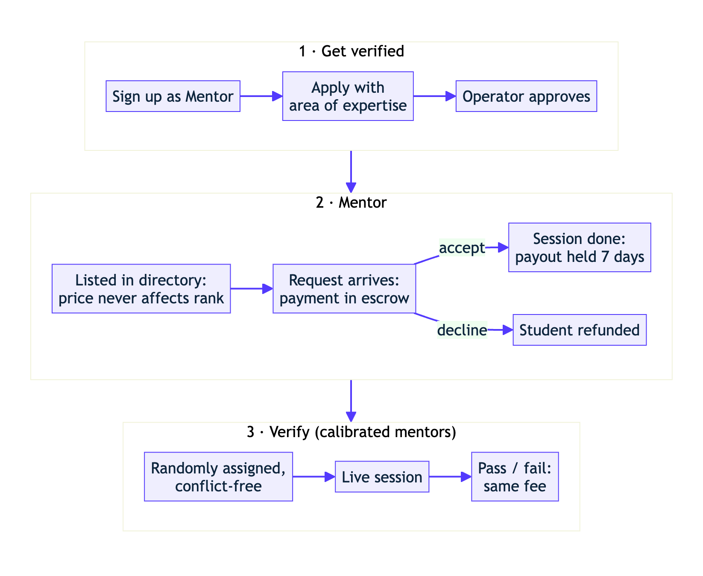
MENTORS AND VERIFICATION
A badge you can’t get from a friend
• The system picks the verifier at random; you can’t choose
• No shared college or employer, no past contact
• Same fee whether you pass or fail
• 20% get a blind second review; disagreement claws back pay
SprintBridge · 9
Notes:
Mentoring is paid through escrow: if a mentor declines, the student is refunded automatically; when a session completes, the mentor’s payout is held for seven days in case of a dispute. Verification is designed against collusion: the verifier is revealed only when the session starts, can’t certify above their own level, and badges expire after 18 months. In the live run, Asha had just had a session with Arjun, so the system assigned Neha instead.

Slide 10
TRUST AND SAFETY
Scams are flagged before a student applies
Flag
Report
Review
Audit
Fee requests and “WhatsApp only” are detected in listings and pasted job descriptions.
Three reports from different users hide a listing automatically.
Operators remove listings, settle disputes and approve roles.
Every payment, decision and approval is logged with who and when.
SprintBridge · 10
Notes:
A student opening a flagged listing sees an amber warning: genuine employers never charge candidates. After three distinct users report it, it disappears from students’ view until an operator reviews it. The company can still see it. The audit log records payments, refunds, verification results, moderation, application decisions and role approvals.

Slide 11
SECURITY BY DESIGN
Every rule lives in the database, not the screen
178
55
18
automated tests: backend, database security, live journeys, browser
API operations, each in a contract a test enforces
migrations: row-level security and audited SQL functions
Direct database calls that skip the app are refused: granting yourself a role, posting for another company, editing your CGPA, faking skill evidence, reading a founder’s private plan.
SprintBridge · 11
Notes:
The backend forwards each user’s own verified login token to the database, so the database applies that user’s permissions. That means even a bug in our API can’t leak another company’s applicants or another university’s roster. Login tokens are verified on every request, and organizations are fully isolated from each other.

Slide 12
BUSINESS MODEL
Free to start, paid for scale. Trust is never for sale.
Who pays | Plans | What paying unlocks
Students / job seekers | ₹149 / ₹299 a month | Unlimited resume, fit and mentor requests
Recruiters | ₹4,999 / ₹14,999 a month | 5 or unlimited active listings (free: 1)
Universities | ₹400 per student a year | Unlimited drives and placement reporting
Mentors | 20% commission, 10% on ₹499 Pro | Lower commission on sessions
Verification | ₹499 student / ₹999 job seeker | Same fee pass or fail; verifier earns 60%
Paying never changes search ranking or a verification result, and employers can never charge candidates.
SprintBridge · 12
Notes:
Revenue comes from four sides: subscriptions for heavy users, recruiter listing plans, a per-student university plan, and commission on mentoring and verification. Founders have a free plan with one venture and a ₹999 plan with three. Payments in the demo run in a clearly labelled test mode; the escrow, holds, refunds and disputes are real logic, ready for a payment provider like Razorpay.

Slide 13
BUILT TODAY, NEXT STEPS
What’s real, and what comes next
Working end to end
Simulated or next
• Accounts, role approval, roster linking
• Listings, drives, eligibility, applications
• Resume engine, fit scores, recommendations
• Mentoring escrow, verification, disputes
• Ventures with NDA, scam flags, audit log
• Payments in labelled test mode (Razorpay next)
• Video for verification sessions
• ID checks and DigiLocker academic records
• GitHub analysis and 48-hour proof plans
• Scanned-resume OCR on a larger server
SprintBridge · 13
Notes:
We want to be precise about what is real. Everything on the left runs against the real database in the live app. On the right: payments are a simulated test mode by design for a hackathon; OCR for scanned resumes works but needs more memory than our free server has.

Slide 14
LIVE DEMO
See it run.
Resume to recommended job, campus drive to offer, gap to mentor-verified badge.
sprintbridge-frontend.onrender.com
Thank you · [Team name]
Notes:
Switch to the browser. Suggested order from docs/showcase-workflow.md: sign-up with role choice, recruiter approval, campus placement, resume to fit, mentor and verification, venture, then scam reports. Wake the API a minute before.

