Slide 1

Piyush Kashyap
144238
Good Morning!

Slide 2

GENETIC ALGORITHM OPTIMIZATION IN ANTENNA DESIGN
Practical Approach

Slide 3

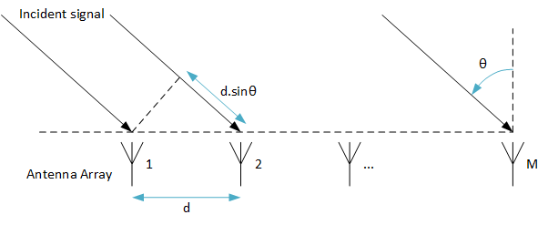
Antenna under consideration:
“ Linear Antenna Arrays “
What is Linear Antenna Array?
Assembly of radiating elements in an electrical or geometrical configuration.
The individual antennas (elements) are connected to a single receiver or transmitter by feed lines that feed the power to the elements in a specific phase relationship.
The radio waves radiated by each individual antenna combine (vector addition) and superpose, adding together to enhance the power of radiated/ received signal in desired directions, and cancelling to reduce the power of radiated/received signal in other directions.

Slide 4
Why antenna array?
High Gain
High Directivity
Multi-beams for multifunction
Electronic Beam steering
Five controls in an antenna array which can be used to shape the pattern properly:
Geometrical configuration (linear, circular, rectangular, spherical) of the overall array.
Spacing between the elements,.
Excitation amplitude of the individual elements.
Excitation phase of the individual elements.
Relative pattern of the individual elements.

Slide 5
Reference Design

Slide 6
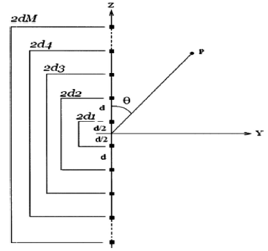
Practically considered conditions / design constraints:
Broadside array of 2M isotropic radiators
Elements to be uncoupled
Equally spaced along the z-axis
Center of the array as origin
Symmetric in both geometry and excitation

Slide 7

Equation:
Far Field Radiation Pattern = ‘Element Pattern’ X ‘Array Factor’
Array Factor:
Where,
θ = zenith angle measured from the broadside direction of the array
I_{n} = current excitation amplitude
φ_{n} = excitation phase of the nth array element
d = spacing between two consecutive elements
k ( = 2π/λ ) = wave numbers

Slide 8
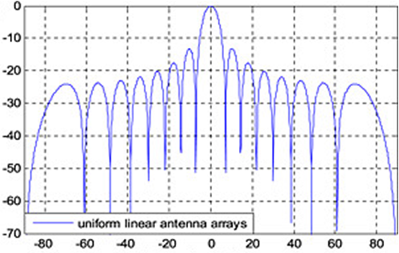
Radiation pattern observed:
Side lobe level relative to the
main lobe (dB)
Angle of arrival (degrees)

Slide 9
OPTIMIZATION

Slide 10
- AIM -
To introduce deeper null/nulls in the interference directions and to suppress the relative SLLs with respect to the main beam with the constraint of a fixed first null beam width (FNBW) for a symmetric linear antenna array of isotropic elements

Slide 11
Different evolutionary optimization algorithms:
Fuzzy logic
The bees algorithm
Particle swarm optimization (PSO)
The genetic algorithm (GA)
Of these algorithms, GA is a promising global optimization method for the design of antenna arrays due to:
Multi-path technique that searches many peaks in parallel and hence decreases the possibility of local minimum trapping.
Needs to evaluate the objective function (fitness) to guide its search which can also minimize the non-derivable objective function.
Explores the search space where the probability of finding improved performance is high.

Slide 12
1
Defining the far field radiation pattern:
Equation:
Far Field Radiation Pattern = ‘Element Pattern’ X ‘Array Factor’
Array Factor:
Where,
θ = zenith angle measured from the broadside direction of the array
I_{n} = current excitation amplitude
φ_{n} = excitation phase of the nth array element
d = spacing between two consecutive elements
k ( = 2π/λ ) = wave numbers

Slide 13



2
Formulate the objective function that is to be minimized:
Cost Function = + +
To keep FNBW of the
optimized pattern the same as in the initial pattern
‘Array Factor value at the particular null position and side lobe peaks ‘
<
‘The reference pattern’
Side lobes whose peaks exceed the threshold 𝛿 must be
suppressed
FNBW_{computed} = computed first
null beam width for the non-uniform excitation - optimal spacing case
FNBW(I_{n}=1) = for the uniform excitation with uniform inter-element spacing case
m = maximum number of positions where the null
can be imposed (1 or 2)
Adjustments:
1. Non-uniform excitation
2. Optimal spacing

Slide 14
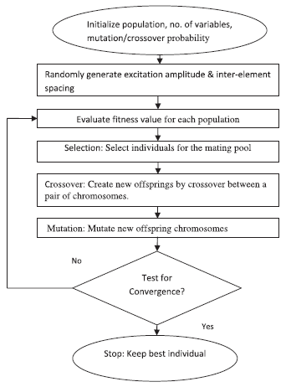
GENETIC ALGORITHM (GA)
Terminologies:
Chromosome/Individual
Population
Fitness/Cost/Objective Function
Parameters:
Selection
Reproduction
Crossover
Mutation
The GA flow for determining the optimized non-uniform excitation current amplitudes and optimum location of array elements.

Slide 15
GENETIC ALGORITHM (GA)
Assumption: Array is symmetric
Chromosome 1:
Where,
W₁₁;W₁₂; . . .W_{1M} are antenna element excitation weights
W_{1(M+1)} is inter-element spacing
Limits:
Used to create random set of chromosomes

Slide 16
IMPLEMENTATION

Slide 17
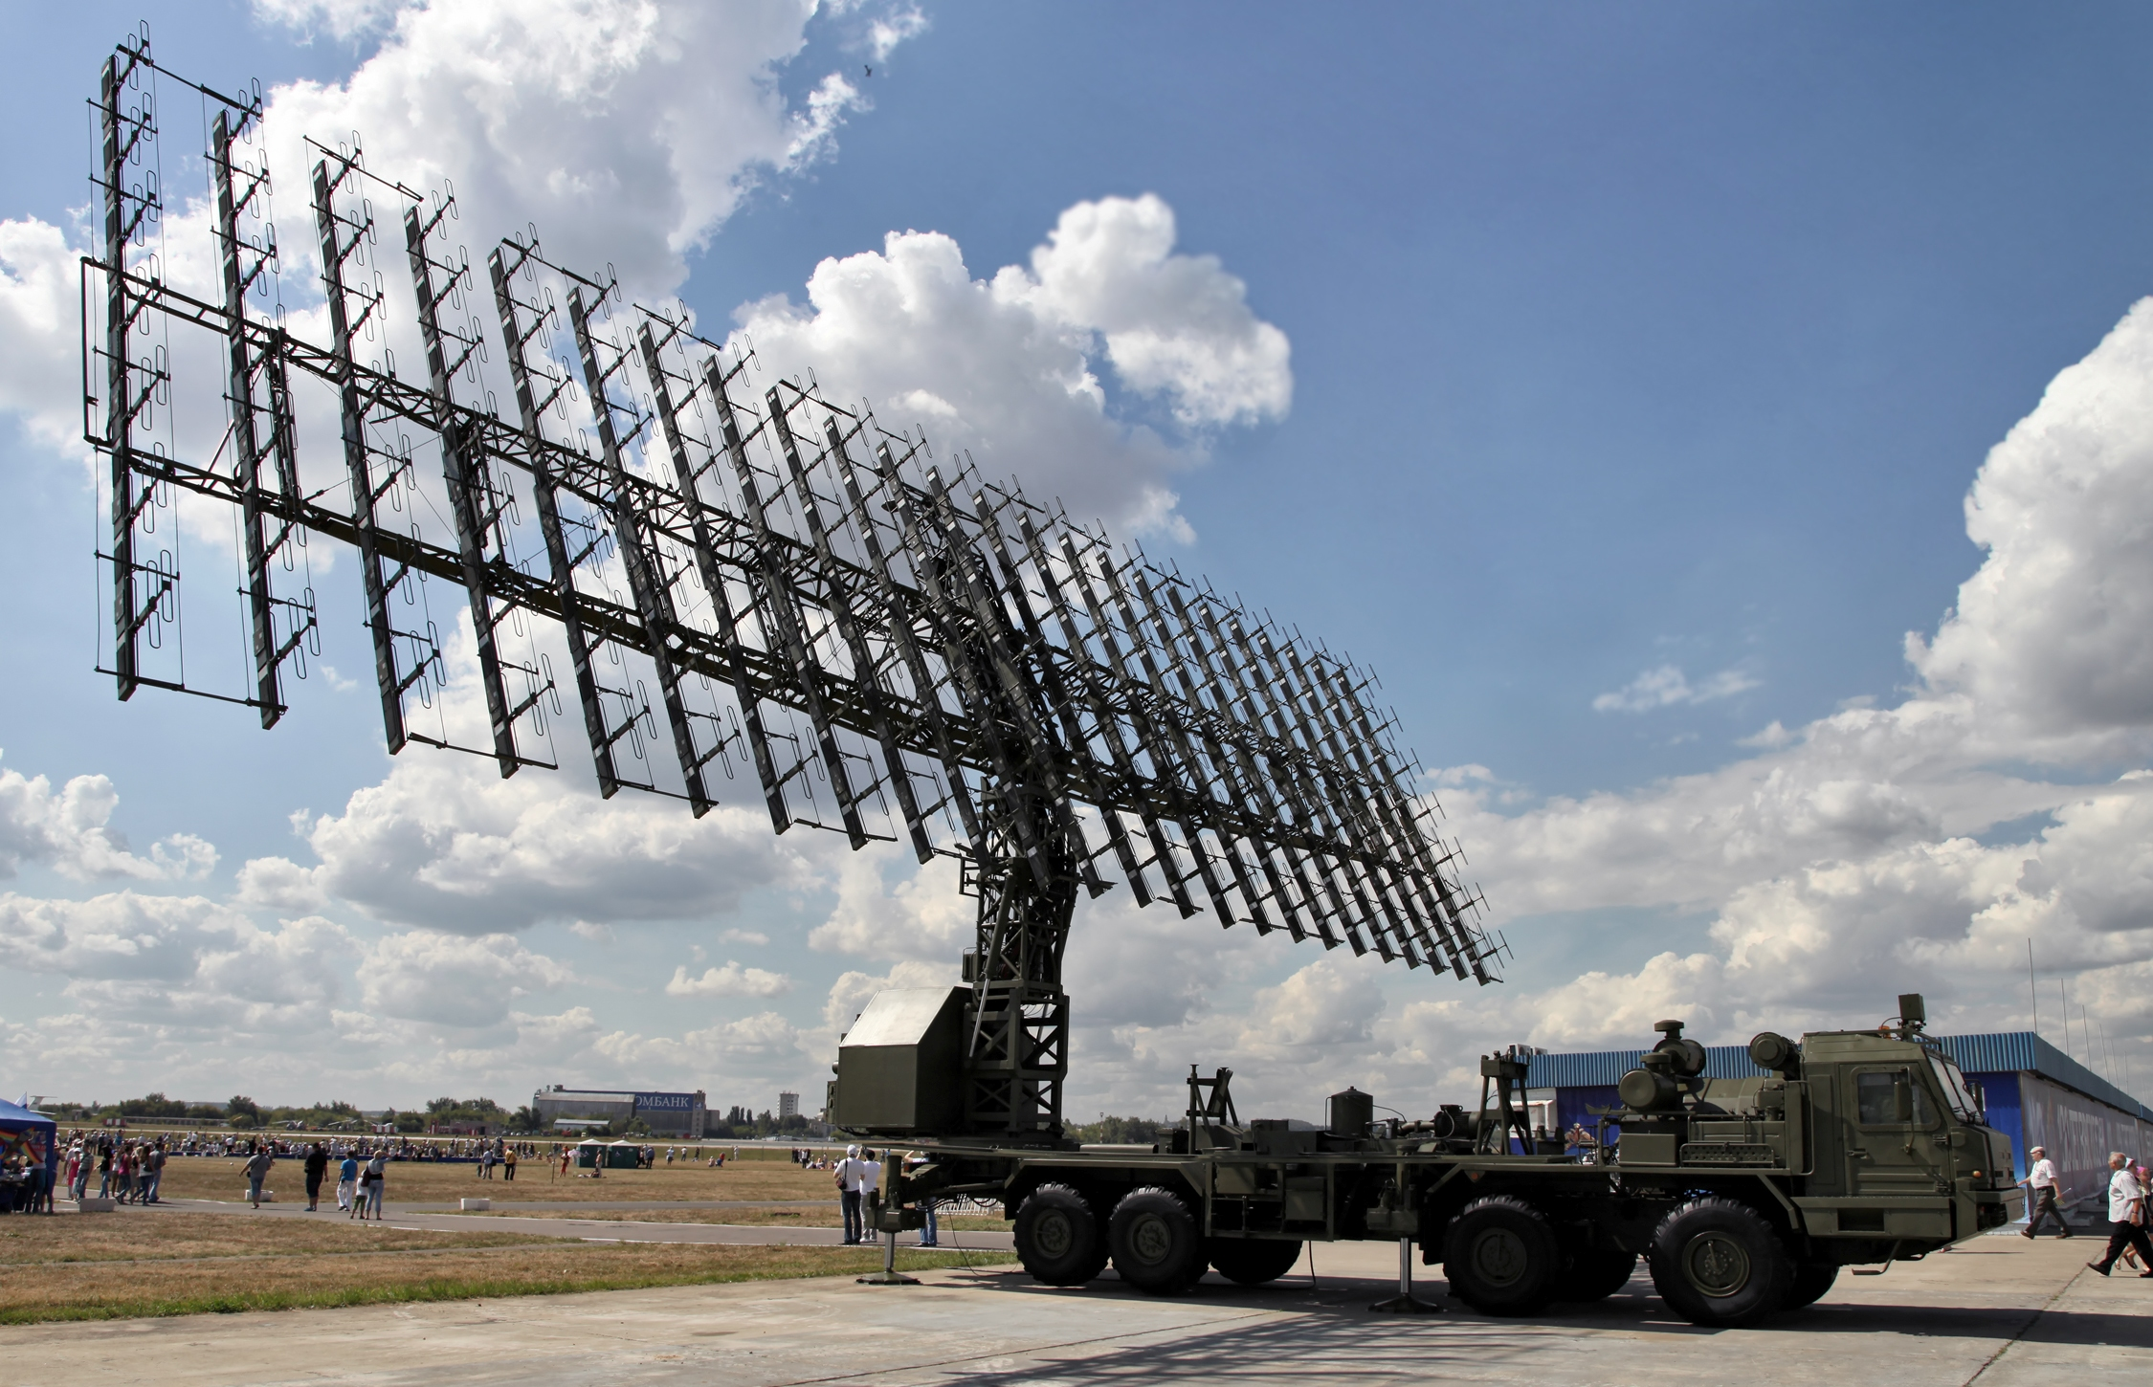
1
Linear element array with 12 Isotropic radiators taken with
uniform excitation and separation d= λ/2
2
500 iterations and the population size was fixed at 120
Mutation probability = 0.05
Uniform crossover
3
IMPLEMENTATION STEPS
Algorithm initialized using random values of excitation
(0 < I_{n} < 1) and spacing between elements (λ/2 < d < λ)
Nulling performances were improved for predefined nulls
of the radiation pattern.
Similarly, nulls were imposed at predefined peak positions

Slide 18
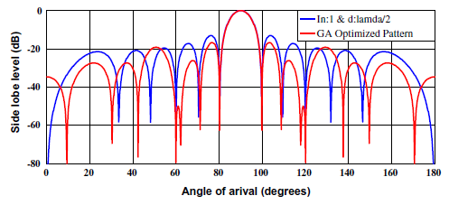
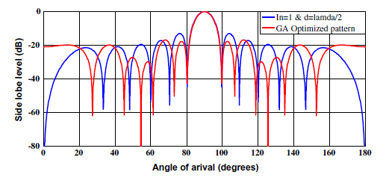
SIMULATIONS

Slide 19
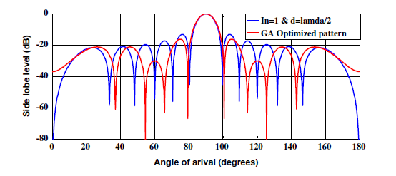
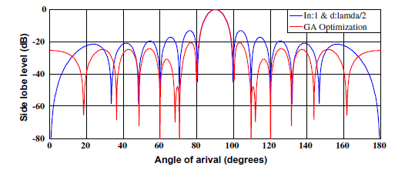
SIMULATIONS

Slide 20
CONCLUSIONS
An optimized 16 element linear array antenna imposes nulls with values of 83.87 dB and 69.09 dB at
the second and third peaks, respectively, from initial peak values of 17.49 dB and 20.10 dB at second and third peaks, respectively.
The SLL was also reduced by 6.84 dB.
Main contributions:
Null depth improves by approximately 80 dB.
Maximum SLL is reduced.
FNBW of the initial and final radiation pattern remains approximately same.
The proposed algorithm can easily be implemented in non-isotropic element antenna arrays with different geometries to design various array patterns.

Slide 21
References
A genetic algorithm for the level control of nulls and side lobes in linear antenna arrays by Bipul Goswami and Durbadal Mandal
OPTIMIZATION OF AN ANTENNA ARRAY USING GENETIC ALGORITHMS by Shahideh Kiehbadroudinezhad, Nor Kamariah Noordin, A. Sali and Zamri Zainal Abidin
Sidelobe reduction of the low profile multi-subarray antenna by genetic algorithm by Zhiqiang Lin, Minli Yao, and Xiaowei Shen
Genetic Algorithms in the Design and Optimization of Antenna Array Patterns by Francisco J. Ares-Pena,, Juan A. Rodriguez-Gonzalez, Emilio Villanueva-Lopez, and S. R. Rengarajan

Slide 22
QUERIES!

