Slide 1


Department of Computer Science and Engineering
(Artificial Intelligence)
Academic Year 2024-2025
MTP End - Term Presentation
on
MediGenius : AI Powered Prescription Guide
Guided by : Dr. Sumit Kumar Gupta Presented by : Piyush Khanke
MTECH CSE(AI) - 222415014

Slide 2


TABLE OF CONTENTS
MOTIVATION 3
RESEARCH GAP 4
AIM & OBJECTIVE 5
PROPOSED METHODOLOGY 6
TECHNOLOGY USED 7
RESULT & DISCUSSION 8
REFERENCES 12

Slide 3
Healthcare inaccessibility[1] due to time constraints and infrastructure limitations
Need for early, automated medical guidance to reduce self-medication risks
Utilization of AI for personalized symptom-based healthcare[3]
MOTIVATION
Reduction of prescription errors through data-driven recommendations[4]
Scalable and offline-capable system for deployment in low-resource areas

Slide 4
Literature Review
Title | ML Model Used | Dataset | Findings | Limitations | Country
A Framework of Hybrid Recommender System for Personalized Clinical Prescription | Hybrid Model (Collaborative Filtering + Content-Based Filtering) | Clinical datasets from hospitals | Hybrid models improve personalized recommendations[3] for clinical prescriptions | Data privacy concerns, integration challenges, reliance on historical data, potential bias in recommendations, and lack of real-time adaptability​ | Australia
A Literature Review on Medicine Recommender Systems | Ontology-Based Reasoning, Collaborative Filtering (CF), Knowledge-Based Methods | Multiple datasets from various sources | No unified accuracy[4] metric, approach-dependent performance | Limited real-world validation, high computational complexity, difficulty in handling sparse data, and lack of personalization for individual patients | USA
Table 1 : Literature Review

Slide 5
Title | ML Model Used | Dataset | Findings | Limitations | Country
A Tree-Based RAG-Agent Recommendation System for Medical Test Data | Decision Tree, Retrieval-Augmented Generation (RAG) | Medical test recommendation datasets | 88.7% accuracy, 2.1% miss rate for critical tests | Bias in dataset, reliance on hierarchical reasoning, inability to handle rare test cases effectively, dependency on structured input data, and lack of adaptability to dynamic medical conditions | USA
Recommender Systems in the Healthcare Domain: State-of-the-Art and Research Issues | Support Vector Machine (SVM), Decision Tree, Hybrid Methods | Various medical records and health service logs | Hybrid models perform best for personalized recommendations | Data privacy and integration challenges, interpretability issues in complex models, risk of overfitting, challenges in handling real-time data, and lack of standardization across healthcare systems | Austria, Germany
A Study on AI-Based Healthcare Recommender Systems | Neural Networks, Random Forest, Naïve Bayes | Electronic Health Records (EHR) | 85.2% accuracy in diagnosis prediction | Lack of interpretability, data imbalance issues, high dependency on labeled medical data, potential errors due to missing patient information, and difficulty in handling multi-modal medical data | Not mentioned

Slide 6

RESEARCH GAP
- Overfitting in existing models with 100% accuracy claims.
- Lack of adaptability to diverse or dynamic symptom inputs.
- No real-time deployment in many existing models.
- Limited personalization for user-specific factors.
- No clinical validation in most prior works.

Slide 7
AIM & OBJECTIVE
AIM : To design and implement a Medicine Recommendation System (MRS) that predicts diseases based on symptoms and recommends medications, precautions, diets, and physical activities.
OBJECTIVE :
Use Machine Learning (Random Forest) to classify diseases based on 132 binary symptoms.
- Provide accurate recommendations for medications and lifestyle adjustments.
- Deploy the system as a web application for accessible, real-time use.
- Support preliminary diagnosis to reduce the burden on healthcare providers.

Slide 8
PROPOSED METHODOLOGY
Input Symptoms
(Via web Interface)
Input Vectorization (132 – Features)
Random Forest Classifier
Disease Prediction
(Prognosis)
Medication
Diet
Precautions
Workout
Output on Web Interface

Slide 9
TECHN0LOGY USED
Programming Language | Python 3.11.3
ML Library | Scikit-learn
Data Handling | Pandas, Numpy
Web Framework | Flask
Interface | HTML, CSS, Javascript (Flask Templates)
Dataset Source | Kaggle (symptom-disease dataset)
Dev Environment | Jupyter Notebook, Intel core i5, 16 GB RAM
Algorithm used | Random Forest
Table 2. Technology Stack

Slide 10
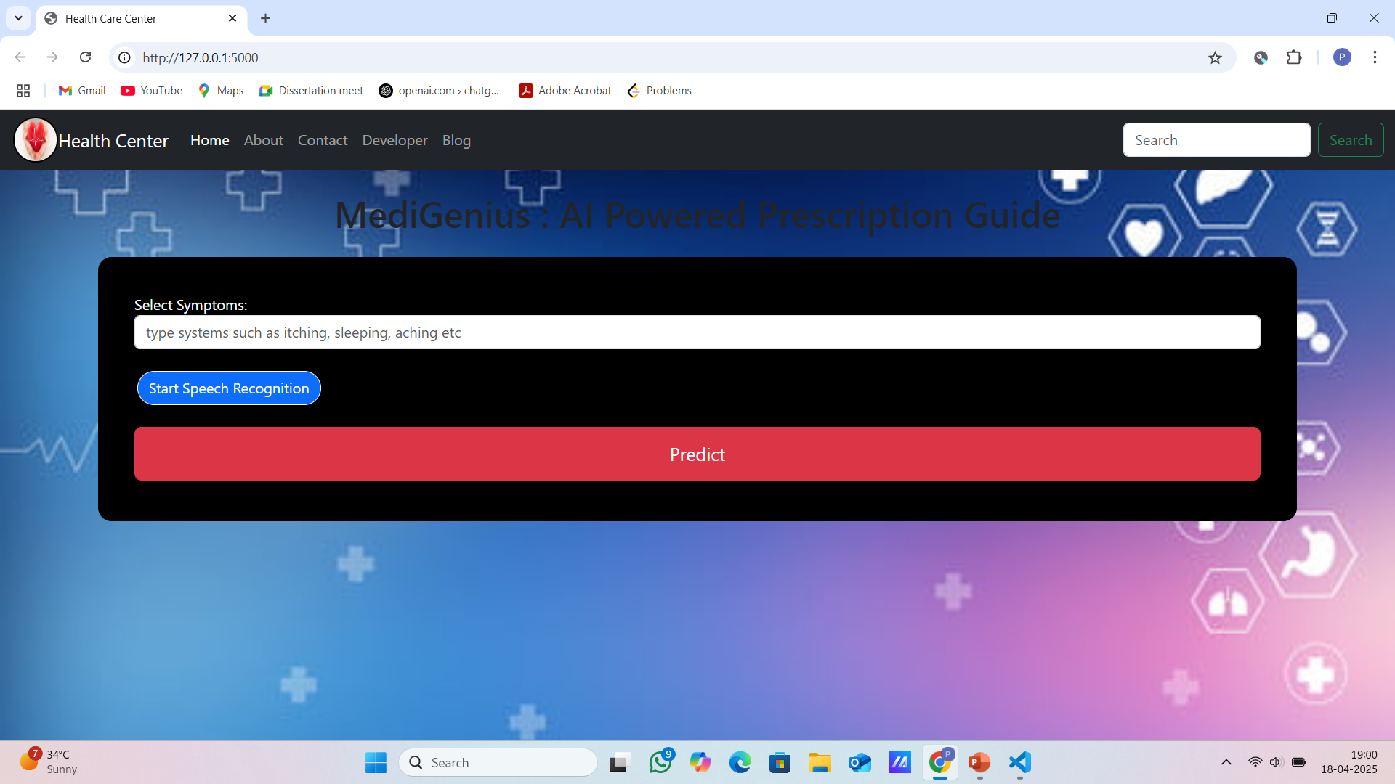
RESULT & IMPLEMENTATION
Fig 1 : UI Image

Slide 11
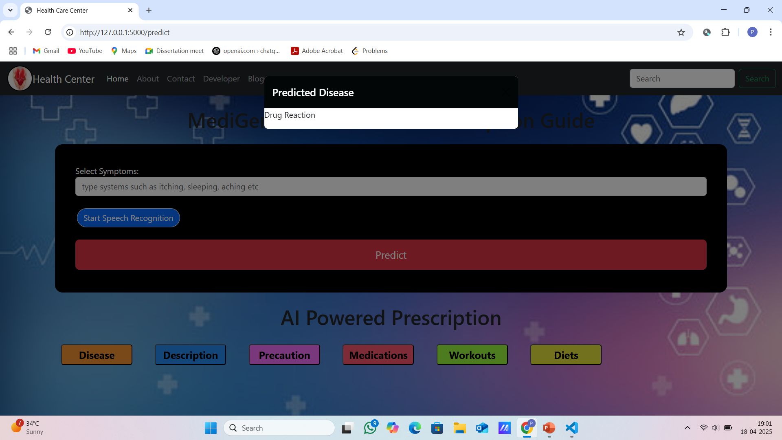
RESULT & IMPLEMENTATION
Fig 2 : Predicted disease on entered symptom

Slide 12
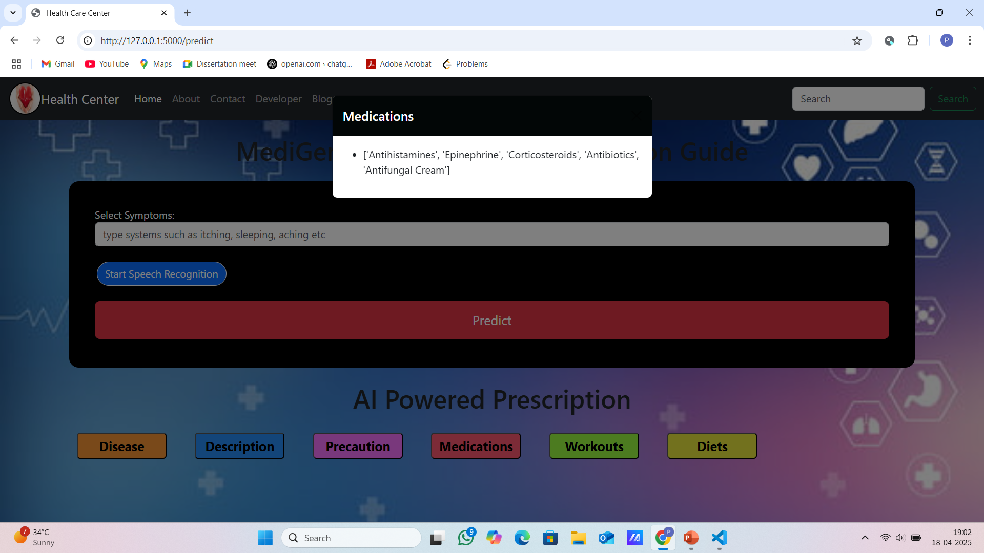
RESULT & IMPLEMENTATION
Fig 3 : Medications(Combination of Medicines)

Slide 13

RESULT & IMPLEMENTATION
Fig 4 : Diets Recommended

Slide 14
Classification Models | Evaluation Metrics | Testing Accuracy |  | Validation Accuracy
[1] Bhidve et al. (SVM) | Accuracy | 73.50% |  | 74.20%
 | Precision | 72.80% |  | 73.50%
 | Recall | 71.90% |  | 72.60%
 | F1-Score | 72.35% |  | 73.05%
 | ROC-AUC | 80.10% |  | 81.30%
[6] Patel et al. (CNN, Hypothetical) | Accuracy | 79.80% |  | 81.50%
 | Precision | 82.10% |  | 83.40%
 | Recall | 78.60% |  | 80.20%
 | F1-Score | 80.30% |  | 81.80%
 | ROC-AUC | 87.50% |  | 89.00%
[7] Kumar et al. (CF, Hypothetical) | Accuracy | 65.40% |  | 66.80%
 | Precision | 64.70% |  | 66.10%
 | Recall | 63.90% |  | 65.30%
 | F1-Score | 64.30% |  | 65.70%
 | ROC-AUC | 72.20% |  | 73.90%
Proposed Model ( Random Forest) | Accuracy | 92.68% |  | 94.72%
 | Precision | 93.10% |  | 95.20%
 | Recall | 92.40% |  | 94.50%
 | F1-Score | 92.75% |  | 94.85%
 | ROC-AUC | 98.30% |  | 99.10%
Comparison of Models

Slide 15


Conclusion
High predictive accuracy using Random Forest Classifier
Comprehensive symptom-to-recommendation pipeline
Lightweight, scalable, and CPU-efficient design
User-friendly Flask web interface
Scope for future improvements and real-world validation

Slide 16
REFERENCES
Aggarwal, C. C. (2016). Recommender systems: The textbook. Springer. https://doi.org/10.1007/978-3-319-29659-3 (Covers foundational concepts of recommendation systems, relevant to your MRS’s recommendation pipeline.)
Breiman, L. (2001). Random forests. Machine Learning, 45(1), 5–32. https://doi.org/10.1023/A:1010933404324 (Seminal work on Random Forest, used in your notebook for disease prediction.)
Chen, T., & Guestrin, C. (2016). XGBoost: A scalable tree boosting system. Proceedings of the 22nd ACM SIGKDD International Conference on Knowledge Discovery and Data Mining, 785–794. https://doi.org/10.1145/2939672.2939785 (Related to Gradient Boosting, used in your notebook, providing context for ensemble methods.)
Garg, S. (2021). Drug recommendation system based on sentiment analysis of drug reviews using machine learning. arXiv preprint arXiv:2104.01113v2. Retrieved from https://arxiv.org/abs/2104.01113 (Provided PDF, cited for sentiment-based recommendation comparison in Discussion.)
Hastie, T., Tibshirani, R., & Friedman, J. (2009). The elements of statistical learning: Data mining, inference, and prediction (2nd ed.). Springer. https://doi.org/10.1007/978-0-387-84858-7 (Foundational text for machine learning methods like SVC and Naive Bayes, used in your study.)
Holzinger, A., Biro, P., & Holzinger, K. (2014). Biomedical informatics: Discovering knowledge in big data. Springer. https://doi.org/10.1007/978-3-319-04528-3 (Provides context for applying machine learning in healthcare, relevant to your MRS.)

Slide 17
THANK YOU !!!

