Slide 1

01
Travel safe
Geofenced zones, one-tap SOS,
live emergency services — all live.
PRODUCT OVERVIEW
YatraWise
02
Explore smart
Real Places, AI itineraries,
live maps, weather & routes.
Smart Tourism &
Safety Assistant
03
Stay verified
Digital Emergency ID with
QR verification against Firestore.
Android · Flutter · Firebase
04
Travel greener
Eco Score from real walk
and cycle GPS sessions.
Presented by Team Genesis
September 2026

Slide 2
OVERVIEW
Agenda
01
The problem
Why travelers still juggle five apps and feel unsafe on the ground
02
What we built
YatraWise — one assistant for travel, safety, identity & eco
03
Product tour
Home, Trip Planner, Safety, SOS, Explore, Maps, AI, Digital ID
04
How it works
Architecture, full feature set, tech stack, security model
05
Delivery
What ships as real today, and where Genesis takes it next
YatraWise · Team Genesis
2 / 16

Slide 3
CONTEXT
The gap on the ground
Tourists carry five apps and still feel unsafe, overcharged, and lost.
Fragmented tools
Weak safety loop
Maps, weather, translation, SOS and booking live in separate apps with no shared location or profile context.
Most travel apps stop at a helpline number. No geofence alerts, no local zone data, no digital emergency ID.
No single trip brain
Trust & verification gap
Itineraries, budgets, multi-stop routes and nearby essentials are rarely planned together around where you actually are.
Paper IDs get lost. Static QR cards can leak personal data. Emergency contacts are not always one scan away.
YatraWise · Team Genesis
3 / 16

Slide 4
SOLUTION
One app. Real safety. Real travel.
YatraWise unifies premium travel UX with end-to-end safety — every module is live and wired.
A native Android assistant that knows where you are, what is nearby, whether the area is safe, and how to get help — with live Google Maps, NVIDIA AI, OpenWeather, and a verifiable Digital Emergency ID.
Travel
Safety
Identity
Eco
Explore places, AI trip plans, weather, budget & wallet, multi-stop routes, nearby essentials.
Geofenced zones, one-tap SOS with live GPS, incident reporting, nearby hospitals & police.
Digital Emergency ID — QR encodes only a 64-char token, verified live in Firestore.
Eco Score from real walk/cycle GPS sessions, levels and badges persisted in Firestore.
YatraWise · Team Genesis
4 / 16

Slide 5
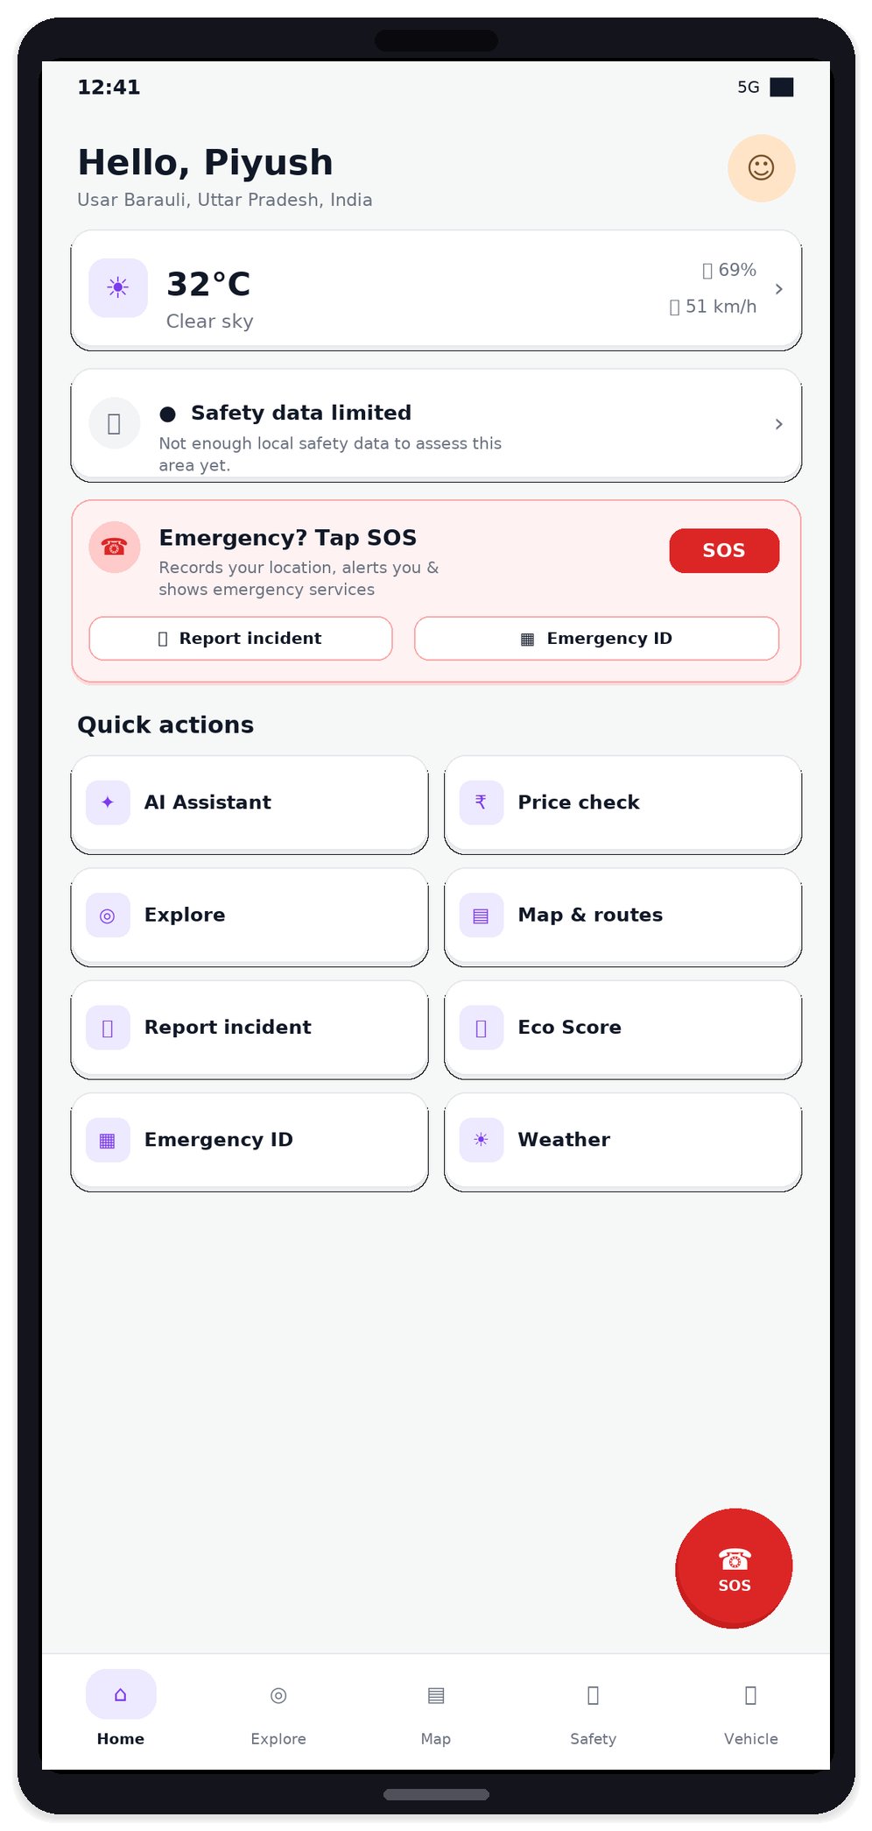
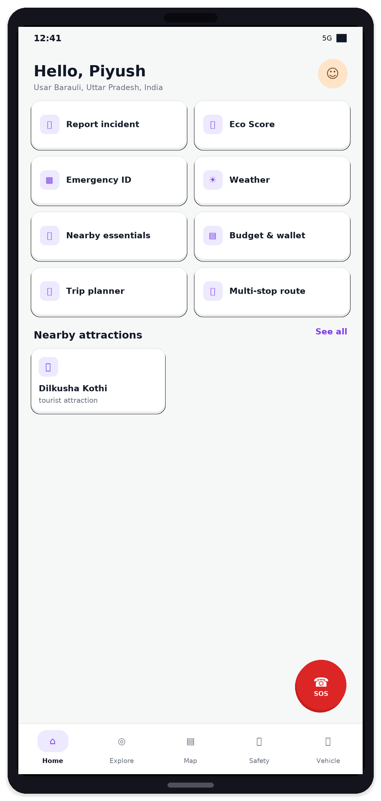
PRODUCT TOUR
Home — live context at a glance
Location, weather, safety status, SOS and quick actions. Every card opens a working feature.
Live greeting
Name from profile, reverse-geocoded place label, avatar from Storage.
Weather strip
OpenWeather current conditions via secure Cloud Function proxy.
Safety status
Nearest active zone for your GPS — or an honest limited-data state.
SOS always ready
Confirm → real GPS fix → emergencyEvents doc → call nearby services.
Quick actions grid
AI, Explore, Map, Incidents, Trips, Eco, Digital ID, Weather.
YatraWise · Team Genesis
5 / 16

Slide 6
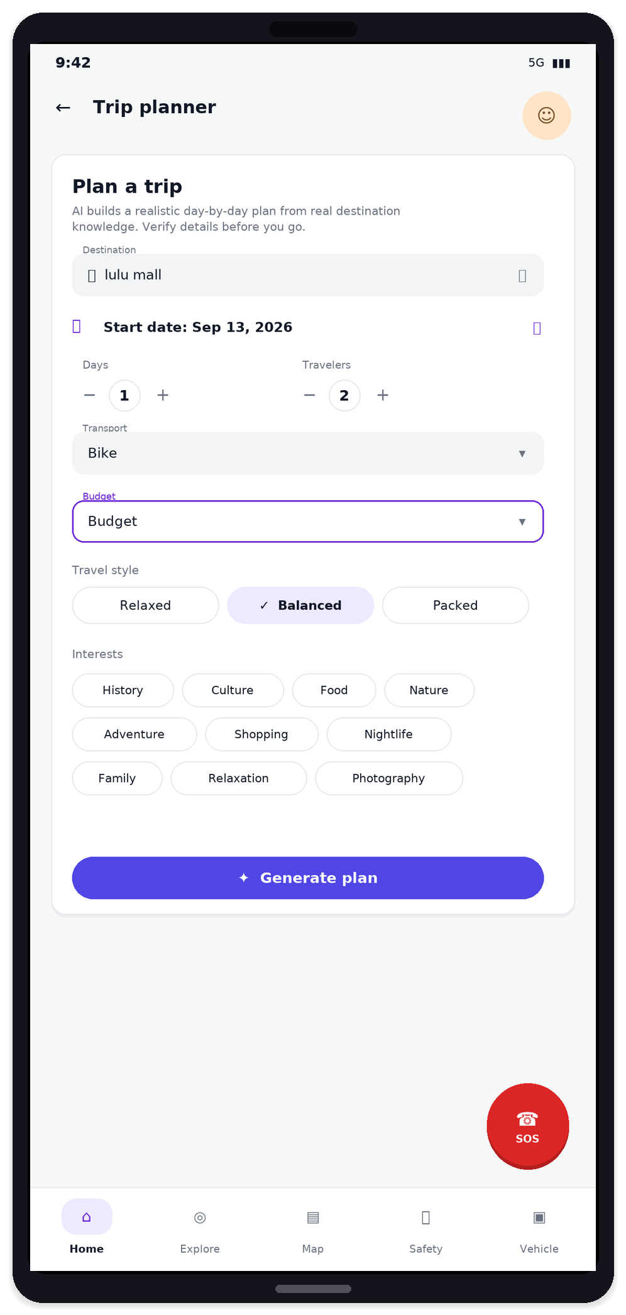
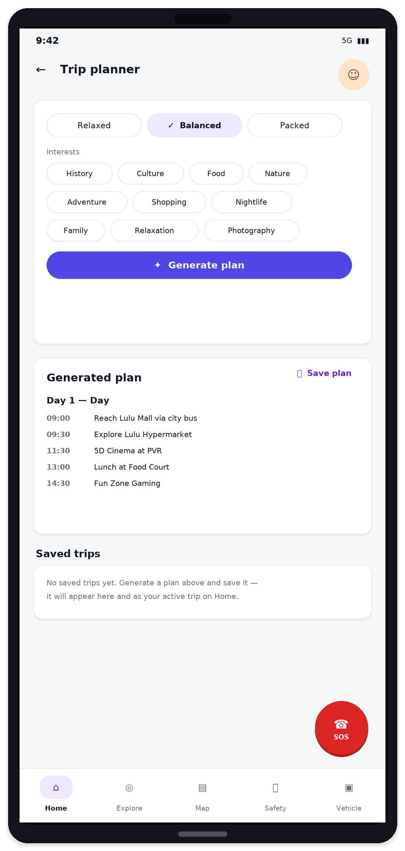
PRODUCT TOUR
AI Trip Planner — working end-to-end
Destination, days, travelers, transport, budget, style & interests → NVIDIA day-by-day plan you can save.
Real AI generation
NVIDIA Llama 3.1 70B builds a timed day plan from your inputs — not a static template.
Rich trip inputs
Destination search, start date, days, travelers, transport mode, budget tier, travel style.
Interest chips
History, Culture, Food, Nature, Adventure, Shopping, Nightlife, Family, and more.
Save to Firestore
Generated plan saves per user; appears under Saved trips and as active trip on Home.
Honest copy
UI reminds travelers to verify details before they go — no overclaiming.
YatraWise · Team Genesis
6 / 16

Slide 7
PRODUCT
Complete feature map
Every module below is implemented and reachable in the app — no placeholders.
Home dashboard
AI Trip Planner
Explore
Map & routes
Live location, weather, safety, SOS, attractions, alerts
Destination → NVIDIA day plan → save to Firestore
Google Places search, categories, photos, navigate
Maps SDK, zones, multi-stop routes, live GPS dot
AI Assistant
Safety hub
One-tap SOS
Incident report
NVIDIA chat with location + preference context
Zones list, geofence monitor, emergency services
GPS-backed emergency event + real call buttons
Photo/video upload → AI triage → admin review
Digital Emergency ID
Eco Score
Weather
Notifications
64-hex QR token, camera scan, live verify
Walk/cycle GPS sessions, points, levels, badges
Current + 5-day forecast with safety notes
Safety, geofence, incident, emergency history
Profile & prefs
Nearby essentials
Budget & wallet
Admin console
Photo, language, emergency contact, budget/style
Hospitals, police, ATMs and services near you
Travel budget preference wired into trip planning
Incidents, zones, SOS — role-gated server-side
YatraWise · Team Genesis
7 / 16

Slide 8
SAFETY
Safety loop that stays honest
Detect risk → warn the traveler → capture location → surface real help. Never fake a dispatch.
1
Detect
2
Warn
3
Respond
Active safety zones from Firestore. Geofence monitor with foreground and background location.
→
In-app banner + Android notification + history when entering a high-risk zone.
→
SOS records live GPS to emergencyEvents. Nearby hospital / police / fire with real tel: dial.
Incident reporting
What we refuse to claim
• Description + photo + video, type and size validated
• Upload to Firebase Storage under incidents/{uid}/
• NVIDIA triage → category, severity, summary, action
• Stored in Firestore with full admin review workflow
• We do not auto-dial police or ambulance
• We do not invent coordinates if GPS is off
• We do not put personal data inside the QR
• SOS is stored for admins — never “dispatched”
YatraWise · Team Genesis
8 / 16

Slide 9
TRAVEL INTELLIGENCE
Explore, navigate, converse
Real Google Places and Maps. Real NVIDIA chat with your location injected server-side.
Explore
Map & multi-stop routes
AI Assistant
• Text search + category browse (attractions, food, hidden gems)
• Place detail: proxied photos, rating, price, open/closed
• Distance from you + one-tap Google Maps navigation
• Nearby attractions strip on Home (live Places results)
• Nearby essentials for hospitals, ATMs and services
• Official Google Maps SDK — live blue dot, pan/zoom/rotate
• Attraction markers and color-coded safety zone circles
• Directions polyline when available; honest straight-line fallback
• Multi-stop route planning across the day
• Emergency service markers you can call or navigate to
• Conversational AI via NVIDIA Llama 3.1 70B Instruct
• Current location + travel preferences as live context
• Typing indicator, error states, suggestion chips
• Complements the Trip Planner for on-trip questions
• All keys stay on Cloud Functions — never in the APK
YatraWise · Team Genesis
9 / 16

Slide 10
IDENTITY & LIFESTYLE
Digital ID, Eco, Weather & account
Identity that verifies. Sustainability that measures. Weather that informs. Profile that personalizes.
Digital Emergency ID
Eco Score
GPS-tracked walk and cycle sessions, manual logs, points, levels and badges in Firestore.
How it works
• Profile with name, photo, emergency contacts
• QR encodes only a random 64-hex verification token
• No personal data ever rides inside the QR payload
• Active / revoked status controlled by the owner
Verification
• Camera scan via mobile_scanner, or manual paste
• Live Firestore lookup — not a static offline card
• Copy-token support for desk / hotel handoff
Weather
OpenWeather current + 5-day forecast via backend proxy, with practical safety notes and retry states.
Profile & notifications
Photo, language, emergency contact, budget/style/interests. Per-user notification history with deep-links.
YatraWise · Team Genesis
10 / 16

Slide 11
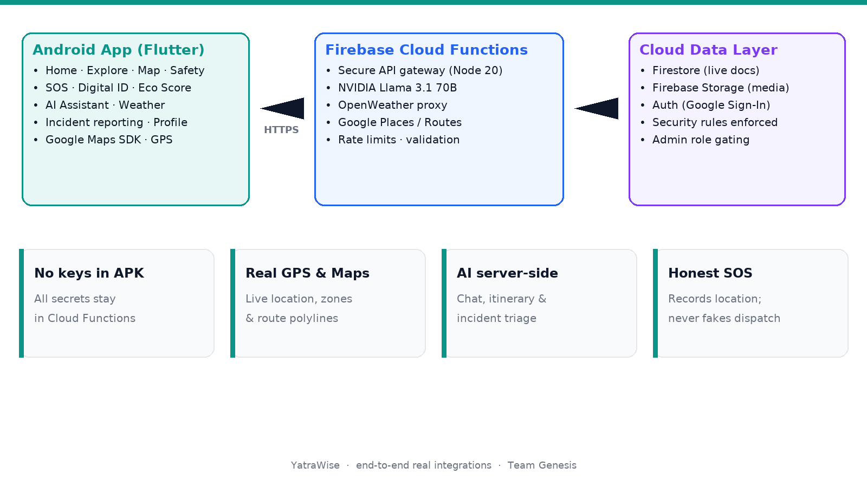
ENGINEERING
Architecture
Flutter client talks only to Firebase. All third-party keys live in Cloud Functions secrets.
YatraWise · Team Genesis
11 / 16

Slide 12
ENGINEERING
Tech stack
Chosen for real device capability — every integration is production-wired.
Client
Backend
Intelligence & data
Flutter 3.32 / Dart 3.8
Firebase Auth
NVIDIA Llama 3.1 70B
Material 3, GoRouter
Google Sign-In
Chat, trip plans, incident triage
google_maps_flutter
Cloud Firestore
OpenWeather
Official Maps SDK
Live documents & security rules
Current + 5-day forecast
geolocator
Cloud Functions v2
Google Places
Fine / background GPS
Node 20 secure API gateway
Search, details, photos
mobile_scanner + qr_flutter
Firebase Storage
Google Routes / Geocoding
Digital ID scan & render
Incident media & avatars
Polylines & place labels
dio + image_picker
GitHub Actions
Per-user rate limits
Networking & media capture
Analyze · test · release APK
Firestore transaction quotas
YatraWise · Team Genesis
12 / 16

Slide 13
ENGINEERING
Security model
Zero third-party secrets in the APK. Rules enforced server-side.
No keys in the client
Firestore & Storage rules
Rate limiting
NVIDIA, OpenWeather and Google server keys live only as Cloud Function secrets. The app talks to Firebase and its own endpoints.
Users write only their own docs. Safety zones are admin-writable. Incident media type/size capped. rateLimits denied to clients.
Per-user per-minute quotas in a Firestore transaction — chat 10, itinerary 5, places 30, weather 20, and more.
Input validation
Admin gating
Honest Digital ID
Shared Validators on the client and full type/range/length checks on every backend endpoint.
Admin UI is role-gated in-app and blocked by security rules even if the client is tampered with.
QR carries only a 64-hex token. Verification is a live Firestore read — revoke anytime.
YatraWise · Team Genesis
13 / 16

Slide 14
ENGINEERING
Live backend capabilities
Cloud Functions gateway — every path is implemented, validated and rate-limited.
Endpoint
What it does
/chat
NVIDIA conversational AI with location context
/itinerary
NVIDIA JSON day-by-day trip plan
/incidentAnalyze
NVIDIA triage — category, severity, action
/weatherCurrent
OpenWeather current conditions
/weatherForecast
OpenWeather 5-day forecast
/placesSearch
Google Places text + nearby search
/placesDetails
Place detail by id
/placesPhoto
Places photo proxy (GET)
/emergencyNearby
Hospital / police / fire / doctor
/route
Google Routes polyline + fallback
/geocodeReverse
GPS → human-readable label
YatraWise · Team Genesis
14 / 16

Slide 15
DELIVERY
What ships as real
Every integration is wired end-to-end. If something is not ready, the UI says so honestly.
Working today
Honest scope notes
• Google Sign-In → personalized Home dashboard
• Live weather + reverse-geocoded location label
• Places search, details, photos, navigation
• Maps with zones, routes, emergency markers
• NVIDIA chat + AI Trip Planner (generate & save)
• SOS event write + nearby services dial
• Incident media upload + AI triage
• Digital ID issue / revoke / live verify
• Eco session tracking + badges
• Notifications, profile prefs, admin console
• Geofence runs while the app process is alive — not a separate OS-level geofence service yet
• CI release APK is debug-keystore signed until a store keystore is supplied
• SOS stores location and surfaces help — it does not contact authorities on your behalf
• Blockchain is intentionally not claimed; Digital ID is modular for later anchoring
• Safety quality depends on zones admins configure for each region
YatraWise · Team Genesis
15 / 16

Slide 16
THANK YOU
YatraWise
Explore India · Pay Fair · Travel Safe
Presented by
Team Genesis
Smart tourism · real safety · working features
Questions welcome · September 2026

