Slide 1

01
Travel safe
Geofenced zones, one-tap SOS and live emergency help.
PRODUCT OVERVIEW
Tourism
02
Explore smart
Places, maps, weather and AI-powered trip planning.
Smart Travel & Safety Assistant
03
Stay verified
Digital Emergency ID with secure QR verification.
Android App · Flutter · Firebase
04
Travel greener
Eco Score from real walk and cycle sessions.
Presented by Team Genesis
September 2026

Slide 2
OVERVIEW
Agenda
01
The problem
Why travelers still feel unsafe and juggle too many apps
02
Our solution
Tourism — one app for travel, safety, AI and identity
03
Product tour
Home, AI Trip Planner, safety, explore and more
04
Features & tech
Full feature set, architecture and security
05
Delivery
What is live today — presented by Team Genesis
Tourism · Team Genesis
2 / 10

Slide 3
CONTEXT
From fragmented tools to one smart assistant
Tourism brings travel, safety and AI together in a single Android app.
The gap today
What Tourism does
• Maps, weather, SOS and booking live in separate apps
• No shared location or profile context across tools
• Safety often stops at a helpline number
• No geofence alerts or digital emergency ID
• Trip plans are manual, static and easy to lose
• Travelers feel overcharged, lost and unsafe
• One home dashboard with live location & weather
• AI Assistant for on-trip questions
• AI Trip Planner for day-by-day plans
• Safety zones, SOS and incident reporting
• Digital Emergency ID with QR verification
• Explore, maps, eco score and profile — all live
Tourism · Team Genesis
3 / 10

Slide 4
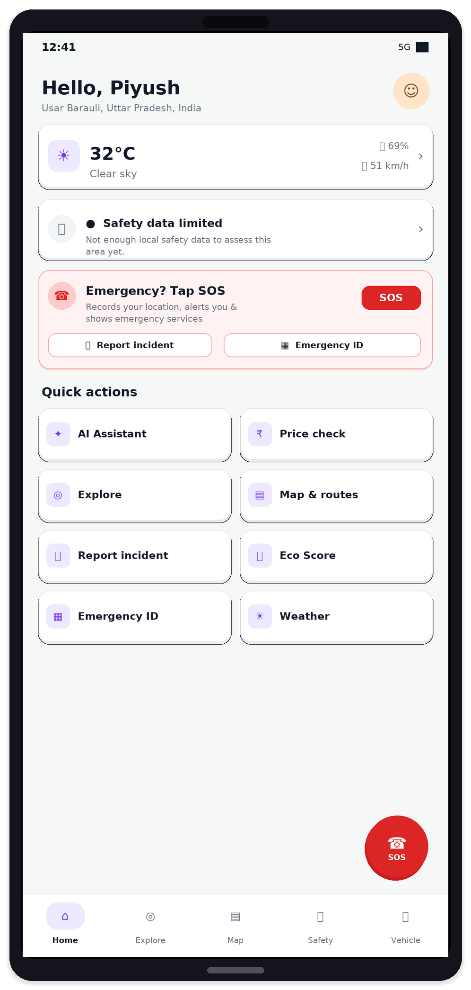
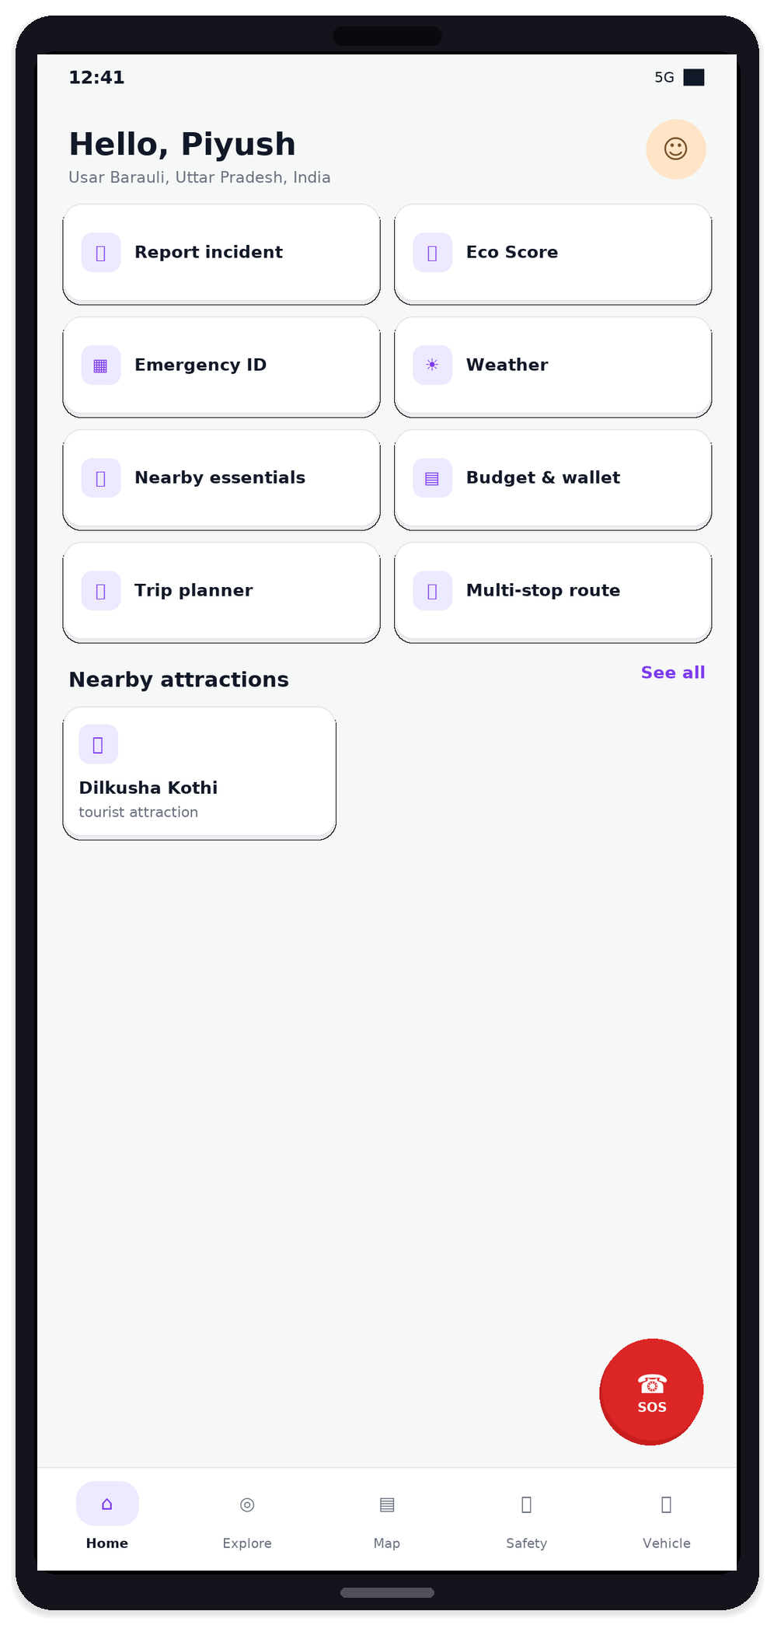
PRODUCT TOUR
Home — everything in one place
Live location, weather, safety status, SOS and quick actions. Every card opens a working feature.
Live greeting
Your name, place label and profile photo.
Weather
Current conditions for your location.
Safety status
Nearby zone check for where you are.
SOS ready
One tap records GPS and shows local help.
Quick actions
AI, Explore, Map, Trips, Eco, Digital ID.
Tourism · Team Genesis
4 / 10

Slide 5
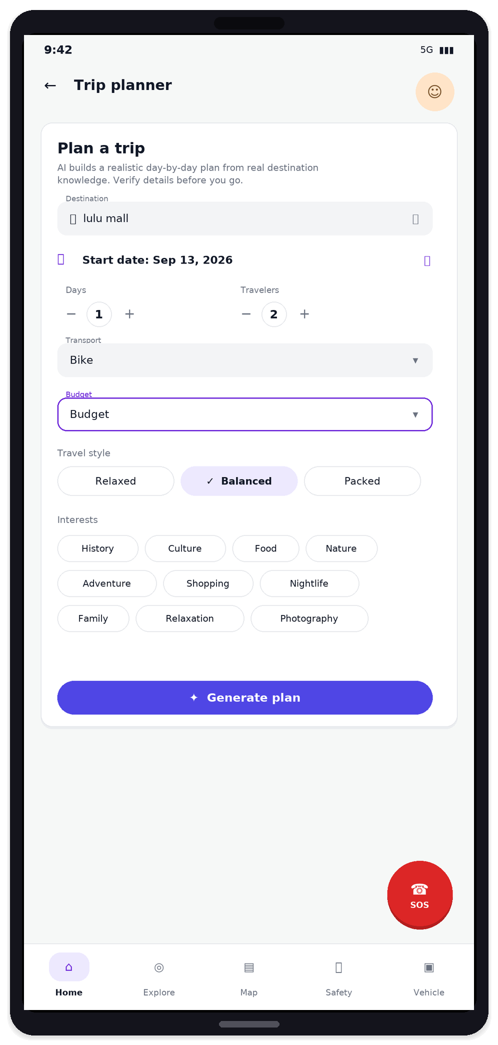
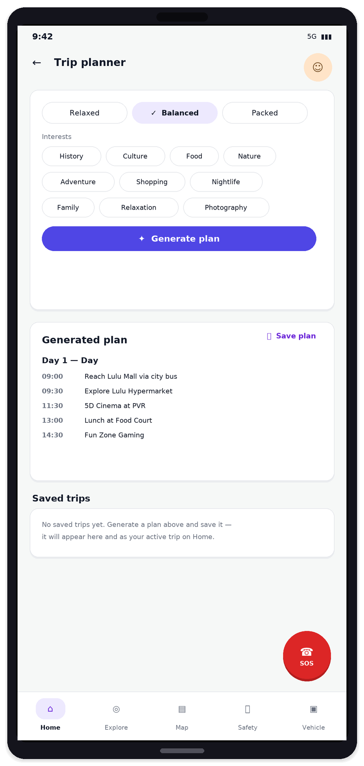
PRODUCT TOUR · ARTIFICIAL INTELLIGENCE
AI inside the app — real and working
Tourism uses AI for trip planning, on-trip help and incident understanding.
AI Trip Planner
Enter destination, days, travelers, transport, budget, style and interests. AI builds a timed day-by-day plan you can save.
AI Assistant
Chat while you travel. Answers use your live location and preferences so help stays relevant on the ground.
AI Incident triage
When you report an incident with photo or video, AI classifies severity and suggests the next action for review.
Tourism · Team Genesis
5 / 10

Slide 6
PRODUCT
Complete feature set
Every module below is live in the app — including AI.
Home dashboard
AI Trip Planner
AI Assistant
Explore
Location, weather, safety, SOS, attractions
Day-by-day plans generated by AI
On-trip chat with location context
Places search, photos, navigate
Map & routes
Safety hub
One-tap SOS
Incident report
Live map, zones, multi-stop routes
Geofence alerts & emergency services
GPS event + call nearby help
Media upload + AI triage
Digital Emergency ID
Eco Score
Weather
Notifications
QR verify, active / revoke
Walk & cycle tracking, badges
Current + multi-day forecast
Safety & trip alerts history
Profile
Nearby essentials
Budget & wallet
Admin console
Photo, contacts, travel prefs
Hospitals, police, ATMs
Budget prefs for trip plans
Zones, incidents, SOS review
Tourism · Team Genesis
6 / 10

Slide 7
SAFETY
Safety loop that stays honest
Detect risk → warn the traveler → capture location → show real help.
1
Detect
2
Warn
3
Respond
→
→
Active safety zones. Geofence monitor while you travel.
In-app alert + notification when you enter a high-risk zone.
SOS saves live GPS and lists nearby hospital, police and fire you can call.
Also included
Honest by design
• Incident report with photo / video
• AI triage for category and severity
• Digital Emergency ID with QR verify
• Admin review for zones, SOS and incidents
• SOS does not fake a police dispatch
• No location is invented if GPS is off
• QR carries a token — not personal data
• Call buttons open your phone dialer
Tourism · Team Genesis
7 / 10

Slide 8
ENGINEERING
How it is built
Flutter client · Firebase backend · secure cloud functions for AI and maps data.
Android app
Firebase platform
Smart services
• Flutter + Material design
• Live GPS and Google Maps
• AI Assistant & Trip Planner UI
• SOS, Digital ID, Eco Score
• Camera QR scan & notifications
• Google Sign-In (Auth)
• Cloud Firestore (live data)
• Cloud Storage (photos / video)
• Cloud Functions (secure APIs)
• Security rules + admin roles
• AI chat for travelers
• AI day-by-day trip plans
• AI incident understanding
• Places, routes & weather
• All sensitive work server-side
Tourism · Team Genesis
8 / 10

Slide 9
DELIVERY
Secure by default · live today
Sensitive work stays on the server. The app ships working features, not placeholders.
Server-side secrets
Firebase rules
Validated inputs
Private Digital ID
Third-party credentials never ship inside the Android app.
Users only access their own data. Admin actions are role-gated.
Client and server both check types, sizes and limits.
QR holds only a verification token — no personal payload.
Working in the app today
• Google Sign-In & profile
• Live weather & location
• Explore places & maps
• AI Assistant chat
• AI Trip Planner + save
• SOS with live GPS
• Incident report + AI triage
• Safety zones & alerts
• Digital Emergency ID
• Eco Score tracking
• Notifications history
• Admin console
Tourism · Team Genesis
9 / 10

Slide 10
THANK YOU
Tourism
Explore · Travel Safe · Powered by Team Genesis
Presented by
Team Genesis
Smart travel · real safety · working AI
Questions welcome · September 2026

