Slide 1


AI-Integrated Mentor for Quality Education and Career Guidance
Submitted By: Piyush Mehta(02620802821)
Project Guide: Mrs. Prachi Kaushik

Slide 2
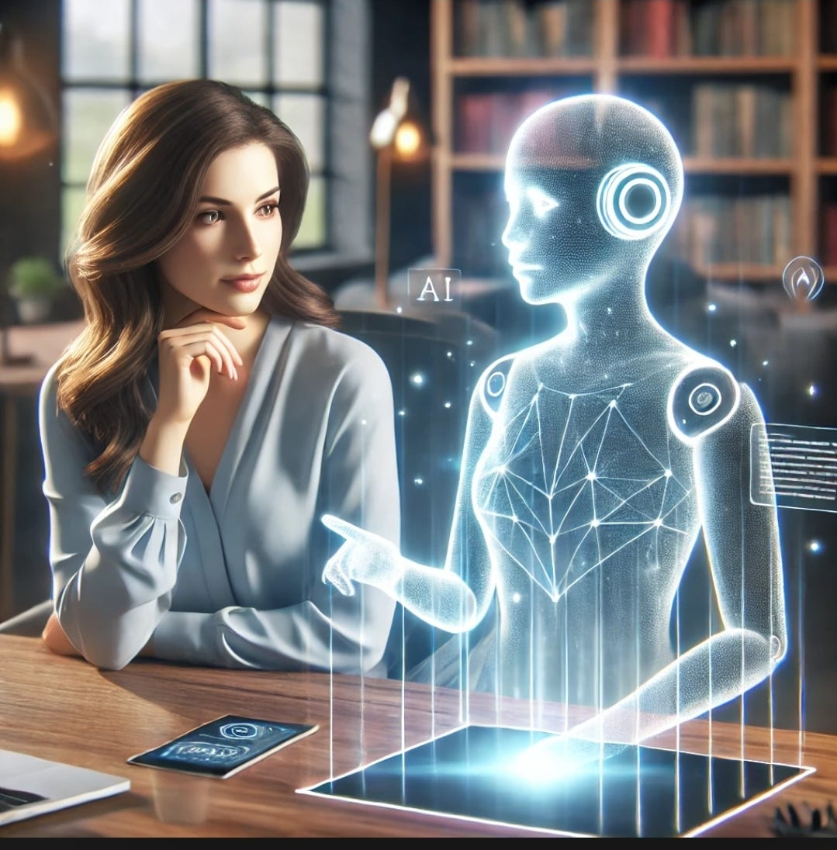
Problem Statement
In the evolving landscape of education and employment, many candidates, particularly fresh graduates and career switchers, struggle to access personalized career guidance, which creates a gap between their education and the skills demanded by the workforce. There is a need for a solution that offers scalable, AI-driven support, providing candidates with personalized resources to help them transition smoothly into the job market and foster long-term professional growth.

Slide 3

Mapping with the SDG’s
SDG4(Quality Education): The project ensures career guidance and skill development, helping individuals bridge the gap between education and industry demands. By integrating AI-driven learning personalized career paths, and interactive assessments, it promotes lifelong learning and enhances the quality of education by offering structured, data-driven insights for professional growth.
SDG8(Decent work and economic growth): By equipping job seekers, fresh graduates, and career switchers with industry-specific guidance, AI-powered resume building, and skill assessments, the project directly improves employability and workforce readiness supports sustainable economic growth.
SDG9(Industry, Innovation and Infrastructure): The project integrates cutting-edge AI technologies, cloud-based databases like Neon DB, and automation tools like Inngest to create a scalable and intelligent career mentoring platform. Furthermore, it supports the digital transformation of career guidance, making it more accessible, data driven, and efficient, aligning with SDG 9’s emphasis on innovation, sustainable industry growth, and resilient infrastructure.
SDG10(Reduced Inequalities): The project ensures equal access to career guidance for individuals from diverse backgrounds, including underprivileged communities, may lack personalized mentorship and industry insights. This contributes to reducing socioeconomic inequalities by empowering individuals with the knowledge needed to compete effectively in the job market

Slide 4
Introduction
The main concern with the problem is that traditional mentoring methods fail to provide personalized, scalable, and timely guidance to candidates, leaving them unprepared and under equipped for the specific demands of the rapidly evolving job market. This lack of tailored support creates significant barriers to career success, particularly for fresh graduates and career switchers, who require industry-specific insights, structured learning pathways, and practical tools to navigate their professional journeys effectively. Without real-time feedback, skill assessments, and adaptive learning mechanisms, these individuals struggle to bridge the gap between academic knowledge and industry expectations.
The proposed project aims to bridge this gap by creating an AI-powered career mentoring platform that integrates with quality education principles, ensuring candidates receive personalized, actionable guidance tailored to their career aspirations. By utilizing AI-driven tools for resume building, cover letter generation, skill development quizzes, and personalized industry insights, the platform will offer scalable, accessible support. This solution will empower candidates with the knowledge, skills, and resources needed for career success by providing personalized guidance, industry insights, and AI-driven recommendations tailored to their goals

Slide 5
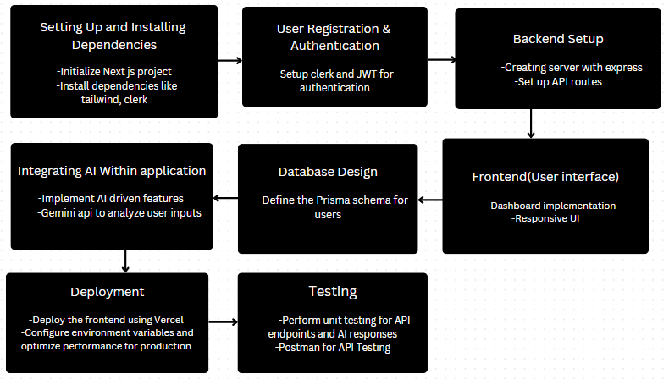
Proposed Work

Slide 6
Software and Hardware Requirements
Software :
Frontend: React 19, Next.js 15 and Tailwind CSS are used to create a dynamic, responsive, and visually appealing user interface with a focus on performance and ease of use.
Backend: Node.js, Express.js, Prisma DB, Neon DB, Clerk and JWT to build a scalable, secure, and efficient backend for managing user data, authentication, and real time career insights.
IDE: VS Code or any suitable IDE.
AI Integration: Tensor Flow, Inngest
Deployment: Vercel for deploying the Next.js application.
Hardware :
CPU: Minimum 2.0 GHz or higher processor (Intel or AMD).
RAM: At least 8 GB of RAM for smooth development experience.
Storage: 50 GB or more of available disk space for storing code, dependencies, and project files.
Graphics: Integrated graphics should be sufficient, but a dedicated GPU may be beneficial for AI development and resource-intensive tasks.

Slide 7
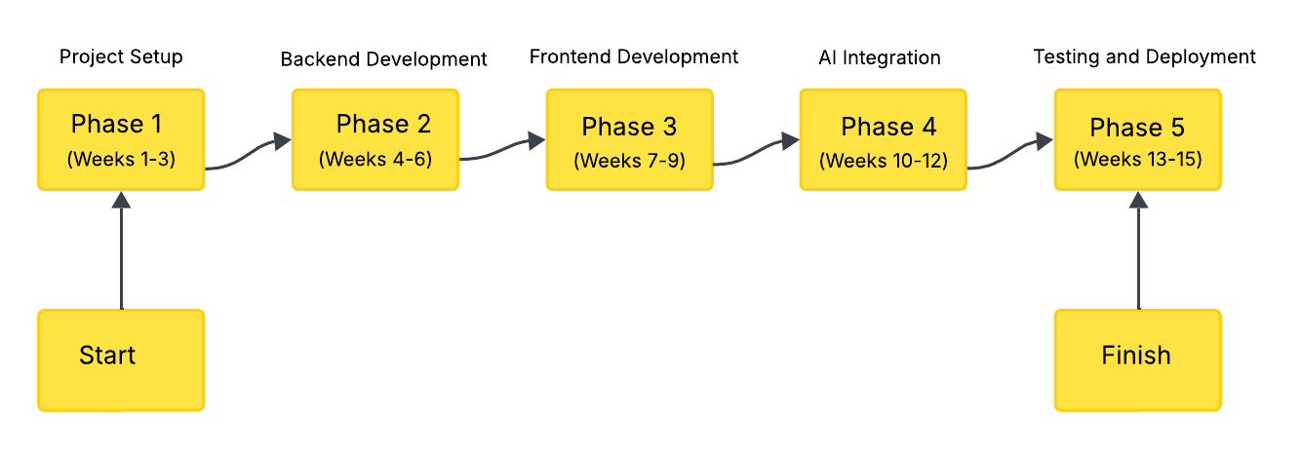
Proposed Timeline

Slide 8





Applications
Personalized Career Advice: Provides tailored guidance that aligns user goals with relevant job opportunities, promoting informed career decisions and lifelong learning.
Skill Identification and Enhancement: Helps users identify and develop essential skills for their career paths, fostering continuous education and personal growth.
AI Driven Skill Assessments: Offers actionable feedback to help users identify areas for improvement, encouraging focused development and skill mastery.
Industry-Specific Insights: Provides real-time insights into industry trends and in demand skills, enabling users to stay competitive and informed in their field.

Slide 9
References
[1] Jarkko Suhonen, Erkki Sutinen and others, "Artificial Intelligence for Career Guidance – Current Requirements and Future Perspectives.”
Link: https://files.eric.ed.gov/fulltext/EJ1318705.pdf
[2] International Research Journal of Modernization in Engineering Technology and Science, “AI- driven career counselling platform.”
Link: https://www.irjmets.com/uploadedfiles/paper/issue_11_november_2024/63607/final/finirjmets1731301418.pdf
[3] NICEC Journal, “Opportunities and Risks in the Use of AI in Career Development Practice.”
Link: https://nicecjournal.co.uk/index.php/nc/article/view/395

