Slide 1
Automatic Vehicle Parking Sytem Submitted By
Akshay Kumar
Khushboo
Niha Firdouse
Piyush Kumar Mishra

Slide 2
Aim of the project
In the modern world, where parking-space has become a very big problem and it is a very crucial necessity to avoid the wastage of space in big companies and shopping malls etc. In places where more than 100 vehicles need to be parked, this system proves to be useful in reducing wastage of time.
The main objective of this project is to intimate about the information of the vehicle, and the vehicle must be parked automatically by itself. Automatic multistoried vehicle parking system helps to minimize the vehicle parking area.
This Automatic vehicle Parking System enables the parking of vehicles, floor after floor and thus reducing the space used. The main advantage of this project is to avoid wastage of time and provide high security. This makes the system modernized and even a space-saving one.

Slide 3
CONTENTS
INTRODUCTION
SYSTEM OVERVIEW
BLOCK DIAGRAM
CIRCUIT COMPONENT
CIRCUIT DIAGRAM
ADVANTAGES
DISADVANTAGES
RESULT
CONCLUSION
FUTURE SCOPE
REFERENCES

Slide 4
Introduction
It involves the parking as well as sending the message to the owner. In this car parking system, there are two sections, one is allocating a slot for parking and another is vehicle section.
The present design deals with a display board which shows a vacancy slot for a car together with a message displaying, car parked safely after parking.
Here we are using Arduino ATMega328p as a microcontroller.
In this project we have a display board, which shows the information about vacant slots in each floor. Display section is the main part of this project. Display system used here is a 16 * 2 LCD. Liquid Crystal Displays consumes less power and it is cheaply available.

Slide 5
This vacancy is sensed by IR Reflectance Module which is placed in the parking slot. The vacant slot is displayed according to the priority concept.
Once the vacant slot is known then the code for it is typed in the mobile of the owner which is then decoded using the DTMF decoder.
The DTMF signals from the mobile is decoded using the decoder IC HT9170.Here the owner presses the code for entrance or exit in the mobile.
This DTMF signal from the mobile is then sent to the IC HT9170 which decodes it into its corresponding binary codes.
This is then given to the microcontroller which then performs the entrance or exit action according to the program.

Slide 6
System Overview
This system is effectively in use in most of the European countries and many of the American states. This design is mainly comprised of low manual operation as well as efficient equipment which can be installed in any of the commercial, industrial, apartments, institutions/universities ,etc.
It is a low cost system which uses micro controllers which is programmable, which is easy to install in any of the above places mentioned.
It provides high security and reduces the wastage of time.

Slide 7
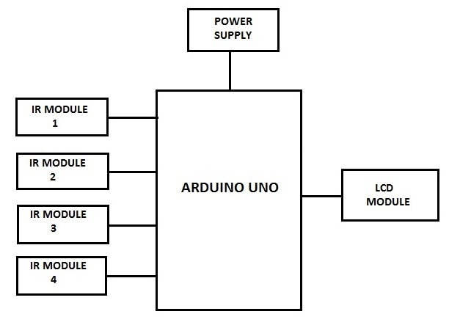
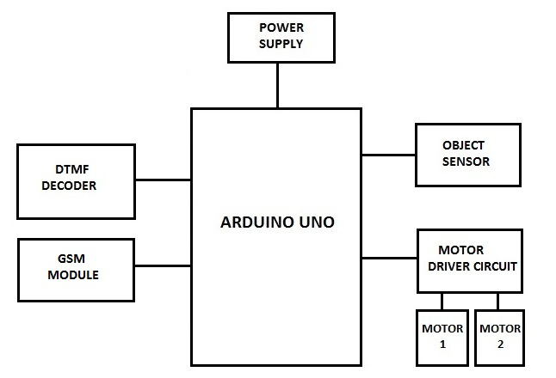
BLOCK DIAGRAM
The block diagram consists of two sections.
Parking section
Vehicle section
Parking section
Vehicle section

Slide 8
CIRCUIT COMPONENTS
POWER SUPPLY
ARDUINO UNO R3
INFRARED SENSOR MODULE
LCD DISPLAY
OBJECT SENSOR
GSM MODULE
DTMF DECODER
MOTOR DRIVER
DC MOTOR

Slide 9
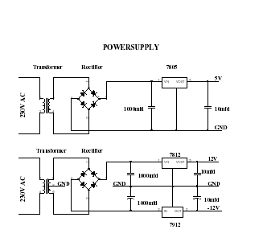
POWER SUPPLY

Slide 10
Power supply is the circuit from which we get a desired dc voltage to run the other circuits.
The voltage we get from the main line is 230V AC but the other components of our circuit require 5V DC.
Hence a step-down transformer is used to get 12V AC which is later converted to 12V DC using a rectifier.
The output of rectifier still contains some ripples even though it is a DC signal due to which it is called as Pulsating DC.
The 12V DC is rated down to 5V using a positive voltage regulator chip 7805. Thus a fixed DC voltage of 5V is obtained.

Slide 11
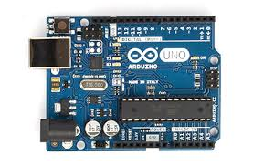
ARDUINO UNO R3
The Uno is a microcontroller board based on the ATmega328P. It has 14 digital input/output pins (of which 6 can be used as PWM outputs), 6 analog inputs, a 16 MHz quartz crystal, a USB connection, a power jack, an ICSP header and a reset button.
It contains everything needed to support the microcontroller; we connect it to a computer with a USB cable or power it with AC-to-DC adapter or battery to get started.
The Atmega328P has 32 KB of flash memory for storing code (of which 0.5 KB is used for the bootloader); It has also 2 KB of SRAM and 1 KB of EEPROM (which can be read and written with the EEPROM library).
The Arduino Uno has a number of facilities for communicating with a computer, another Arduino, or other microcontrollers. The ATmega328 provides UART TTL (5V) serial communication, which is available on digital pins 0 (RX) and 1 (TX).

Slide 12
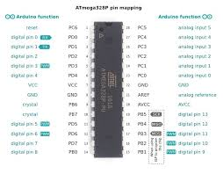
Pin Configuration

Slide 13
Features
32KB of Flash memory
· 2KB of SRAM
· 1 KB of EEPROM
· Available in 28-Pin IC
16 MHz of clock speed
· One 16-bit Timer/Counter
· Digital to Analog Comparator.

Slide 14
INFRARED TX AND RX

Slide 15
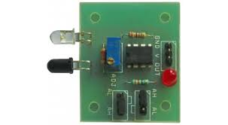
Infrared transmitter is one type of LED which emits infrared rays generally called as IR Transmitter.
Similarly IR Receiver is used to receive the IR rays transmitted by the IR transmitter.
The transmitted signal is given to IR transmitter whenever the signal is high, the IR transmitter LED is conducting it passes the IR rays to the receiver. The IR receiver is connected with comparator.
In the comparator circuit the reference voltage is given to inverting input terminal. The non inverting input terminal is connected IR receiver.
When interrupt the IR rays between the IR transmitter and receiver, the IR receiver is not conducting.
When IR transmitter passes the rays to receiver, the IR receiver is conducting due to that non inverting input voltage is lower than inverting input.

Slide 16
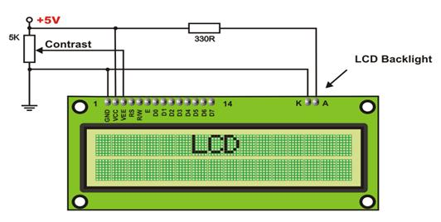
LCD

Slide 17
The display used here is 16x2 LCD (Liquid Crystal Display); this means 16 characters per line by 2 lines.
The LCD display consists of two lines, 20 characters per line that is interfaced with the PIC16F73.
The display contains two internal byte-wide registers, one for commands (RS=0) and the second for characters to be displayed (RS=1).
It also contains a user-programmed RAM area (the character RAM) that can be programmed to generate any desired character that can be formed using a dot matrix.

Slide 18
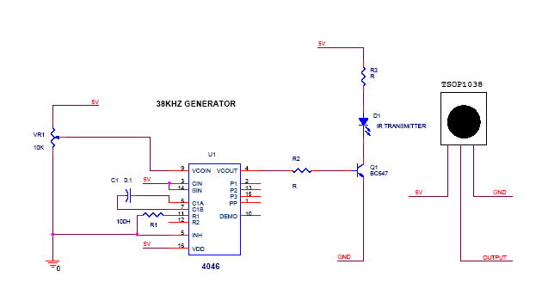
OBJECT SENSOR

Slide 19
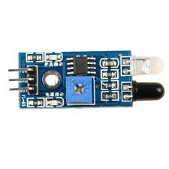
This project is used to sense the object for different application.
The 4046 clock generator is used to generate 38 KHZ carrier signal which is transmitted through the sensor TSOP1038.
The CD4046 micro power phase locked loop consists of a low power, linear, voltage controlled oscillator, a source follower, a zener diode, and two phase comparators.
Phase comparator 1, an exclusive OR gate, provides a digital error signal and maintain 90 phase shifts at the VCO center frequency between signal input and comparator input.
Phase comparator 2 is an edge controlled digital memory network. It provides a digital error signal to indicate a locked condition and maintain the 0 phase shift between signal input and comparator input.

Slide 20
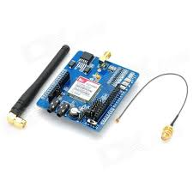
GSM MODULE (SIM900A)
The GSM shield by Arduino is used to send/ receive messages and make/receive calls just like a mobile phone by using a SIM card by a network provider. We can do this by plugging the GSM shield into the Arduino board and then plugging in a SIM card from an operator that offers GPRS coverage.
The shield employs the use of a radio modem by SIMComm. We can communicate easily with the shield using the AT commands. The GSM library contains many methods of communication with the shield.
This GSM Modem can work with any GSM network operator SIM card just like a mobile phone with its own unique phone number. Advantage of using this modem will be that its RS232 port can be used to communicate and develop embedded applications.
Applications like SMS Control, data transfer, remote control and logging can be developed easily using this. The modem can either be connected to PC serial port directly or to any microcontroller through MAX232.
It can be used to send/receive SMS and make/receive voice calls. It can also be used in GPRS mode to connect to internet and run many applications for data logging and control.

Slide 21
Features-
Dual-Band 900/ 1800 MHz
GPRS multi-slot class 10/8
GPRS mobile station class B
Compliant to GSM phase 2/2+
• Class 4 (2 W @900 MHz)
• Class 1 (1 W @ 1800MHz)
Dimensions: 24*24*3 mmϖ Weight: 3.4g
Control via AT commands (GSM 07.07, 07.05 and SIMCOM enhanced AT Commands)
SIM application toolkit
Supply voltage range: 3.1- 4.8V
Low power consumption: 1.5mA(sleep mode)
Operation temperature: -40° C to +85°C

Slide 22
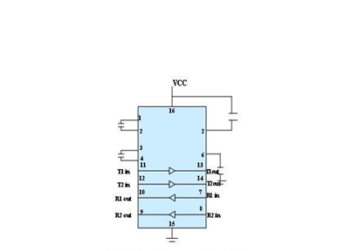
Pin Diagram

Slide 23
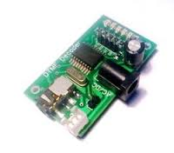
DTMF DECODER
HT9170 is the series of Dual Tone Multi Frequency (DTMF) receivers. They employ digital counting techniques to detect and decode the 16 DTMF tones into 4 bit output code.
HT9170 series receivers do not require any external filters as they use highly accurate switched capacitor filters for filtering low and high frequency signals from the DTMF tones. They also support power down (PWDN) and inhibit (INH) modes. PWDN mode is used to power off the crystal, while INH mode to inhibit the A, B, C & D DTMF tones. The clock is provided by a 3.58 MHz crystal.
In simple terms, HT9170 IC detects and decodes the 16 DTMF tones into 4 bit output. In case the tones are not detected, the four output bits remain low. The DV pin goes high on detection of a valid tone.

Slide 24
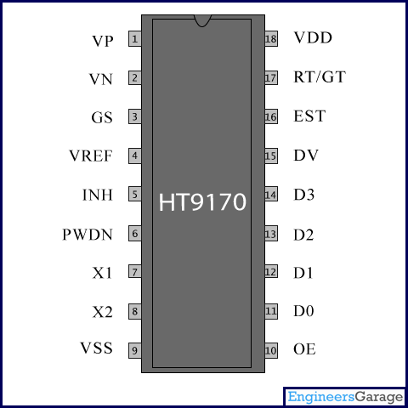
PIN DIAGRAM

Slide 25
MOTOR DRIVER(L293D)
L293D is a typical Motor driver or Motor Driver IC which allows DC motor to drive on either direction. L293D is a 16-pin IC which can control a set of two DC motors simultaneously in any direction. It means that you can control two DC motorwith a single L293D IC. Dual H-bridge Motor Driver integrated circuit(IC).
It works on the concept of H-bridge. H-bridge is a circuit which allows the voltage to be flown in either direction. As you know voltage need to change its direction for being able to rotate the motor in clockwise or anticlockwise direction, Hence H-bridge IC are ideal for driving a DC motor.
In a single l293d chip there two h-Bridge circuit inside the IC which can rotate two dc motor independently. Due its size it is very much used in robotic application for controlling DC motors. Given below is the pin diagram of a L293D motor controller.
There are two Enable pins on l293d. Pin 1 and pin 9, for being able to drive the motor, the pin 1 and 9 need to be high. For driving the motor with left H-bridge you need to enable pin 1 to high. And for right H-Bridge you need to make the pin 9 to high. If anyone of the either pin1 or pin9 goes low then the motor in the corresponding section will suspend working. It’s like a switch.

Slide 26
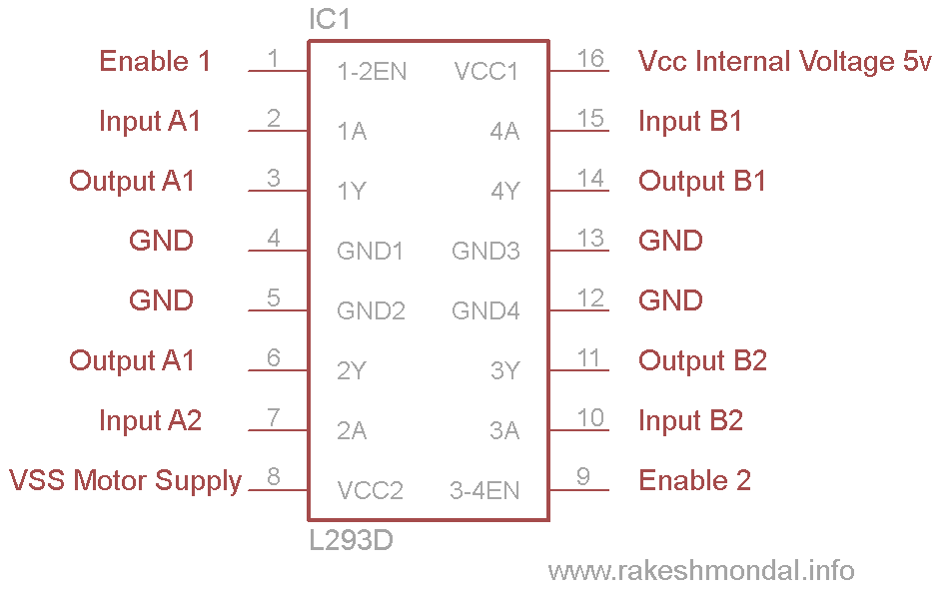
Pin diagram

Slide 27
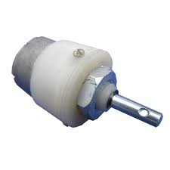
Dc motor
100RPM Centre Shaft Economy Series DC Motor is high quality low cost DC geared motor. It has steel gears and pinions to ensure longer life and better wear and tear properties. The gears are fixed on hardened steel spindles polished to a mirror finish.
The output shaft rotates in a plastic bushing. The whole assembly is covered with a plastic ring. Gearbox is sealed and lubricated with lithium grease and require no maintenance. The motor is screwed to the gear box from inside.
Although motor gives 100 RPM at 12V but motor runs smoothly from 4V to 12V and gives wide range of RPM, and torque. Tables below gives fairly good idea of the motor’s performance in terms of RPM and no load current as a function of voltage and stall torque, stall current as a function of voltage.

Slide 28
specification
DC supply: 4 to 12V
RPM: 100 at 12V
Total length: 46mm
Motor diameter: 36mm
Motor length: 25mm
Brush type: Precious metal
Gear head diameter: 37mm
Gear head length: 21mm
Output shaft: Centred
Shaft diameter: 6mm
Shaft length: 22mm
Gear assembly: Spur
Motor weight: 100gms

Slide 29
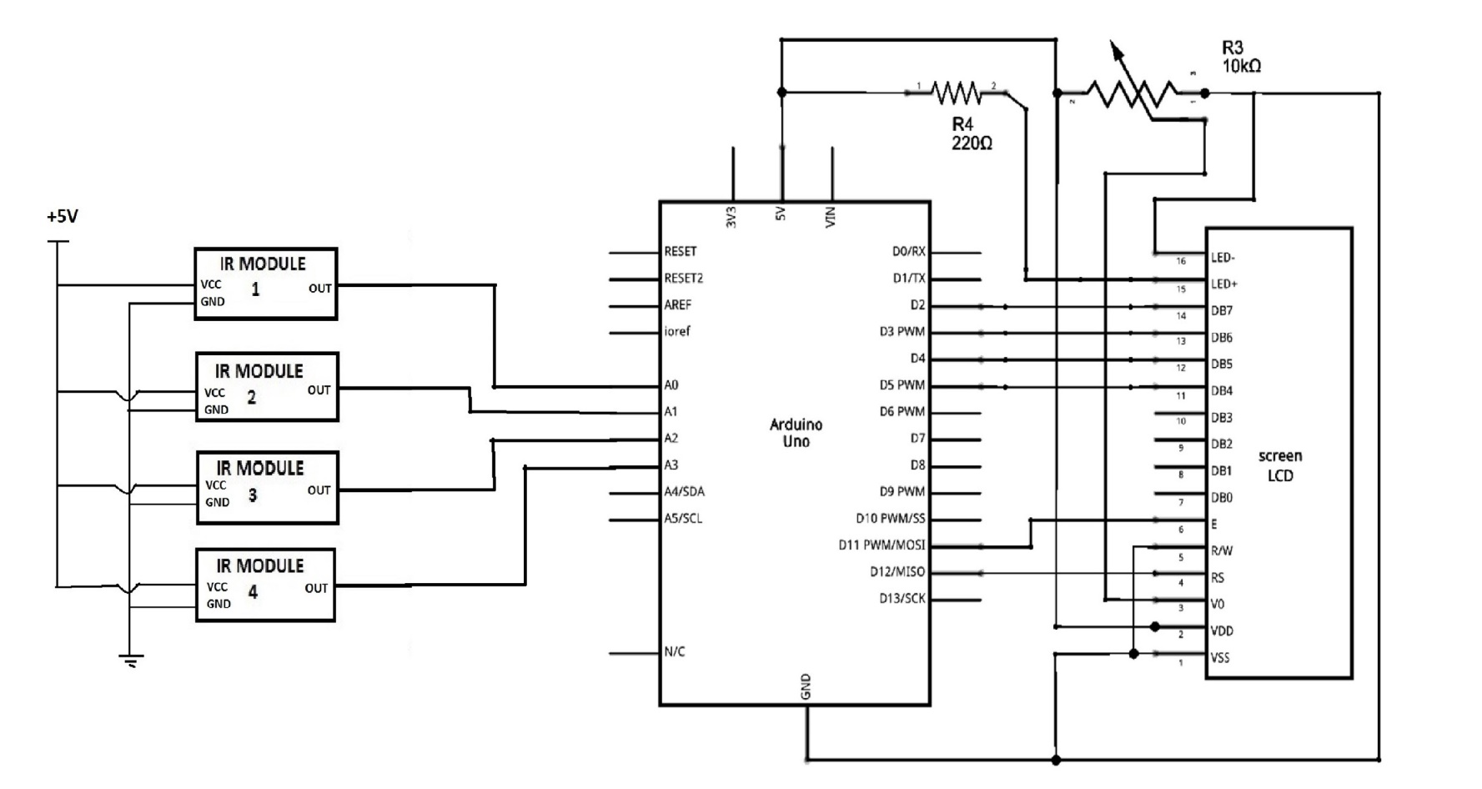
CIRCUIT DIAGRAM
For parking section

Slide 30
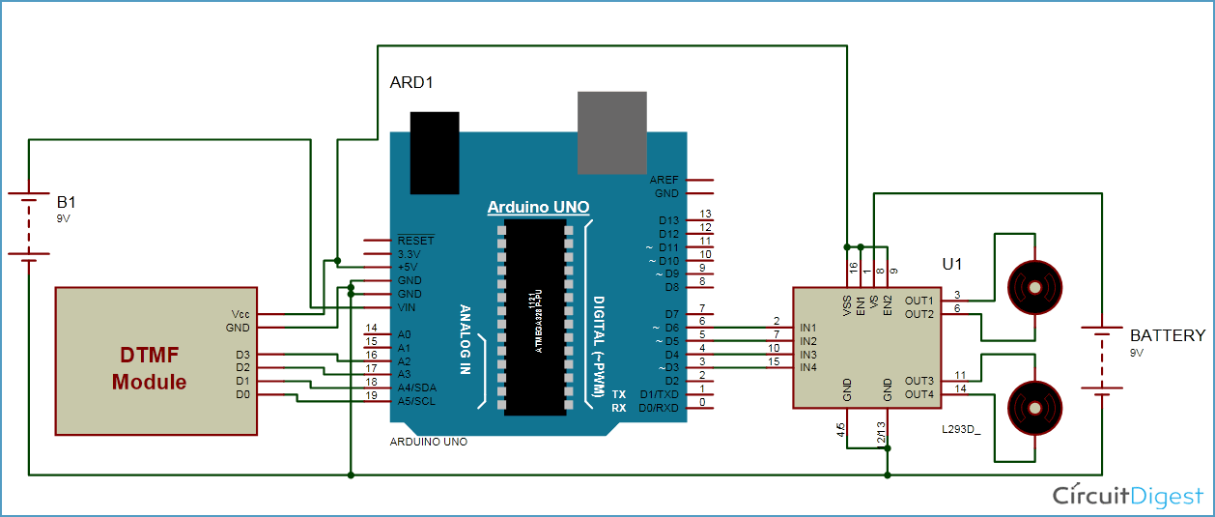
For vehicle section

Slide 31
CIRCUIT OPERATION
IR sensor senses the car in the parking area, it then sends message to microcontroller which operates the LCD to show the vacant slots.
The owner of the vehicle watches the vacant slot on LCD and then presses the vacant slot number on his/her cellular device, then DTMF decodes the code which is entered by owner’s cellular device and sends to the arduino.
Later vehicle will move to that slots, then the message will send by GSM module to owner’s mobile that the “car has been parked safely”.

Slide 32
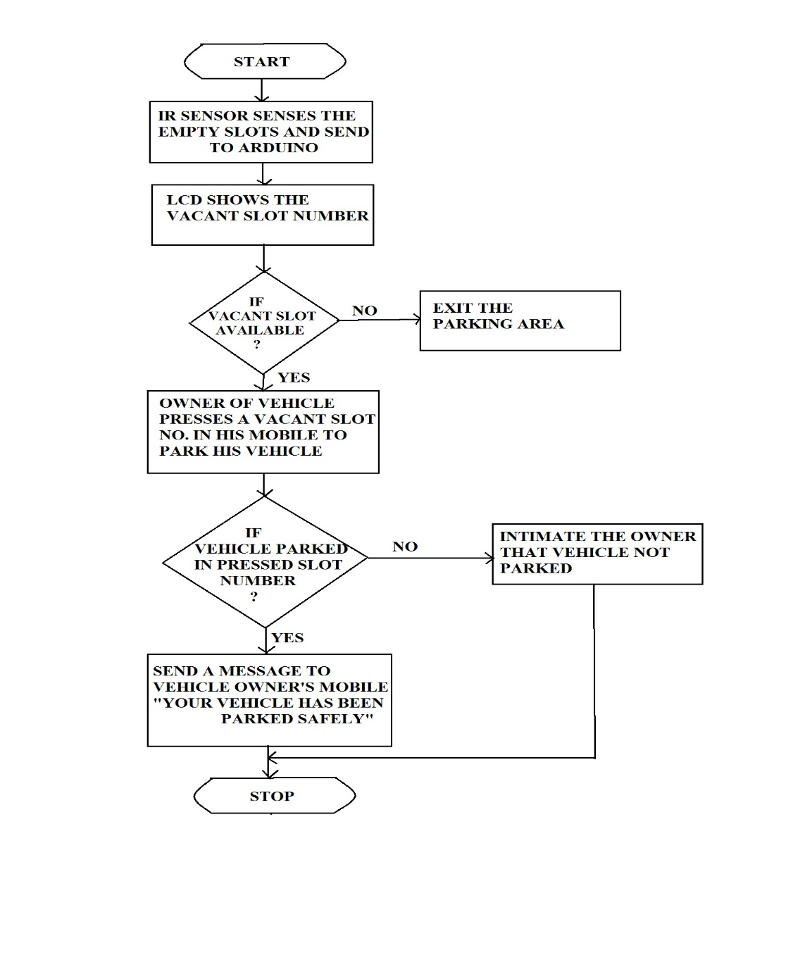
Flow Diagram

Slide 33
Programming
For parking sections
int sensorPin1 = A0;
int sensorPin2 = A1;
int sensorPin3 = A2;
int sensorPin4 = A3;
int sensorValue1 = 0;
int sensorValue2 = 0;
int sensorValue3 = 0;
int sensorValue4 = 0;
#include <LiquidCrystal.h>
LiquidCrystal lcd(12, 11, 5, 4, 3, 2);
void setup()
{
Serial.begin(9600);
lcd.begin(16, 2);
}

Slide 34
void loop()
{
sensorValue1 = analogRead(sensorPin1);
// Serial.println(sensorValue);
// delay(100);
if(sensorValue1<5)
{
lcd.setCursor(0,0);
lcd.print("A-01");
}
if(sensorValue1>500)
{
lcd.setCursor(0,0);
lcd.print("NA-1");
}
sensorValue2 = analogRead(sensorPin2);
if(sensorValue2<6)
{
lcd.setCursor(4,0);
lcd.print("A-02");

Slide 35
}
If(sensorValue2>500)
{
lcd.setCursor(4,0);
lcd.print("NA-2");
}
sensorValue3 = analogRead(sensorPin3);
// Serial.println(sensorValue);
// delay(100);
if(sensorValue3<5)
{
lcd.setCursor(8,0);
lcd.print("A-03");
}
if(sensorValue3>500)
{
lcd.setCursor(8,0);
lcd.print("NA-3");
}
}

Slide 36
sensorValue4 = analogRead(sensorPin4);
if(sensorValue4<6)
{
lcd.setCursor(12,0);
lcd.print("A-04");
}
if(sensorValue4>500)
{
lcd.setCursor(12,0);
lcd.print("NA-4");
}
}

Slide 37
For vehicle section
#define m11 3
#define m12 4
#define m21 5
#define m22 6
#define D0 19
#define D1 18
#define D2 17
#define D3 16
int sensorPin = A0;
int sensorValue = 0;
#include <SoftwareSerial.h>
SoftwareSerial mySerial(9, 10);
void forward()
{
digitalWrite(m11, HIGH);
digitalWrite(m12, LOW);
digitalWrite(m21, HIGH);
digitalWrite(m22, LOW);
}

Slide 38
void backward()
{
digitalWrite(m11, LOW);
digitalWrite(m12, HIGH);
digitalWrite(m21, LOW);
digitalWrite(m22, HIGH);
}
void left()
{
digitalWrite(m11, HIGH);
digitalWrite(m12, LOW);
digitalWrite(m21, LOW);
digitalWrite(m22, LOW);
}
void right()
{
digitalWrite(m11, LOW);
digitalWrite(m12, LOW);
digitalWrite(m21, HIGH);
digitalWrite(m22, LOW);
}

Slide 39
void Stop()
{
digitalWrite(m11, LOW);
digitalWrite(m12, LOW);
digitalWrite(m21, LOW);
digitalWrite(m22, LOW);
}
void SendSms()
{
mySerial.println("AT+CMGF=1"); //Sets the GSM Module in Text Mode
delay(1000); // Delay of 1000 milli seconds or 1 second
mySerial.println("AT+CMGS=\"+918197975954\"\r"); // Replace x with mobile number
delay(1000);
mySerial.println("Vehicle parked safely");// The SMS text you want to send
delay(100);
mySerial.println((char)26);// ASCII code of CTRL+Z
delay(1000);
}

Slide 40
void setup()
{
Serial.begin(9600);
mySerial.begin(9600); // Setting the baud rate of Serial Monitor (Arduino)
delay(100);
pinMode(D0, INPUT);
pinMode(D1, INPUT);
pinMode(D2, INPUT);
pinMode(D3, INPUT);
pinMode(m11, OUTPUT);
pinMode(m12, OUTPUT);
pinMode(m21, OUTPUT);
pinMode(m22, OUTPUT);
}
void loop()
{
int temp1=digitalRead(D0);
int temp2=digitalRead(D1);
int temp3=digitalRead(D2);
int temp4=digitalRead(D3);

Slide 41
sensorValue = analogRead(sensorPin);
// Serial.println(sensorValue);
//delay(1000);
if(sensorValue>700)
{
Stop();
exit(0);
}
else if(temp1==1 && temp2==0 && temp3==0 && temp4==0)
{
digitalWrite(m11, HIGH);
digitalWrite(m21, HIGH); delay(4800);
digitalWrite(m11, LOW);
digitalWrite(m21, LOW);
SendSms();
exit(0);
}
else if(temp1==0 && temp2==1 && temp3==0 && temp4==0)
{
digitalWrite(m11, HIGH);
digitalWrite(m21, HIGH); delay(2400);

Slide 42
digitalWrite(m21, HIGH);
digitalWrite(m11, LOW);delay(1200);
digitalWrite(m21, LOW);
digitalWrite(m11, HIGH);delay(1200);
digitalWrite(m11, HIGH);
digitalWrite(m21, HIGH);delay(1200);
digitalWrite(m11, LOW);
digitalWrite(m21, LOW);
SendSms();
exit(0);
}
else if(temp1==1 && temp2==1 && temp3==0 && temp4==0)
{
digitalWrite(m11, HIGH);
digitalWrite(m21, HIGH); delay(2400);
digitalWrite(m21, HIGH);
digitalWrite(m11, LOW);delay(1200);
digitalWrite(m11, HIGH);
digitalWrite(m21, HIGH); delay(2400);

Slide 43
digitalWrite(m21, LOW);
digitalWrite(m11, HIGH);delay(1200);
digitalWrite(m11, HIGH);
digitalWrite(m21, HIGH);delay(1200);
digitalWrite(m11, LOW);
digitalWrite(m21, LOW);
SendSms();
exit(0);
}
else if(temp1==0 && temp2==0 && temp3==1 && temp4==0)
{
digitalWrite(m11, HIGH);
digitalWrite(m21, HIGH); delay(2400);
digitalWrite(m21, HIGH);
digitalWrite(m11, LOW);delay(1200);
digitalWrite(m11, HIGH);
digitalWrite(m21, HIGH); delay(3600);
digitalWrite(m21, LOW);
digitalWrite(m11, HIGH);delay(1200);

Slide 44
digitalWrite(m11, HIGH);
digitalWrite(m21, HIGH);delay(1200);
digitalWrite(m11, LOW);
digitalWrite(m21, LOW);
SendSms();
exit(0);
}
else
{
Stop();
}
}

Slide 45
ADVANTAGES
Security from Theft and Car Damages.
Time saving.
It can be constructed and implemented in residential areas.
DISADVANTAGES
Area consumption is more.
It is costlier compare to simple parking.

Slide 46
RESULT
When the free slot number will display on LCD then vehicle is ready for entrance and then the vacant slot number will be pressed by owner of vehicle .The car will then parked safely.
The IR Reflectance Module will be then deactivated, decreasing the count, and the next free slot will then be displayed.
The message "safely parked" will be sent to the mobile (owner's) through GSM. If any object comes in front of vehicle , the object sensor will detect and stop the vehicle.

Slide 47
CONCLUSION
The project has been successfully implemented to park the vehicle automatically and to intimate the parking information to the user.
In this project two sections-Parking and Vehicle sections were implemented. The IR reflectance module gives the information regarding the vacant slot.
The basic component in this project is the microcontroller which controls all the actions performed by various devices.
LCD is provided in this project in order to intimate the user about the vacant slots. Since this project is a demonstration unit, only four slots are assumed for parking.

Slide 48
FUTURE SCOPE
At present we have implemented only for four slots. We can increase the number of slots as well as the number of floors in order to utilize the parking space to its maximum.
The RFID system can be used for authorized and more safer parking system.

Slide 49
REFERENCES
Electronics for you-Magazine
www.alldatasheets.com
www.wikipedia.com
www.projectarchive.com
http://electrofriends.com/projects/microcontrollers/automated-multistoried-car-parking-system/
http://electrosofts.com/carparking/
Microcontrollers http://www.nxp.com

Slide 50

ANY QUERIES

